Slide 1
Getting Connected [or Reconnected] with School-wide Positive Behavior Supports
Minnesota Educator Academy
River Centre, Saint Paul, MN
October 20, 2016
8:30-9:30
Aaron Benesh – Birchview Elementary, Wayzata
Jacqueline Kuhns – Oak Grove Elementary, Bloomington
Becky Nies – Minnesota Department of Education
Garrett Petrie – Minnesota Department of Education
Notes:
Survey the audience for PBIS experience?
Survey the audience for team level – school/program, charter/district/coop, region?

Slide 2
Session Objectives
See examples of what positive school climate look like.
Understand the steps that school teams can follow to build positive school climates.
Know where to find freely available tools to measure positive behavior supports and make team-based action plans.
Connect with existing district and/or regional supports after this morning’s session if you need help.

Slide 3
First, A brief history . . .

Slide 4
Historical Responses
Get Tough
Weakens child adult-relationship
Weakens academic and social behavior
Creates environments of control
Triggers and reinforces antisocial behavior
Shifts accountability away from child
Train and Hope
“Training by itself does not result in positive implementation…or intervention outcomes”
(Fixen, Naoom, Blasé, Friedman, & Wallace, 2005, pp.. 40-41)

Slide 5
Schoolwide-PBIS Logic!
Successful individual student behavior support is linked to host environments or school climates that are effective, efficient, relevant, & durable for all students.
(Zins & Ponti, 1990)

Slide 6
Experimental Research on SWPBIS
SWPBIS Experimentally Related to:
Reduction in problem behavior
Increased academic performance
Improved attendance
Improved perception of safety
Reduction in bullying behaviors
Improved organizational efficiency
Reduction in staff turnover
Increased perception of teacher efficacy
Improved Social Emotional competence
Bradshaw, C.P., Koth, C.W., Thornton, L.A., & Leaf, P.J. (2009). Altering school climate through school-wide Positive Behavioral Interventions and Supports: Findings from a group-randomized effectiveness trial. Prevention Science, 10(2), 100-115
Bradshaw, C.P., Koth, C.W., Bevans, K.B., Ialongo, N., & Leaf, P.J. (2008). The impact of school-wide Positive Behavioral Interventions and Supports (PBIS) on the organizational health of elementary schools. School Psychology Quarterly, 23(4), 462-473.
Bradshaw, C. P., Mitchell, M. M., & Leaf, P. J. (2010). Examining the effects of School-Wide Positive Behavioral Interventions and Supports on student outcomes: Results from a randomized controlled effectiveness trial in elementary schools. Journal of Positive Behavior Interventions, 12, 133-148.
Bradshaw, C.P., Reinke, W. M., Brown, L. D., Bevans, K.B., & Leaf, P.J. (2008). Implementation of school-wide Positive Behavioral Interventions and Supports (PBIS) in elementary schools: Observations from a randomized trial. Education & Treatment of Children, 31, 1-26.
Bradshaw, C., Waasdorp, T., Leaf. P., (in press). Effects of School-wide positive behavioral interventions and supports on child behavior problems and adjustment. Pediatrics.
Horner, R., Sugai, G., Smolkowski, K., Eber, L., Nakasato, J., Todd, A., & Esperanza, J., (2009). A randomized, wait-list controlled effectiveness trial assessing school-wide positive behavior support in elementary schools. Journal of Positive Behavior Interventions, 11, 133-145.
Horner, R. H., Sugai, G., & Anderson, C. M. (2010). Examining the evidence base for school-wide positive behavior support. Focus on Exceptionality, 42(8), 1-14.
Ross, S. W., Endrulat, N. R., & Horner, R. H. (2012). Adult outcomes of school-wide positive behavior support.
Journal of Positive Behavioral Interventions. 14(2) 118-128.
Waasdorp, T., Bradshaw, C., & Leaf , P., (2012) The Impact of Schoolwide Positive Behavioral Interventions and
Supports on Bullying and Peer Rejection: A Randomized Controlled Effectiveness Trial. Archive of
Pediatric Adolescent Medicine. 2012;166(2):149-156
Bradshaw, Pas, Goldweber, Rosenberg, & Leaf, 2012
bit.ly/PBISoutcomes2014-03

Slide 7
Continuum Logic
TERTIARY PREVENTION (Tier 3)
Most individualized
Most differentiated
Most specialized
SECONDARY PREVENTION (Tier 2)
Group implemented
More differentiated
More specialized
PRIMARY PREVENTION (Tier 1)
All students
All staff
All settings
Notes:
This TIERED LOGIC can be illustrated by a schools that has ALIGNED its BEHAVIOR SUPPORT INTERVENTIONS OR PRACTICES BY THREE GENERAL TIERS
TIER 1 PRACTICES ARE FOR ALL STUDENTS ACROSS ALL SCHOOL SETTINGS
TIER 2 PRACTICES ARE FOR STUDENTS WHO REQUIRE SUPPLEMENTAL SPECIALIZED (SMALL GROUP) SUPPORTS
TIER 3 PRACTICES ARE HIGHLY SPECIALIZED AND INTENSIVE FOR INDIVIDUAL STUDENTS.
It is important to notice that these practices are
SMALL IN NUMBER
CONCEPTUALLY ALIGNED
AND WOULD HAVE DATA RULES FOR MOVEMENT UP AND DOWN THE CONTINUUM

Slide 8
Integrated Elements

Slide 9
Negative School Climate
Coercive Cycle
Non-compliance & non-cooperation
SCHOOL:
Negative School climate
Reactive management
KID:
Negative School Climate
Informal social skills instruction
Poor implementation fidelity of effective practices
Inefficient organization support
Poor leadership preparation
Non-data-based decision making
Inefficient, ineffective instruction
Disrespect
Teasing, harassment, & intimidation
Disengagement & withdrawal
Nonattendance, tardy, & truancy
Violent/aggressive behavior
Littering, graffiti, & vandalism
Substance use
Exclusionary disciplinary practices
Negative adult role models

Slide 10
Impact of Negative Climate
Why is negative school climate undesirable?
Creates environments of control
Triggers & reinforces antisocial behavior
Shifts accountability away from school
Devalues child-adult relationship
Weakens academic & social behavior development

Slide 11
Positive School Climate
Positive Reinforcement Cycle
Positive > negative contacts
KID:
Positive School Climate
Compliance & cooperation
SCHOOL:
Positive School Climate
Respect & responsibility
Positive peer & adult interactions
Engagement & participation
Attendance & punctuality
Anger & conflict management
Safe & clean environment
Healthy food & substance use
Self-management behavior
Predictable, consistent, & equitable treatment
Challenging academic success
Adults modeling expected behavior
Recognition & acknowledgement
Opportunity to learn
Safe learning environment
Academic & social engagement

Slide 12
Our Minnesota Journey . . .

Slide 13
By the Numbers………….
# of Districts/Charters in MN PBIS to date = 203
# Schools in MN PBIS to date = 583
% of MN schools PBIS = 29%
# Students impacted by SW-PBIS = 250,613
Notes:
The percentage of students served is 29%.
These numbers are based on Cohort 12 (2016-2018). The 29% represents .2852 rounded up.

Slide 14
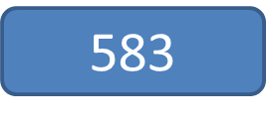
Growth of Minnesota PBIS Schools
Notes:
As part of the initial blueprint there was a goal to expand to regional sites to help with capacity. As school based team applications grew (100 or more schools) the State put out an RFP for three separate regions across the state. During the 2009-10 school year three regional Implementation project were in place.
In 2009, to accommodate the growth of SW-PBIS implementation, Minnesota moved to a regional training model, dividing the state into 3 regions that now coordinate the training, coaching and evaluation of new schools under the direction of the State Leadership Team (SLT).
Presently, ten (10) cohorts have completed Minnesota’s two-year training sequence.
The long range goals for 2011-2016 included:
30% of schools trained
PBIS as a re-licensure requirement
Training and coaching capacity
Data collection, analysis and synthesis in place at all level
Recognition system in place for exemplar schools
Sustainability options are identified via data
Adequate funding sources are secured
Annual communication with critical stakeholders for political support and policy

Slide 15
SW-PBIS across Districts
Cohorts 1- 12
(2005-2018)
Team-based training
9 training days over two years
Distributed, team-based implementation of PBIS
Intended to build capacity, skills, competency and beliefs to sustain implementation beyond initial training in a school
Notes:
Our district map is useful for deciding where a to explore a state-level partnership with a district team.
Not likely to start a partnership with a district team for PBIS implementation until schools in district have gotten up to Full Implementation.
Also implementation partnerships may have different considerations for give-and-get depending on what proportion of schools got up to Full Implementation.

Slide 16
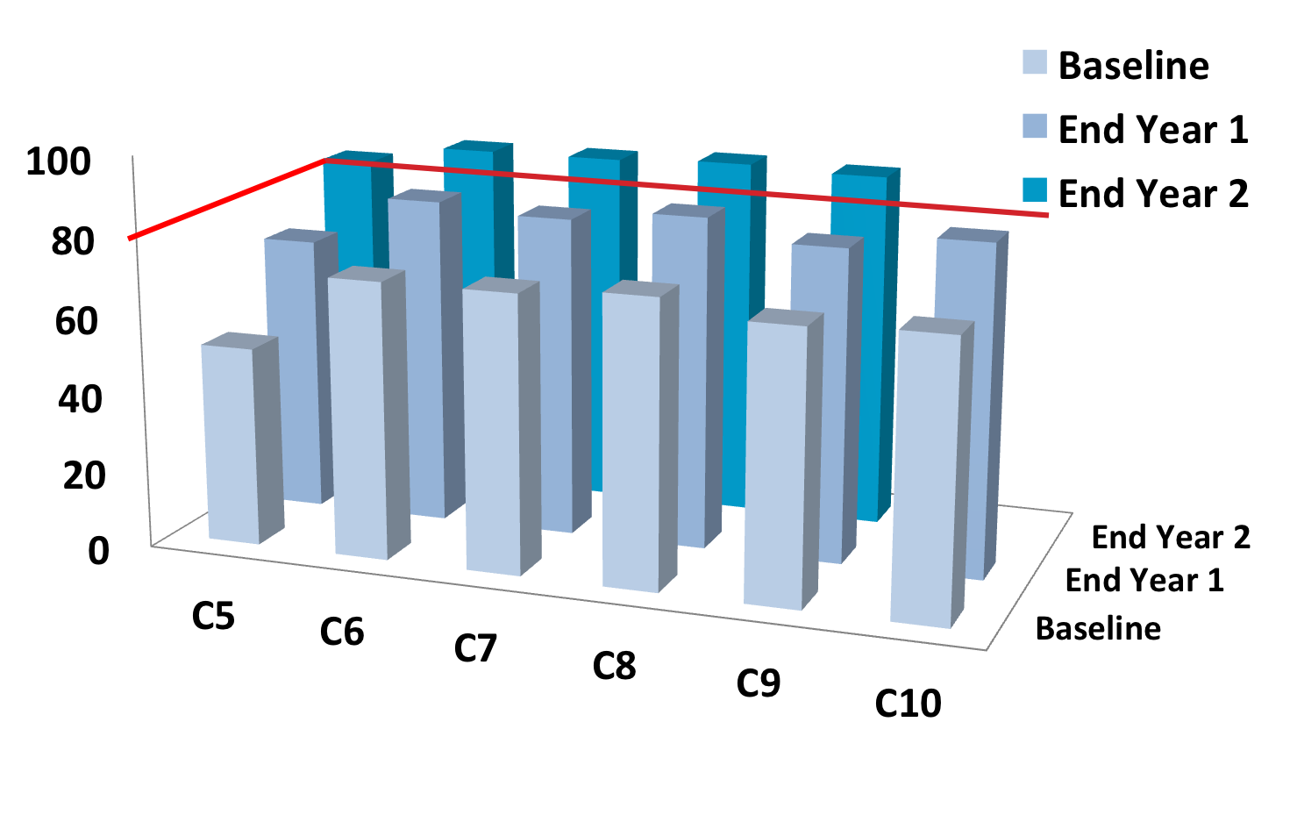
Cohort Implementation Fidelity
Notes:
We always work with school teams. Our training trends in Minnesota continue and remain consistent.
Over two years of training and coaching support, we help our schools get to full implementation of school-wide PBIS with fidelity. Cohort Training continues to do what it is intended to do.
Stars represent partnerships with new levels of teams. In 2009-10 we now had 3 regional partners – North, Metro and South.
The blue arrows represent our 5-year blueprints

Slide 17
Emerging Examples of Results Having a Statewide Impact in Minnesota
Statewide Reductions in Disciplinary Incidents
For All Students
For Students with Disabilities
For All Subgroups of Students with Disabilities
Statewide Reductions in use of Restrictive Procedures
Prone Restraint
Physical Holding
Seclusion

Slide 18
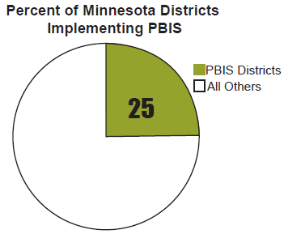
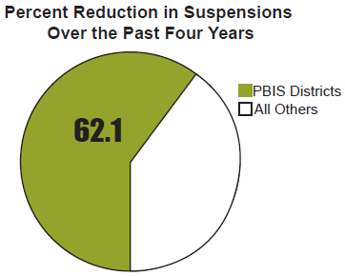
State Level Updates
Impact of Positive Behavioral Interventions and Supports –Schools implementing Positive Behavioral Interventions and Supports (PBIS) represent approximately 25 percent of Minnesota districts, yet account for approximately 62.1 percent of the decrease in suspensions!
Notes:
PBIS praised by our Education Commissioner Cassellius:
“It is truly remarkable that we can attribute a majority of the decreases in suspensions to schools using PBIS. These schools understand that suspensions are not an effective measure of discipline, and often cause a child to fall behind in class. I want to thank Governor Dayton for recognizing the importance of this work and including it in his budget proposal.”
Education Minnesota President Denise Specht’s Statement:
“The program called ‘Positive Behavioral Interventions and Supports’ has produced promising results in districts where it has been implemented with sufficient training and support for the teachers and other staff members.”

Slide 19
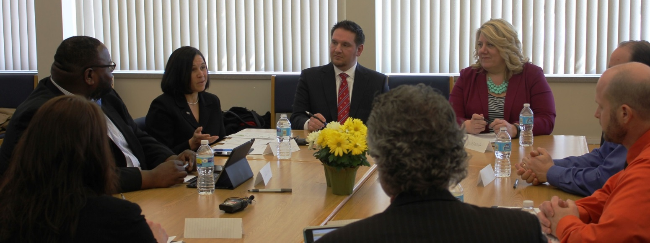
Minnesota Education Commissioner Brenda Cassellius on the Impact of PBIS
“It is truly remarkable that we can attribute a majority of the decreases in suspensions to schools using PBIS. These schools understand that suspensions are not an effective measure of discipline, and often cause a child to fall behind in class.”
February 19, 2015

Slide 20
Education Minnesota
Education Minnesota President Denise Specht’s Statement:
“The program called ‘Positive Behavioral Interventions and Supports’ has produced promising results in districts where it has been implemented with sufficient training and support for the teachers and other staff members.”
Source: http://www.wdaz.com/news/3683390-racial-discipline-gap-narrows-minnesota-schools
Notes:
These

Slide 21
A School Team Effort . . .

Slide 22
‘8 Steps of Implementation’
Establish Team Membership
Develop Behavior Purpose Statement
Identify Positive SW Expectations
Develop Procedures for Teaching SW Positive Expectations
Develop Lesson Plans for Teaching Positive CW Expectations
Develop Continuum of Procedures for Encouraging SW Expectations
Develop Continuum of Procedures for Discouraging Behavior Rule Violations-Corrective Response
Develop Procedures for Data-Based Decision-Making & Monitoring

Slide 23
Highlighting PBIS Implementation at:
Bloomington Public Schools
District 271
Bloomington, MN
https://oge.bloomington.k12.mn.us
Wayzata Public Schools
District 284
Wayzata, MN
http://wayzata.k12.mn.us/birchview

Slide 24
Steps 1&2
Establish team membership & Behavior Purpose statement

Slide 25
Oak Grove Elementary
*K-5 building in Bloomington with an enrollment of 434
*Our student population: 20% African American, 45% Caucasian, 16% Hispanic, 17% Asian, 2% American Indian, 50% free/reduced lunch
We began PBIS in the fall of 2014 with 100% staff buy in. We were all ready for something that would change the climate in our building and put the focus on being positive in our interactions with students and each other.

Slide 26
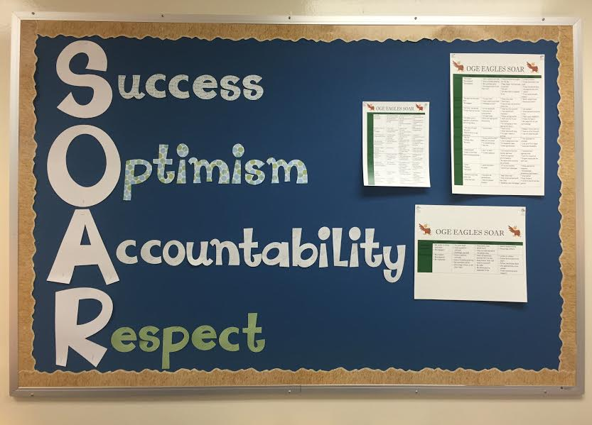
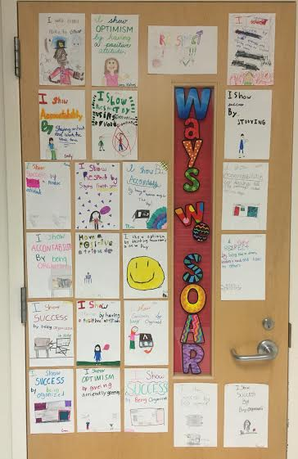
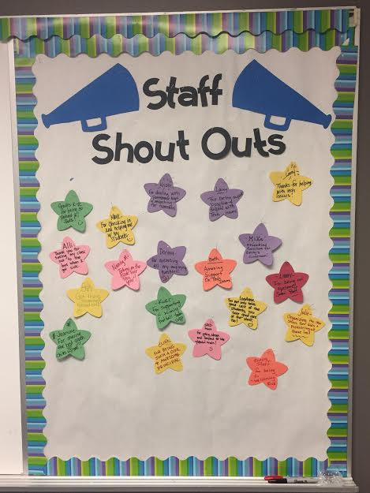
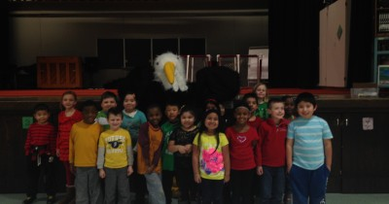
PBIS at Oak Grove Elementary

Slide 27
Introduction
Aaron Benesh
Birchview Elementary (Year 10)
2nd Grade Teacher (Year 10)
PBIS Coach (Year 3)

Slide 28
Learning Objectives
1. Discuss specific steps that Birchview Elementary has found success with as aligned with the “8 steps toward School-Wide PBIS”
2. Share interviews of Birchview staff and students expressing opinions on the effects of PBIS (Trojan Pride) on our school

Slide 29
Steps 3&4
Identify Positive SW Expectations &
Develop Procedures for Teaching SW Positive Expectations

Slide 30
Identify Positive SW Expectations
Year 1 workshop week
Built upon our already in-place foundation
(4 C’s commitment, compassion, community, curiosity)
All staff wrote focused statements of what each “c” looked like in all areas of school
School-wide matrix formed by PBIS team and continually amended since that day

Slide 31
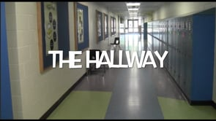
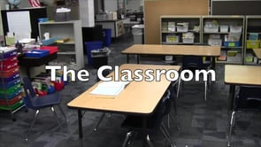
Develop Procedures for teaching SW-Positive Expectations
Production of “Trojan Pride” movies which model behaviors that do and do not align with PBIS expectations.
Movies debut at school assemblies, are reshown on weekly news, used in mini lessons in classrooms, and rewatched based on school/classroom needs
Movie topic based on school needs/behavior data

Slide 32
Develop Lesson plans for teaching SW Positive Expectations
Year 2 Workshop week
Grade level teams partnered with specialists and interventionists to share specific lessons they use to teach and support our 4 C’s
Categorized ideas under Purpose/Materials/Activities/ shared in a Google doc spreadsheet organized in folders by the foundational “C”
Great collaboration and cross grade-level view of how we are teaching SW-PBIS in our classrooms

Slide 33
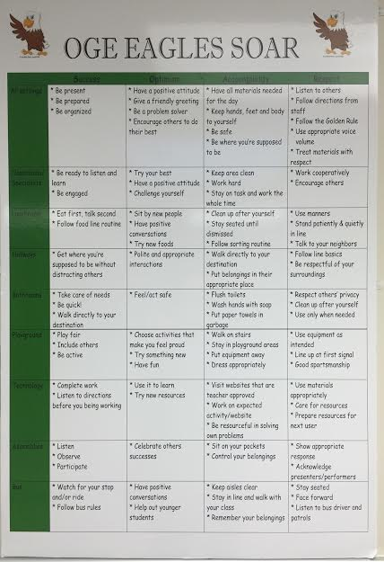
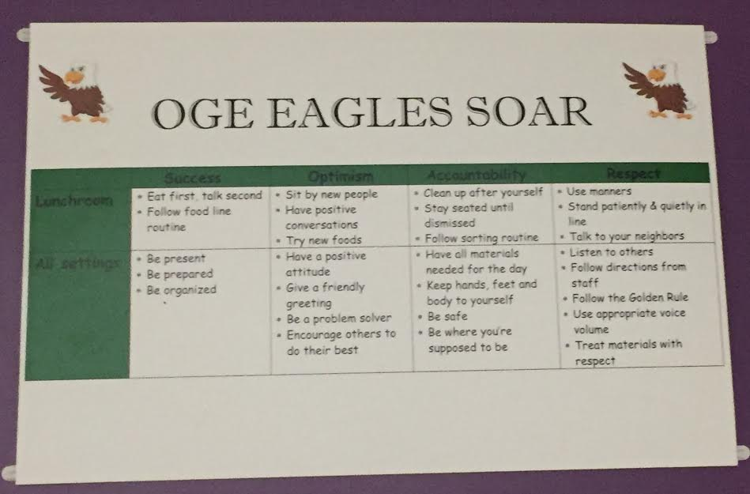
Teaching Matrix
Full matrix
Location specific matrix

Slide 34
Teaching the Matrix
We have created a staff handbook with information to help teachers implement PBIS, including lesson plans for teaching the matrix.
https://docs.google.com/document/d/17fHIRLSnNkDGR2Mi7NJEz-b8TDF-pDCEIqzeb_CLUFY/edit
We begin each school year with Eagle Camp and
complete Eagle Camp 2.0 the day we come back from Winter Break.

Slide 35
Step 5
Develop Lesson Plans for Teaching Positive CW Expectations

Slide 36
Steps 6&7
Develop Continuum of Procedures for Encouraging SW Expectations
Develop Continuum of Procedures for Discouraging Behavior Rule Violations-Corrective Response

Slide 37
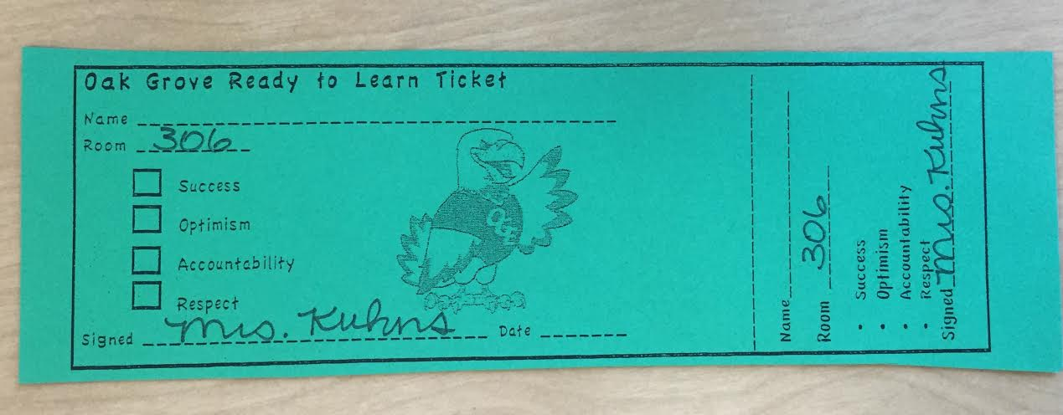
Positive Reinforcement
Soaring Eagle tickets are given out to students displaying our SOARing behaviors.

Slide 38
Positive Reinforcement
Students who have earned Soaring Eagles get their name put into a weekly drawing to be their grade level’s student of the week. Students also work on earning individual rewards based on the number of tickets they have earned.

Slide 39
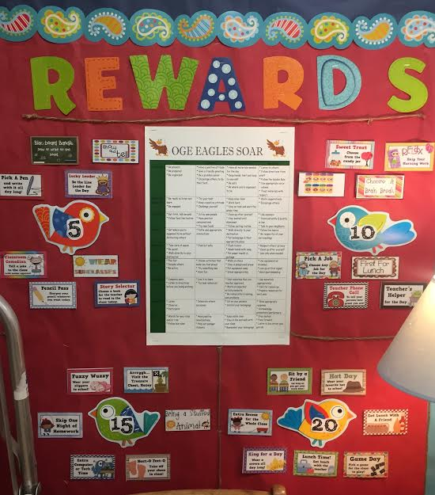
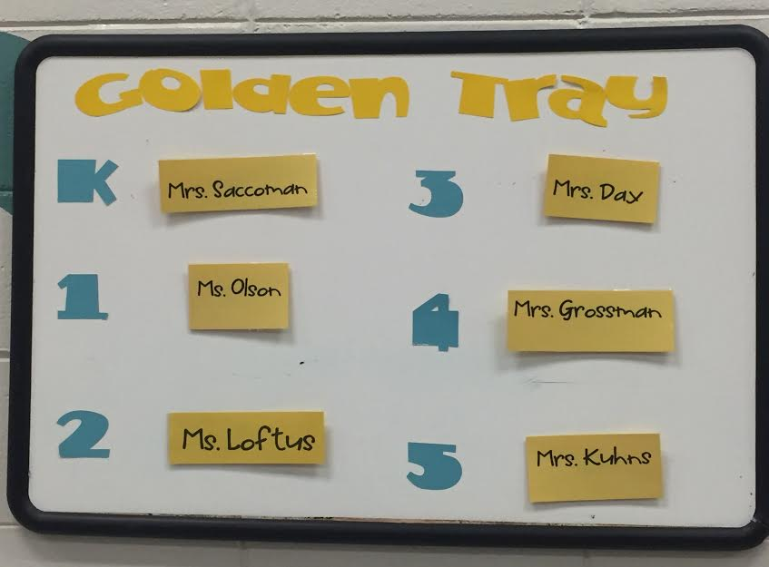
Examples
An area of concern was our lunch room so we created the Golden Tray Award.
Example of a rewards menu in a classroom

Slide 40
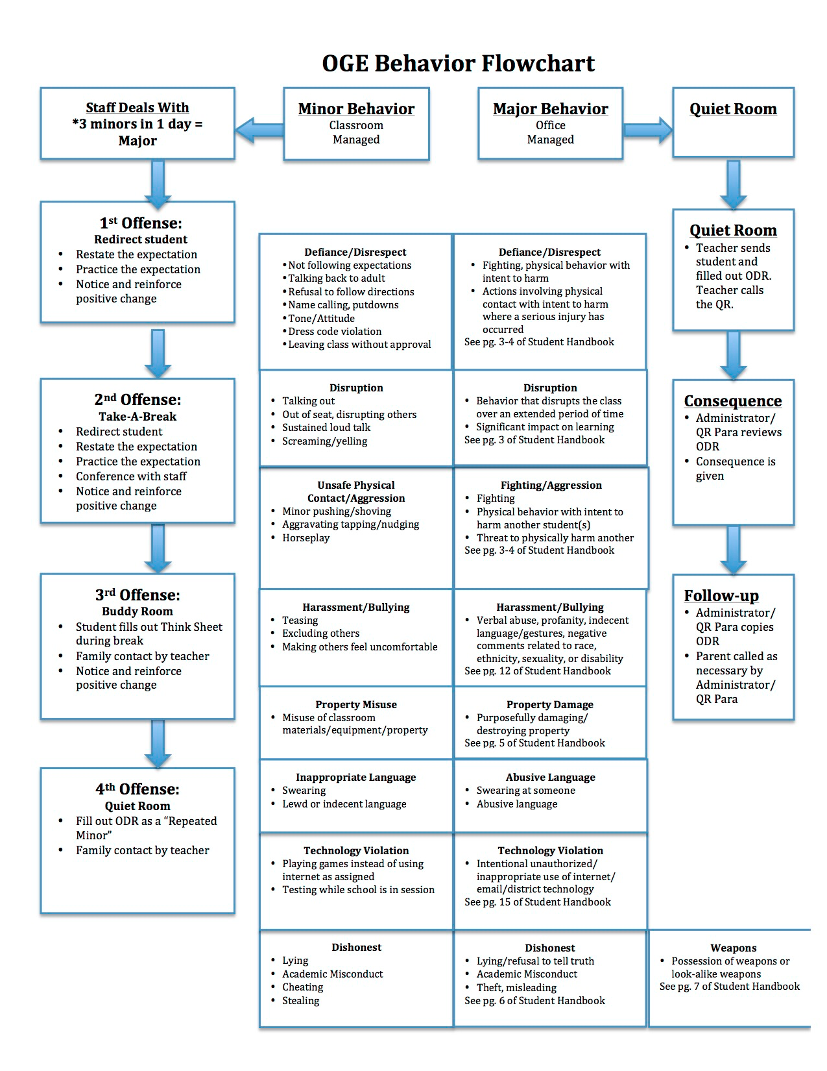
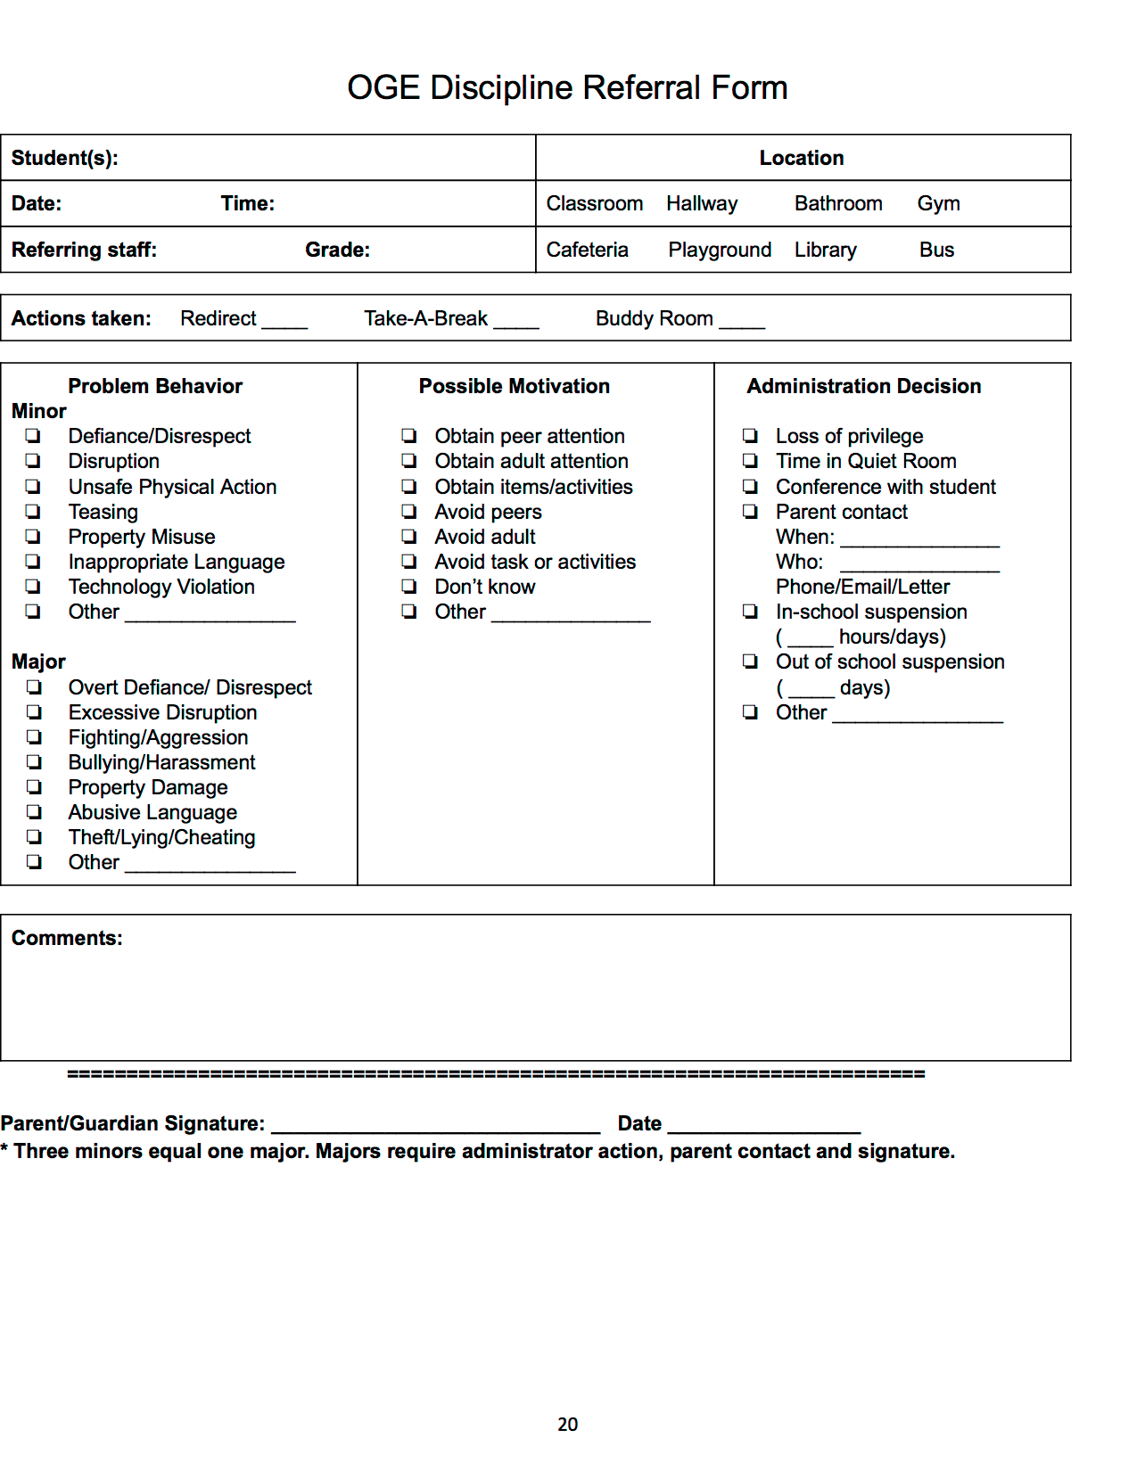
Behavior Flowchart

Slide 41
Develop Continuum of Procedures for encouraging SW Expectations
Trojan Pride slips
Fix-It Forms (ODR)
New posters, floor decal, wall painting, noise-level visuals, on-going responsive movie series
Trojan Pride Update Weekly News
Golden Trojan Pride slips
Trojan Pride Fridays
Passport System
Bobcat Collectable Key-Chains

Slide 42
Step 8
Develop Procedures for Data-Based Decision-Making & Monitoring

Slide 43
Reporting Data to Staff
We report data to our staff once a month. That data includes how many Soaring Eagles and referrals were given out, the time and place of referrals written and the demographics of the students receiving referrals.
With our data we’re able to determine which students need additional supports and come up with interventions to help them succeed.

Slide 44
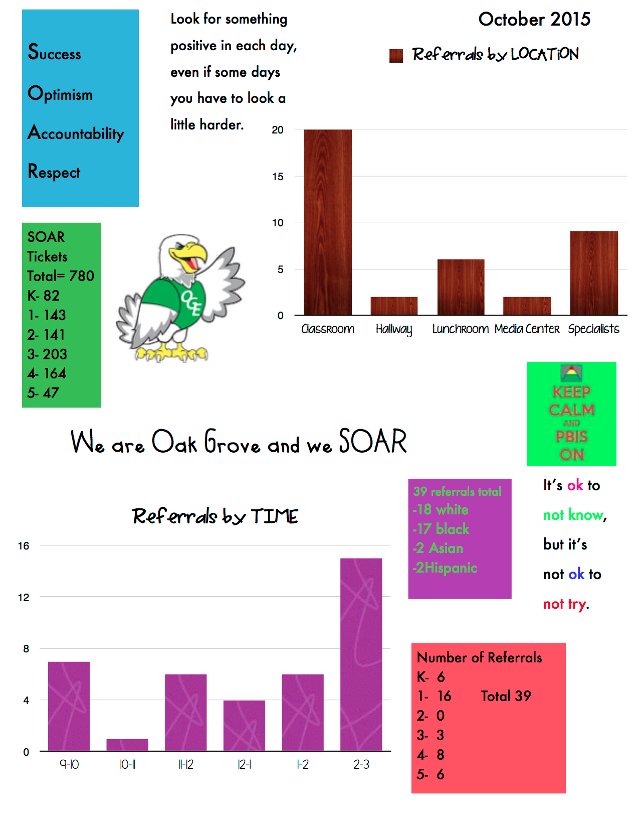
Data Report

Slide 45
5:1 Ratio
In our first two years of implementing PBIS, our school handed out 13,577 Soaring Eagle tickets.

Slide 46
How It Feels for Kids & Colleagues. . .

Slide 47
Birchview Interviews

Slide 48
Closing Thoughts
There are concrete steps that school teams can follow to build positive school climates.
There are freely available tools to measure positive behavior supports and make team-based action plans.
Use district and/or regional supports if you need help at any time.

Slide 49
Giveaways & Shameless plugs . . . For Reconnecting Schools & ‘New’ Schools

Slide 50
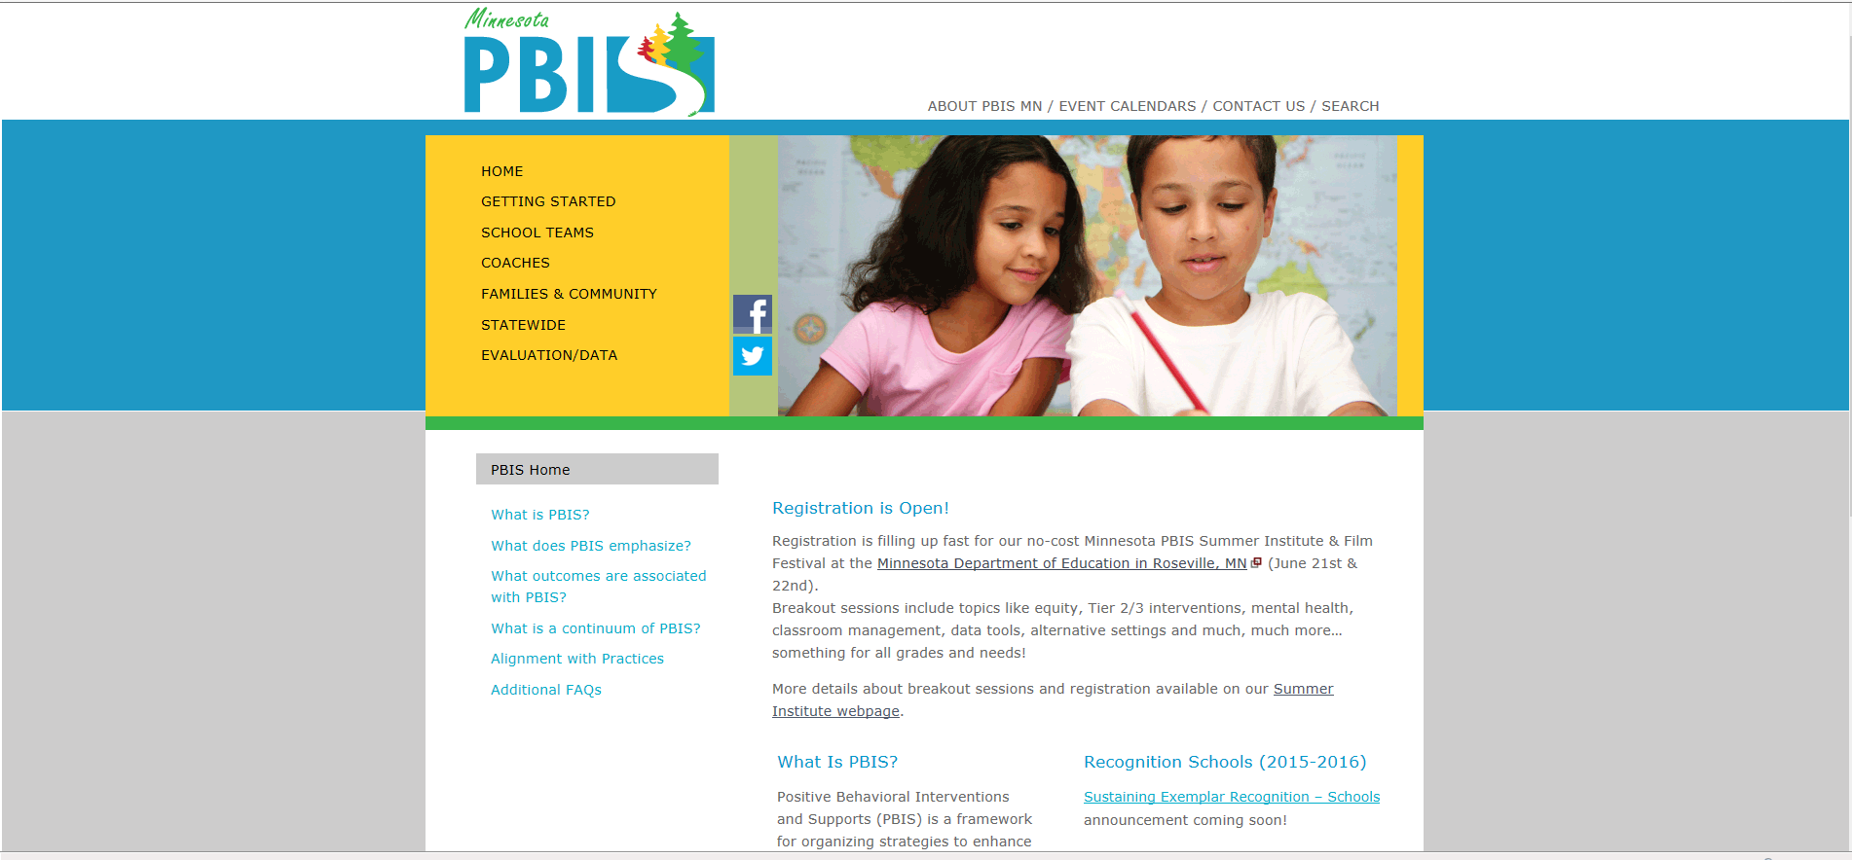
PBISMN.org Home Page
Home
Page

Slide 51
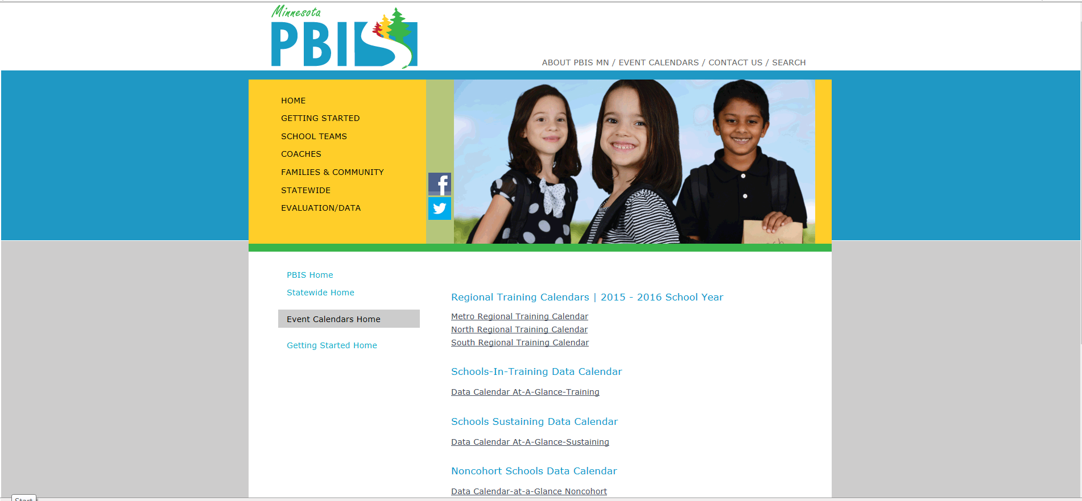
Statewide
State-wide
Data Calendars

Slide 52
Data Calendar

Slide 53
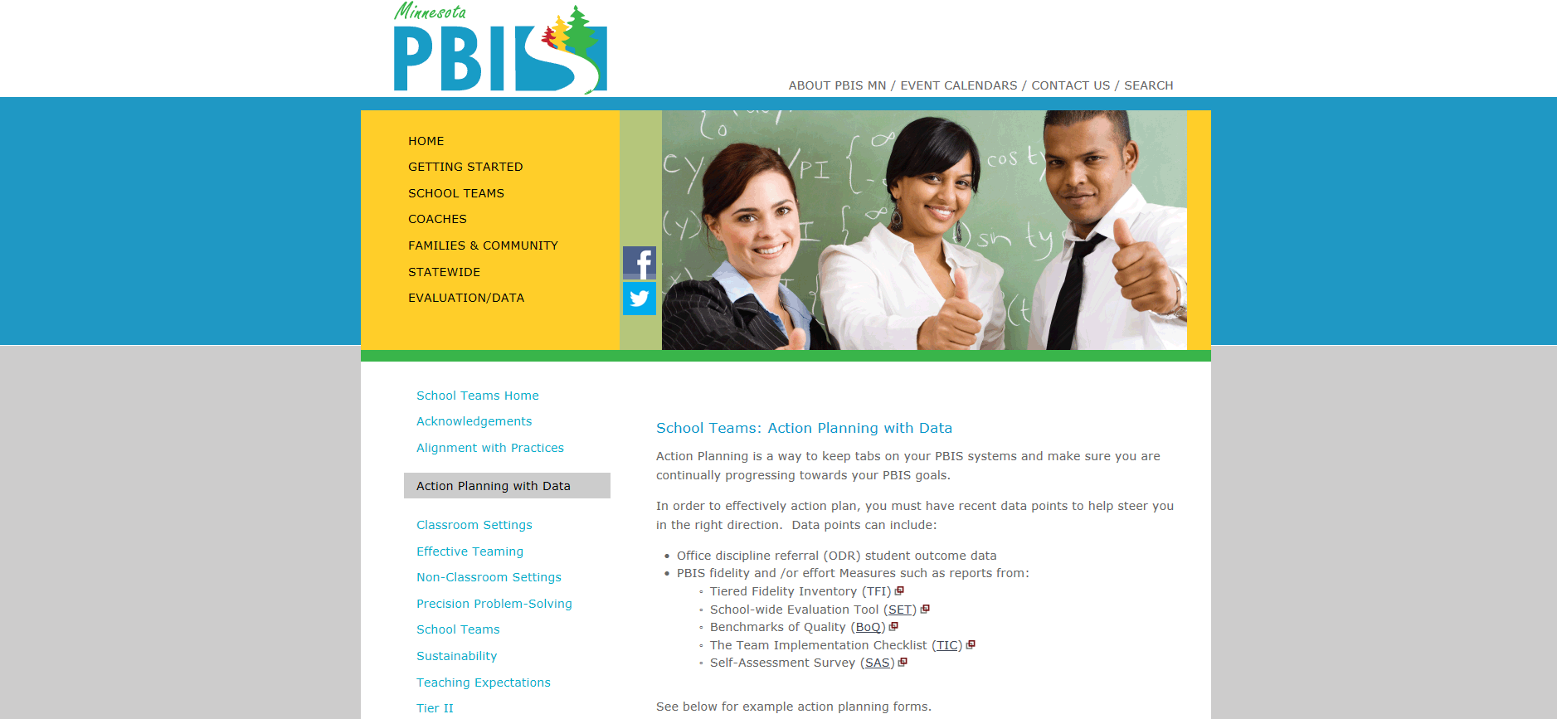
Action Planning with Data
School Teams
Action Planning
Tools

Slide 54
School teams Page
School Teams
Home
Content by Topic
Recommendations for Common Issues

Slide 55
Team Turnover
Representative team membership
Team agreements on roles and responsibilities
Completion of PBIS tool for action planning (TIC, SET, TFI, BoQ)
Drill down data
average per day/per month
average per student
types of behavior
location of behavior incidences
time of behavior
student ethnicity

Slide 56
Administrative Turnover
Communication- meeting invitations, agenda, minutes
Fidelity Measurement(SET, BoQ, TFI+walkthrough)- measure the implementation of critical components of PBIS and select 3-5 items to action plan.
Data Summary- highlight trends and patterns-
Average per day/per month
Average per student
Types of behavior
Location of behavior incidences
Time of behavior
Student Ethnicity
Networking- Encourage him or her to explore that national technical assistance center (PBIS.org), the Minnesota website (pbisMN.org) to look at videos, read more about SWPBIS research and see the list of exemplar schools and/or attend Minnesota PBIS Summer Institute as a team.

Slide 57
PBIS Booster
Students-
Prevention: How can we avoid the problem context?
Who, When, Where
Schedule change, curriculum change, etc
Teaching: How can we define, teach, and monitor what we want?
Teach appropriate behavior
Use problem behavior as negative example
Reinforcement How can we build in systematic reward for desired behavior?
Staff-
Training: Do staff need additional or supplemental training for them to better understand the decisions being made and the work being done? How could the PBIS team do some training boosters?
Coaching: Do staff need coaching to be able to follow through on the action plans and complete the tasks/activities/strategies effectively? How could the PBIS team incorporate some coaching into the action plan?
Evaluation: Do staff need more data to show what has been accomplished by the PBIS team and the outcomes or data trends? How and when could you report back more data to staff?
Sometimes there is just a lull in energy or increase of stress and the school needs to have a shared activity that increases opportunities to build rapport and provide positive feedback to students. Examples include creating a game of Jeopardy or BINGO, making a film about what PBIS looks/sounds/feels like in your building, or making a sign or poster about what PBIS means in your school and have everyone sign it.

Slide 58
Re-engaging with Data
Make an inventory of what data has been collected in the past and what tools were used. Oftentimes it is easiest to start with tools you are familiar with and complete one.
How did you measure effort- the TIC?
How did you measure fidelity- SET, BoQ or TFI?
How did you measure outcomes- ODRs?
How do you solicit staff input- SAS?
Create a data calendar. In the school calendar or a 12 month calendar make some goals of when you will collect certain data, when you will review that data and when will you report that data out to stakeholders?
Check out these resources and videos to help you determine the next right steps for you to re-engage with the data.
Data Calendar from PBISMN.org
http://www.pbismn.org/documents/dataCalendarAtAGlance_Sustaining2015_16.pdf
Links to tools and resources from the National TA Center pbis.org
http://www.pbismn.org/documents/dataCalendarAtAGlance_Sustaining2015_16.pdf
Creating district-wide evaluation plans video from PBISApps
https://www.pbisapps.org/Resources/Pages/Developing-District-PBIS-Evaluation-Plans.aspx

Slide 59
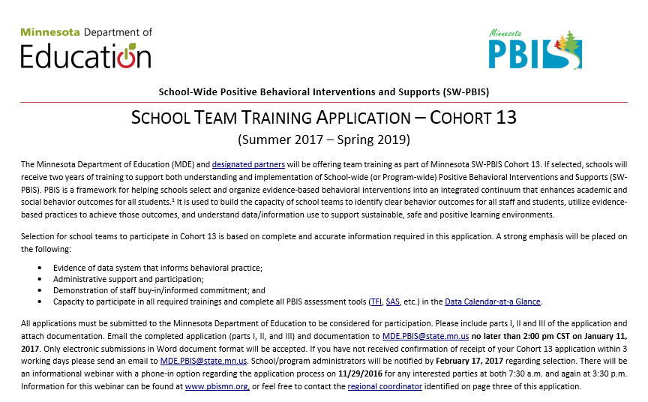
Applying for Cohort Training
Cohort application guides you through Exploration activities to form a team and get data system in place.
Teams get the pre-requisites in place to be ready for PBIS Installation, including commitment to data collection and analysis.
pbisMN.org
59
Notes:
http://www.pbismn.org/gsapplication.html
This school application requires school-wide team that is representative of that school. This applying school team represents the unit that all teams above need to support so that student outcomes will be positive. This application is reviewed by a state team member as well as a regional team member to determine fit for the school. In addition, there is a requirement in the application to name the members of a district team if more than one school is or will be implementing PBIS Data requirement is spelled out as well as commitment and buy-in.
Exploration/formation of District team
The lets teams know what will be required of them as well as what the training will provide.

Slide 60
MN SW-PBIS Regional Implementation Projects

Slide 61
Logos
Wilder Research
Notes:
Recognize our partners and the importance of the varied partnership. This diagram also demonstrates how each partner contributes to the larger buckets we will be discussing

Slide 62
North Regional Contacts
North Regional Implementation Project
Erin Engness NRIP Coordinator pbis.erin@gmail.com 320-267-7818
Karie Belling NRIP Conference Planner belling@charter.net 320-529-9631
320-309-9735 cell
PBIS Management - Regional Contacts
Mary Hunt
Mary.Hunt@state.mn.us
651-582-8676 Ellen Nacik Ellen.Nacik@state.mn.us
651-582-8665
Eric Kloos Eric.Kloos@state.mn.us 651-582-8268
PBIS Evaluation Contact
Wilder Research pbisevalmn@wilder.org 651-280-2960
Find other MN PBIS contacts on our website: www.pbismn.org/contactus.html

Slide 63
Metro Regional Contacts
Metro Regional Implementation Project
Ingrid Aasan Regional Implementation Project Coordinator Ingrid.Aasan@metroecsu.org 612-638-1517
Deborah Saxhaug Regional Implementation Project Coordinator dsaxhaug@macmh.org
Emily Robb Coach Coordinator pbis.emily@gmail.com
Megan Gruis Data & Evaluation Coordinator pbis.megan@gmail.com
PBIS Management - Regional Contacts
Maci Spica Maci.Spica@state.mn.us 651-582-8596 Becky Nies Rebecca.Nies@state.mn.us 651-582-8648
Eric Kloos Eric.Kloos@state.mn.us 651-582-8268
PBIS Evaluation Contact
Wilder Research pbisevalmn@wilder.org 651-280-2960
Find other MN PBIS contacts on our website: www.pbismn.org/contactus.html

Slide 64
South Regional Contacts
South Regional Implementation Project
Teresa Hunt, South West Service Cooperative SRIP Coordinator, Marshall Area Teresa.Hunt@swsc.org
Erin Toninato, South Central Service Cooperative
Mankato Area PBIS
etoninato@mnscsc.org
PBIS Management - Regional Contacts
Aaron Barnes
Aaron.Barnes@state.mn.us
651-582-8592 Garrett Petrie Garrett.Petrie@state.mn.us
651-582-8396
Eric Kloos Eric.Kloos@state.mn.us 651-582-8268
PBIS Evaluation Contact
Wilder Research pbisevalmn@wilder.org 651-280-2960
Find other MN PBIS contacts on our website: www.pbismn.org/contactus.html

Slide 65
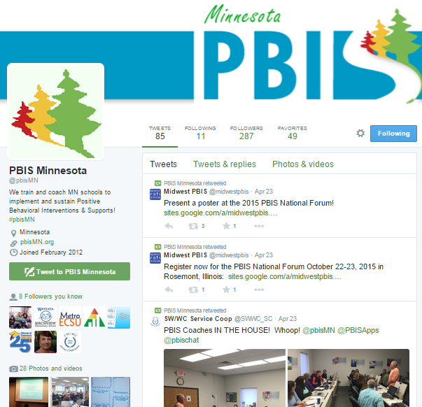
Social Media
twitter.com/pbisMN
facebook.com/pbisMN

Slide 66
Contact Us
Jackie Kuhns jmkuhns@bloomington.k12.mn.us
Aaron Benesh aaron.benesh@wayzata.k12.mn.us
Garrett Petrie garrett.petrie@state.mn.us
Becky Nies rebecca.nies@state.mn.us

