Slide 1
Minnesota PBIS Fall Training Cohort 13
MDE PBIS Management Team
MDE.PBIS@state.mn.us

Slide 2
Takeaways
PBIS growth in Minnesota
It takes teams
Implementing Schoolwide-PBIS
Supports in Minnesota

Slide 3
PBIS Growth in Minnesota

Slide 4
Growth of PBIS in Minnesota !
690

Slide 5
Growth of PBIS in Minnesota Your Efforts and Contribution!
690
Cohort 13
You are here!

Slide 6
PBIS by the Numbers in Minnesota
234 districts/charters
690 schools
33.3% of the state’s schools
335,598 students impacted by SWPBIS
38.9% of the state’s students
Notes:
33.3% of the schools was calculated by dividing 2072 (total number of schools on MDE website for 2018) by 690 schools as identified in the second bullet
335,598 students was determined by adding 311,280 (last count) with 24,318 ( the number of students pulled from the application. This number may change as the child count may be different once Kirsten looks at it. Also, it may not account for schools that have closed or dropped.
38.9% of states students was determined by dividing 335,598 by 862,160 ( k-12 child count 2018 on MDE website.

Slide 7
Cohort Implementation Fidelity Benchmarks Cohort 11 (2015-2017)
C11: 2015-2017

Slide 8
Cohort Implementation Fidelity Benchmarks Cohort 12 (2016-2018)
C12: 2016-2018

Slide 9
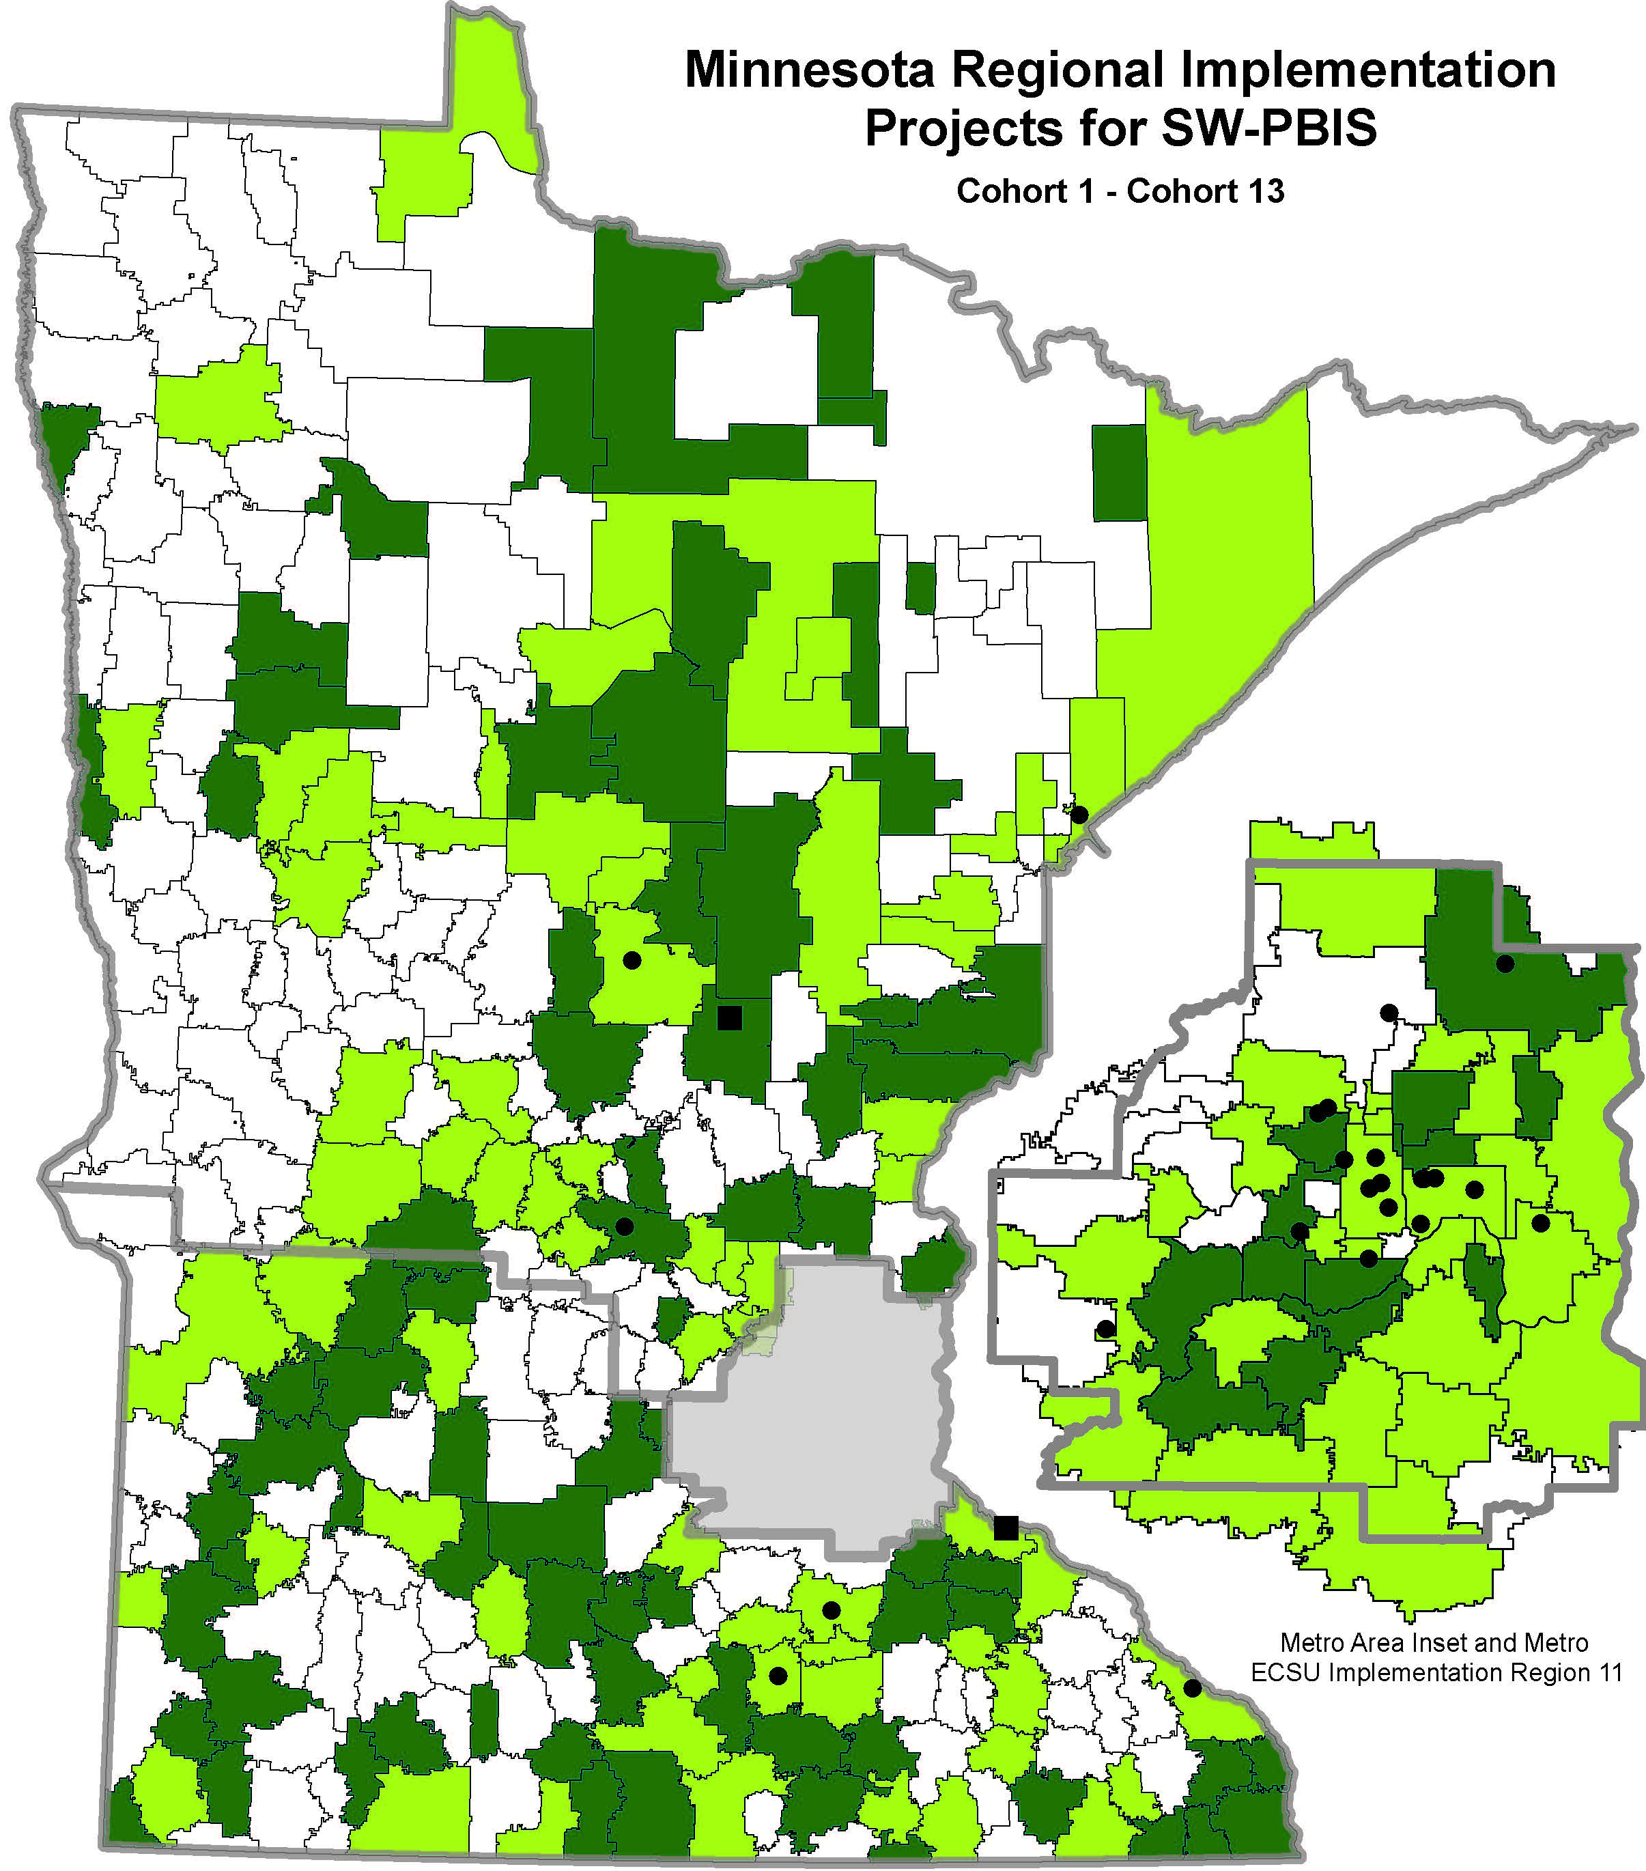
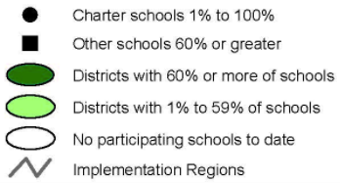
Schoolwide PBIS Across Districts
Cohorts 1- 14
(2005-2020)
Team-based training
9 training days over two years
Distributed, team-based implementation of PBIS
Intended to build capacity, skills, competency and beliefs to sustain implementation beyond initial training in a school

Slide 10
It Takes Teams

Slide 11
Teams
Notes:
Thank you partners!
Recognize our partners and the importance of the varied partnership. This diagram also demonstrates how each partner contributes to the larger buckets we will be discussing

Slide 12
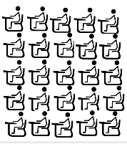
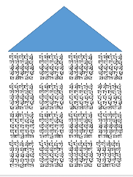
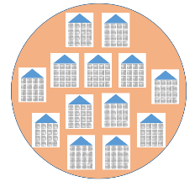
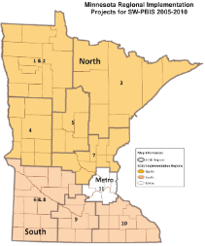
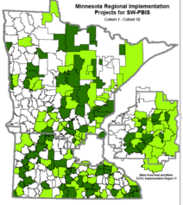
Teams Involved in Systems Change
The practices & systems put into place
are all in service to better outcomes for students
Adapted from Brandi Simonson, PBIS Leadership Conference
Chicago, Illinois 2016
Notes:
We use the data to provide better outcomes for students across systems. Our journey (with Improvement Cycles across data analysis) has allowed us to better understand systems from classroom to state and state to classroom.
Each level in the “cascading logic” builds capacity to scale-up and sustain implementation at each level through dedicated Implementation Teams.

Slide 13
Implementing SW-PBIS

Slide 14
Let’s Do the Math…
Notes:
Implementation Teams (PBIS teams) actively create positive school environments. Team can improve environments (e.g. scheduling, resources, curriculum choices, professional development resource allocation). Teams need to systematically and transparently communicate. The team collectively has the knowledge, skills, abilities, and authority
PBIS helps reduce major disciplinary infractions
Show improvement in aggressive behavior, concentration, prosocial behavior, and emotional regulation
Improvements in academic achievement
Enhanced perception of organizational health and safety

Slide 15
Formula for Success
Usable Innovations
(SW-PBIS)
Effective Implementation Methods
(Stages and Drivers)
Enabling Contexts
(Linking Teams and Improvement Cycles)
Educationally Significant Outcomes
Notes:
Implementation Teams (PBIS teams) actively create positive school environments. Team can improve environments (e.g. scheduling, resources, curriculum choices, professional development resource allocation). Teams need to systematically and transparently communicate. The team collectively has the knowledge, skills, abilities, and authority
PBIS helps reduce major disciplinary infractions
Show improvement in aggressive behavior, concentration, prosocial behavior, and emotional regulation
Improvements in academic achievement
Enhanced perception of organizational health and safety

Slide 16
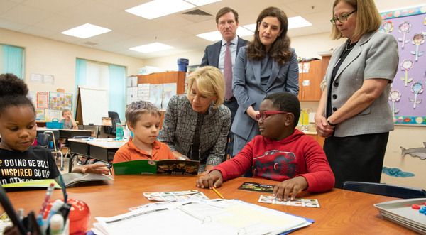
Educationally Significant Outcomes of PBIS When Implemented with Fidelity
Educationally Significant Outcomes
Reductions in major disciplinary infractions and antisocial behavior.
Improvements in aggressive behavior, concentration, prosocial behavior, and emotional regulation
Improvements in academic engagement and achievement
Enhancements in perceptions of organizational health and safety
Reductions in teacher and student reported bullying behavior, peer rejection, and substance abuse
Improvements in school climate
Source: https://www2.ed.gov/documents/press-releases/fssc-field-visit-sugai.pdf

Slide 17
It Takes Time

Slide 18
School Level Implementation Occurs in Stages
Stages of Implementation:
Exploration
Installation
Initial Implementation
Full Implementation
2 – 4 Years
Fixsen, Naoom, Blase, Friedman & Wallace, 2005

Slide 19
SRIP Cohort 13 !
Look at the growth!

Slide 20
SRIP Cohort 13 Progress!

Slide 21
MRIP Cohort 13 !
Look at the growth!

Slide 22
MRIP Cohort 13 Progress!

Slide 23
NRIP Cohort 13 !
Look at the growth!

Slide 24
NRIP Cohort 13 Progress!

Slide 25
PBIS Assessment Improves Efficiency
Used by schools teams for these purposes:
Initially determine how SW-PBIS should be adopted.
Assess SW-PBIS implementation fidelity of procedures.
Sustained assessment of SW-PBIS implementation for ongoing use of core positive behavior support features for all students.​
Assist in designing action plans to improve fidelity.
Adapted from: https://www.pbisapps.org/Applications/Pages/PBIS-Assessment.aspx

Slide 26
School and District Predictors of Sustained Implementation
Team sharing data
Collect, Disaggregate, Inform Decisions, Shared with staff, etc.
Capacity Building
Internal and external coaching, Professional Development, etc.
School Priority
Administrative/staff support, buy-in, perceived efficiency
District Priority
Explicit funding and policy, promoted to outside organization
McIntosh, K., Sterett, H., Nese, R, Strikcland-Cohen, K., Kittleman, A., Hoselton, R., Horner R. (2018). Factors Predicting Implementation of a universal Behavior Support Framework. Positive Behavior Support. Educational Researcher, 47, 307-316.
#1 Predictor

Slide 27
Improving Efficiency in Minnesota
MN Quick Facts
Evidence shows schools are measuring assessment both in and out of training (TFI, SAS, BoQ, & SET)
In 2017-2018, 357 schools completed a TFI
388 schools in Minnesota used a
PBIS fidelity assessment last year!

Slide 28
Supports in Minnesota

Slide 29
Evaluation Schedule for Schools in Training
Source: pbisMN.org/documents/dataCalendarAtAGlance_Training2015_16.pdf

Slide 30
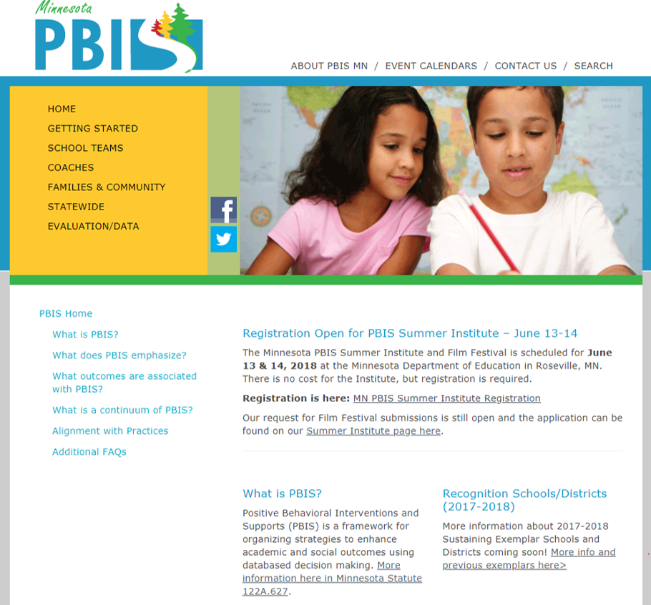
Applications Due
Minnesota PBIS page
pbisMN.org

Slide 31
Minnesota PBIS Sustaining Exemplar School Recognition
Connect with a MN recognized sustaining school or district
Apply the year after completing cohort training
Criteria: complete PBIS training and demonstrate continued implementation with fidelity
Giving back at the local, state, or national level
http://pbismn.org/statewide/sustaining-exemplar-schools.php

Slide 32
Recommendations for Common Issues
School Teams
Home
Content by Topic
Recommendations for Common Issues…
Source: http://pbismn.org/school-teams

Slide 33
What do we do?
Most of our PBIS team that went through training is no longer here.
We have a new principal.
We don’t have current data. How do we get a data system back into place?
We got buy-in to start training. Do we have to continue getting buy-in?

Slide 34
Staff Perceptions of Behavior & Discipline Findings
Staff buy-in
80% to support of buy into PBIS
Philosophical barriers can interfere with fully implementing PBIS
Staff are motivated to change practices when there is a clear need for change in discipline practices
SWPBIS is compatible with their environment
Admin is committed to implementation (actively involved)
Staff have and are aware of supports & resources
Training and Professional Development
Fuerborn, et al. The staff Perceptions of Behavior and Discipline Survey: A Tool to Help Systemic Change Through Schoolwide Positive Behavior Support (2014)
Notes:
Talking points: PBISMN has a staff buy-in recommendations page
Research: A tool available to assess that staff buy-in by examining staff beliefs about behavior and discipline and their perceptions of schoolwide expectations, school climate, systemic supports, & resources.
Key points listed above.
Research: Fuerborn, et al. Journal of Positive Behavior Supports (2014)
Sample size of 1,210 school staff from 36 schools
Likert scale & open-ended survey conducted (Staff Perceptions of Behavior and Discipline-SPBD) to support 80% staff buy-in

Slide 35
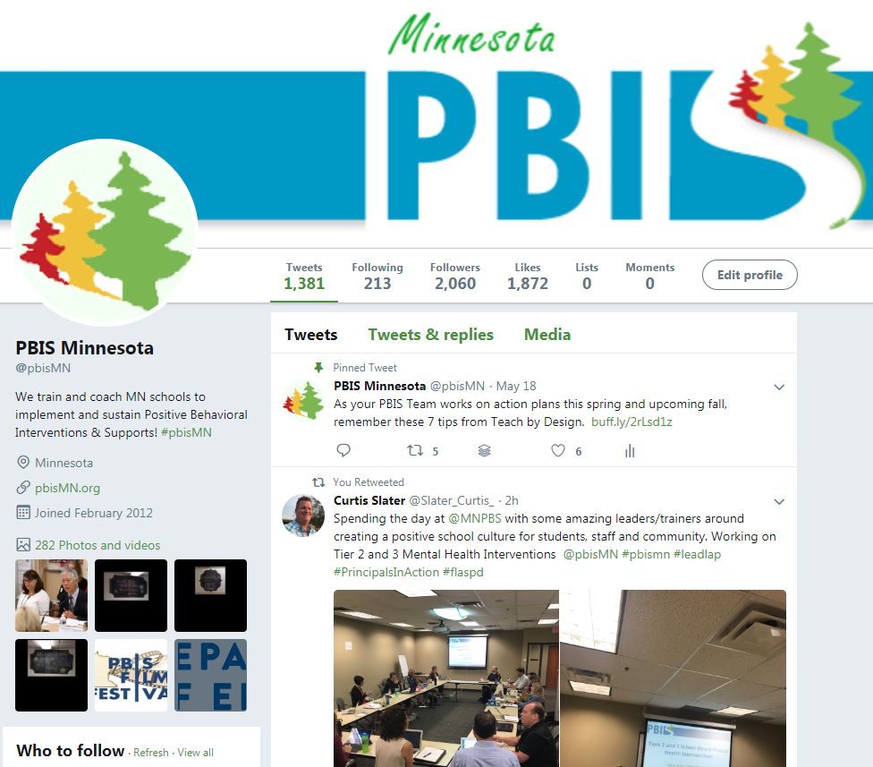
Social Media - pbisMN
twitter.com/pbisMN
#pbisMN
facebook.com/pbisMN
Notes:
Like us on Facebook or follow us on Twitter

Slide 36
2019 Minnesota PBIS Institute & Film Festival
Save-the-dates for June 11-13, 2019 at MDE - Roseville, MN
Request for proposals for breakout sessions and films
Submission forms and presentations from previous institutes at Minnesota PBIS Summer Institute

Slide 37
2019 Collaborators Forum
2019 Collaborators Forum
Tuesday, April 30, 2019 Minnesota Department of Education – Roseville, MN
mnpsp.org/mnpbs
The Collaborators Forum is an event for people interested in Positive Behavior Supports
across settings and the lifespan in Minnesota.

Slide 38
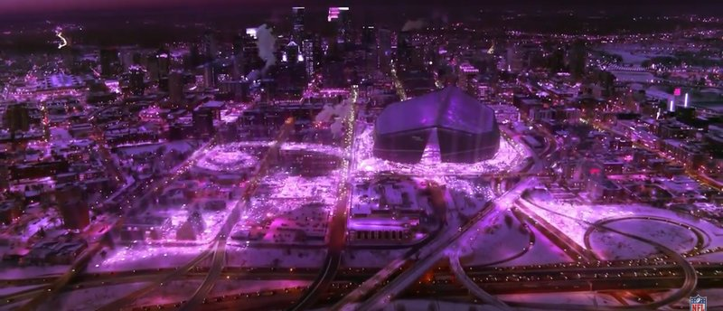
2021 APBS Conference Minneapolis
APBS Conference 2021 – Minneapolis
March 17th-20th Hyatt Regency - Minneapolis
https://twitter.com/MNPBS/status/960660570532990976

Slide 39
Closing Thoughts
Implementing and sustaining PBIS takes time
It takes teams – we are all in this together!
Work smarter, not harder
MN PBIS is here for YOU!

Slide 40
North Regional Contacts
North Regional Implementation Project
Erin Engness NRIP Coordinator pbis.erin@gmail.com
PBIS Management - Regional Contacts
Eric Kloos Eric.Kloos@state.mn.us
Mary Hunt
Mary.Hunt@state.mn.us
Erin Farrell
Erin.Farrell@state.mn.us
PBIS Evaluation Contact
Wilder Research pbisevalmn@wilder.org
Find other MN PBIS contacts at: http://pbismn.org/contact-us.php

Slide 41
Metro Regional Contacts
Metro Regional Implementation Project
Lauren Sparr MRIP Coordinator Lauren.Sparr@metroecsu.org
PBIS Management - Regional Contacts
Eric Kloos Eric.Kloos@state.mn.us
Becky Nies
Rebecca.Nies@state.mn.us
Clay Keller
Clay.Keller@state.mn.us
Ellen Nacik Ellen.Nacik@state.mn.us
PBIS Evaluation Contact
Wilder Research pbisevalmn@wilder.org
Find other MN PBIS contacts at: http://pbismn.org/contact-us.php

Slide 42
South Regional Contacts
South Regional Implementation Project
Teresa Hunt
Regional Implementation
Project Coordinator
Teresa.Hunt@swsc.org
Amber Bruns Southwest West Central Service Cooperative Amber.Bruns@swsc.org
PBIS Management - Regional Contacts
Eric Kloos Eric.Kloos@state.mn.us
Garrett Petrie
Garrett.Petrie@state.mn.us
Janet Christensen
Janet.Christensen@state.mn.us
PBIS Evaluation Contact
Wilder Research pbisevalmn@wilder.org
Find other MN PBIS contacts at: http://pbismn.org/contact-us.php

Slide 43
References
McIntosh, K., Mercer, S. H., Hume, A. E., Frank, J. L., Turri, M. G., & Mathews, S. (2013). Factors related to sustained implementation of School-wide Positive Behavior Support. Exceptional Children, 79, 293-311.
Feuerborn, L., Tyre, A., King, J. (2015). The Staff Perceptions of Behavior and Discipline Survey; A Tool to Help Achieve Systemic Change Through School-wide Positive Behavior Support. Positive Behavior Interventions, 17, 116-126.
Frank, J. L., Matthews, S., McIntosh K., (2013). Critical Features Predicting Sustained Implementation of School-Wide Positive Behavioral Interventions and Supports. Journal of Positive Behavior Supports, 16, 168-178
Biglan, A. et al., (2018). Positive Behavioral Interventions and Support: Brief Introduction. Retrieved from www.pbis.org
Dylan Bragg, Mateus Carvalho, Josh Charles, Ann Hoang, Rob Horner, Hassan Lachgar, Devin Sullivan.” SISEP, www.sisep.org/.
Swain-Broadway, J., et al (2017). PBIS Technical Guide on Classroom Data: Using Data to Support Implementation of Positive Classroom Behavior Support Practices and Systems. Retrieved from http://www.pbis.org

Slide 44
Thank You!
MDE PBIS Management Team
MDE.PBIS@state.mn.us

