Slide 1
Minnesota PBIS Welcome New Teams!
MDE PBIS Management Team
MDE.PBIS@state.mn.us

Slide 2
Welcome to MN PBIS Training!

Slide 3
Takeaways
PBIS overview
PBIS growth in Minnesota
It takes teams
It takes time
Supports in Minnesota

Slide 4
PBIS Overview

Slide 5
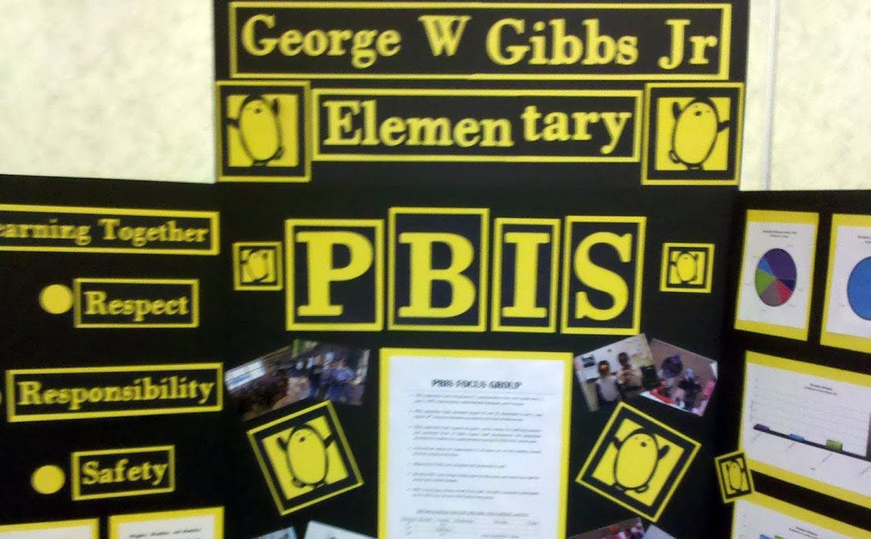
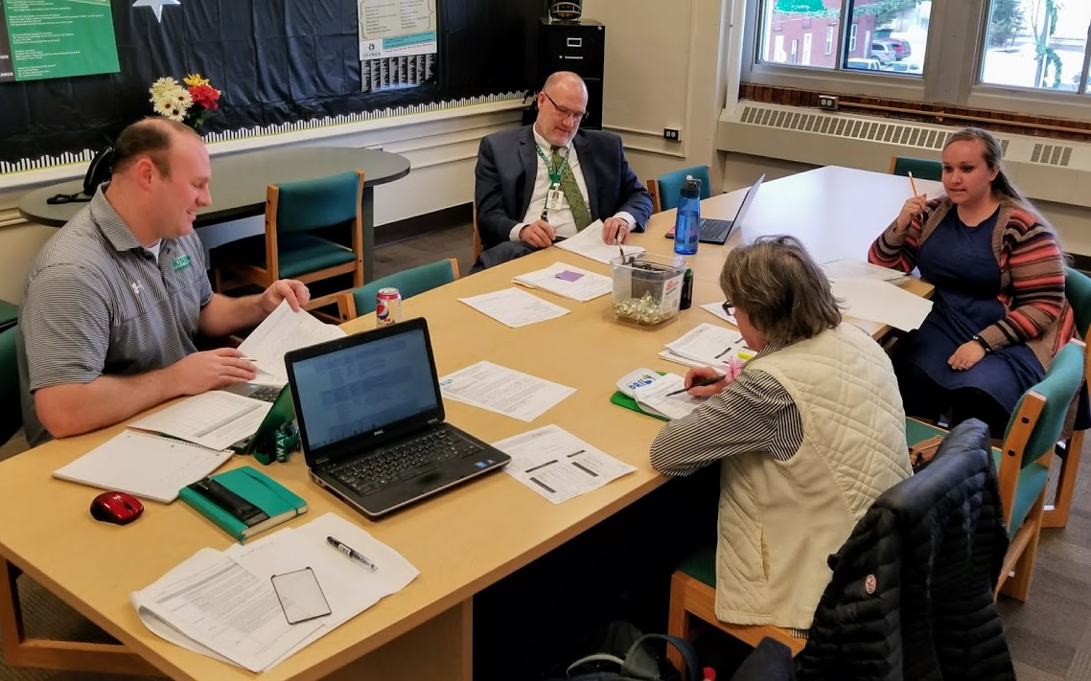
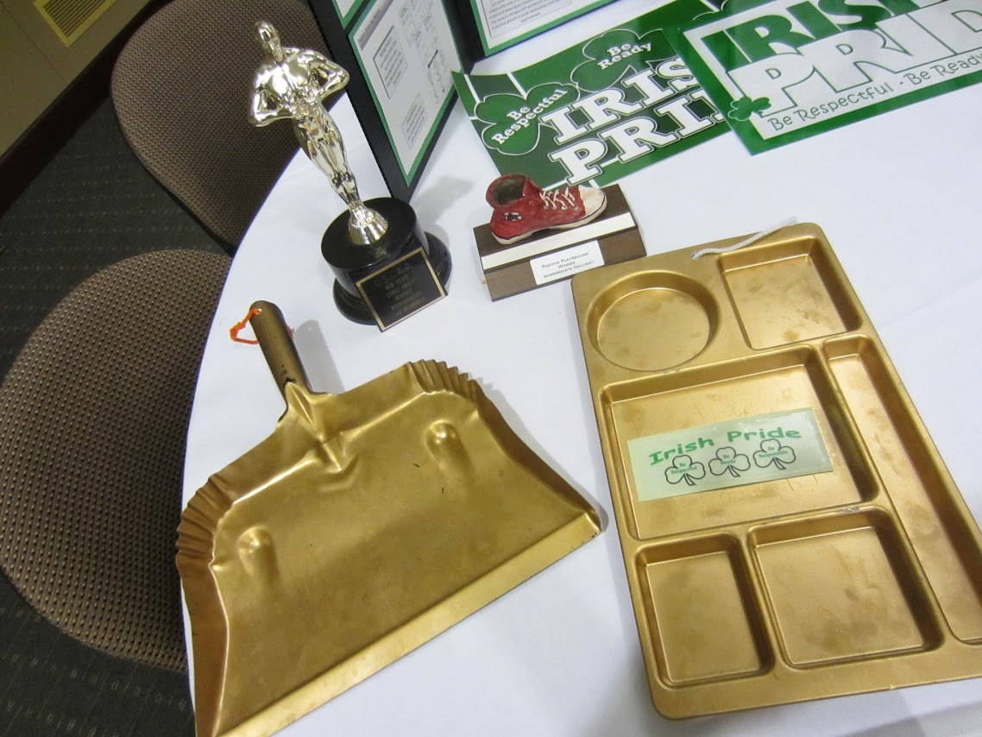
Tier 1 Basics
School Leadership Team
3-5 Positive Expectations
Acknowledgement System
Continuum of Procedures to Correct Behavior
Data Based Decision Making

Slide 6
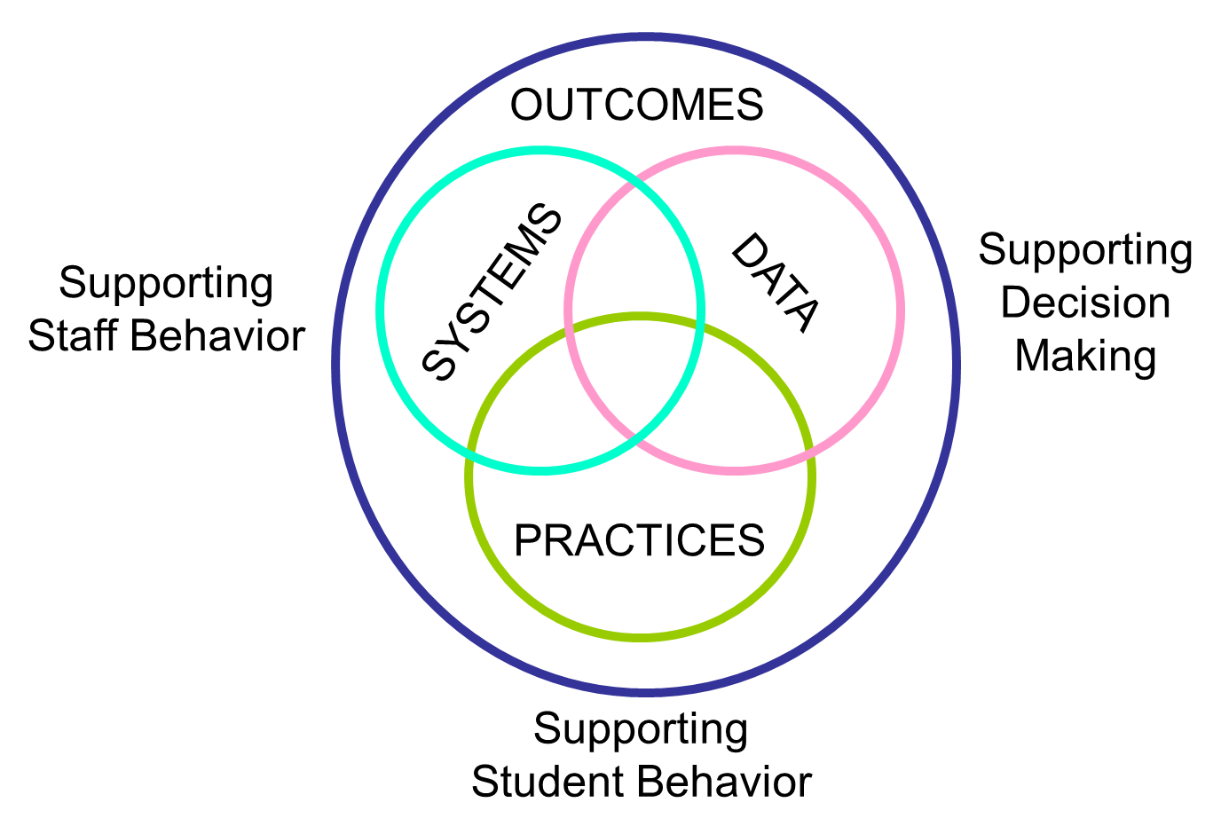
Four Key Elements of SW-PBIS
Supporting culturally equitable social competence and academic achievement
https://www.pbis.org/school
Notes:
Effective, efficient, and relevant school-wide discipline is based on a balance of four key and interactive elements:
Outcomes supporting culturally equitable social competence and academic achievement of all students
Data supporting culturally valid decision-making.
Practices supporting culturally relevant evidence-based interventions
Systems supporting culturally knowledgeable staff behavior
(Vincent, Randal, Cartledge, Tobin, & Swain-Bradway, 2011; Sugai, O’Keefe, & Fallon 2012 ab)
Implementation of PBIS is not an event. It is "a specified set of activities designed to put into practice an activity or program of known dimensions"
Ask these questions about Implementing PBIS:
What practices do you want to implement?
Where are the practices implemented?
Who are your implementation supporters?
How will you support implementation?
Outcomes are the desired goals.
Systems refer to the structures and supports school and district leadership teams provide to enhance teachers' implementation of evidence-based practices with fidelity.
Data is part of decision-making in the classroom that allow educators to identify patterns of strengths and needs. It is specific, observable, measurable. It should be accurate, reliable, and efficient, and socially relevant (involving multiple perspectives for equity work).
Practices are preventative and responsive approaches that may be effectively implemented with ALL students in a school and intensified to support small groups or a few individual students.

Slide 7
Four Key Elements of SW-PBIS – Analogy
Supporting Social Competence &
Academic Achievement
OUTCOMES
DATA
Supporting
Decision
Making
PRACTICES
SYSTEMS
Supporting
Student Behavior
Supporting
Staff Behavior
Notes:
Implementation of PBIS is not an event. It is "a specified set of activities designed to put into practice an activity or program of known dimensions"
Ask these questions about Implementing PBIS:
What practices do you want to implement?
Where are the practices implemented?
Who are your implementation supporters?
How will you support implementation?
Outcomes are the desired goals.
Systems refer to the structures and supports school and district leadership teams provide to enhance teachers' implementation of evidence-based practices with fidelity.
Data is part of decision-making in the classroom that allow educators to identify patterns of strengths and needs. It is specific, observable, measurable. It should be accurate, reliable, and efficient, and socially relevant (involving multiple perspectives for equity work).
Practices are preventative and responsive approaches that may be effectively implemented with ALL students in a school and intensified to support small groups or a few individual students.

Slide 8
PBIS as a Framework for Implementation
Multi-Tiered System of Supports
Emphasis on Evidence-based Practices
Focus on Outcomes and Data-based Decision Making
Team-led Implementation
Focus on Contextual Fit & Fidelity
Emphasizes Sustainability
Notes:
Every school is unique therefore PBIS has to be School-wide components. Implementing PBIS is not a single event or a one year process; PBIS is not a prescribed curriculum
-use evidence based practices
-focus on data and outcomes (PDSA cycles)
-team approach
-interventions should be relative to population and implemented with fidelity
***The implementation process includes active administrator leadership; school-wide leadership teams; coaching; data-based decision making; and student, family, and staff input.

Slide 9
Continuum Logic: Support for All
Universal
Targeted
Intensive
TERTIARY PREVENTION (Tier 3)
Most individualized
Most differentiated
Most specialized
SECONDARY PREVENTION (Tier 2)
Group implemented
More differentiated
More specialized
PRIMARY PREVENTION (Tier 1)
All students
All staff
All settings
Notes:
This TIERED LOGIC can be illustrated by a schools that has ALIGNED its BEHAVIOR SUPPORT INTERVENTIONS OR PRACTICES BY THREE GENERAL TIERS
TIER 1 PRACTICES ARE FOR ALL STUDENTS ACROSS ALL SCHOOL SETTINGS
TIER 2 PRACTICES ARE FOR STUDENTS WHO REQUIRE SUPPLEMENTAL SPECIALIZED (SMALL GROUP) SUPPORTS
TIER 3 PRACTICES ARE HIGHLY SPECIALIZED AND INTENSIVE FOR INDIVIDUAL STUDENTS.
It is important to notice that these practices are
SMALL IN NUMBER
CONCEPTUALLY ALIGNED
AND WOULD HAVE DATA RULES FOR MOVEMENT UP AND DOWN THE CONTINUUM

Slide 10
PBIS Defined in MN Statute 122A.627
Source: https://www.revisor.mn.gov/laws/?id=5&year=2017&type=1#laws.2.26.0

Slide 11
PBIS Growth in Minnesota

Slide 12
Growth of PBIS in Minnesota !
690

Slide 13
Growth of PBIS in Minnesota Your Efforts and Contribution!
690
Cohort 14
You are here!

Slide 14
PBIS by the Numbers in Minnesota
234 districts/charters
690 schools
33.3% of the state’s schools
335,598 students impacted by SWPBIS
38.9% of the state’s students
Notes:
33.3% of the schools was calculated by dividing 2072 (total number of schools on MDE website for 2018) by 690 schools as identified in the second bullet
335,598 students was determined by adding 311,280 (last count) with 24,318 ( the number of students pulled from the application. This number may change as the child count may be different once Kirsten looks at it. Also, it may not account for schools that have closed or dropped.
38.9% of states students was determined by dividing 335,598 by 862,160 ( k-12 child count 2018 on MDE website.

Slide 15
Cohort 14 by the Numbers: State
35 districts/charters
45 schools
24,318 students impacted by SWPBIS

Slide 16
Cohort 14 by the Numbers: SRIP
7 districts/charters
8 schools
2,886 students impacted by SWPBIS

Slide 17
Cohort 14 by the Numbers: MRIP
17 districts/charters
20 schools
15,842 students impacted by SWPBIS

Slide 18
Cohort 14A by the Numbers: NRIP
8 districts/charters
11 schools
4,899 students impacted by SWPBIS

Slide 19
Cohort 14B by the Numbers: NRIP
3 districts/charters
6 schools
691 students impacted by SWPBIS

Slide 20
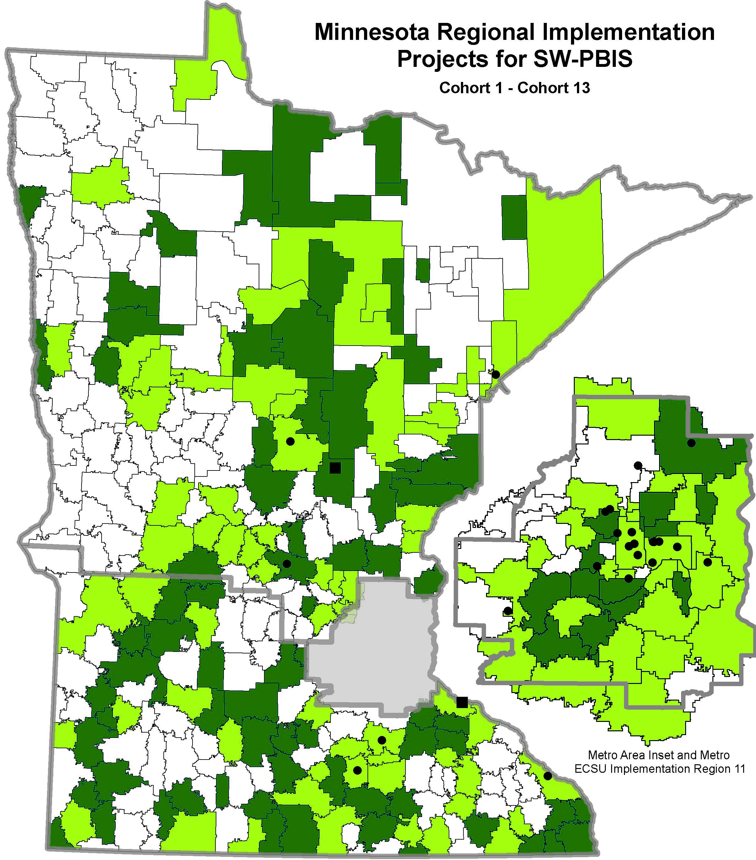
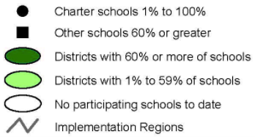
Schoolwide PBIS Across Districts
Cohorts 1- 14
(2005-2020)
Team-based training
9 training days over two years
Distributed, team-based implementation of PBIS
Intended to build capacity, skills, competency and beliefs to sustain implementation beyond initial training in a school

Slide 21
It Takes Teams

Slide 22
Teams
Notes:
Thank you partners!
Recognize our partners and the importance of the varied partnership. This diagram also demonstrates how each partner contributes to the larger buckets we will be discussing

Slide 23
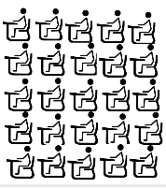
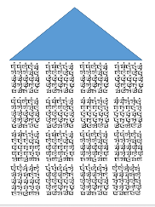
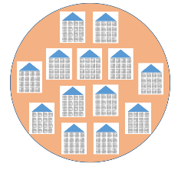
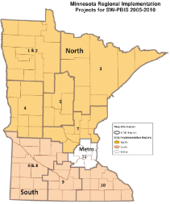
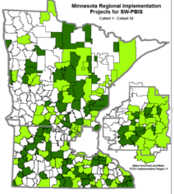
Teams Involved in Systems Change
The practices & systems put into place
are all in service to better outcomes for students
Adapted from Brandi Simonson, PBIS Leadership Conference
Chicago, Illinois 2016
Notes:
We use the data to provide better outcomes for students across systems. Our journey (with Improvement Cycles across data analysis) has allowed us to better understand systems from classroom to state and state to classroom.
Each level in the “cascading logic” builds capacity to scale-up and sustain implementation at each level through dedicated Implementation Teams.

Slide 24
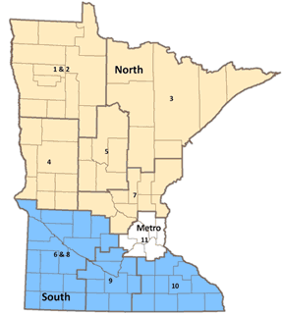
Minnesota Regional Implementation Projects (RIPs)
Cohort Support and Capacity for
Schools and Districts
Team training
Data and evaluation support
Coaches meetings
RIP Coordinators
PBIS trainers
External PBIS coaches

Slide 25
It Takes Time

Slide 26
Let’s Do the Math…
Notes:
Implementation Teams (PBIS teams) actively create positive school environments. Team can improve environments (e.g. scheduling, resources, curriculum choices, professional development resource allocation). Teams need to systematically and transparently communicate. The team collectively has the knowledge, skills, abilities, and authority
PBIS helps reduce major disciplinary infractions
Show improvement in aggressive behavior, concentration, prosocial behavior, and emotional regulation
Improvements in academic achievement
Enhanced perception of organizational health and safety

Slide 27
Formula for Success
Usable Innovations
(SW-PBIS)
Effective Implementation Methods
(Stages and Drivers)
Enabling Contexts
(Linking Teams and Improvement Cycles)
Educationally Significant Outcomes
Notes:
Implementation Teams (PBIS teams) actively create positive school environments. Team can improve environments (e.g. scheduling, resources, curriculum choices, professional development resource allocation). Teams need to systematically and transparently communicate. The team collectively has the knowledge, skills, abilities, and authority
PBIS helps reduce major disciplinary infractions
Show improvement in aggressive behavior, concentration, prosocial behavior, and emotional regulation
Improvements in academic achievement
Enhanced perception of organizational health and safety

Slide 28
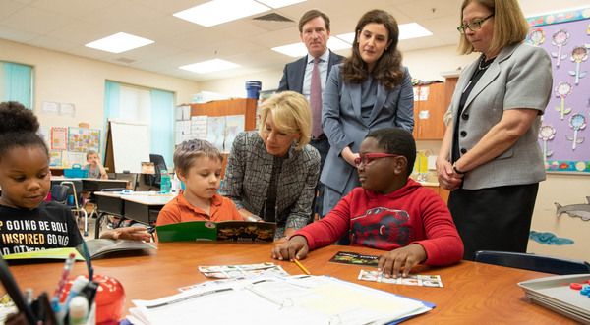
Educationally Significant Outcomes of PBIS When Implemented with Fidelity
Educationally Significant Outcomes
Reductions in major disciplinary infractions and antisocial behavior.
Improvements in aggressive behavior, concentration, prosocial behavior, and emotional regulation
Improvements in academic engagement and achievement
Enhancements in perceptions of organizational health and safety
Reductions in teacher and student reported bullying behavior, peer rejection, and substance abuse
Improvements in school climate
Source: https://www2.ed.gov/documents/press-releases/fssc-field-visit-sugai.pdf

Slide 29
Changing School Culture
Products v. Participation & Buy-in
Developed materials
Posters on wall, tickets
Handbook
Is there staff participation and buy-in
80% + participation by staff
Do staff & students know rules?
Is the acknowledgment system reaching all students?
Is a leadership team focused on School-wide PBIS programs meeting regularly to maintain the strength of SW-PBIS systems?
Adopted from Borgmeier, C. (2018)

Slide 30
Cohort Implementation Fidelity Benchmarks Cohort 11 (2015-2017)
C11: 2015-2017

Slide 31
Cohort Implementation Fidelity Benchmarks Cohort 12 (2016-2018)
C12: 2016-2018

Slide 32
Cohort Implementation Fidelity Benchmarks Cohort 13 (2017-present)
C13: 2017-present

Slide 33
School and District Predictors of Sustained Implementation
Team sharing data
Collect, Disaggregate, Inform Decisions, Shared with staff, etc.
Capacity Building
Internal and external coaching, Professional Development, etc.
School Priority
Administrative/staff support, buy-in, perceived efficiency
District Priority
Explicit funding and policy, promoted to outside organization
McIntosh, K., Sterett, H., Nese, R, Strikcland-Cohen, K., Kittleman, A., Hoselton, R., Horner R. (2018). Factors Predicting Implementation of a universal Behavior Support Framework. Positive Behavior Support. Educational Researcher, 47, 307-316.
#1 Predictor

Slide 34
Improving Efficiency in Minnesota
MN Quick Facts
Evidence shows that a lot of schools are using a fidelity assessment including the TFI, SAS, BoQ, & SET
In (2017-2018) 357 schools that have completed a TFI cohort and non-cohort trained
388 schools in Minnesota used a
PBIS fidelity assessment last year!
pbisapps.org

Slide 35
Supports in Minnesota

Slide 36
Applications Due
Minnesota PBIS page
pbisMN.org

Slide 37
Evaluation Schedule for Schools in Training
Source: pbisMN.org/documents/dataCalendarAtAGlance_Training2015_16.pdf

Slide 38
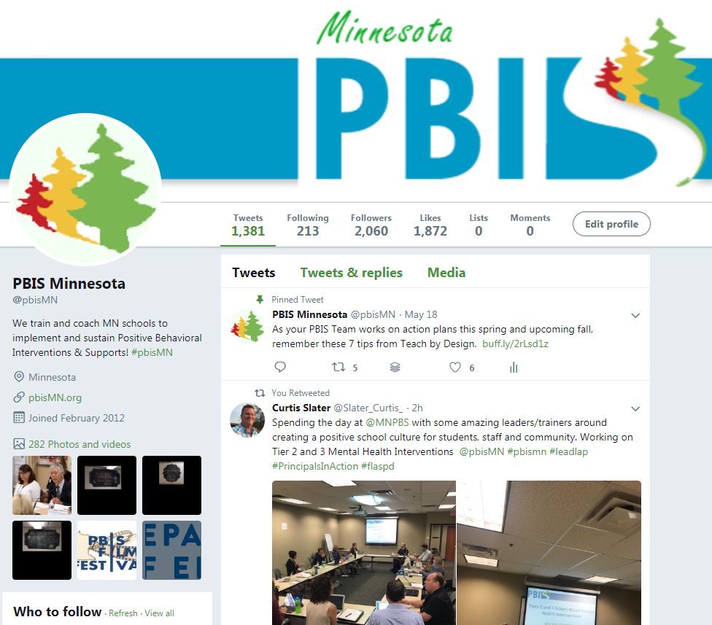
Social Media - pbisMN
twitter.com/pbisMN
#pbisMN
facebook.com/pbisMN
Notes:
Like us on Facebook or follow us on Twitter

Slide 39
Closing Thoughts
PBIS continues to grow and be recognized thanks to the efforts of schools, districts and regions across Minnesota!
Teams use data around shared PBIS practices and outcomes to sustain and improve.
PBIS support is available for ALL schools in Minnesota.

Slide 40
North Regional Contacts
North Regional Implementation Project
Erin Engness NRIP Coordinator pbis.erin@gmail.com
PBIS Management - Regional Contacts
Eric Kloos Eric.Kloos@state.mn.us
Mary Hunt
Mary.Hunt@state.mn.us
Erin Farrell
Erin.Farrell@state.mn.us
PBIS Evaluation Contact
Wilder Research pbisevalmn@wilder.org
Find other MN PBIS contacts at: http://pbismn.org/contact-us.php

Slide 41
Metro Regional Contacts
Metro Regional Implementation Project
Lauren Sparr MRIP Coordinator Lauren.Sparr@metroecsu.org
PBIS Management - Regional Contacts
Eric Kloos Eric.Kloos@state.mn.us
Becky Nies
Rebecca.Nies@state.mn.us
Clay Keller
Clay.Keller@state.mn.us
Ellen Nacik Ellen.Nacik@state.mn.us
PBIS Evaluation Contact
Wilder Research pbisevalmn@wilder.org
Find other MN PBIS contacts at: http://pbismn.org/contact-us.php

Slide 42
South Regional Contacts
South Regional Implementation Project
Teresa Hunt
Regional Implementation
Project Coordinator
Teresa.Hunt@swsc.org
Amber Bruns Southwest West Central Service Cooperative Amber.Bruns@swsc.org
PBIS Management - Regional Contacts
Eric Kloos Eric.Kloos@state.mn.us
Garrett Petrie
Garrett.Petrie@state.mn.us
Janet Christensen
Janet.Christensen@state.mn.us
PBIS Evaluation Contact
Wilder Research pbisevalmn@wilder.org
Find other MN PBIS contacts at: http://pbismn.org/contact-us.php

Slide 43
References
McIntosh, K., Mercer, S. H., Hume, A. E., Frank, J. L., Turri, M. G., & Mathews, S. (2013). Factors related to sustained implementation of School-wide Positive Behavior Support. Exceptional Children, 79, 293-311.
Feuerborn, L., Tyre, A., King, J. (2015). The Staff Perceptions of Behavior and Discipline Survey; A Tool to Help Achieve Systemic Change Through School-wide Positive Behavior Support. Positive Behavior Interventions, 17, 116-126.
Frank, J. L., Matthews, S., McIntosh K., (2013). Critical Features Predicting Sustained Implementation of School-Wide Positive Behavioral Interventions and Supports. Journal of Positive Behavior Supports, 16, 168-178
Biglan, A. et al., (2018). Positive Behavioral Interventions and Support: Brief Introduction. Retrieved from www.pbis.org
Dylan Bragg, Mateus Carvalho, Josh Charles, Ann Hoang, Rob Horner, Hassan Lachgar, Devin Sullivan.” SISEP, www.sisep.org/.
Swain-Broadway, J., et al (2017). PBIS Technical Guide on Classroom Data: Using Data to Support Implementation of Positive Classroom Behavior Support Practices and Systems. Retrieved from http://www.pbis.org

Slide 44
Thank You!
MDE PBIS Management Team
MDE.PBIS@state.mn.us

