Slide 1
Welcome New Teams!
Minnesota PBIS Cohort 15 Fall Training – Days 1&2
MDE PBIS Management Team
MDE.PBIS@state.mn.us
Notes:
UPDATED 08/06/19

Slide 2
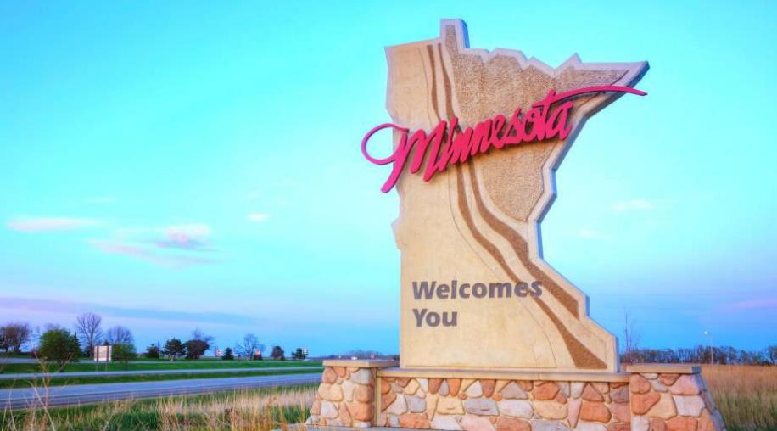
Welcome to
Minnesota PBIS Cohort Training!

Slide 3
Welcome New Teams!
Takeaways
It takes teams
PBIS growth in Minnesota
Supports in Minnesota

Slide 4
It Takes Teams

Slide 5
Effective Team-Based Implementation of PBIS:
Lessons Learned
Teams drive implementation
  Helps sustain SW-PBIS over time and buffer effects of annual staff turnover.
  Use pertinent data for making decisions and measuring success. (Judkins et al., 2019)
Teams engage staff
  Staff buy-in to principles of SW-PBIS.
  Staff commitment to engage in implementation behaviors. (Filter et al., 2019)
Teams sustain PBIS
  Measuring fidelity regularly, and
  Sharing data with staff. (McIntosh et al., 2018; Judkins et al., 2019)
Notes:
School-wide PBIS Implementation is ongoing
Turnover is a normal part of growth each year
Team-based implementation helps sustain PBIS over time
Teams may have already experienced turnover since completing the cohort training application
3-5 years from now the team will likely have turned over again
Staff involvement is essential for lasting commitment
Measuring fidelity is essential for sustaining

Slide 6
School and District Predictors of
Sustained Implementation
Team sharing data
    Collect, disaggregate, inform decisions, shared with staff, etc.
Capacity Building
  Internal and external coaching, professional development, etc.
School Priority
  Administrative/staff support, buy-in, perceived efficiency
District Priority
Explicit funding and policy, promoted to outside organization
  McIntosh, K., Sterett, H., Nese, R, Strikcland-Cohen, K., Kittleman, A., Hoselton, R., Horner R. (2018). Factors Predicting Implementation of a universal Behavior Support Framework. Positive Behavior Support. Educational Researcher, 47, 307-316.
#1 Predictor

Slide 7
PBIS Growth in Minnesota

Slide 8
PBIS Scale-Up in Minnesota
As of 2019
242 districts/charters
769 schools
  60% early childhood and/or elementary
  15% middle school
  25% high schools or ALCs
37% of schools in Minnesota
40% of students (approx. 353,371) in Minnesota
Notes:
769 schools have been or are in cohort training.
Approximately 20 schools have been through training more than once.
The parentages of school types were determined using the numbers at the end of the current list.
Out of 754 on list
452 (60%) were EC and Elementary
115 (15%) were MS
186 (25%) were HS or ALC

Slide 9
Growth of PBIS in Minnesota
2005-2019
769

Slide 10
Growth of PBIS in Minnesota
(Cohort 15 highlighted) 2005-2019
Cohort 15
You are here!
769

Slide 11
PBIS by the Numbers in Minnesota
(as of 2019)
60 schools completed PBIS training this past spring
79 schools entered Cohort 15
442 schools used a fidelity measure this past year (2018-19)
  By June 1st, 274 of 410 schools met fidelity (67%), then 32 more schools measured that month
  339 schools – Cohort 1-12 schools (258) and non-cohort schools (81) – used a fidelity assessment
72 Schools and 6 Districts Recognized for sustained, effective implementation of PBIS

Slide 12
Implementation Occurs in Stages
Stages of Implementation:
Exploration
Installation
Initial Implementation
Full Implementation
2 – 4 Years
Fixsen, Naoom, Blase, Friedman & Wallace, 2005

Slide 13
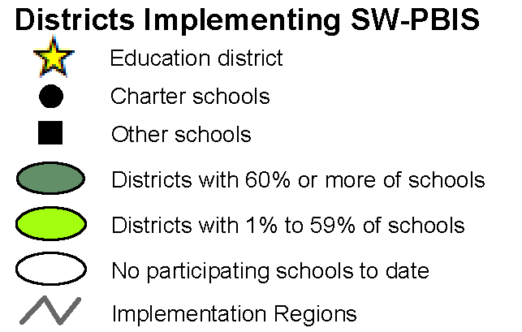
Schoolwide PBIS Across Districts
As of 2019
Cohorts 1- 15
(2005-2021)
Team-based training
9 training days over two years
Distributed, team-based implementation of PBIS
Intended to build capacity, skills, competency and beliefs to sustain implementation beyond initial training in a school
Notes:
This is what you signed up for, you’ve gone through Exploration.

Slide 14
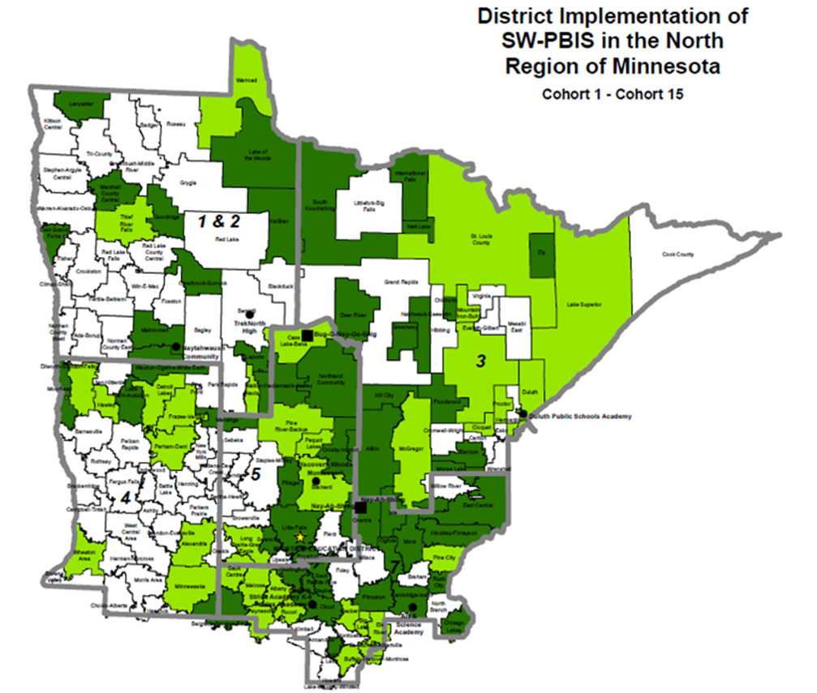
North Regional Implementation Project
As of 2019
The impact of schools from
NRIP Cohorts 1-15:
100 districts / charters
241 schools
≈ 104,676 students

Slide 15
North Regional Implementation Project
The Addition of NRIP Cohort 15 in 2019
The inclusion and impact of schools in
NRIP Cohort 15 adds:
39 new schools + 2 reconnecting
  20 elementary schools
  7 middle schools
  10 secondary and high schools
  4 other types of schools
≈ 11,704 students in new PBIS schools

Slide 16
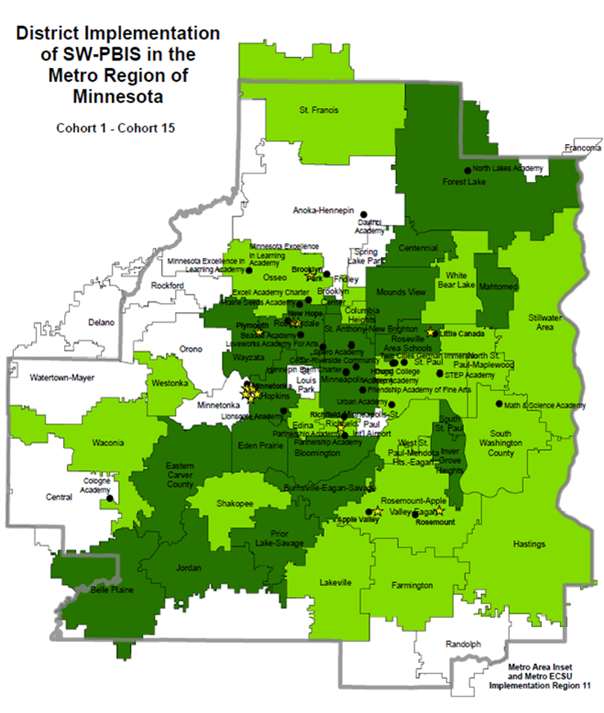
Metro Regional Implementation Project
As of 2019
The impact of schools from
MRIP Cohorts 1-15:
69 districts / charters
326 schools
≈ 183,938 students

Slide 17
Metro Regional Implementation Project
The Addition of SRIP Cohort 15 in 2019
The inclusion and impact of schools in
MRIP Cohort 15 adds:
17 new schools + 5 reconnecting
  13 pre-K/elementary schools
  2 middle schools
  1 high school
  6 other types of schools
≈ 6,664 students in new PBIS schools

Slide 18
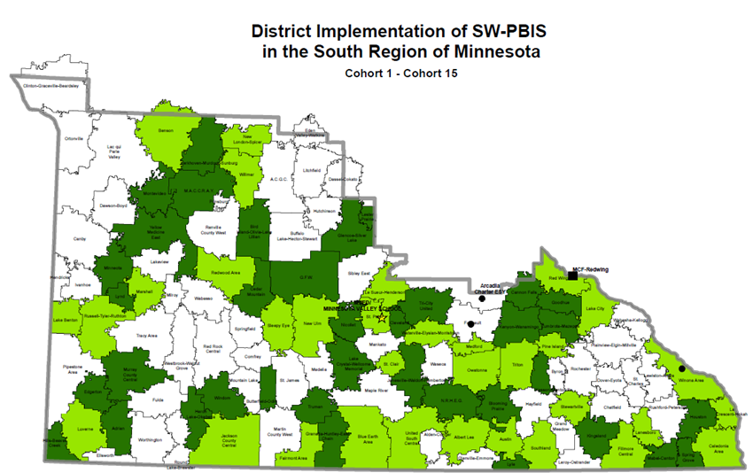
South Regional Implementation Project
As of 2019
The impact of schools from
SRIP Cohorts 1-15:
86 districts / charters
186 schools
≈ 65,657 students

Slide 19
South Regional Implementation Project
The Addition of SRIP Cohort 15 in 2019
The inclusion and impact of schools in
SRIP Cohort 15 adds:
12 new schools + 4 reconnecting
  11 elementary schools
  1 middle school
  3 secondary and high schools
  1 other type of school
≈ 4,300 students in new PBIS schools

Slide 20
Supports for PBIS in
Minnesota

Slide 21
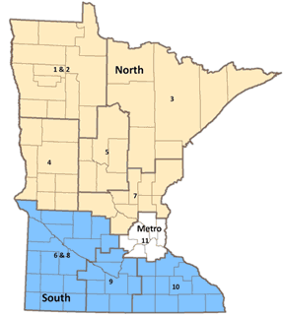
Minnesota Regional Implementation Projects (RIPs)
Support and Capacity for Schools & Districts
Team training
Data and evaluation support
Coaches meetings
RIP Coordinators
PBIS trainers
External PBIS coaches

Slide 22
North Regional Contacts
North Regional Implementation Project
Erin Engness
NRIP Coordinator
pbis.erin@gmail.com
PBIS Management - Regional Contacts
Eric Kloos
Eric.Kloos@state.mn.us
Mary Hunt
Mary.Hunt@state.mn.us
Erin Farrell
Erin.Farrell@state.mn.us
PBIS Evaluation Contact
Wilder Research
pbisevalmn@wilder.org
Find other PBIS Minnesota contacts at: http://pbismn.org/contact-us.php

Slide 23
Metro Regional Contacts
Metro Regional Implementation Project
Lauren Sparr
MRIP Coordinator
Lauren.Sparr@metroecsu.org
PBIS Management - Regional Contacts
Eric Kloos
Eric.Kloos@state.mn.us
Becky Nies
Rebecca.Nies@state.mn.us
Clay Keller
Clay.Keller@state.mn.us
Ellen Nacik
Ellen.Nacik@state.mn.us
PBIS Evaluation Contact
Wilder Research
pbisevalmn@wilder.org
Find other PBIS Minnesota contacts at: http://pbismn.org/contact-us.php

Slide 24
South Regional Contacts
South Regional Implementation Project (SRIP)
Liz Deen
Lead SRIP Coordinator
Liz.Deen@swwc.org
Hazel Ashbeck
SRIP Coordinator – SWWC
Hazel.Ashbeck@swwc.org
Erin Toninato
SRIP Coordinator – South Central Service Cooperative
EToninato@mnscsc.org
Amber Bruns
Southwest West Central Service Cooperative
Amber.Bruns@swwc.org
PBIS Management - Regional Contacts
Eric Kloos
Eric.Kloos@state.mn.us
Garrett Petrie
Garrett.Petrie@state.mn.us
Janet Christensen
Janet.Christensen@state.mn.us
PBIS Evaluation Contact
Wilder Research
pbisevalmn@wilder.org
Find other PBIS Minnesota contacts at: http://pbismn.org/contact-us.php

Slide 25


Share your #pbisMN work!
facebook.com/pbisMN
twitter.com/pbisMN

Slide 26
We’re excited to partner with you!
Minnesota Department of Education – PBIS Management Team
MDE.PBIS@state.mn.us

Slide 27
References
Filter, Kevin J & Brown, Jeffrey. (2019). Validation of the PBIS-ACT Full: An Updated Measure of Staff Commitment to Implement SWPBIS. Remedial and Special Education, February 2019, Vol.40(1), pp.40-50.
McIntosh, K., Sterett, H., Nese, R, Strikcland-Cohen, K., Kittleman, A., Hoselton, R., Horner R. (2018). Factors Predicting Implementation of a universal Behavior Support Framework. Positive Behavior Support. Educational Researcher, 47, 307-316.
McIntosh, K., Mercer, S. H., Hume, A. E., Frank, J. L., Turri, M. G., & Mathews, S. (2013). Factors related to sustained implementation of School-wide Positive Behavior Support. Exceptional Children, 79, 293-311.
Judkins, M., Bosworth, K., & Garcia, R. (2019). Leadership Team Components Leading to Implementation Success: An Exploratory Study. Journal of School Leadership, 29(5), 409–426. https://doi.org/10.1177/1052684619858835

