Slide 1
Minnesota PBIS Spring Training Cohorts 16
MDE PBIS Management Team
MDE.PBIS@state.mn.us
Notes:
Updated 2/24/2021

Slide 2
Supporting and Sustaining PBIS Implementation
Recognize your progress Cohort 16!
MN Student Survey Data available to your teams
Staying connected to the broader PBIS community
Upcoming PBIS opportunities for you and your teams

Slide 3
Recognizing your Progress and Growth!

Slide 4
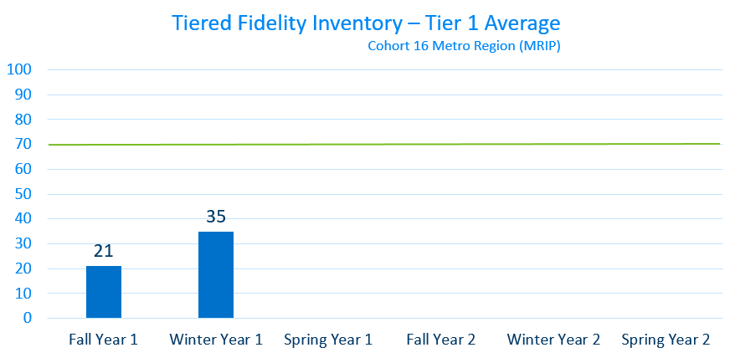
MRIP Cohort 16 (2020-2022)

Slide 5
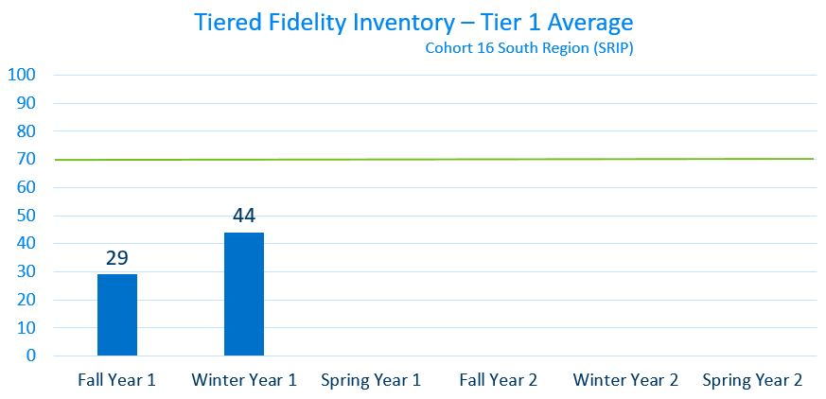
SRIP Cohort 16 (2020-2022)
Notes:
End of Day 1 SRIP Cohort 15 – 2019-2021

Slide 6
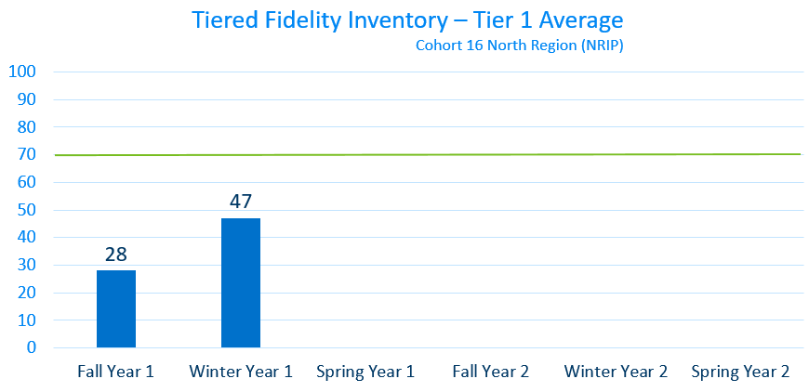
NRIP Cohort 16 (2020-2022)

Slide 7
2019 Minnesota Student Survey Information

Slide 8
Student –Teacher Relationships
Notes:
Select use easy to implement PREVENTATIVE evidence-based-practices to BUILD relationship (e.g., positive greeting at door) see Cook, C. R. , Fiat, A., Larson, M., Daikos, C., Slemrod. T., Holland, E. A., Thayer, A. & Renshaw (2018). Positive Greetings at the Door: Evaluation of a Low-Cost, High-Yield Proactive Classroom Management Strategy. Journal of Positive Behavior Supports, 20, (149-159).
https://journals.sagepub.com/doi/full/10.1177/1098300717753831

Slide 9
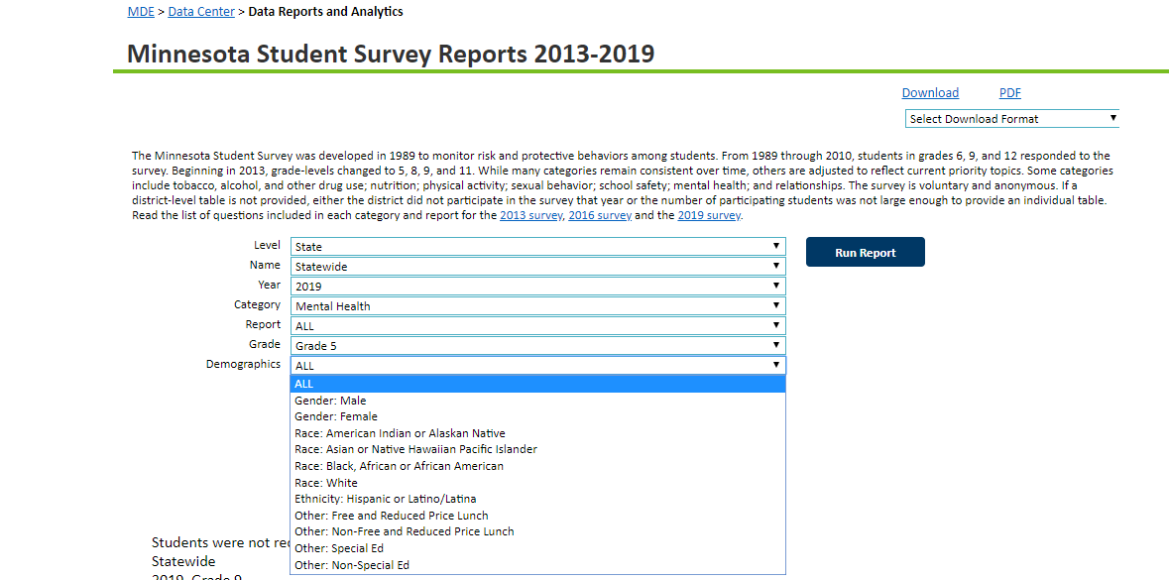
MN Student Survey Reports
Notes:
Activity Sheet – Yellow

Slide 10
Teacher-Student Relationships: Questions from MN Student Survey
Overall, adults at my school treat students fairly.
Adults at my school listen to the students.
The school rules are fair.
At my school, teachers care about students.
Most teachers at my school are interested in me as a person.
Notes:
This is a subset of MN SSR questions which focuses on Teacher-Student Relationships
5 questions in school section relationship area of survey
You can disaggregate at State and District (school IF REPORT CARD) levels to look at student perception of relationships

Slide 11
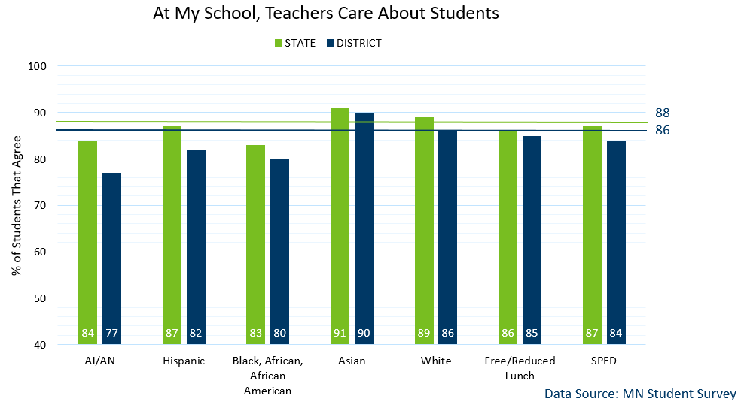
MN Statewide vs a selected District Average
Notes:
Took 2 questions, #4 & #5 and used info for all grades (grade 5, 8, 9, 11) see in this slide ALL grades by same categories. % students who agree with the statement at the top… Blue is ALL students (again NOT ALL student rep here)– Blue students in district, GREEN statewide
Let’s look at 2 questions now in depth (question #4 and #5)
This is actual district data (blue bars) compared to MN statewide data (green bar) disaggregated in response to question #4 “At my school, teachers care about students” (in affirmative/agree)
Can disaggregate multiple ways: demographis, race/cultural, ethnicity, spec ed status, FRL proxy for SES etc.

Slide 12
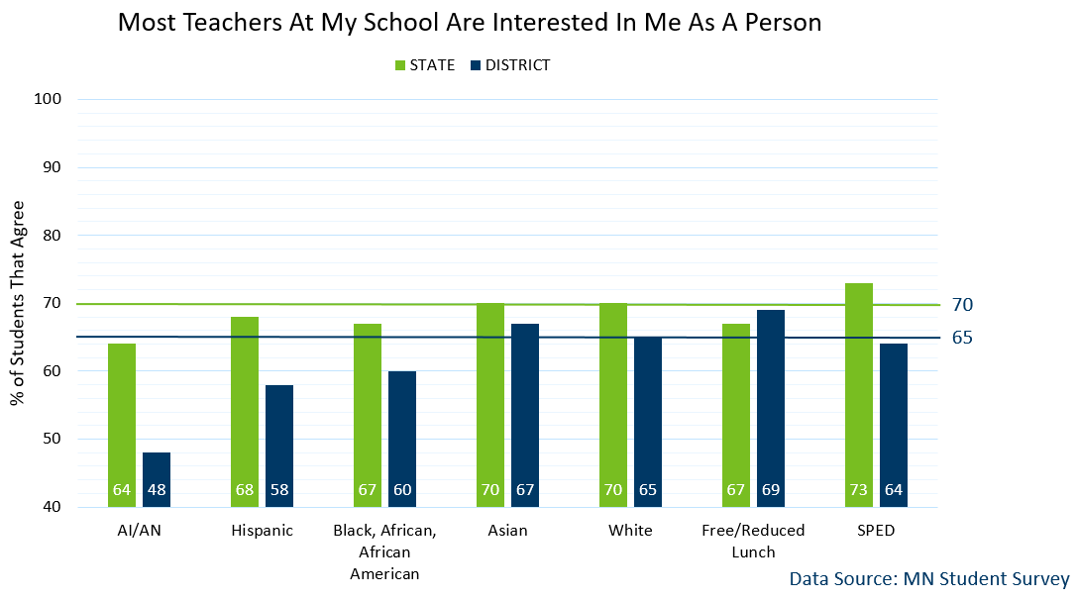
MN Statewide v District Average
Notes:
Let’s look at 2 questions now in depth (question #4 and #5)
Again, actual district data (blue bars) compared to MN statewide data (green bar) disaggregated in response to question #5 “Most teachers at my school are interested in me as a person” (in affirmative/agree)
Took 2 questions (info are for all grades – grade 5 8 9 11) see in this slide ALL grades by same categories. % students who agree with the statement at the top… Blue is ALL students (again NOT ALL student rep here)– Blue students in district, GREEN statewide

Slide 13
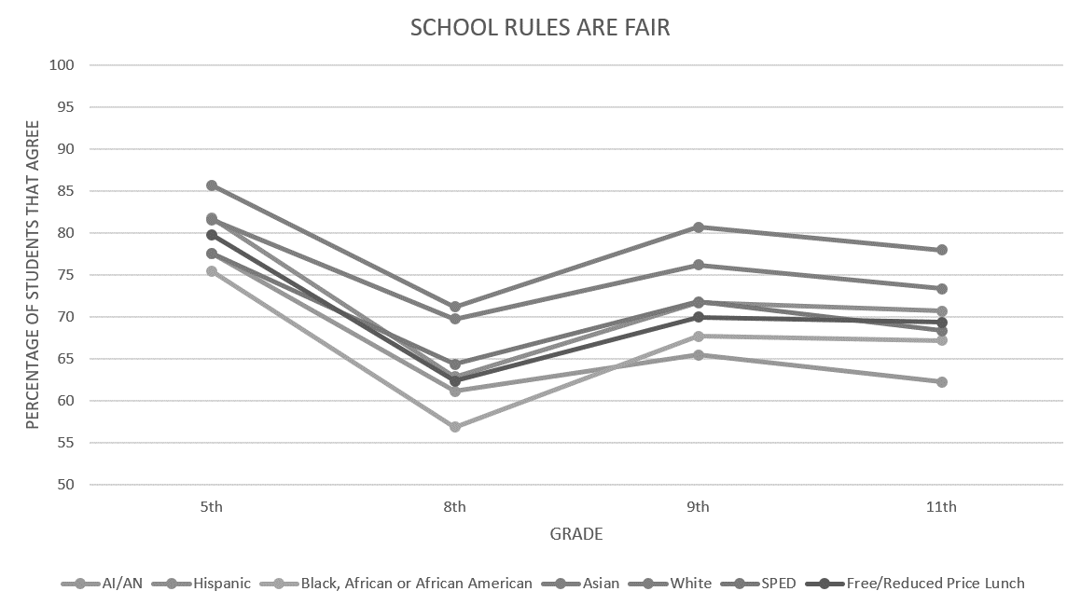
MN Statewide Average: School Rules Are Fair
Notes:
Let's look at question #3: School rules are fair (in affirmative/agree)
Past 2 slides were broken by ALL grade levels were averaged together.
These 2 slides show responses of the course of the different grades 5th ave response by different demographic breakdown. School rules are fair- 5th grade AA, 8th grade AA least. Over course of time need to establish those relationships– importance WHEN to intervene. Some bounce back 9th (more mature? Also may have lost students? Same with 11th?? Talk about grad rates and looking at HS may be too late? When to intervene and how to intervene

Slide 14
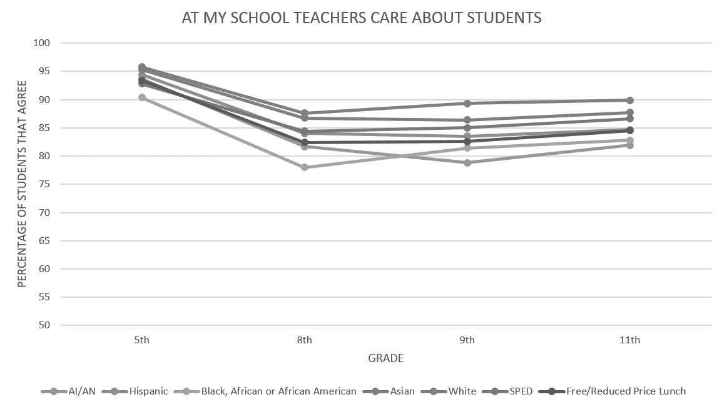
MN Statewide Average: Teachers Care About Students
Notes:
Compare TEACHERS CARE ABOUT STUDENTS (understand good nature of adults and hard work and is noticed hypothesis- there to do good work… compare to

Slide 15
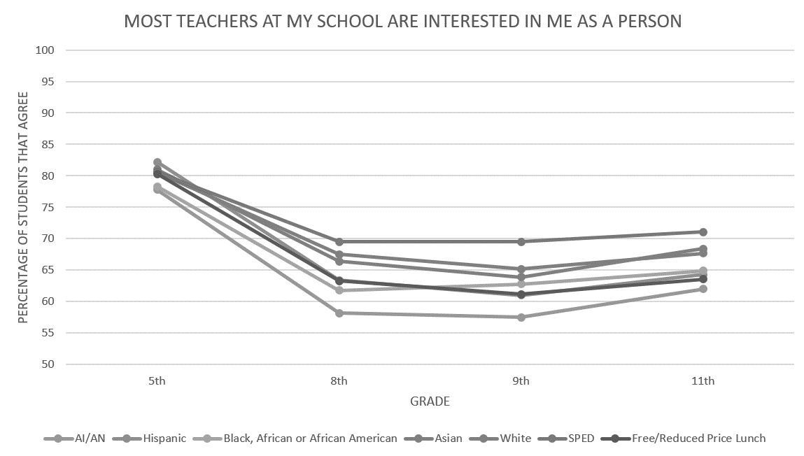
MN Statewide Average
Notes:
ME. As a person– see a significant decline in that statement. RELATIONSHIPS what specific things so that all students being recognized as an individual (PGD- how to do in a big way)- master schedule, middle school advisory etc. how do we set up systems so that our approach intentionally recognizes and connect with students. E.g., relationship and connect are inherent need for all– but put contingencies on builing those– if hungry– don’t do 5 math problems– get them set human need for hunger– don’t need to earn… yet when acting up for attention we make them doing less desirable before desirable (premack), contingencies but also have tons of structures set up to take care of those other needs (clothes, hunger fed/state/$ to do that structures--- do we have the same systems level all students feeling cared for).

Slide 16
Stay Connected to the PBIS Community!

Slide 17
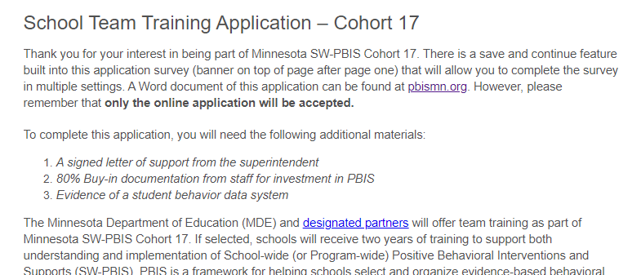
Schools Can Apply for Cohort 17 (2021-2023)
Cohort application guides through Exploration activities to form a team and get data system in place.
Teams get pre-requisites in place to be ready for PBIS Installation, including commitment to data collection and analysis.
Extended deadline to May 10th!
http://pbisMN.org/Getting-Started

Slide 18
Share about your local examples, events and stories!
facebook.com/pbisMN
twitter.com/pbisMN

Slide 19
2021 Minnesota PBIS Summer Institute and Film Festival
VIRTUAL again this year
June 16-17
NO cost for participation
registration is required
Minnesota PBIS - PBIS MN Institute & Film Festival

Slide 20
18th International Virtual Conference on Positive Behavior Supports March 16-19, 2021
Sessions featuring Minnesota work:
PBIS and Aligned Initiatives: How do We Make This All Fit Together
Implementing PBIS With A Native Voice: One State's Story
Scaling-up PBIS in Big Ways: Stories from Two Large Urban School Districts
Commitment Issues: Supporting Staff Across a Range of Intentions to Implement SWPBIS
Check & Connect: Monitoring & Increasing Students’ Academic, Behavioral, Cognitive, and Affective Engagement
Implementing a Three-Tiered PBS Model in Organizations Supporting People with IDD
Link to Conference Agenda at a Glance

Slide 21
Thank you!
Minnesota Department of Education – PBIS Management Team MDE.PBIS@state.mn.us

