Slide 1
Minnesota PBIS Spring Training – Year 2
Minnesota PBIS Cohort 16 Spring Training – Day 9
MDE PBIS Management Team
MDE.PBIS@state.mn.us

Slide 2

Ten Minnesota Commitments to Equity
Prioritize equity.
Start from within.
Measure what matters.
Go local.
Follow the money (be accountable).
Start early.
Monitor implementation
Value people.
Improve conditions for learning.
Give students options.
Notes:
TIP: If you are highlighting a specific item, select the list and change the color to Minnesota green. Then select the items you want to highlight and change the color back to white and bold.

Slide 3
Action Planning with Results
Implementation Progress

Slide 4
Stage-based Implementation
Cohorts 11-15 – 2015-2021

Slide 5
End of Year 2
Cohort 16 – 2020-2022

Slide 6
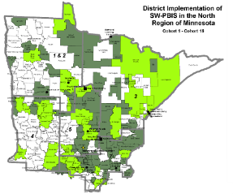
End of Day 8
NRIP Cohort 16 – 2020-2022

Slide 7
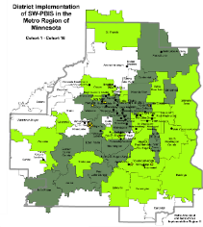
End of Day 8
MRIP Cohort 16 – 2020-2022

Slide 8
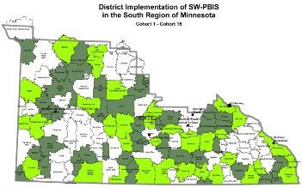
End of Day 8
SRIP Cohort 16 – 2020-2022

Slide 9
Sustainability began at Exploration Stage through Installation
Sustainability: Initial to Full Implementation

Slide 10
Average time to adequate implementation by level
Nese, et al., (2019)
Nese, R. N. T., Nese, J. F. T., McIntosh, K., Mercer, S. H., & Kittelman, A. (2019). Predicting latency of reaching adequate implementation of tier I school-wide positive behavioral interventions and supports. Journal of Positive Behavior Interventions, 21, 106-116.
Notes:
Rationale to continue to work towards implementation and you graduate and continue to consider strategies to leverage funding and sustaining work over the next 5 years

Slide 11
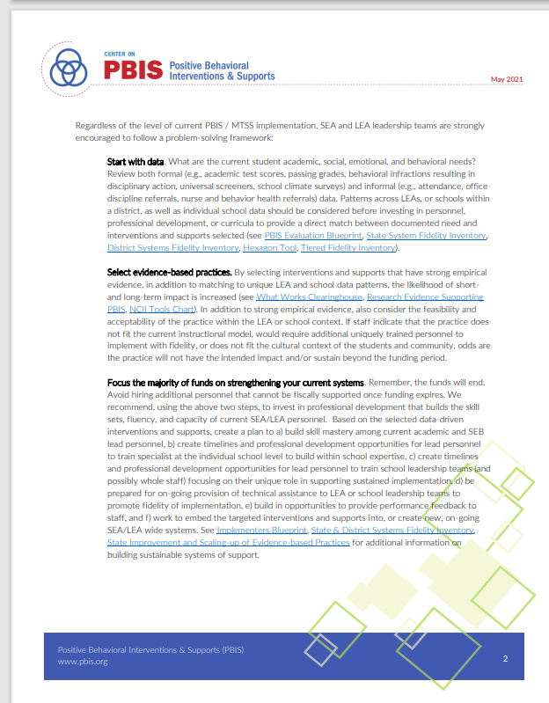
THREATS: Short term funding to build long term capacity
Examples of Grant Funding as a threat to sustainability
  Hiring then firing external support personnel
  Singular focus on only training school and district personnel
  "Project Mentality" v. This is our way of work
Lewis, T. J., Goodman, S., & Barrett, S. (May, 2021). Leveraging short term funding to build long term capacity. Eugene, OR: Center on PBIS. www.pbis.org

Slide 12
Leveraging short term funding to build long term capacity
(Lewis et al., 2021)
Keep long-term student and staff measurable outcomes in mind with all fiscal decisions
When making short-term decisions to meet immediate needs include plans to embed into ongoing systems of support (value-added)
Create a plan with a timeline to sample impact (PDSA cycles) to ensure you are getting a return on the investment (i.e., progress towards staff and student outcomes)
Ensure plan has strategies to disaggregate data across groups, especially students with disabilities or from other marginalized groups, to continually examine for equitable benefit across groups of students and embed strategies to address any noted inequities
Lewis, T. J., Goodman, S., & Barrett, S. (May, 2021). Leveraging short term funding to build long term capacity. Eugene, OR: Center on PBIS. www.pbis.org

Slide 13

Minnesota PBIS Featured in US Department of Education (2020)
Minnesota: Leveraging Policy and Funding
Intentionally embeds the PBIS framework in a comprehensive approach to school mental health.
Draws on the behavioral approaches currently in place in schools developed through PBIS initiatives and integrates that knowledge with the array of evidence-based strategies that Mental Health partners bring.
Currently, SLMH services are provided in 51% of Minnesota schools;
  63% of the PBIS trained schools have SLMH services and
  46% of all SLMH schools are in a PBIS trained building.
Minnesota attends to the relationship building between school staff and mental health providers.
  Co-creation of a ‘give’ and ‘get’ agreement with school and provider teams
Supporting Child and Student Social, Emotional, Behavioral, and Mental Health Needs
Notes:
Working smarter not harder by purposefully integrating key support initiatives (and which ones need to be taken off plates based on availability of implementation data?

Slide 14
Action Planning with Results
Featured Webinar Recordings

Slide 15
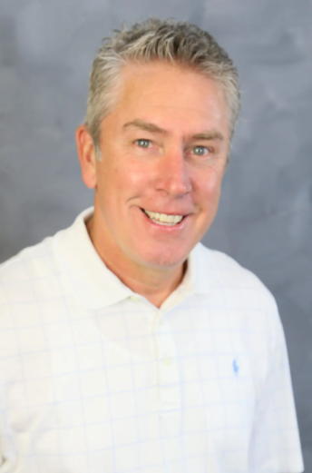
Webinar: PBIS 101
Summary:
Tier 1 Implementation
Acknowledgement and Recognition Systems
Implementing in different settings
Charlie Eisenreich
This, and other accessible recordings and materials, can be found at the MDE Special Education Training webpage (https://education.mn.gov/MDE/dse/sped/spedtrain)

Slide 16
MDE Division of Special Education
Trainings and Webinar Recordings Available
Five Practically Good Ideas for Any Reality
Returning to School During and After Crisis
Check-in/Check-Out as a Tier 2 Support
The Interconnected Systems Framework: School mental health and MTSS
Systematic Screening in the COVID-19 Era: Comprehensive, Integrated, Three-Tiered Model of Prevention
All accessible recordings and materials can be found at the MDE Special Education Training webpage (https://education.mn.gov/MDE/dse/sped/spedtrain)

Slide 17
Action Planning with Results
News and Updates

Slide 18

Save-the-Date: Collaborators Forum 2022
2022
March 10, 2022 – 10:00-3:00
Highlighting the positives in PBS
The online forum is will include:
Panel discussion: Experiences of people who have utilized positive behavior support (PBS) and applied behavior analysis (ABA) to enhance quality of life
Collaborative approaches to school-wide implementation of PBS
Alternatives to punishment: Strategic ways to listen and support
Notes:
10:00-10:30
Introduction and Updates on MNPBS Network Activities
Rachel Freeman, University of Minnesota
10:30-12:00
Panel Discussion: Experience of People who have Utilized Positive Behavior Support and Applied Behavior Analysis to Enhance Quality of Life
Moderator: Liz Harri-Dennis, MN Dept of Human Services
Confirmed panelists: Tara Nelson-Anderson, Lynn Stansberry-Brusnahan, Lynn's son, Parent (Erin F.'s contact), Self-advocate (Rachel's contact)
12:00-1:00
Lunch
Moderated discussion if people wish to stay on to connect - see actions below - we need someone to moderate and a topic to guide discussion
1:00-1:50
Implementation of School-Wide PBIS in a High School Context
Steve Wagner, Sauk Rapids-Rice School District
2:00-2:50
Alternatives to Punishment: Strategic Ways to Listen and Support
Introduction: Liz Harri-Dennis, MN Dept of Human Services
Exemplar 1: Allison Bohlke, Mains'l Services
Exemplar 2: Nicole Kelly, SWSC

Slide 19
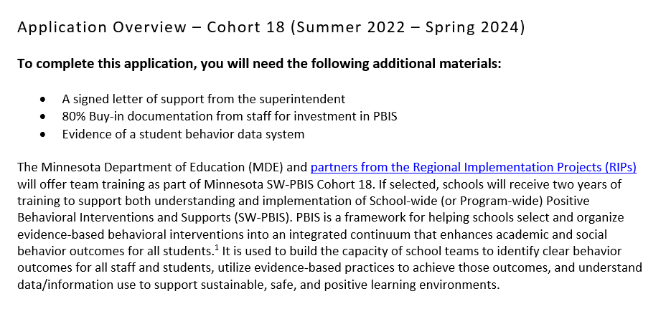
Cohort 18 (2022-2024) Application Available
Cohort application guides through essential Exploration activities (e.g., staff commitment, establishing team and data system in place.
Team pre-requisites in place for Installation (e.g., including a commitment to data collection/analysis, systematically bringing implementation activities back to staff)
Application Open NOW!
(https://pbisMN.org/Getting-Started)

Slide 20

2022 Minnesota PBIS Institute and Film Festival
Save-the-dates for June 14-16, 2022
Save-the-dates for June 14-16, 2022 for Summer Institute, Film Festival and Annual Sustaining Exemplar Recognition Ceremony
Request for proposals for breakout sessions and films coming soon
  Info from previous institutes available on the Minnesota PBIS Summer Institute webpage (https://pbismn.org/summer-institute)
See Summer Institute 2020 and 2021 presentations, including the keynote by Dr. Tamika LaSalle, “[Culturally Responsive] PBIS: Leveraging Existing Systems to Advance Equity” (https://youtube.com/c/PBISMinnesota/videos)

Slide 21
Partnering with Minnesota PBIS:
Become a Trainer, Coach, or SWIS Facilitator
Interested in supporting other school and district teams to implement PBIS in Minnesota?
We are looking for educators with these skills and interests:
  Schoolwide or Tier 2/3 PBIS Trainer
  External Coach
  School-wide Information System (SWIS) Facilitator
sgiz.mobi/s3/Supporting-PBIS-Minnesota

Slide 22


Share your #pbisMN work!
facebook.com/pbisMN
twitter.com/pbisMN

Slide 23
North Regional Contacts
North Regional Implementation Project
Erin Engness
NRIP Coordinator
EEngness@resourcecoop-mn.gov
PBIS Management - Regional Contacts
Angie Scott
Angela.Scott@state.mn.us
Erin Farrell
Erin.Farrell@state.mn.us
Eric Kloos
Eric.Kloos@state.mn.us
PBIS Evaluation Contact
Wilder Research
pbisevalmn@wilder.org
Find other PBIS Minnesota contacts at: https://pbismn.org/contact-us.php

Slide 24
Metro Regional Contacts
Metro Regional Implementation Project
Lauren Sparr
MRIP Coordinator
Lauren.Sparr@metroecsu.org
Debi Doran
Coaching and Evaluation Coordinator
PBIS.Debi@gmail.com
PBIS Management - Regional Contacts
Ellen Nacik
Ellen.Nacik@state.mn.us
Daniel Torrez
Daniel.Torrez@state.mn.us
Eric Kloos
Eric.Kloos@state.mn.us
PBIS Evaluation Contact
Wilder Research
pbisevalmn@wilder.org
Find other PBIS Minnesota contacts at: https://pbismn.org/contact-us.php

Slide 25
South Regional Contacts
South Regional Implementation Project
Liz Deen
Lead SRIP Coordinator
Liz.Deen@swwc.org
Hazel Ashbeck
SRIP Coordinator – SWWC
Hazel.Ashbeck@swwc.org
Erin Toninato
South Central Service Cooperative
EToninato@mnscsc.org
Amber Bruns
Southwest West Central Service Cooperative
Amber.Bruns@swwc.org
PBIS Management - Regional Contacts
Garrett Petrie
Garrett.Petrie@state.mn.us
Janet Christensen
Janet.Christensen@state.mn.us
Eric Kloos
Eric.Kloos@state.mn.us
PBIS Evaluation Contact
Wilder Research
pbisevalmn@wilder.org
Find other PBIS Minnesota contacts at: https://pbismn.org/contact-us.php

Slide 26
Thank You!
Minnesota Department of Education – PBIS Management Team
MDE.PBIS@state.mn.us

