Slide 1
Minnesota PBIS Spring Training – Year 1 Cohorts 17
MDE PBIS Management Team
MDE.PBIS@state.mn.us
Notes:
Updated 2/25/2022

Slide 2
Ten Minnesota Commitments to Equity
Prioritize equity.
Start from within.
Measure what matters.
Go local.
Follow the money (be accountable).
Start early.
Monitor implementation
Value people.
Improve conditions for learning.
Give students options.
Notes:
TIP: If you are highlighting a specific item, select the list and change the color to Minnesota green. Then select the items you want to highlight and change the color back to white and bold.

Slide 3
Supporting and Sustaining PBIS Implementation
Recognize your progress Cohort 17!
MN Student Survey Data available to your teams
Staying connected to the broader PBIS community
Upcoming PBIS opportunities for you and your teams

Slide 4
Recognizing your Progress and Growth!

Slide 5
Average time to adequate implementation by level Nese, et al., (2019)
Nese, R. N. T., Nese, J. F. T., McIntosh, K., Mercer, S. H., & Kittelman, A. (2019). Predicting latency of reaching adequate implementation of tier I school-wide positive behavioral interventions and supports. Journal of Positive Behavior Interventions, 21, 106-116.
Notes:
Rationale to continue to work towards implementation and you graduate and continue to consider strategies to leverage funding and sustaining work over the next 5 years

Slide 6
2019 Minnesota Student Survey Information

Slide 7
Student –Teacher Relationships
Notes:
Select use easy to implement PREVENTATIVE evidence-based-practices to BUILD relationship (e.g., positive greeting at door) see Cook, C. R. , Fiat, A., Larson, M., Daikos, C., Slemrod. T., Holland, E. A., Thayer, A. & Renshaw (2018). Positive Greetings at the Door: Evaluation of a Low-Cost, High-Yield Proactive Classroom Management Strategy. Journal of Positive Behavior Supports, 20, (149-159).
https://journals.sagepub.com/doi/full/10.1177/1098300717753831

Slide 8
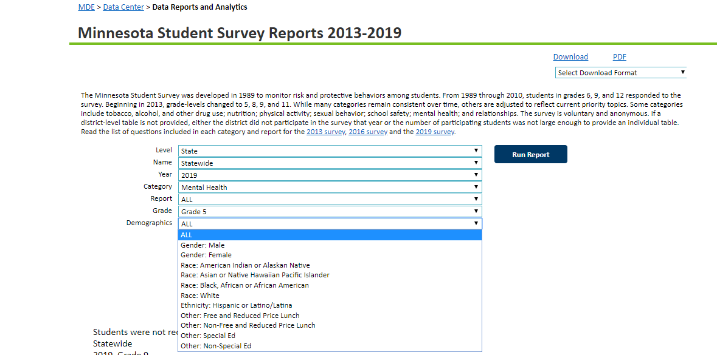
MN Student Survey Reports
Notes:
Activity Sheet – Yellow

Slide 9
Teacher-Student Relationships: Questions from MN Student Survey
Overall, adults at my school treat students fairly.
Adults at my school listen to the students.
The school rules are fair.
At my school, teachers care about students.
Most teachers at my school are interested in me as a person.
Notes:
This is a subset of MN SSR questions which focuses on Teacher-Student Relationships
5 questions in school section relationship area of survey
You can disaggregate at State and District (school IF REPORT CARD) levels to look at student perception of relationships

Slide 10
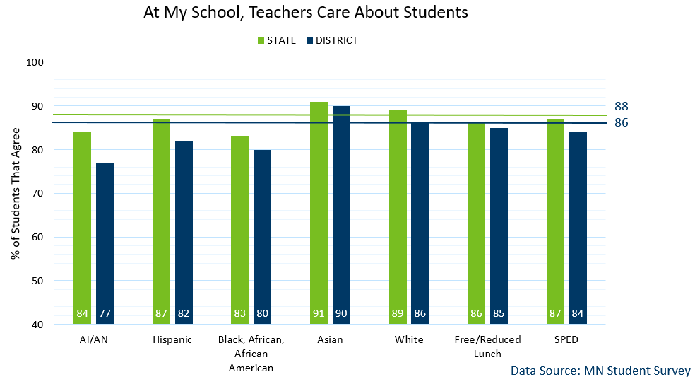
MN Statewide vs a selected District Average
Notes:
Took 2 questions, #4 & #5 and used info for all grades (grade 5, 8, 9, 11) see in this slide ALL grades by same categories. % students who agree with the statement at the top… Blue is ALL students (again NOT ALL student rep here)– Blue students in district, GREEN statewide
Let’s look at 2 questions now in depth (question #4 and #5)
This is actual district data (blue bars) compared to MN statewide data (green bar) disaggregated in response to question #4 “At my school, teachers care about students” (in affirmative/agree)
Can disaggregate multiple ways: demographis, race/cultural, ethnicity, spec ed status, FRL proxy for SES etc.

Slide 11
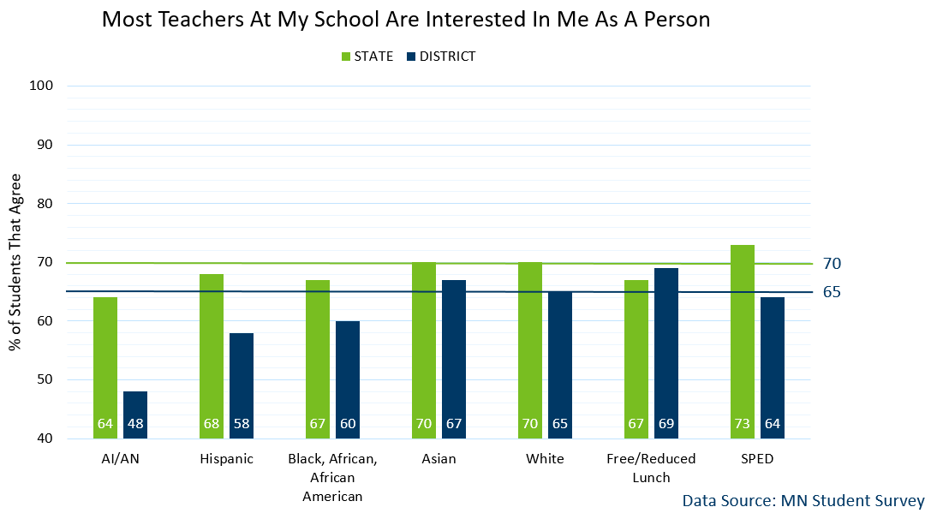
MN Statewide v District Average
Notes:
Let’s look at 2 questions now in depth (question #4 and #5)
Again, actual district data (blue bars) compared to MN statewide data (green bar) disaggregated in response to question #5 “Most teachers at my school are interested in me as a person” (in affirmative/agree)
Took 2 questions (info are for all grades – grade 5 8 9 11) see in this slide ALL grades by same categories. % students who agree with the statement at the top… Blue is ALL students (again NOT ALL student rep here)– Blue students in district, GREEN statewide

Slide 12
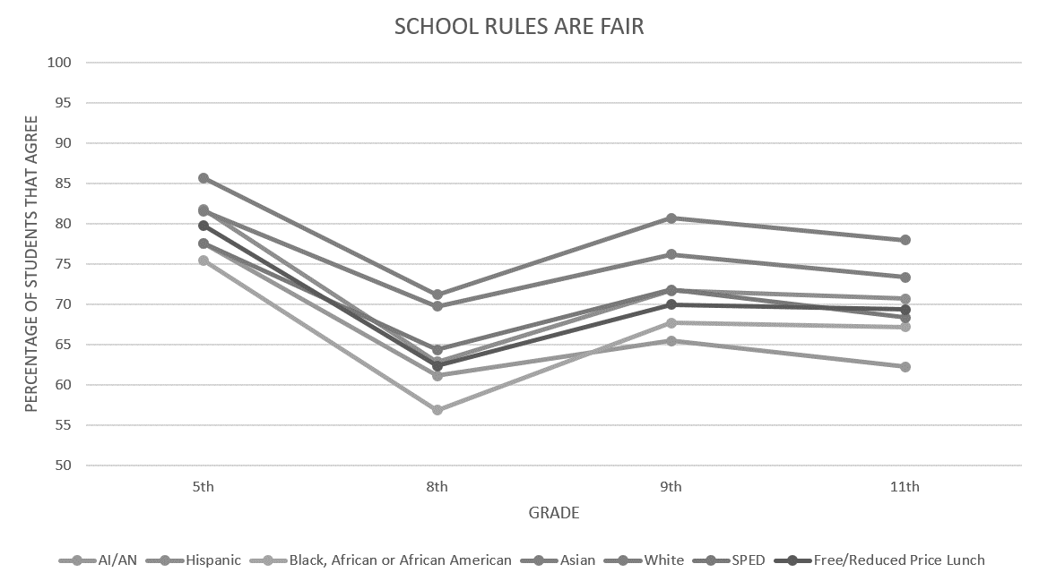
MN Statewide Average: School Rules Are Fair
Notes:
Let's look at question #3: School rules are fair (in affirmative/agree)
Past 2 slides were broken by ALL grade levels were averaged together.
These 2 slides show responses of the course of the different grades 5th ave response by different demographic breakdown. School rules are fair- 5th grade AA, 8th grade AA least. Over course of time need to establish those relationships– importance WHEN to intervene. Some bounce back 9th (more mature? Also may have lost students? Same with 11th?? Talk about grad rates and looking at HS may be too late? When to intervene and how to intervene

Slide 13
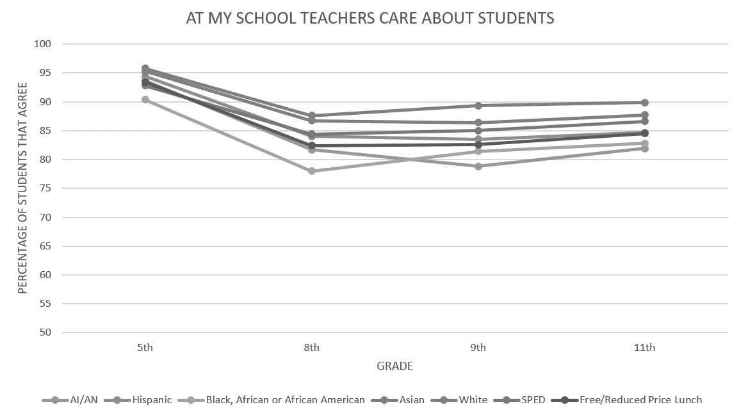
MN Statewide Average: Teachers Care About Students
Notes:
Compare TEACHERS CARE ABOUT STUDENTS (understand good nature of adults and hard work and is noticed hypothesis- there to do good work… compare to

Slide 14
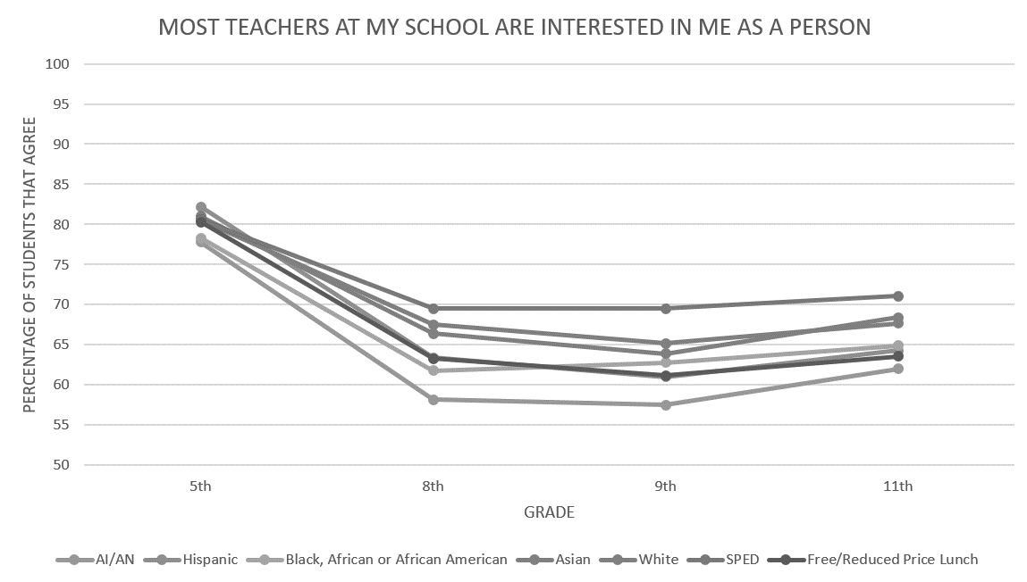
MN Statewide Average
Notes:
ME. As a person– see a significant decline in that statement. RELATIONSHIPS what specific things so that all students being recognized as an individual (PGD- how to do in a big way)- master schedule, middle school advisory etc. how do we set up systems so that our approach intentionally recognizes and connect with students. E.g., relationship and connect are inherent need for all– but put contingencies on builing those– if hungry– don’t do 5 math problems– get them set human need for hunger– don’t need to earn… yet when acting up for attention we make them doing less desirable before desirable (premack), contingencies but also have tons of structures set up to take care of those other needs (clothes, hunger fed/state/$ to do that structures--- do we have the same systems level all students feeling cared for).

Slide 15
Stay Connected to the PBIS Community!

Slide 16
Share about your local examples, events and stories!
facebook.com/pbisMN
twitter.com/pbisMN

Slide 17
Cohort 18 (2022-2024) Application Available
Cohort application guides through essential Exploration activities (e.g., staff commitment, establishing team and data system in place.
Team pre-requisites in place for Installation (e.g., including a commitment to data collection/analysis, systematically bringing implementation activities back to staff)
Application Open NOW!
(https://pbisMN.org/Getting-Started)

Slide 18
North Regional Contacts
North Regional Implementation Project
Erin Engness NRIP Coordinator EEngness@resourcecoop-mn.gov
PBIS Management - Regional Contacts
Angie Scott
Angela.Scott@state.mn.us
Erin Farrell
Erin.Farrell@state.mn.us
Eric Kloos Eric.Kloos@state.mn.us
PBIS Evaluation Contact
Wilder Research pbisevalmn@wilder.org
Find other PBIS Minnesota contacts at: https://pbismn.org/contact-us.php

Slide 19
Metro Regional Contacts
Metro Regional Implementation Project
Lauren Sparr MRIP Coordinator Lauren.Sparr@metroecsu.org
Debi Doran
Coaching and Evaluation Coordinator
PBIS.Debi@gmail.com
PBIS Management - Regional Contacts
Ellen Nacik Ellen.Nacik@state.mn.us
Daniel Torrez
Daniel.Torrez@state.mn.us
Eric Kloos Eric.Kloos@state.mn.us
PBIS Evaluation Contact
Wilder Research pbisevalmn@wilder.org
Find other PBIS Minnesota contacts at: https://pbismn.org/contact-us.php

Slide 20
South Regional Contacts
South Regional Implementation Project
Liz Deen
Lead SRIP Coordinator
Liz.Deen@swwc.org
Hazel Ashbeck
SRIP Coordinator – SWWC
Hazel.Ashbeck@swwc.org
Erin Toninato South Central Service Cooperative EToninato@mnscsc.org
Amber Bruns Southwest West Central Service Cooperative Amber.Bruns@swwc.org
PBIS Management - Regional Contacts
Garrett Petrie
Garrett.Petrie@state.mn.us
Janet Christensen
Janet.Christensen@state.mn.us
Eric Kloos Eric.Kloos@state.mn.us
PBIS Evaluation Contact
Wilder Research pbisevalmn@wilder.org
Find other PBIS Minnesota contacts at: https://pbismn.org/contact-us.php

Slide 21
Thank you!
Minnesota Department of Education – PBIS Management Team MDE.PBIS@state.mn.us

