Slide 1
Minnesota PBIS Winter 2018 Training
Cohort 13
MDE PBIS Management Team
November 2018
MDE.PBIS@state.mn.us

Slide 2
Takeaways
MDE News
TFI progress!
Sustainability
2018 PBIS Leadership Forum
Cohort 15 applications
Save the Dates

Slide 3
TFI Statewide Cohort 13

Slide 4
TFI MRIP Cohort 13

Slide 5
Predictive Factors for Sustainability
Team sharing data
    Collect, Inform Decisions, Shared with staff, etc.
Capacity Building
  Internal and external coaching, Professional Development, etc.
School Priority
  Administrative/staff support, buy-in, perceived efficiency
District Priority
  Explicit funding and policy, promoted to outside organizations
  McIntosh, K., Mercer, S. H., Hume, A. E., Frank, J. L., Turri, M. G., & Mathews, S. (2013). Factors related to sustained implementation of School-wide Positive Behavior Support. Exceptional Children, 79, 293-311.
#1 Predictor

Slide 6
Data Calendar At-A Glance

Slide 7
By the Numbers:
1 Year After Training
57 Cohort 11 school teams
49 completed a TFI
86% completed TFI
69% average TFI score

Slide 8
PBIS Sustainability by the Numbers 2017-2018
641 Cohort trained schools (Cohorts 1-13)
339 completed a fidelity measure
53% completed a fidelity measure
69 non-cohort trained schools completed a TFI
100% DOABLE to measure and sustain PBIS after training is completed!!!
Notes:
Looking at all schools from Cohort 1-13 during only the 2017-18 school year we can see that 53% percent of eligible schools completed a fidelity measure,
307 completed a TFI
24 Completed a BoQ
8 Completed a SET
Also, 69 Non-cohort trained schools completed a TFI.
Some completed a SAS
Keep in mind that the training helps build your capacity and ability to measures and use data so you can also do it after training is completed. We are here during and after training to support this.

Slide 9

Implementers Forum 2018
This two-day forum for school, state, district, and regional Leadership Teams and other professionals has been designed to help increase the effectiveness of PBIS implementation.
https://www.pbis.org/presentations/chicago-forum-18

Slide 10
Implementers Forum 2018:
PD for Low Intensity Strategies
https://www.pbis.org/Common/Cms/files/Forum18_Presentations/D4_Lane_et_al.pdf
ci3t.org

Slide 11
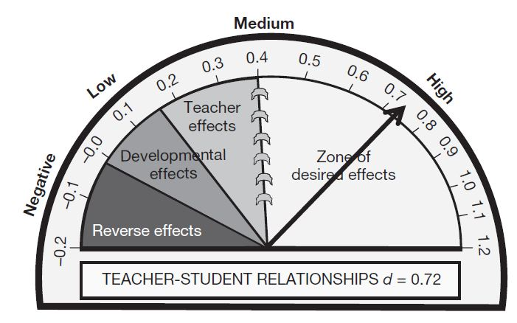
Classroom Mgt. Implementers Forum 2018:
D5 Climate, Culture & Classroom Mgt.
One stable and committed adult relationship
  National Scientific Council on the Developing Child (2015). Supportive Relationships and Active Skill-Building Strengthen the Foundations of Resilience. Harvard University.
Teacher-Student Relationship has a .72 effect size on student learning’
Average effect size of all interventions studied was .40
Hattie. J. (2009). Visible learning: A synthesis of over 800 meta-analyses relating to achievement. London: Routledge.

Slide 12
Cohort 15 Application
Application is now available for new schools to join cohort training
  Please help spread the word
Link: Minnesota PBIS website (http://pbisMN.org/gsapplication.html)
Deadline: Monday, February 11, 2019.

Slide 13


2019 Collaborators Forum
2019 Collaborators Forum
Tuesday, April 30, 2019
Minnesota Department of Education – Roseville, MN
mnpsp.org/mnpbs
The Collaborators Forum is an event for people interested in Positive Behavior Supports
across settings and the lifespan in Minnesota.

Slide 14


2019 Minnesota PBIS Institute and Film Festival
Save-the-dates for June 11-12, 2019 at MDE - Roseville, MN
Request for proposals for breakout sessions and films will appear in the winter
Submission forms and presentations from previous institutes at Minnesota PBIS Summer Institute

Slide 15

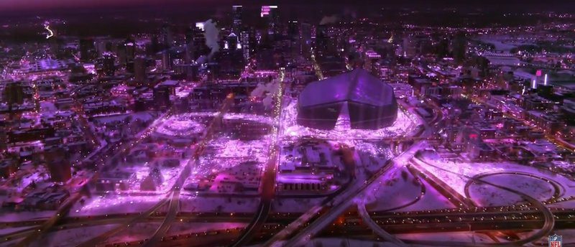
2021 APBS Conference Minneapolis
APBS Conference 2021 March 17th-20th Hyatt Regency - Minneapolis
There is no text here
MN PBS Twitter Feed about the 2021 APBS Conference in Minneapolis

Slide 16
Metro Regional
MDE Regional Contacts
Clay Keller
Clay.Keller@state.mn.us
651-582-8392
Ellen Nacik
Ellen.Nacik@state.mn.us
651-582-8665
Becky Nies
Rebecca.Nies@state.mn.us
651-582-8648
Eric Kloos
Eric.Kloos@state.mn.us
651-582-8268

Slide 17
Thank you!
Minnesota Department of Education
PBIS Management Team
mde.pbis@state.mn.us

