Slide 1
Stage-based Implementation:
Small Changes, Big Impact
Minnesota PBIS Cohort 17 Winter Training – Days 3 & 4
MDE PBIS Management Team
MDE.PBIS@state.mn.us

Slide 2

Ten Minnesota Commitments to Equity
Prioritize equity.
Start from within.
Measure what matters.
Go local.
Follow the money.
Start early.
Monitor implementation of standards.
Value people.
Improve conditions for learning.
Give students options.
Notes:
TIP: If you are highlighting a specific item, select the list and change the color to Minnesota green. Then select the items you want to highlight and change the color back to white and bold.

Slide 3
Small Changes, Big Impact
PBIS Minnesota Cohort Training
Takeaways
PBIS in practice
Implementation progress
News and save-the-dates

Slide 4
Small Changes, Big Impact
PBIS in Practice

Slide 5
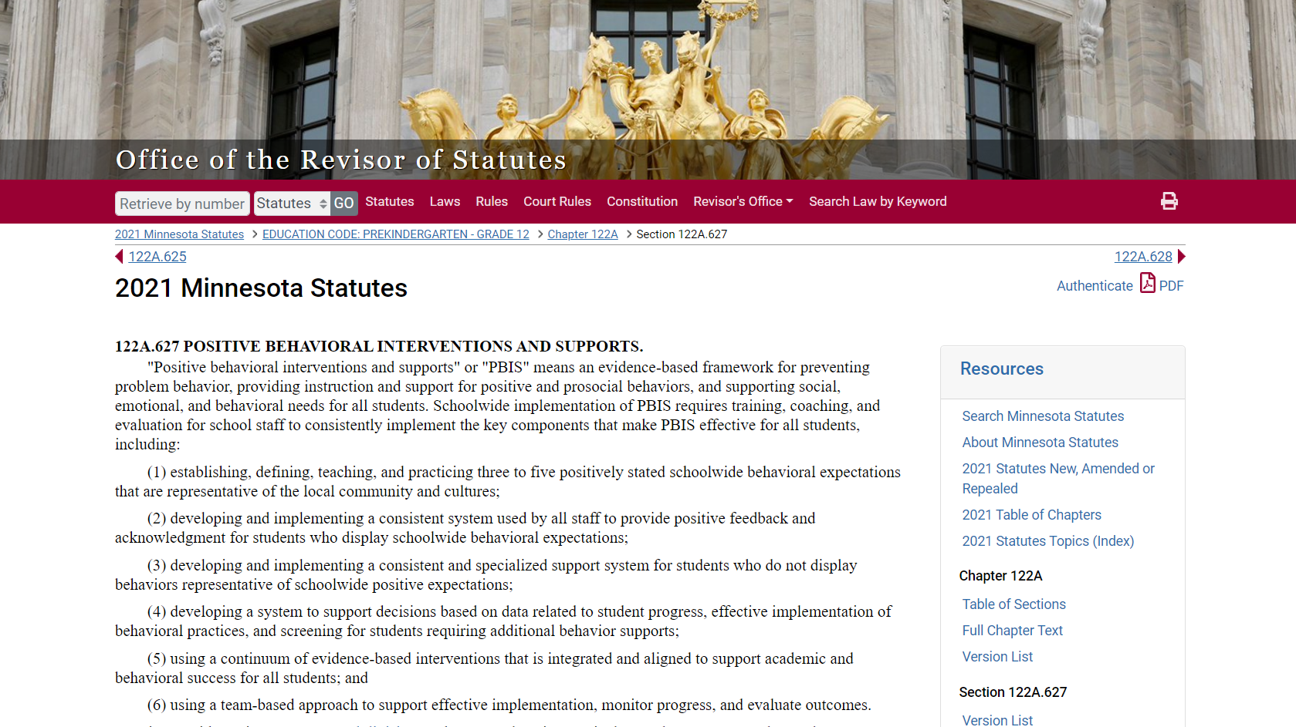
PBIS Defined in MN Statute 122A.627
Source: https://www.revisor.mn.gov/statutes/?id=122A.627
Notes:
This was done in consultation with the National TA Center, with many iterations to get to this point. There was a rationale to get this in plain language. We careful with the education language because we knew it had to be read by other agencies as well as legislatures.
122A.627 POSITIVE BEHAVIORAL INTERVENTIONS AND SUPPORTS.
"Positive behavioral interventions and supports" or "PBIS" means an evidence-based framework for preventing problem behavior, providing instruction and support for positive and prosocial behaviors, and supporting social, emotional, and behavioral needs for all students. Schoolwide implementation of PBIS requires training, coaching, and evaluation for school staff to consistently implement the key components that make PBIS effective for all students, including:
(1) establishing, defining, teaching, and practicing three to five positively stated schoolwide behavioral expectations that are representative of the local community and cultures;
(2) developing and implementing a consistent system used by all staff to provide positive feedback and acknowledgment for students who display schoolwide behavioral expectations;
(3) developing and implementing a consistent and specialized support system for students who do not display behaviors representative of schoolwide positive expectations;
(4) developing a system to support decisions based on data related to student progress, effective implementation of behavioral practices, and screening for students requiring additional behavior supports;
(5) using a continuum of evidence-based interventions that is integrated and aligned to support academic and behavioral success for all students; and
(6) using a team-based approach to support effective implementation, monitor progress, and evaluate outcomes.
Consistent with section 120B.232, subdivision 1, character education curriculum and programs may be used to support implementation of the key components of PBIS.
History:
1Sp2017 c 5 art 2 s 26
Source: https://www.revisor.mn.gov/statutes/?id=122A.627

Slide 6
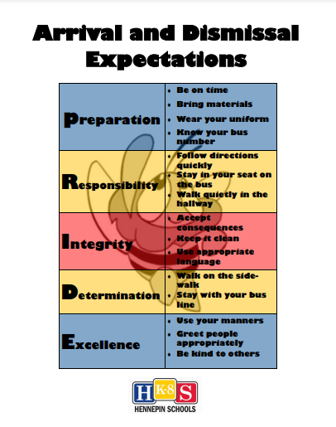

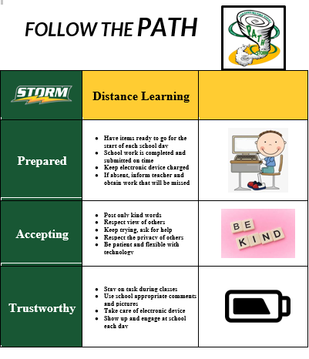
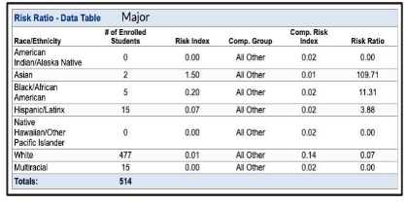
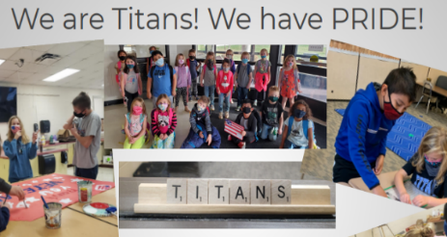
Statute PBIS Definition in Practice:
An Evidence-Based Framework to Prevent Problem Behavior and Support Positive, Prosocial Behaviors
3-5 positive expectations, taught and practiced
Acknowledgement and feedback system
Consistent and specialized supports
Data-based decision making
Continuum of interventions for all to support Behavior
Team-based approach
School Leadership Team that supports all staff, students, and families with:
Source: https://www.revisor.mn.gov/statutes/?id=122A.627
Notes:
From the bike to the statute – this is what it looks like with MN examples.
It’s not just good enough. How do you know it is being done? There are tools and measures for teams to use.
122A.627 POSITIVE BEHAVIORAL INTERVENTIONS AND SUPPORTS.
"Positive behavioral interventions and supports" or "PBIS" means an evidence-based framework for preventing problem behavior, providing instruction and support for positive and prosocial behaviors, and supporting social, emotional, and behavioral needs for all students. Schoolwide implementation of PBIS requires training, coaching, and evaluation for school staff to consistently implement the key components that make PBIS effective for all students, including:
(1) establishing, defining, teaching, and practicing three to five positively stated schoolwide behavioral expectations that are representative of the local community and cultures;
(2) developing and implementing a consistent system used by all staff to provide positive feedback and acknowledgment for students who display schoolwide behavioral expectations;
(3) developing and implementing a consistent and specialized support system for students who do not display behaviors representative of schoolwide positive expectations;
(4) developing a system to support decisions based on data related to student progress, effective implementation of behavioral practices, and screening for students requiring additional behavior supports;
(5) using a continuum of evidence-based interventions that is integrated and aligned to support academic and behavioral success for all students; and
(6) using a team-based approach to support effective implementation, monitor progress, and evaluate outcomes.
Consistent with section 120B.232, subdivision 1, character education curriculum and programs may be used to support implementation of the key components of PBIS.
History:
1Sp2017 c 5 art 2 s 26
Source: https://www.revisor.mn.gov/statutes/?id=122A.627
From National TA Center
School-wide PBIS is:
A multi-tiered framework for establishing the social culture and behavioral supports needed for a school achieve behavioral and academic outcomes for all students.
Evidence-based features of PBIS
Prevention
Define and teach positive social expectations
Acknowledge positive behavior
Arrange consistent consequences for problem behavior
On-going collection and use of data for decision-making
Continuum of intensive, individual intervention supports.
Implementation of the systems that support effective practices

Slide 7
Importance of Ensuring Core Features
“Be adamant about the core features,
be flexible about the rest.”
                Rob Horner
                October 2020
                ABAI Culturo-Behavior Science for a Better World Conference

Slide 8
Small Changes, Big Impact Implementation Progress

Slide 9
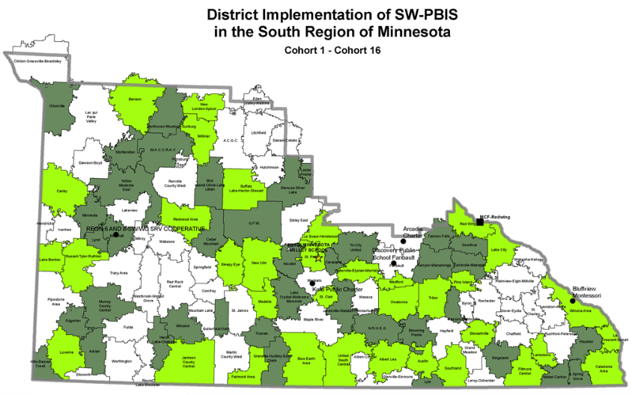
End of Day 1 – South Region
Cohort 17 – 2021-2023
What will growth look like with
team-based action planning to get to
Full Implementation over two years?

Slide 10
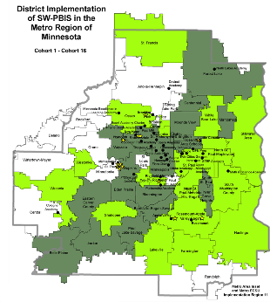
End of Day 1 – Metro Region
Cohort 17 – 2021-2023
What will growth look like with
team-based action planning to get to
Full Implementation over two years?

Slide 11
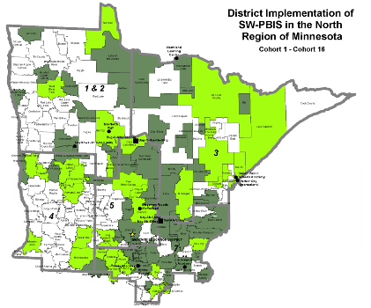
End of Day 1 – North Region
Cohort 17 – 2021-2023
What will growth look like with
team-based action planning to get to
Full Implementation over two years?

Slide 12
End of Day 1
Cohorts 11-15 – 2015-2021
Action planning towards
Full Implementation over two years…

Slide 13
Growth During Cohort Training
Cohorts 11-15 – 2015-2021

Slide 14
Completion of Day 7
Cohort 16 – 2020-2022

Slide 15
Small Changes, Big Impact
News and Save-the-Dates

Slide 16

PBIS Leadership Forum Presentations
This three-day virtual forum for school, state, district and regional Leadership Teams and other professionals has been designed to help increase the effectiveness of PBIS implementation.
Center on PBIS Leadership Forum website (http://PBISforum.org)
Recordings from PBIS Leadership Forums, including keynotes and presentations about PBIS concepts and applications, continue to be posted.
Check PBIS Leadership Forum Session Materials
(https://pbis.org/conference-and-presentations/pbis-leadership-forum) when made available.
Check Videos on the Center on PBIS YouTube Channel (https://youtube.com/c/CenteronPBIS/videos) for recordings available now

Slide 17


2022 Minnesota PBIS Institute and Film Festival
Save-the-dates for June 14-16, 2022
Save-the-dates for June 14-16, 2022 for Summer Institute, Film Festival and Annual Sustaining Exemplar Recognition Ceremony
Request for proposals for breakout sessions and films will appear this winter
  Submission forms and presentations from previous institutes available on the Minnesota PBIS Summer Institute webpage (https://pbismn.org/summer-institute)
See Summer Institute 2020 and 2021 presentations, including the keynote by Dr. Tamika LaSalle, “[Culturally Responsive] PBIS: Leveraging Existing Systems to Advance Equity” (https://youtube.com/c/PBISMinnesota/videos)

Slide 18
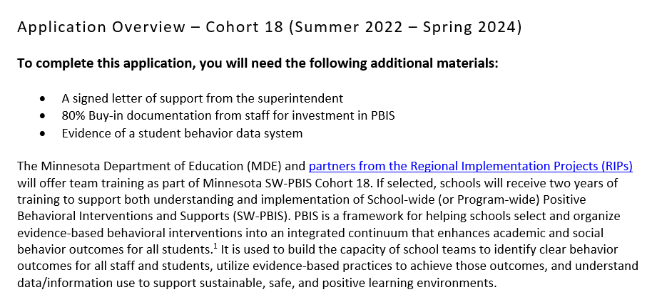
Schools Can Apply for Cohort 18 (2022-2024)
Cohort application guides through Exploration activities to form a team and get data system in place.
Teams get pre-requisites in place to be ready for PBIS Installation, including commitment to data collection and analysis.
Opens in November!
(https://pbisMN.org/Getting-Started)

Slide 19


Share your #pbisMN work!
facebook.com/pbisMN
twitter.com/pbisMN

Slide 20
North Regional Contacts
North Regional Implementation Project
Erin Engness
NRIP Coordinator
EEngness@resourcecoop-mn.gov
PBIS Management - Regional Contacts
Angie Scott
Angela.Scott@state.mn.us
Erin Farrell
Erin.Farrell@state.mn.us
Eric Kloos
Eric.Kloos@state.mn.us
PBIS Evaluation Contact
Wilder Research
pbisevalmn@wilder.org
Find other PBIS Minnesota contacts at: https://pbismn.org/contact-us.php

Slide 21
Metro Regional Contacts
Metro Regional Implementation Project
Lauren Sparr
MRIP Coordinator
Lauren.Sparr@metroecsu.org
Debi Doran
Coaching and Evaluation Coordinator
PBIS.Debi@gmail.com
PBIS Management - Regional Contacts
Ellen Nacik
Ellen.Nacik@state.mn.us
Daniel Torrez
Daniel.Torrez@state.mn.us
Eric Kloos
Eric.Kloos@state.mn.us
PBIS Evaluation Contact
Wilder Research
pbisevalmn@wilder.org
Find other PBIS Minnesota contacts at: https://pbismn.org/contact-us.php

Slide 22
South Regional Contacts
South Regional Implementation Project
Liz Deen
Lead SRIP Coordinator
Liz.Deen@swwc.org
Hazel Ashbeck
SRIP Coordinator – SWWC
Hazel.Ashbeck@swwc.org
Erin Toninato
South Central Service Cooperative
EToninato@mnscsc.org
Amber Bruns
Southwest West Central Service Cooperative
Amber.Bruns@swwc.org
PBIS Management - Regional Contacts
Garrett Petrie
Garrett.Petrie@state.mn.us
Janet Christensen
Janet.Christensen@state.mn.us
Eric Kloos
Eric.Kloos@state.mn.us
PBIS Evaluation Contact
Wilder Research
pbisevalmn@wilder.org
Find other PBIS Minnesota contacts at: https://pbismn.org/contact-us.php

Slide 23
Thank You!
Minnesota Department of Education – PBIS Management Team
MDE.PBIS@state.mn.us

