Slide 1
Small Changes, Big Impact
Minnesota PBIS Cohort 15 Winter Training – Days 3&4
MDE PBIS Management Team
MDE.PBIS@state.mn.us
Notes:
UPDATED 11/05/19

Slide 2
Small Changes, Big Impact
Takeaways
PBIS in action
TFI progress!
2019 PBIS Leadership Forum
MDE News & Save the Dates

Slide 3
Small Changes, Big Impact
PBIS in Action

Slide 4
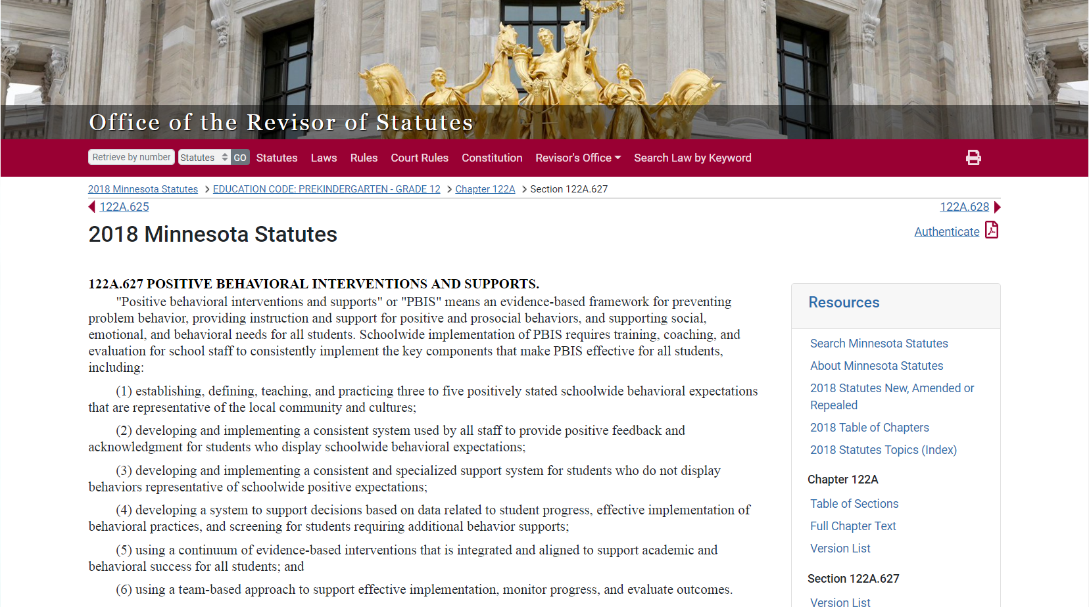
PBIS Defined in MN Statute 122A.627
Source: https://www.revisor.mn.gov/statutes/?id=122A.627
Notes:
This was done in consultation with the National TA Center, with many iterations to get to this point. There was a rationale to get this in plain language. We careful with the education language because we knew it had to be read by other agencies as well as legislatures.
122A.627 POSITIVE BEHAVIORAL INTERVENTIONS AND SUPPORTS.
"Positive behavioral interventions and supports" or "PBIS" means an evidence-based framework for preventing problem behavior, providing instruction and support for positive and prosocial behaviors, and supporting social, emotional, and behavioral needs for all students. Schoolwide implementation of PBIS requires training, coaching, and evaluation for school staff to consistently implement the key components that make PBIS effective for all students, including:
(1) establishing, defining, teaching, and practicing three to five positively stated schoolwide behavioral expectations that are representative of the local community and cultures;
(2) developing and implementing a consistent system used by all staff to provide positive feedback and acknowledgment for students who display schoolwide behavioral expectations;
(3) developing and implementing a consistent and specialized support system for students who do not display behaviors representative of schoolwide positive expectations;
(4) developing a system to support decisions based on data related to student progress, effective implementation of behavioral practices, and screening for students requiring additional behavior supports;
(5) using a continuum of evidence-based interventions that is integrated and aligned to support academic and behavioral success for all students; and
(6) using a team-based approach to support effective implementation, monitor progress, and evaluate outcomes.
Consistent with section 120B.232, subdivision 1, character education curriculum and programs may be used to support implementation of the key components of PBIS.
History:
1Sp2017 c 5 art 2 s 26
Source: https://www.revisor.mn.gov/statutes/?id=122A.627

Slide 5
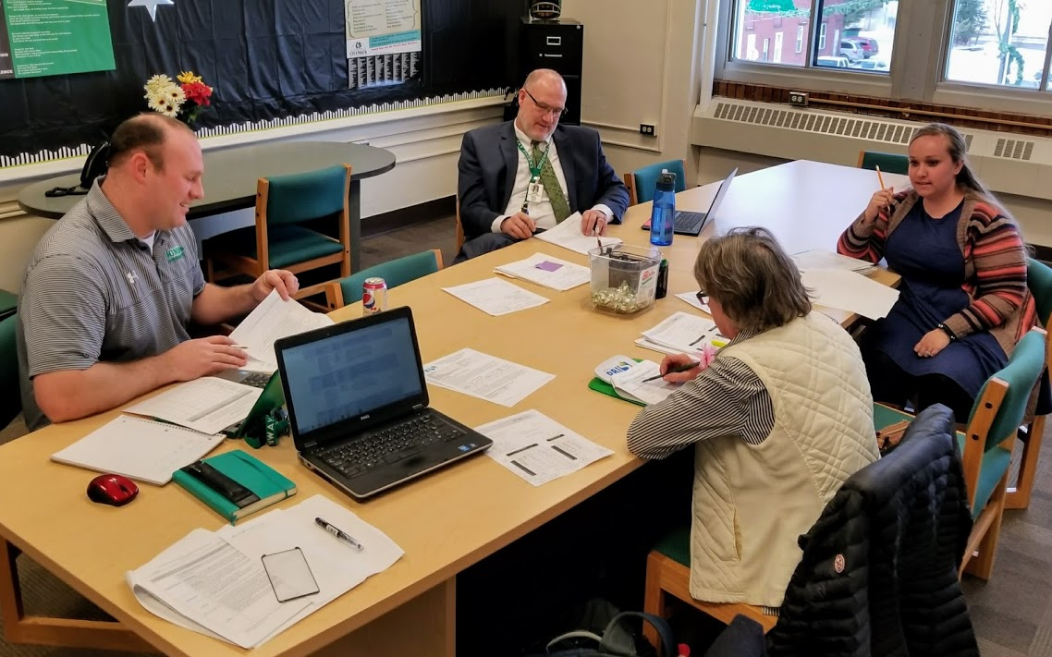
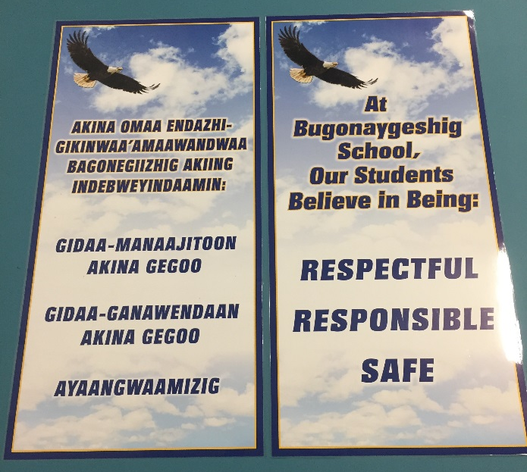
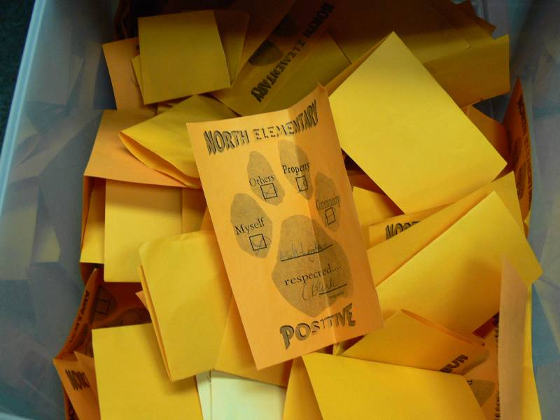
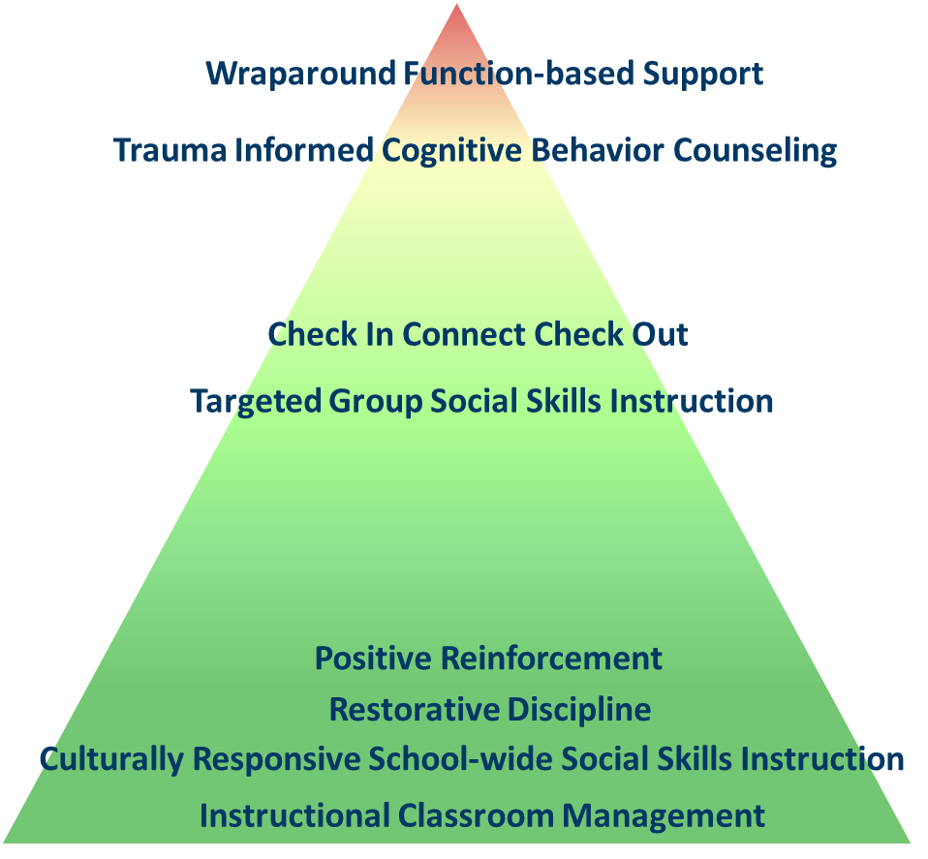
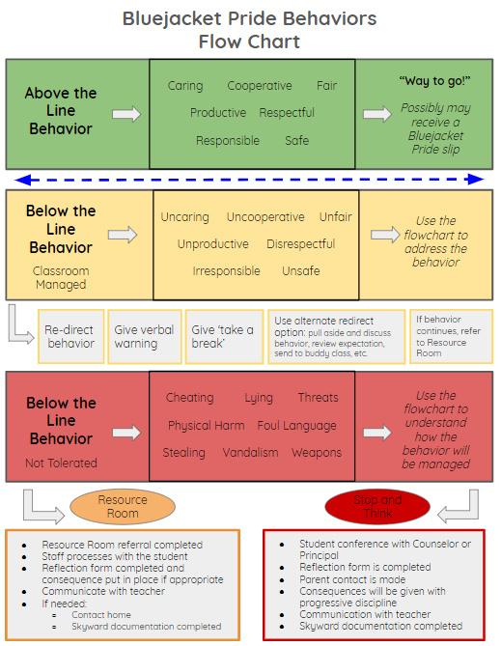
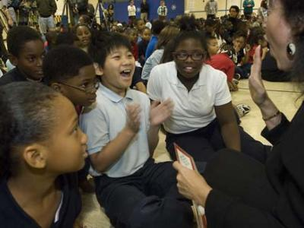
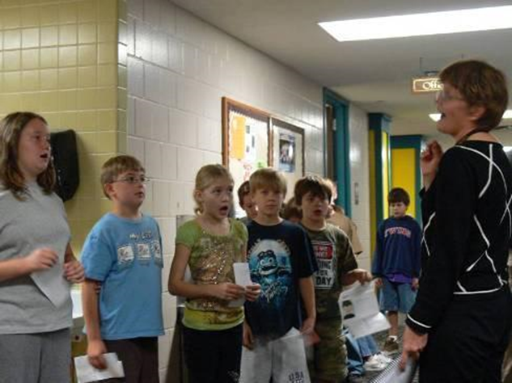
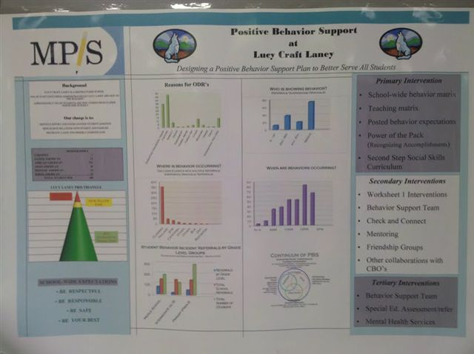
Statute PBIS Definition in Practice:
An Evidence-Based Framework to Prevent Problem Behavior and Support Positive, Prosocial Behaviors
3 to 5 positive expectations, taught and practiced
Acknowledgement and feedback system
Consistent and specialized supports for student needs
Data-based decision making
Continuum of interventions for all, integrated and aligned with supports to ensure academic success
Team-based approach
Source: https://www.revisor.mn.gov/statutes/?id=122A.627
Notes:
From the bike to the statute – this is what it looks like with MN examples.
It’s not just good enough. How do you know it is being done? There are tools and measures for teams to use.
122A.627 POSITIVE BEHAVIORAL INTERVENTIONS AND SUPPORTS.
"Positive behavioral interventions and supports" or "PBIS" means an evidence-based framework for preventing problem behavior, providing instruction and support for positive and prosocial behaviors, and supporting social, emotional, and behavioral needs for all students. Schoolwide implementation of PBIS requires training, coaching, and evaluation for school staff to consistently implement the key components that make PBIS effective for all students, including:
(1) establishing, defining, teaching, and practicing three to five positively stated schoolwide behavioral expectations that are representative of the local community and cultures;
(2) developing and implementing a consistent system used by all staff to provide positive feedback and acknowledgment for students who display schoolwide behavioral expectations;
(3) developing and implementing a consistent and specialized support system for students who do not display behaviors representative of schoolwide positive expectations;
(4) developing a system to support decisions based on data related to student progress, effective implementation of behavioral practices, and screening for students requiring additional behavior supports;
(5) using a continuum of evidence-based interventions that is integrated and aligned to support academic and behavioral success for all students; and
(6) using a team-based approach to support effective implementation, monitor progress, and evaluate outcomes.
Consistent with section 120B.232, subdivision 1, character education curriculum and programs may be used to support implementation of the key components of PBIS.
History:
1Sp2017 c 5 art 2 s 26
Source: https://www.revisor.mn.gov/statutes/?id=122A.627
From National TA Center
School-wide PBIS is:
A multi-tiered framework for establishing the social culture and behavioral supports needed for a school achieve behavioral and academic outcomes for all students.
Evidence-based features of PBIS
Prevention
Define and teach positive social expectations
Acknowledge positive behavior
Arrange consistent consequences for problem behavior
On-going collection and use of data for decision-making
Continuum of intensive, individual intervention supports.
Implementation of the systems that support effective practices

Slide 6

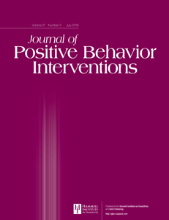
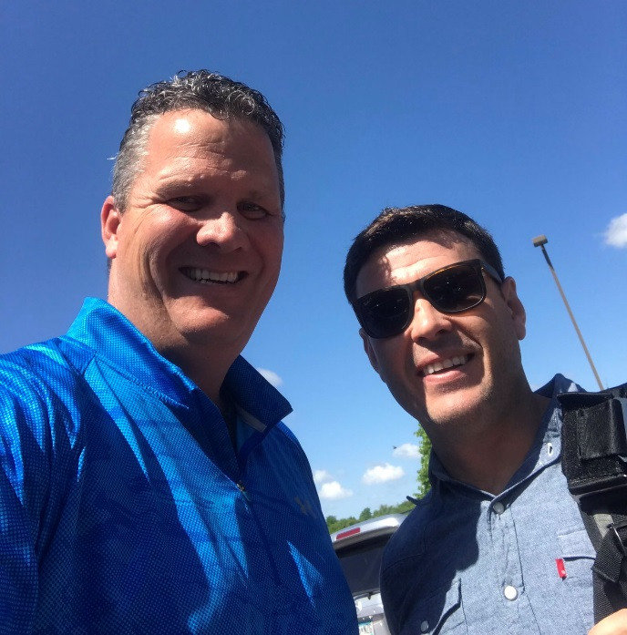
University of Minnesota
Dr. Clay Cook, PhD
Positive Greetings at the Door: Evaluation of a Low-Cost, High-Yield Proactive Classroom Management Strategy, Clayton R. Cook et al. was the most read JPBI article for over 6 months!
https://journals.sagepub.com/doi/full/10.1177/1098300717753831
Notes:
Dr. Cook (school psychology) specializes in school-based mental health, investigating practices that facilitate the implementation of a multi-tiered system of support (MTSS). His research focuses on helping practitioners (teachers, administrators, mental health providers) improve the delivery of school-based services to youth in schools, as demonstrated by a range of improved outcomes, including gains in academic achievement, improvements in social-emotional functioning, reductions in punitive disciplinary practices, and remediation of disparities for minority youth.

Slide 7
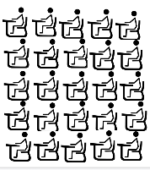
Positive Greetings at the Door:
Low-Cost, Classroom-wide Intervention
Few
All Students
Four (4) components – layered up from Tier 1
  Behavior-specific praise statements to certain students to reinforce desired behavior,
  Privately pre-correcting and encouraging individual students who struggled the previous day,
  Pre-corrective statements for all students as they transition into the classroom, and
  Specific positive interactions with each student as he or she enters room.
Some
Classroom-wide
Notes:
Garrett
Method:
Intervention
PGD strategy. As discussed, the PGD strategy integrates
three lines of research (i.e., classroom climate, precorrection,
and positive reinforcement) into a single strategy.
These lines of research informed the three intervention
components on which teachers received training and implementation
support, with the end goal of creating behavioral
momentum for academically engaged behavior. The first
component, which sought to increase social belonging and
promote a positive classroom climate, involved specific
positive interactions (i.e., greeting using the student’s
name, handshake) with each student as they enter the classroom.
Teachers stand at the door and engage in positive
verbal (e.g., greeting using the student’s name, statement
expressing interest in the student, etc.) or nonverbal (e.g.,
handshake, fist bump, pat on the shoulder, head nod indicating
approval, etc.) positive interactions (i.e., greetings)
with each student as they enter the room. The second component
entailed providing both individual student and
whole class precorrective statements to facilitate students’
successful transition into the classroom setting. An effective
precorrective statement reminds the student of the
behaviors that will result in success, prior to the students
beginning classroom activities (Colvin et al., 1997). As
part of the precorrection, teachers prepared a structured
learning activity that was ready for students as they transitioned
into the classroom. Teachers also delivered precorrective,
encouraging messages to specific students who
had struggled with their behavior the previous day to
increase the likelihood the student would comply with the
instructional requests. Last, a positive reinforcement contingency
is included so teachers contingently recognize
students’ behavior for being on time to class to decrease
truancy and facilitate on-time behavior. Although it is
incorporated to decrease truancy, data on this outcome
were not gathered or reported as part of this study. All of
these strategies were combined into the PGD, and teachers
received implementation support in the form of training
and coaching with performance feedback.

Slide 8
Results
Classrooms with teachers trained and supported to use the Positive Greetings at the Door (PGD) strategy were associated with diminished Disruptive Behaviors (DB) and greater Academic Engaged Time (AET) than those in the control group
  Additional hour of engagement over the course of a 5-hr instructional day
  Potential gains of several more hours of additional academic engagement over the course of the academic year, which could produce significant improvements in actual academic achievement
PGD may serve to enhance teacher–student relationships, thereby creating a more positive classroom climate for all.
Notes:
As hypothesized, this experimental study found that classrooms in which teachers received training and support to use the PGD strategy were associated with diminished Disruptive Behavior (DB) and greater academic engaged time (AET) than those in the attention control
Extra 12 min of on-task behavior per instructional hour or an additional hour of engagement over the course of a 5-hr instructional day
On a larger scale, use of the PGD strategy could potentially result in gains of several more hours of additional academic engagement over the course of the academic year, which could produce significant improvements in actual academic achievement
PGD may serve to enhance teacher–student relationships, thereby creating a more positive classroom climate for all
In addition, preservice preparation programs should consider providing training on evidence-based behavior management strategies, such as the PGD, that are relatively quick, easy to implement, and effective.

Slide 9
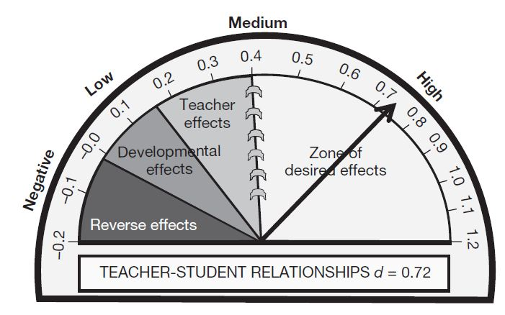
Student-Teacher Relationships
One stable and committed adult relationship
  National Scientific Council on the Developing Child (2015). Supportive Relationships and Active Skill-Building Strengthen the Foundations of Resilience. Harvard University.
Teacher-Student Relationship has a .72 effect size on student learning’
Average effect size of all interventions studied was .40
Hattie. J. (2009). Visible learning: A synthesis of over 800 meta-analyses relating to achievement. London: Routledge.

Slide 10
Small Changes, Big Impact Implementation Progress

Slide 11

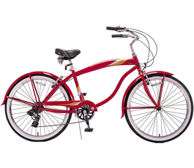
PBIS Framework
Coaching
School Team
Data
PBIS
Evidence-based
Interventions
School Principal
Implementation
Adapted from Don Kincaid
Notes:
From KM keynote at the implementers forum –really a great analogy-once you learn how to ride a bike you never fit-taking the training wheels off
This is about the analogy of the bike and the MN statute. Number 6 in statute is using a team-based approach to support effective implementation , monitor progress, and evaluate outcomes.
Bike frame = PBIS as framework
Seat= school team sits in drivers seat
Steering= coaches make adjustments along the way
Gears/derailleur= principal controls resources (changes gears)
Pedals= implementation is what powers the work
Wheel= evidence based practice (can be different types of wheels)
Map= data is what lets you know where your heading
And whether or not your valued outcomes are one or more of the following:
Reductions in major disciplinary infractions and antisocial behavior.
Improvements in aggressive behavior, concentration, prosocial behavior, and emotional regulation
Improvements in academic engagement and achievement
Enhancements in perceptions of organizational health and safety
Reductions in teacher and student reported bullying behavior, peer rejection, and substance abuse
Improvements in school climate
Something else?
You will always be part of the broader PBIS community with the common experience of coming together as a team, looking at shared information, celebrating growth and making decisions on the best next steps for you, your team, your school, and your entire community.

Slide 12
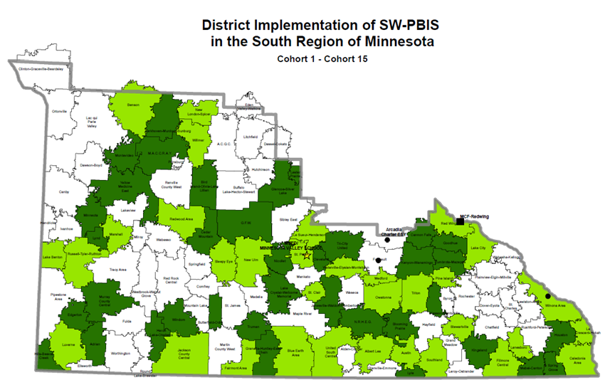
End of Day 1
Cohort 15 – 2019-2021
What will growth look like with
team-based action planning to get to
Full Implementation over two years?

Slide 13
End of Day 1
Cohort 11 – 2015-2017
Action planning towards
Full Implementation over two years…

Slide 14
Completion of Cohort Training
Cohort 11 – 2015-2017

Slide 15
End of Day 1
Cohort 12 – 2016-2018

Slide 16
Completion of Cohort Training
Cohort 12 – 2016-2018

Slide 17
End of Day 1
Cohort 13 – 2017-2019

Slide 18
Completion of Cohort Training
Cohort 13 – 2017-2019

Slide 19
End of Day 1
Cohort 14 – 2018-2020

Slide 20
Completion of Day 7
Cohort 14 – 2018-2020

Slide 21
Completion of Day 7
SRIP Cohort 14 – 2018-2020

Slide 22
Completion of Day 8
SRIP Cohort 14 – 2018-2020
SRIP Cohort 14
Yesterday!

Slide 23
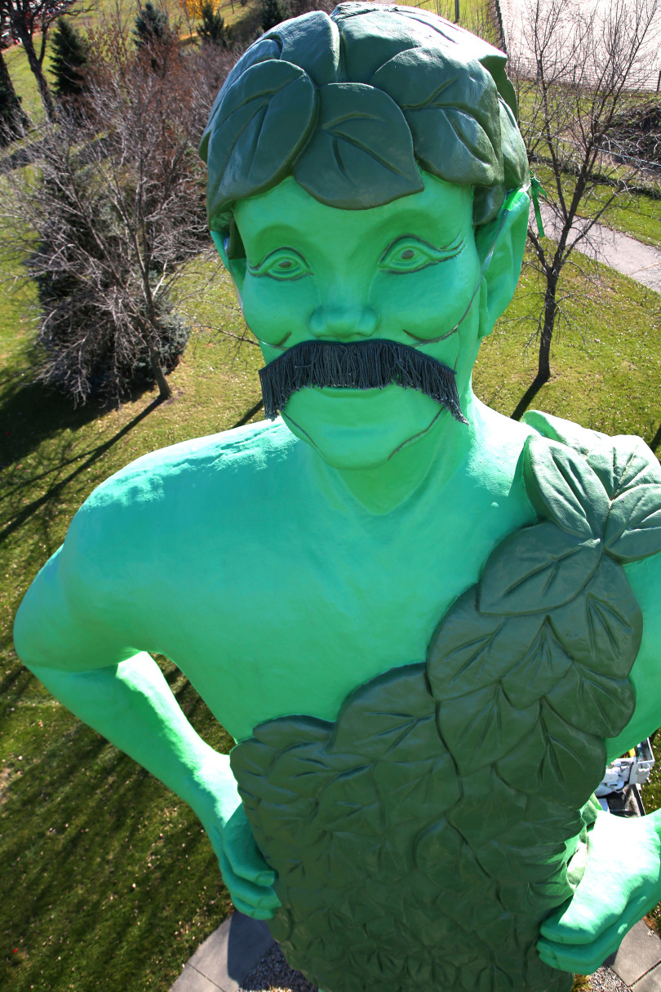
End of Day 1
Cohort 15 – 2019-2021
Excited for your growth towards
Full Implementation …

Slide 24
PBIS Leadership Forum

Slide 25

Implementers Forum 2019
This two-day forum for school, state, district, and regional Leadership Teams and other professionals has been designed to help increase the effectiveness of PBIS implementation.
https://www.pbis.org/conference-and-presentations/pbis-leadership-forum
Notes:
Links and examples from the Forum even if you cannot attend in person
Power points are listed and contacts are listed in presentations
Great resource!

Slide 26
Implementers Forum 2019
Strand Introductions
Equity
Family Engagement
High School
Juvenile Justice
Mental Health
PBIS Foundations
Tier 2
Tier 3
Notes:
Here is a list of the strands that part of the Forum with a link to the introductions.
Preview of strands that were covered with resources and videos

Slide 27
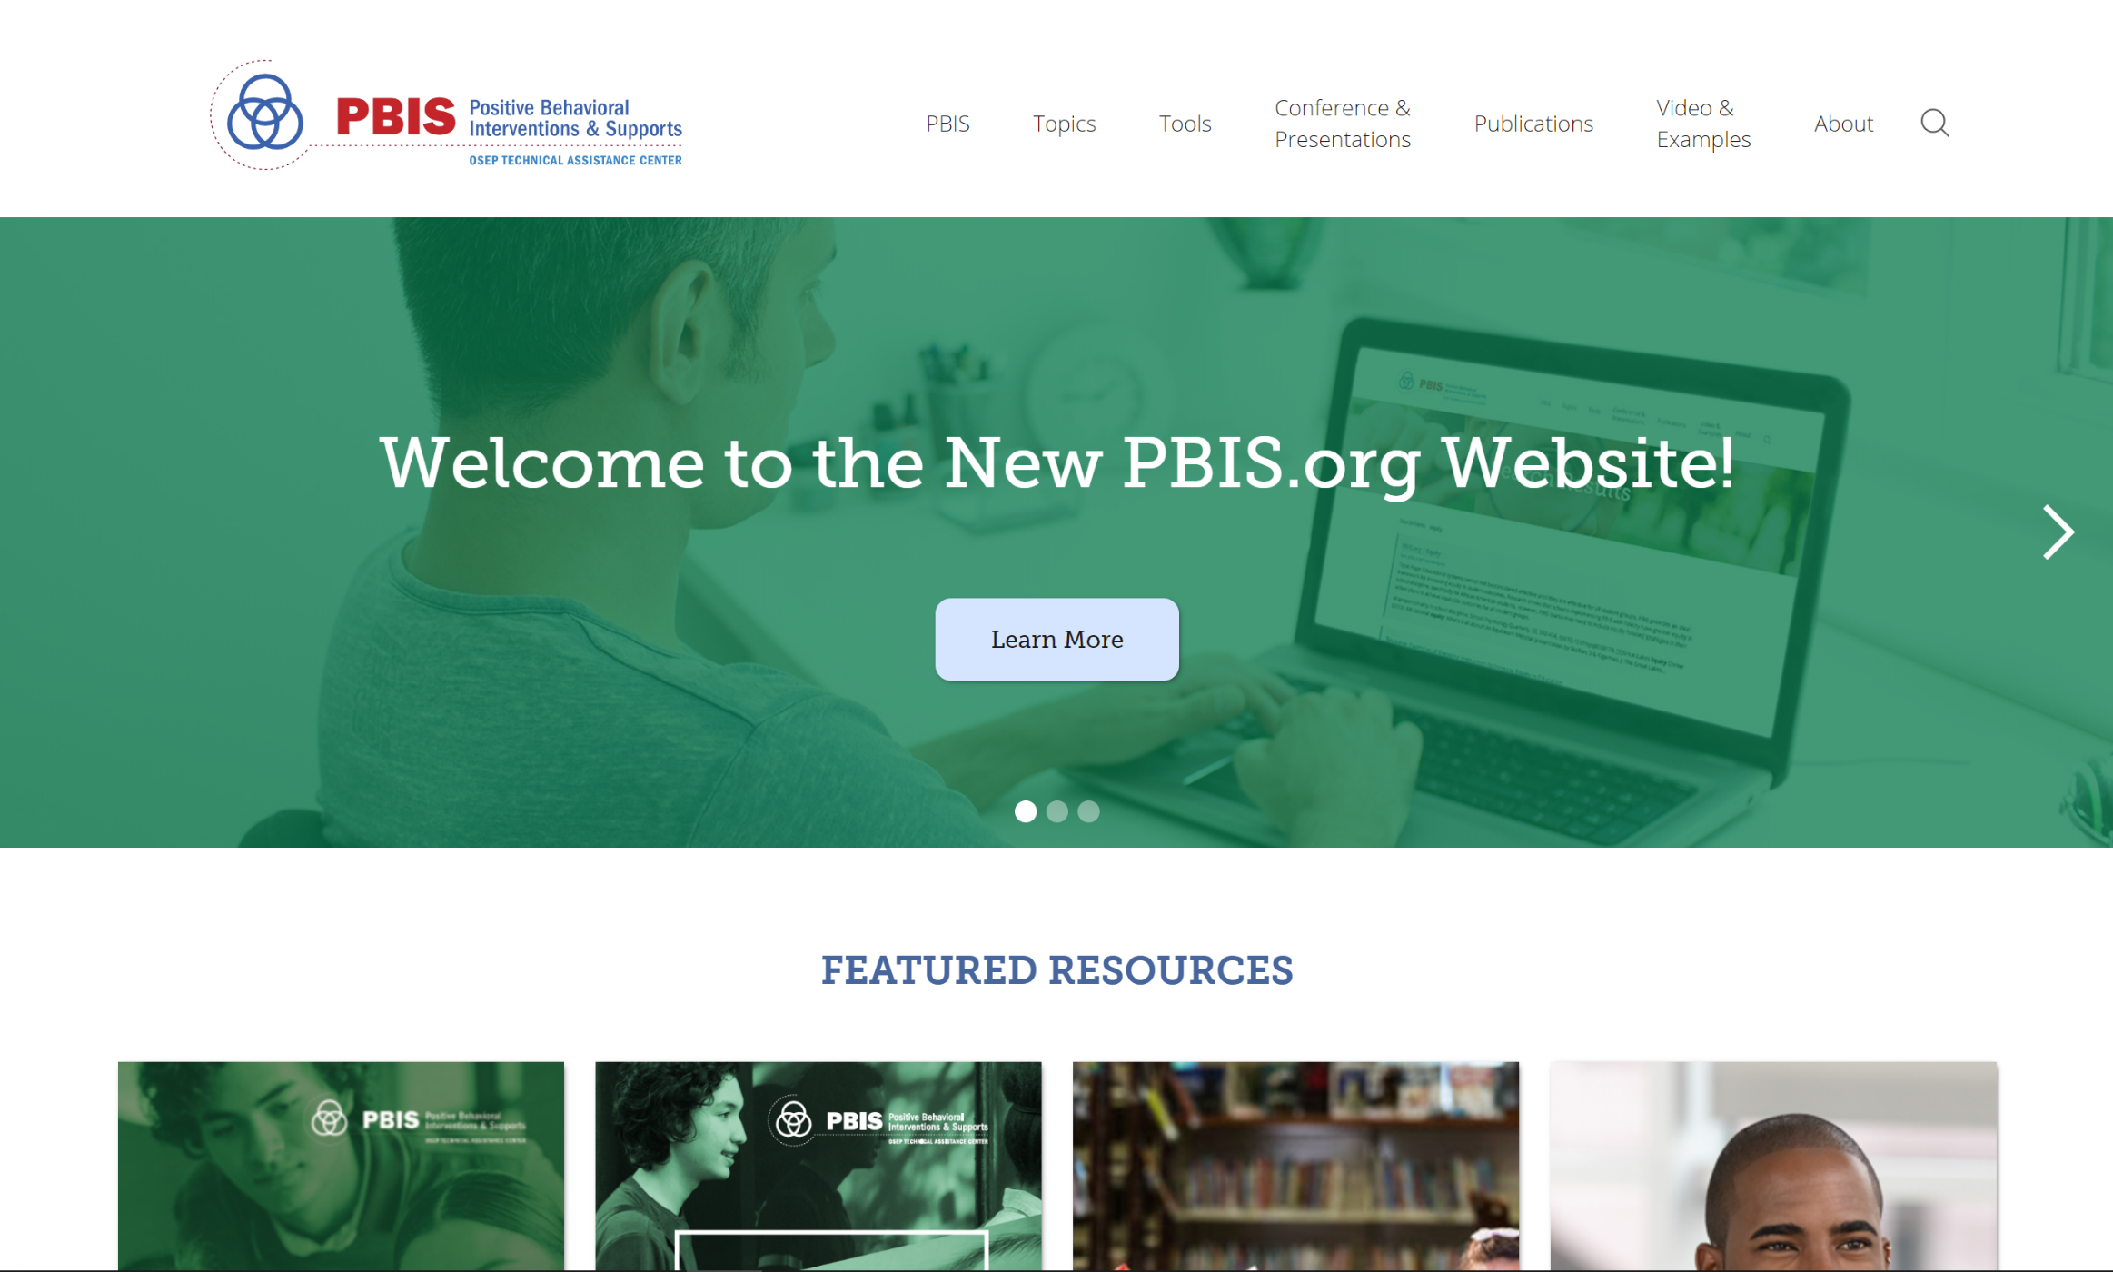
PBIS.org
Notes:
System to support the way it works – positive specific feedback
Not quite ready for Apple IOS
UPDATE to main page and add link

Slide 28

Get Positive!
Download here:
  https://play.google.com/store/apps/details?id=edu.uoregon.emberex_bpositive
iOS version coming soon

Slide 29
News & Save the Dates

Slide 30
Cohort 16 Application
Application is now available for new schools to join cohort training
  Please help spread the word
Link: Minnesota PBIS website (http://pbismn.org/getting-started/application-for-school-training.php)
Deadline: Monday, February 10, 2020

Slide 31
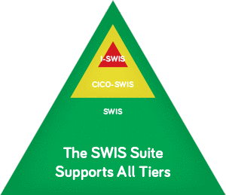
SWIS Facilitator Training
The reports available within SWIS allow teams to:
    Review school-wide referral patterns
    Define behavior patterns in greater detail
Training dates to be determined
Notes:
There will be SWIS facilitator trainings in the Metro and in the North with dates yet to be determined. South already held a training
Through SWIS, school staff enter office discipline referrals online. The data are summarized to provide information about individual students, groups of students, or the entire student body over any time period.
The reports available within SWIS allow teams to do precision problem-solving:
Review school-wide referral patterns: The five basic reports in SWIS frame the context within which problem behaviors occur at school helping teams to answer these questions:
How often do referrals occur?
What problem behaviors occur most frequently in our building?
Where are problem behaviors most likely to occur?
When are problem behaviors most likely to occur?
Which students are involved in referrals?
Define behavior patterns in greater detail: Eight other reports allow teams to dive into the data, getting more detailed information about specific questions related to the overall school-wide patterns. Using these reports, teams can look at disproportionality by ethnicity, detailed information about individual students’ referral patterns and year-end reports to guide action planning for the upcoming school year.

Slide 32

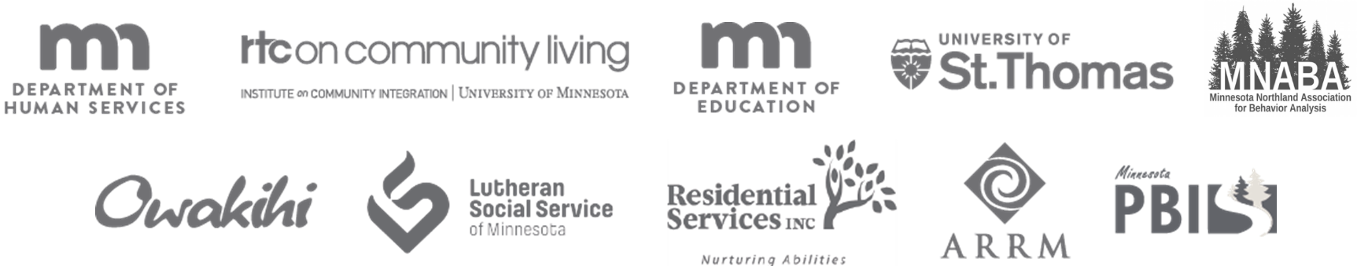
2020 Collaborators Forum
2020 Collaborators Forum
Tuesday, April 14, 2020
Minnesota Department of Education – Roseville, MN
Satellite Sites to be determined
mnpsp.org/mnpbs
The Collaborators Forum is an event for people interested in Positive Behavior Supports
across settings and the lifespan in Minnesota.
Notes:
Unique opportunity outside of school teams to see other facilities that are doing Positive behavior supports across the life-span

Slide 33


2020 Minnesota PBIS Institute and Film Festival
Save-the-dates for June 16-17, 2020 at MDE - Roseville, MN
Request for proposals for breakout sessions and films will appear in the winter
Submission forms and presentations from previous institutes at Minnesota PBIS Summer Institute

Slide 34

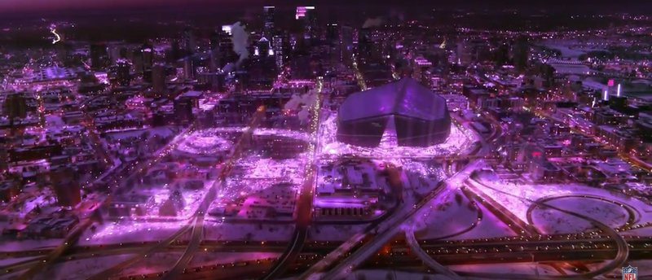
2021 APBS Conference Minneapolis
APBS Conference 2021 March 17th-20th Hyatt Regency - Minneapolis
MN PBS Twitter Feed about the 2021 APBS Conference in Minneapolis

Slide 35


Share your #pbisMN work!
facebook.com/pbisMN
twitter.com/pbisMN

Slide 36
North Regional Contacts
North Regional Implementation Project
Erin Engness
NRIP Coordinator
pbis.erin@gmail.com
PBIS Management - Regional Contacts
Eric Kloos
Eric.Kloos@state.mn.us
Mary Hunt
Mary.Hunt@state.mn.us
Erin Farrell
Erin.Farrell@state.mn.us
PBIS Evaluation Contact
Wilder Research
pbisevalmn@wilder.org
Find other PBIS Minnesota contacts at: http://pbismn.org/contact-us.php

Slide 37
Metro Regional Contacts
Metro Regional Implementation Project
Lauren Sparr
MRIP Coordinator
Lauren.Sparr@metroecsu.org
PBIS Management - Regional Contacts
Eric Kloos
Eric.Kloos@state.mn.us
Becky Nies
Rebecca.Nies@state.mn.us
Ellen Nacik
Ellen.Nacik@state.mn.us
PBIS Evaluation Contact
Wilder Research
pbisevalmn@wilder.org
Find other PBIS Minnesota contacts at: http://pbismn.org/contact-us.php

Slide 38
South Regional Contacts
South Regional Implementation Project (SRIP)
Liz Deen
Lead SRIP Coordinator
Liz.Deen@swwc.org
Hazel Ashbeck
SRIP Coordinator – SWWC
Hazel.Ashbeck@swwc.org
Erin Toninato
SRIP Coordinator – South Central Service Cooperative
EToninato@mnscsc.org
Amber Bruns
Southwest West Central Service Cooperative
Amber.Bruns@swwc.org
PBIS Management - Regional Contacts
Eric Kloos
Eric.Kloos@state.mn.us
Garrett Petrie
Garrett.Petrie@state.mn.us
Janet Christensen
Janet.Christensen@state.mn.us
PBIS Evaluation Contact
Wilder Research
pbisevalmn@wilder.org
Find other PBIS Minnesota contacts at: http://pbismn.org/contact-us.php

Slide 39
Thank you for the little things that make a big difference!
Minnesota Department of Education – PBIS Management Team
MDE.PBIS@state.mn.us

Slide 40
References
Cook, Clayton & Fiat, Aria & Larson, Madeline & Daikos, Christopher & Slemrod, Tal & Holland, Elizabeth & Thayer, Andrew & Renshaw, Tyler. (2018). Positive Greetings at the Door: Evaluation of a Low-Cost, High-Yield Proactive Classroom Management Strategy. Journal of Positive Behavior Interventions. 109830071775383. 10.1177/1098300717753831.

