Slide 1
Improvement Cycles Toward Full Implementation:
Action Planning with Results
Minnesota PBIS Southern Region Cohort 15 Winter Training – Day 8
November 5, 2020
MDE PBIS Management Team | MDE.PBIS@state.mn.us

Slide 2

Ten Minnesota Commitments to Equity
Prioritize equity.
Start from within.
Measure what matters.
Go local.
Follow the money.
Start early.
Monitor implementation of standards.
Value people.
Improve conditions for learning.
Give students options.

Slide 3
Action Planning with Results
PBIS Minnesota Cohort Training
Takeaways
PBIS in practice
Implementation progress
Featured webinar recordings
News and updates

Slide 4
Action Planning with Results
PBIS in Practice

Slide 5
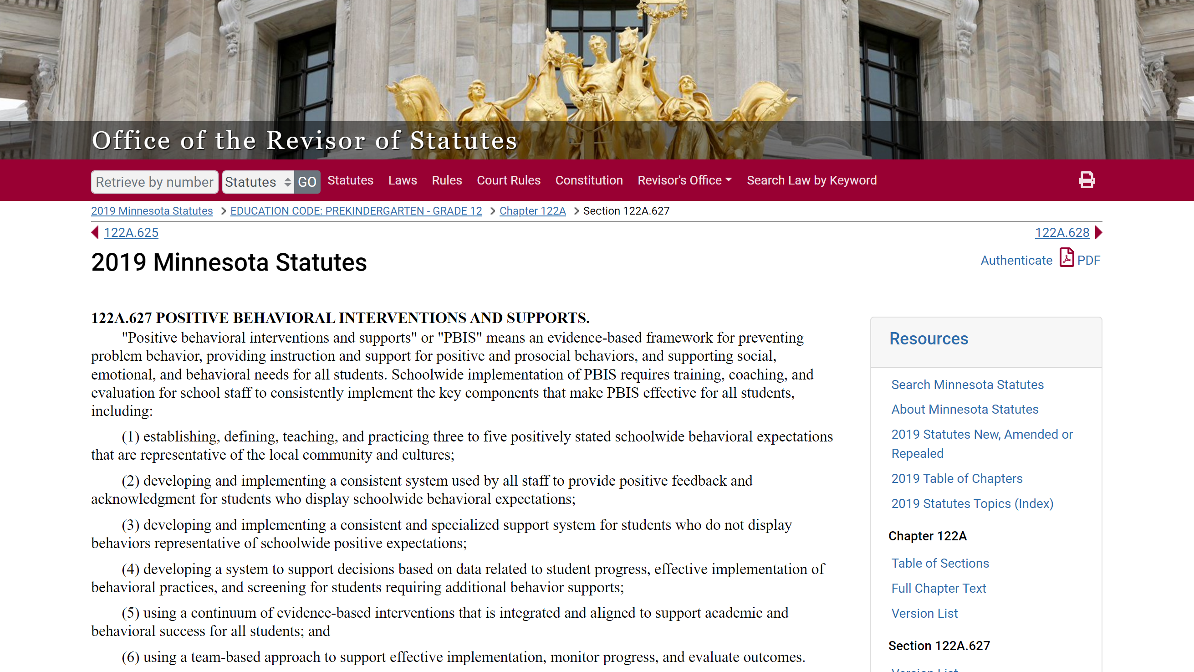
PBIS Defined in MN Statute 122A.627
Source: https://www.revisor.mn.gov/statutes/?id=122A.627
Notes:
This was done in consultation with the National TA Center, with many iterations to get to this point. There was a rationale to get this in plain language. We careful with the education language because we knew it had to be read by other agencies as well as legislatures.
122A.627 POSITIVE BEHAVIORAL INTERVENTIONS AND SUPPORTS.
"Positive behavioral interventions and supports" or "PBIS" means an evidence-based framework for preventing problem behavior, providing instruction and support for positive and prosocial behaviors, and supporting social, emotional, and behavioral needs for all students. Schoolwide implementation of PBIS requires training, coaching, and evaluation for school staff to consistently implement the key components that make PBIS effective for all students, including:
(1) establishing, defining, teaching, and practicing three to five positively stated schoolwide behavioral expectations that are representative of the local community and cultures;
(2) developing and implementing a consistent system used by all staff to provide positive feedback and acknowledgment for students who display schoolwide behavioral expectations;
(3) developing and implementing a consistent and specialized support system for students who do not display behaviors representative of schoolwide positive expectations;
(4) developing a system to support decisions based on data related to student progress, effective implementation of behavioral practices, and screening for students requiring additional behavior supports;
(5) using a continuum of evidence-based interventions that is integrated and aligned to support academic and behavioral success for all students; and
(6) using a team-based approach to support effective implementation, monitor progress, and evaluate outcomes.
Consistent with section 120B.232, subdivision 1, character education curriculum and programs may be used to support implementation of the key components of PBIS.
History:
1Sp2017 c 5 art 2 s 26
Source: https://www.revisor.mn.gov/statutes/?id=122A.627

Slide 6
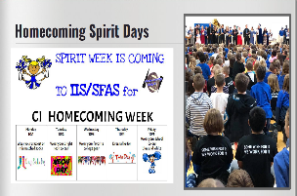
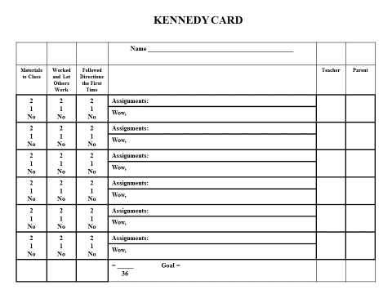
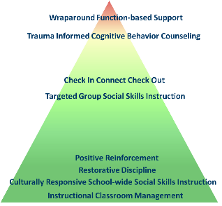
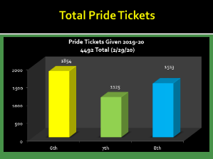
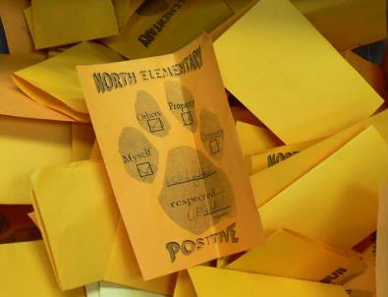
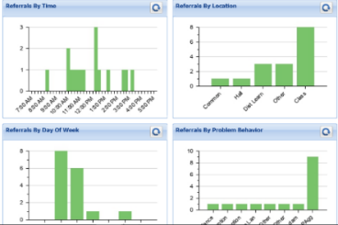
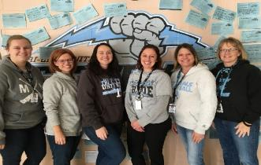
Statute PBIS Definition in Practice:
An Evidence-Based Framework to Prevent Problem Behavior and Support Positive, Prosocial Behaviors
3-5 positive expectations, taught and practiced
Acknowledgement and feedback system
Consistent and specialized supports
Data-based decision making
Continuum of interventions for all to support behavioral success
Team-based approach
School Leadership Team that supports all staff, students, and families with:
Source: https://www.revisor.mn.gov/statutes/?id=122A.627
Notes:
From the bike to the statute – this is what it looks like with MN examples.
It’s not just good enough. How do you know it is being done? There are tools and measures for teams to use.
122A.627 POSITIVE BEHAVIORAL INTERVENTIONS AND SUPPORTS.
"Positive behavioral interventions and supports" or "PBIS" means an evidence-based framework for preventing problem behavior, providing instruction and support for positive and prosocial behaviors, and supporting social, emotional, and behavioral needs for all students. Schoolwide implementation of PBIS requires training, coaching, and evaluation for school staff to consistently implement the key components that make PBIS effective for all students, including:
(1) establishing, defining, teaching, and practicing three to five positively stated schoolwide behavioral expectations that are representative of the local community and cultures;
(2) developing and implementing a consistent system used by all staff to provide positive feedback and acknowledgment for students who display schoolwide behavioral expectations;
(3) developing and implementing a consistent and specialized support system for students who do not display behaviors representative of schoolwide positive expectations;
(4) developing a system to support decisions based on data related to student progress, effective implementation of behavioral practices, and screening for students requiring additional behavior supports;
(5) using a continuum of evidence-based interventions that is integrated and aligned to support academic and behavioral success for all students; and
(6) using a team-based approach to support effective implementation, monitor progress, and evaluate outcomes.
Consistent with section 120B.232, subdivision 1, character education curriculum and programs may be used to support implementation of the key components of PBIS.
History:
1Sp2017 c 5 art 2 s 26
Source: https://www.revisor.mn.gov/statutes/?id=122A.627
From National TA Center
School-wide PBIS is:
A multi-tiered framework for establishing the social culture and behavioral supports needed for a school achieve behavioral and academic outcomes for all students.
Evidence-based features of PBIS
Prevention
Define and teach positive social expectations
Acknowledge positive behavior
Arrange consistent consequences for problem behavior
On-going collection and use of data for decision-making
Continuum of intensive, individual intervention supports.
Implementation of the systems that support effective practices

Slide 7
Importance of Ensuring Core Features
“Be adamant about the core features,
be flexible about the rest.”
                Rob Horner
                October 2020
                ABAI Culturo-Behavior Science for a Better World Conference

Slide 8
… “(6) using a team-based approach to support effective implementation, monitor progress, and evaluate outcomes.”
Few
Supports for
All Students
Some
Notes:
Updated 9/16/2020
Year 1 T1 ave= 73.5% T2 ave = 65.0% T3 ave= 60.0% n= 323
Year 2 T1 ave= 79.2% T2 ave = 74.5% T3 ave= 69.9% n= 176
Year 3 T1 ave= 82.2% T2 ave = 78.4% T3 ave= 76.5% n= 98
Year 4 T1 ave= 84.4% T2 ave = 80.1% T3 ave= 79.2% n= 51
Year 5 T1 ave= 84.3% T2 ave = 81.9% T3 ave= 81.7% n= 14

Slide 9
Action Planning with Results
Implementation Progress

Slide 10
Stage-based Implementation
Cohorts 11-14 – 2015-2020

Slide 11
End of Year 1
Cohort 15 – 2019-2021

Slide 12
Starting the 2020 School Year
Cohort 15 – 2019-2021

Slide 13
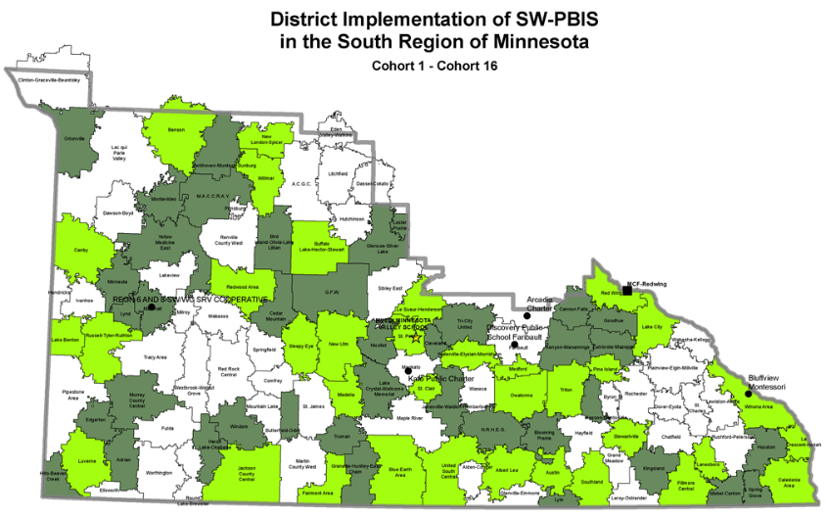
Starting the 2020 School Year
SRIP Cohort 15 – 2019-2021

Slide 14
Action Planning with Results
Featured Webinar Recordings

Slide 15

5 Practically Good Ideas for Any Reality
Summary:
Concrete practices for selection and implementation in any educational reality
Building relationships & healthy social connections in person and adapted to virtual settings
Creating the conditions for learning to promote and invest proactively with strategies to gain learning time
Understand how to create school-wide supports through an equity lens
Positive Greetings at the Door (in-person & virtual) which provides connection, pre-correction, and restoration
Accessible recording of the webinar can be found at MDE Mediasite
Notes:
Recording available at following link: https://mndepted.mediasite.com/mediasite/Play/6839a49a74eb468381d8a59f7d4e4ccd1d

Slide 16

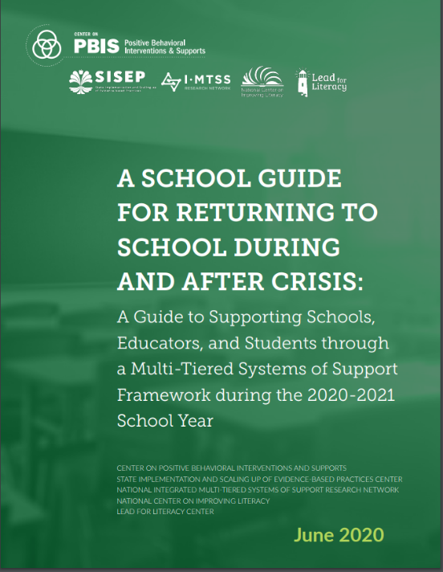
Returning to School After a Crisis
Summary:
Maintaining the evidence based practices that are already working, are culturally relevant for all students, and doing them well
Screening
Intervention matching
Invest in ourselves and systems that allow us to do well
Utilizing stakeholder input for decision making at the state, region, district, school level including students and staff
A small number of critical practices and supports “Back to the Basics” like:
Check-In Check-Out (CICO)
Positive Greetings at the Door (PGD)
Authentic family engagement
Accessible recording of the webinar can be found at MDE Mediasite
Notes:
Recording available at following link: https://mndepted.mediasite.com/mediasite/Play/5a209b50549d4ff78a81e9564aafc0b21d
Dr. Brandi Simonsen-University of Connecticut is a Researcher and Professor at the University of Oregon, and Co-Director on the Center for PBIS. Brandi specializes in Special Education, Positive Behavioral Interventions and Supports
This recorded session provides an overview of the new resource guide and describes the use of a multi-tiered systems of support (MTSS) framework to support students, families, and educators during the transitions back to school during and following the global pandemic in a manner that prioritizes their health and safety, social and emotional needs, and behavioral and academic growth
A Guide to Supporting States, Districts, Schools, Educators, and Students through a Multi-Tiered Systems of Support Framework during the 2020-2021 School Year

Slide 17
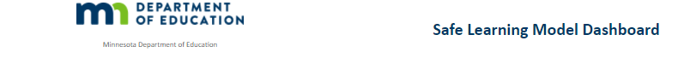
Predictable Supports Across Safe Learning Models
In-Person
Hybrid
Distance
Combination
16%
23%
18%
44%
*This information reflects data reported by school districts and charter schools as of 11/4/2020 3:30:28 PM.
Summary Table: Percent of districts & charter schools reported per learning model
Trauma-Focused Cognitive Behavioral Therapy
(School-Linked Mental Health grants)
CICO with social skills instruction
(MSU – Kevin Filter / ADSIS)
Videoconference room CICO
(MSU – Kevin Filter / ADSIS)
A small number of critical practices and supports:
Identified by teams
Supported by staff
Reflective of student, family and community culture and values
Positive Greetings at the Door
(UMN – Clay Cook)
Positive Greetings at the Virtual Door
(UMN – Clay Cook)
Teaching Procedures & Establishing
Classroom Routines
(Midwest PBIS Network)
Teaching asynchronous procedures &
synchronous online routines
Engagement & Opportunities to Respond
(Midwest PBIS Network)
Notes:
There are increasingly more opportunities available in Minnesota to make practices possible in a multi-tiered system of support to improve academic and behavioral success.
Virtual Mentoring Recommendations
Guidance on Check & Connect Mentoring
The C&C training team recognizes the challenges of mentoring. Reaching students and families during this time is challenging and every connection a mentor makes is cause for celebration. A mentor's demonstration of care and consistent support to their students and families is most important during this difficult time.
We also understand that how you connect with students and families may have shifted, depending on your site. Mentors and school leaders have asked for guidance from the C&C office, and we offer you the following structures to incorporate into your C&C mentoring practice, if you are finding yourself needing to adapt your approach.
Recommendations for Structuring Virtual "Connect" sessions: Temperature Checks - Incorporate an SEL practice or a beginning routine like a “high” or “low” for each week.
Gathering Data - With distance learning, data on attendance, behavior and grades may not be available or even reliable indicators on how our students are doing. Do some self-reporting with students using a virtual thumbs-up or emoji. Ask them to rate how things are going with their school work, their connection to peers, and their connection to teachers.
Providing Feedback - Validate student effort and reflect on their concerns. Promoting School Success - Remind students you believe in them and that you want them to feel successful in school. Ask them if there is one thing that could help make school better for them, what would it be? Problem Solving with Student - Engage in the five-step problem solving process with the student around a challenge or difficult situation that came up in the “connect” session. Recommendations for Structuring Family Conversations:
Greet - Ask “How are you?” and “Is this an ok time to talk?”
Outline - Explain purpose of call and ask “What else would you like to discuss?”
Reflect - Validate their efforts and ask “What do you need to help support learning at home?”
Share - Highlight something positive about their child and ask “How do you think your child is doing in their classes?” Discuss how their child is progressing and their child’s current goal(s).
Plan - Problem-solve with parent and ask, “Is there anything that might get in the way of your child accomplishing their goal?” Decide next steps and follow through.
We hope these insights are helpful as you go about the important work supporting students and their families!

Slide 18
Action Planning with Results
News and Updates

Slide 19

PBIS Leadership Forum Presentations
This three-day virtual forum for school, state, district and regional Leadership Teams and other professionals has been designed to help increase the effectiveness of PBIS implementation.
http://PBISforum.org
Recordings from PBIS Leadership Forum, including keynotes and presentations about PBIS concepts and applications, are now posted.
Check direct link for topics covered:
https://pbis.org/conference-and-presentations/pbis-leadership-forum

Slide 20
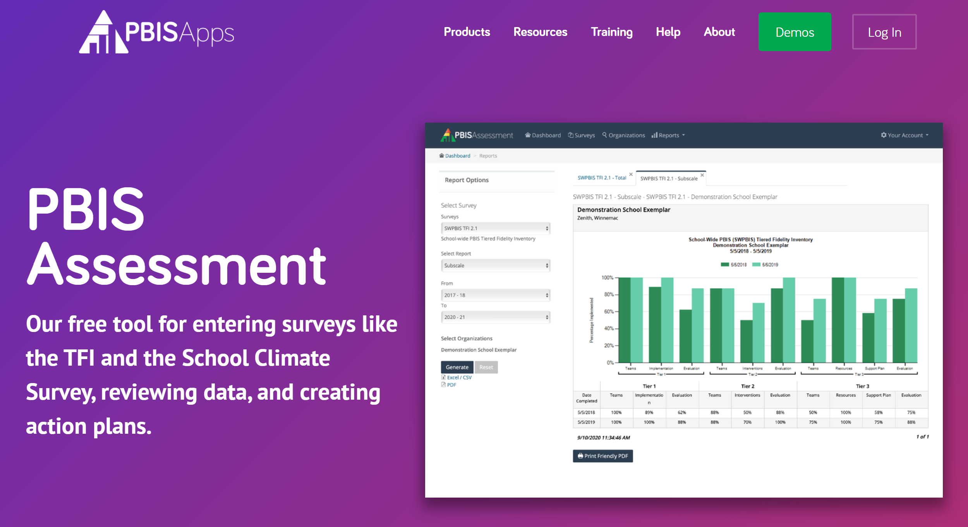
New Look for PBIS Apps – Coming Soon!

Slide 21
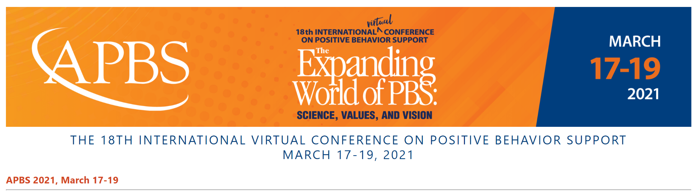
APBS 2021 Conference
The Association for Positive Behavior Support is very excited to announce that planning has begun for the 18th International Virtual Conference on Positive Behavior Support.
The 18th International Virtual Conference on Positive Behavior Support will be held March 17-19, 2021. Plans for the virtual conference include live streamed sessions, pre-recorded sessions, ignite sessions, the PBIS Film Festival, meet the presenter networking sessions, a poster session and more. All live sessions will be recorded and available to attendees for six (6) months following the conference.
Stay Safe, Stay Healthy and we look forward to seeing you March 17-19, 2021!

Slide 22
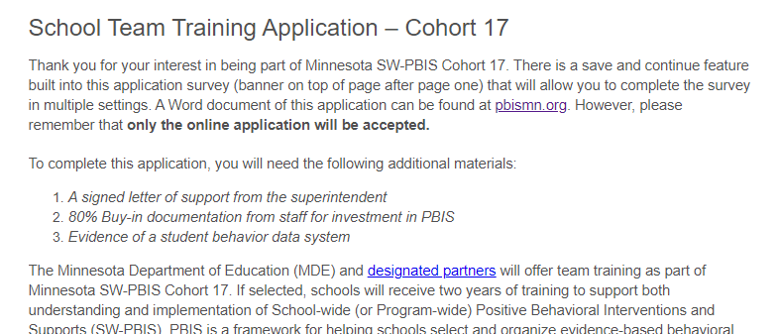
Schools Can Apply for Cohort 17 (2021-2023)
Cohort application guides through Exploration activities to form a team and get data system in place.
Teams get pre-requisites in place to be ready for PBIS Installation, including commitment to data collection and analysis.
Open now!
http://pbisMN.org/Getting-Started

Slide 23


Share your #pbisMN work!
facebook.com/pbisMN
twitter.com/pbisMN

Slide 24
South Regional Contacts
South Regional Implementation Project
Liz Deen
Lead SRIP Coordinator
Liz.Deen@swwc.org
Hazel Ashbeck
SRIP Coordinator – SWWC
Hazel.Ashbeck@swwc.org
Erin Toninato
SRIP Coordinator – South Central Service Cooperative
EToninato@mnscsc.org
Amber Bruns
Southwest West Central Service Cooperative
Amber.Bruns@swwc.org
PBIS Management - Regional Contacts
Garrett Petrie
Garrett.Petrie@state.mn.us
Janet Christensen
Janet.Christensen@state.mn.us
Eric Kloos
Eric.Kloos@state.mn.us
PBIS Evaluation Contact
Wilder Research
pbisevalmn@wilder.org
Find other PBIS Minnesota contacts at: http://pbismn.org/contact-us.php

Slide 25
Thank You!
Minnesota Department of Education – PBIS Management Team
MDE.PBIS@state.mn.us

