Slide 1
Improvement Cycles Toward Full Implementation:
Action Planning with Results
Minnesota PBIS Southern Region Cohort 16 Winter Training – Day 8
November 5, 2021
MDE PBIS Management Team | MDE.PBIS@state.mn.us
Notes:
Updated 2/24/2021

Slide 2

Ten Minnesota Commitments to Equity
Prioritize equity.
Start from within.
Measure what matters.
Go local.
Follow the money.
Start early.
Monitor implementation of standards.
Value people.
Improve conditions for learning.
Give students options.
Notes:
TIP: If you are highlighting a specific item, select the list and change the color to Minnesota green. Then select the items you want to highlight and change the color back to white and bold.

Slide 3
Action Planning with Results
PBIS Minnesota Cohort Training
Takeaways
PBIS implementation elements and factors
Implementation progress
Featured webinar recordings
News and updates

Slide 4
Action Planning with Results
PBIS Elements and Factors

Slide 5
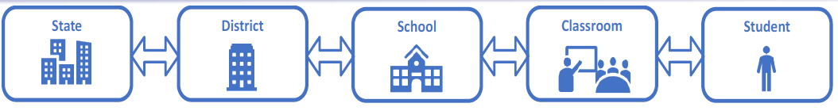
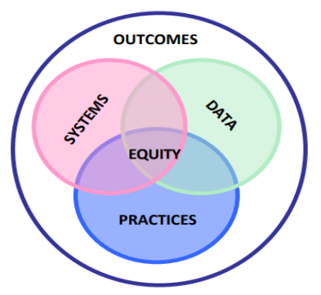
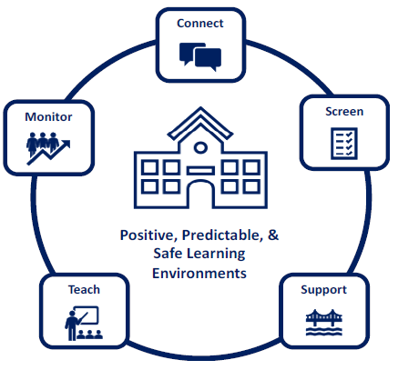
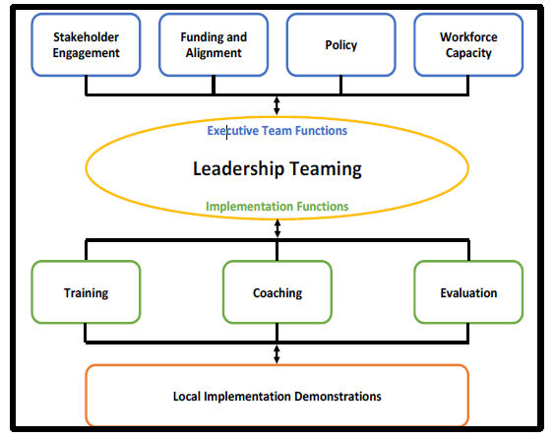

Making Data Based Decisions
Notes:
Adapted from PBIS.org Presentation from Heather Peshak George, Laura Kern, Karen Robbie & Janet VanLone
Equity and equitable outcomes being at the center of all decision making
We use state level data to support districts, schools, the classroom and then student data to inform what we do

Slide 6
Factors Predicting Sustained Implementation
#1 Predictor
Team sharing data
  Collect, Inform Decisions, Shared with staff, etc. at least monthly
Capacity Building
  Internal and external coaching, Professional Development, etc.
School Priority
  Administrative/staff support, buy-in, perceived efficiency
District Priority
  Explicit funding and policy, promoted to outside organizations
  McIntosh, K., Mercer, S. H., Hume, A. E., Frank, J. L., Turri, M. G., & Mathews, S. (2013). Factors related to sustained implementation of School-wide Positive Behavior Support. Exceptional Children, 79, 293-311.
5 minute video here:
https://www.pbis.org/video/four-tips-for-sustaining-pbis

Slide 7
Action Planning with Results
Implementation Progress

Slide 8
Stage-based Implementation
Cohorts 11-15 – 2015-2021

Slide 9
End of Year 1
Cohort 16 – 2020-2022

Slide 10
Starting the 2020 School Year
Cohort 16 – 2020-2022

Slide 11
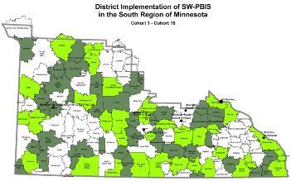
Starting the 2020 School Year
SRIP Cohort 16 – 2020-2022

Slide 12
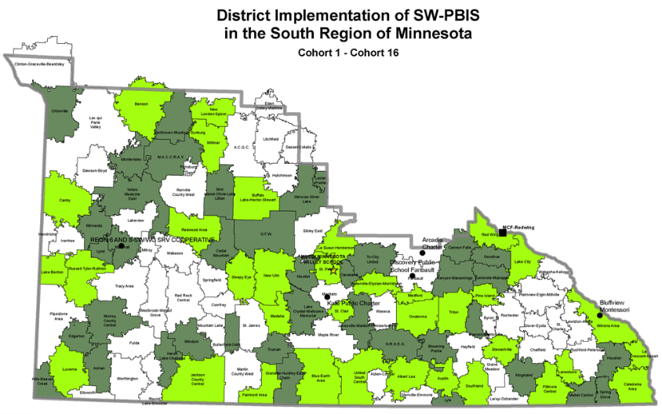
Yesterday, End of Day 4 – South Region
Cohort 17 – 2021-2023

Slide 13
Action Planning with Results
Featured Webinar Recordings

Slide 14
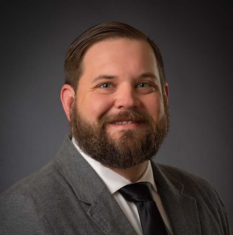
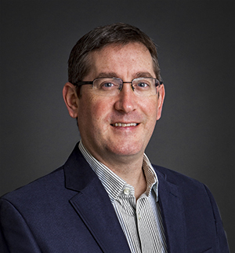
Webinar: Behavior Specific Praise Observation Tool
“Implementing, Coaching, and Measuring the Impact of this Simple Yet Specific Strategy”
Summary:
Behavior specific praise has been researched for decades
Offers specific strategies for the classroom for all students
Can be used for students with the most challenging behaviors
Beneficial to specific, general, and contingent praise to encourage improved positive classroom behaviors
Offers strategies for general versus behavior specific praise
Included are hands-on opportunities to practice using observation tools and use specific feedback statements within the webinar
Dr. Benjamin Riden
Dr. Andy Markelz
This, and other accessible recordings and materials, can be found at the MDE Special Education Training webpage (https://education.mn.gov/MDE/dse/sped/spedtrain)

Slide 15
MDE Division of Special Education
Trainings and Webinar Recordings Available
Five Practically Good Ideas for Any Reality
Returning to School During and After Crisis
Check-in/Check-Out as a Tier 2 Support
The Interconnected Systems Framework: School mental health and MTSS
Systematic Screening in the COVID-19 Era: Comprehensive, Integrated, Three-Tiered Model of Prevention
All accessible recordings and materials can be found at the MDE Special Education Training webpage (https://education.mn.gov/MDE/dse/sped/spedtrain)

Slide 16
Action Planning with Results
News and Updates

Slide 17

PBIS Leadership Forum Presentations
This three-day virtual forum for school, state, district and regional Leadership Teams and other professionals has been designed to help increase the effectiveness of PBIS implementation.
Center on PBIS Leadership Forum website (http://PBISforum.org)
Recordings from PBIS Leadership Forums, including keynotes and presentations about PBIS concepts and applications, continue to be posted.
Check PBIS Leadership Forum Session Materials
(https://pbis.org/conference-and-presentations/pbis-leadership-forum) when made available.
Check Videos on the Center on PBIS YouTube Channel (https://youtube.com/c/CenteronPBIS/videos) for recordings available now

Slide 18


2022 Minnesota PBIS Institute and Film Festival
Save-the-dates for June 14-16, 2022
Save-the-dates for June 14-16, 2022 for Summer Institute, Film Festival and Annual Sustaining Exemplar Recognition Ceremony
Request for proposals for breakout sessions and films will appear this winter
  Submission forms and presentations from previous institutes available on the Minnesota PBIS Summer Institute webpage (https://pbismn.org/summer-institute)
See Summer Institute 2020 and 2021 presentations, including the keynote by Dr. Tamika LaSalle, “[Culturally Responsive] PBIS: Leveraging Existing Systems to Advance Equity” (https://youtube.com/c/PBISMinnesota/videos)

Slide 19
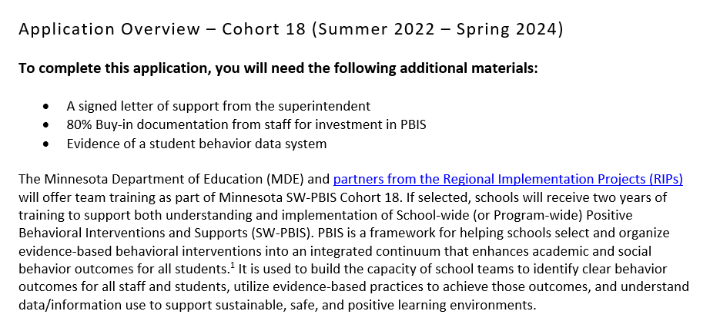
Schools Can Apply for Cohort 18 (2022-2024)
Cohort application guides through Exploration activities to form a team and get data system in place.
Teams get pre-requisites in place to be ready for PBIS Installation, including commitment to data collection and analysis.
Opens in November!
(https://pbisMN.org/Getting-Started)

Slide 20


Share your #pbisMN work!
facebook.com/pbisMN
twitter.com/pbisMN

Slide 21
South Regional Contacts
South Regional Implementation Project
Liz Deen
Lead SRIP Coordinator
Liz.Deen@swwc.org
Hazel Ashbeck
SRIP Coordinator – SWWC
Hazel.Ashbeck@swwc.org
Erin Toninato
South Central Service Cooperative
EToninato@mnscsc.org
Amber Bruns
Southwest West Central Service Cooperative
Amber.Bruns@swwc.org
PBIS Management - Regional Contacts
Garrett Petrie
Garrett.Petrie@state.mn.us
Janet Christensen
Janet.Christensen@state.mn.us
Eric Kloos
Eric.Kloos@state.mn.us
PBIS Evaluation Contact
Wilder Research
pbisevalmn@wilder.org
Find other PBIS Minnesota contacts at: https://pbismn.org/contact-us.php

Slide 22
Thank You!
Minnesota Department of Education – PBIS Management Team
MDE.PBIS@state.mn.us

