Slide 1
Tier 1
Training Day 1 Overview and Getting Started
Notes:
Updated June 2021
This presentation must be done in its entirety. Plan to take 1.5 hours to do this and then take the TFI so then entire morning will be covered.
Will provide a link to entire brief, but what we show teams will be a shortened
Should stress to teams that they will be supported in their work and that the work is done over the next 9 days
Updated 7/2018

Slide 2
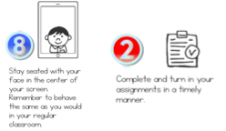
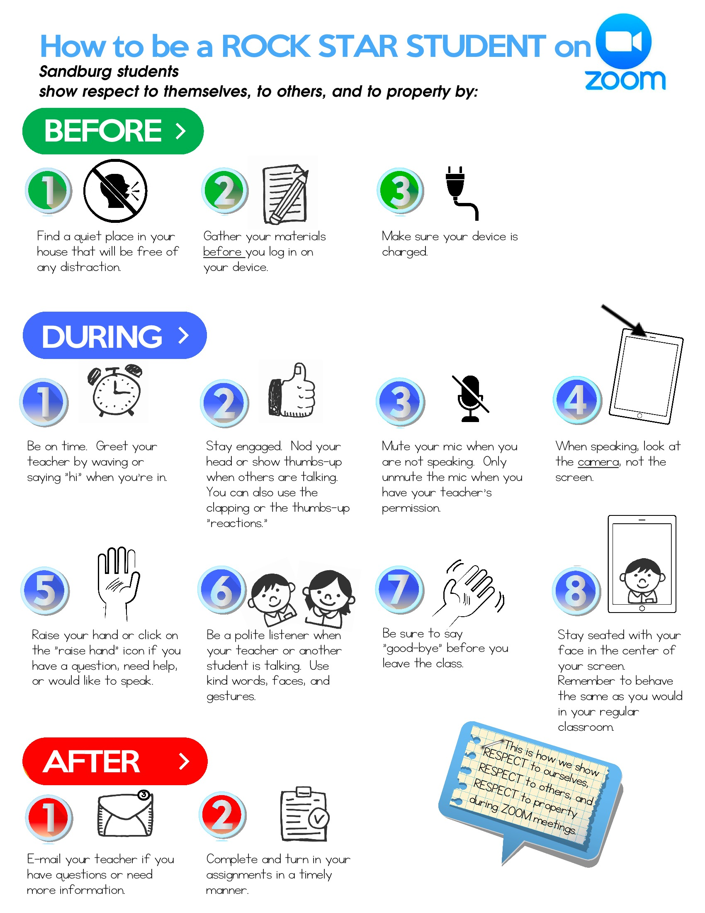
Learning Expectations for Virtual Training
EXPECTATION | BEHAVIOR
Be Responsible
Be Respectful
Be Committed
1
2
3
4
5
6
7
8
9
10
Awesome expectations from the team at Sandburg Elementary, SPS186!
Notes:
2
Use for virtual training

Slide 3
Learning Expectations
EXPECTATION | BEHAVIOR
Be Responsible | Make yourself comfortable Take care of your needs (water, food, restroom, etc.) Action plan to implement what you are learning Follow through on your action items
Be Respectful | Turn cell phones off or to “vibrate” Listen attentively while others are speaking Have only the training materials up on your computer/tablet/phone
Be Engaged | Ask what you need to know to understand and contribute Contribute to the group by sharing relevant information and ideas
Notes:
3
Use for live training

Slide 4
Materials
Get online to find materials: www.pbismn.org
Go to: Statewide >North Region/Metro Region/South Region>Current Training Handouts
TRAINING WORKBOOK
https://bit.ly/TrainingWorkbook2020
IDEA #1: One person on the team can make a copy and then share that with team so you can work together through workbook
IDEA #2: Create a shared folder and add the link to the first page in workbook so it is easy to find.
Notes:
NEEDS TO BE UPDATED
Trainer: Please check to see that this is correct. Presentation created before things were posted online.

Slide 5
Session Goals
Introduce key components of the PBIS Framework
Explore resources for the integration of Culturally Responsive and Trauma Informed Approaches within the PBIS Framework.
Create your vision of PBIS at your school.
Notes:
Review the session goals with teams.

Slide 6
Consistency Matters
Common
Vision/Expectations
Positive School Culture
Common
Language
Common
Practices
(USDOE OSEP PBIS TA Center, 2010)
Notes:
6
When staff, students and families know the the school’s vision and 3-5 school-wide expectations, as well as the practices and common language there is consistency among all stakeholders. Consistency matters in developing a safe and predictable environment.

Slide 7
PBIS - A Framework for All Schools
Notes:
PBIS is a framework, not a packaged program.
Link to video on St. Paul Public Schools webpage https://www.spps.org/PBIS
Link to video on YouTube https://www.youtube.com/watch?v=AD300K3AQt0&t=30s

Slide 8
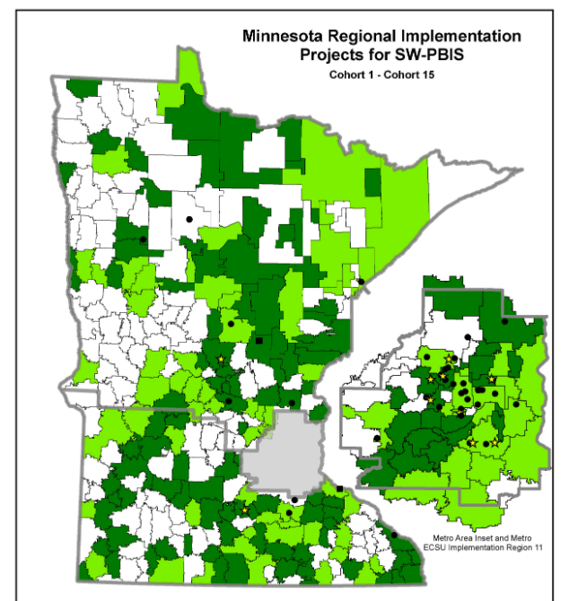
PBIS is…
Used across MN (803 Schools/39%)
Used across the world (29,000+ schools)
Research Based
A building-based team approach
A way to build on existing strengths
A process able to flex to fit a school’s situation
Enduring
(USDOE OSEP PBIS TA Center, 2010)
Notes:
The PBIS Framework is used in schools across the globe for the reasons listed on this slide. In MN 39% or 803 schools are using the PBIS Framework to create a safe, predictable, positive environment for teaching and learning.

Slide 9
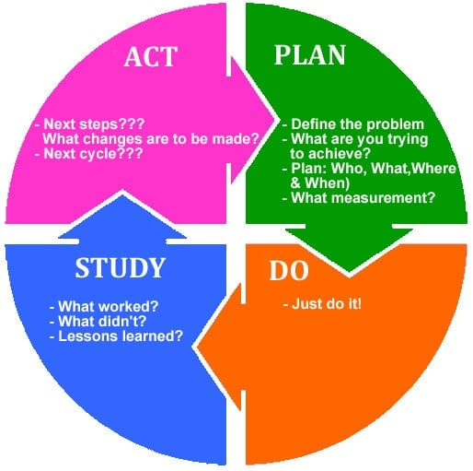
PBIS is a Multi-Tiered FRAMEWORK
Not “another initiative”- it’s a FRAMEWORK for continuous improvement
(USDOE OSEP PBIS TA Center, 2010)
Notes:
You will analyze what needs to be put in place to provide behavioral supports for all your students to create an effective learning environment. This creates effective and efficient practices, remembering that the process is continuously improving. This increases our effectiveness to be preventative and respond early and our efficiency in the ways we use our resources to support the continuum of social and behavioral needs
USDOE, OSEP (2010). Implementation Blueprint and Self-Assessment: Positive Behavioral Interventions and Supports. Retrieved May 1, 2015, from http://www.pbis.org/Common/Cms/files/pbisresources/SWPBS_ImplementationBlueprint_vSep_23_2010.pdf

Slide 10
Three-tiered Continuum of Support
Tier III Prevention:
Specialized, Individualized
Data, Systems, Practices for High-Need and Complex Behaviors
~5%
Students
Staff
Families
Community
~15%
Tier II Prevention:
Group-based Data, Systems, Practices Targeting At-Risk Behaviors
Tier I Prevention:
School/Classroom-wide Data, Systems, Practices
for all Students, Staff, Settings
~80% responding
Midwest PBIS Network 7-25-19
Adapted from: USDOE OSEP PBIS TA Center
Notes:
Primary prevention or universal support focuses on giving students the necessary pro-social skills that prevent the establishment and occurrence of problem behavior. If done systematically and comprehensively with fidelity, we know that will be sufficient for about 80% of our students.
For a small group of students (typically around 10-15%) we will need to add another layer of support. The goal of secondary prevention targeted support is to reduce/prevent the likelihood of problem behavior occurrences, and to enable these students to be supported by the school-wide MTSS effort.
Still, a small number/few students (about 1-5% ) will need yet another layer of very individualized/intensive support. The goal of tertiary intensive individualized support is to reduce the intensity, complexity, and impact of the problem behaviors displayed by these students by providing supports that are (a) function-based, (b) contextually appropriate and person-centered or core tier 1 curriculum and practices.

Slide 11
Levels of Support - Student Profile
Tier 3 Supports
Attend.
English
Distracting others
Tier 2 Supports
Working ind.
Science
Ask assist.
Peer rel.
Anxiety
Math
PE
Problem sol.
Tier 1 Supports
Adult rel.
Band
Anger man.
Notes:
We do not label students. Students are not Tier 1, or Red. Students are not “on” a tier. Avoid language like “that is a Tier 2 kid,” and “He is on Tier 2.”
Rather, Tiers help us structure the many supports that students may need to be successful for aspects of their life. So a better statement example is “this student is receiving Tier 2 support for problem solving,”
Compare this to academics. Students have an academic profile too. They may respond to Tier 1 supports for math, but need individual tutoring (Tier 3?) for reading comprehension.
Tiers are levels of support. Students access levels of support.

Slide 12
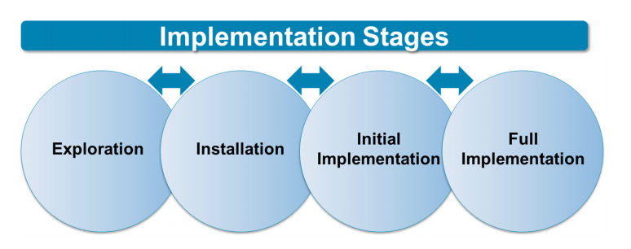
mplementation Stages
Installation – establishing the resources needed to use an innovation and resources required to implement the innovation with fidelity resulting in good outcomes for students
Notes:
Exploration is what has already been done...learning about PBIS, surveying staff, submitting application.
The installation phase is where adults (team) work to get things ready to implement in the settings with staff and students
The 2 year cohort training will help you move from initial implementation to full implementation in Tier 1. To reach full implementation with fidelity can take 2-5 years.

Slide 13
Tier 1 Implementation Process
What Your Team Will Work On Over the Next 2 Years
•Baseline Implementation Data-TFI
•Overview of PBIS
•Team Operations
•Establish SW Expectations & Procedures of Teaching SW Expectations
•Progress Monitor Implementation-TFI
•Establish Procedures for Providing Feedback & Acknowledgement
•Collecting Discipline Data
•Establish Procedures for Providing Corrective Feedback & Crisis Response
•Progress Monitor Implementation-TFI
•Establish Procedures for Implementing the 6 Core PBIS Classroom Practices
Day 1
Day 2
Day 3
Day 4
Day 5
•Progress Monitor Implementation-TFI
•Establish Procedures for Staff PD
•Establish Non-Classroom Active Supervision
•Progress Monitor Implementation-TFI
•Establish Procedures for Student/Family Engagement
•Progress Monitor Implementation-TFI
•Data-based Decision Making Practices
•Managing Escalating Behavior
•Progress Monitor Implementation-TFI
•Establish Procedures for Introducing Tier 2
•Establish Procedures for Sustaining Tier 1
Day 6
Day 7
Day 8
Day 9
Notes:
Trainer Note: Tell teams this is our plan but the day content presented can change based on TFI and other data sources as we progress through training.

Slide 14
Core Components Found in Every Tier of the PBIS Framework
PBIS is organizes your school to achieve its outcomes through understanding its data, providing a continuum of practices, and supported staff through systems.
Supporting culturally equitable Targets including social/emotional competence & academic achievement
OUTCOMES
Supporting culturally knowledgeable
Staff Behavior
Supporting culturally valid Data-based Decision Making
SYSTEMS
DATA
EQUITY
PRACTICES
Midwest PBIS Network 2/7/19. Adapted from:
“What is a systems Approach in school-wide PBIS?” OSEP Technical Assistance on Positive Behavioral Interventions and Supports. https://www.pbis.org/school
McIntosh, K.& Goodman, S. (2016). Integrated Multi-Tiered Systems of Support: Blending RTI and PBIS. New York: Guilford Press.
Supporting Student Behavior
Notes:
14
“This visual is the organizing logic of a Multi-Tiered Behavioral Framework…
Sources:
1. What is a systems Approach in school-wide PBIS? OSEP Technical Assistance on Positive Behavioral Interventions and Supports.
2. McIntosh, K.& Goodman, S. (2016). Integrated Multi-Tiered Systems of Support: Blending RTI and PBIS. New York: Guilford Press.
Outcomes: academic and behavior targets that are endorsed and emphasized by students, families, and educators. (What is important to each particular learning community?)
Practices: interventions and strategies that are evidence based. (How will you reach the goals?)
Data: information that is used to identify status, need for change, and effects of interventions. (What data will you use to support your success or barriers?)
Systems: supports that are needed to enable the accurate and durable implementation of the practices of MTSS. (What durable systems can be implemented that will sustain this over the long haul?)
The framework language is familiar and used often when discussing MTSS. By framework, we mean MTSS is a singular method of organizing the decision making, implementation, and progress monitoring of school operations. The circles represent the key components of that framework, and are used to organize the school’s way of work. Start with identifying outcomes, which for whole school is often Social Competence and Academic achievement…
Then we look to the data to uncover our “current reality” or what is showing up around this outcome-where are we/where do we stand. We would use the data to identify a precision statement that clearly defines the current reality (problem to address). Then we would look to our resources (e.g., resource map) to identify what practices we might have that would support students with the issues showing up in our data (e.g., school-wide expectations defined, taught, and reinforced for respectful behavior). Then we look at what supports would be necessary to support the adults to implement the practices identified to support students. Then we return to data to monitor progress and make decisions as to whether or not what we implemented worked. If not, was it because we lacked fidelity? Or was it because it wasn’t the right match of practices to need? Do we need different systems (supports) for the adults.
Cultural Relevancy:
Culturally relevant behavior support: Teach behaviors that are socially relevant to Culturally and Linguistically Diverse (CLD) students
Culturally validating behavior support: Acknowledge students’ cultural identity as a strength
Establish cultural validity of data: Carefully review operational definitions of behavioral violations
Disaggregate ODR data by student race. For example, ethnicity report of the School Wide Information System (www.swis.org)
Revise measures: Provide schools with tools to assess extent to which culturally responsive systems and practices are in place
Generate school-wide commitment to culturally equitable behavioral outcomes: Define school-wide behavioral goals in collaboration with parents of CLD students
Increase accountability for equitable outcomes. Review extent to which defined goals are met.

Slide 15
Outcomes
Outcomes
Identify measurable targets connected to your organization’s priorities and needs
For example:
Culturally Relevant Systems and Practices
Social and Emotional Competence
Academic Achievement
Relationship Building
Behavior
Mental Wellness
Organizational Climate and Culture
Building protective factors for students who experienced trauma etc.
Student College and Career Readiness
Student Community Readiness
Notes:
While these are typical and expected outcomes for schools using the PBIS Framework, each school will determine outcomes that align with their mission and vision.

Slide 16
Culturally Responsive Field Guide
“The primary goal of cultural responsiveness within a School-Wide Positive Behavioral Interventions and Supports (SWPBIS) framework is to use SWPBIS principles to change school cultures and systems to enhance educational equity. Because contextual fit is a core principle of SWPBIS, SWPBIS is not fully implemented until it is culturally responsive.”
What student and family populations at your school might be underrepresented in decision making, policy setting...?
https://assets-global.website-files.com/5d3725188825e071f1670246/6062383b3f8932b212e9c98b_PBIS%20Cultural%20Responsiveness%20Field%20Guide%20v2.pdf
Notes:
Trainers the question is meant to get teams thinking about groups in their building beyond race and ethnicity such as gender, religion, socio-economic status, special education, LGBTQ.

Slide 17
Cultural Responsiveness and Its Core Components in SWPBIS
Cultural responsiveness includes:
holding high expectations for all students
using students’ cultures and experiences to enhance their learning
providing all students with access to effective instruction and adequate resources for learning
(Klingner et al., 2005)
Notes:
Trainers make sure you have read the PBIS Cultural Responsiveness Field Guide: Resources For Trainers and Coaches prior to training.
https://assets-global.website-files.com/5d3725188825e071f1670246/6062383b3f8932b212e9c98b_PBIS%20Cultural%20Responsiveness%20Field%20Guide%20v2.pdf

Slide 18
Section 1 - Identity Awareness
What is Identity Awareness?
An understanding of:
personal cultures and values AND how those cultures and values impact classrooms and school environment.
Notes:
Allow 10 minutes for this activity. Teams can do this individually for a few minutes and then share at their table.
Questions to ask after activity
Allow time for discussion in small groups and sharing with the whole group. Some guiding questions include:
• What differences are there among staff in values growing up (or now)?
• How universal are these values? What dangers are there in assuming they are?
• How have your values changed over time? Are changes in values good, bad, or neutral?
• How is our “school culture” created, even if we don’t explicitly try to make a school culture?
• What happens when we assume school values are the “right values?”
• How would students experience a school culture that is vastly different from culture at home?
• To what extent can we prevent values conflicts from occurring?

Slide 19
Section 2 - Tiered Fidelity Inventory (TFI) Cultural Responsiveness Companion
The TFI is a fidelity of implementation measure that helps guide teams implement School-Wide PBIS (SWPBIS)
TFI Question #1
1.1 | Tier I team includes a Tier I systems coordinator, a family member and individuals able to provide behvioral expertise, coaching expertise, ...
1.1 CR | School teams include family/student subcommittees or access to grade-level family subcommittees.
1.1 CR | Family/student participation and role is clearly outlined, defined, and understood by the family/ student representatives and the team.
1.1 CR | Families have ownership of system components (e.g., celebrations, acknowledgments).
1.1 CR | Families assist in reporting team meeting discussions and data to stakeholders.
1.1 CR | Family feedback is sought regarding school processes such as hiring and policies
Culturally Relevant Considerations for the TFI question. Helps ensure ALL students will be included in your framework

Slide 20
Staff Elements of Culture Activity p. 52-53
Fill in the empty row based on your own experience
Discuss in your group similarities and difference.
What happens when we assume school values are the “right values?”
Activity Handout
Notes:
Allow 10 minutes for this activity
Potential questions to ask after activity:
Allow time for discussion in small groups and sharing with the whole group. Some guiding questions include:
• What differences are there among staff in values growing up (or now)?
• How universal are these values? What dangers are there in assuming they are?
• How have your values changed over time? Are changes in values good, bad, or neutral?
• How is our “school culture” created, even if we don’t explicitly try to make a school culture?
• What happens when we assume school values are the “right values?”
• How would students experience a school culture that is vastly different from culture at home?
• To what extent can we prevent values conflicts from occurring?

Slide 21
Systems
SYSTEMS
Team-based leadership and coordination (District and School)
District and School Administrator Commitment
Ongoing professional development including coaching and performance feedback
Support for staff in Implementing practices
Communication/input from stakeholders
Documentation and Policies
Items in bold denote core features of MTSS
McIntosh, K.& Goodman, S. (2016). Integrated Multi-Tiered Systems of Support: Blending RTI and PBIS. New York: Guilford Press.
Notes:
Systems are what give staff the support they need to implement PBIS with fidelity. Brief - Installing an Interconnected Systems Framework

Slide 22
A Multi-Tiered Framework for Aligning Your Practices/Initiatives
Check & Connect
Suicide Prevention
Bullying Prevention
Community Involvement in the School
Check-in Check-out
Restorative Practices
Relationship Building
Social and Academic Instructional Groups
Wraparound
Social Emotional Learning
FBA/BIPs
Second Step
Trauma Informed
Academic Curricula
Behavior Lesson Plans
Midwest PBIS Network 1-15-19
Adapted from: USDOE OSEP PBIS TA Center
Notes:
Earlier we talked about levels of support in the PBIS Framework. Let’s review them again and then teams will reflect on their current level of behavior support.
The goal of primary prevention or universal support is to provide all students with the necessary pro-social skills they need to prevents the establishment and occurrence of problem behavior.
The goal of secondary prevention or targeted support is to reduce/prevent the likelihood of problem behavior occurrences, and to enable these students to be supported by the school-wide MTSS effort.
The goal of tertiary or individualized support is to reduce the intensity, complexity, and impact of the problem behaviors displayed by these students by providing supports that are (a) function-based, (b) contextually appropriate and person-centered, or core tier 1 curriculum and practices.

Slide 23
Activity- What Do Your School’s Tiers Look Like?
What are you doing to support students at each tier?
Tier 3
Tier 2
Tier 1
Notes:
Give Teams 10 minutes to reflect on and record what their levels of behavioral support they have in place at their school.

Slide 24
Practices
PRACTICES
Three-tiered continuum of evidence-based practices and lessons to support community members
Interventions to match level of need
Practices implemented with fidelity
Practices result in improved outcomes
Tier 3 Individualized Prevention for high need behaviors
~ 5%
~ 15%
Tier 2 Group-based Prevention for at-risk behaviors
Tier 1 Prevention for all community members in all settings
~ 80% Responding
Items in bold denote core features of MTSS
McIntosh, K.& Goodman, S. (2016). Integrated Multi-Tiered Systems of Support: Blending RTI and PBIS. New York: Guilford Press.
Notes:
PRACTICES are how we interact with and support students. The three-tiered approach to organizing practices is represented by the multi-tiered triangle. Practices are what we do.

Slide 25
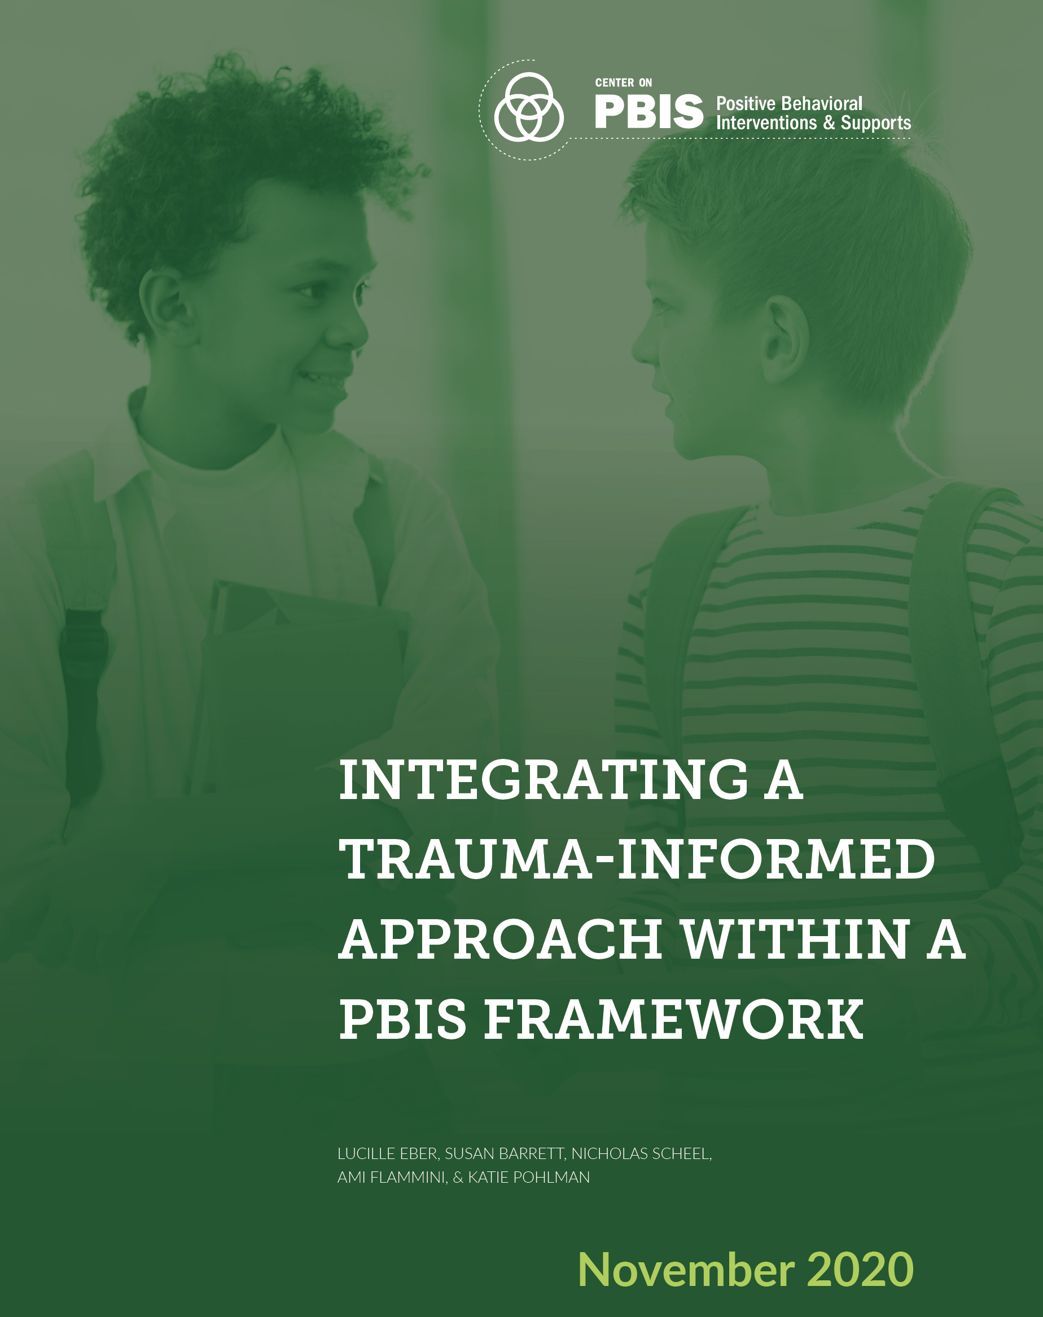
Integrating PBIS and trauma-informed practices
The impact of trauma on our children is so prevalent we must adapt our practices to help them heal.
The purpose of the field guide is to describe how school leaders can incorporate trauma-informed practices within the PBIS framework. We will refer back to this guide as we introduce Tier 1 PBIS Components over our 9 days of PBIS Training.
Link
With your team explore this PBIS Sample Crosswalk from the guide and as a team reflect on your school within the context of these Tier 1 Components & Trauma Features.
10 Minutes
Notes:
We are living in a time period when schools are aware of the impact of trauma on learning and are working hard to make school a place that is inclusive and healing. As you select practices over the next two years to put into your PBIS framework, we want you to be aware of this guide and we will refer back to it as we train on the content of the PBIS Framework. Give teams 10 minutes to get a small introduction by exploring the crosswalk provided.

Slide 26
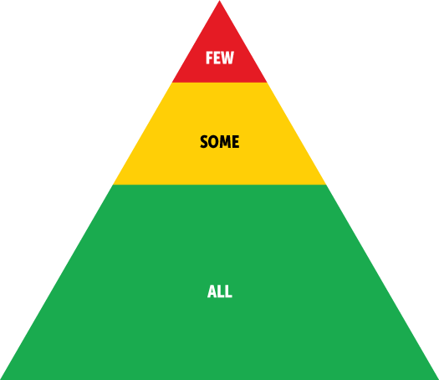
Main Points
A safe and positive environment coupled with positive and dependable relationships promotes resiliency and healthy brain functioning in children who have experienced trauma (Sciaraffa, Zeanah, & Zeanah, 2018).
PBIS establishes a learning environment that is predictable, consistent, positive, safe, and equitable (Horner & Macaya, 2018).
These qualities are important to the healing of students who have experienced trauma.
PBIS and trauma-informed approaches
The goals of PBIS and trauma-informed approaches overlap as they are grounded in similar science. Specifically, PBIS establishes a clear and predictable social environment, reduces problem behaviors linked to increased internalizing distress, diminishes classroom distractions and interruptions, and provides an instructional framework for teaching and practicing adaptive social and emotional skills
(McIntosh, Ty, & Miller, 2014).
Notes:
Review the main points from the guide. Encourage staff to select practices that will help students impacted by trauma heal.

Slide 27
Data
DATA
Establish comprehensive universal screening measures (entry and exit criteria) for internalizing and externalizing needs
Select which evidence-based practices to install
Team data-based problem solving for decision-making
Continuous data-based progress monitoring of organizational and student outcomes (grades, attendance, referrals, perception, equity, etc.)
Process for layering up supports
Evaluation of implementation fidelity
Items in bold denote core features of MTSS
McIntosh, K.& Goodman, S. (2016). Integrated Multi-Tiered Systems of Support: Blending RTI and PBIS. New York: Guilford Press.
Notes:
Data is central to all of the core features of PBIS. Data helps us implement with fidelity, and guide our next steps. Your team will review data at least monthly to celebrate student success, solve problems and determine next steps. DATA IS OUR FRIEND!

Slide 28
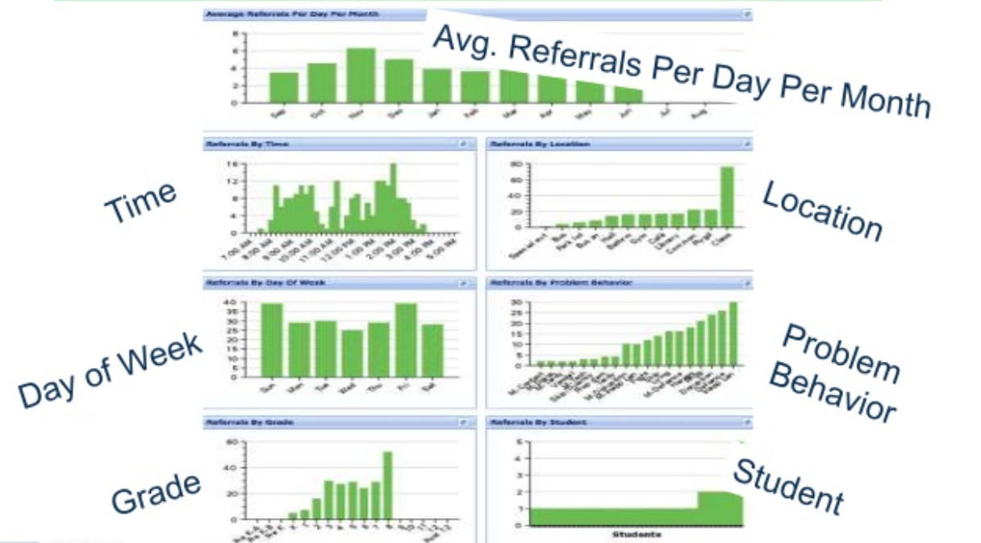
Core Reports
Data System should allow you to drill down to look at specific groups of students to determine supports needed
Notes:
Your data collection system has to enable you to analysis data efficiently by time, location, behavior, students, etc. for your team to make data-based decisions.

Slide 29
5 Point Intervention Approach for Enhancing Equity in School Discipline
Collect, Use and Report Disaggregated Discipline data
Day 3 and beyond
Implement a Behavior Framework that is preventative, Multi-Tiered and Culturally Responsive Days 1-9
Use Engaging Instruction to Reduce the Opportunity (Achievement) Gap Day 4
Develop Policies with Accountability for Disciplinary Equity
Day 3 and Day 4
Teach Strategies for Neutralizing Implicit Bias in Discipline Decisions
https://www.pbis.org/resource/a-5-point-intervention-approach-for-enhancing-equity-in-school-discipline
Notes:
As we work to interrupt inequity in our schools and help all students thrive, the national center has provided us with A 5 Point Intervention approach for enhancing equity in school discipline. This slide shows where our training team will specifically train on content from the 5 point approach. Keep general for this discussion

Slide 30
The PBIS Framework Helps Staff Shift Practice
This work is not about changing kids.
This work is about changing the environment to make it more likely that kids will succeed (both academically and socially/emotionally).
We change STUDENT behavior by changing ADULT behavior
INTERVENTIONS = changes in staff procedures & practices
Notes:
As we have learned PBIS is a framework the adults in the school use to impact the teaching and learning environment. PBIS is used by the adults and impacts both students and staff. Adult behavior will change when your school implements PBIS with fidelity. We change student behavior by changing adult behavior. The interventions will involve changes in our procedures and practices.

Slide 31
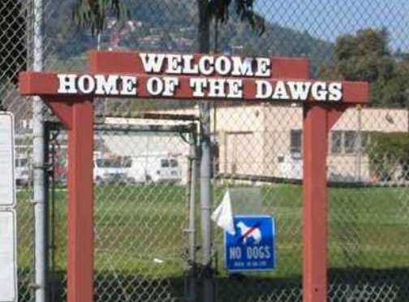
How do we make schools more inviting for ALL students?
Something to think about in preparation for Vision Activity at the end of the presentation
Notes:
SO let’s brainstorm and dream big...

Slide 32
Does your team have a vision that compels new ways of thinking and acting?
Task Assignments:
Identify note-taker, facilitator (coach), and time-keeper for your team. (Add their names to the first page of workbook)
Ensure your team’s Tier 1 Workbook is set up, and shared for editing with all members.
As a team, brainstorm what you would see, hear, and achieve in the school of your dreams (Overview Activity 3).
How does the team’s ideas align with the School Improvement Plan, Mission Statements, and school-wide expectations?
Prepare to Report Out. And also share why you are here today.
If you could create the school of your dreams, what would it look like and sound like with a positive, proactive, and instructional approach to discipline?
Workbook: Overview Activity 3
Notes:
Use this slide for virtual
Direct participants to activity in their workbook and state that this activity will set up the discussion for Mission and Vision statements.

Slide 33
Does your team have a vision that compels new ways of thinking and acting?
Think: Using post-its – write descriptors of what you would see, hear, and achieve in the school of your dreams.
Pair: At your table share your vision creating a team poster through words and/or pictures representing what it will look and sound like.
Share: Hang your poster on the wall and complete a gallery walk of the t-charts.
If you could create the school of your dreams, what would it look like and sound like with a positive, proactive, and instructional approach to discipline? How does this align with your Mission or School Improvement Plan?
Workbook: Overview Activity 3
Notes:
Check workbook page and activity # - this may need to be updated
Use this slide for in-person or virtual if your teams are together in a room
Direct participants to activity in their workbook and state that this activity will set up the discussion for Mission and Vision statements.

Slide 34
Reflecting on the Session Goals
Introduce key components of the PBIS Framework
Explore resources for the integration of Culturally Responsive and Trauma Informed Approaches within the PBIS Framework.
Create your vision of PBIS at your school.
Notes:
Review the session goals again and ask teams to reflect on their own learning briefly.

Slide 35
Tier 1: Professional Learning Roadmap
TFI Sub-Scale: Team
TFI 1.1 | Team Composition
TFI 1.2 | Team Operating Procedures
TFI Sub-Scale: Evaluation
TFI 1.12 | Discipline Data
TFI 1.13 | Data-based Decision Making
TFI 1.14 | Fidelity Data
TFI 1.15 | Annual Evaluation
TFI Sub-Scale: Implementation
TFI 1.3 | Behavioral Expectations
TFI 1.4 | Teaching Expectations
TFI 1.5 | Problem Behavior Definitions
TFI 1.6 | Discipline Policies
TFI 1.7 | Professional Development
TFI 1.8 | Core Classroom Practices
TFI 1.9 | Feedback and Acknowledgement
TFI 1.10 | Faculty Involvement
TFI 1.11 | Student/Family/Community Involvement
Notes:
As we go through training our implementation map and progress monitoring tool will be the School-Wide Tiered Fidelity Inventory. We will focus on Tier 1 over the next two years. We will take the TFI, which is how we will refer to it from here on out at every training session.

Slide 36
References
Algozzine et al., (2014). Tiered Fidelity Inventory.
Kincaid, Childs, & George. (2010). Benchmarks of Quality
Loman, S., Borgmeir, C. & Rodriguez, B.J. Practical Functional Behavioral Assessment & Behavior Support Planning Training Manual for School-Based Personnel. Retrieved May 1, 2015, from http://basicfba.pbworks.com/w/file/fetch/58926672/Basic%20FBAandBSP4.2012.%20RACER.pdf
Missouri PBIS Resources. Retrieved May 1, 2015 from http://pbismissouri.org/
PBISApps.org
United States Department of Education, Office of Special Education Programs (2010). Implementation Blueprint and Self-Assessment: Positive Behavioral Interventions and Supports. Retrieved May 1, 2015, from http://www.pbis.org/Common/Cms/files/pbisresources/SWPBS_ImplementationBlueprint_vSep_23_2010.pdf
Notes:
USDOE, OSEP (2010). Implementation Blueprint and Self-Assessment: Positive Behavioral Interventions and Supports. Retrieved May 1, 2015, from http://www.pbis.org/Common/Cms/files/pbisresources/SWPBS_ImplementationBlueprint_vSep_23_2010.pdf

Slide 37
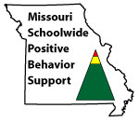
Appreciation is given to the following for their contributions to this Professional Learning:

Slide 38
Slide left blank intentionally
Notes:
Slide left blank intentionally
Any slides after this will be shifted to other presentations

Slide 39
Evidence Base and Outcomes
Notes:
Move to Opening Day 2
PBIS is a framework supported by research spanning decades. Study after study confirms the positive impact these systems and practices have on improving student outcomes. The evaluation brief, "Is School-wide Positive Behavior Support an Evidence-based Practice?" and the article "Examining the Evidence Base for School-wide Positive Behavior Support" each lay out some of the research and provide additional resources to explore the topic further.

Slide 40
Why Prioritize Behavior Support?
Without effective behavior support, research has documented that students and educators experience negative outcomes, including:
Increased exclusionary discipline (e.g., office referrals, suspension, expulsion)
Lost instructional time and decreased achievement for excluded students and their peers
Particularly poor outcomes for students from marginalized groups, especially Black students and students with disabilities, who are at highest risk of experiencing exclusionary discipline
Increased educator burnout, resulting in alarming numbers of educators leaving the field.
Link
Notes:
Move To Opening Day 2

Slide 41
Why Prioritize Behavior Support?
Research has shown implementing PBIS with fidelity is related to the following outcomes:
Improved academic achievement
Improved attendance
Improved mental health, social-emotional competence, and pro-social behavior
Less reported bullying and substance abuse
Reduced exclusionary discipline
Increased racial/ethnic equity in school discipline
Improved outcomes for students with disabilities
Improved perceptions of school climate, organizational health, and safety
Improved outcomes for educators (e.g., greater efficacy, reduced stress and burnout)
Link
Notes:
Move to Opening Day 2

Slide 42
“Shifting” our Thinking
Share in Chat:
Read article “Rethinking Discipline”
Workbook Overview Activity 2 p. 11
https://drive.google.com/file/d/0B4vgYg8K9_ZnMUo1S3F3akhXU2M/view
What is your WHY for pursuing an educational approach to discipline?
Impact of Relationships?
Impact of Trauma?
Growth Mindset?
Approaching Behavior like Academics?
Treat students like adults want to be treated?
Punishment vs Teaching
Impact of shaming and other Response Cost strategies (e.g. clip-charts, demerits, three-minors equals a major, etc.)
Skill deficit/function vs defiance
Restorative Practices?
All humans have performance deficits, and need tiered supports
High expectations, High Patience
Others?
How will we
“Rethink” Discipline?
Notes:
Move to Day 3 or 4 when they do flowcharts...
Circle Approach: Hand out the Rethinking Discipline article. Give participants a few minutes to read over the last page with the charts comparing approaches to discipline and academics. Have the principal and coaches guide the teams in this exercise that was completed the day before. (Have team members stand in 2 lines, inner outer circle or just pair up to discuss what gave them pause to rethink their approach to discipline)

Slide 43
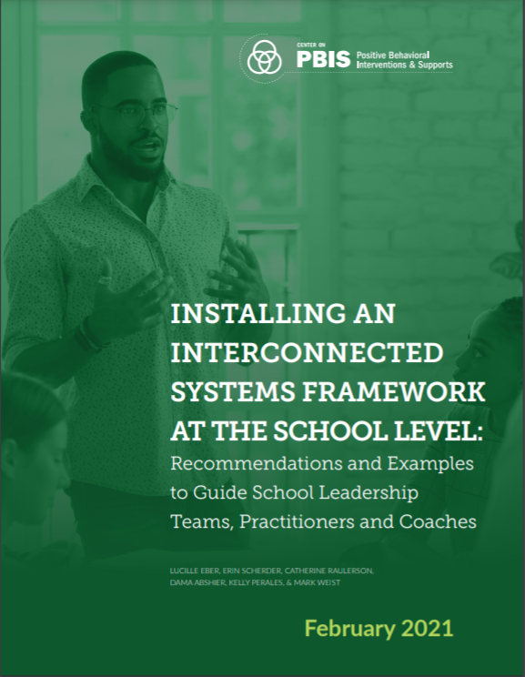
Installing an Interconnected Systems Framework at the School Level
Interconnected Systems Framework (ISF) is an example of integration within a PBIS framework, blending PBIS and School Mental Health strengths into a single system of delivery focused on prevention and intervention (Barrett, Eber, and Weist, 2013).
Link
Notes:
Move to year 2-Day 8

Slide 44
Main Points Related to Implementation
Expand team membership
Include families as active partners (WISE parent)
Data-based process for selecting interventions
Notes:
Year 2 Day 8

Slide 45
Suggested Next Steps
Specific description and discussion of interventions used
School Level Intervention Mapping Tool
Selection process for interventions
Consumer Guide for Selection of Evidence-based Mental Health Services
Progress monitoring of Tier 2/3 supports
Notes:
Year 2 Day 8

