Slide 1
PBIS Team Training 1A Overview Introductions and Getting Started
Notes:
Updated July 2019
Updated 7/2018

Slide 2
Overview of PBIS
Purpose:
Understand the rational and foundational concepts of multi-tiered behavior supports; Prepare for team training
You should be able to:
Understand the format and process of team training modules
Define PBIS
Define Data, Systems, Practices
Define Discipline through an educational frame
Begin Action Planning for Implementation
Notes:
Trainer Notes:
The purpose of this overview is to provide the teams with an understanding of the Tier I Components and begin action planning for implementation at each school.

Slide 3
Learning Expectations
EXPECTATION | BEHAVIOR
Be Responsible | Make yourself comfortable Take care of your needs (water, food, restroom, etc.) Action plan to implement what you are learning Follow through on your action items
Be Respectful | Turn cell phones off or to “vibrate” Listen attentively while others are speaking Have only the training materials up on your computer/tablet/phone
Be Engaged | Ask what you need to know to understand and contribute Contribute to the group by sharing relevant information and ideas
Notes:
3

Slide 4
Materials
Get online to find materials: www.pbismn.org
Go to: Statewide >North Region/Metro Region/South Region>Current Training Handouts
Notes:
Trainer: Please check to see that this is correct. Presentation created before things were posted online.

Slide 5
Materials Walk
For each team member
Access to materials online
For each team
Agenda
Team Workbook
Artifact Template (bit.ly/PBISArtifactsFolders)
Action Plan
Presentations
Title, Number, Letter
Overview (Title, Number (day) Letter (presentation order of the day)

Slide 6
Items to be Submitted
Tiered Fidelity Inventory (TFI)
Training Survey (developed by Wilder Research)
Artifact Template including Action Plan

Slide 7
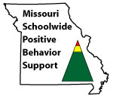
Appreciation is given to the following for their contributions to this Professional Learning:

Slide 8
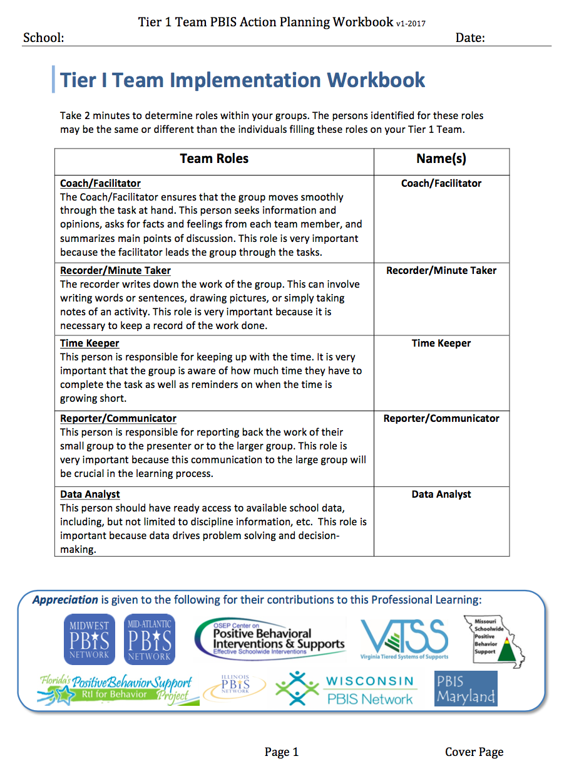
Team Implementation Workbook
Identify group roles for today and tomorrow
Notes:
Explain the purpose of this workbook: contains training activities and the action planner for each section.
At this time determine who will fill each of the roles on the cover of the workbook for today and tomorrow.
Be prepared to share something of interest about your school with the larger group.
?????? Check on this

Slide 9
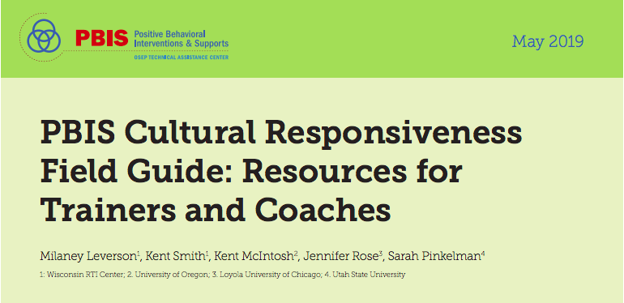
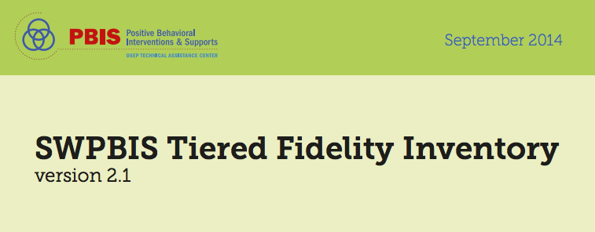
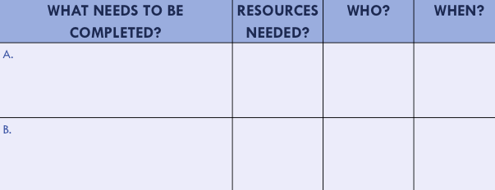
Organization of Modules
Content:
Aligned to TFI Items 1.1 – 1.15
Activities/Team Time: Activities for Fluency
Culturally Responsive:
Aligning culturally responsive practices to the core components of SWPBIS
Self-Assessment:
Tiered Fidelity Inventory
Action Planning: Applying the core content to your school
Notes:
MOVE UP
These are the icons that you will see throughout the training and will serve as a guide and a prompt to the content of each slide.
Change

Slide 10
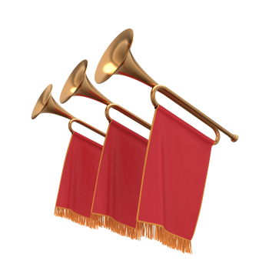
READY? LETS GO!

Slide 11
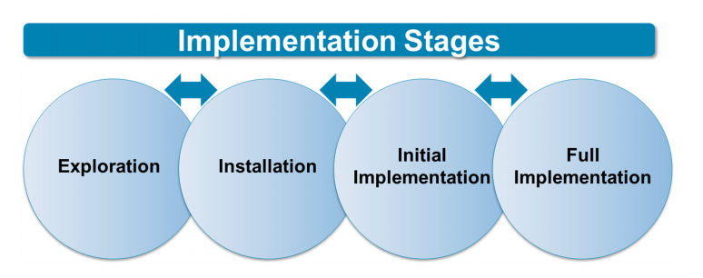
Implementation Stages
Installation – establishing the resources needed to use an innovation and resources required to implement the innovation with fidelity resulting in good outcomes for students
Notes:
Exploration is what has already been done...learning about PBIS, surveying staff, submitting application.
The installation phase is where adults (team) work to get things ready to implement in the settings with staff and students

Slide 12
Implementation Stages
Initial Implementation – the first use of an innovation by educators and others working in a school and district environment that is just learning how to support the new ways of work (sometimes referred to as the “awkward stage”)
Notes:
The 2 year cohort training will help you move from initial implementation to full implementation in Tier 1. To reach full implementation with fidelity can take 2-5 years.

Slide 13
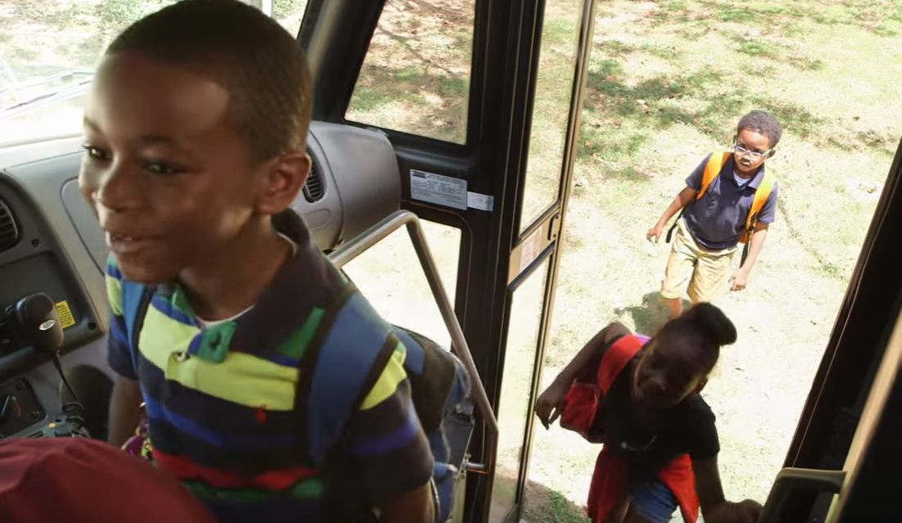
Every Opportunity
https://www.youtube.com/watch?v=VxyxywShewI
Notes:
https://www.youtube.com/watch?v=VxyxywShewI
3 minutes 49 seconds
Sets tone for how PBIS can create a positive culture

Slide 14
PBIS is…
Research Based
Used across MN (# of Schools)
Used across the world (25,911 schools and counting!)
A building-based team approach
A way to build on existing strengths
A process able to flex to fit a school’s situation
Enduring
(USDOE OSEP PBIS TA Center, 2010)
Notes:
This is a framework, not a packaged program. You will look at what you already have in place at your school, what works and uses evidence based practices. You will analyze what needs to be put in place to provide behavioral supports for all your students to create an effective learning environment. This creates effective and efficient practices, remembering that the process is continuously improving.
This increases our effectiveness to be preventative and respond early and our efficiency in the ways we use our resources to support the continuum of social and behavioral needs
USDOE, OSEP (2010). Implementation Blueprint and Self-Assessment: Positive Behavioral Interventions and Supports. Retrieved May 1, 2015, from http://www.pbis.org/Common/Cms/files/pbisresources/SWPBS_ImplementationBlueprint_vSep_23_2010.pdf

Slide 15
PBIS is cont…
a data-driven decision making framework for establishing the social culture and behavioral supports needed for a school to be an effective learning environment for
all students and staff.
Increase Effectiveness and Efficiency
Process for Continuous Improvement
TURN and TALK:
What are your current improvement processes and how does PBIS fit into this?
(USDOE OSEP PBIS TA Center, 2010)
Notes:
This is a framework, not a packaged program. You will look at what you already have in place at your school, what works and uses evidence based practices. You will analyze what needs to be put in place to provide behavioral supports for all your students to create an effective learning environment. This creates effective and efficient practices, remembering that the process is continuously improving.
This increases our effectiveness to be preventative and respond early and our efficiency in the ways we use our resources to support the continuum of social and behavioral needs
USDOE, OSEP (2010). Implementation Blueprint and Self-Assessment: Positive Behavioral Interventions and Supports. Retrieved May 1, 2015, from http://www.pbis.org/Common/Cms/files/pbisresources/SWPBS_ImplementationBlueprint_vSep_23_2010.pdf

Slide 16
PBIS is a FRAMEWORK
Not “another initiative”- it’s a FRAMEWORK
You will look at what you already have in place at your school, what works and uses evidence based practices.
You will analyze what needs to be put in place to provide behavioral supports for all your students to create an effective learning environment.
This creates effective and efficient practices, remembering that the process is continuously improving.
(USDOE OSEP PBIS TA Center, 2010)
Notes:
This is a framework, not a packaged program. You will look at what you already have in place at your school, what works and uses evidence based practices. You will analyze what needs to be put in place to provide behavioral supports for all your students to create an effective learning environment. This creates effective and efficient practices, remembering that the process is continuously improving.
This increases our effectiveness to be preventative and respond early and our efficiency in the ways we use our resources to support the continuum of social and behavioral needs
USDOE, OSEP (2010). Implementation Blueprint and Self-Assessment: Positive Behavioral Interventions and Supports. Retrieved May 1, 2015, from http://www.pbis.org/Common/Cms/files/pbisresources/SWPBS_ImplementationBlueprint_vSep_23_2010.pdf

Slide 17
PBIS Components
Social Competence &
Academic Achievement
OUTCOMES
Supporting
Decision
Making
Supporting
Staff Behavior
SYSTEMS
DATA
PRACTICES
Supporting
Student Behavior
(USDOE OSEP PBIS TA Center, 2010)
Notes:
17
This looks at the integration of these four components that support implementation of PBIS (and other initiatives/practices/programs).We identify the outcomes we are looking to address (social competence, academic achievement). Then we look to the data to uncover our “current reality” or what is showing up around this outcome-where are we/where do we stand. We would use the data to identify a precision statement that clearly defines the current reality (problem to address). Then we would look to our resources (e.g., resource map) to identify what practices we might have that would support students with the issues showing up in our data (e.g., school-wide expectations defined, taught, and reinforced for respectful behavior). Then we look at what supports would be necessary to support the adults to implement the practices identified to support students. Then we return to data to monitor progress and make decisions as to whether or not what we implemented worked. If not, was it because we lacked fidelity? Or was it because it wasn’t the right match of practices to need? Do we need different systems (supports) for the adults.

Slide 18
PBIS Components with cultural considerations
Supporting Social Competence &
Academic Achievement
CULTURAL
EQUITY
Supporting
Staff Behavior
OUTCOMES
SYSTEMS
DATA
CULTURAL
VALIDITY
CULTURAL
KNOWLEDGE
Supporting
Decision
Making
PRACTICES
Supporting
Student Behavior
CULTURAL
RELEVANCE
Vincent, Randall, Cartledge, Tobin, &
Swain-Bradway 2011
Notes:
Culturally relevant behavior support: Teach behaviors that are socially relevant to Culturally and Linguistically Diverse (CLD) students
Culturally validating behavior support: Acknowledge students’ cultural identity as a strength
Establish cultural validity of data: Carefully review operational definitions of behavioral violations
Disaggregate ODR data by student race. For example, ethnicity report of the School Wide Information System (www.swis.org)
Revise measures: Provide schools with tools to assess extent to which culturally responsive systems and practices are in place
Generate school-wide commitment to culturally equitable behavioral outcomes: Define school-wide behavioral goals in collaboration with parents of CLD students
Increase accountability for equitable outcomes. Review extent to which defined goals are met.

Slide 19
Your Turn!
Workbook: Overview Activity 1
Turn to your shoulder partner
1st Person explains “what is PBIS” in their words in 1 minute
2nd Person reflects, and gives feedback and/or additional details
Notes:
Activity purpose: Allows participants to interact with and process the content just presented and begin shaping how they will relay key messages to others.
Having some participants share out will allow a brief assessment to ensure audience was understanding key messages of:
Continuous improvement cycle
Increased efficiency and effectiveness
Data based decision making
Practices that support students
Systems to support staff

Slide 20
Researched Outcomes
Results are experimentally related to:
Reduction in problem behavior
Increased academic performance
Increased attendance
Improved perception of safety
Improved organizational efficiency
Reduction in staff turnover
Increased perception of teacher efficacy
Reduction in teacher reported bullying behavior and peer rejection
Bradshaw, C.P., Koth, C.W., Thornton, L.A., & Leaf, P.J. (2009). Altering school climate through school-wide Positive Behavioral Interventions and Supports: Findings from a group-randomized effectiveness trial. Prevention Science, 10(2), 100-115
Bradshaw, C.P., Koth, C.W., Bevans, K.B., Ialongo, N., & Leaf, P.J. (2008). The impact of school-wide Positive Behavioral Interventions and Supports (PBIS) on the organizational health of elementary schools. School Psychology Quarterly, 23(4), 462-473.
Bradshaw, C. P., Mitchell, M. M., & Leaf, P. J. (2010). Examining the effects of School-Wide Positive Behavioral Interventions and Supports on student outcomes: Results from a randomized controlled effectiveness trial in elementary schools. Journal of Positive Behavior Interventions, 12, 133-148.
Bradshaw, C.P., Reinke, W. M., Brown, L. D., Bevans, K.B., & Leaf, P.J. (2008). Implementation of school-wide Positive Behavioral Interventions and Supports (PBIS) in elementary schools: Observations from a randomized trial. Education & Treatment of Children, 31, 1-26.
Horner, R., Sugai, G., Smolkowski, K., Eber, L., Nakasato, J., Todd, A., & Esperanza, J., (2009). A randomized, wait-list controlled effectiveness trial assessing school-wide positive behavior support in elementary schools. Journal of Positive Behavior Interventions, 11, 133-145.
Horner, R. H., Sugai, G., & Anderson, C. M. (2010). Examining the evidence base for school-wide positive behavior support. Focus on Exceptionality, 42(8), 1-14.
Bradshaw, C., Waasdorp, T., Leaf. P., (in press). Effects of School-wide positive behavioral interventions and supports on child behavior problems and adjustment. Pediatrics.
Waasdorp, T., Bradshaw, C., & Leaf , P., (2012) The Impact of Schoolwide Positive Behavioral
Interventions and Supports on Bullying and Peer Rejection: A Randomized Controlled
Effectiveness Trial. Archive of Pediatric Adolescent Medicine. 2012;166(2):149-156
Notes:
When school communities are unsure of how PBIS will affect their school’s progress, it may be helpful to share these results that many schools have discovered. In fact, there is experimental research that indicates that schools implementing a schoolwide approach to behavior often see reduction in problem behavior, increase academic performance, increased attendance, improved perception of safety, improved organizational efficiency, reduction in staff turnover, increased perception of teacher efficacy and reduction in teacher reported bullying behavior and peer rejection.

Slide 21
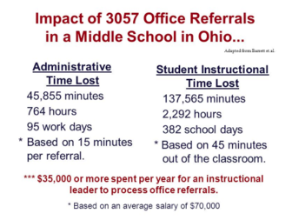
Cost-benefit Analysis
http://www.pbismaryland.org/

Slide 22
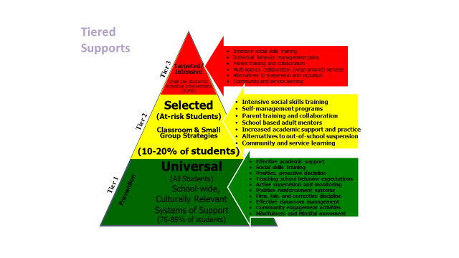
Multi-Tiered Framework
~80% of Students
Notes:
Primary prevention is provided to all students and focuses on giving students the necessary pro-social skills that prevents the establishment and occurrence of problem behavior. If done systemically and comprehensively with fidelity, we now that will be sufficient for about 80% of our students.
For a small group of students (typically around 10-15%) we will need to add another layer of support- secondary/tier 2/targeted supports. The goal of secondary prevention is to reduce/prevent the likelihood of problem behavior occurrences, and to enable these students to be supported by the school-wide PBIS effort.
Still, a small number/few students (about 1-5% )will need yet another layer of very individualized/intensive support. The goal of tertiary/tier 3 supports is to reduce the intensity, complexity, and impact of the problem behaviors displayed by these students by providing supports that are (a) function-based, (b) contextually appropriate and person-centered, (or core tier 1 curriculum and practices.

Slide 23
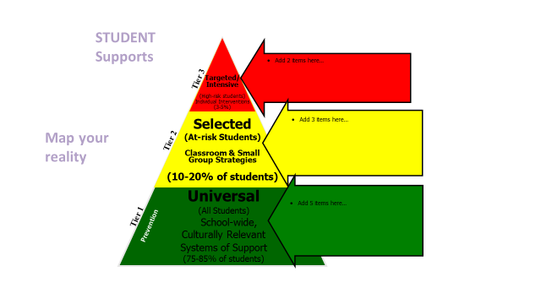
Student Supports
23
Notes:
23
Our language and the ways we communicate with our colleagues, families, and other school community members is important. Sometimes we hear folks referencing T II students or T III students. It's important to communicate that the tiers refer to the layer of support and we use person first language. So, it might be a student needing T II support with math computation or a student needing TIII support with comprehension or a student needing TI support with making friends.
Support is always “layered” onto the previous supports. When a small group of students require a little more support, they continue to receive universal/tier 1 core or instruction. Students receiving secondary supports have increased opportunities for more frequent contingent feedback, additional structure, re-teaching of expectations, etc.
Students in need of intensive, individualized support, continue to receive universal supports. Tier III often builds upon the supports that the student receives with Tier II interventions.
All that we do is anchored to tier 1 and this is true for social and academic (e.g., literacy, math) instruction.
23

Slide 24
Staff Supports
Notes:
Discuss this whole group

Slide 25
Related Initiatives
Social-Emotional Learning | Mental Health |  | Positive Behavioral Interventions & Supports | Restorative Practices
Individual social skills instruction | Crisis counseling Individual support teams/plans Psychiatric care | Tier 3 Intensive | Wraparound Complex FBA/BIP Individual planning | Family group conferencing Community conferencing
Targeted social skills instruction | Group counseling & support groups Staff & family Coordinated referral process/progress monitoring | Tier 2 Targeted | Brief FBA/BIP Check-in/out Check/Connect Social academic instructional groups | Peer Jury Conferencing Problem-solving circles
SEL curriculum School climate assessment | Mental Health screening Prevention/Wellness promotion | Tier 1 Universal | Culturally Responsive School-wide behavior expectations Acknowledge positive behaviors Data-based planning | Circles Restorative chats Data-based planning

Slide 26
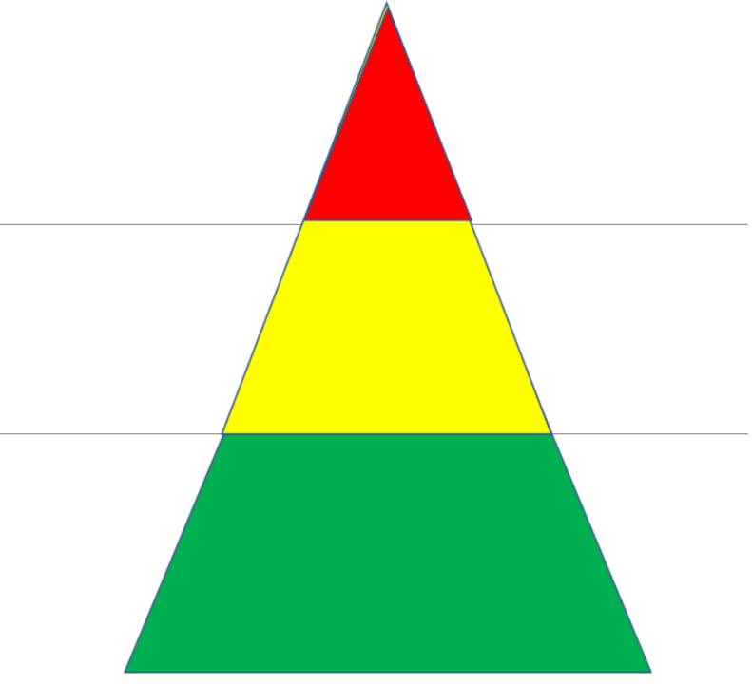
Tiered Restorative Practices
Tiered Restorative Practices
Restorative dialogue between several students
Community conferences/ circle with students, parents and teachers
Classroom Circle with a whole class
Conference/circle with a smaller group
Restorative & Chats
Affective Statements
Flash Mob Circles
Community Building Circles
Notes:
Resource for team to use at site if needed

Slide 27
PBIS & Responsive Classroom
Notes:
Teams can use this at sites if needed

Slide 28
PBIS & ENVoY
Notes:
Teams can use at site if needed

Slide 29
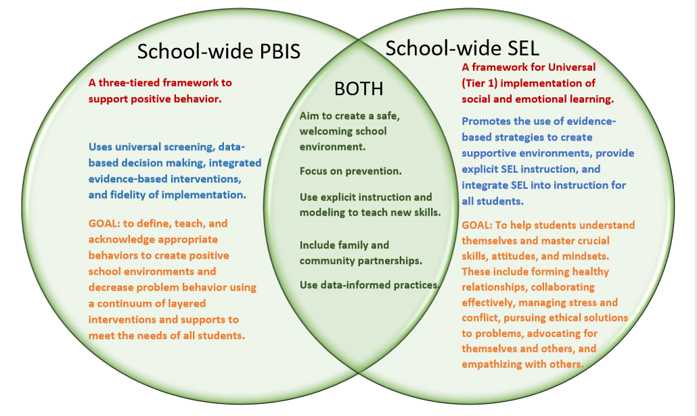
School-Wide PBIS & SEL
Notes:
Teams can use this at site if needed

Slide 30
Initiatives & YOU!
Take a moment to think about the initiatives at your site.
How can using the PBIS Framework help you work smarter versus harder?
Notes:
Don’t skip this activity!

Slide 31
Rethinking Discipline Behavior Change…
as an instructional process
We change STUDENT behavior by
changing ADULT behavior
INVERVENTIONS = changes in staff procedures & practices
Notes:
Would you agree that behavioral change is an instructional process? We change student behavior by changing adult behavior. The interventions will involve changes in our procedures and practices.

Slide 32
ABCs of Behavior
Traditional Approach
Instructional Approach
2
Antecedent/
Trigger:
When _____ happens….
1
Behavior:
the student does (what)__
3
Consequence/
Outcome
..because (why) ______
(Loman, Borgmeier, Rodriguez)
Notes:
The traditional approach to discipline has been reactionary. With PBIS, we are shifting from a traditional, reactive response to student behavior to a preventative response.

Slide 33
A “Shift” in our Thinking Your Turn!!
Read article “Rethinking Discipline”
Workbook Overview Activity 2
Positive Mindset change from punitive mindset
How will we
“Rethink” Discipline?
Notes:
Give out the Rethinking Discipline article – each participant should have their own article.
Give participants a few minutes to read over the last page with the charts comparing approaches to discipline and academics

Slide 34
Traditional View of Discipline - Punishment
Modified from Colvin, G. & Sugai, G. (1988). Proactive strategies for managing social behavior problems: An instructional approach. Intervention In Schools, 28, 143-150
Punishment focuses on what not to do, does not teach desired behaviors, can damage relationships, impede learning, and lead to students dropping out of school. Some educators feel that these punitive and exclusionary policies are fine and served them well to eliminate the irritating and unnecessary intrusions into their teaching agendas. Many believe that students know the right way to behave, that their behavior is a performance deficit and that they have the skills but are merely choosing defiance or subordination. They therefore assume that punishment will bring a halt to the problem behavior and the student will behave appropriately. Use is further supported because of the relief from the immediate effects offered by the short-term solution of removing the problem.
Unfortunately, such a punitive view of discipline results in approaches that have questionable, if not harmful effects (Skiba & Peterson, 1999).
In reality, punishments satisfy the punisher, but have little lasting effect on the punished (Losen, 2011). Most sadly, these exclusionary approaches are in direct conflict with school missions to help all students achieve their fullest potential. Our punitive policies fail the very students they target. Is it reasonable to exclude students with social, emotional, and behavioral needs from the one environment that may allow them to learn the value of an education and the vital skills, behaviors, and attitudes necessary to function successfully, not only in school, but in the community and later on the job?
Notes:
Ask participants to take a moment to read through and note any statements/ideas that give them pause.

Slide 35
Discipline is Teaching
As we seek to ensure inclusive learning environments, our attitudes regarding discipline must change, Is discipline concerned with punishing misconduct or with preventing it?
Discipline is the slow, ongoing, sometimes time-consuming task of helping students see the sense of acting in certain ways. This thinking is in line with the high probability explanation for many discipline problems today – skill deficit. This understands that many students come from environments that have not taught or expected pro-social behavior for school success and they have a limited repertoire of behaviors and do not know how to behave responsibly in the school setting. Blaming the child and responding by “getting tough” will not alter this skill deficit; teaching will.
According to the dictionary, discipline refers to prevention and remediation, “training to act in accordance with rules;” and “instruction and exercise designed to train proper conduct or action;” “training that is expected to produce a specified character pattern of behavior;” and “controlled behavior resulting from such training.”
Notes:
Ask participants to take a moment to read through and note any statements/ideas that give them pause.

Slide 36
Academic & Social Problems: A Comparison of Approaches
Notes:
Exercise to explore the ways we approach academic errors in learning and the ways we approach social behavior.
Ask for examples from the audience of infrequent academic errors?
Ask for examples from the audience of frequent academic errors?
Ask for examples from the audience of infrequent social problems?
Ask for examples from the audience of frequent social problems?

Slide 37
Academic & Social Problems: A Comparison of Approaches
Notes:
Explain the table and ask participants to take a moment to read through and note any statements/ideas that give them pause.
Engage in sharing activity by sharing and discussing their ideas with a colleague. What gave them pause to rethink their approach to discipline.

Slide 38
Does your team have a vision that compels new ways of thinking and acting?
If you could create the school of your dreams, what would it look like and sound like with a positive, proactive, and instructional approach to discipline?
Notes:
Direct participants to activity in their workbook and state that this activity will set up the discussion for Mission and Vision statements.

Slide 39
Create your vision
Workbook: Overview Activity 3
Think: Using post-its – write descriptors of what you would see, hear, and achieve in the school of your dreams.
Pair: At your table share your vision creating a team poster through words and/or pictures representing what it will look and sound like.
Share: Hang your poster on the wall and complete a gallery walk of the t-charts.
Looks like… What will we see? | Sounds like… What will we hear? | Achieve these outcomes…
Notes:
Activity Purpose: We want all voices on the team to be heard and this step allows each person to share their ideas.
How: Give participants 2-3 minutes to individually think. Have them write individual ideas of what their dream school would look like and sound like. One idea per post-it.

Slide 40
Align your vision
How will this vision of your school align with your School Improvement Plan and your Mission Statements?
Notes:
Workbook p.
Activity: Use the workbook or a large sheet of chart paper. Draw a T-chart for what you would like to see and hear in your school. Discuss how this will align with your School Improvement Plan, your Mission and Vision statements. Hang on the walls for reference during the rest of training.

Slide 41
Cultural Responsiveness and Its Core Components in SWPBIS
Cultural responsiveness includes:
holding high expectations for all students
using students’ cultures and experiences to enhance their learning
providing all students with access to effective instruction and adequate resources for learning
(Klingner et al., 2005)
Notes:
PBIS Cultural Responsiveness Field Guide: Resources For Trainers and Coaches
https://www.pbis.org/Common/Cms/files/pbisresources/PBIS%20Cultural%20Responsiveness%20Field%20Guide.pdf

Slide 42
Core Components of Cultural Responsiveness within SWPBIS
1. Identity
2. Voice
3. Supportive Environment
4. Situational Appropriateness
5. Data for Equity

Slide 43
Tier 1: Professional Learning Roadmap
TFI Sub-Scale: Team
TFI 1.1 | Team Composition
TFI 1.2 | Team Operating Procedures
TFI Sub-Scale: Evaluation
TFI 1.12 | Discipline Data
TFI 1.13 | Data-based Decision Making
TFI 1.14 | Fidelity Data
TFI 1.15 | Annual Evaluation
TFI Sub-Scale: Implementation
TFI 1.3 | Behavioral Expectations
TFI 1.4 | Teaching Expectations
TFI 1.5 | Problem Behavior Definitions
TFI 1.6 | Discipline Policies
TFI 1.7 | Professional Development
TFI 1.8 | Classroom Procedures
TFI 1.9 | Feedback and Acknowledgement
TFI 1.10 | Faculty Involvement
TFI 1.11 | Student/Family/Community Involvement
Notes:
Fix the Classroom management practices

Slide 44
References
Algozzine et al., (2014). Tiered Fidelity Inventory.
Kincaid, Childs, & George. (2010). Benchmarks of Quality
Loman, S., Borgemeier, C. & Rodriguez, B.J. Practical Functional Behavioral Assessment & Behavior Support Planning Training Manual for School-Based Personnel. Retrieved May 1, 2015, from http://basicfba.pbworks.com/w/file/fetch/58926672/Basic%20FBAandBSP4.2012.%20RACER.pdf
Missouri PBIS Resources. Retrieved May 1, 2015 from http://pbismissouri.org/
PBISApps.org
United States Department of Education, Office of Special Education Programs (2010). Implementation Blueprint and Self-Assessment: Positive Behavioral Interventions and Supports. Retrieved May 1, 2015, from http://www.pbis.org/Common/Cms/files/pbisresources/SWPBS_ImplementationBlueprint_vSep_23_2010.pdf
Notes:
USDOE, OSEP (2010). Implementation Blueprint and Self-Assessment: Positive Behavioral Interventions and Supports. Retrieved May 1, 2015, from http://www.pbis.org/Common/Cms/files/pbisresources/SWPBS_ImplementationBlueprint_vSep_23_2010.pdf

