Slide 1
PBIS Team
Tier 1
Virtual Training Day 1
Fidelity Data (TFI 1.14)
Annual Evaluation (TFI 1.15 )
Notes:
Updated June 2020
Updated 7/2018

Slide 2
Learning Expectations for Virtual Training
EXPECTATION | BEHAVIOR
Be Responsible
Be Respectful
Be Committed
1
2
3
4
5
6
7
8
9
10
Awesome expectations from the team at Sandburg Elementary, SPS186!
Notes:
2

Slide 3
Tier 1: Professional Learning Roadmap
TFI Sub-Scale: Team
TFI 1.1 | Team Composition
TFI 1.2 | Team Operating Procedures
TFI Sub-Scale: Evaluation
TFI 1.12 | Discipline Data
TFI 1.13 | Data-based Decision Making
TFI 1.14 | Fidelity Data
TFI 1.15 | Annual Evaluation
TFI Sub-Scale: Implementation
TFI 1.3 | Behavioral Expectations
TFI 1.4 | Teaching Expectations
TFI 1.5 | Problem Behavior Definitions
TFI 1.6 | Discipline Policies
TFI 1.7 | Professional Development
TFI 1.8 | Classroom Procedures
TFI 1.9 | Feedback and Acknowledgement
TFI 1.10 | Faculty Involvement
TFI 1.11 | Student/Family/Community Involvement

Slide 4
Fidelity Data and Evaluation Purpose & Outcomes
Purpose: Prepare to measure fidelity and outcomes of all Tier 1 efforts using multiple forms of data
Outcomes:
Tier I team reviews and uses SWPBIS fidelity e.g., Tiered Fidelity Inventory (TFI), SAS, data at least annually. (TFI 1.14)
Tier I team documents fidelity and effectiveness (including on academic outcomes) of Tier I practices at least annually (including yearly- year comparisons) that are shared with stakeholders (staff, families, community, district) in a usable format. (TFI 1.15)

Slide 5
Rationale
Evaluation systems are a way to hold ourselves accountable, celebrate our successes, and change our PBIS implementation based on data.
Evaluation helps us see the big picture and fit in all the small details.

Slide 6
How Will You Get Feedback?
Self-Assessment Survey (SAS)
Tiered Fidelity Inventory
(TFI)
Staff
Team
Notes:
In addition to assessing how effective professional development / trainings are, soliciting ongoing, routine feedback is important to maintain buy-in and support from the staff.
For this project, we will be using two main surveys: SAS and TFI

Slide 7
Day to Day…
The SAS and TFI provide perception data
Teachers
Team and coach
There are other “quick” ways to evaluate teachers use of PBIS Tier 1 practices

Slide 8
Tiered Fidelity Inventory (TFI)
Assists teams in finding areas of implementation strength and needs
Completed by PBIS team members and coach at the same time.
Goal: 70% or more of total points for implementation
Notes:
The TFI is the implementation measure for fidelity, The SAS is the perception and knowledge measure.

Slide 9
Taking The TFI
To identify our perception of our current implementation status
To celebrate our success and plan for sustaining those efforts
To determine next steps of implementation
To communicate with staff
Purpose

Slide 10
External Facilitators will guide your team

Slide 11
Opening TFI Window
Notes:
Should we do this for them to make our lives easier this time around???

Slide 12
Enter TFI Scores
www.pbisapps.org
Notes:
Teams should have already designated a person that will enter scores- see Regional Coordinator for help logging in
Username-email
Password- should have been emailed to them, but they can always click “Forgot Password”

Slide 13
Enter TFI from Team Training
Notes:
ACTIVITY: Pull up a SAS report (item analysis)
1. Fidelity (TFI or BoQ)
Perception (SAS)
Outcome (ODR, Attendance)
2. Precision statement, What, where, when, why, who

Slide 14
Enter TFI from Team Training
Notes:
ACTIVITY: Pull up a SAS report (item analysis)
1. Fidelity (TFI or BoQ)
Perception (SAS)
Outcome (ODR, Attendance)
2. Precision statement, What, where, when, why, who

Slide 15
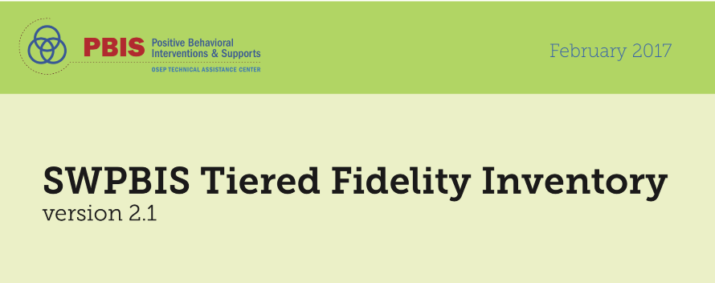
What is the Walk Through Tool?
An individual interviews a random selection of staff (at least 10% of staff or at least 5 for smaller schools) and students (minimum of 10).
Your team will collect walk through data prior to November training to use when you take the TFI on Day 3.
p. 27-28

Slide 16
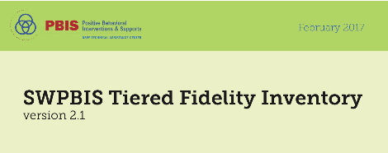
Staff Questions in Walk Through Tool
Staff Interview Questions
Interview at least 10% of staff or at least 5 for smaller schools
What are the __________________ (school rules, high 5's, 3 bee’s)?
(Define what the acronym means)
Have you taught the school rules/behavioral expectations this year?
Have you given out any _______________________ since _______________?
(recognition for appropriate behavior) (1 months ago)
Remember:
In the SPRING one person from each team will go to another school to do
a TFI WalkThrough AND facilitate the TFI.
p. 27-28

Slide 17
Student Questions in Walk Through Tool
Student interview Questions
Interview a minimum of 10 students
What are the _________________ (school rules, high 5's, 3 bee’s)?
(Ask for the name of the school rules, and what they look like in that setting)
Have you received a _______________________ since ________________?
Remember:
In the SPRING one person from each team will go to another school to do
a TFI WalkThrough AND facilitate the TFI.
p. 27-28

Slide 18
Coach will Enter Your Team’s Score – keep paper copy too!
Notes:
Slides 27-31 are about entering TFI scores. These are included so the whole group can see how easy it is and because typically it is not the same person entering it from training to training.

Slide 19
Process for taking the TFI
The coach will have the survey open on pbisapps and record the vote of the team
A facilitator will have the survey open and read and show the questions and criteria for voting to the team
The team will briefly assess current status and vote using a visual signal response to as indicated by the scoring criteria
0=not implemented
1=partially implemented
2=fully implemented

Slide 20
Coach will Submit Your TFI
You are only required to
Tier 1 of the TFI
After Tier I is done…..scroll down to the bottom of the page CLICK NEXT
Scroll down to the bottom of the page and CLICK SUBMIT

Slide 21
Plan for Taking TFI
Notes:
Each region will need to update this slide to show how they will be taking TFI
one big group
half and half
breakout rooms...

Slide 22
After TFI

Slide 23
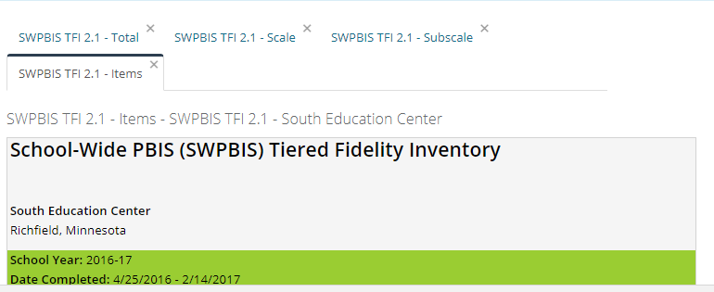
Pull All Reports and Review As a Team
Total
Scale
Subscale
Items
Notes:
Show to whole group after TFI completion
Can also show at indivudal tables

Slide 24
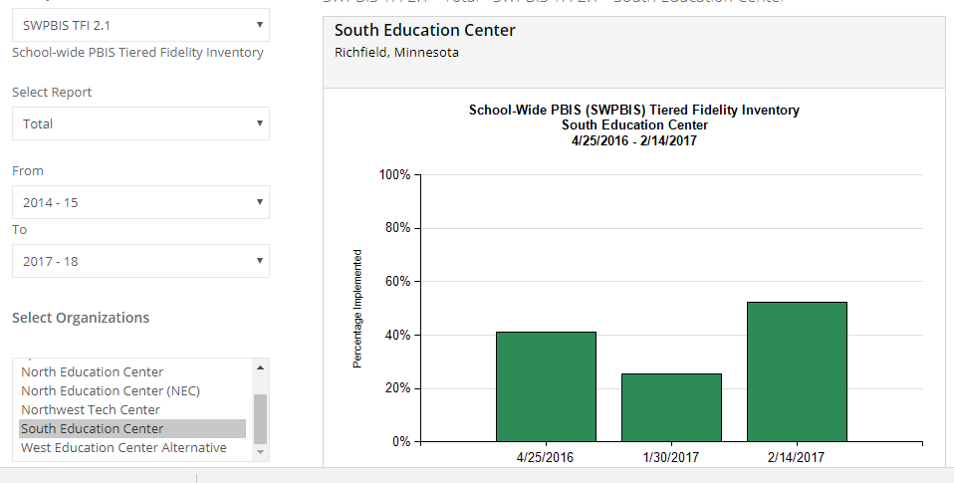
Total Report
Notes:
This report assumes you have taken all three tiers- it does not give an accurate picture of just Tier I!!

Slide 25
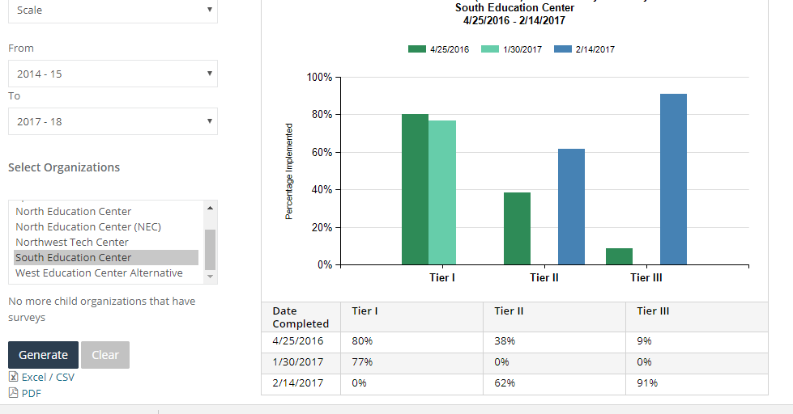
Scale Report
Notes:
Use this report to see your Tier I score

Slide 26
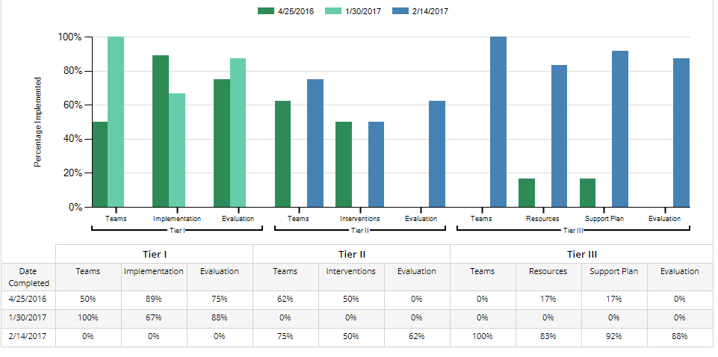
Subscale Report

Slide 27
Prioritize Action Plan

Slide 28
Prioritize Your Action Plan
One Method: A, B, C Priority for all items
Put an A, B, or C next to each line on your action plan.
Use A for items of highest priority
Use B for items of moderate priority
Use C for items of lower priority
Review the A’s, and sub prioritize those into A1, A2, A3. Repeat for the B’s and C’s.
Assign roles and timelines for the work.
Notes:
Action plan templates are in handbook and online

