Slide 1
Tier 1
Training Day 2
Behavioral Expectations (TFI 1.3)
Updated April 2022
Notes:
This presentation will prepare teams for teaming success.
Updated 7/2018

Slide 2
Learning Expectations
EXPECTATION | BEHAVIOR
Be Responsible | Make yourself comfortable Take care of your needs (water, food, restroom, etc.) Action plan to implement what you are learning Follow through on your action items
Be Respectful | Turn cell phones off or to “vibrate” Listen attentively while others are speaking Have only the training materials up on your computer/tablet/phone
Be Engaged | Ask what you need to know to understand and contribute Contribute to the group by sharing relevant information and ideas
Notes:
2
Have teams review behavioral expectations

Slide 3
Tier 1: Implementation Fidelity
TFI Sub-Scale: Team
TFI 1.1 | Team Composition
TFI 1.2 | Team Operating Procedures
TFI Sub-Scale: Evaluation
TFI 1.12 | Discipline Data
TFI 1.13 | Data-based Decision Making
TFI 1.14 | Fidelity Data
TFI 1.15 | Annual Evaluation
TFI Sub-Scale: Implementation
TFI 1.3 | Behavioral Expectations
TFI 1.4 | Teaching Expectations
TFI 1.5 | Problem Behavior Definitions
TFI 1.6 | Discipline Policies
TFI 1.7 | Professional Development
TFI 1.8 | Classroom Procedures
TFI 1.9 | Feedback and Acknowledgement
TFI 1.10 | Faculty Involvement
TFI 1.11 | Student/Family/Community Involvement
Notes:
3

Slide 4
TFI 1.3 Purpose & Outcome
Purpose:
Teams will identify 5 or fewer positively stated behavioral expectations and define by setting/location for students and staff behaviors.
Outcome:
Five or fewer behavioral expectations exist that are positively stated, identified and posted for specific locations across the school campus.
Notes:
Read through the purpose and outcome emphasizing that teams will develop 3-5 school wide expectations defined by setting/location across the school campus.

Slide 5
A Reminder…
PBIS is all about Adult Actions
This work is not about changing kids.
This work is about changing the environment to make it more likely that kids will succeed (both academically and socially/emotionally).
We change STUDENT behavior by changing ADULT behavior
INTERVENTIONS = changes in staff procedures & practices
Notes:
5
We change student behavior by changing adult behavior. The interventions will involve changes in our procedures and practices. PBIS is all about getting the adults on the same page. Consistent proactive adult action will benefit everyone in the school.

Slide 6
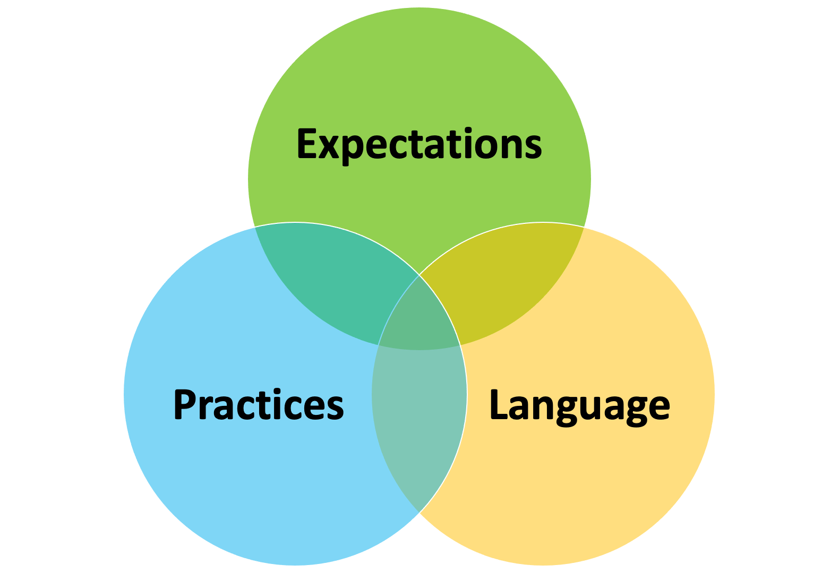
Creating Consistent Adult Actions
Notes:
6
When staff, students and families know the the school’s vision and 3-5 school wide expectation, as well as the practices and common language there is consistency among all stakeholders. Consistency matters in developing a safe and predictable environment.

Slide 7
Cultural Responsive Elaboration
SWPBIS Big Idea
School-wide expectations are a brief, memorable set of positively stated expectations that create a school culture that is clear, positive, consistent, and focused on teaching social and emotional competencies.
Establishing Behavioral Expectations Focuses On…
Teams adopt or revise expectations that are reflective of the cultural values of students, families, and their communities.
Expectations and specific rules are identified based on a legitimate purpose within the setting, as opposed to simply school tradition or maintaining the status quo.
Within a culturally responsive framework, behavior expectations should focus on high standards for all students, be able to be taught and learned, and be respectful of the students’ cultures.
Notes:
7
Provide teams with the overall goal of Tier 1 Behavioral Expectations

Slide 8
How can we make our SW Expectations more culturally responsive?
Teams provide staff and community with periodic orientation and opportunities to examine and give input regarding school-wide expectations and rules to ensure that they reflect the values and norms of the community.
Teams examine expectations and rules for implicit bias to ensure that expectations are truly universal.
Families and students are given opportunities to examine and give feedback on the school-wide expectations and rules before implementing and at least annually after implementation.
Expectations and rules are included in family and student orientation materials, including explicit statements on possible differences between school and home.
School staff model expectations and refer to them regularly in daily interactions.
page 15
Notes:
8
The main idea of this slide is to get teams thinking about how to make their SW behavioral expectations more equitable for all stakeholders.

Slide 9
Behavioral Expectations Tasks
Select 3-5 broad SW Expectations
Develop SW Teaching Matrix
Communicate plan with staff to gain feedback
Notes:
This slide let’s teams know the implementation actions they will take to develop behavioral expectations with fidelity so they can achieve the outcomes just outlined.

Slide 10
Moving Away from the Do Nots
T H E DO NOTs
(A Non-Example)
Notes:
10
What is wrong with Ms. Mutner’s list? It’s a list of arbitrary rules; it doesn’t say what students should do instead. If you’re in Ms. Mutner’s class, what should you be doing? How do these rules make students more successful; they are more arbitrary than instructional. You can never teach everything a student should do by teaching the negatives. We could be telling them what we want instead. Would we teach academics like this? 2+2 is not 5; 2+2 is not 20, etc.

Slide 11
Guideline for Expectations
Common Language: Expectations
Broadly stated and easy to remember
3-5 positively stated behaviors
Consistent with school’s mission statement
Expected of all staff/students
Notes:
11
These are a few really broad guidelines for developing SW Expectations. Stating what you want them to do, rather than what you don’t want them to do is more effective.

Slide 12
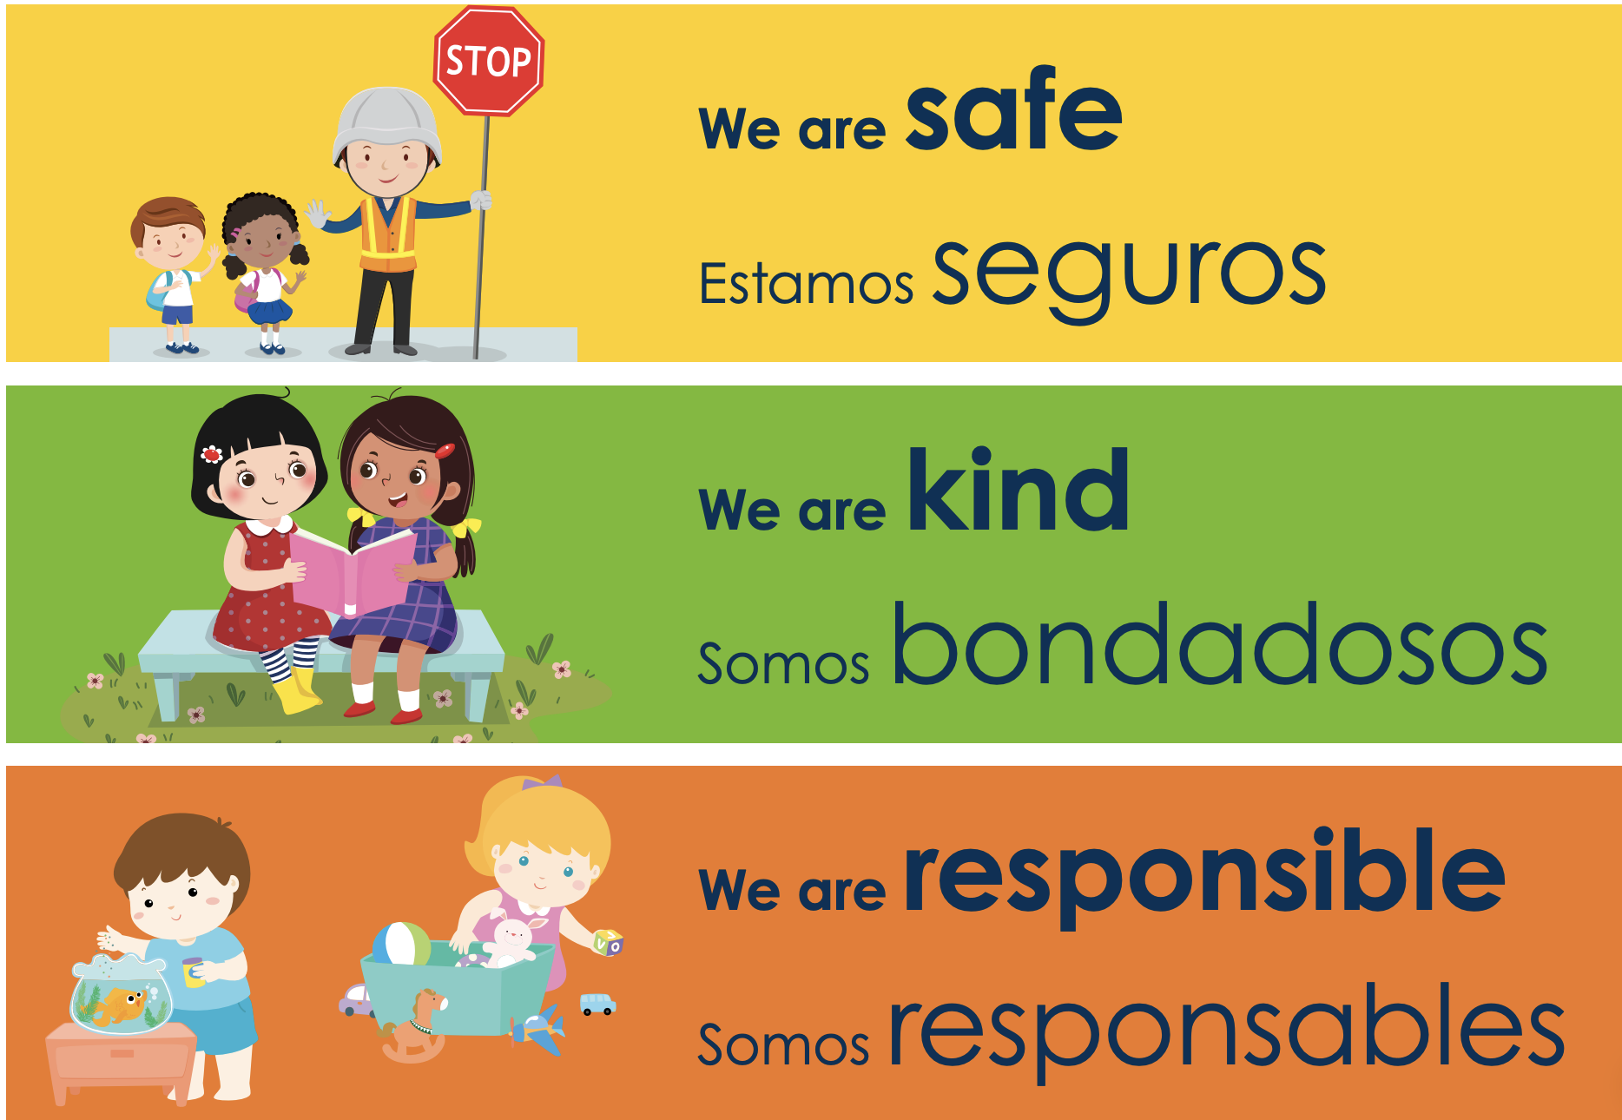
Example-Early Education
Notes:
12
Early Childhood Example

Slide 13
Examples-Elementary
Notes:
13
Elementary example

Slide 14
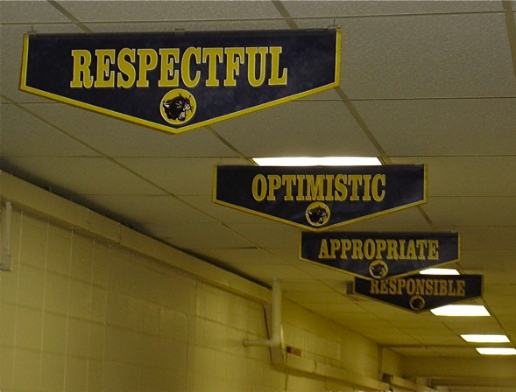
Example-MS/HS
Notes:
14
Middle and High School Examples

Slide 15
Example-Specialized School Settings
Be a STAR
Show respect
Take responsibility
Accept adult directions
Respond Appropriately
Notes:
15
Specialized school setting examples

Slide 16
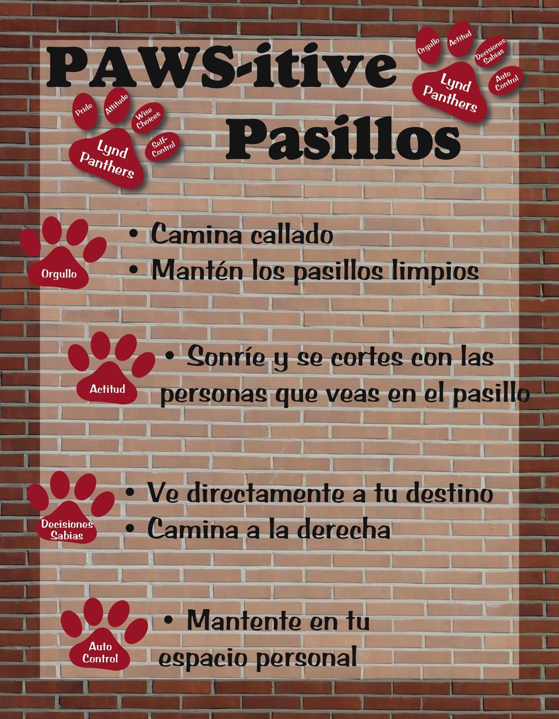
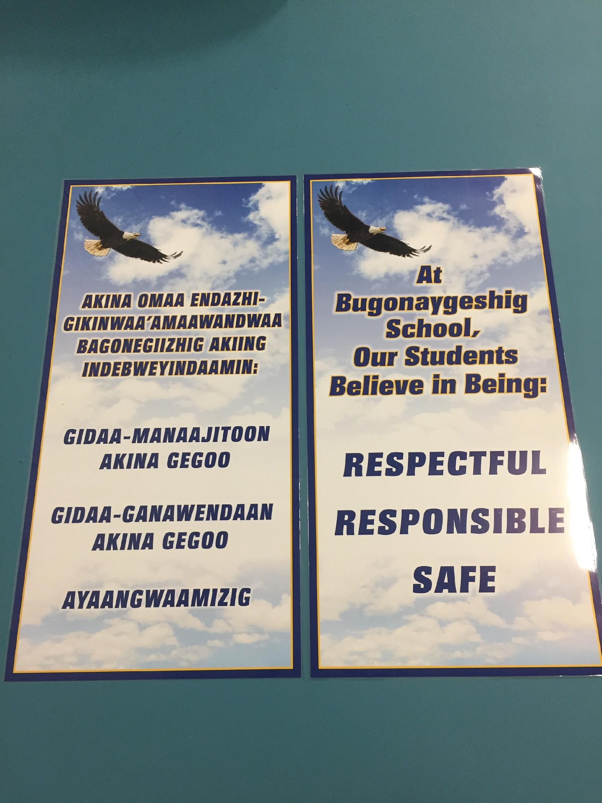
Examples-Cultural Responsiveness
Notes:
16
Accessible to students/families who attend example

Slide 17
Building Your School-wide Expectations
Think school vision statement
Think School Improvement Plan
Think data: what is showing up in your school?
Think about what you already have in your school
Get input from stakeholders
What words describe the culture you want in your school?
Can you also come up with a name for your school-wide expectations?
The Wilson Way
Tiger ROAR
SOAR Expectations
Panther Pride
Bradley B’s
Notes:
17
These are more explicit guidelines or think abouts for to lead teams into some work time for developing expectations. If your school system does not have school-wide expectations, proceed to developing expectations for your school.
Engagement Activity Idea: Pick 3

Slide 18
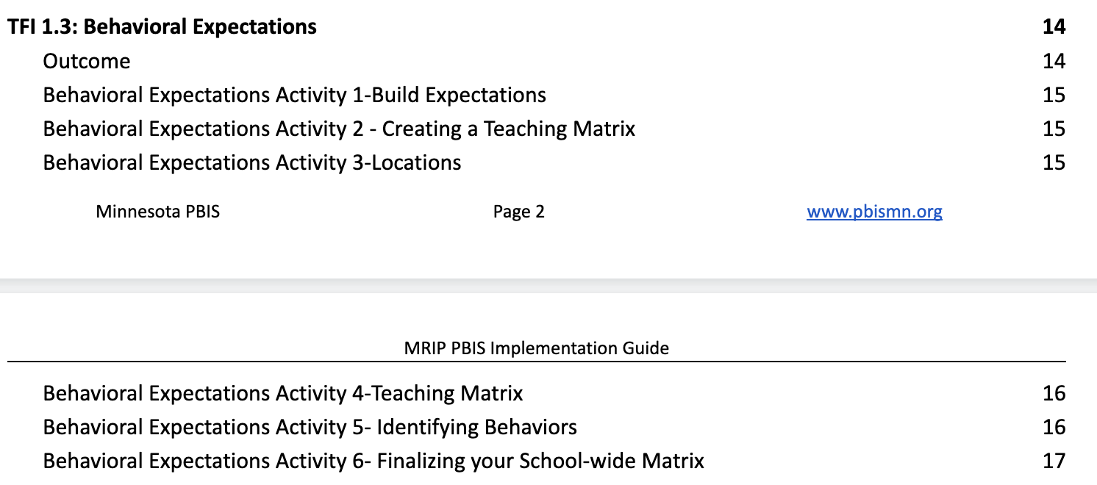
Team Implementation Planning
Complete Behavior Expectations Activities 1-3 in your Implementation Planning Workbook
Implementation Planning Workbook: TFI 1.3 Behavior Expectations Activities 1-3
Notes:
18
The workbook activities can be used to guide teams into the pick 3 engagement activity. Or they can be used as a stand alone. Regions can choose this.

Slide 19
School wide Teaching Matrix
School-wide ROAR Expectations | Rules (examples) rev 11-4-19
 | All Settings | Hallways | Lunch | Bus | Online | Classrooms
Respectful | Be on time Assume positive intent | Walk to the right Use level 2 volume | Invite those sitting alone to join | Stay in my seat Use level 1 volume | Consider feelings of others before I post Be an upstander – speak up when I see unsafe behavior | See classroom specific matrices for classroom rules and routines
Organized and Achieving | Hands and feet to self Help/share with others | Walk directly to my designated area | Have a lunch plan Choose quiet or social area | Have a plan Use headphones to listen to music | Check my feelings before I post Re-read messages before I post.
Responsible | Recycle Be prepared | Pick up litter | Use my breathing technique Listen to my signals | Watch for my stop | Double check sources before I post Think before I forward
Teacher’s Role (Conditions for Learning) | Use specific praise to reinforce behavior | Stand in hall during passing periods | Use active supervision (move, scan, interact) | Ensure students enter bus calmly | Teach and practice routine monthly | Develop classroom matrix Post; teach; reinforce
2. Natural Context
1. 3-5 School-Wide Expectations
3. Behavior Examples
4. Staff Role
Notes:
19
Allow teams at least 30 min. to begin the teaching matrix with facilitation from coaches and trainers. Have them prepare to share at least one square with the large group for feedback. For example, what does Responsibility look like in the cafeteria.

Slide 20
Including Pro-social, Emotional, Mental Health Skills on Your Matrix
How will your teaching matrix increase the effectiveness of school-wide PBIS supports for students in your building who exhibit internalizing behaviors?
Not talking with other children
Being shy
Timid and/or unassertive
Avoiding or withdrawing from social situations
Not standing up for one’s self
Sources:
Barrett, S., Eber, L., McIntosh, K., Perales, K., & Romer, N. (2018). Teaching Social-Emotional Competencies within a PBIS Framework. OSEP Technical Assistance Center on Positive Behavioral Interventions and Supports. www.pbis.org.
https://www.pbis.org/resource/teaching-social-emotional-competencies-within-a-pbis-framework
Notes:
20
Be sure to include social emotional skills you expect students to practice within each setting on your matrix.

Slide 21
Examples-Incorporating Social Emotional Skills
School-wide ROAR Expectations | Rules (examples) rev 11-4-19
 | All Settings | Hallways | Lunch | Bus | Online | Classrooms
Respectful | Be on time Assume positive intent | Walk to the right Use level 2 volume | Invite those sitting alone to join | Stay in my seat Use level 1 volume | Consider feelings of others before I post Be an upstander – speak up when I see unsafe behavior | See classroom specific matrices for classroom rules and routines
Organized and Achieving | Hands and feet to self Help/share with others | Walk directly to my designated area | Have a lunch plan Choose quiet or social area | Have a plan Use headphones to listen to music | Check my feelings before I post Re-read messages before I post.
Responsible | Recycle Be prepared | Pick up litter | Use my breathing technique Listen to my signals | Watch for my stop | Double check sources before I post Think before I forward
Teacher’s Role (Conditions for Learning) | Use specific praise to reinforce behavior | Stand in hall during passing periods | Use active supervision (move, scan, interact) | Ensure students enter bus calmly | Teach and practice routine monthly | Develop classroom matrix Post; teach; reinforce
INCORPORATE social emotional skills
Notes:
21
Here is an example of how to do incorporate social emotional skills on your matrix.

Slide 22
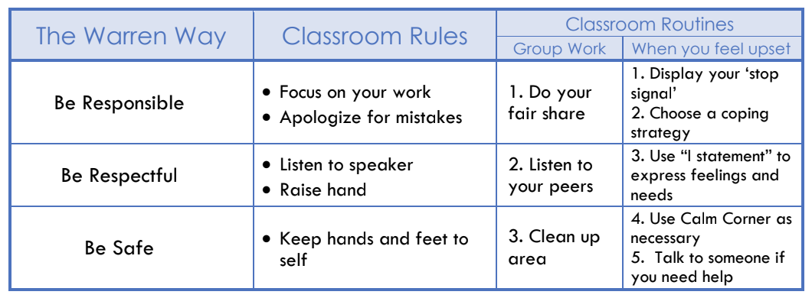
What about the Classroom?
Days 5 & 6 will be dedicated to supporting PBIS in the classroom through the Classroom Matrix.
Notes:
22
Inform teams that they do not need to put Classroom on their matrix as that will be covered through the development of the Classroom Matrix which we will train on in Days 5 and 6

Slide 23
Team Implementation Planning
Use TFI 1.3 Behavior Expectations Activities 4-6 to guide your work.
Prepare to share one location
Implementation Planning Workbook: TFI 1.3 Behavior Expectations Activities 4-6
Notes:
23
Allow teams at least 30 min. to begin the teaching matrix with facilitation from coaches and trainers. Have them prepare to share at least one square with the large group for feedback. For example, what does Respect look like in the cafeteria.

