Slide 1
PBIS Team
Tier 1
Training Day 1
Faculty Involvement (TFI 1.5)
Students, Family and Community Involvement (TFI 1.6)
Updated April 2022
Notes:
Updated 7/2018

Slide 2
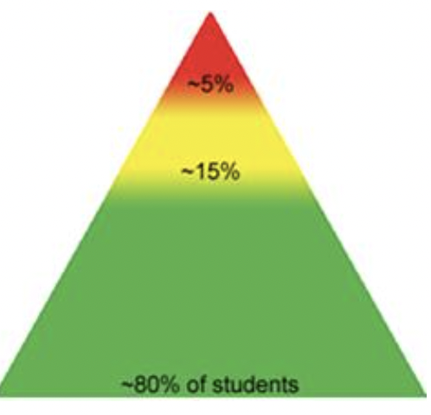
Tier 1: Implementation Fidelity
TFI Sub-Scale: Team
TFI 1.1 | Team Composition
TFI 1.2 | Team Operating Procedures
TFI Sub-Scale: Evaluation
TFI 1.12 | Discipline Data
TFI 1.13 | Data-based Decision Making
TFI 1.14 | Fidelity Data
TFI 1.15 | Annual Evaluation
TFI Sub-Scale: Implementation
TFI 1.3 | Behavioral Expectations
TFI 1.4 | Teaching Expectations
TFI 1.5 | Problem Behavior Definitions
TFI 1.6 | Discipline Policies
TFI 1.7 | Professional Development
TFI 1.8 | Classroom Procedures
TFI 1.9 | Feedback and Acknowledgement
TFI 1.10 | Faculty Involvement
TFI 1.11 | Student/Family/Community Involvement

Slide 3
Learning Expectations
EXPECTATION | BEHAVIOR
Be Responsible | Make yourself comfortable Take care of your needs (water, food, restroom, etc.) Action plan to implement what you are learning Follow through on your action items
Be Respectful | Turn cell phones off or to “vibrate” Listen attentively while others are speaking Have only the training materials up on your computer/tablet/phone
Be Engaged | Ask what you need to know to understand and contribute Contribute to the group by sharing relevant information and ideas
Notes:
3
Regions- Use for live training or add a different one

Slide 4
TFI 1.10 & 1.11
Purpose & Outcomes
Purpose:
Prepare and plan for involving all stake holders in decision-making and implementation
Outcome:
TFI 1. 10 Faculty Involvement
Faculty are shown school-wide data regularly and
provide input on universal foundations (e.g., expectations, acknowledgements, definitions, consequences) at least every 12 months.
TFI 1.11 Student/Family/Community Involvement
Stakeholders (students, families, and community members) provide input on universal foundations (e.g., expectations, consequences, acknowledgements) at least every 12 months.
Notes:
Read through the purpose and outcome emphasizing that teams will develop a written plan for professional development focused on the 4 core practices.

Slide 5
Culturally Responsive Elaboration
1.10 School-Wide PBIS Big Idea
Faculty voice is essential to establishing and maintaining staff commitment and consistency in implementation.
Faculty Involvement Focuses on:
School staff are actively engaged in SWPBIS Tier I Practices
School staff demonstrate ownership of the system
School staff accept responsibility for sustaining practices that are effective for all students
Notes:
Provide teams with the overall goal of faculty/student/family involvement from an Equity or Cultural Responsiveness perspective.

Slide 6
How can we make Faculty Involvement
more equitable?
Examples
Teams have a process for frequently facilitating two-way communication between the school administration, leadership team, and faculty.
Teams have procedures for school staff to play an active role in planning and delivery of school-wide activities.
School staff are acknowledged for their participation in SWPBIS systems.
Teams use and collect feedback from school staff regarding their perceptions of their suggestions for Tier 1 SWPBIS systems at least annually.
PBIS Cultural Responsiveness Field Guide-page 22
Notes:
The main idea here is to get teams thinking about how to make family/student/community involvement more equitable. Restate a couple of the examples for emphasis. Add any local examples you have.

Slide 7
Student, Families, and Community Involvement Outcomes
1.11 School-Wide PBIS Big Idea
Engaging stakeholders enhances the contextual fit of SWPBIS systems and may increase consistency across school and other settings.
Student/Family Involvement Focuses on:
Student/Family/Community involvement is vital to student outcomes.
Partnerships provide opportunities for all voices to be heard and have histories and experiences represented in the school setting.
Connections to school are authentic and collaborative.
Teams must engage families who are representative of the schools’ demographics and underserved populations.
Notes:
Provide teams with the overall goal of faculty/student/family involvement from an Equity or Cultural Responsiveness perspective.

Slide 8
How can we make Student, Families, and Community involvement more equitable?
Examples
Teams research their communities to determine which ethnic groups are represented among the broad federal race categories.
Teams have procedures for specific community outreach actions to ensure frequent two-way communication with stakeholders.
Teams have procedures in place to inform families and community member of and actively engage them in volunteer opportunities within the school (e.g. school-wide or classroom orientations or celebrations).
Teams actively seek feedback from stakeholders regarding their perceptions of and suggestions for Tier 1 SWPBIS systems at least annually.
Teams have procedures to ensure that stakeholders and community resources are connected to Tier I SWPBIS systems, including increasing students’ and families access to resources that specifically address underrepresented ethnicity groups or underserved populations.
Teams share all information with stakeholders in multiple languages and modes of delivery (e.g., written, audio, visual).
PBIS Cultural Responsiveness Field Guide-page 23
Notes:
The main idea here is to get teams thinking about how to make family/student/community involvement more equitable. Restate a couple of the examples for emphasis. Add any local examples you have.

Slide 9
Faculty Involvement

Slide 10
Faculty Involvement Involves at least 80% buy-in
Why do we need faculty involvement?
Collectively, staff will:
identify focus
identify ways to monitor progress
identify goals
Identify ways to evaluate outcomes
Identify how to engage resistant staff

Slide 11
Increasing Staff Buy-in/Commitemnt Quick Tips
Have a PBIS calendar with all PBIS lessons, events, timelines ready in advance of the school year to share with staff
Provide simple classroom management strategies that tie into school-wide systems
share data
Provide PD to staff as needed
Staff Acknowledgements

Slide 12
How will you engage staff in the implementation of PBIS?
Building a shared vision
Rethinking Discipline
Sharing data
Encouraging input and feedback
Implementation prompts/reminders for staff
Establishing a communication system

Slide 13
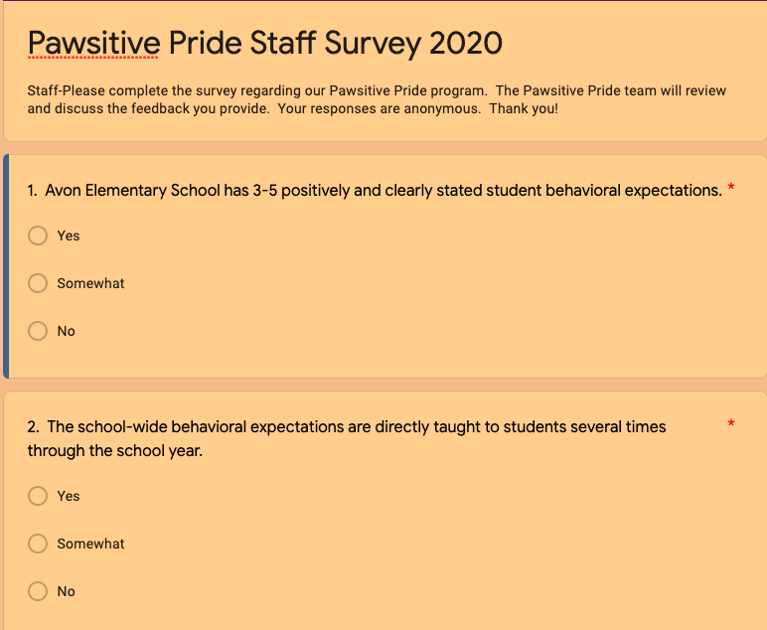
Staff Feedback
Staff Survey Questions
Needs to happen on a regular basis
formalized survey
suggestion box
post it notes at staff meeting
What to get input on
what acknowledgements work (staff and students)
how lessons are going
what behaviors they are seeing and does it match up to the data
Notes:
Staff Survey example from Avon Elementary - this is a quick survey to take and would be individualized for the school
More formal survey would be the SAS

Slide 14
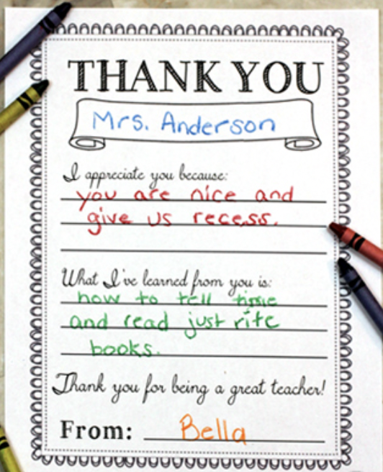
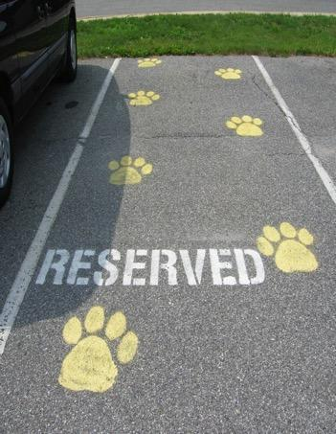
Staff Acknowledgement

Slide 15
Share Data With Staff
Share data monthly
staff meeting
bulletin board in staff areas
emails
Tik Tok Style video
Update Staff on School-wide PBIS acknowledgements
focus areas/behaviors
how it is making a difference

Slide 16
Orienting Guest Teachers and Substitutes
New adults in the school and classroom need to know how they participate in PBIS.
Most relevant for expectations, acknowledgements and discipline.
Part of the binder, part of the PD, part of substitute / guest teacher information for EVERY class.
Teams: Take a few minutes to discuss what you do familiarize guest teachers/substitute teachers to your building? Does this include your PBIS framework?

Slide 17
Student Involvement

Slide 18
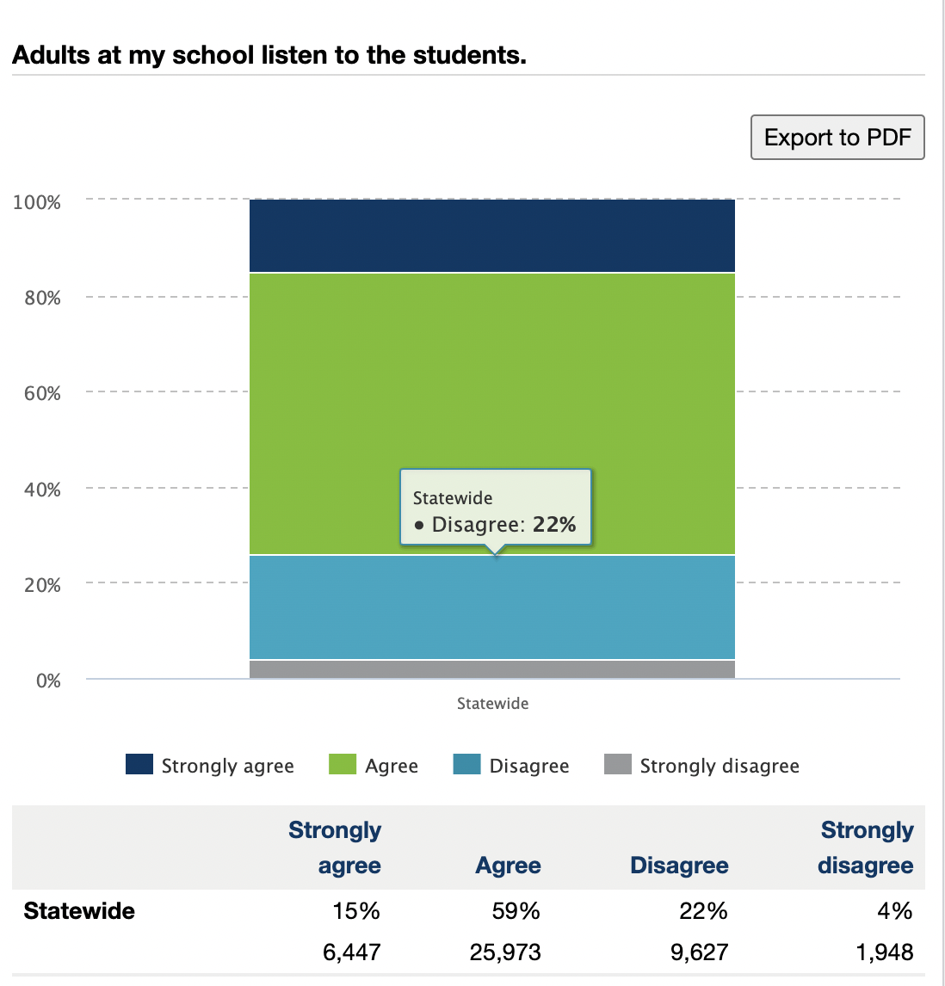
Student Survey- Statewide Data
9th grade results from 2019
What are your initial thoughts when you see this?

Slide 19
Student Voice
“Since adolescents have a developmental need to play an active role in their own lives,
students who are included
in decision-making and implementation
are more likely to
accept and participate in the initiative.”
(Mager & Nowak, 2012; Mitra, Serriere, & Kirshner, 2013)

Slide 20
Student Voice…it counts
https://www.youtube.com/watch?v=s1V6kEJ2qXI
Notes:
Optional video to play
https://www.youtube.com/watch?v=s1V6kEJ2qXI (2:47 in length)

Slide 21
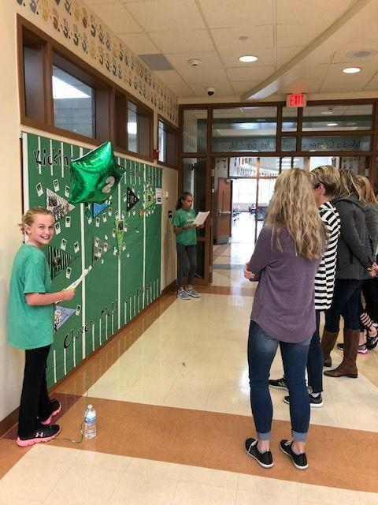
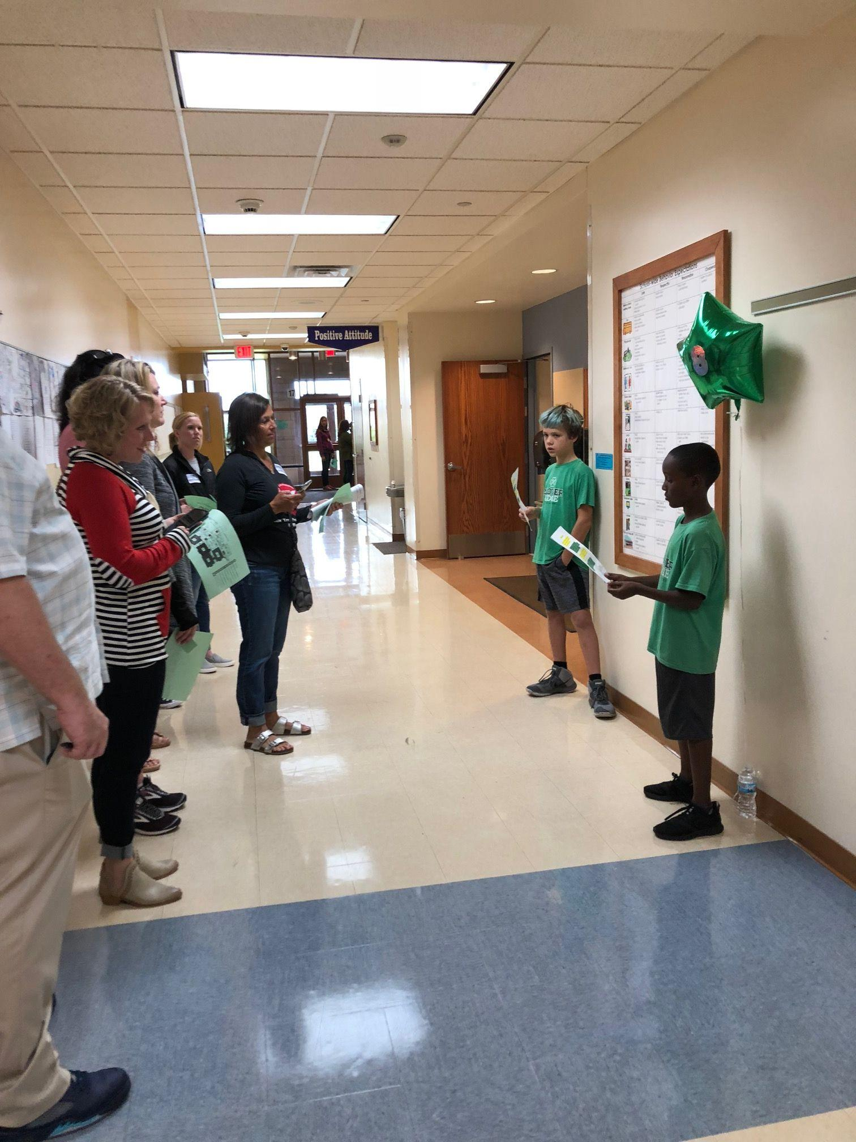
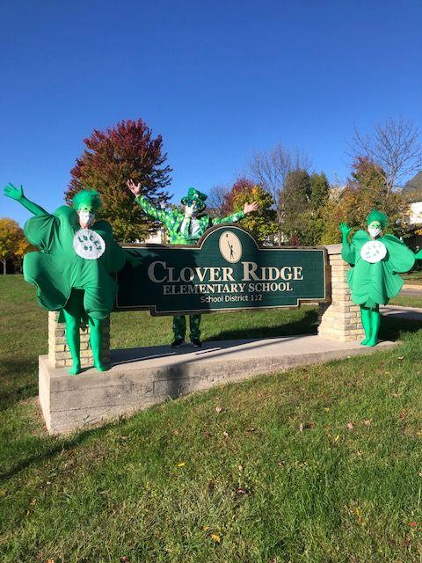
Students as Leaders, Teaching Adults
Clover Ridge Elementary
PBIS Tour
Students teaching matrix to adults

Slide 22
Full Representation Needed
High School/MS: Student Voice is essential for social validity
Students teaching students is powerful
Student clubs (e.g. the Expect Respect club) can develop curriculum and social media
Students can help problems solve behaviors
Students can give input on rewards
Remember these Guidelines for who needs to be on the Tier 1 team?
TFI 1.1 Team Composition: Tier I team includes a Tier I systems coordinator, a school administrator, a family member, and individuals able to provide (a) applied behavioral expertise, (b) coaching expertise, (c) knowledge of student academic and behavior patterns, (d) knowledge about the operations of the school across grade levels and programs, and for high schools, (e) student representation.
How do you include student voice?
Notes:
remind teams that student voice needs to be heard from all groups in the school. Don’t always rely on student council or other groups that may bot represent all
Give teams a few minutes to talk about how they already get student voice - share with large group.

Slide 23
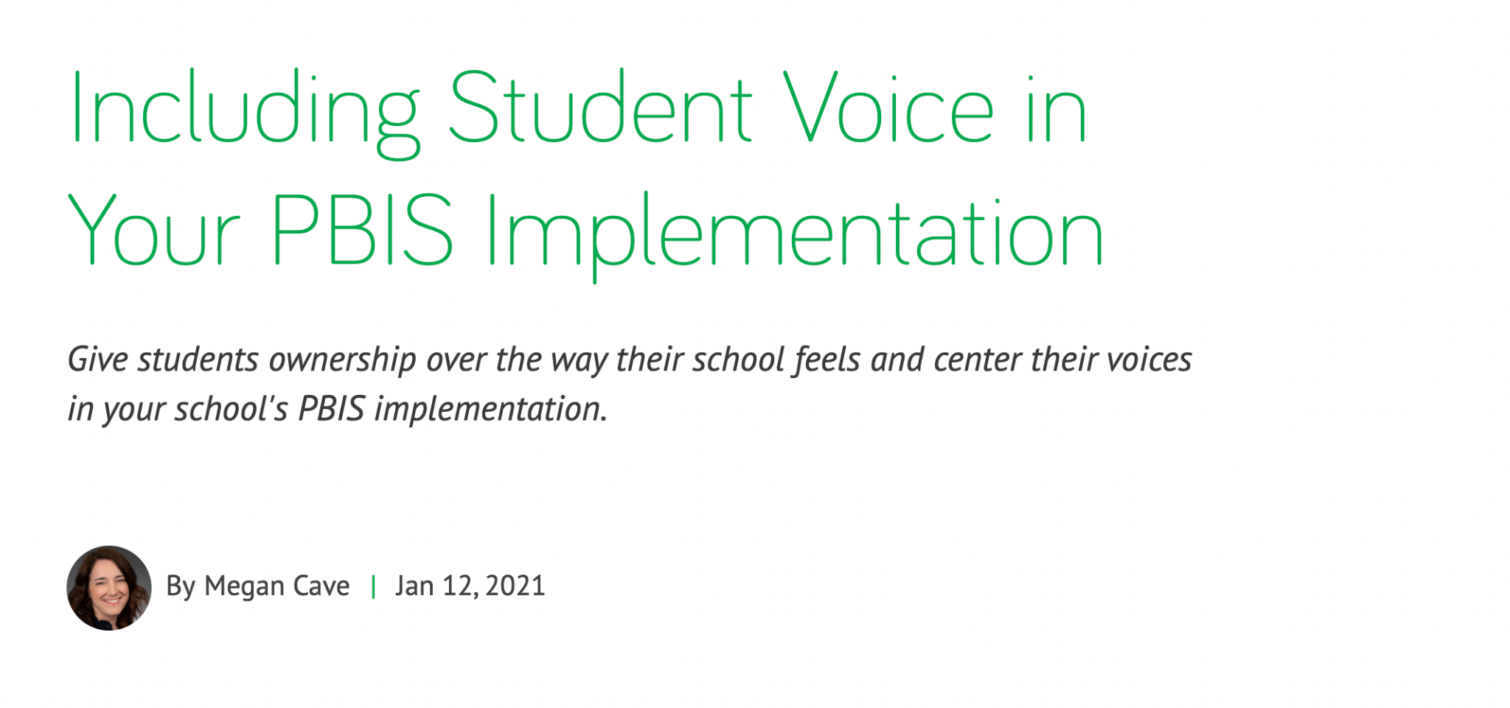
Team Activity
Read this article on your own
Including Student Voice Article
Share with a partner your thoughts
Bring your partner discussion back to the team to share interesting ideas
Notes:
Optional Activity

Slide 24
Family Involvement

Slide 25
Applying the Logic to Families
Tier 3: Intensive, Individual Interventions
Family Liaison-matched with family, needs matched with community resources
Individual Skill Building Sessions
1-5%
Tier 2: Targeted Group Interventions
Support Groups (Military Families, Newcomer Group)
Skill Building Sessions (Academic and Behavior)
5-10%
Tier 1: Universal Interventions
Family representative(s) on Tier I team
Self Assessments: Family Engagement Checklist, Surveys
Skill Building Series Guest Speaker (Topics Vary- Survey Families)
Newsletter, Resource Library , “Shout Outs”
Volunteer Opportunities (DOGS- Dads of Great Students)
Teacher Conferences- Goal Setting, Family Vision, Strengths Discovery
Family Fun Nights throughout the year
Participate in development of the School Handbook (Teaching Matrix – promote common language between school and home)
80-90%
Notes:
Family engagement also utilizes the MTSS tiered framework and engaging families needs to be considered throughout the tiers.
Activities at Tier I demonstrating Engagement over Involvement:
Family Member on Tier I Team
Self Assessment /Family Screener --- providing voice of family to identify additional supports for individual students and data can also indicate need for Family Edu Nights
Newsletter could have opportunities for families to respond
Teacher Conferences with family voice in goal setting, vision and identifying strengths --- what if all teachers started year off with phone call home to est strengths, vision and goals for that school year?
Family participation and feedback on PBIS implementation (e.g.: discipline policies, acknowledgements, expectations, etc)

Slide 26
Family Involvement
As a parent in your building…
I am aware of the school’s PBIS acronym.
I have seen the school’s teaching matrix.
I feel welcomed in the school.
I feel the staff here really care about my child.
I feel there is a place within the school where I can share my input about the school climate and programs.

Slide 27
Family Involvement
As a parent…
I feel my input about the school climate and programs is valued.
It is easy for me to talk to staff about my child.
I believe that the staff in the school feel that I am doing the very best that I can for my child.
I know what my child is learning.

Slide 28
Enrichment Opportunities
Invite families to share information about their cultural background.
Perspectives
Families meet
Share experiences
Listening Circles

Slide 29
Introducing PBIS to Families
Methods of communication:
Written
Letters, newsletters, marques
Face-to-Faces
School and/or community events
Other:
Hold message when they call into the office
Video demonstrations
Website blurbs
Why introduce PBIS to your Families?
Notes:
We want the plan to live beyond teachers, and a notebook, but also pull in families and make sure they understand what we are doing, and over time provide input into the process. Your staff need to be fluent in the process first.
Here are ways to engage families and let them know what is going on with PBIS.

Slide 30
Teaching Matrix
Send home before start of school/semester
Handbook
For fridge
Newsletter back page
Printed on homework folder
Translated into multiple languages
Available online
Conference/event tables

Slide 31
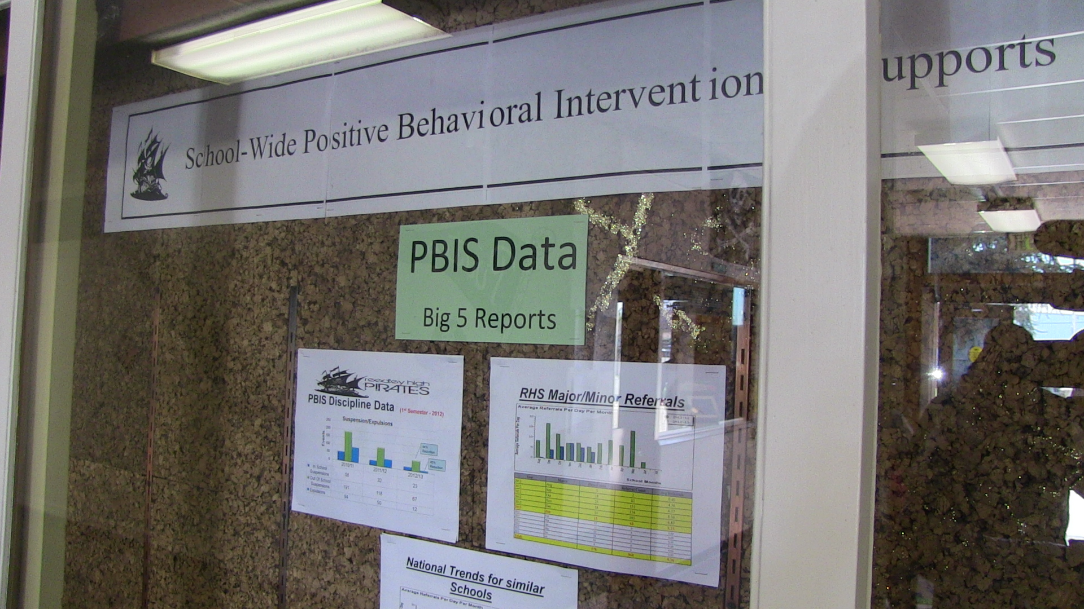
Visuals When at School
Tickets for parents & volunteers to hand out when they are at school.

Slide 32
Family Brochure
Cherry Elementary

Slide 33
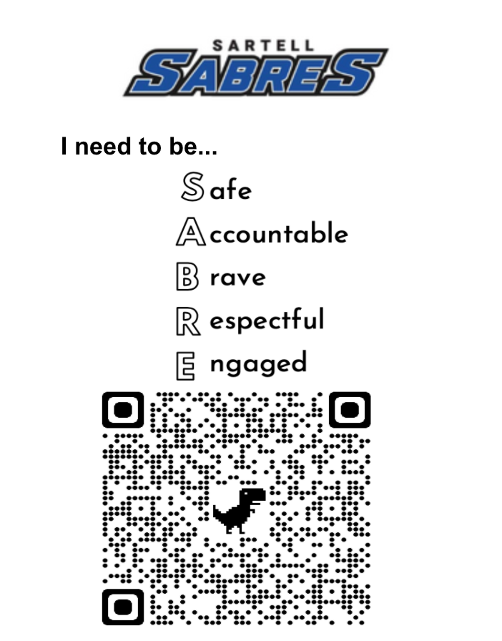
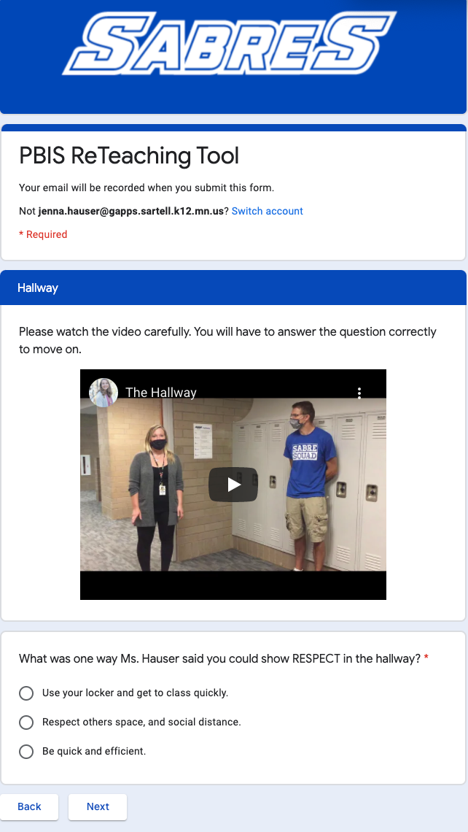
Information in Common Areas
Sartell Middle School
Reteaching Expectations as Needed
QR Codes around common areas in the building
Students who need reteaching will watch training video for that specific area and fill out a Google Form
Could modify to be a video that informs visitors about the expectations as well

Slide 34
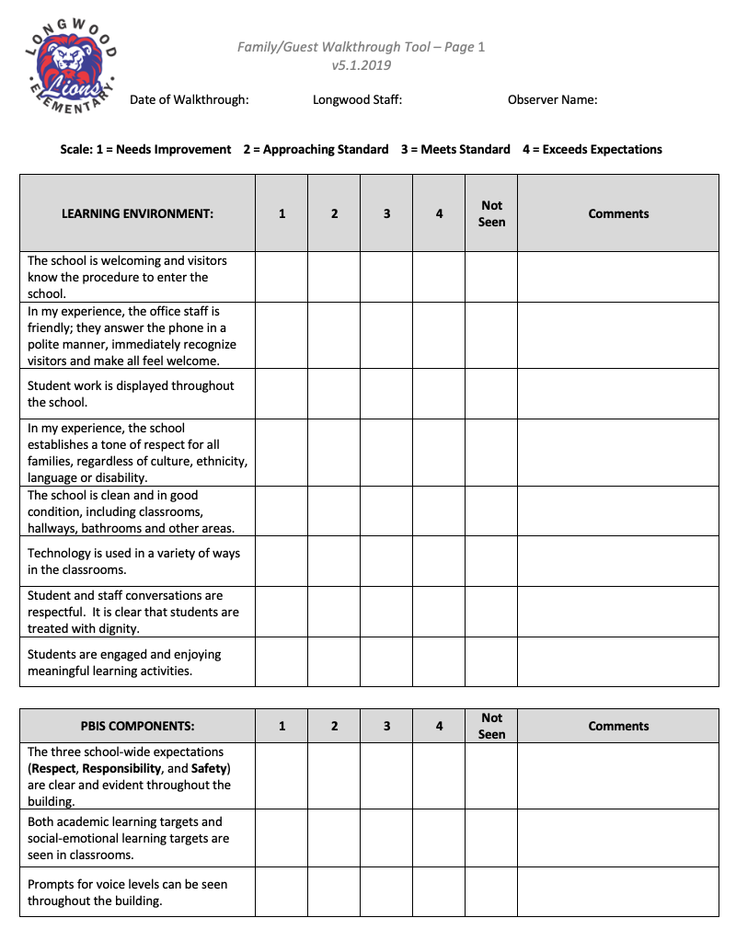
Family Building Walkthrough Survey
Notes:
Allows school to see building through parent lens

Slide 35
Parent Resource Library
Parents can check out books/Digital Access
Positive parenting
Brain research
Single parenting
Stepparent resources
School navigation
Various articles, multiple copies
Parent Book Club?

Slide 36
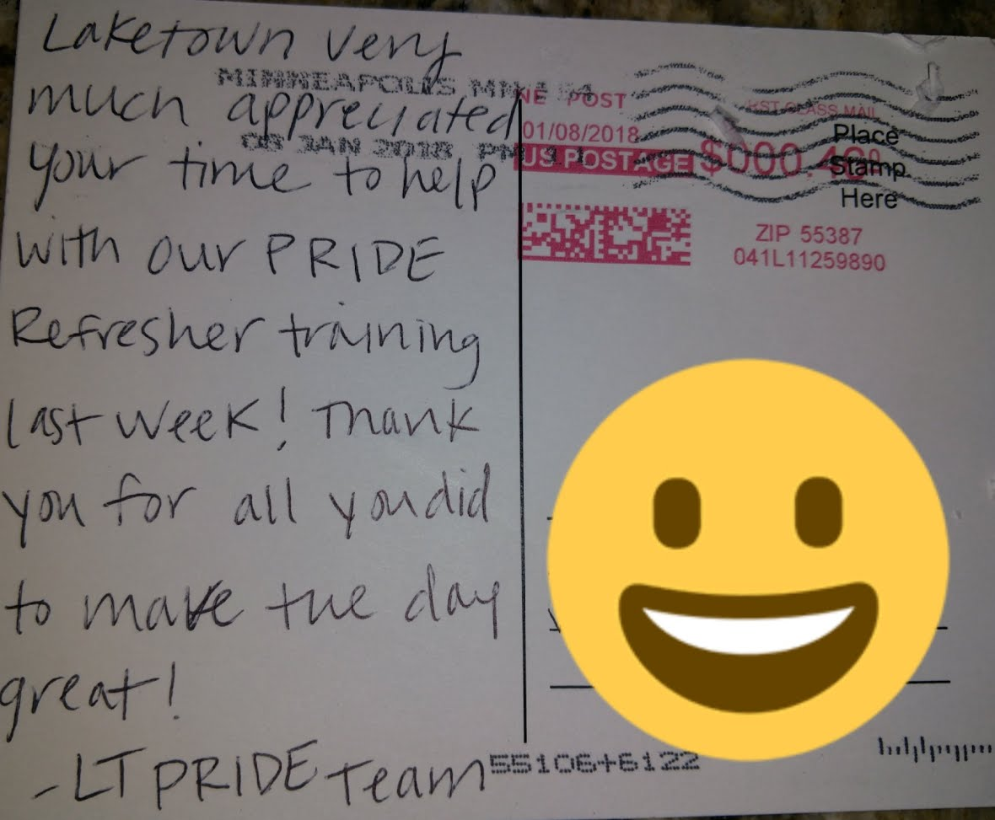
Postcards Home
For students and families
Notes:
If your school has a postcard example feel free to add it here

Slide 37
Community Involvement

Slide 38
Community Involvement
First off, think of WHO your school community is:
Former students
Former parents
Volunteers
Sports teams
Business partnerships
So much more!!!!

Slide 39
Common Language in Community
Goodridge Elementary

Slide 40
Business Investment
Celebration night at a local restaurant for all students who received 35 gotchas in a month. Students bring in gotcha tickets and family receives one free entre
Teacher supply and bookstore discounts or gift certificates for for giving out the most gotcha ticket
Notes:
How can schools procure business support? Invite business owners to visit the schools, visit the Rotary Club and talk about success stories in the schools, invite businesses to the PBIS stakeholder group, and when visiting the business mention the program and ask for support.

Slide 41
How do you orient people new to your school community?
How will you share your School-wide PBIS plan with:
Short-term and long-term substitutes?
Staff starting after your school’s kick-off?
Students starting after your school’s kick-off?
Guest teachers or presenters?
Volunteers?

Slide 42
Plan for Stakeholder Input …
Universal Foundations and Stakeholders | Expectations and Rules (Teaching Matrices) | Initial and on-going instruction on expectations | Acknowledgment Program | Discipline (problem behavior definitions, policies, procedures)
Students
Families
Communities
Workbook: TFI 1.10. 1.11 Activity 2
Notes:
Identify how your team will involve all your stakeholders in developing the Universal Foundations. How will you receive their input, as well as their continued feedback?

Slide 43
Team Implementation Planning
Implementation Workbook: TFI 1.10 & 1.11 Activities
Activity 1 Communication Systems,
Activity 2 Plan for Stakeholder Feedback
Cultural Responsiveness Field Guide
1.10 Faculty Involvement Examples p.22
1.11 Student, Family, Community Involvement Examples p. 23
Professional Development
How and when will you bring this information back to staff?
Notes:
43
Remind teams to work on the things they need to work on. If they are not ready for 1.10/1.11 they can make a plan for when they might work on this and back up to what they may need to spend time on expectations, matrix, teaching expectations, acknowledgements, flowcharts and referral forms.

Slide 44
Family Matrix
Notes:
The slides in this section are optional. This was great information during distance learning, but in August 2022 we can decide to keep or skip this section.

Slide 45
Setting Home Expectations
Developing a Family Expectations Matrix
Click here for video recording of this PowerPoint you can share with Families Directly!
Notes:
Welcome to a support provided by the Midwest PBIS Network. We know that managing families under normal life circumstances and routines is challenging so throwing in the extra responsibilities and uncertainties from COVID19 is a whole new ball game!
To help your family be more successful while engaging in activities at home, we hope to help you to establish expectations for your family through a behavior matrix. Maybe you have seen a behavior matrix when visiting your child’s school.
Recording Link: https://drive.google.com/open?id=1ZKlyiG1Oba_XMIYm0Jqx8nZDeOTuw3kK

Slide 46
Home Expectations
Access this new brief for families…
https://www.pbis.org/resource/supporting-families-with-pbis-at-home
…to learn more about:
Setting home expectations
Setting routines
Teaching, Reminding, and Rewarding behaviors
Today,
We will walk you though how to set home expectations
Center on Positive Behavioral Interventions and Supports, Center for Parent Information & Resources. (March, 2020). Supporting Families with PBIS at Home. University of Oregon. www.pbis.org.
Notes:
We are excited to share a new resource published yesterday, as a collaboration between the Center on PBIS and the Center for Parent Information and Resources.
This brief is for FAMILIES – to help you understand how to create expectations, routines, and to teach, prompt, and reward expected behaviors.
This PPT will expand specifically on creating a family expectations matrix for expectations and routines. We will provide another recording on Teaching, Reminding, and Rewarding Behaviors. Lets jump in!

Slide 47
What Is a Family Expectations Matrix?
It is a visual reminder of your family’s expectations (values), rules, and routines
Expectations | 3 to 5 overarching family values/expectations that represent what is important to you
Rules | Specific examples or steps to demonstrate the family expectations.
Routines | Routines are a series of actions to follow that help form good habits, and keep the home running like clockwork.

Slide 48
Why Are Expectations Important?
Clearly states the core values of your family
Keeps everyone focused
Gives you the language to use
Good for all ages, whether you have toddlers, teenagers, or are all adults in the same house.

Slide 49
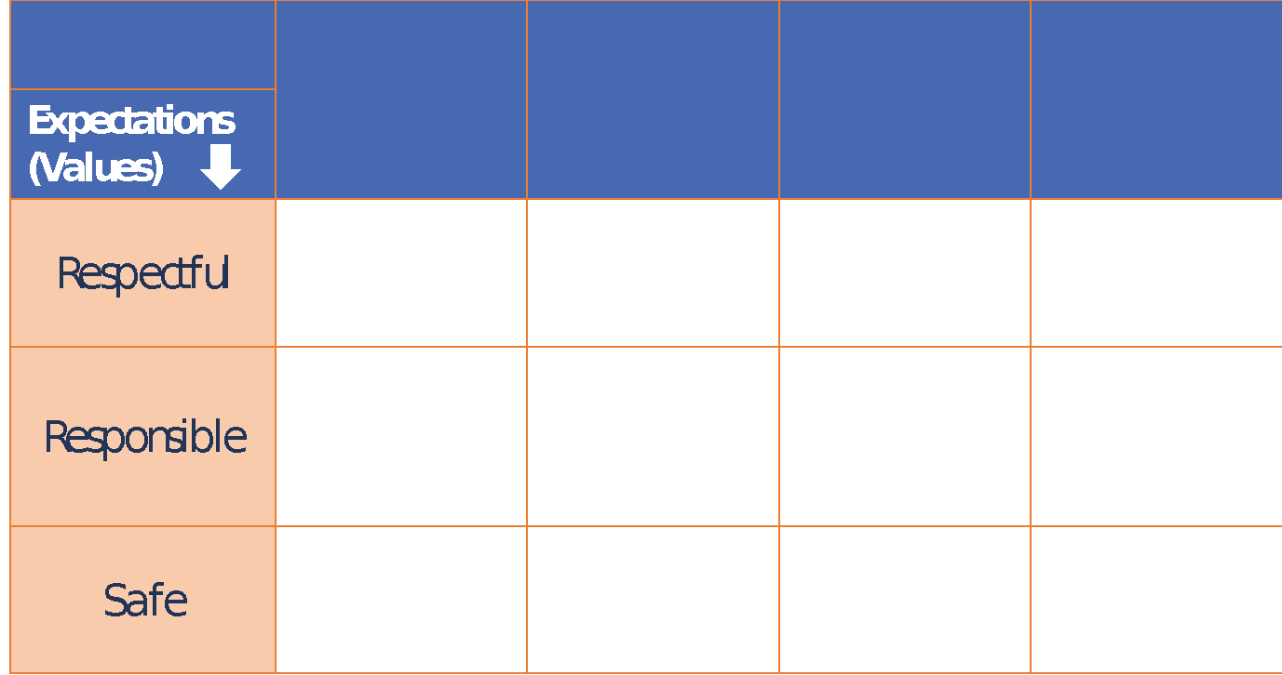
How to Develop a Family
Expectations Matrix:
Click HERE for steps to create
a Family Matrix
Make a table (on paper, bulletin board, poster, etc.)
Identify 3-5 over-arching expectations that reflect the values you want in your home. Add them to the table.
Get input from everyone
Example: Responsible, Respectful, Safe
Notes:
The first step to creating your family matrix is to make a table on paper, a bulletin board, poster board or any other creative way you would like.
Next, define three to five overarching expectations for your family. Typically in schools these overarching expectations are something like Be Respectful, Be Responsible and Be Safe. These seem very applicable to the home setting as well, but you get to choose what is most important for your family.
Or even better, ask your child what the expectations are at their school and use those!

Slide 50
Sample 1
The Johnson Family Expectations
 | Mealtime | Basement | Yard | Bedtime Routine
Be Respectful | • Say please, thank you, and excuse me • Ask and share about your day | • Play with toys as intended • Keep low volume • Include everyone | • Share with siblings and friends | • Put dirty clothes in basket • Use quiet voices • Say something you are grateful for
Be Responsible | • Help set the table or meal prep • Try new foods • Clean up together | • Follow rules during games and say ’good job’ • One toy at a time | • Put toys away before going in • Come in first time asked | • Put on PJs • Brush teeth • Use bathroom • Read for fun
Be Safe | • Wash hands • Keep chair on 4 legs | • Keep small pieces on table • Use toys and games as intended | • Ask permission before you leave yard • Wear helmets, gear | • Clean up room before you go to bed • Lights out at 9
Adult Role | • Announce mealtime in advance • Assign chore roles | • Watch for small pieces and remind about table rule | Provide 5 min warning for time to come in | Remind to go potty and to get water
Notes:
Let’s take a look at a full example. (Click for animation 1) Down the left side are the family’s overarching expectations – Be Responsible, Be Respectful and Be Safe. (Click for animation 2) Across the top are common routines for this family. Then the matrix is filled in to describe behavior and rules for those areas and routines. Notice that throughout the behaviors are defined by what you would want to see happening. The behaviors are also specific and something that could actually be observed happening.
(Click for animation 3) The bottom row defines the adult role for that area or routine.

