Slide 1
Tier 1 Team Training
Day 8
Solutions Development Tool & Practice
(TFI 1.12 & 1.13)
Updated September, 2022
Notes:
Updated 7/2018

Slide 2
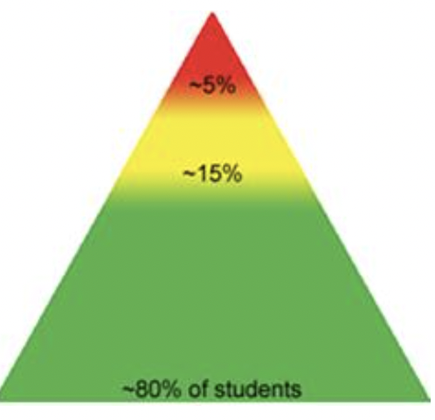
Tier 1: Implementation Fidelity
TFI Sub-Scale: Team
TFI 1.1 | Team Composition
TFI 1.2 | Team Operating Procedures
TFI Sub-Scale: Evaluation
TFI 1.12 | Discipline Data
TFI 1.13 | Data-based Decision Making
TFI 1.14 | Fidelity Data
TFI 1.15 | Annual Evaluation
TFI Sub-Scale: Implementation
TFI 1.3 | Behavioral Expectations
TFI 1.4 | Teaching Expectations
TFI 1.5 | Problem Behavior Definitions
TFI 1.6 | Discipline Policies
TFI 1.7 | Professional Development
TFI 1.8 | Classroom Procedures
TFI 1.9 | Feedback and Acknowledgement
TFI 1.10 | Faculty Involvement
TFI 1.11 | Student/Family/Community Involvement
Notes:
You’ve been exposed to a number of PBIS Implementation components. Today’s new material relates to what we’ve already learned regarding using Discipline Data or TFI 1.12 and 1.13, and then takes the use of data to a more in-depth analysis so your team can make improved decisions.

Slide 3
Learning Expectations
EXPECTATION | BEHAVIOR
Be Responsible | Make yourself comfortable Take care of your needs (water, food, restroom, etc.) Action plan to implement what you are learning Follow through on your action items
Be Respectful | Turn cell phones off or to “vibrate” Listen attentively while others are speaking Have only the training materials up on your computer/tablet/phone
Be Engaged | Ask what you need to know to understand and contribute Contribute to the group by sharing relevant information and ideas
Notes:
3
Let’s model the behaviors we expect and need from our students by being responsible, respectful, and engaged, paying close attention to item #3 under Be Responsible - Action Plan to implement what you are learning. Always be thinking how to make these ideas real in your school and how to include in your overall Action Plan.

Slide 4
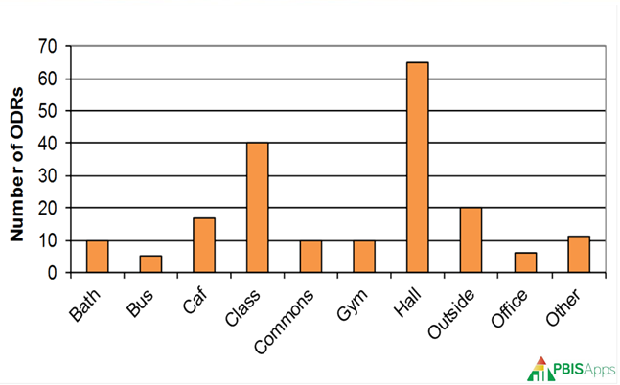
Purpose & Outcomes
Purpose: Prepare, plan, & practice using a
data decision-making process
Outcomes:
1.12 Discipline Data: Tier I team has instantaneous access to graphed reports summarizing discipline data
1.13 Data-based Decision Making: Tier I team reviews and uses discipline data at least monthly for decision-making, and implements a problem solving process that includes 1- a precision problem statement, 2- goal setting, 3- action plan, 4- fidelity measures and 5- monitoring of student outcomes
Notes:
Review to set the context/stage for work. The focus today is to practice using a decision-making process that includes a precision problem statement, goal setting, action plan, fidelity measures, and monitoring of student outcomes.

Slide 5
Culturally Responsive Elaboration
SWPBIS Big Idea
Teams use data on a regular basis to problem solve and identify solutions that are efficient, effective, relevant, and durable.
Tier 1 Team …
engages in active data-based decision making with a specific focus on equity
and school staff take responsibility for the outcomes for each student, regardless of her or his circumstances
inequitable outcomes are first examined from a system perspective before considering individual behavior support
Notes:
Review to set the context/stage for work. As your team continues to review your student outcome data, ensure you are conducting your analysis using an equity lens. This will allow for your team to make improved equity-conscious decisions based on data.

Slide 6
How can analyze data more equitably?
Examples
• Teams have procedures to ensure that data are shared frequently with stakeholders for input and feedback.
• Teams examine the data for patterns that would indicate a need for systemic change (vs. student intervention).
• When concerning patterns are noted, teams develop action plans with short-term (e.g., immediate response) and long-term (e.g., information gathering, professional development) solutions.
PBIS Cultural Responsiveness Field Guide-page 25
Notes:
6
Let’s model the behaviors we expect and need from our students by being responsible, respectful, and engaged, paying close attention to item #3 under Be Responsible - Action Plan to implement what you are learning. Always be thinking how to make these ideas real in your school and how to include in your overall Action Plan.

Slide 7
Data Decision-Making Tasks
Teams will ….
analyze their current data systems
learn how to use the 5-step Data Decision-Making process
refer to Cultural Responsiveness Field Guide - p. 25
include Data Decision-Making in Overall Action Plan

Slide 8
REVIEW: Data in the PBIS Framework
Data is one of the three major components to effective outcomes with PBIS implementation
We are doing a deep dive into how you can use your outcome data to develop goals and solutions of continuous improvement.
Notes:
Let’s first briefly REVIEW regarding what we know about data: Remember, using data is one of the three important components, too often not emphasized enough in supporting PBIS implementation. Emphasize second bullet point: “We are doing a deep dive into how you can use your outcome data to develop goals and solutions of continuous improvement.”

Slide 9
Quote
“If we have data, let’s look at data.
If all we have are opinions,
let’s go with mine.”
–Jim Barksdale, former Netscape CEO
Notes:
Review to set the context/stage for work.

Slide 10
REVIEW: 3 Types of Data
Effort: What is the current status of your systems?
School-wide Tiered Fidelity Inventory (TFI Progress Monitoring)
Self-Assessment Survey (SAS) – Staff
Opinion Survey
Fidelity: Are you doing what the framework outlines? Are you doing what you said you would?
School-wide Tiered Fidelity Inventory (TFI-Annual Assessment)
Self-Assessment Survey (SAS) – Staff
Outcome: Are your systems working?
Office Discipline Referrals (ODR’s)
Check-In Check-out (CICO)/Point Sheets
Suspensions/Expulsions
Attendance
Grades/Test Scores
Notes:
Go over the importance of Effort & Fidelity Data. We will focus on Outcome Data right now, particularly STUDENT outcome data.

Slide 11
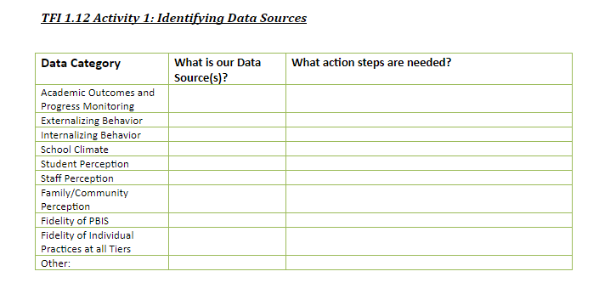
REVIEW: Outcome Data
Tells us if our systems are working
Office Discipline Referrals (ODR’s)
Check-In Check-out (CICO)/Point Sheets
Suspensions/Expulsions
Attendance & Tardies
Grades/Test Scores
Health Office Visits
Other?
Notes:
Remember back on Day 4, we had you reflect on your data systems, first identifying all of your data sources, and then, asking yourself - Are the systems working efficiently and effectively at your school?

Slide 12
Useful Data Decision-Making
It’s important to begin with a statement of a problem
Everyone must be working on the same problem with the same assumptions
Problems often are framed in “primary” form.
This raises awareness and concern, but is not useful for problem solving
Use a more detailed review of the data to build precise problem statements, which are solvable
Notes:
Main Idea: We need to be on the same page of data collection and how we are using that data to develop precision, versus our typical mode of operations which is in primary form. Example in primary form: “The majority of our ODRs involve cafeteria behavior”. We are going to learn how to be more specific or detailed in order to be more effective in solving problems.

Slide 13
Useful Data Decision-Making
Example of Problem framed in “primary” form:
The majority of our ODRs involve cafeteria behavior

Slide 14
Data Decision-Making Process
Precision Problem Statement
Monitor Outcome vs Goal
Set Measurable Goal
Use Data
Monitor Fidelity of Plan
Develop Solution & Action Plan
Notes:
Restate second purpose: “1.13 Data-based Decision Making: Tier I team reviews and uses discipline data and academic outcome data (e.g., Curriculum-Based Measures, state tests) at least monthly for decision-making.” To make the best decisions possible based on data, teams should use a decision-making process. Here’s a 5-step process that allows teams to use data efficiently and effectively when making decisions. We start the Data-Based Decision Making process by developing a Precision Problem Statement.

Slide 15
Example: Precision Statements
There are 25% more ODRs for aggression in the cafeteria this month than last year. These are most likely to occur during first lunch, with 15 eighth grade students, and the aggression is related to getting access to the new lunch line options.
What?
25% More ODRs for aggression
When?
First lunch
Where?
In the cafeteria
Why?
Getting access to the new lunch line options.
Who?
15 eighth grade students
Notes:
Go through the precision problem solving statement development process. Recall the previous “Primary” form: “The majority of our ODRs involve cafeteria behavior”. This isn’t very helpful in pinpointing the issue with cafeteria behaviors. Creating a precision statement of There are 25% more ODRs for aggression in the cafeteria this month than last year. These are most likely to occur during first lunch, with 15 eighth grade students, and the aggression is related to getting access to the new lunch line options.” Now we have more detail to work with and have identified the problem to address.

Slide 16
Activity 2A : Develop Precision Statements
Using your own data create a precision problem statement
(or use sample data from the document provided)
MN PBIS Implementation Workbook-Day 8 Activity 2
Data-based Decision Worksheet
Notes:
Now you try with our own data. Develop a Precision Statement as a team, using your own ODR data. If teams don’t have their own data, refer to the Activities 1.13 & 1.12 document - there are sample data scenarios in the document for teams to use Refer to the link on agenda to this activity or have handout prepared in advance. This usually takes some time to develop but is a beneficial activity for teams to complete as it can create more focus on how they use their data. Have teams stop, just do Activity 2A, upon completing problem statement.

Slide 17
Data Decision-Making Process
Precision Problem Statement
Monitor Outcome vs Goal
Set Measurable Goal
Use Data
Monitor Fidelity of Plan
Develop Solution & Action Plan
Notes:
Once your team has identified the problem and developed a Precision Problem Statement, the next step is to “Set Measurable Goal”.

Slide 18
Set a Measurable Goal
Goals allow you to analyze, monitor, and adjust professional practice.
Referring to the cafeteria example, how can we create a measurable goal to address the problem?
Notes:
Using the cafeteria example, continue through this as a large group. They should write in their workbook. (Think I Do/We Do). Use this slide in conjunction with the next slide. SMART goals are Specific, Measurable, Achievable, Realistic, and Time-bound.

Slide 19
Measurable Goals
Precision Statement
There are 25% more ODRs for aggression in the cafeteria this month than last year. These are most likely to occur during first lunch, with 15 eighth grade students, and the aggression is related to getting access to the new lunch line options.
Measurable Goal
Current cafeteria referrals in 8th grade average 28 per month. Our goal is to reduce cafeteria referrals by 20% per month for Feb through May.
Notes:
Given the precision statement, here’s a measurable goal that provides focus for all involved.

Slide 20
Activity 2B : Create a SMART Goal
Develop your own SMART goal
MN PBIS Implementation Workbook-Day 8 Activity 2
Data-based Decision Worksheet
Notes:
Now you try developing a SMART goal using YOUR data based on the precision statement you worked on in Activity 2A. Allow time to complete activity 2B and transition into a BREAK prior to Part 2 of Data Development and Solution Components.

Slide 21
Data Decision-Making Process
Precision Problem Statement
Monitor Outcome vs Goal
Set Measurable Goal
Use Data
Monitor Fidelity of Plan
Develop Solution & Action Plan
Notes:
Now that we’ve had a chance to learn about and work on a Precision Problem Statement and Set a Measurable Goal, logically, the next step in using data is Develop Solution & Action Plan. Developing Solutions and Action Planning can seem like an overwhelming process. The goal is to work through the solution components and then put into action the components that are realistically doable, feasible, and likely make the most impact. Let’s go through a non-behavior related scenario first so you can paint the picture of the process in your head.

Slide 22
Develop Solution & Action Plan
Precision Statement: On the days when I work from home, I have 5,000 less steps than when I don’t, due to sitting at a desk or a table the majority of the day.
Goal: Increase steps per day from 10,000 to 15,000 within the next 8 weeks, by January 1st, 2023.
Prevention: | How can we avoid the problem context? Not getting enough steps, so I’ll put a mini bike peddler at my desk Build a desk to go over my treadmill
Teaching: | How can we define, teach, and monitor what we want? Learn how walking improves health Learn how to use a pedometer & bike peddler
Recognition: | How can we build in systematic reward for desired behavior? Each day that I reach 15,000 steps, I’ll put a sticker on my calendar After 8 weeks of meeting my goal, I’ll buy a new pair of shoes
Notes:
Read Precision Statement and Goal as stated on slide. First step in the process is Prevention: how can we avoid the problem context?

Slide 23
Develop Solution & Action Plan
Precision Statement: On the days when I work from home, I have 5,000 less steps than when I don’t, due to sitting at a desk or a table the majority of the day.
Goal: Increase steps per day from 10,000 to 15,000 within the next 8 weeks, by January 1st, 2023.
Prevention: | How can we avoid the problem context? Not getting enough steps, so I’ll put a mini bike peddler at my desk Build a desk to go over my treadmill
Teaching: | How can we define, teach, and monitor what we want? Learn how walking improves health Learn how to use a pedometer & bike peddler
Recognition: | How can we build in systematic reward for desired behavior? Each day that I reach 15,000 steps, I’ll put a sticker on my calendar After 8 weeks of meeting my goal, I’ll buy a new pair of shoes
Notes:
The second component in Developing a Solution is Teaching: how can we define, teach, and monitor what we want?

Slide 24
Develop Solution & Action Plan
Precision Statement: On the days when I work from home, I have 5,000 less steps than when I don’t, due to sitting at a desk or a table the majority of the day.
Goal: Increase steps per day from 10,000 to 15,000 within the next 8 weeks, by January 1st, 2023.
Prevention: | How can we avoid the problem context? Not getting enough steps, so I’ll put a mini bike peddler at my desk Build a desk to go over my treadmill
Teaching: | How can we define, teach, and monitor what we want? Learn how walking improves health Learn how to use a pedometer & bike peddler
Recognition: | How can we build in systematic reward for desired behavior? Each day that I reach 15,000 steps, I’ll put a sticker on my calendar After 8 weeks of meeting my goal, I’ll buy a new pair of shoes
Notes:
Third component is Recognition: how can we build in systematic reward for desired behavior?

Slide 25
Develop Solution & Action Plan
Extinction: | How can we prevent problem behavior from being rewarded? I will remove the candy/mint jar from my desk I will bring my speaker to my office
Correction: | What are efficient, consistent corrective consequences for problem behavior? No sticker on the chart when 15,000 steps are not met
Data Collection: | How will we collect and use data to evaluate (a) implementation fidelity, and (b) impact on student outcomes? Use of the pedometer daily Use of daily calendar to collect days achieved
Notes:
Fourth component is Extinction: how can we prevent problem behavior from being rewarded?

Slide 26
Develop Solution & Action Plan
Extinction: | How can we prevent problem behavior from being rewarded? I will remove the candy/mint jar from my desk I will bring my speaker to my office
Correction: | What are efficient, consistent corrective consequences for problem behavior? No sticker on the chart when 15,000 steps are not met Have to walk more days in order to get new shoes
Data Collection: | How will we collect and use data to evaluate (a) implementation fidelity, and (b) impact on student outcomes? Use of the pedometer daily Use of daily calendar to collect days achieved
Notes:
Fifth component is Correction: What are efficient, consistent, and corrective consequences for problem behavior?

Slide 27
Develop Solution & Action Plan
Extinction: | How can we prevent problem behavior from being rewarded? I will remove the candy/mint jar from my desk I will bring my speaker to my office
Correction: | What are efficient, consistent corrective consequences for problem behavior? No sticker on the chart when 15,000 steps are not met
Data Collection: | How will we collect and use data to evaluate (a) implementation fidelity, and (b) impact on student outcomes? Use of the pedometer daily Use of daily calendar to collect days achieved
Notes:
Final component is Data Collection: how will we collect and use data to evaluate implementation fidelity and impact on student outcomes?

Slide 28
Develop Solution & Action Plan
GOAL: Current cafeteria referrals in 8th grade average 28 per month. Our goal is to reduce cafeteria referrals by 20% per month for Feb through May.
Solution component | Definition and Example
Prevention | How can we avoid the problem context? e.g. schedule lunch times, change lighting, rearrange lunch lines
Teaching | How can we define, teach, and monitor what we want? e.g. build curriculum around roughhousing, teach line expectations
Recognition | How can we build in systematic rewards for positive behavior? e.g. 3 days without referrals = 5 extra minutes of social time at lunch
Notes:
Going back to our cafeteria example, here is what it can look like with the Measurable Goal of reducing cafeteria referrals by 20% per month for Feb through May. Go through each component with large group. Emphasize your team’s responses should “fit” the context of your school. This may be similar or much different than other schools with a similar issue. You know your school best so make it your own.

Slide 29
Develop Solution & Action Plan
Solution component | Definition and Example
Extinction | How can we prevent problem behavior by removing the reward? e.g. Continued roughhousing at lunch equals a loss in lunch options
Correction | What are efficient, consistent corrections for problem behavior? e.g: Error correction; practice appropriate behavior (document with Major/Minor ODR)
Data | How will we collect and use data for evaluating the fidelity of our solution (e.g. walkthrough reports, observations, self-assessments), and student outcomes (e.g. SWIS ODR data, time on task, etc.)?
Notes:
Go through each component with large group.

Slide 30
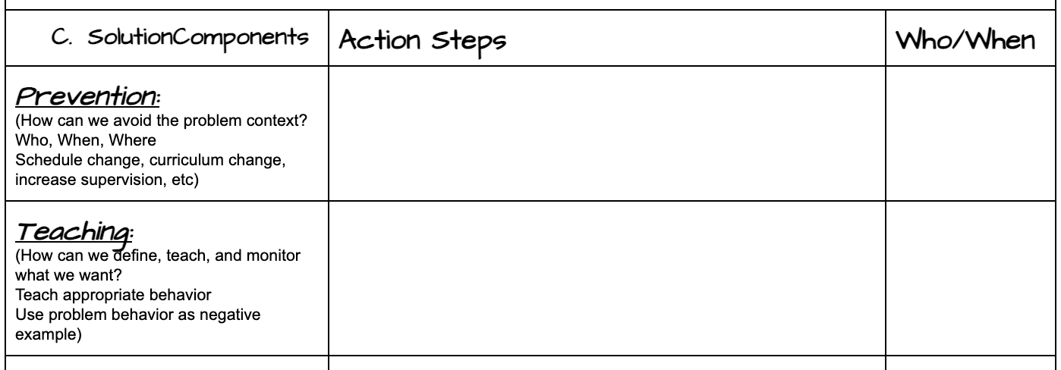
Activity 2C: Work through Solution Components and Action Steps
MN PBIS Implementation Workbook-Day 8 Activity 2
Data-based Decision Worksheet
Notes:
Now you try using your own Precision Statement and corresponding Goal. Refer to the Activities 1.13 & 1.12 document or have Activity 2C handout.
Depending on available time, teams can work on this portion right now, or complete the upcoming slides and emphasize Activity 2C be completed during team work time.

Slide 31
Data Decision-Making Process
Precision Problem Statement
Monitor Outcome vs Goal
Set Measurable Goal
Use Data
Monitor Fidelity of Plan
Develop Solution & Action Plan
Notes:
We’ve considered the initial steps in the data decision-making process of developing a Precision Problem Statement, Setting Measurable Goal, and Developing Solution & Action Plan. The next step is for your team to monitor fidelity as you implement the plan.

Slide 32
Monitor the Fidelity of Plan
Place it on your next PBIS Agenda
Develop extra check-ins on goal as needed
Make sure the right people are in place to implement the action plan
Communicate with staff
Continue to collect data
Notes:
Here are five actions your team can implement to monitor the plan. Regular check-ins on implementation efforts are crucial to success. Too often, teams put plans in place and do not continuously review their implementation efforts. Research indicates a plan (intervention) should generally be in place for at least 4-6 weeks before making significant changes. This allows the process to be tested over an ample amount of time. Make this step a priority!

Slide 33
Data Decision-Making Process
Precision Problem Statement
Monitor Outcome vs Goal
Set Measurable Goal
Use Data
Monitor Fidelity of Plan
Develop Solution & Action Plan
Notes:
Related to monitoring fidelity of the plan is Monitoring Outcome vs Goal.

Slide 34
Monitor Outcome vs Goal
Place it on your PBIS Agenda for when you wish to follow-up
Bring your new outcome data based on your SMART goal & Solution Development
Evaluate if you met your outcome or need to create an updated goal
Keep the new process/procedure/system in place or start the solution development with a new goal
Notes:
Here are four actions for teams to implement when monitoring their goal. Again, this should be a priority to determine if goal was met or needs adjusting to match progress.

Slide 35
Think About Your Process
Carve out time during your Tier 1 PBIS Team meeting to do this work
Add the components to your agenda
Come to your meeting with your precision statement
Work through setting a SMART goal
Develop an action plan based on your solution components and communicate this plan
Monitor the plan
Monitor the outcome
Repeat as necessary
Notes:
Encourage teams to reflect back on the activities during this session. In summary, review the listed ideas of the data based decision-making process. Teams should critically reflect on how they may be able to change their processes when not successfully looking/working though data. Do teams need to be combined, focus shifted, adopt new strategies for looking at data, etc?

Slide 36
Team Implementation Planning
Teams will prepare and plan for data decision-making:
finish practicing 5-step decision-making process - Activity 2A-2C, p. 60 or data activity worksheet
refer to Cultural Responsiveness Field Guide - p 25
include Data Decision-Making process in Overall Action Plan
Professional Development
How and when will you bring this information back to staff?
Update your action plan as needed for
1.12-1.13

