Slide 1
Tier 1 Team Training
Day 9
Introducing Tier 2 Systems
Updated December, 2022
Notes:
Make sure attendees know this is an introduction to Tier 2, still need to have a solid Tier 1 before moving on to this next step. This is a whole day workshop when your team is ready. It’s one of the reasons we have discussed Tier 1 Sustainability first prior to Introducing Tier 2 strategies.
Updated 7/2018

Slide 2
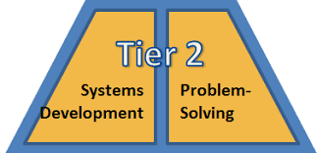
Tier 2: Implementation Fidelity
TFI Sub-Scale: Teams
TFI 2.1 | Team Composition
TFI 2.2 | Team Operating Procedures
TFI Sub-Scale: Evaluation
TFI 2.10 | Level of Use
TFI 2.11 | Student Performance Data
TFI 2.12 | Fidelity Data
TFI 2.13 | Annual Evaluation
TFI 2.3 | Screening
TFI 2.4 | Requesting Assistance
TFI Sub-Scale: Interventions
TFI 2.5 | Options for Tier II Interventions
TFI 2.6 | Tier II Critical Features
TFI 2.7 | Practices Matched to Student Need
TFI 2.8 | Access to Tier I Supports
TFI 2.9 | Professional Development
Notes:
This is our professional roadmap for Tier 2 and the items you will be addressing when you are ready for Tier 2.

Slide 3
Learning Expectations
EXPECTATION | BEHAVIOR
Be Responsible | Make yourself comfortable Take care of your needs (water, food, restroom, etc.) Action plan to implement what you are learning Follow through on your action items
Be Respectful | Turn cell phones off or to “vibrate” Listen attentively while others are speaking Have only the training materials up on your computer/tablet/phone
Be Engaged | Ask what you need to know to understand and contribute Contribute to the group by sharing relevant information and ideas
Notes:
‹#›
Let’s model the behaviors we expect and need from our students by being responsible, respectful, and engaged, paying close attention to item #3 under Be Responsible - Action Plan to implement what you are learning. Always be thinking how to make these ideas real in your school and how to include in your overall Action Plan.

Slide 4
Purpose and Outcomes
Review continuum of support
Understand Tier 2 interventions/supports
Discuss essential components of effective Tier 2 systems
Tier 2 team
Establish criteria to access Tier 2
Determine/identify collection of Tier 2 interventions
Intervention evaluation process (review data)
Notes:
Review to set the context/stage for work. The focus today is to provide an introduction to Tier 2 systems that include …..

Slide 5
Introduction to Tier 2 Tasks
Teams will ….
analyze their current Tier 2 systems
review their Tier 2 team membership & responsibilities
examine criteria for accessing Tier 2 supports
learn about common Tier 2 interventions
update Overall Action Plan to include Tier 2 interventions
Notes:
Here are the tasks teams will be instructed to complete during and/or following this presentation.

Slide 6
Continuum of Support
Tier 3
Individualized
Intense Intervention
Tier 2
Some Students
Targeted Intervention
Tier 1
All Students
All Staff
All Settings
Notes:
Efficient process for students to move along continuum of support
Fluid system - all students continue to have access to Tier 1 supports, other tiers are an extension of Tier 1

Slide 7
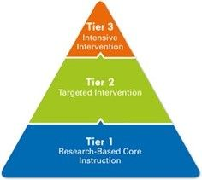
Build a Solid Tier 1
Tier 1 will reduce the need for Tier 2
There is so much power in Tier 1 to:
Prevent problems from happening
Reduce current problems
Build connections and form relationships
Establish systems and practices that are efficient and effective for your school
Use data to determine what your school community needs and decide how to meet that need as a school staff
Is what we are doing working?
Notes:
Keep building and adjusting, use the strengths that you have, easy to compare to other schools. TEAM effort!

Slide 8
Tier 2 is …
Students not responding to Tier 1 supports
Students that share a common need
Interventions remain constant - not tailored to individual student
Low effort for teachers/staff - Can be implemented by any/all school staff
Notes:
Who is Tier 2 for?

Slide 9
Table Talk Reflection
Is Tier 2 what you thought it was?
What components do you have at your site?
What are you missing?
Notes:
Give individuals times to think. Assuming teams have some sort of Tier 2 in place, but may not call it that. More defined process with more Tier 2 training.

Slide 10
Tier 2 Team
Responsible for meeting regularly:
Review data to identify new Tier 2 referrals
Evaluate intervention effectiveness for students currently accessing Tier 2
Disseminate information & provide PD training to school staff
Consider staff availability:
Do not need to be on the team to implement intervention(s)
Notes:
A quick snapshot of Tier 2 Team responsibilities.

Slide 11
Table Talk Reflection
Do you have a Tier 2/3 team at your school?
If so, who is on the Tier 2 team?
What is that team called and how do they function?
Notes:
Some common Tier 2 Team names are Behavior Support Team (BST), Student Assistance Team (SAT), Behavioral Assessment Team (BAT) –might already have something, but maybe not clear process, or clear understanding of team’s function. Have a few teams share out

Slide 12
Criteria for Accessing Tier 2 Support
Develop a process for identifying students
Train Teachers on the process
Make it accessible by all
Consistent and clear processes
strengthen the system
Notes:
Need to have some sort of criteria for how students receive Tier 2 support. You decide as a building what works for you.

Slide 13
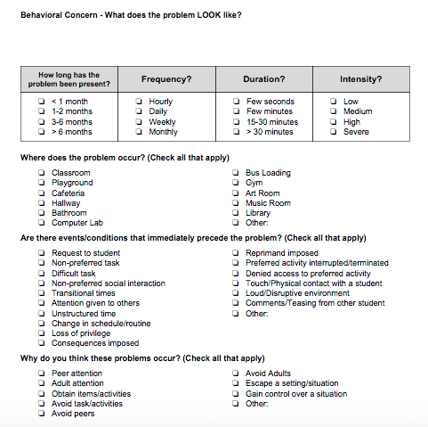
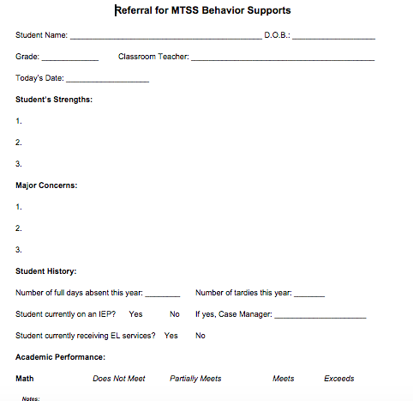
Example Criteria to Access
Academic performance (performing below grade level)
ODR data (2-5 office discipline referrals)
Attendance (frequently absent, tardy or truant)
Setting events (life outside of school)
Universal Screening Data
Performing at grade level
Office referrals are down
Life outside of school has stabilized
Notes:
A checklist of common criteria to review when assessing the need for Tier 2 interventions.

Slide 14
Determine Tier 2 Interventions
Based on common student need
Avoid including too many intervention options
Interventions must include:
Additional time for instruction and skill development
Increased structure/predictability
Increased opportunities for feedback
Notes:
Skill development - - Establish a Routine - - Establish Acknowledgment System (tangible & non-tangible) - - Daily Progress Report - - Connection with Staff - -
Positive reinforcement and corrective feedback - - Always available for students - - Implementation is possible within 3-5 days of determining student need

Slide 15
Training-Professional Development Considerations
Is everyone trained on the interventions you selected?
Does everyone know their role in the intervention?
Is there time built into the professional development calendar?
Notes:
Ensure that everyone understands what Tier 2 is about, how to screen and access this support, as well as how to implement the interventions.

Slide 16
Tier 2 is Not About….
the number of interventions,
it is about quality of the interventions!
Notes:
Similar to teaching academics, to be most effective, it’s advantageous to develop a small number of well-thought-out interventions that connect well to your students and your school system. Let’s take a deeper look at a few of the more common Tier 2 interventions used by schools.

Slide 17
Tier 2 Intervention:
Check In – Check Out
Involves a daily routine where the student:
Checks in each morning with a designated adult to review daily behavioral goals aligned with school wide expectations
Throughout day teachers provide rating and behavioral feedback regarding expectations and observed behavior
Review points and receive feedback (and reward if met goal) at end of day with designated adult
Notes:
The first Tier 2 intervention to share with you and one of the most widely used interventions is Check-in, Check-out. In general, most Check-in, Check-out interventions involve some kind of daily routine, or as close to daily as possible. Review slide info … and insert your own Tier 2 CICO example here.

Slide 18
Tier 2 Intervention:
Social Skills Groups
Build this intervention into Tier 2 system proactively
Avoid attempting to create and schedule groups reactively during school year
Requires time, resources, and is typically poorly implemented = NOT EFFICIENT
Identify several staff (e.g., social worker, guidance counselor..etc.) that will implement social skills groups
Schedule blocks of time into staff schedules at beginning of school year
No need to identify group focus at this time - can be determined when student need is observed
Efficiency is key!
Notes:
A second Tier 2 intervention commonly used is some form of a Social Skills Group. Social Skills Groups is to be PROACTIVE and create schedules IN ADVANCE - at the beginning of the school year or as early as possible. If we compare to academics, having a scheduled “class” or “social skills group” provides a sense of priority rather than reacting to issues and not having a solid plan in place. Most Social Skills Groups will meet 1x or 2x per week pending needs.

Slide 19
Tier 2 Intervention:
Behavior Contract
MUST be the same for each student if used as Tier 2 intervention
Avoid creating individualized contracts
Implemented similar to CICO - without scheduled check in(s)/out(s)
Use point sheet (can be same as CICO sheet) to provide feedback on behavior throughout day
Contract Details:
Outlines school wide expectations
Explains point system and contingency
Example: earn 80% of points = 10 minutes of free time at end of day
Notes:
Our third intervention is placing a student on a behavior contract. A contract is a hybrid of Check-in, Check-out, and often facilitated by a counselor or social worker in partnership with classroom teachers and other specific staff. The student is given more ownership, often using some kind of a progress report sheet to each teacher. Some schools have gone to electronic means to gather individual student data. (Review slide info)

Slide 20
Group Talk
What interventions do you have at your site? Consider mapping out your interventions:
Tiers 2 and 3 Resource Map
Notes:
Now that you’ve got a taste of Tier 2 Interventions, let’s take a brief moment, five minutes, to get with your team members and talk about what interventions you have at your site. And then, during the upcoming work time or when your team has an opportunity to get together, there’s a nice Tier 2 & 3 Resource Mapping template that can assist in guiding your team when developing a plan for interventions. A link to that template is located here on the this slide and on your agenda.

Slide 21
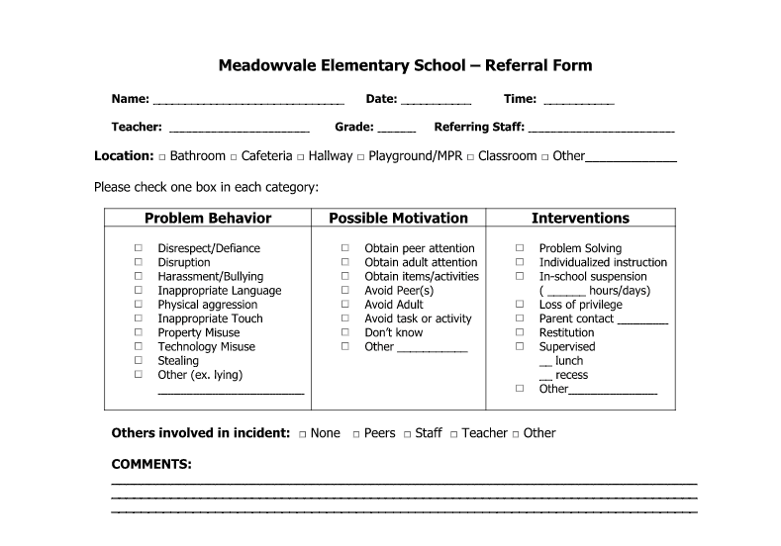
Student Intervention Selection
Process for selecting intervention
TEAM decision
Use data
Perceived motivation on referral form
Avoid guessing
Be purposeful when selecting an intervention - this sets the student up for success!
Notes:
As part of the “system”, an intervention is selected by the Tier 2 team using data - identifying possible motivation is a key step in the process and used to identify appropriate intervention. Review slide information.

Slide 22
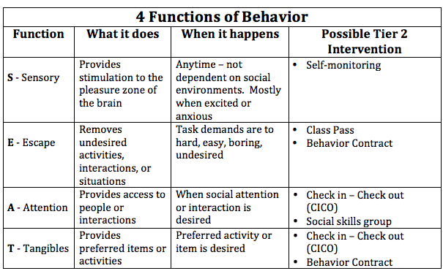
Why Behavior Happens
Notes:
To help teams identify appropriate interventions, here’s a quick reference to use as a guide for developing those interventions.

Slide 23
Intervention Evaluation
DATA are required to determine if intervention is working or not
Data Based Decision-Making
Fade out intervention?
or
2. Provide additional supports?
IMPORTANT: Data collection is necessary for each Tier 2 intervention
Notes:
To emphasize, Data are necessary to determine if an intervention is working and for students to move along the continuum - without data to evaluate intervention effectiveness, there is no continuum.

Slide 24
Intervention Evaluation Process
Determine process for fading out each intervention and “graduation”
TEAM decision
Examples:
8/10 days met percentage goal ------- Reduce check ins
8/10 days met percentage goal with reduced check ins --- exit intervention
Determine process if progress not made
TEAM decision
Move to Tier 3 or continue intervention
How/where is intervention data collected and analyzed?
Determine who will compile student data sheets
Is data easily accessible?
Stack of point sheets vs spreadsheet generated graph
Review student data at least monthly to measure progress
Notes:
Here’s a quick look at some guidelines for evaluating an intervention. (Summarize slide info)

Slide 25
What to do when:
a student does not make progress
with Tier II intervention?
OR
challenging behavior worsens?
Notes:
So what happens when a student is not making progress with Tier 2 intervention? (Again, intervention should have been in place for at least 4 weeks)

Slide 26
Individualize Tier 2 Intervention
Notes:
If not successful, there should be a gradual fade into an individualized intervention. Here again is where the student receives more intense intervention. Often similar to what was happening within Tier 2.

Slide 27
Tier 2 Modification Examples
Tier 2
CICO
Change CICO contact person
Change reward/incentive options
Behavior Contract
Change reward/incentive options
Switch from paper point sheet to electronic
Tier 3
CICO
Adjust goal percentage
Identify specific behaviors (instead of general school-wide expectations)
E.g., Keep hands to self, raise hand before speaking in class...etc.
Additional check-ins
Behavior Contract
Adjust goal percentage
Modify general contract
E.g, specific individualized behaviors
Notes:
Here are some examples of what we mean when fading to Tier 3. (Review slide info)

Slide 28
Team Implementation Planning
Teams will prepare and plan for Tier 2 Interventions:
Confirm who is on Tier 2 team and complete Activity 1: Tier 2 Systems Checklist, p. 63. Implementation Planning Workbook p. 63
Have your Tier 2 team complete the TFI Tier 2 by end of the year.
Use the Tier 2 Features Checklist when developing your interventions.
Map out the interventions you use - remember quality versus quantity. Tiers 2 and 3 Resource Map
Train your Tier 2 team on this work and let them run with it!
Professional Development
How and when will you bring this information back to staff?
Update your action plan as needed for
Tier 2
Notes:
Next steps and guidelines for developing a solid Tier 2 system of supports. (Review slide information noting links are included to respective documents, also located on the agenda)

