Slide 1
PBIS Team
Tier 1
Virtual Training Day Artifact Template Introduction
Notes:
Updated June 2020

Slide 2
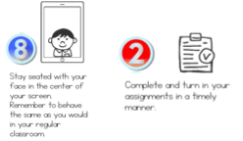
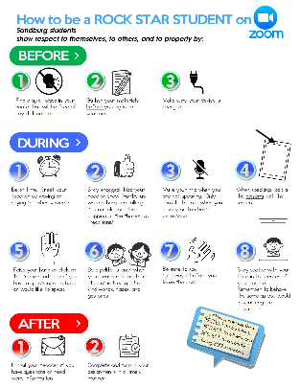
Learning Expectations for Virtual Training
EXPECTATION | BEHAVIOR
Be Responsible
Be Respectful
Be Committed
1
2
3
4
5
6
7
8
9
10
Awesome expectations from the team at Sandburg Elementary, SPS186!
Notes:
2

Slide 3
Purpose & Outcomes
Purpose:
Create a tool to show your progress
of PBIS implementation
Outcome:
A comprehensive document that can be used to organize your PBIS products, share your PBIS implementation with stakeholders and train staff.
Notes:
RIPs will look at the presentations after each training to better understand where teams are at and offer individual support to each team

Slide 4
Food for thought
“PLC products are NOT something else to do…products guide the process. Monitoring is essential to make sure team’s have what they need to be successful.”
Notes:
Comparing this quote about PLC products to the artifact template as a useful tool rather than just another thing to do.
This quote was found on Twitter so there is no reference as to who said it.

Slide 5
Example Templates
Write this down in a safe place!
http://bit.ly/PBISArtifactsFolders
Notes:
Click in to the folders to show some examples
Teams will have time at each training to work on these
Artifact templates will be used to showcase work being done to other teams

Slide 6
Resource Guide for Artifact Template
https://goo.gl/9Q7mwz

Slide 7
Checklist for Artifact Template Located on first slides
https://goo.gl/F57xvY
Notes:
This tool can be used as a way to think about what you might want to include on your template.

Slide 8
Where to Find Your Template
http://bit.ly/PBISArtifactsFolders
Notes:
You will be able to view templates from all other teams across the state in Cohort 13 or Cohort 14

