Slide 1
PBIS Team Training 3A Non-Classroom

Slide 2
Learning Expectations
EXPECTATION | BEHAVIOR
Be Responsible | Make yourself comfortable Take care of your needs (water, food, restroom, etc.) Action plan to implement what you are learning Follow through on your action items
Be Respectful | Turn cell phones off or to “vibrate” Listen attentively while others are speaking Have only the training materials up on your computer/tablet/phone
Be Engaged | Ask what you need to know to understand and contribute Contribute to the group by sharing relevant information and ideas
Notes:
2

Slide 3
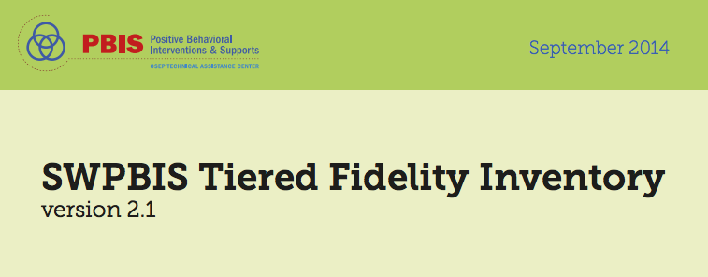
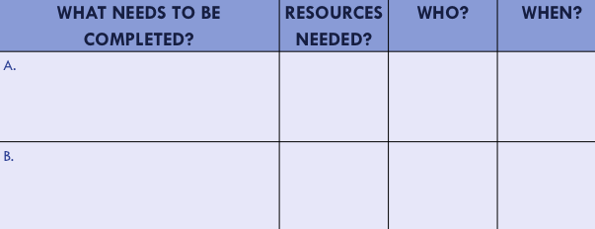
Organization of Modules
Content:
Aligned to TFI Items 1.1 – 1.15 and Classroom Management Practices
Activities/Team Time: Activities for Fluency
Self-Assessment:
Tiered Fidelity Inventory
Action Planning: Applying the core content to your school
Notes:
These are the icons that you will see throughout the training and will serve as a guide and a prompt to the content of each slide.

Slide 4
Tier 1: Professional Learning Roadmap
TFI Sub-Scale: Team
TFI 1.1 | Team Composition
TFI 1.2 | Team Operating Procedures
TFI Sub-Scale: Evaluation
TFI 1.12 | Discipline Data
TFI 1.13 | Data-based Decision Making
TFI 1.14 | Fidelity Data
TFI 1.15 | Annual Evaluation
TFI Sub-Scale: Implementation
TFI 1.3 | Behavioral Expectations
TFI 1.4 | Teaching Expectations
TFI 1.5 | Problem Behavior Definitions
TFI 1.6 | Discipline Policies
TFI 1.7 | Professional Development
TFI 1.8 | Classroom Procedures
TFI 1.9 | Feedback and Acknowledgement
TFI 1.10 | Faculty Involvement
TFI 1.11 | Student/Family/Community Involvement
Notes:
Point Out that non-classroom is not a piece of the TFI, but it has an important part in PBIS implementation

Slide 5
SWPBS Subsystems
School-wide
Classroom
Family
Non-classroom
Student
Notes:
*
Have audience callout some non-classroom areas
Review the School-wide system’s key components and emphasize this morning’s portion of the training focuses on non-classroom settings. Point out that most will assume behavioral issues are generated from the classroom. However, we have learned student behavioral concerns are often generated in unstructured areas of the building.

Slide 6
Non-Classroom
Positive expectations & routines taught & encouraged
Active supervision by all staff
Scan, move, interact
Pre-corrections & reminders
Positive reinforcement

Slide 7
Non-classroom areas
What is the non-classroom area in your building that causes the biggest disruption to learning in your class?
Notes:
1 minute turn and talk

Slide 8
Purposes
Development and implementation of a formal, consistent, and continuous system of SW-PBIS in non-classroom settings.
To review critical features & essential practices of active supervision.
Notes:
Point out the key feature of improving student behavior in non-classroom settings is to involve all school personnel in Active Supervision, emphasizing ALL school staff.
*

Slide 9
Outcomes
Teams will update their action plan to include a method, materials, personnel etc. needed to train staff on the use of Active Supervision.

Slide 10
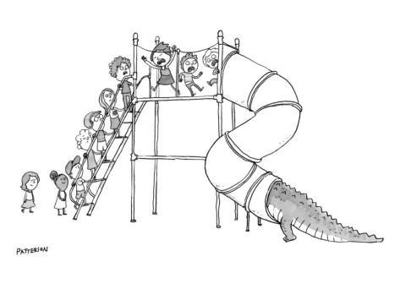
Using Data – Elementary School
An elementary school principal found that over 45% of their behavioral incident reports were coming from the playground.

Slide 11
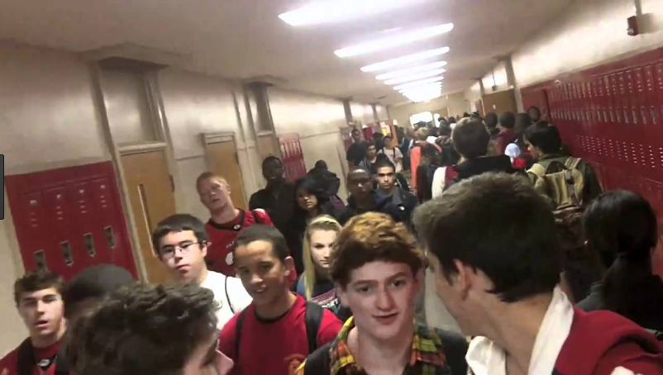
Using Data – High School
High school assistant principal reports that over 2/3 of behavior
incident reports come from “four corners.”

Slide 12
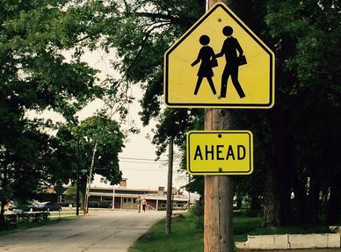
Using Data – Middle School
A middle school secretary reported that she was getting at least one neighborhood complaint daily about student behavior on & off school grounds.
Notes:
*

Slide 13
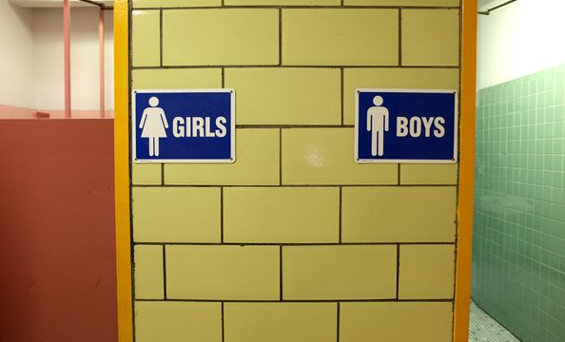
Using Data – Health Office
High school nurse lamented that “too many students were asking to use her restroom during class transitions.
Notes:
*

Slide 14
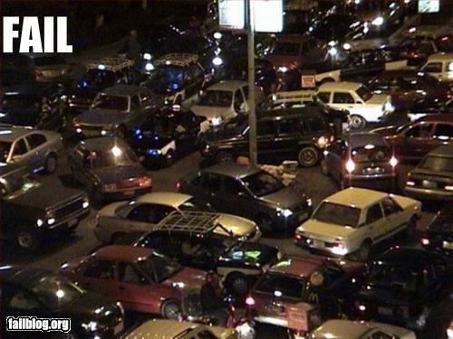
Using Data – Parking Lot
At least 2 times/month, police are called to settle arguments by parents & their children in parking lot
Notes:
*

Slide 15
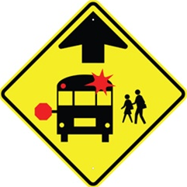
Using Data - Bus
Over 50% of referrals occurring on “buses” during daily transitions.
Notes:
Often bus referrals are more prevalent in elementary and middle schools than they are in the high schools.
*

Slide 16
Non-classroom Settings
Particular times or places where supervision is emphasized:
Cafeteria, hallways, playgrounds, bathrooms, buses, parking lots, study halls, media center, assemblies, sporting events, dances
Wherever instruction is not available as behavior management tool
Notes:
*

Slide 17
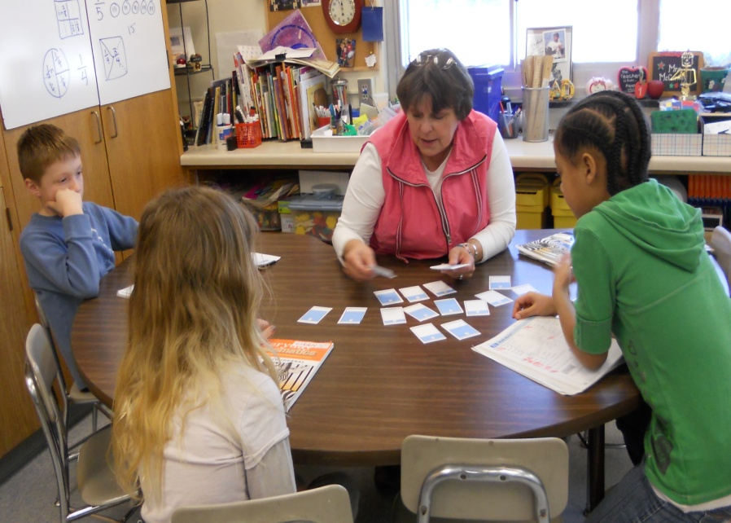
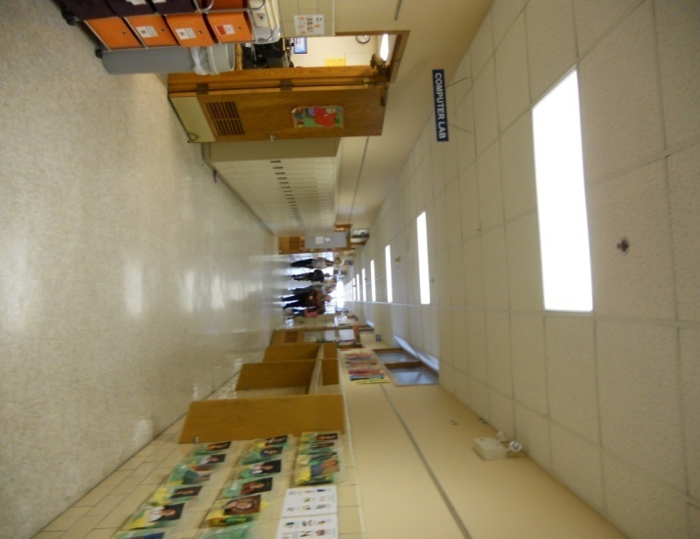
Classroom v. Non-classroom
Classroom
Teacher directed
Instructionally focused
Small # of predictable students
Non-classroom
Student focused
Social focus
Large # of unpredictable students
Notes:
*

Slide 18
5 Minute Activity
Pick 1 problematic non-classroom setting you have experienced
Identify 2-3 features of problem
Identify 2-3 possible solutions
Report (<1 min.) main features of your example

Slide 19
Social Competence & Academic Achievement
Positive
Behavior
Support
OUTCOMES
SYSTEMS
Supporting
Decision
Making
Supporting
Staff Behavior
DATA
PRACTICES
Supporting
Student Behavior
Notes:
*

Slide 20
SYSTEMS FEATURES
School-wide implementation
All staff
Direct teaching 1st day/week
Regular review, practice, & positive reinforcement
Team-based identification, implementation, & evaluation
Data-based decision making
Notes:
*

Slide 21
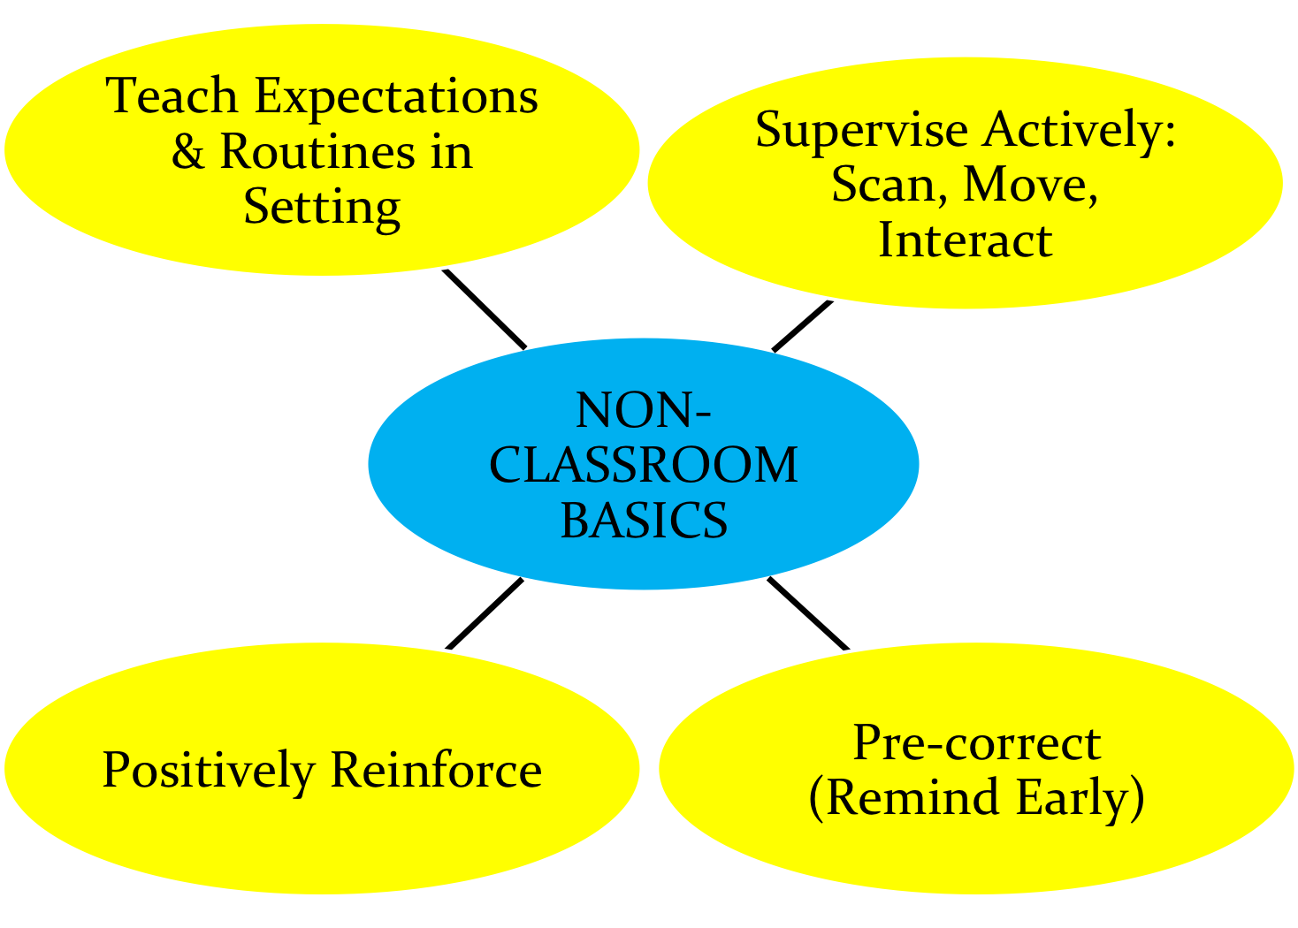
Non-Classroom Basics
What, where, when, who, how at YOUR school?
Notes:
Turn and talk - teaching expectations, discuss pre-correction before moving off this slide. Point out that active supervision and positive reinforcement go hand in hand.

Slide 22
Identify Expectations
Physical Environment
Routine Expectations
Staff Behavior
Student Behavior

Slide 23
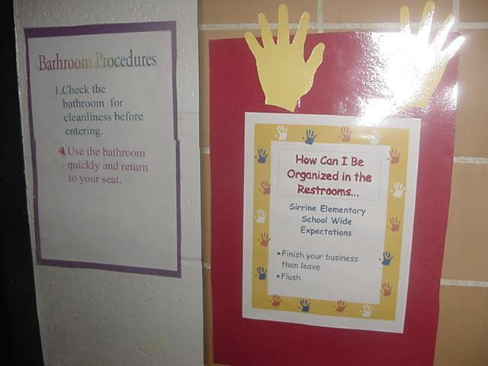
Expected behaviors are visible
Notes:
*

Slide 24
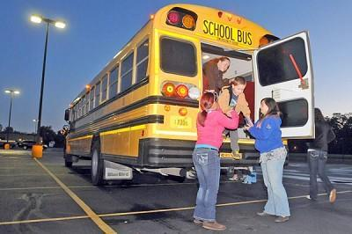
Teach Expectations in the Setting
Notes:
Point out that many PBIS schools – particularly at the elementary level – use a checkoff system where expectations are taught in each setting by different staff – and students have their list “checked off” for each non-classroom setting.
*

Slide 25
Lesson
TEACH - Overview of the lesson: “Today we are going to talk about how ‘we are kind, responsible, and safe in the restroom.”
Show the Teaching Poster of Expectations with pictures and walk through the expectations.
Discuss the details of the expectations with students.
MODEL – Adults demonstrate examples of not following expectations.
Choose a couple of students to “show” examples of following the expectations.
Discussion. “Tell me what Kind, Responsible, and Safe look like, feel like, or sound like in the restroom.”
PRACTICE
Have all students line up outside the restroom, and two at a time come into the restroom to show the following of the restroom expectations with an adult monitoring.
Debrief with students any questions. “Are there any questions you have about being Kind, responsible, and safe behavior in the restroom?”

Slide 26
Hallway Expectations
HS Level
Notes:
https://www.youtube.com/watch?v=65eDkEjkQU8 2:04

Slide 27
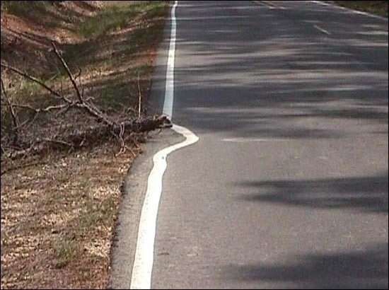
Why does everyone need to be involved?
Staff outnumbered
Unified Front/Same page
Adult presence
Prompts desired behavior
Deters problem behavior
“Being a good citizen”
Contribute to school climate
“Not my job”
Notes:
*

Slide 28
1. At least 4 positives for each negative student contact?
Contextually, developmentally, culturally appropriate
Genuine, efficient, effective
Specific, meaningful
Varied in type and form

Slide 29
“Good morning, class!”
Teachers report that when students are greeted by an adult in morning, it takes less time to complete morning routines & get first lesson started.
Notes:
*

Slide 30
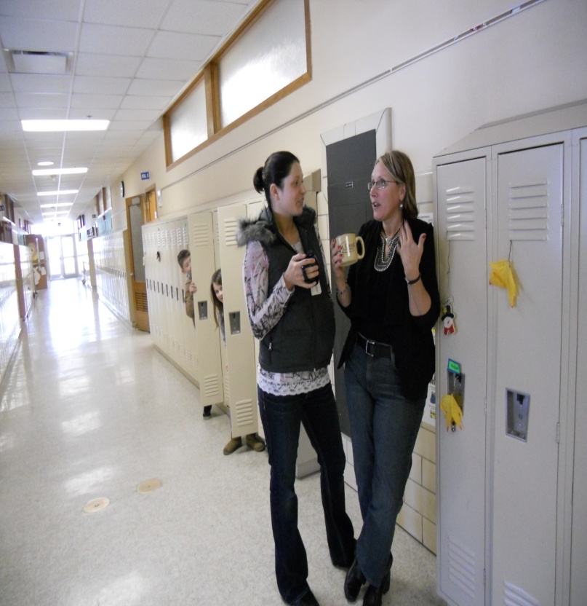
2. Did I move continuously throughout the area?
Obvious
Positive
Interactive
Unpredictable

Slide 31
3. Did I scan frequently?
Head up
Make Eye Contact
Open Body Posture
Head/Body orientation
Varied type/form
Predictable vs Unpredictable

Slide 32
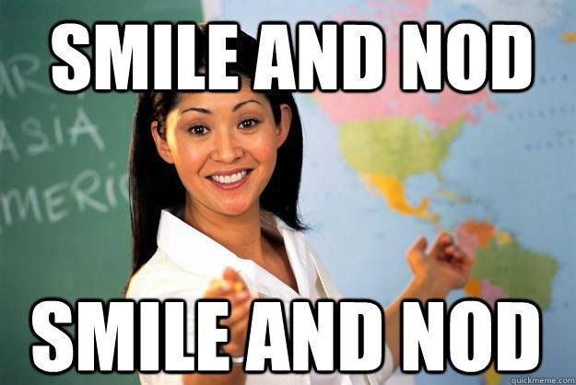
4. Positive Interactions with most students?
Contextually, developmentally, culturally appropriate
Genuine, efficient, effective
Specific, meaningful
Varied in type and form

Slide 33
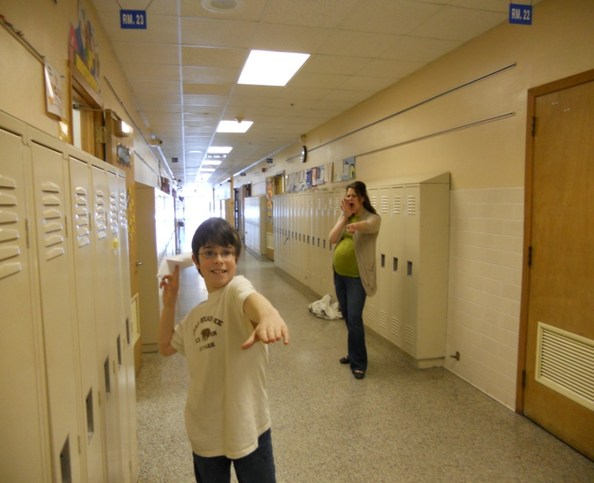
5. Did I handle minor rule violations efficiently?
Quickly
Privately
Culturally, contextually and developmentally appropriate
Neutral, Business-like
Reinforce rule-following
Notes:
Culturally, contextually developmentally appropriate

Slide 34
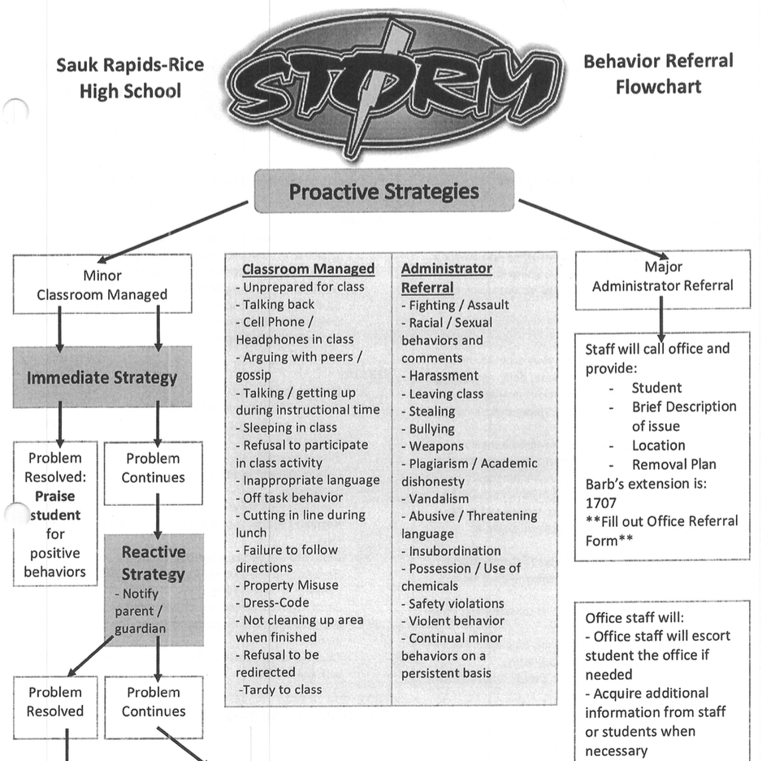
6. Follow SW procedures for major rule violations?
Calm and businesslike
Follow procedure
Disengage if escalation
Pre-correct for next occurrence
Look for opportunity to reinforce

Slide 35
Stop, Walk and Talk

Slide 36
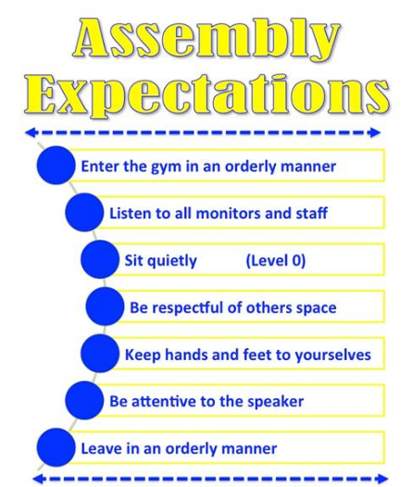
7. Fluent with SW positive expectations?
Positively stated and visible
Taught directly across contexts
Context specific behavioral examples
Frequently acknowledged
Culturally and contextually appropriate

Slide 37
Behavior Matrix
Notes:
Local Elem. example

Slide 38
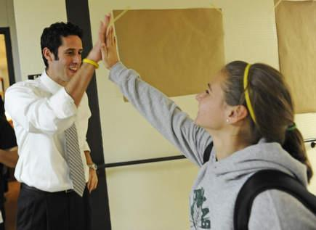
8. Positively acknowledge at least 5 different students in setting?

Slide 39
Active Supervision –Video!
Notes:
Possible Videos:
Local Elementary Example 2:03 - https://www.youtube.com/watch?v=sxwl_TiB1xU
Local Secondary Example 2:13 - https://www.youtube.com/watch?v=e9FU2WybbYk
Systematic Supervision MS 2:13 - https://www.youtube.com/watch?v=95YA8mfY-2c
Systematic Supervision HS 2:14 - https://www.youtube.com/watch?v=rCqIzeU-0hQ&t=14s
Systematic Supervision Elem- 2:07 - https://www.youtube.com/watch?v=5JB2xSf-S58
*

Slide 40
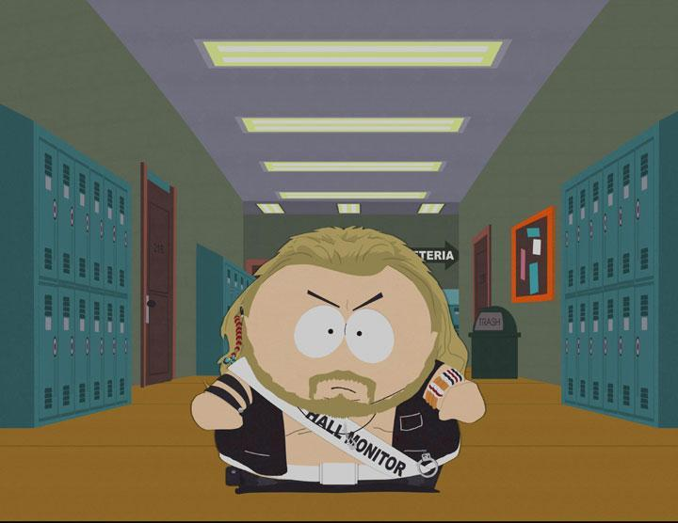
Basics
“Active Supervision:
Self-Assessment”
YES or NO
Notes:
*

Slide 41
Non-Classroom Management: Self-Assessment
Name______________________________ |  | Date_____________
Setting □ Hallway □ Entrance □ Cafeteria □ Playground □ Other_______________ |  | Time Start_________ Time End _________
Tally each Positive Student Contacts | Total # | Ratio of Positives to Negatives: _____: 1
Tally each Negative Student Contacts | Total #
Notes:
*

Slide 42
Supervision Self-Assessment
Did I have at least 4 positive for 1 negative student contacts? | Yes No
2. Did I move throughout the area I was supervising? | Yes No
3. Did I frequently scan the area I was supervising? | Yes No
4. Did I positively interact with most of the students in the area? | Yes No
5. Did I handle most minor rule violations quickly and quietly? | Yes No
6. Did I follow school procedures for handling major rule violations? | Yes No
7. Do I know our school-wide expectations (positively stated rules)? | Yes No
8. Did I positively acknowledge at least 5 different students for displaying our school-wide expectations? | Yes No
Overall active supervision score: 7-8 “yes” = “Super Supervision” 5-6 “yes” = “So-So Supervision” <5 “yes” = “Improvement Needed” | # Yes______
Notes:
*

Slide 43
Purpose of the Self-Assessment
Determine the extent effective non-classroom management practices are in place.
Teach best practices.
Develop an action plan for enhancing or maintaining practices – what, when, how, by when?
Evaluate impact of changes in practice.
Can be completed as a self-assessment or by an observer.

Slide 44
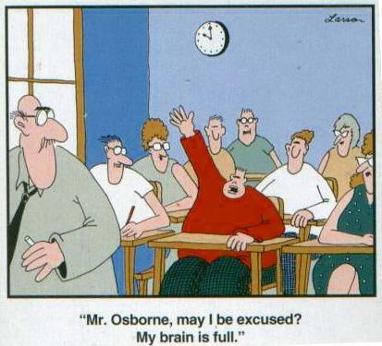
Time for planning!

Slide 45
Action Plan:
Discuss teaching/re-teaching expectations in non-classroom settings.
Active Supervision
Who needs training?
What non-classroom settings should be the focus in your school?

Slide 46
Appreciation is given to the following for their contributions to this Professional Learning:

