Slide 1
PBIS Team Tier 1 Virtual Training Day 3
Classroom Practices #1-3 (TFI 1.8)
Notes:
Updated September 2020

Slide 2
Purpose and Outcomes
Purpose:
Learn about and begin to develop an implementation plan for 3 of the 6 core PBIS classroom practices.
Outcomes:
Tier I features are implemented within classrooms and are consistent with school-wide systems. (TFI 1.8)

Slide 3
Tier 1: Professional Learning Roadmap
TFI Sub-Scale: Team
TFI 1.1 | Team Composition
TFI 1.2 | Team Operating Procedures
TFI Sub-Scale: Evaluation
TFI 1.12 | Discipline Data
TFI 1.13 | Data-based Decision Making
TFI 1.14 | Fidelity Data
TFI 1.15 | Annual Evaluation
TFI Sub-Scale: Implementation
TFI 1.3 | Behavioral Expectations
TFI 1.4 | Teaching Expectations
TFI 1.5 | Problem Behavior Definitions
TFI 1.6 | Discipline Policies
TFI 1.7 | Professional Development
TFI 1.8 | Classroom Procedures
TFI 1.9 | Feedback and Acknowledgement
TFI 1.10 | Faculty Involvement
TFI 1.11 | Student/Family/Community Involvement
6 Core Classroom Practices
1 | Physical Environment
2 | Classroom Teaching Matrix (Expectations, Routines and Procedures)
3 | Active Supervision
4 | Encouraging Appropriate Behavior
5 | Continuum of Response Strategies for Inappropriate Behaviors
6 | Engagement and Opportunities to Respond

Slide 4
It is important…
to have
both non-classroom
and classroom systems
in place in order
to support
all students

Slide 5
Big Ideas of Classroom Systems
Positive classroom systems provide a felt sense of safety by maximizing predictability.
Positive classroom systems are designed to promote connection and a sense of belonging.
Positive classroom systems teach students how to demonstrate school wide expectations within the routines of the classroom.
Positive classroom systems provide recognition and celebrate success.
Positive classroom systems support behavioral growth that focuses on teaching replacement behaviors, skill building and providing practice opportunities.

Slide 6
Classroom Management Practices
Classroom Management Practices
6 Classroom Practices
Physical environment
Classroom Teaching Matrix (Expectations, Rules, Routines)
Active Supervision
Encouraging Appropriate Behavior
Direct instruction of expectations, rules, routines
Preventative Prompts
Specific Praise for Behavior
Individual Reinforcers
Class-Wide Group Contingency
Continuum of Response Strategies for Inappropriate Behaviors
Praise other students/groups
Specific Error Correction
Etc.
6. Engagement & Opportunities to Respond
Rev 3-16-19. Midwest PBIS Network. Developed through the ongoing research and shared knowledge of many partners, including the National TA Center on PBIS, Midwest PBIS Network, Mid-Atlantic PBIS Network, Missouri PBIS, Lincoln Public Schools, Brandi Simonsen (UConn) & Diane Myers (Texas Women’s University).
Notes:
These are the 6 Classroom Management Practices that research has shown has a positive impact on students.
We want your teachers to have effective strategies that they are all using consistently. Tier I features are implemented within classrooms and are consistent with school-wide systems.
(The classroom is a critical aspect of Tier I training and includes 8 key components. These strategies maximize classroom management to allow for instructional time and less teacher stress!

Slide 7
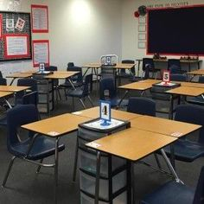
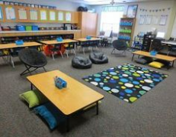
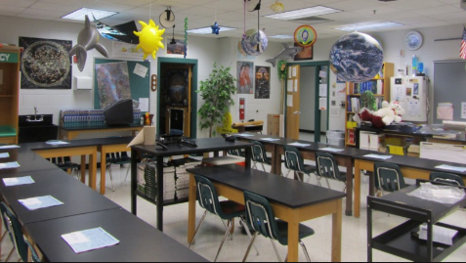
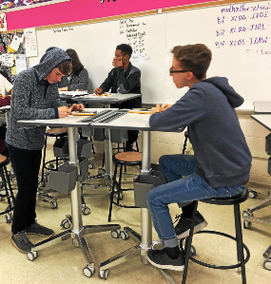
The Physical Environment
Teachers can prevent many instances of problem behavior and minimize disruptions by strategically planning the arrangement of the physical environment (Wong & Wong, 2009)
Does the room allow for traffic flow?
Are materials labeled and easy to access?
Is there a semi-private spot to process emotions and reset?
Does the arrangement promote different types of learning (solo, partner, whole class?)
Does the room offer choice? (i.e. standing, sitting)

Slide 8
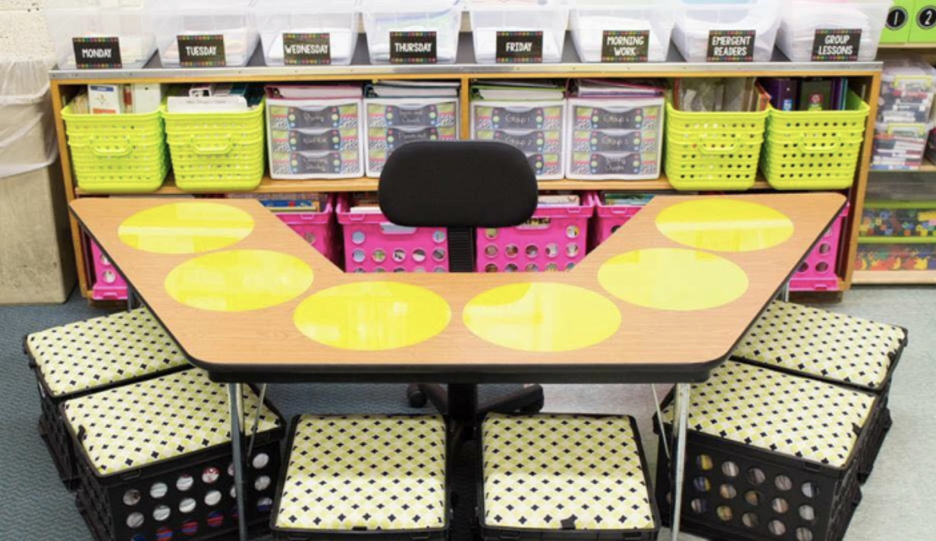
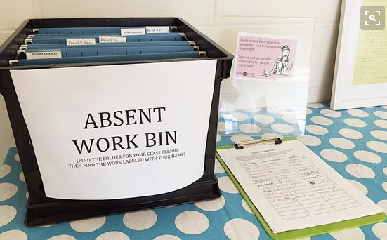
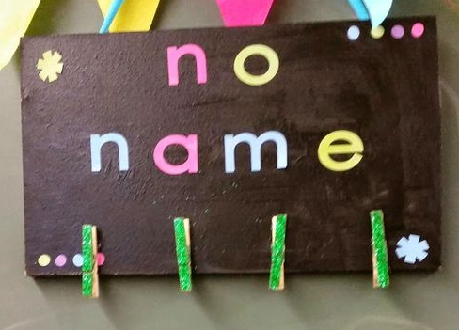
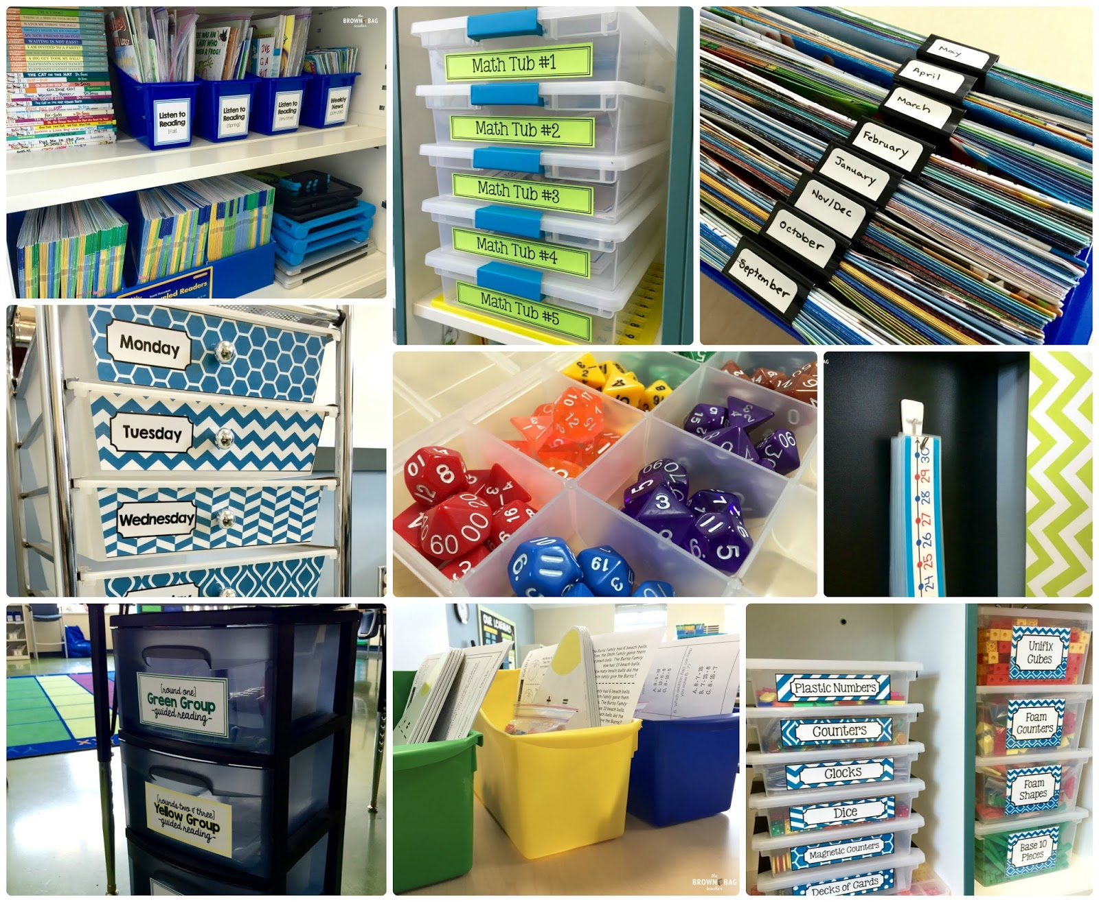
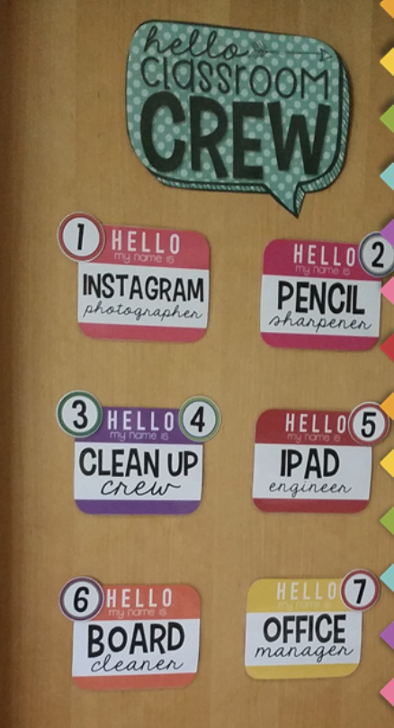
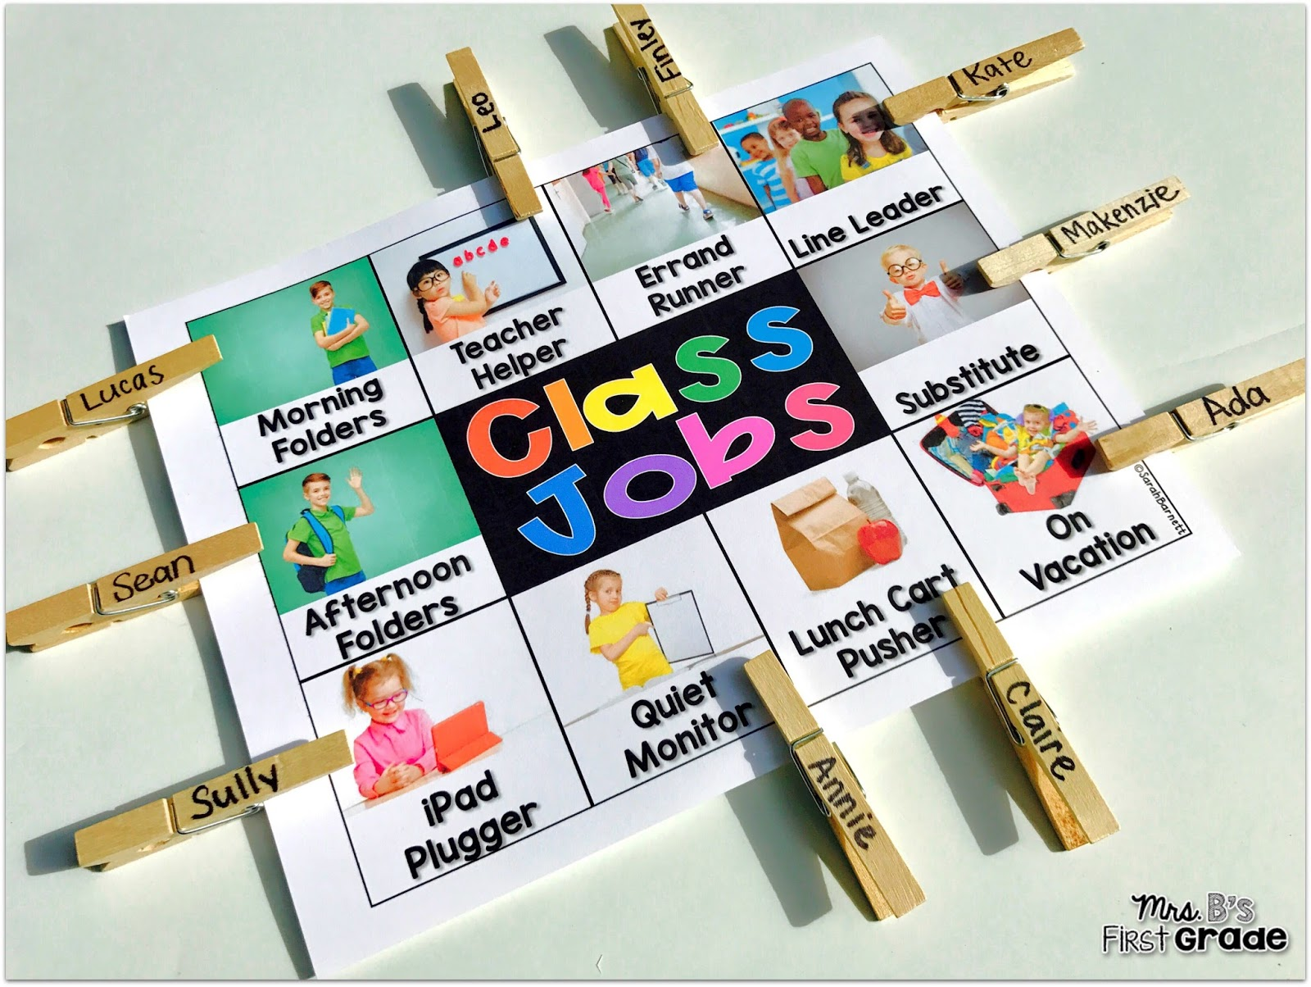
The Physical Environment
Easy Access to Doing & Fixing Things
Easy Access to Supplies

Slide 9
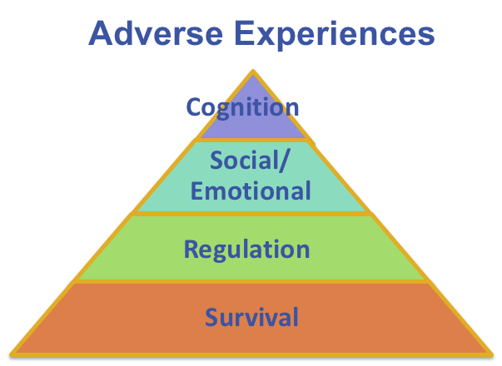
Arrange Orderly Physical Environment
is also trauma informed because
A well-designed classroom environment promotes of sense of safety and security for students impacted by trauma.
Notes:
As we explore the 6 classroom practices, we want to make a link to how each practices is trauma informed. In this strategy, a well designed environment promotes a sense of safety and security for students who have been impacted by trauma. It helps students be able to be less focused on survival and regulation and more focused on social emotional and cognitive learning.

Slide 10
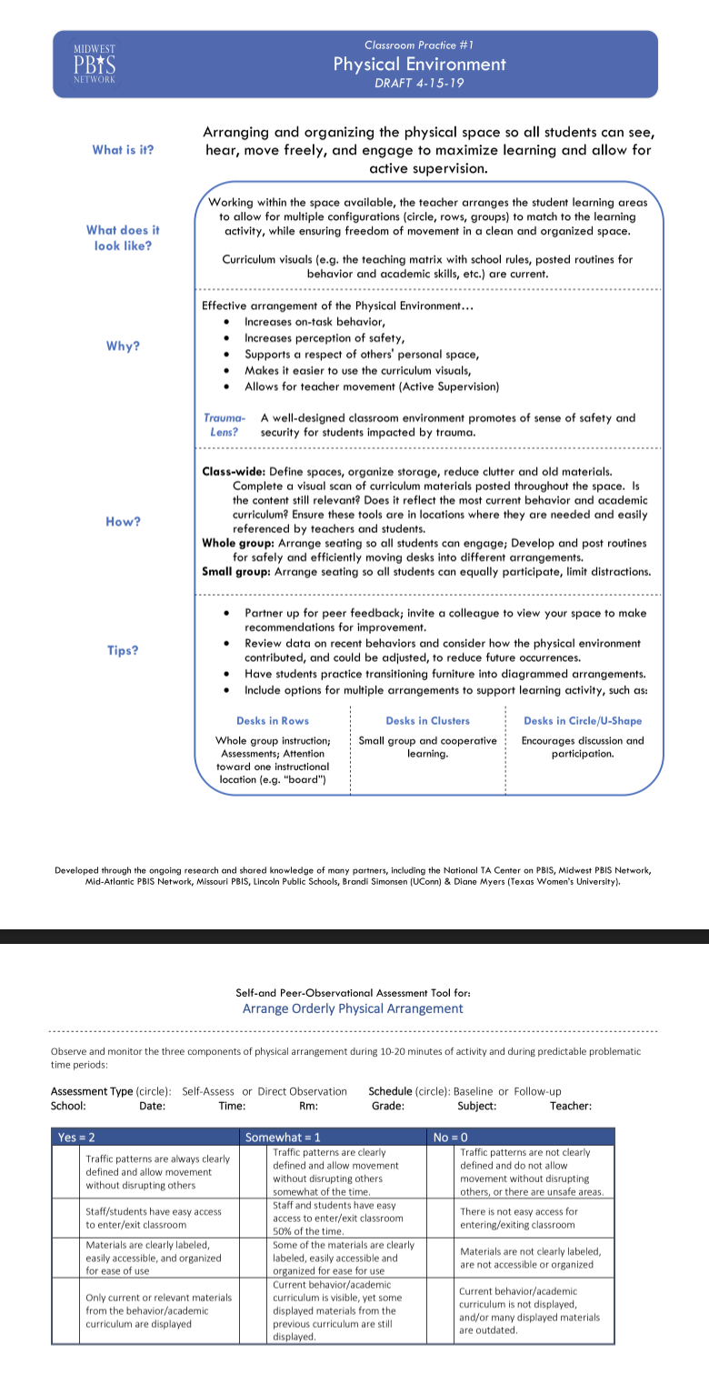
The Physical Environment
Workbook Pages
With your team
Read The Snapshot and take the self-reflection.
Complete the mapping activity to determine your next steps on the core PBIS classroom practice.

Slide 11
Classroom Management Practices
Classroom Management Practices
6 Classroom Practices
Physical environment
Classroom Teaching Matrix (Expectations, Rules, Routines)
Active Supervision
Encouraging Appropriate Behavior
Direct instruction of expectations, rules, routines
Preventative Prompts
Specific Praise for Behavior
Individual Reinforcers
Class-Wide Group Contingency
Continuum of Response Strategies for Inappropriate Behaviors
Praise other students/groups
Specific Error Correction
Etc.
6. Engagement & Opportunities to Respond
Rev 3-16-19. Midwest PBIS Network. Developed through the ongoing research and shared knowledge of many partners, including the National TA Center on PBIS, Midwest PBIS Network, Mid-Atlantic PBIS Network, Missouri PBIS, Lincoln Public Schools, Brandi Simonsen (UConn) & Diane Myers (Texas Women’s University).
Notes:
These are the 6 Classroom Management Practices that research has shown has a positive impact on students.
We want your teachers to have effective strategies that they are all using consistently. Tier I features are implemented within classrooms and are consistent with school-wide systems.
(The classroom is a critical aspect of Tier I training and includes 8 key components. These strategies maximize classroom management to allow for instructional time and less teacher stress!

Slide 12
By Teaching Procedures and Establishing Routines you will…
Increase instructional time by preventing problem behavior
Help students navigate the classroom more effectively
Reduce anxiety
Improve classroom climate
Create shared ownership of the classroom
Develop self-discipline
Make the classroom more equitable
(Evertson, Emmer, & Worsham, 2003; Good & Brophy, 2003)

Slide 13
Identify the procedures that will become the common routines of the classroom
The classroom matrix is a tool that helps a teacher bring the school-wide expectations into the common routines of the classroom.
Notes:
From the list of procedures you will teach students, which one will occur every day and are core routines that prevent problem behaviors from happening. Develop a matrix with students if possible on how to demonstrate your expectations within the routines of the classroom. These are the ones that a teacher needs to include on the classroom procedures matrix and M.A.P. out for students.

Slide 14
The Classroom Teaching Matrix is also trauma informed because
A well-designed teaching matrix creates consistency and predictability through clearly stated rules.
Routines support regulation, and can develop social-emotional competencies.
When teachers are consistent in expectations from class to class, it results in a predictable environment for students, helping them to regulate and operate in a state of calm.
Notes:
The classroom teaching matrix is trauma informed because it allows for consistency and predictability, offers routines to support regulation and can develop social emotional competencies, and when teachers are consistent, it results in a predictable environment and can allow students to operate in a state of calm.
For the recorder/webinar lead: You could go into the following in more detail. Resources are included.
Some regulation activities could include rhythmic and might be music, dance, drumming. Also note that not all students regulate at the same beat and it is actually based on their resting heart rate. Classical music may be regulating to one while a fast tempo may be more regulating to another.
Movement activities could be running/walking, dancing.
Relationship Development Activities might include
-Classroom professions such as being the giver, story teller, noticer, kindness keeper, resource manager, collaborator (Unwritten, The Story of a Living System: A Pathway to Enlivening and Transforming Education Dr. Lori Desautels)
-Copy Cat --- mirroring the actions of a partner
-Group drumming* --- hits both relationship and regulation
Emotional Development Activities
-Self-awareness exercises: S. Craig (Trauma Sensitive Schools, pg 82) refers to building student’s ‘resilience muscles’ or ‘rebound skills’ by responding to the 4 open-ended sentence stems often. This is an example, but there are other strategies that teachers’ may already be using that could have same intention.
-Emotion posters --- have a poster with emotions in your classroom that you reference it often for students to connect (i.e.: reading a story and ask how a character might be feeling, when debriefing a situation individually with a student, or a student is journaling).
-Connect through conflict (Whole Brain Child) --- view conflict as an opportunity to teach new skills

Slide 15
How to Use the Classroom Matrix
The teacher identify the most important behaviors for students to use in order to demonstrate the school wide expectations within the common routines of the classroom.
Now teach, model and reinforce those behaviors.
Model
Add Visuals
Practice
M.A.P. it out for students

Slide 16
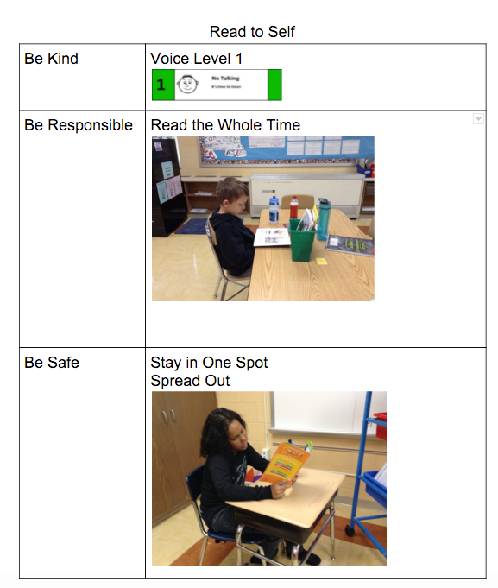
You can also use the Classroom Matrix to…
Use routine specific pre-correction to prompt use of school wide expectations prior to the transition of the new routine
Communicate your routine expectations to families (send it home)
Communicate your routine expectations with the central office

Slide 17
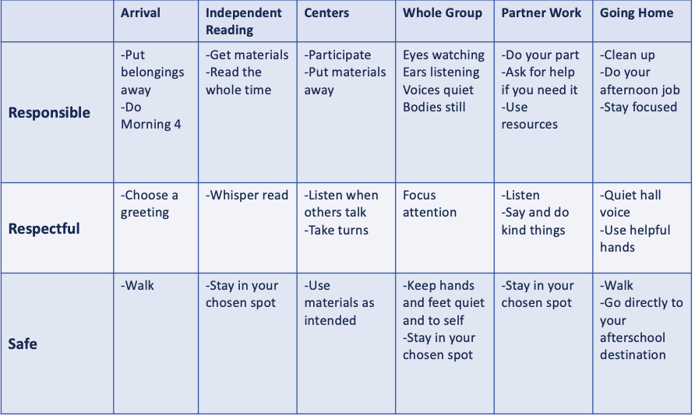
In Person Classroom Matrix Example

Slide 18
DL Classroom Matrix Example

Slide 19
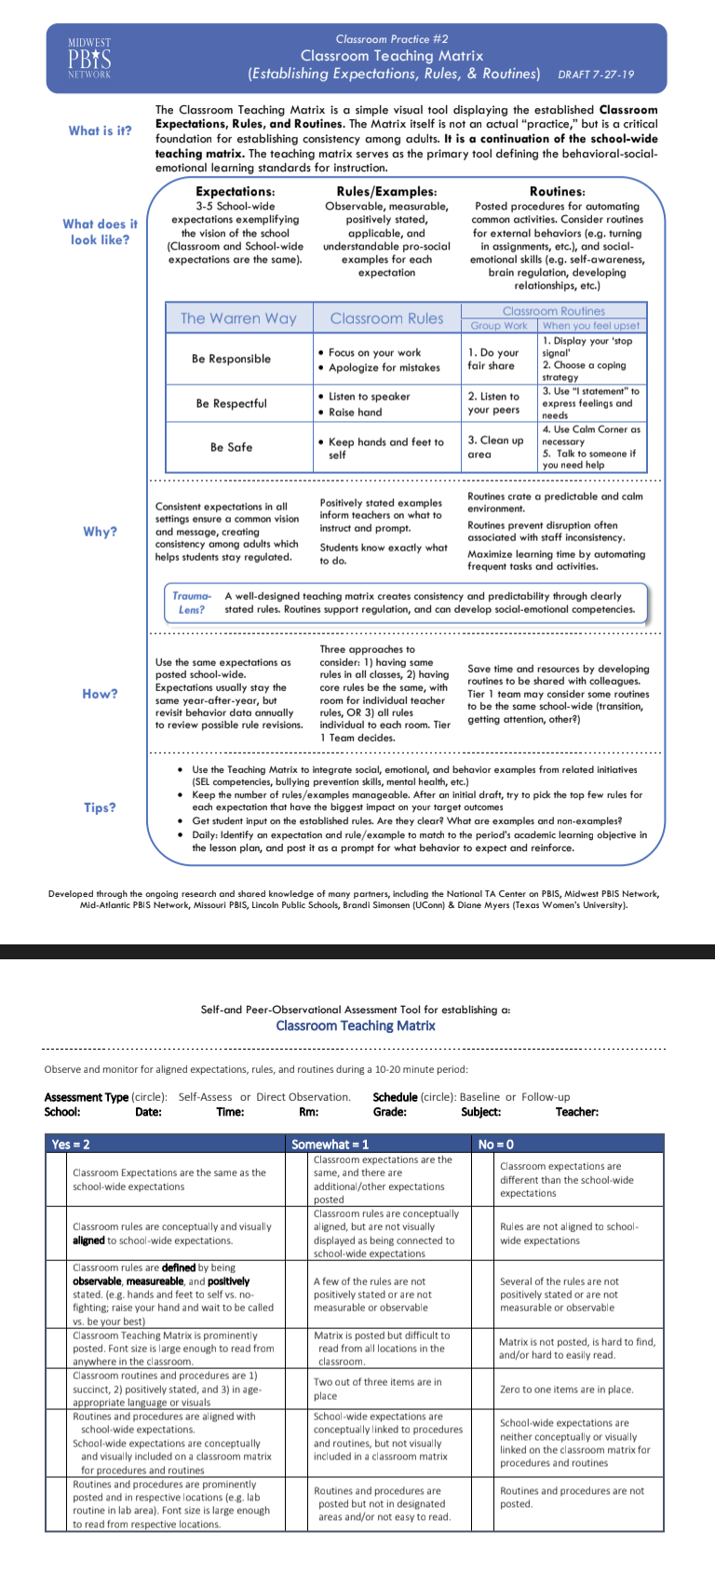
Classroom Teaching Matrix
Workbook Pages
With your team
Read The Snapshot and take the self-reflection.
Complete the mapping activity to determine your next steps on the core PBIS classroom practice.
Discuss how you will provide PD on this core practice at your site.

Slide 20
Classroom Management Practices
Classroom Management Practices
6 Classroom Practices
Physical environment
Classroom Teaching Matrix (Expectations, Rules, Routines)
Active Supervision
Encouraging Appropriate Behavior
Direct instruction of expectations, rules, routines
Preventative Prompts
Specific Praise for Behavior
Individual Reinforcers
Class-Wide Group Contingency
Continuum of Response Strategies for Inappropriate Behaviors
Praise other students/groups
Specific Error Correction
Etc.
6. Engagement & Opportunities to Respond
Rev 3-16-19. Midwest PBIS Network. Developed through the ongoing research and shared knowledge of many partners, including the National TA Center on PBIS, Midwest PBIS Network, Mid-Atlantic PBIS Network, Missouri PBIS, Lincoln Public Schools, Brandi Simonsen (UConn) & Diane Myers (Texas Women’s University).
Notes:
These are the 6 Classroom Management Practices that research has shown has a positive impact on students.
We want your teachers to have effective strategies that they are all using consistently. Tier I features are implemented within classrooms and are consistent with school-wide systems.
(The classroom is a critical aspect of Tier I training and includes 8 key components. These strategies maximize classroom management to allow for instructional time and less teacher stress!

Slide 21
Components of Active Supervision
…a process for monitoring the classroom, or any school setting, that incorporates
Moving: Continuous, random teacher movement throughout all parts of classroom
Scanning: Frequent and intentional visual sweep of all parts of classroom
Interacting: Frequent and positive communication to encourage, reinforce, and correct
Notes:
Scanning
This involves frequently and intentionally look around at students and making eye contact with student. Teachers can visually sweep all areas of the room as well as look directly at students nearest you. Visual Scanning allows the teacher to watch for instances of appropriate and inappropriate behavior that he/she will want to respond to immediately or as soon as possible. It will also help a teacher to identify students who may need his/her assistance.
Interacting
While moving and scanning you should also frequently interact with students. This communicates care, trust, and respect and creates positive climate and increases likelihood of accepting correction if needed. Interacting includes proximity, listening, eye contact, smiles, pleasant voice tone, and use of student’s name

Slide 22
Active Supervision is also trauma informed because
Provides a sense of safety for students
More likely to identify trigger and prevent problem behavior
Creates frequent opportunities to interact with students for relationship development
Remember 15 seconds is long enough to have a meaningful connection with a student
Notes:
Active Supervision is trauma informed because it provides a sense of safety for students and allows the adult to be more likely to identify triggers in order to prevent problem behaviors. It also creates frequent opportunities to interact with students to develop relationships. It only takes 15 seconds to develop a meaningful connection with a student.

Slide 23
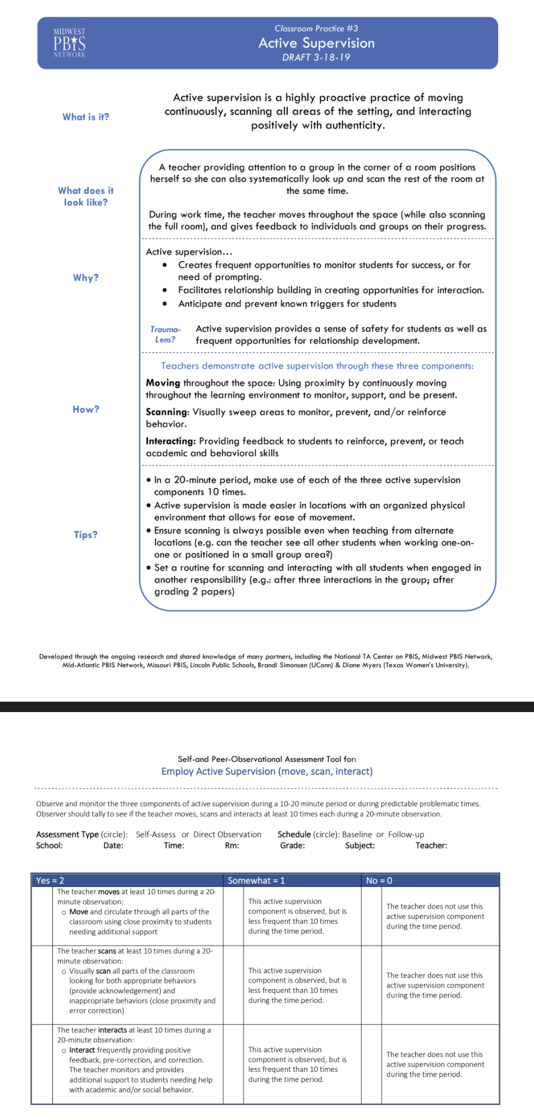
Active Supervision
Workbook Pages
With your team
Read The Snapshot and take the self-reflection.
Complete the mapping activity to determine your next steps on the core PBIS classroom practice.

Slide 24
Closing Activity
Think about the 3 core PBIS practices we have discussed so far:
Physical Environment, Classroom Teaching Matrix, Active Supervision
Begin to develop an implementation plan for these core practices at your school.
How will staff be introduced to each practice?
How much time will you give staff to implement each practice?
What kind of coaching support is available for staff who need Tier 2 and/or Tier 3 support?
Notes:
The following slides are EXAMPLES for teams to look at; trainers do not need to go through them but you can reference they are there for information/exploration.

Slide 25
Resources
pbismn.org-Distance Learning Resources
https://sites.google.com/view/pbismndistancelearning/home
Midwest PBIS – Classroom Modules
http://www.midwestpbis.org/materials/classroom-practices

Slide 26
Appreciation is given to the following for their contributions to this Professional Learning:

