Slide 1
PBIS Team Training Non-Classroom Settings
Basic Strategies
Notes:
Updated September 2021
The purpose of this presentation is to help adults focus in on adult actions in non-classroom settings that will help students be more successful within non-classroom settings.

Slide 2
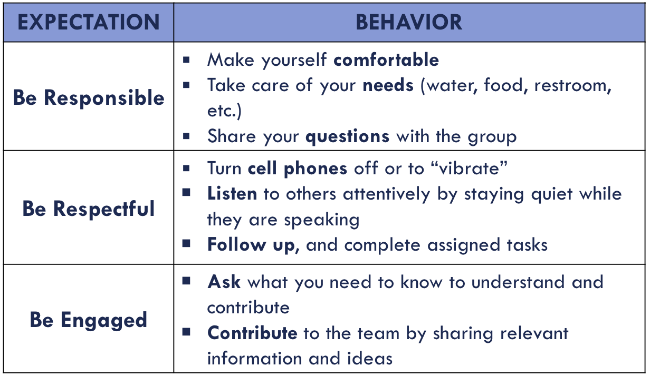
Learning Expectations
Notes:
Trainers can review team expectations for training.

Slide 3
Tier 1: Professional Learning Roadmap
These strategies are used with implementation of these TFI Items
TFI Sub-Scale: Team
TFI 1.1 | Team Composition
TFI 1.2 | Team Operating Procedures
TFI Sub-Scale: Evaluation
TFI 1.12 | Discipline Data
TFI 1.13 | Data-based Decision Making
TFI 1.14 | Fidelity Data
TFI 1.15 | Annual Evaluation
TFI Sub-Scale: Implementation
TFI 1.3 | Behavioral Expectations
TFI 1.4 | Teaching Expectations
TFI 1.5 | Problem Behavior Definitions
TFI 1.6 | Discipline Policies
TFI 1.7 | Professional Development
TFI 1.8 | Classroom Procedures
TFI 1.9 | Feedback and Acknowledgement
TFI 1.10 | Faculty Involvement
TFI 1.11 | Student/Family/Community Involvement
Notes:
Non-classroom areas are not specifically listed on the TFI, but this presentation will outline specific actions adults can take to help implement the outlined areas in real time.

Slide 4
Outcomes
Teams will review basic non-classroom strategies.
Teams will update their action plan
on the use of Basic Non-Classroom Strategies.
Teams will bring active supervision into their acknowledgement and corrective response systems.
Notes:
These are the outcomes we want teams to accomplish as a result of this training session.

Slide 5
Non-Classroom Challenges
Classroom
Teacher directed
Instructionally focused
Smaller # of predictable students
Relationship
Non-classroom
Student focused
Social focus
Larger # of unpredictable students
Lack of Relationship
Notes:
This slide helps teams understand why consistent adult action is needed in non-classroom settings.
*

Slide 6
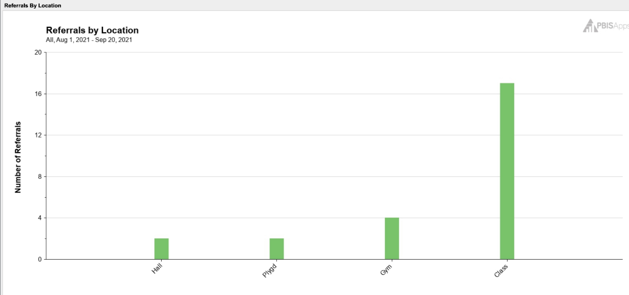
Finding Your Focus
Your Data Helps You Identify Non-Classroom Areas to Focus On
Notes:
Teams may wonder what non-classroom area they need to start with. Their data can help them find their “hot spots” where consistent adult action will increase safety and a sense of belonging and decrease problem behaviors. Slides 7-10 provide examples of how schools found their focus.

Slide 7
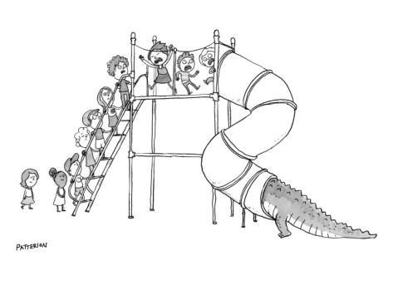
Using Data – Elementary School
An elementary school principal found that over 45% of their behavioral incident reports were coming from the playground.
Notes:
Data Example

Slide 8
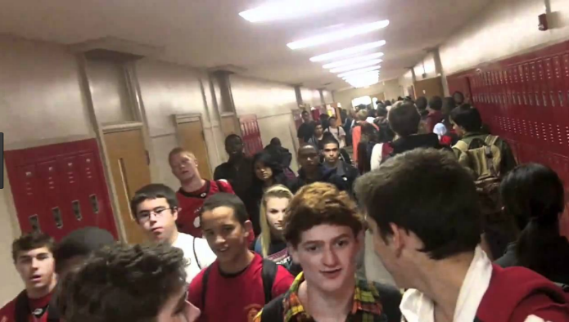
Using Data – High School
High school assistant principal reports that over 2/3 of behavior incident reports come from “four corners.”
Notes:
Data Example

Slide 9
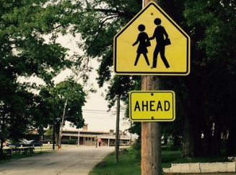
Using Data – Middle School
A middle school secretary reported that she has documented 3 neighborhood complaints daily over the past week about student behavior on school grounds.
Notes:
Data Example
*

Slide 10
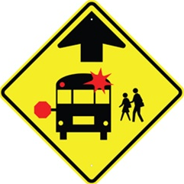
Using Data - Bus
Over 50% of referrals occurring on “buses” during daily transitions
Notes:
Data Example
*

Slide 11
Think about your school…
What non-classroom setting in your building do you think needs your focus first?
Notes:
1 minute turn and talk

Slide 12
Consider...
As you listen, think about how implementing these strategies could help reduce problems in the non-classroom setting you identified.
Notes:
This is the introduction slide to active supervision practices and a prompt for thinking.

Slide 13
Basic Non-Classroom Strategies
Teach Expectations & Routines in Context and Add Visuals
Actively Supervise
Scan
Move
Interact
Notes:
Elements of Active Supervision

Slide 14
Teach Expectations & Routines
in Non-Classroom Settings and Add Visuals
Notes:
Schools follow an instructional approach for teaching behavior expectations and routines.

Slide 15
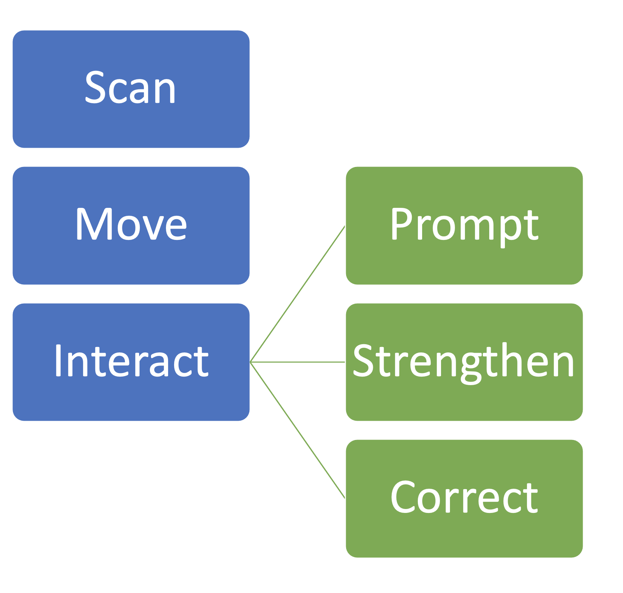
Actively Supervise
Non-Classroom Areas
Notes:
The elements of active supervision are sequential and intentional. The interact element helps staff develop and maintain positive relationships with students, prevent problems, and correct problems when prevention fails.

Slide 16
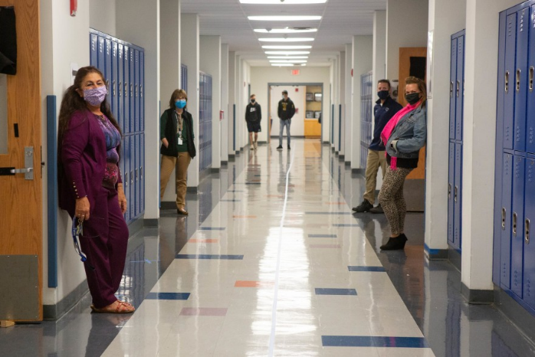
Scan Frequently
Head up
Look & Listen
Open Body Posture
Pause and Breathe
Notes:
Scanning involves looking, listening and maintaining an open body position.

Slide 17
Move Throughout the Area
Move as Your Scan Indicates
Notes:
Your movement will vary depending on your role. If you are a classroom teacher you will generally be near your classroom door. If you are not a classroom teacher you are more free to move about.

Slide 18
Positively Interaction with Students
Contextually, developmentally, culturally appropriate
Genuine, efficient,
effective
Provide Feedback
Greet students
Specific, meaningful
Prompt Desired Behaviors
Strengthen Appropriate Behaviors
Notes:
The interaction element is intentional and powerful. This slide outlines how we create consistent positive outcomes through consistent adult actions.

Slide 19
Correct Minor Behavioral Errors
Calmly
Quickly
Privately
Culturally, contextually and developmentally appropriate
Neutral, Business-like
Reinforce & Encourage
Notes:
Staff correct students as needed when actively supervising. This slide outlines how an interaction in responding to minor problem behaviors moves from punitive to corrective.

Slide 20
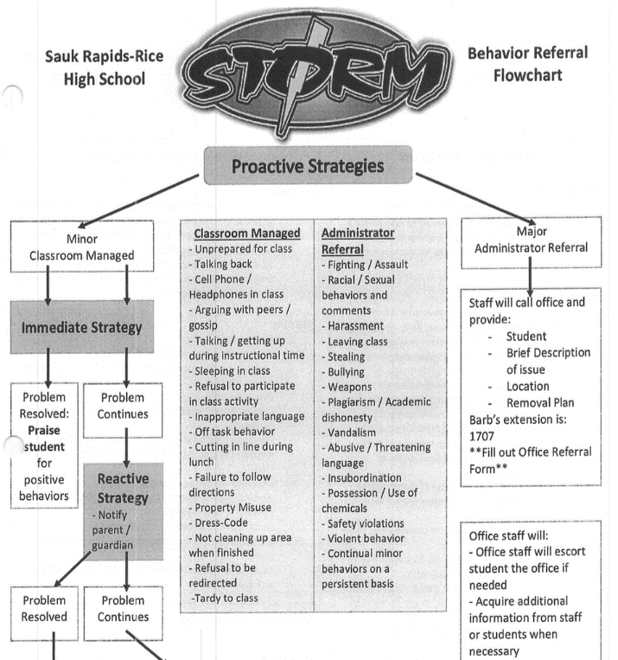
Follow SW Procedures for Major Behavioral Incidents
Calm and businesslike
Follow procedure
Disengage if escalation
Pre-correct for next occurrence
Look for opportunity to reinforce
Notes:
This slide outlines the importance of adults following actions outlined in their major/minor flowchart to ensure safety and sense of belonging.

Slide 21
Outline Consistent Action From Adults
Staff Matrix | SETTING
 | Hallways | Cafeteria | Library/ Computer Lab | Bus
Be Respectful | Keep hands feet and other objects to self | Eat only your food | Study, read, compute | Watch for your stop
Be Responsible | Use quiet voice | Replace trays & utensils | Push in chairs. Treat books carefully. | Wipe your feet Sit appropriately
Be Safe | Maintain your own physical space Stay to the right | Clean up your eating area | Whisper. Return books | Use a quiet voice Stay in your seat
Conditions for Learning | Stand in hall during passing periods Scan • Positively Interact • Correct Errors | Actively Supervise Scan • Move • Interact | Instruct from back to keep eyes on all screens | Prompt students to enter bus calmly and find a seat • Provide Praise • Correct Errors
Consistent Action
Notes:
This slide helps team know how to plan for consistent adult actions in non-classroom settings.

Slide 22
What Happens When Adults Take Consistent Action
A More Predictable School Environment
Lowers student anxiety
Creates a felt sense of safety
Consistently Positive Staff Behaviors
Builds Positive Relationships
Contributes to a healthy school climate
Opportunities to Provide Feedback Are Created
Prompt desired behaviors
Strengthen appropriate behaviors
Deter problem behaviors
Correct problem behaviors
Notes:
This slide starts to bring your session to a close. It helps teams understand what they can expect to happen when utilizing Active Supervise.
*

Slide 23
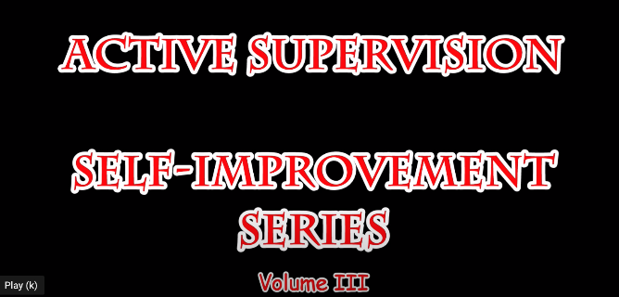
Active Supervision – Video!
Active Supervision – Checklist
https://www.youtube.com/watch?v=u23WEkt1FvM&t=109s
Notes:
This slide shows that active supervision has a checklist staff can use to check fidelity of implementation. The video is there as a resource for teams.
Possible Videos:
Systematic Supervision MS 2:13 - https://www.youtube.com/watch?v=95YA8mfY-2c
Systematic Supervision HS 2:14 - https://www.youtube.com/watch?v=rCqIzeU-0hQ&t=14s
Systematic Supervision Elem- 2:07 - https://www.youtube.com/watch?v=5JB2xSf-S58 LINK is not working
*

Slide 24
Non-Classroom Basic Strategies
Teach Expectations & Routines in the Setting and Add Visuals
•What non-classroom setting do you need to focus on first?
•Do you have what you need to teach expectations & routines for the setting?
Teach Expectations & Routines in Context and Add Visuals
Active Supervision
•What non-classroom settings do you need to focus on first?
•Who needs training?
Actively Supervise
Scan
Move
Interact
Notes:
This slide outlines actions teams can now take to check where they are at with active supervision, and develop action steps to fill in their active supervision gaps.

Slide 25
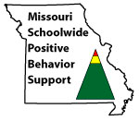
Appreciation is given to the following for their contributions to this Professional Learning:
Notes:
Make sure to thank the partners who support our work.

