Slide 1
PBIS Tier 1
Team Training
Problem Behavior Definitions & Discipline Policies (TFI 1.5 & 1.6)
Notes:
Updated September 2021

Slide 2
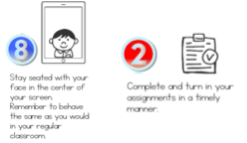
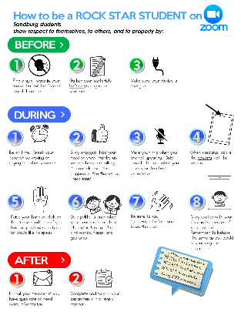
Learning Expectations for Virtual Training
EXPECTATION | BEHAVIOR
Be Responsible
Be Respectful
Be Committed
1
2
3
4
5
6
7
8
9
10
Awesome expectations from the team at Sandburg Elementary, SPS186!
Notes:
2

Slide 3
Tier 1: Professional Learning Roadmap
TFI Sub-Scale: Team
TFI 1.1 | Team Composition
TFI 1.2 | Team Operating Procedures
TFI Sub-Scale: Evaluation
TFI 1.12 | Discipline Data
TFI 1.13 | Data-based Decision Making
TFI 1.14 | Fidelity Data
TFI 1.15 | Annual Evaluation
TFI Sub-Scale: Implementation
TFI 1.3 | Behavioral Expectations
TFI 1.4 | Teaching Expectations
TFI 1.5 | Problem Behavior Definitions
TFI 1.6 | Discipline Policies
TFI 1.7 | Professional Development
TFI 1.8 | Classroom Procedures
TFI 1.9 | Feedback and Acknowledgement
TFI 1.10 | Faculty Involvement
TFI 1.11 | Student/Family/Community Involvement

Slide 4
TFI 1.5 & 1.6 Purpose & Outcomes
Purpose:
Prepare and plan for facilitating implementation of effective discipline procedures
Outcomes:
1.5 Problem Behavior Definitions:
School has clear definitions for behaviors that interfere with academic and social success and a clear policy/ procedure (e.g., flowchart) for addressing office-managed versus staff-managed problems
1.6 Discipline Policies:
School policies and procedures describe and emphasize proactive, instructive, and/or restorative approaches to student behavior that are implemented consistently

Slide 5
Rationale for Discipline
Definitions and Policies
Clearly defined procedures support consistency with responding to behavioral infractions. Consistency creates the conditions for increased structure, feelings of safety, and a positive learning environment.
Differentiating between behaviors addressed in the classroom, versus those addressed by administration, can:
improve consistency within the classroom
provide more meaningful information for problem solving
increase instructional minutes
free up administrative time spent on discipline.
Notes:
Effective discipline procedures ultimately: increase consistency in the building, increase the collection of and problem solving with meaningful data, and to increase instructional minutes and keep students engaged in learning.

Slide 6
Responsibility for Behaviors
Behavioral Examples
Classroom-managed (minor) | Office-managed (major)
Involve opportunities for teachable moments and minimizing interruption to instruction | Involve school and student physical and emotional safety
Notes:
Involve school and student physical and emotional safety -Behaviors that significantly violate rights of others, put others at risk or harm

Slide 7
Classroom or Office Managed?
Tardy to class?
Not prepared?
Aggressive Language?
Electronic Devices?
Touching?
Gambling?
Dress code?
Chronic minors?
Notes:
Opportunity for group participation

Slide 8
How does your school/district differentiate between classroom and office managed behaviors?
Notes:
Turn and Talk
Then large group talk

Slide 9
Defining Behaviors
The SWIS developers have definitions for problem behaviors that can be used by anyone regardless of the data system they use.
The definitions are clear, observable, and can be measurable.
Definitions are located in your Team Training Workbook in section 1.5/1.6

Slide 10
Minor Examples
Team Training Workbook: Section 1.5/1.6
Notes:
These are our starting points - they come from SWIS. Stress these can be used by anyone. The main point is that schools should have common behavior definitions that staff know and understand.

Slide 11
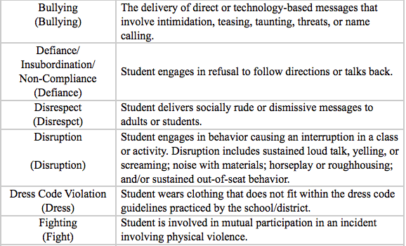
Major Examples
Team Training Workbook: Section 1.5/1.6
Notes:
These are our starting points for Major offenses

Slide 12
“T-Chart” School Example
Teacher Managed Behavior (Minor)
Attendance/Tardy – Inform parents on effect on academic performance
Profanity directed at student
Gum chewing
Homework
No supplies
Tattling
Non-compliance
Name calling
Lying
Minor stealing
Cheating
Dress Code Violations
Minor Harassment
Disrespect
Disruption
Defiance
Office Managed Behavior (Major)
Attendance/Tardy
Vandalism
Substances
Weapons
Profanity directed at Adults
Fighting
Verbal/Physical intimidation
Major stealing
Cutting school
Wanderers
Gang Related Activity
Chronic Dress Code Violation
Harassment (including sexual)
Disrespect
Disruption
Defiance

Slide 13
“T-Chart” School Example
Teacher Managed Behavior (Minor)
Attendance/Tardy – Inform parents on effect on academic performance
Profanity directed at student
Gum chewing
Homework
No supplies
Tattling
Non-compliance
Name calling
Lying
Minor stealing
Cheating
Dress Code Violations
Minor Harassment
Disrespect
Disruption
Defiance
Office Managed Behavior (Major)
Attendance/Tardy
Vandalism
Substances
Weapons
Profanity directed at Adults
Fighting
Verbal/Physical intimidation
Major stealing
Cutting school
Wanderers
Gang Related Activity
Chronic Dress Code Violation
Harassment (including sexual)
Disrespect
Disruption
Defiance
What about these examples?

Slide 14
5 Ways to Help School Systems become more Culturally Responsive
1. Identity Awareness (staff/student/community)
2. Voice
3. Supportive Environment
4. Situational Appropriateness
5. Data for Accountability
Notes:
When we think about making T Charts for major and minor behaviors, there is a lot of bias that goes into it. We need to be aware of our own experiences and upbringings in order to make sure we are not trying to project our values, but rather the values of the students we serve. We need to first Identify what has impacted us and then we need to be sure that we are offering education on when certain behaviors can be situationally appropriate

Slide 15
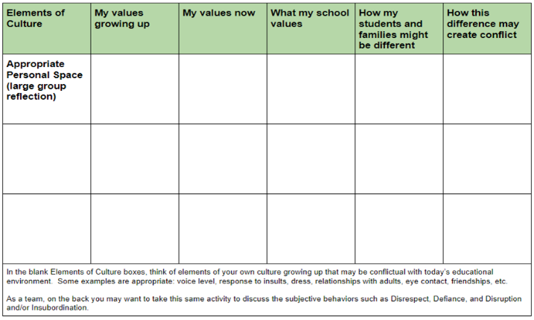
#1: Identity Awareness
Self-Reflection on Values
Notes:
This comes from the Cultural Responsive Field Guide - Walk participants through this activity - Read the guide for directions
There is a handout for this - make one per person (or however your region wants to do it)

Slide 16
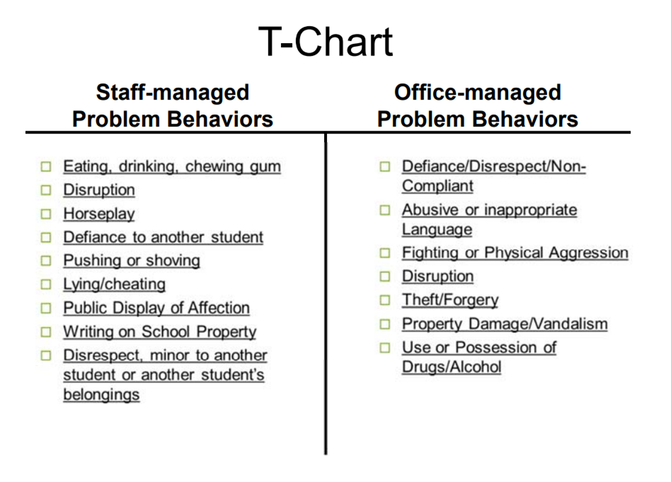
#4: Situational Appropriateness
Most Common:
Notes:
Least culturally responsive but most common

Slide 17
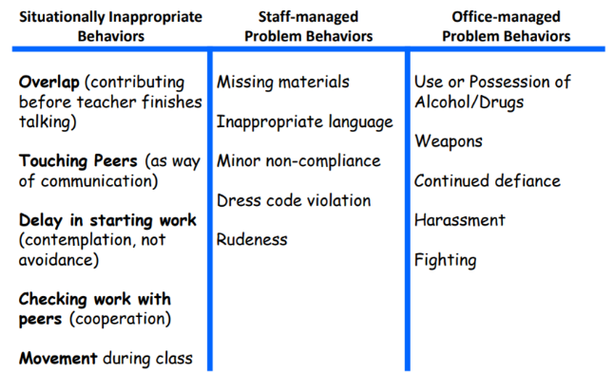
#4: Situational Appropriateness
Culturally Responsive Elaboration: “Pi” Chart
Clarifies what is ok and what is not ok
The tweak:
Highlights situational specificity
Some problem behaviors are universally wrong
Some problem behaviors are “not for school” (may be ok outside of school)
Notes:
Adding in times when certain behaviors may be situationally appropriate and not

Slide 18
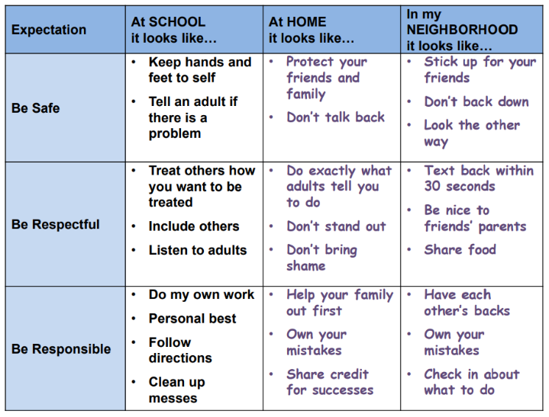
#4: Situational Appropriateness
Culturally Responsive Adaptation: Personal Matrix
Aka “behavior dictionary”
Tool to assist in “code-switching”
The tweak:
Take school expectations and…
Add differences at home
Add differences in community
Notes:
A matrix that is adaptive to school-home-neighborhood and helping students to understand that the environment we are in affects the behaviors that are acceptable

Slide 19
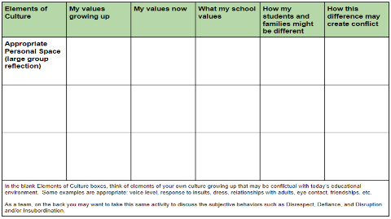
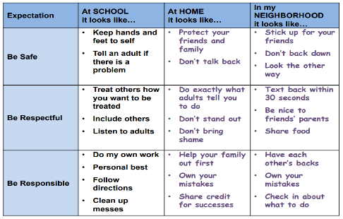
Pause to complete the activities
1. Identity Awareness (staff/student/community)
Individually complete the Self-Reflection on Values activity
As a team, use the self-reflection on values activity to discuss subjective behaviors of: Disrespect, Defiance, Disruptions and/or Insubordination.
4. Situational Appropriateness
As a team, consider the information about situational appropriateness presented. Discuss as a team:
How can specificity of situationally appropriate, staff managed and office managed behaviors be helpful?
How could defining expectations at school, home and school be helpful to students understanding the concept of “code switching?”
Notes:
When we think about making T Charts for major and minor behaviors, there is a lot of bias that goes into it. We need to be aware of our own experiences and upbringings in order to make sure we are not trying to project our values, but rather the values of the students we serve. We need to first Identify what has impacted us and then we need to be sure that we are offering education on when certain behaviors can be situationally appropriate

Slide 20
TFI 1.5 & 1.6 Problem Behavior Definitions & Discipline Policies
SELF-ASSESSMENT
Complete TFI item(s)
Assess additional action items at end of module
ACTION PLANNING
Add action items to Action plan
Plan for PD
Add to your Staff Presentation PPT

Slide 21
Analysis of Data on Disruption:
What does Disruption look like and sound like?
Classroom-managed | Office-managed
Refusal to do work | Disruption escalated into a physical or verbal confrontation
Argue with the teacher | Minor actions repeated to the point of an “un-teachable” learning environment
Calling out
Tapping pencil/objects
Talking to others
Unnecessary movement (out of seat/fidgeting)
Touching others
Notes:
What are some minor and major examples of the behavior described?
Is there a point in the scenario in which the behavior might be considered minor? Is there a point when it crosses the line and might be considered major?
Have you considered what is developmentally appropriate, culturally responsive, gender responsive, special needs?
When does a recurring teacher-managed behavior (minor) become an administrator-managed (major) behavior?
How many minor incidents of the same behavior warrant administrative action?
How do you factor in minor incidents with multiple teachers?
How do you factor in the timeframe in which the minor incidents occur?
Lessons learned…
Establish a system for collecting, monitoring, and analyzing minor incidents
Define decision rules to design supports, not as a “gotcha” or a 3 strikes you’re out!

Slide 22
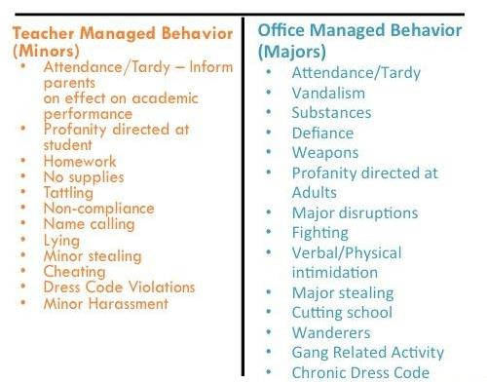
Completing T-charts with Staff
Pause to complete
the activity
T Chart for All Behaviors
Workbook: TFI 1.5/1.6 Activities 1 & 2
List all Minor Behaviors (Classroom managed) on one side
List all Major Behaviors (Office managed) on the other side
Finalize the list and definitions
Provide additional examples for any behaviors that are listed as both Minor and Major.

Slide 23
Q-tip
“When everyone handles infractions with instructional correction procedures, students learn that what happens when they misbehave is procedure not personal.”
~Bob Algozzine

Slide 24
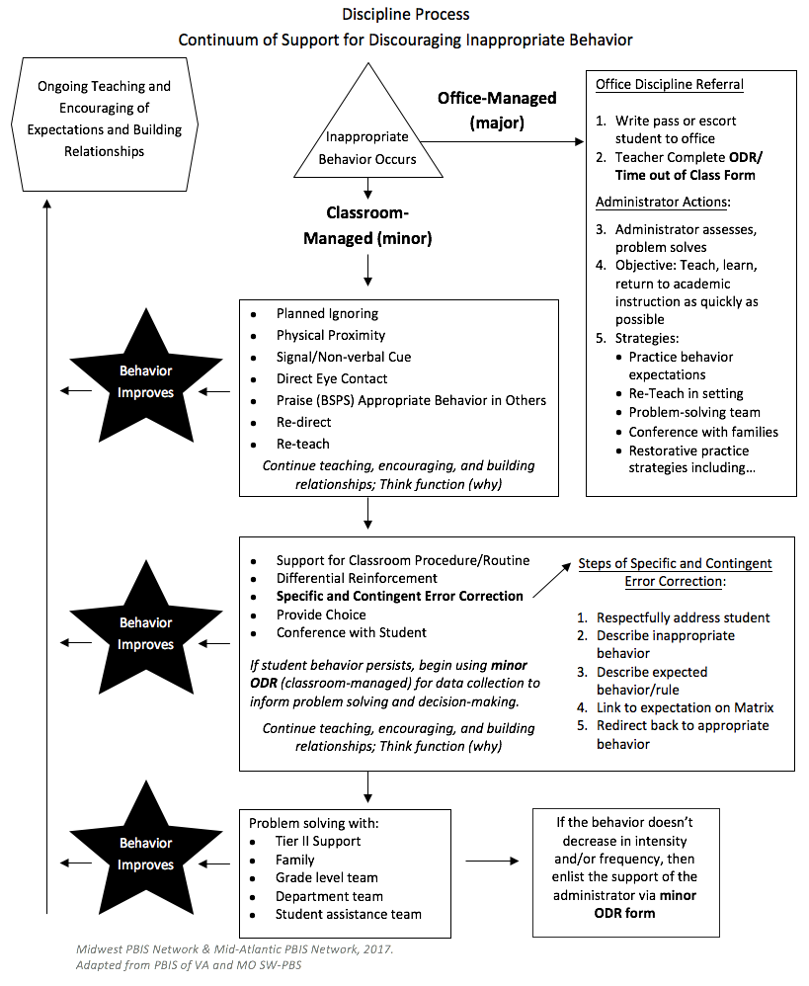
Where do you document the process and practices for how staff prevent and respond to problem behaviors?
SAMPLE
Notes:
This will be addressed more completely through classroom behavior systems- EBPs, problem solving, responding/error correction and preventing

Slide 25
What happens if a student needs to be referred to the office?
Sample
Do you complete an office referral electronically?
Do you complete an office referral on paper?
What is the procedure for getting a student to the office (call to office, student goes to the office)?
What’s the administrator’s disposition and is it communicated to referring teachers?
Office Procedures for Discipline Referral
Write pass or escort student to office
Teacher Complete Time out of Class Form
Administrator assesses, problem solves
Objective: Teach, learn, return to academic instruction as quickly as possible
Strategies:
Practice behavior expectations
Re-Teach in setting
Problem-solving team
Conference with families
Restorative practice strategies including…

Slide 26
What is the purpose of the office discipline referral form?
Is it used as an intervention?
Is it used to collect data?
Notes:
Fields on data collection-odr
Minor collection tool fields
Procedures for odrs and minors
PD for staff protocol

Slide 27
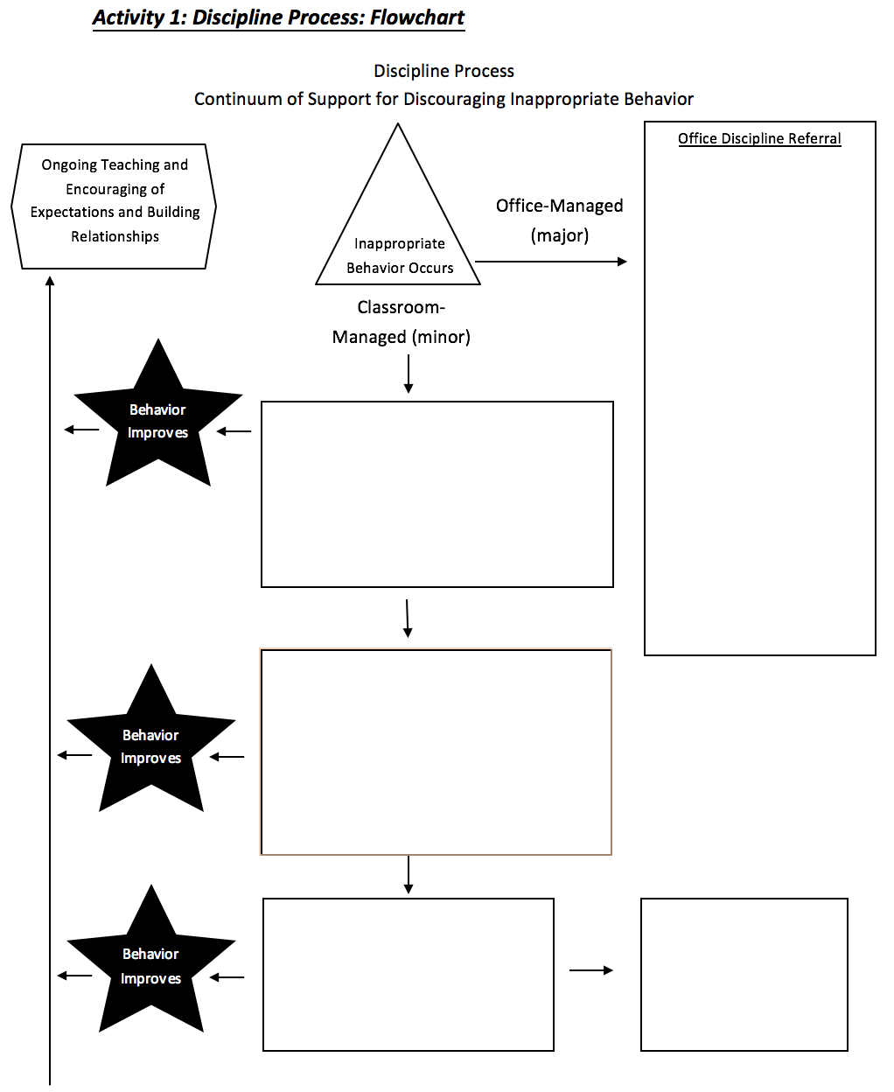
Add a process for Major Discipline Referrals to your Discipline Flowchart
Pause to complete the activities
What practices are in place for how school administration responds to a major discipline referral?
Identify your office process and practices
Include prevention strategies
Include re-teaching and other educational approaches to discipline
Add your process for Major ODRs to the flowchart
Office Procedures and Practices
Workbook: TFI 1.5/1.6 Activities 3 & 6
Notes:
NOTES
This is a sample flowchart for discipline procedures.
We have pre-populated with practices. Your end goal for this module is to create a complete flow chart or narrative of the discipline procedures at your school.
We are going to go step by step to do that.
ENGAGE:
Ask the participants
1- Do you have one already? What does it look like? Do people use it?
2- What would the impact of having a flowchart be your building? Would it make it easier or harder for teachers to navigate discipline procedures?
To operationalize this system, you will need to: 1) define what constitutes major or office-managed behavior, 2) know strategies to respond to minor or staff-managed behaviors, and 3) develop related data gathering tools. (Adapted from Colvin, 2007, pp. 65-66).

Slide 28
Do your data collection tools have all the
information to make data-informed decisions?
Student’s Name
Date
Time of Incident
Location of Incident
Student’s Teacher
Student’s Grade Level
Referring Staff
Others Involved
Problem Behavior
Possible Motivation
What was happening before the behavior (antecedent)?
Possible consequences
Administrative Decision
Other Comments

Slide 29
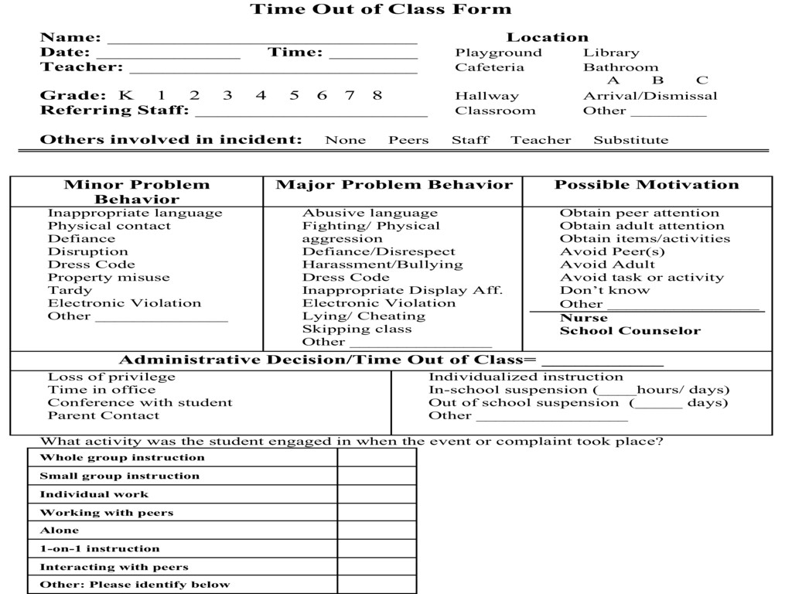
Time Out of Class Form
Sample
Notes:
UPDDATE: Page #
Because ORDs are for documenting and problem solving we need to include all of this info.
Purpose of the Form = “to provide and eventually accumulate information” – from which decisions can be made about interventions

Slide 30
Your Referral Form
Does it collect all of the info needed?
Does everyone know where to find them?
Does everyone know how to fill them out?
Just the facts
No previous info (yesterday, a week ago, etc.)
No opinions

Slide 31
Create Your Office Referral Form
Pause to complete the activity
Workbook: TFI 1.5/1.6
Review “Constructing your Office Referral” resource in the workbook
Review sample data collection tools for office-managed (major)
Review your current office discipline referral and identify data fields to add
Identify when and how you will provide support staff to use data collection tools
Notes:
A time to reflect and talk among teams. These are a few prompts for dialogue and planning. Direct participants to dialogue about where they are with the process of revising data collection forms, creating data collection forms for classroom managed, supporting staff to use them, etc.

Slide 32
TFI Self-Assessment
TFI Features | Possible Sources | Criteria
1.5 Problem Behavior Definitions: School has clear definitions for behaviors that interfere with academic and social success and a clear policy/ procedure (e.g., flowchart) for addressing office-managed versus staff-managed problems | • Staff handbook • Student handbook • School policy • Discipline flowchart | 0 = No clear definitions exist, and procedures to manage problems are not clearly documented 1 = Definitions and procedures exist but are not clear and/or not organized by staff- versus office-managed problems 2 = Definitions and procedures for managing problems are clearly defined, documented, trained, and shared with families
1.6 Discipline Policies: School policies and procedures describe and emphasize proactive, instructive, and/or restorative approaches to student behavior that are implemented consistently | • Discipline policy • Student handbook • Code of conduct • Informal administrator interview | 0 = No process for teaching staff is in place 1 = Process is informal/unwritten, not part of professional development calendar, and/or does not include all staff or all 4 core Tier I practices 2 = Formal process for teaching all staff all aspects of Tier I system, including all 4 core Tier I practices
Notes:
Teams should complete this self assessment and use the results to determine action planning steps on Workbook page 11.

Slide 33
Dig Deeper into Problem Behaviors and Discipline Policies
TFI | Action Item (Not In Place; Partially; Fully In Place) | NI | PI | FI
1.5 | Engage staff in facilitated process to define behaviors and differentiate between office-managed and classroom-managed behavioral examples
1.5 | Create a narrative and/or flowchart to establish discipline procedures
1.5 | Develop data collection forms for office-managed and classroom-managed behavioral examples and plan for training staff
1.5 | Ensure data form fields exist for meaningful decision-making
1.5 | Define a continuum of appropriate instructional responses to office-managed and classroom-managed behavioral examples
1.5 CR | Teams actively seek input on problem behavior definitions (especially subjective behaviors such as defiance or disrespect)from school staff, students, families, community members and school staff.
1.5 CR | Teams provide information and seek feedback in multiple languages and modes of delivery (e.g., written, audio visual.)
1.5 CR | Teams actively seek consensus among staff with responses to problem behavior by revisiting and practicing the procedures at least annually or as data indicates a need.
1.5 CR | Teams work with school staff to develop categories for behavior that include staff-managed, office-managed and situationally inappropriate behaviors (e.g., transform T-charts to Pi-charts.)
p. 17 & 18

Slide 34
Dig Deeper Continued
TFI | Action Item (Not In Place; Partially; Fully In Place) | NI | PI | FI
1.6 | Identify school policies and procedures that describe and emphasize proactive, instructive, and/or restorative approaches to student behavior that are implemented consistently.
1.6 CR | Teams and staff review existing discipline policies to ensure that inclusionary practices are used whenever possible and that exclusionary practices are used with discretion for safety purposes only, and always with an instructional component.
1.6 CR | Teams actively seek input from families and the community on discipline policies and attempt to align disciplinary procedures with community expectations.
1.6 CR | Teams have procedures for staff to respond to behaviors by reteaching the skill and teaching students to code-switch across settings, with additional practice, acknowledgment and a focus on restoring relationships.
1.6 CR | Teams work with local law enforcement agencies to emphasize positive interactions between authority figures and students (as opposed to negative or threatening interactions when problem behaviors occur.)

Slide 35
Considerations for Consequences
Pause to complete the activities
Workbook TFI 1.5/1.6, Activity 4
Workbook TFI 1.5/1.6, Activity 5
In small groups, read and discuss the statements on considerations for consequences in your workbook.
Discuss with the full table how your team can use this activity with all staff
Review the examples of alternatives to suspension.
Identify alternatives in place at your school to add to your discipline flowchart.
Peterson, R. L. (2005). Ten alternatives to suspension. Impact: Feature Issue on Fostering Success in School and Beyond for Students With Emotional/Behavioral Disorders, 18(2).
https://ici.umn.edu/products/impact/182/over5.html
Notes:
Direct participants to the workbook. There are two sections with guiding questions for alternatives to suspension and general guidelines for responding to behavior.

Slide 36
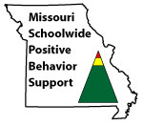
Appreciation is given to the following for their contributions to this Professional Learning:

