Slide 1
PBIS Team Training 4A
Feedback and Acknowledgement
(TFI 1.9)

Slide 2
Learning Expectations
EXPECTATION | BEHAVIOR
Be Responsible | Make yourself comfortable Take care of your needs (water, food, restroom, etc.) Action plan to implement what you are learning Follow through on your action items
Be Respectful | Turn cell phones off or to “vibrate” Listen attentively while others are speaking Have only the training materials up on your computer/tablet/phone
Be Engaged | Ask what you need to know to understand and contribute Contribute to the group by sharing relevant information and ideas
Notes:
2

Slide 3
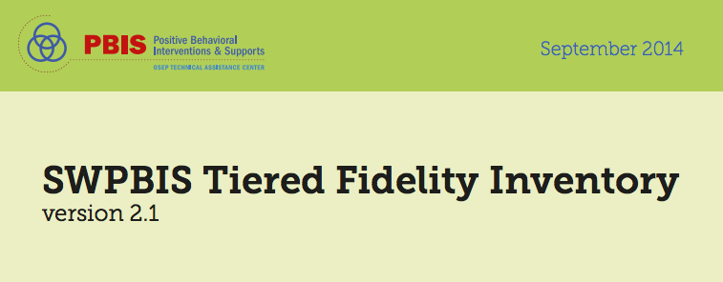
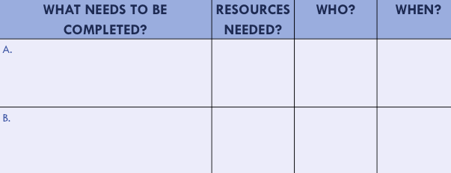
Organization of Modules
Content:
Aligned to TFI Items 1.1 – 1.15 and Classroom Management Practices
Activities/Team Time: Activities for Fluency
Self-Assessment:
Tiered Fidelity Inventory
Action Planning: Applying the core content to your school
Notes:
These are the icons that you will see throughout the training and will serve as a guide and a prompt to the content of each slide.

Slide 4
Tier 1: Professional Learning Roadmap
TFI Sub-Scale: Team
TFI 1.1 | Team Composition
TFI 1.2 | Team Operating Procedures
TFI Sub-Scale: Evaluation
TFI 1.12 | Discipline Data
TFI 1.13 | Data-based Decision Making
TFI 1.14 | Fidelity Data
TFI 1.15 | Annual Evaluation
TFI Sub-Scale: Implementation
TFI 1.3 | Behavioral Expectations
TFI 1.4 | Teaching Expectations
TFI 1.5 | Problem Behavior Definitions
TFI 1.6 | Discipline Policies
TFI 1.7 | Professional Development
TFI 1.8 | Classroom Procedures
TFI 1.9 | Feedback and Acknowledgement
TFI 1.10 | Faculty Involvement
TFI 1.11 | Student/Family/Community Involvement
8 Classroom Management Practices
1 | Arrange orderly physical environment
2 | Define, Teach, Acknowledge Rules and Expectations
3 | Define, Teach Classroom Routines
4 | Employ Active Supervision
5 | Provide Specific Praise for Behavior
6 | Continuum of Response Strategies for Inappropriate Behaviors
7 | Class-Wide Group Contingency
8 | Provide Multiple Opportunities to Respond

Slide 5
TFI 1.9 Purpose & Outcomes
Purpose:
Prepare and plan for implementation a system to acknowledge behaviors
Outcomes:
1.9 Feedback and Acknowledgement: A formal system (i.e., written set of procedures for specific behavior feedback that is [a] linked to school-wide expectations and [b] used across settings and within classrooms) is in place and used by at least 90% of a sample of staff and received by at least 50% of a sample of students.

Slide 6
Science of Behavior Has Taught Us
Are NOT born with “bad behaviors”
Do NOT learn when presented contingent aversive consequences
Do learn better ways of behaving by being taught directly & receiving positive feedback
Notes:
Point out that negative behavior is often the student communicating something else or other need in a negative manner.

Slide 7
Definition
Positive acknowledgement is the presentation of something reinforcing or rewarding immediately following a behavior.
It can be verbal, it can be tangible, or it can include both.
(SBCUSD Positive Behavior Support Initiative)

Slide 8
Rationales for acknowledgments
It is one of the most powerful tools for shaping or changing behavior.
Create positive interactions, rapport, and relationships with students.
It increases instructional time, and minimizes time students are out of the classroom.
Acknowledgment systems prompt adults to recognize expected behaviors
Every time any adult interacts with any student, it is an instructional moment.
(Cameron, 2002; Cameron & Pierce, 1994, 2001;
Cameron, Banko, & Pierce, 2001)

Slide 9
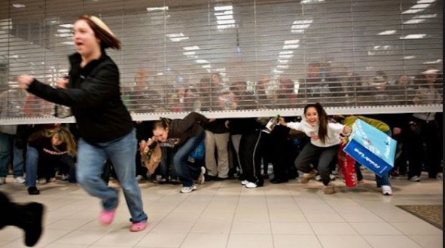
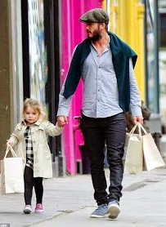
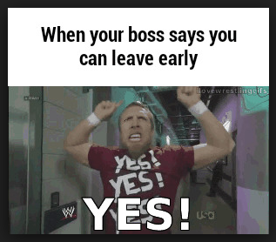
“Why Should I acknowledge Students for Something They Should Be Doing Anyway?”
Notes:
Picture of Black Friday- grownups go crazy for a deal
Picture of Dad and Daughter Shopping (relationship building). Not after the deal, but the connection.
Yes Picture- if your boss said you could leave early because you did well this week, no adult would say “no, I was just doing my job.”

Slide 10
How do rewards shape our behavior?
 | What “should” you be doing? | How do you get reinforced for this?
Driving
Work
Credit card
Notes:
10
Staff commitment: Some staff might have difficulty w reinforcing student behaviors
Provide adults examples of how adults are reinforced for doing what they are expected to be doing (DISCOVER card, Allstate)

Slide 11
Quickest Way to Change Behavior in Anyone is to…
Point out what they’re
doing right!
Research indicates that you
can improve behavior
by 80% just by pointing out
what someone is doing
correctly.
Laura Riffel, OSEP
Notes:
When we (adults) change/shift our focus from giving most of our attention to misbehavior to acknowledging positive behaviors, we create the conditions for behavior to change. (Sprick,& Garrison, 2008)

Slide 12
Receive Frequent Feedback and Acknowledgement (across ALL school settings, including the classroom)
Correction
Acknowledgement
4 : 1
(Scott, 2008)
Notes:
Studies show that in order to be successful the positives need to exceed the negatives by a ratio of more than 4 to 1 (family & marriage therapy research). The BOQ recommends at least 5:1.
If the consequence was access to technology and the behavior increased, then the access was a reinforcer.
If the consequence was sending the student to the office and the behavior increased, then the removal was a reinforcer.
If the consequence was a reprimand (which included adult attention), and the behavior increased, then the reprimand was a reinforcer.

Slide 13
Adults may need a strategy or tool for monitoring ratios of praise to corrections
Notes:
There are essentially two things that we found:
1. We as adults, tend to overestimate how positive we are. We think we're nicer than they do!
2. You are very nice, Think about not just what you are going to do to make your classroom work; but, what you're going to do to make the whole school a more effective environment. There are many adults in the building who may be uncomfortable with how to deliver acknowledgments for doing things the right way, and they're many reasons for that. But the point is, regardless of what the reason, most people can agree, we want the students to behave well. We want the students to identify that our school is a welcoming warm productive, predictable environment. We could agree to that.
Our addition:
3. Quickest, easiest way to use this Cool Tool is INSIDE your classrooms.

Slide 14
Paperclips/Pennies in Your Pocket
Acknowledgement Teaching Tip:
First week, each day:
Put 5 pennies in your pocket.
Every time you acknowledge a student’s appropriate behavior transfer one penny to your other pocket.
When all 5 pennies are in your other pocket…start over!
Second week, each day:
Put 10 pennies in your pocket.
Every time you acknowledge a student’s appropriate behavior transfer one penny to your other pocket.
When all 10 pennies are in your pocket…start over!
Third week, each day:
Put 5 pennies in your pocket.
Use them to acknowledge the appropriate behavior of one of your “difficult” students.
When all 5 pennies are in your pocket…start over with another student.
Notes:
Other things to remind adults to give acknowledgments:
Rubberbands on wrist
Email Dings
Tickets on your lanyard

Slide 15
What really matters
What really matters
is the positive social
acknowledgement
and interaction
Notes:
We all like to hear positive feedback – so what could possibly be wrong about saying to a student, “raising your hand, and waiting to be called upon is so respectful, thank you.” – (then we have to reinforce that behavior so that we can increase the likelihood that it will occur again in similar circumstances.

Slide 16
Change your words, change your world
http://youtu.be/Hzgzim5m7oU
Notes:
http://youtu.be/Hzgzim5m7oU

Slide 17
Activity: Changing our words
Negative
Positive
Workbook: TFI 1.9 Activity 1
Notes:
Each person draws a line down the middle of the card and writes 2-3 negative statements they have heard in their building, said by teachers to students; (e.g., Don’t run in the hallway! How many times do I have to tell you…) on the left side of the card.
Stand when completed.
Exchange card with a person from another school.
Re-write the statement to a positive direction. Return card to owner.
Share out with the large group.
Ask: Would this be a useful activity in your school?

Slide 18
Guiding Questions
How can you increase teacher’s use of behavior specific verbal praise?
What does your school already have in place?
How will you get staff and student input?
Notes:
The truth is, the thing that you give is almost never the important part. The important part is whether you actually connect with the student and say I really appreciate what you just did. So it is always the personal connection.
It’s about building that positive relationship with students.

Slide 19
Acknowledgement Guidelines
School and classroom-wide acknowledgements are for every student
Acknowledge the behavior
Include the students in identifying possible acknowledgements
Acknowledge your students in your classroom
Acknowledge students other than your own in common areas
Effective & Efficient

Slide 20
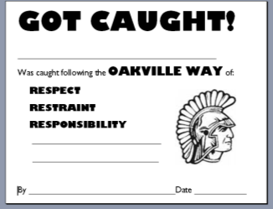
How to Acknowledge
Provide Specific Praise for Behavior:
Step 1: Identify the student or group
Step 2: Acknowledge specific behavior/rule
Step 3: Link to school-wide expectation
Step 4: (optional): Provide tangible reinforcement
Non-examples:
Saying “good job” without connecting to school-rule and expectation
Giving ticket without saying anything
Only giving a ticket for “above and beyond” behavior
You are sitting in your seat when the period bell rang. Way to “be here, be ready!”
"I noticed you were
on time this morning,
that's being responsible.”
Notes:
Feedback MUST accompany a tangible

Slide 21
Components of School-Wide Acknowledgement Plans
High frequency/Predictable Delivered at a high rate for a short period
High Frequency Behavior Specific Verbal Praise
Tokens, Positive referrals, Phone calls, texts, emails
Intermittent and/or Unexpected Bring “surprise” attention to certain behaviors or at scheduled intervals
E.g. Unpredictable use of “Gotchas”, ticket lottery, special announcements, Hi Five surprises, raffles
Mid-term Celebrations
E.g. Weekly or bi-weekly whole class or whole school rewards
DJ Friday’s, Game choice, free time in class, Lunchroom Music, Yoga in the yard before school, etc.
Long term Celebrations
E.g. Quarterly activities, assemblies, parent dinners, field trips

Slide 22
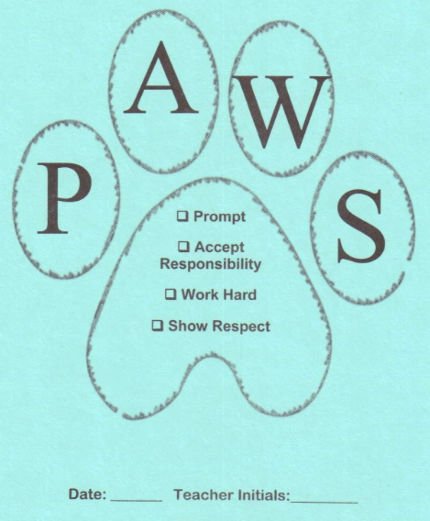
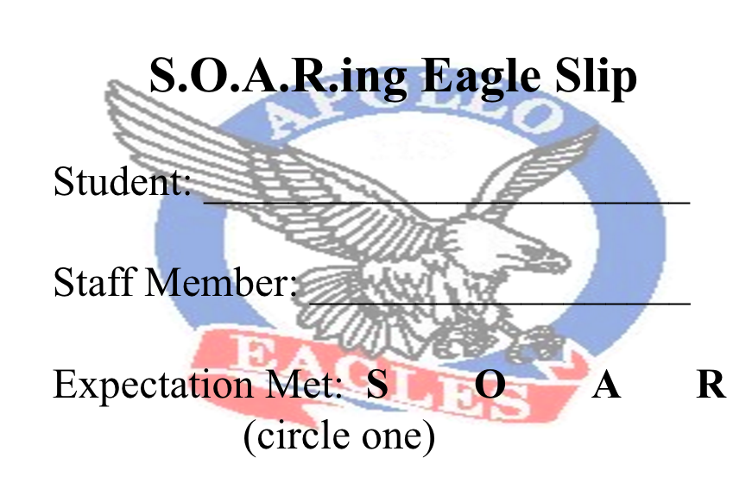
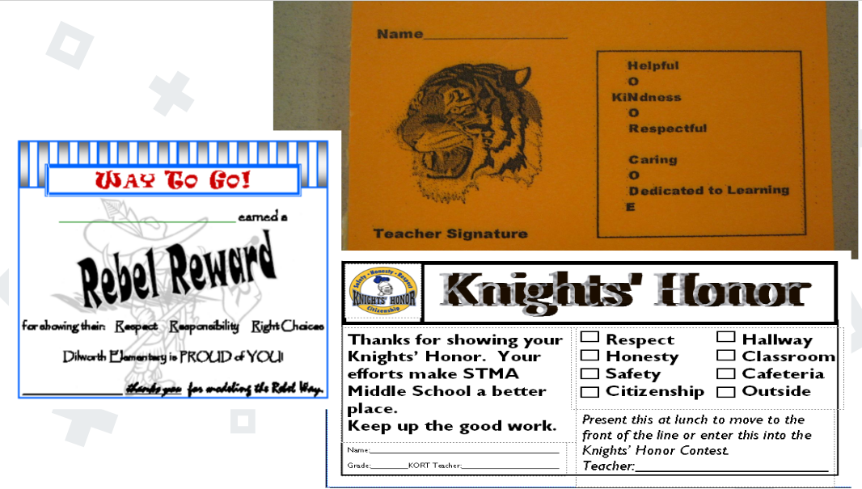
Tokens/Tickets
Notes:
INTERMITTENT

Slide 23
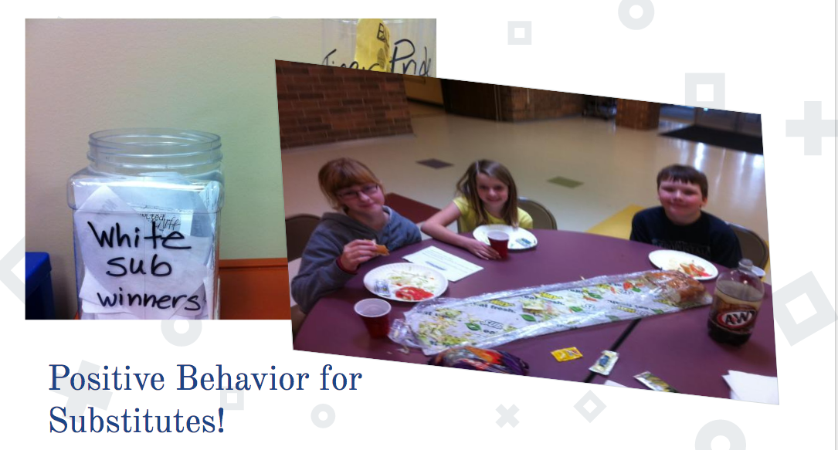
Tickets and Tokens (cont.)
Notes:
Substitutes hand out white tickets and they go into a special drawing for a Subway lunch once a month

Slide 24
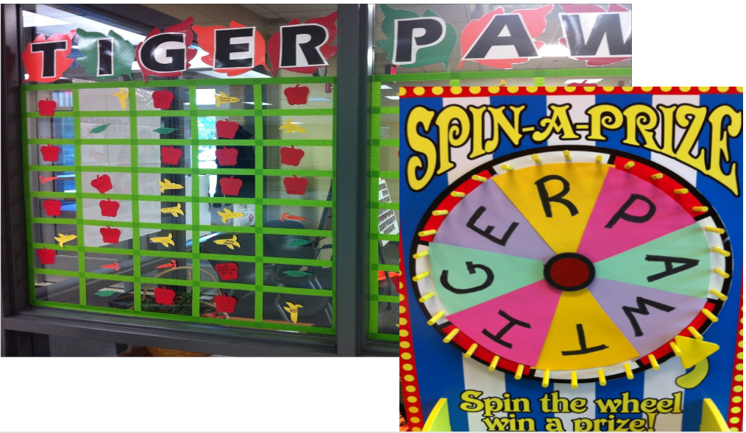
Make it Fun

Slide 25
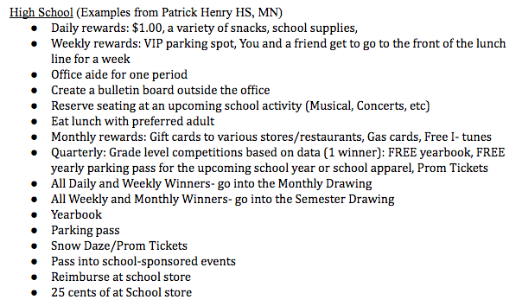
Social Reinforcements
Link to example menu
Notes:
Students collect tickets to spend on a menu of items. This menu could include tangible items or items that promote social connections. Some schools include things students may need such as school supplies, socks, beanie hats, or even blankets.

Slide 26
Monthly
Notes:
New examples

Slide 27
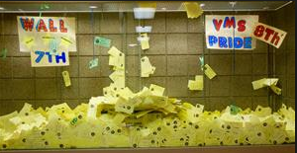
Quarterly
Notes:
School-wide celebrations after so many tickets are collected.

Slide 28
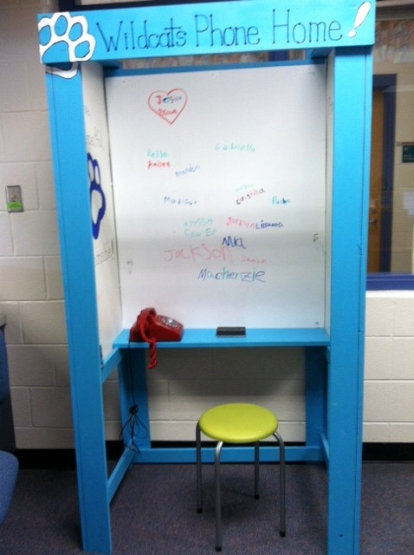
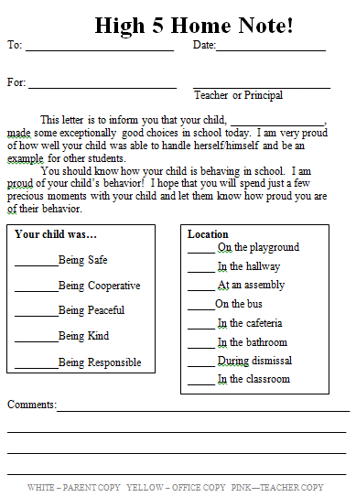
Home-School Connection
Notes:
Create a “Home-School” connection with positive notes home, a special booth in the office for a student to call their parent with good behavior news. Encourage parents to send notes to school about what positive behavior the student was “caught” displaying at home, i.e., Justin was caught being responsible at home doing his homework after dinner without being asked.”
Many schools send home positive post cards
Emphasize linking this type of form to the next ppt slide to support staff acknowledging students and communicating that to parents. EX: when the “yellow office copy” is turned in, the secretary puts the staff member’s name into a box for a drawing (see next slide).

Slide 29
Make It Easy!

Slide 30
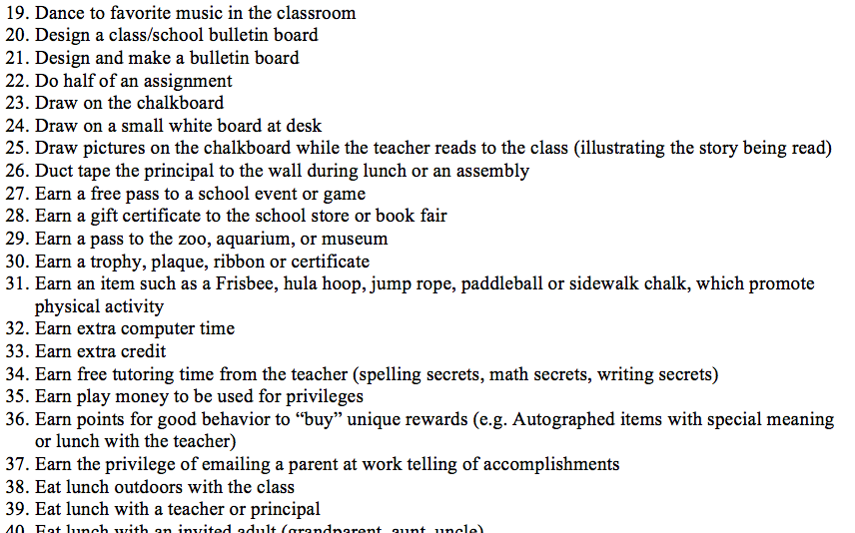
100 No or Low Cost Rewards for Elementary Students
Source, Laura Riffel: https://usm.maine.edu/sites/default/files/smart/freerewards4studentsnstaff.pdf
Notes:
Could be a handout or a link- showcase just a few

Slide 31
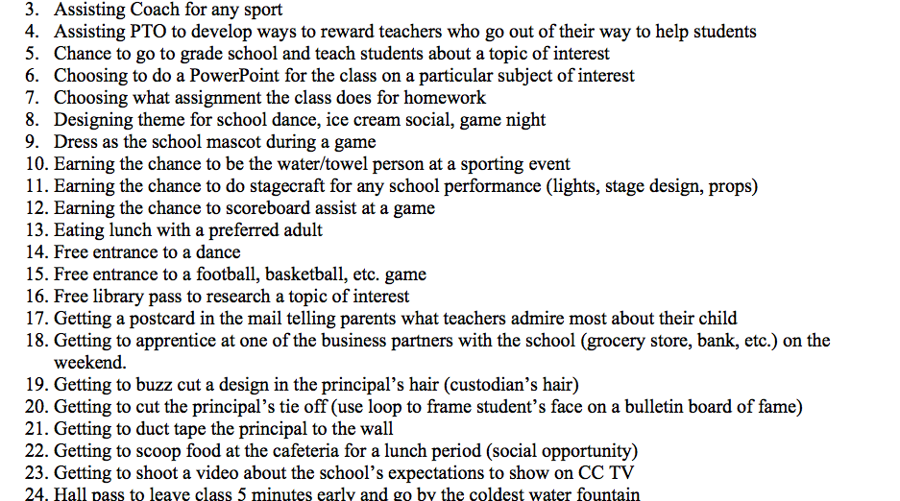
60 No or Low Cost Rewards for Secondary Students
Source, Laura Riffel: https://usm.maine.edu/sites/default/files/smart/freerewards4studentsnstaff.pdf
Notes:
Could be a handout or a link- showcase just a few

Slide 32
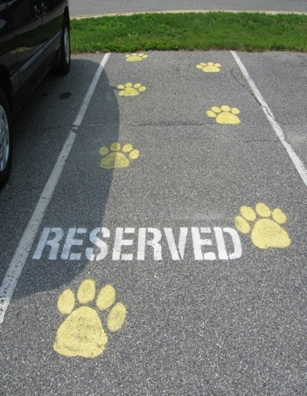
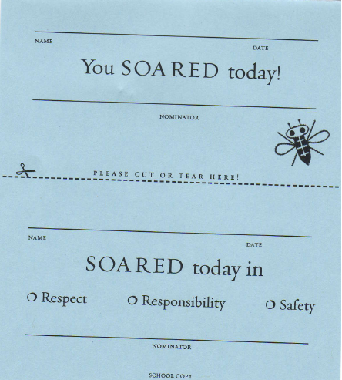
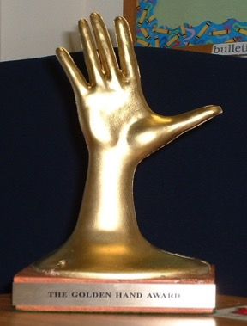
Recognizing Staff
Keep staff motivated and appreciated!
Use community resources and local businesses
Incentives for staff could include:
Tangibles
Tokens
Symbolic
Celebrations
Notes:
Incentives for staff: survey staff for ideas and suggestions
Tangibles: school spirit t-shirt, coffee mug with school name on it
Tokens: raffle ticket for chance to “win” a free gas card, meal from a restaurant, salon pass
Symbolic: thank you note from principal, golden hand award for catching kids being respectful,
Celebrations: ice cream social, dinner as a team, jeans day (the most popular!)
New examples

Slide 33
The Golden Plunger Award
Notes:
This elementary school (Liberty Elementary School in Loudoun County, VA) reviewed their data and discovered that problems were occurring in many of the restrooms across the school. The custodian became involved in rewarding the cleanest restrooms with a “bejeweled pink, blue or yellow (if both boys and girls restrooms were clean). It became a very exciting reward and follow up data showed cleaner restrooms and more appropriate behavior in restrooms throughout the school.
SCHOOL-WIDE focus on cleanest classrooms in the bldg. Custodian judges & whops plunger on wall/bulletin board for cleanest room.

Slide 34
Teacher Rugs
Notes:
Teachers receive this “door mat” as a result of student nominations. These became so popular that the school had to order more to accommodate all the requests.

Slide 35
Staff Reinforcements
Restaurant coupons for staff who gave winning student coupon
Auto detailing for staff member
Starbucks delivered to class
“Rock Star” (parking closest to school)
“Whale Done” Trophy - The principal presents it to the first recipient at the first faculty meeting, modeling how it is to be presented. After that each winner looks for a colleague to whom the trophy can be given the next time
Principal takes over a teacher’s classroom for ½ hour one time during the course of a week if their name is pulled with a student’s gotcha
Extra planning period
Thank you cards to teachers for support

Slide 36
35 No or Low Cost Rewards for Staff
Source, Laura Riffel: https://usm.maine.edu/sites/default/files/smart/freerewards4studentsnstaff.pdf

Slide 37
Guidelines for Development of Acknowledgement Matrix
School-wide acknowledgements are for every student in the building
As you achieve success with a behavior, plan for:
Moving from high frequent to less frequent acknowledgement
Predictable reinforcement toward unpredictable
Tangible to social
Acknowledging families, acknowledging staff, Students acknowledging each other,
Plan modifications to increase acknowledgements for students who need greater support
Notes:
Could be a handout or a link- showcase just a few

Slide 38
Guidelines for Acknowledgement Systems
As you develop your acknowledgement system make sure you check for the following:
The system is simple to use
School-wide acknowledgements are for every student in the building
Acknowledgements are aligned to school-wide expectations
Classrooms systems are aligned with school-wide reward systems
Clearly defined criteria for earning rewards
Supportive of and aligned with the data collection system
Supportive of behavioral and academic success
Varied to maintain student interest
Ongoing opportunity to earn rewards
Age-appropriate
Flexible enough to meet the needs of diverse students
Plan modifications to increase acknowledgements for students who need greater support
Hierarchical: Small increments of success are recognized with small rewards
As you achieve success with a behavior, plan for moving from:
high frequent to less frequent acknowledgement
Predictable reinforcement toward unpredictable
Tangible to social rewards
Acknowledging families, acknowledging staff, students acknowledging each other
REMEMBER: Once an acknowledgement is given it is never taken away.
Notes:
Use this Self-Check to review/revise your Acknowledgement Matrix.
Brainstorm ideas and begin planning your classroom reward system
Use the Self-check items to determine strengths and weaknesses of the plan
Generate ideas for strengthening the plans

Slide 39
School-wide Acknowledgement Matrix
TYPE | WHAT | WHEN | WHERE | WHO
Immediate/High Frequency In the moment, predictable, Delivered at a high rate for a short period (e.g., Gotchas, Paws, High Fives) | STUDENTS: ADULTS: | High frequency for a short time when first teaching desired behavior or re-teaching identified problem behavior from data |  | ALL STUDENTS, ALL ADULTS
Redemption of high frequency (e.g., school store, drawings) | STUDENTS: ADULTS: | At least monthly |  | ALL STUDENTS, ALL ADULTS
Intermittent/Unpredictable (e.g., surprise homework completion treat, lottery/drawing, random use of gotchas in hallway) | STUDENTS: ADULTS: | Maintaining a taught behavior (fading) |  | ALL STUDENTS, ALL ADULTS
Mid-term class-wide and/or school-wide Celebrations (e.g. DJ Fridays, Extra Recess, Game choice) | STUDENTS: ADULTS: | Weekly or Bi-Weekly |  | ALL STUDENTS, ALL ADULTS
Long-term School-wide Celebrations (school-wide not individually based) FOR: e.g. school-wide target met for certain setting/behavior area ACTIVITY: (e.g., ice cream social, dance/yoga, game day, assemblies) | BOTH TOGETHER: | At least quarterly |  | ALL STUDENTS, ALL ADULTS
Notes:
39
Emphasize 3 different types/ 3 different purposes and when to use
Long term celebrations are for ALL students….referral free parties DO NOT count!!!!!
Information from George Sugai:
The discussion was about long-term celebrations that all kids attend vs. long term celebrations that have criteria (0-1 referrals for a semester) for attendance.
1. Contingencies that link reinforcer to whole group behavior performance (e.g., If more than 80% of students have perfect attendance, whole school gets special assembly).
2. For kids with challenges, I like having separate individualized criteria and reinforcers (e.g., If Steve attends school 70% of days, he can also sit with friends of his choice).
3. Students with 100% can get some additional acknowledgement beyond what whole group get.
Etc.
The general big idea is that all kids get what the collective earns. Some kids (100% AND specialized needs kids) get extra for exceptional performance

Slide 40
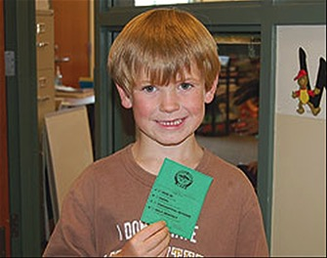
Team Time
Consider various ideas for acknowledging both staff and students.
Complete acknowledgement matrix for staff and students (high frequency, intermittent, long term).
Share the acknowledgement plan with all the stakeholders (staff and students alike).
Workbook: TFI 1.9 Activities 2 & 3

Slide 41
Frequently Asked Questions:
Q: Should I give reinforcements to students
that ask for them?
A: No – it is up to the discretion of the adult to
disperse them. A common response can
be “I have to catch you!”

Slide 42
Frequently Asked Questions:
Q: Why should I reinforce students who are
already doing well behaviorally?
A: School-wide acknowledgements are a level
of intervention for all students. Reinforcing
students already displaying school-wide
expectations shows them appreciation for
their efforts, acknowledges their presence,
provides example to other students, creates
opportunities to build rapport with them, and
encourages them to keep up the great work.

Slide 43
Frequently Asked Questions:
Q: Should we keep utilizing school-wide
acknowledgements with students identified with secondary and tertiary needs?
A: Absolutely. You can individualize them to fit the
student needs but they serve as the foundation
for secondary and tertiary interventions.
PBIS is an RTI model meaning ALL students get
core + more as needed.

Slide 44
Frequently Asked Questions:
Q: Can we include students in special education,
with BIP (behavior intervention plan), and
BEP (behavior education plan)?
A: Absolutely. Again, you can individualize
acknowledgements as needed.

Slide 45
Frequently Asked Questions:
Q: The student started misbehaving after I
gave them the acknowledgement. Can I
take it back?
A: No – once they’ve earned one it’s theirs to
keep; however, you can re-teach or give a
related consequence if necessary to address
the current misbehavior.

Slide 46
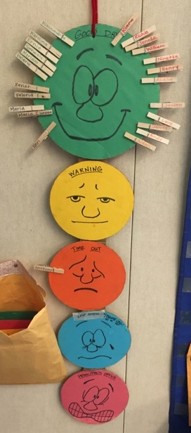
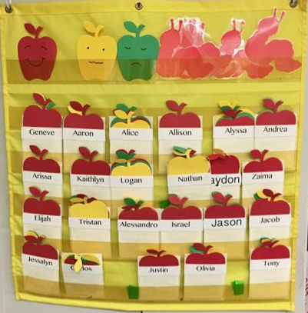
Frequently Asked Questions:
Q: I currently have a classroom behavior management system (color cards, move your clothespin, stones in jar, numbers up, names on a wall)… Can I still use this?
A: Next slide…

Slide 47
Frequently Asked Questions:
Q: I currently have a classroom behavior management system (color cards, move your clothespin, stones in jar, numbers up, names on a wall)… Can I still use this?
A: Compare your practice to PBIS:
Pro-active or reactive?
Does your system include teaching, pre-correcting, subtle re-directs before consequence?
Does your system include re-teaching as part of consequence?
Does your system acknowledge students when they are displaying appropriate behaviors?
Do you take acknowledgments away once they are earned?
Does your system publicly shame students for negative behavior?

Slide 48
Frequently Asked Questions:
Q: Can we exclude students who had a behavior problem from school-wide celebrations?
A: Based on what we learned today, what rationales would you provide against the idea of excluding students?

Slide 49
Reflection
Identify action items below needed for full implementation
Add action items to the Action Plan in your workbook
Add completed items and artifacts to the PPT Overview for your school
TFI | Action Item (Not In Place; Partially; Fully In Place ->) | NI | PI | FI
1.9 | A system of acknowledgements has elements that are implemented consistently across campus
1.9 | A variety of methods are used to reward students
1.9 | Acknowledgements are linked to expectations and rules
1.9 | Acknowledgements are varied to maintain student interest
1.9 | Ratios of acknowledgement to corrections are high
1.9 | Students are involved in identifying/developing incentives
1.9 | The system includes incentives for staff/faculty
1.8 | Classroom teachers use immediate and specific praise
1.8 | Acknowledgement of students demonstrating adherence to classroom rules occurs more frequently than acknowledgement of inappropriate behavior

Slide 50
TFI Self-Assessment
Features | Possible Sources | Criteria
1.9 Feedback and Acknowledgement: A formal system (i.e., written set of procedures for specific behavior feedback that is [a] linked to school-wide expectations and [b] used across settings and within classrooms) is in place and used by at least 90% of a sample of staff and received by at least 50% of a sample of students | • TFI Walkthrough Tool or Staff Handbook | 0 = No formal system for acknowledging students 1 = Formal system is in place and is used by at least 90% of staff OR received by at least 50% of students 2 = Formal system for acknowledging student behavior is used by at least 90% of staff AND received by at least 50% of students
Notes:
Teams should complete this self assessment and use the results to determine action planning steps on Workbook page 11.

Slide 51
Appreciation is given to the following for their contributions to this Professional Learning:

