Slide 1
Tier 1
Virtual Training Day 1 Reintegration after COVID-19
Notes:
(Updated June 2020)

Slide 2
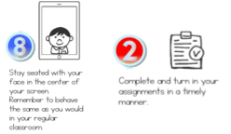
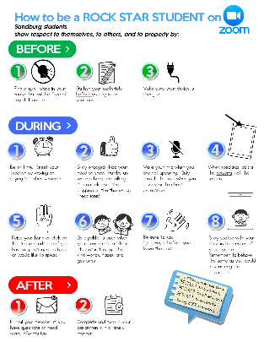
Learning Expectations for Virtual Training
EXPECTATION | BEHAVIOR
Be Responsible
Be Respectful
Be Committed
EXPECTATION | BEHAVIOR
Be Responsible
Be Respectful
Be Committed
1
2
3
4
5
6
7
8
10
9
10
Awesome expectations from the team at Sandburg Elementary, SPS186!
Awesome expectations from the team at Sandburg Elementary, SPS186!
Awesome expectations from the team at Sandburg Elementary, SPS186!

Slide 3
“The past cannot be changed.
The future is yet in your power.”
Discuss in
CHAT
As we get started, reflect on this quote in the chat.
Notes:
Quotes to ground the work

Slide 4
We are planning for the unknown.
This is open-ended and that is what makes this work so important.
Notes:
Our reality

Slide 5
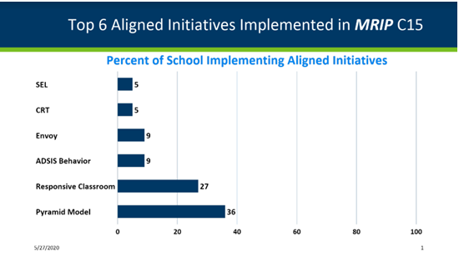
Top 6 aligned initiatives implemented in MRIP C15
Notes:
Change for each region - information from Tamarah Jacklen at MDE from the Cohort 15 applications - what schools noted as the aligned initiatives they were implementing.
Justification for incorporating this work, along with PBIS, into reintegration.

Slide 6
Multiple Scenarios
Plan A - Start Fall 2020 in person
Plan B - Start Fall 2020 virtually
Plan C - Start.Stop.Start.Stop
Plan D - Hybrid
Plan E - ….
Plan F - ….
No matter what the scenario is when we return from COVID-19, we’ve got to be ready to meet the needs of the whole child.
Notes:
We can get stuck in the minutiae of the planning for every single scenario. This is time intensive, exhausting, and completely overwhelming. What we need to focus on is, what our staff, students, and families need from us, no matter what.

Slide 7
We need to build/enhance our capacity with:
Systems
Equitable Access
For Adults
For Students
For Families
Predictability & Consistency (PBIS)
Expectations & Routines
Acknowledgement
School Connectedness
Psychosocial Climate
Relationships
Adult to Adult
Adult to Student
Student to Student
School to Family
Trauma Responsiveness
Emotional Safety
Moving beyond being informed to being responsive
SEL
For Adults
For Students
For Families
Notes:
In order to reintegrate, we must have the systems in place to address the needs. Systems include the practices and frameworks we have in place to help adults, students and families. When we look at the vital systems with reintegration, we must put the academic needs aside and meet the needs of the whole child first. We first need to address the predictability & consistency for students and the school connectedness. We have spent so much time away, we need to place an extended amount of time helping staff, students, and families get re-adjusted to the school environment and helping them to feel safe with new guidelines and expectations. Within this work, we need to be responsive to the trauma that adults and students have faced and have programming in place to help staff and students develop the social-emotional skills needed for success.

Slide 8
What is your mission that you can practice day one?
What is your school/district main mission going to be that is connected to the social, emotional, and behavioral well-being of both your staff and your students?
Develop collective systems to provide consistency to recognize the trauma that EVERYONE is going through.
Discuss in
CHAT
What is the mission/message for your school and/or district?
Notes:
Each and every school must re-focus on the social, emotional and behavioral needs of both staff and students. We cannot just reintegrate without addressing the common situation that we’ve all faced and the common traumas among us. We have to address this via a mission and message that will be consistently supported.

Slide 9
#1: Core Systems Components
Functioning Leadership Teams
District Level & Site Level
Use of data to inform the need for program and practice decisions
A process for selection of practices
Professional development to guide implementation
Screening to know what students need supports the most
Structured communication and policy
Notes:
These core components are a must in order for this work to happen

Slide 10
Systems
Practices
Systems support adult behavior
Adult sense of safety, predictability and consistency is key to high performing staff
Developing common language, practices and routines
Systems allow the planning and intentional education of the mission we have put into place
Practices support student behavior
Student sense of safety, predictability and consistency is key to high performing students
Developing common language, practices and routines
Practices allow our systems to be implemented with fidelity
Notes:
The systems that we put in place for adults are going to be vitally important for them to feel safe and supported to do their job. We have to be very intentional with providing the systems that are needed to support adults so that we can have high functioning teachers and staff. The adults will have so many concerns, worries, unsupportive thoughts, and possibly even irrational actions based on what they’ve been through. We need to emphasize the systems work so they have the capacity to implement the practices with students in order to support their behavior.

Slide 11
#2: Predictability & Consistency
Predictability and consistency will need to be the main focus, no matter the reintegration scenario.
This applies to staff, students and families.

Slide 12
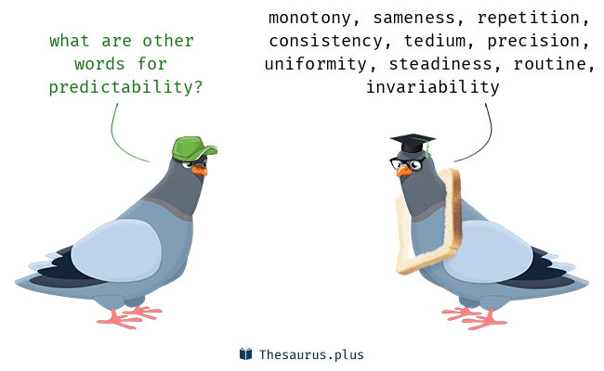
Other words for predictability

Slide 13
Expectations & Routines
Systems & Routines help create psychosocial safety
Predictability & consistency for both staff & students.
Three to five school-wide expectations & class expectations should align
Expectations & routines developed and taught for each activity & transition
Considerations for teaching new routines that may be needed based on COVID-19
Self-monitoring & praise should be integrated

Slide 14
Expectations & Routines
It will be essential to spend an over-accentuated amount of time teaching expectations & routines
Take additional time
Give additional grace
Embed expectations into curricula
Find your systems and figure out how they need to look differently now
i.e. distance between people, hand washing expectations, masks, etc.

Slide 15
Getting Back to School After Disruptions
Discuss in
CHAT
What are the updates routines & procedures you are going to address?
Notes:
Great resources to dig into that addresses the main components of PBIS on how to look at them differently after a school disruption. The guide addresses:
Re-teach, remind, and acknowledge positive school-wide expectations
Re-teach classroom routines
Focus on the positive, and avoid punitive approaches.
Get to know your students - again.
Look for signs that students might need more help.
Re-engage families as partners in their child’s education

Slide 16
Acknowledgments
It will be essential to over-accentuate acknowledgement for student behavior
Helps build/re-build connections
Develops rapport
Reinforces to the student and other students what is expected
Highlights the small daily wins

Slide 17
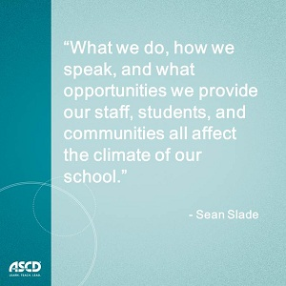
#3: School Connectedness

Slide 18
Psychosocial Climate
Practices & Procedures that protect the health and safety of the adults
Allowing your staff to grieve, tell their experience, and own the difficult
Staff know how to get support, be supported
Adults given permissions to discuss feelings and impact with each other, thus with students
Discuss in
CHAT
How are staff going to be supported at your site?

Slide 19
Relationships
Systems for tracking & monitoring relationships
Staff
Where are staff at with each other?
Establish-Maintain-Restore
Students
Establish-Maintain-Restore
Families
Establish-Maintain-Restore

Slide 20
Common Language: Three phases to every relationship
Banking time
Positive greeting/farewells
2 by 10
Second hand compliments
Establish
5 to 1 ratio
Check-ins
Effective praise
Maintain
Restoring relationships following negative interactions:
Letting go conversation
Owning part of the interaction
Mutual problem solving
Empathy statement
Restore
Dr. Clayton R Cook

Slide 21
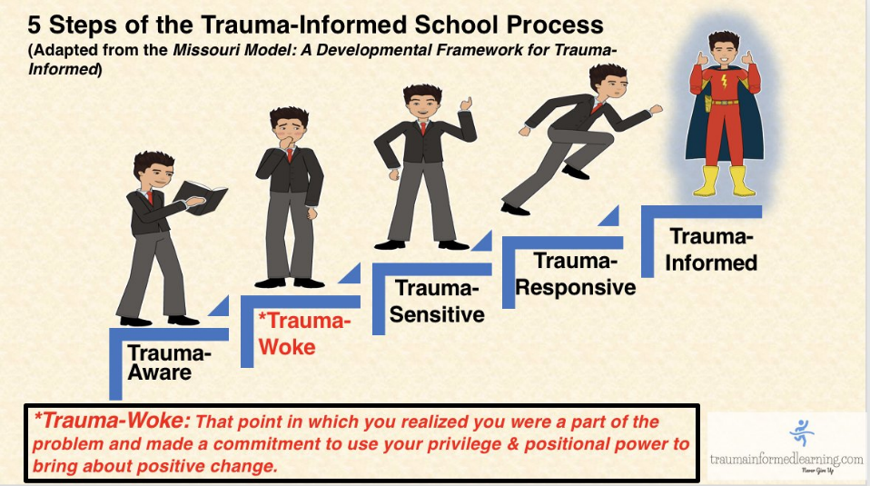
#4: Trauma Responsiveness
Notes:
We need to be extra cognizant of the Trauma that has impacted all. We all have a common experience to use as a foundation and we are able to use our position in education to bring about positive change.

Slide 22
Student Behavior
We will see student behavior, it is how we respond that will make the difference.

Slide 23
When you see behavior, what lens are you looking through?
Trauma-Uninformed View
Anger management problems
May have ADHD
Choosing to act out & disrupt classrooms (i.e. disrespectful or manipulative)
Uncontrollable, destructive
Non-responsive
Trauma-Informed View
Maladaptive responses (in school settings
Seeking to get needs met
Difficulty regulating emotions
Lacking necessary skills
Negative view of world (i.e. adults cannot be trusted)
Trauma response was triggered
Uninformed Response
Student needs consequences to correct behavior or maybe an ADHD evaluation
Informed Response
Student needs to learn skills to regulate emotions & we need to provide support
Adapted from Eber, 2016 & Daniel & Zarling (2012)
Notes:
When we are looking through a trauma - informed lens, we are able to see that students are in need of learning new skills in order to regulate and function with others. When we are looking through and uninformed lens, we see it as the child’s problem and choice and we look towards punishment and evaluation methods.

Slide 24
#5: Social Emotional Learning Skills
Social-Emotional Skills are how children and adults learn to understand and manage emotions, set goals, show empathy for others, establish positive relationships, and make responsible decisions.
Allow adults the ability to reflect on their own skills
Provide adult supports for each competency
Encourage 4 components for adult health:
Sleep, Physical Activity, Gratitude Practices, Mindful Moments
Streamline the curriculum and strategies being taught to students
Offer teaching at the Tier I level - to all students
Common language, practice and implementation calendar

Slide 25
Low burden, high impact school-wide strategies
School-wide & classroom PBIS
Relationship Building through E-M-R
Red Thoughts/Green Thoughts
Who is driving your bus?
Feel good plans
Feelings charts/check-ins
Discuss in
CHAT
Which of these strategies sound like they would fit in your setting?
Notes:
Discuss the importance of school-wide expectations being systemic and carrying over into the classroom.
Use of the Establish - Maintain - Restore method for relationship building is a low burden, high impact strategy that can be used with both adults & students
To help understand the difference between helpful and unhelpful thoughts Dr Paula Barrett uses the terms ‘green’ (helpful) and ‘red’ (unhelpful) thoughts. A red thought is a negative thought that can increase worries, anger, sadness and fear. Such as ‘I can’t do this’ or ‘Nobody likes me’. A green thought is a more helpful thought that can encourage and help them to feel more resilient. Such as ‘I can try my best’ or ‘I have friends and family who love me’.
This concept provides common language around who is controlling your thoughts & actions. Are you acting as the driver of your bus (thoughts, emotions, actions) or are you letting unruly passengers (red thoughts) control your bus. Having quick check-ins throughout the day to ask “who is controlling your bus right now” can be common language and refelction to help assess the social-emotional state for both students and adults
Feel good plans - these are lists created by adults & students that list activities and practices one can engage in to help them feel good when they are starting to get into a place of distress. These feel good plans can include a variety of strategies, such as breathing, reading, self-talk, looking at pictures, etc. Feel good plans for younger students can have 3-5 strategies, older students up to 10. Options are necessary in case one strategy doesn’t work, there are more to rely on.
These charts can look very different depending on your students. The basic concept is that students are given opportunity to check-in at the beginning of a specified transition in order to communicate their social-emotional state. This could be an emoji chart, colors (Zones of regulation), number scale, etc. Key points are to make sure students stay anonymous and safe when checking in.

Slide 26
Staff Reintegration
Immediate (Before Fall 2020) | Short-Term (Fall 2020 - Dec 2020) | Long-Term (Jan 2021 - June 2021)
Validate the loss, the sense of incomplete year, lack of closure on relationships | Re-teaching of vision/mission around school-wide expectations - address any changes that may need to be addressed | Continuous school-wide culture building activities
Affirmation of a job well done, understanding of feelings and the grief/loss | Opportunities to have closure with 2019-2020 students (if not in Spring 2020) | Relationship building amongst students, staff, and families
Permission & Time to let go of “what was lost” the year before | Discussion, reflection on experience, circle work to support relationship building | Continued discussion, reflection on experience, circle work to support relationship building
Opportunity to reflect on how the experience molded the profession and the work | Teambuilding, climate, and culture work amongst all staff (as an entire entity) | Continued education around trauma responsive work and integration of SEL
Reintegration of staff climate, culture, focus on community building and adult SEL skills | Opportunities for staff to get additional mental health support as needed, trauma responsive
Closure conferences with students/families from 2019-2020 | Welcoming Meet & Greet conference with students/families from 2019-2020

Slide 27
Student Reintegration
Immediate (Before Fall 2020) | Short-Term (Fall 2020 - Dec 2020) | Long-Term (Jan 2021 - June 2021)
Closure conferences with 2019-2020 teacher | Meet & Greet with 2020-2021 teacher | Continued explicit teaching of behavior expectations across all settings
Continued resources for SEL skill building work over the summer | Back-to-school socials with grade levels and/or school-wide | Continued exposure to Tier I SEL lessons, addressing skills and strategies
Continued academic support via summer school or extension projects | Explicit teaching of school-wide and classroom behaviors & routines, longer and stronger than in previous years | Continued exposure to restorative circles and relationship building activities
 | Exposure to Tier I SEL lessons, addressing skills and strategies | Continued SEBH screeners and Academic screeners
 | Exposure to restorative circles and relationship building activities | School-wide community building and celebrations
 | SEBH screeners and Academic screeners

Slide 28
Family Reintegration
Immediate (Before Fall 2020) | Short-Term (Fall 2020 - Dec 2020) | Long-Term (Jan 2021 - June 2021)
Closure conferences with 2019-2020 teacher | Meet & Greet with 2020-2021 teacher | Continued focus on family/school involvement and relationship building
Provided with continued resources for COVID-19, parenting while working, SEL skills at home, home expectations, etc. | Back-to-school socials with grade levels and/or school-wide | Continued SEBH Screening Results and Academic Screening Results
 | Meet & Greet conferences with 2020-2021 teacher
 | SEBH Screening Results and Academic Screening Results
 | Opportunities for continued check-ins for families that want it

Slide 29
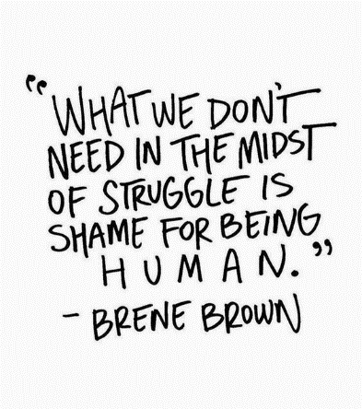
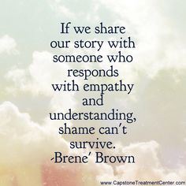
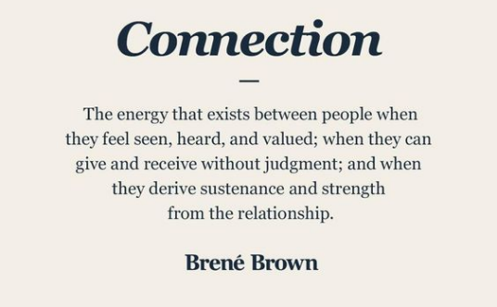
Brene’ Brown

Slide 30
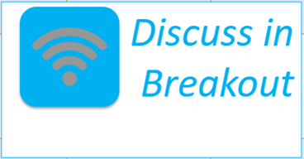
Discuss in breakout
Prioritize the work you need to build or enhance capacity with. (slide 7 & 31)
Develop some reintegration tasks and timelines for your stakeholders:
Staff
Students
Families
Timeline:
Back in Large Group for Professional Development Content Presentation at 10:55

Slide 31
We need to build/enhance our capacity with:
Systems
Equitable Access
For Adults
For Students
For Families
Predictability & Consistency (PBIS)
Expectations & Routines
Acknowledgement
School Connectedness
Psychosocial Climate
Relationships
Adult to Adult
Adult to Student
Student to Student
School to Family
Trauma Responsiveness
Emotional Safety
Moving beyond being informed to being responsive
SEL
For Adults
For Students
For Families
Notes:
In order to reintegrate, we must have the systems in place to address the needs. Systems include the practices and frameworks we have in place to help adults, students and families. When we look at the vital systems with reintegration, we must put the academic needs aside and meet the needs of the whole child first. We first need to address the predictability & consistency for students and the school connectedness. We have spent so much time away, we need to place an extended amount of time helping staff, students, and families get re-adjusted to the school environment and helping them to feel safe with new guidelines and expectations. Within this work, we need to be responsive to the trauma that adults and students have faced and have programming in place to help staff and students develop the social-emotional skills needed for success.

Slide 32
Appreciation is given to the following
for their contributions to this Professional Learning:
Midwest PBIS
PBIS.org
Brene Brown
CASEL
Lucille Eber
Daniel & Zarling
Sean Slade
Trauma Informed Learning
Dr. Lori Lynass
Dr. Bella Bikowsky
Dr. Clay Cook
Megan Gruis

