Slide 1
PBIS Team Training 8A
Discipline Data (TFI 1.12)
Data-based Decision Making (TFI 1.13)

Slide 2
Learning Expectations
EXPECTATION | BEHAVIOR
Be Responsible | Make yourself comfortable Take care of your needs (water, food, restroom, etc.) Action plan to implement what you are learning Follow through on your action items
Be Respectful | Turn cell phones off or to “vibrate” Listen attentively while others are speaking Have only the training materials up on your computer/tablet/phone
Be Engaged | Ask what you need to know to understand and contribute Contribute to the group by sharing relevant information and ideas
Notes:
2

Slide 3
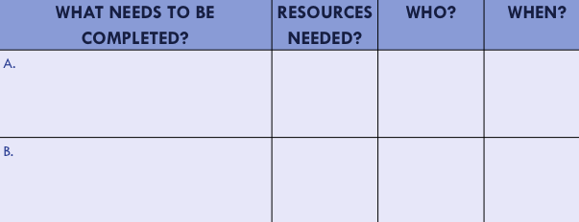
Organization of Modules
Content:
Aligned to TFI Items 1.1 – 1.15 and Classroom Management Practices
Activities/Team Time: Activities for Fluency
Self-Assessment:
Tiered Fidelity Inventory
Action Planning: Applying the core content to your school
Notes:
These are the icons that you will see throughout the training and will serve as a guide and a prompt to the content of each slide.

Slide 4
Tier 1: Professional Learning Roadmap
TFI Sub-Scale: Team
TFI 1.1 | Team Composition
TFI 1.2 | Team Operating Procedures
TFI Sub-Scale: Evaluation
TFI 1.12 | Discipline Data
TFI 1.13 | Data-based Decision Making
TFI 1.14 | Fidelity Data
TFI 1.15 | Annual Evaluation
TFI Sub-Scale: Implementation
TFI 1.3 | Behavioral Expectations
TFI 1.4 | Teaching Expectations
TFI 1.5 | Problem Behavior Definitions
TFI 1.6 | Discipline Policies
TFI 1.7 | Professional Development
TFI 1.8 | Classroom Procedures
TFI 1.9 | Feedback and Acknowledgement
TFI 1.10 | Faculty Involvement
TFI 1.11 | Student/Family/Community Involvement
8 Classroom Management Practices
1 | Arrange orderly physical environment
2 | Define, Teach, Acknowledge Rules and Expectations
3 | Define, Teach Classroom Routines
4 | Employ Active Supervision
5 | Provide Specific Praise for Behavior
6 | Continuum of Response Strategies for Inappropriate Behaviors
7 | Class-Wide Group Contingency
8 | Provide Multiple Opportunities to Respond

Slide 5
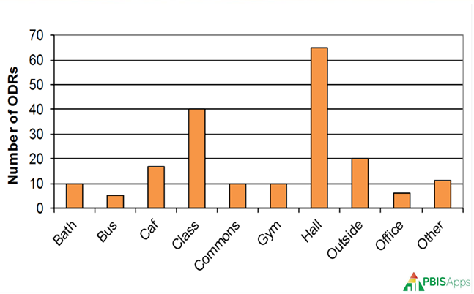
TFI 1.12 & 1.13 Purpose & Outcomes
Purpose: Prepare and plan for facilitating implementation of Data Analysis
Outcomes:
1.12 Discipline Data: Tier I team has instantaneous access to graphed reports summarizing discipline data organized by the frequency of problem behavior events by behavior, location, time of day, and by individual student.
1.13 Data-based Decision Making: Tier I team reviews and uses discipline data and academic outcome data (e.g., Curriculum-Based Measures, state tests) at least monthly for decision-making.
Notes:
Review to set the context/stage for work.

Slide 6
Definition
Data are the many sources of information we use to make decisions about how to allocate our resources of time and attention for teaching, redirecting, prompting, and reinforcing behaviors.
Data come in many forms such as office referrals, attendance records, grades, surveys, verbal feedback, and observations.
Data must be documented, and shared to be most effective in action planning.
Notes:
Review to set the context/stage for work.

Slide 7
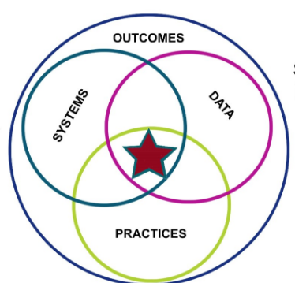
Review
Notes:
Review to set the context/stage for work.

Slide 8
Quote
“If we have data, let’s look at data.
If all we have are opinions,
let’s go with mine.”
–Jim Barksdale, former Netscape CEO
Notes:
Review to set the context/stage for work.

Slide 9
Why Use Data For Decision Making?
Data helps us ask the right questions…it does not provide the answers.
Use data to:
Identify problems
Refine problems
Define the questions that lead to solutions
Data helps place the “problem” in the context rather than in the students.
Notes:
Review to set the context/stage for work.

Slide 10
Types of Data
Effort: What is the current status of your systems?
School-wide Tiered Fidelity Inventory (TFI Progress Monitoring)
Self-Assessment Survey (SAS) – Staff
Opinion Survey
Fidelity: Are you doing what the framework outlines? Are you doing what you said you would?
School-wide Tiered Fidelity Inventory (TFI-Annual Assessment)
Self-Assessment Survey (SAS) – Staff
Outcome: Are your systems working?
Office Discipline Referrals (ODR’s)
Check-In Check-out (CICO)/Point Sheets
Suspensions/Expulsions
Attendance
Grades/Test Scores
Notes:
Review to set the context/stage for work.

Slide 11
Using Outcome Data for Decision Making
Notes:
We are going to be leading the teams through a clear-cut, researched based data for decision making process.

Slide 12
Team Discussion
Outcome: Are your systems working?
Office Discipline Referrals (ODR’s)
Check-In Check-out (CICO)/Point Sheets
Suspensions/Expulsions
Attendance
Grades/Test Scores
Notes:
We need to reflect on the systems we have in place that are collecting our outcome data. Are the systems working?

Slide 13
Team Activity
Look to your handbook
Team Activity Day 8, Activity 1
Have honest discussions with your team about the data sources available.
When are these data sources used in your setting? (i.e. weekly at PLC meetings)
Notes:
Teams should go to their handbook, team activity day 8, activity 1.
Honest conversations should be had about the outcome data they have available to them and how they are currently using this data.
Trainers will likely need to touch base with all teams to keep them focused throughout this content presentation.

Slide 14
Useful Data-Based Decision Making
The statement of a problem is important
Everyone must be working on the same problem with the same assumptions.
Problems often are framed in “primary” form.
This raises awareness and concern, but is not useful for problem solving.
Use a more detailed review of the data to build precise problem statements which are solvable
Notes:
If we have systems in place, but those systems are not working on the correct problems and leading towards action, what is the purpose of our system?

Slide 15
Data Analysis
Is there a problem?
What areas/systems are involved?
Are there many students or a few involved?
What kinds of problem behaviors are occurring?
When are these problems likely to occur?
What is the most effective use of our resources to address this problem?
Notes:
Our data needs to be able to give us answers to these questions in a clean, clear and concise way. When we have this data, we need to know how to use it.

Slide 16
Use This Data to Become More Precise
What is the problem and how often is it happening?
Referrals by Problem Behavior
Where is it happening?
Referrals by Location
Who is engaged in the behavior?
Referrals by Grade
When the problem is most likely to occur?
Referrals by Time and referrals by Day of Week
Why the problem is sustained?
Drilldown Report – Referrals by Motivation
Notes:
Focusing in on discipline data, we need to be able to answer these questions and have a way to problem solve with precision.

Slide 17
Example Precision Statements
There are 25% more ODRs for aggression on the playground this month than last year. These are most likely to occur during first recess, with a large number of students, and the aggression is related to getting access to the new playground equipment.
What?
25% More ODRs for aggression
When?
First recess
Where?
On the playground
Why?
To get new playground equipment
Who?
A large number of students

Slide 18
Problem Solving the Bus
The Data
What? Physical altercations.
How often? Every day. 32 referrals in the last month.
Where? On 3 of the 12 bus routes.
Who? Many students (50)
When? Mostly afternoon bus routes.
Why is the problem sustaining? Students do not have direct supervision or access to supports.
Write an example precision problem statement for bus behavior.
Team Activity Day 8, Activity 2
Notes:
Walk through this as a large group. They can write in their workbook if they choose. (Think I Do/We Do)
What is the problem behavior? Physical altercations.
How often is the problem happening? Every day. 32referrals in the last month in this location.
Where is the problem happening? On 3 of the 12 bus routes
Who is engaged in the behavior? Many students, about 50
When is the problem most likely to occur? Afternoon bus routes
Why is the problem sustaining? Students do not have direct supervision or access to supports.
Now, work through developing a precision problem statement with the entire group. Each team should be writing in their workbook, Team Activity Day 8, Activity 2

Slide 19
Identify a Measurable Goal
Goals allow you to analyze, monitor, and adjust professional practice.
Current playground referrals average 28 per month. Our goal is to reduce playground referrals by 50% per month for Feb through May.
Is the goal above:
Specific?
Measurable?
Achievable?
Relevant?
Timely?
Notes:
Continue Walk through this as a large group. They should write in their workbook. (Think I Do/We Do)

Slide 20
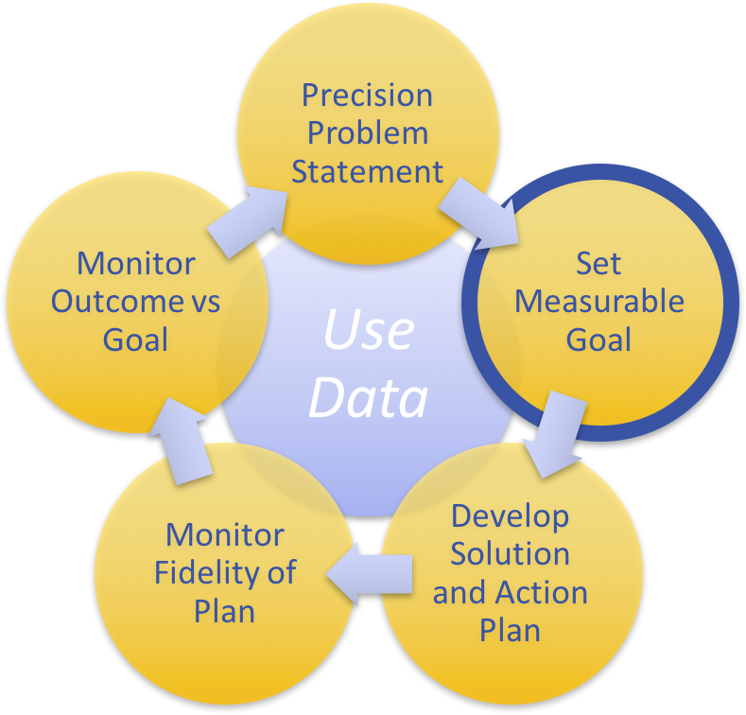
Activity: Write a Measurable Goal
What measurable outcome do you want to achieve from your Precision Problem Statement on hallway behavior outside the cafeteria?
Specific
Measurable
Achievable
Relevant
Timely
Write an example SMART goal for bus behavior based on your precision problem statement.
Team Activity Day 8, Activity 2
Notes:
Continue Walk through this as a large group. They should write a SMART goal in their workbook. (Think I Do/We Do)

Slide 21
Building a Solution & Action Planning
Solution component | Definition and Example | Bus Solution…
Prevention | How can we avoid the problem context? e.g. schedule lunch times, change lighting
Teaching | How can we define, teach, and monitor what we want? e.g. build “Quiet” curriculum, teach hallway expectations, buy decibel meter
Recognition | How can we build in systematic rewards for positive behavior? e.g. 3 quiet days = 5 extra minutes of social time at lunch
Extinction | How can we prevent problem behavior by removing the reward? e.g. Do not respond to student who speaks out instead of raising hand
Consequence | What are efficient, consistent consequences for problem behavior? e.g: Error correction; practice appropriate behavior (document with Major/Minor ODR)
Data | How will we collect and use data for evaluating the fidelity of our solution (e.g. walkthrough reports, observations, self-assessments), and student outcomes (e.g. SWIS ODR data, time on task, etc.)?
Notes:
Introduce the Solution Components and Action Planning model

Slide 22
Building a Solution & Action Planning
Using the Bus Scenario and SMART goal, we are going to practice:
Building a Solution & Action Planning
Solution component | Definition and Example | Bus Solution…
Practice Building a Solution & Action Planning
Team Activity Day 8, Activity 3
Notes:
Have teams walk through the 6 solution components and building an action plan based on the bus scenario. Team Activity Day 8, Activity 3 in their workbook.

Slide 23
Day 8, Activity 3
Go through the 6 solution components and develop examples for each one. These examples should be related to the precision problem statement and SMART goal you came up with for the bus.
After you have completed your workbook pages, take your ideas and place them on the poster paper around the room. If your solution for a specific component is the same/similar to another team, just place an asterisk by it.
Practice Building a Solution & Action Planning
Team Activity Day 8, Activity 3
Notes:
Details on the process.
They will work through the 6 solution components.
They need examples for each one, related to their precision problem statement and SMART goal.
Teams will show you they are done by posting their ideas around the room.
You will need to have prepared 6 poster papers, 1 poster paper per solution component (Prevention, Teaching, Recognition, Extinction, Consequence, Data)
Teams should write their ideas/brainstorms on the poster papers.
If teams have similar solutions, they can asterisk the solution that is similar to theirs.

Slide 24
Your Data. Your Story.
Let’s see how we can use these same steps with your own site-specific data.
Pull your recent data, hopefully with an option to drill down into it.
Then,
Develop a Precision Problem Statement
Develop a SMART goal
Develop an action plan from the 6 solution components.
Post 1-2-3 from above on your own poster paper for others to see.
Your Data. Your Story.
Team Activity Day 8, Activity 4
Notes:
Now, teams will pull out their own data and go through this process with their own data.
They should practice this twice, on the workbook pages. Team Activity Day 8, Activity 4
When they are done, they should make their own poster, as stated in #4
Reminder, teams may need trainers to help coach them through this!

Slide 25
Gallery Walk
Take a walk around the room to view other’s problem solving processes.
Note at least 2 unique ideas that you can bring back to your team.
Do a quick whip-share around your team table with the ideas you noted from other teams.
Notes:
After each team has posted their ideas, everyone should walk around to see the ideas. Go back to teams and share out the unique ideas noted from other teams.

Slide 26
Think About Your Process.
If you can do this process with your behavior data, how can this happen with other data that will guide your decision making?
Going back to Day 8 Activity 1 in your handbook, think about how this problem solving process could be used in your current systems. Do any of your current systems need to change in order to meet Tier 1, Tier 2, and/or Tier 3 needs?
Notes:
This activity is encouraging teams to reflect back on the 1st activity the completed at the start of this session, team activity day 8, activity 1.
They are to critically reflect on how they may be able to change their processes with teams that are not successfully looking/working though data. Do teams need to be combined, focus shifted, adopt new strategies for looking at data, etc.
Examples on next slide.

Slide 27
Process Examples.
MCA score review is not effective. Ideas for change include:
Bring scores, along with attendance data, to Tier 2 intervention team
We look at academic data & behavior data separately. Ideas for change include:
Bring systems-wide data to Tier 1 PBIS team
Bring individual student/grade level data to Tier 2 Intervention Team
Notes:
Here are a few quick examples that will help teams start thinking of ways they may need to adjust their outcome data teams/processes

Slide 28
Report Out: Share your Problem Solving Process.
Notes:
Encourage teams to share out their ideas/successful team layouts/ways they are going to change. This can be done:
As a whole cohort group
In small groups matched with another team
On poster paper.
Use a process that meets the needs of your training cohort

Slide 29
Data Sharing with Staff, Students, Community
SHARE monthly
How are we progressing toward our goal?
What are the results of our fidelity checks for our interventions?
Are these data accurate?
Are we over writing ODRs, under writing ODRs?
Are we being consistent in writing and definitions of behavior?
Get feedback
Communication is two way
Stress to staff the importance of accurate and consistent input
Notes:
Wrapping up, reminders to share out data!

Slide 30
Reflection
Identify action items below needed for full implementation
Add action items to the Action Plan in your workbook
Add completed items and artifacts to the PPT Overview for your school
TFI | Action Item (Not In Place; Partially; Fully In Place ->) | NI | PI | FI
1.12 | Data system is used to collect and analyze Office Discipline Referral (ODR) data
1.12 | Additional data are collected (attendance, grades, faculty attendance, surveys) and used by PBIS Team
1.13 | Data analyzed at least monthly
1.13 | Data shared with team and faculty monthly (minimum)
1.13 | Disaggregate data to inform and monitor equitable practices.
1.13 | Team Implements problem solving process including: precision problem statements, goal setting, action plan, fidelity measure, and monitoring student outcomes.

Slide 31
TFI Self-Assessment
Features | Possible Sources | Criteria
1.12 Discipline Data: Tier I team has instantaneous access to graphed reports summarizing discipline data organized by the frequency of problem behavior events by behavior, location, time of day, and by individual student. | • School policy • Team meeting minutes • Student outcome data | 0 = No centralized data system with ongoing decision making exists 1 = Data system exists but does not allow instantaneous access to full set of graphed reports 2 = Discipline data system exists that allows instantaneous access to graphs of frequency of problem behavior events by behavior, location, time of day, and student
1.13 Data-based Decision Making: Tier I team reviews and uses discipline data and academic outcome data (e.g., Curriculum-Based Measures, state tests) at least monthly for decision-making. | • Data decision rules • Staff professional development calendar • Staff handbook • Team meeting minutes | 0 = No process/protocol exists, or data are reviewed but not used 1 = Data reviewed and used for decision-making, but less than monthly 2 = Team reviews discipline data and uses data for decision-making at least monthly. If data indicate an academic or behavior problem, an action plan is developed to enhance or modify Tier I supports
Notes:
Teams should complete this self assessment and use the results to determine action planning steps

Slide 32
Appreciation is given to the following for their contributions to this Professional Learning:

