Slide 1
Minnesota PBIS
PBIS Team Tier 1 Virtual Training Day 8
Managing the Cycle of Escalating Behavior:
Understanding and Responding
Notes:
Updated September 2020

Slide 2
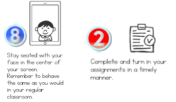
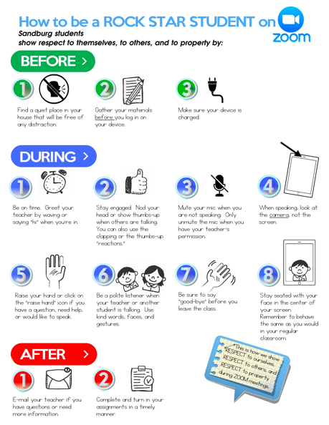
Learning Expectations for Virtual Training
EXPECTATION | BEHAVIOR
Be Responsible
Be Respectful
Be Committed
1
2
3
4
5
6
7
8
9
10
Awesome expectations from the team at Sandburg Elementary, SPS186!
Notes:
2

Slide 3
Purposes
To gain an understanding of how to better respond to student behavior.
Information shared can be used with all staff at your school.
Notes:
Point out the key feature of improving student behavior in non-classroom settings is to involve all school personnel in Active Supervision, emphasizing ALL school staff.
*

Slide 4
Outcomes
Teams will update their action plan to include a method, materials, personnel etc. needed to train staff on the use of Managing the Cycle of Escalating Behaviors.

Slide 5
Outline
Review Escalation Cycle
Different for each individual
Behavior Basics
ABCs of behavior
Determine environmental patterns surrounding display of behavior
Identify Strategies to Manage and Respond to Behavior
Notes:
Goals of the session

Slide 6
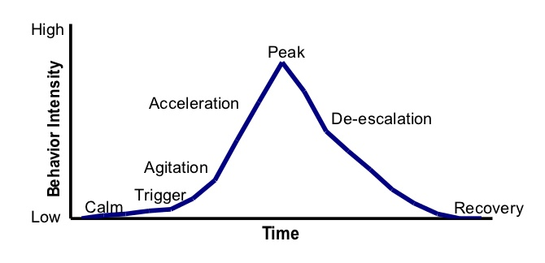
The Basic Model
Notes:
The basic model of Geoff Colvin.

Slide 7
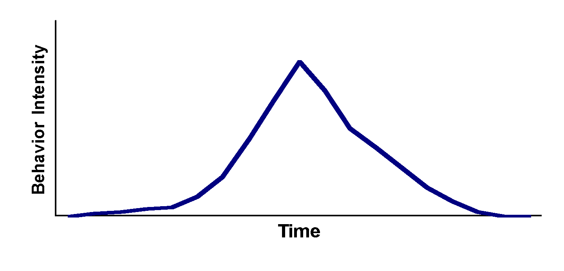
The Escalation Cycle…
can happen to anyone-but is unique for each individual
High
Low
Notes:
Each person’s escalation cycle is follows the phases but uniquely.
Have participants reflect and draw how escalation happens for them on a sticky note.

Slide 8
Why different for every individual?
Learning history
Past experiences
Motivation
Environmental factors

Slide 9
Behavior Basics
To efficiently and effectively change behavior we need to know WHY it is occurring
ABCs of behavior
Identify patterns of events before, during, and after display of behavior
Behavior is learned

Slide 10
ABCs of Behavior
Antecedent
A
Behavior
B
C
Consequence

Slide 11
Table Talk
Who are your school knows this information?
What kind of training have they received on it?
Have they ever been coached on how to use the information?

Slide 12
Antecedent
Any event that precedes a behavior
What happened immediately before the behavior occurred
*Use office referral form to identify patterns*
Notes:
Keep in mind….could also include what didn’t happen (deprivation). Attention example

Slide 13
Behavior
All behaviors occur for a reason.
Behaviors do not occur “out of the blue.”
Behaviors continue to occur because they are effective.
Behaviors stop occurring because they are ineffective.

Slide 14
Consequence
Events occurring after the behavior
Can be positive or negative
Examples:
Get what you want
Get away from you don’t like
People leave you alone
Get a scolding from others
Lose something valuable

Slide 15
Consequence Patterns
Determine effective reactive strategies
Limit access to reinforcing/maintaining variables
E.g., Hypothesized that student displays disruptive behavior during class to get reaction/attention from teacher – When student blurts out inappropriate comment during class, the teacher maintains neutral expression waits 30 seconds (withhold immediate attention/reaction) and then redirects the student
Determine effective proactive strategies
Provide reinforcing/maintaining variables for other appropriate behavior(s)
E.g., Hypothesized that student displays disruptive behavior during class to get reaction/attention from teacher – Teacher increases frequency of praise statements/animated reactions for appropriate/on-task behavior

Slide 16
Identify Patterns Using Data on Referral Forms

Slide 17
Table Talk
Do staff at your school have difficulty filling out this portion of the ODR?
What can you do to ensure this section is filled out correctly?

Slide 18
Why ABCs?
Antecedent patterns:
Determine effective preventative strategies
E.g., identify difficult transition = may use visuals to initiate transition as proactive approach
Consequences maintain behavior
Analysis of consequent events aid in identifying function of behavior
“We do what we do because of what happens to us.”

Slide 19
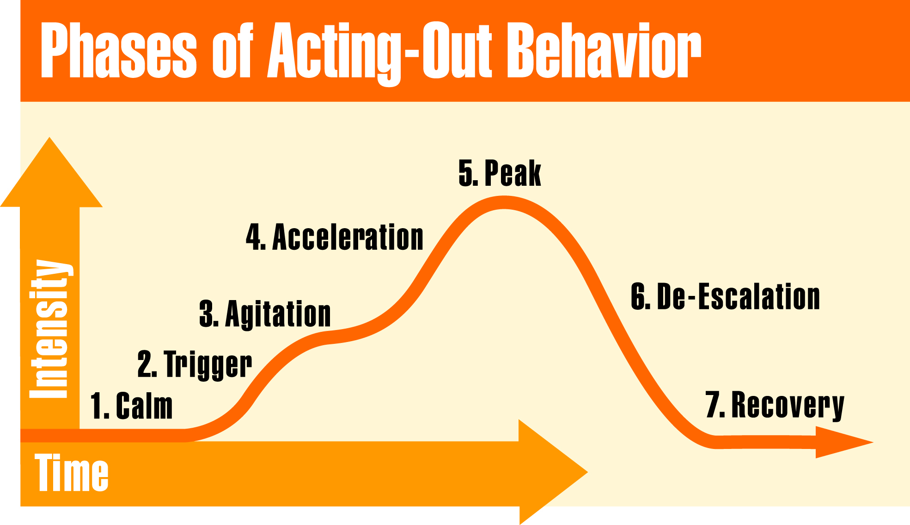
Model for Escalating Behavior
Phases of the Escalation Cycle
Notes:
Section Introduction Slide
Discuss effective strategies per phase of escalation: Blue - proactive & skill teaching, Green - junk & precursor behaviors, Red - dangerous or continuous challenging behaviors

Slide 20
Calm Behaviors
Student is cooperative.
Accepts corrective feedback
Follows directives
Ignores distractions
Accepts praise
On-task
Notes:
Observable behaviors to help adults identify the calm phase.

Slide 21
Calm Strategies
Focus is on prevention.
Arrange for high rates of successful academic & social engagements
Use positive interaction to establish and maintain relationship with students
Teach skills
Communicate positive expectations
Notes:
Strategies to use when the individual is in the calm phase.

Slide 22
Preventative Examples
Four Strategies:
Classroom Structure (safe and connected)
Quality Instruction (culturally relevant & engaging)
Managing Attention (relationships)
Teaching Behavior (SWExpectations within routines)
Discuss examples & non-examples, model, practice, provide consistent feedback on correct and incorrect displays of behavior
Do not rely on discussion alone when teaching
Notes:
Strategies to use when the individual is in the calm phase.

Slide 23
Model for Escalating Behavior
Phases of the Escalation Cycle
Notes:
Section Introduction Slide

Slide 24
Pre-Cursor Behaviors (Trigger & Agitation)
Low-level disruption
Off-task
Verbal protesting
Attempts to negotiate
“Junk” behavior
Not harmful or dangerous but inappropriate
Notes:
Observable behaviors to help adults identify the agitation phase.

Slide 25
Pre-Cursor Strategies
Focus on escalation prevention and redirection.
Increase opportunities for success
Specifically identify alternative behavior that will receive the same outcome as challenging behavior
E.g., If attention is hypothesized function – Say, “I will come over to talk with you when you start working on your assignment.”
Reinforce the student’s first on task response
Intermittently reinforce subsequent on-task behavior

Slide 26
Pre-Cursor Strategies
Focus on escalation prevention and redirection.
Provide controlled choices
Use priming statements
Prompt specific behavior to reinforce
Premack principle

Slide 27
Model for Escalating Behavior
Phases of the Escalation Cycle
Notes:
Section Introduction Slide

Slide 28
Continuous/Escalated Behaviors
Acceleration and Peak
Behaviors that are unsafe and/or occur for an extended period of time
Physical Aggression
Property Destruction (e.g throwing dangerous items)
Leaving school grounds
Notes:
Observable behaviors to help adults identify the acceleration phase.

Slide 29
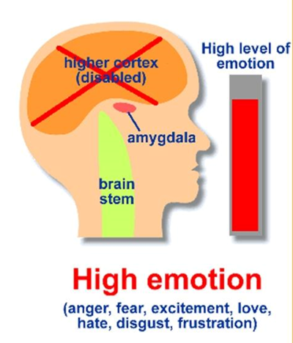
Managing and Responding to Escalated Behaviors
Focus is on safety
Do not attempt to problem solve now
Develop and implement a crisis response plan
Identify and define target behaviors
E.g., Property Destruction: tearing math worksheet versus throwing chair
Describe responding staff roles
E.g., 1st responding staff clears room of potentially dangerous items, 2nd responding staff initiate data collection…etc.
Establish process of communication

Slide 30
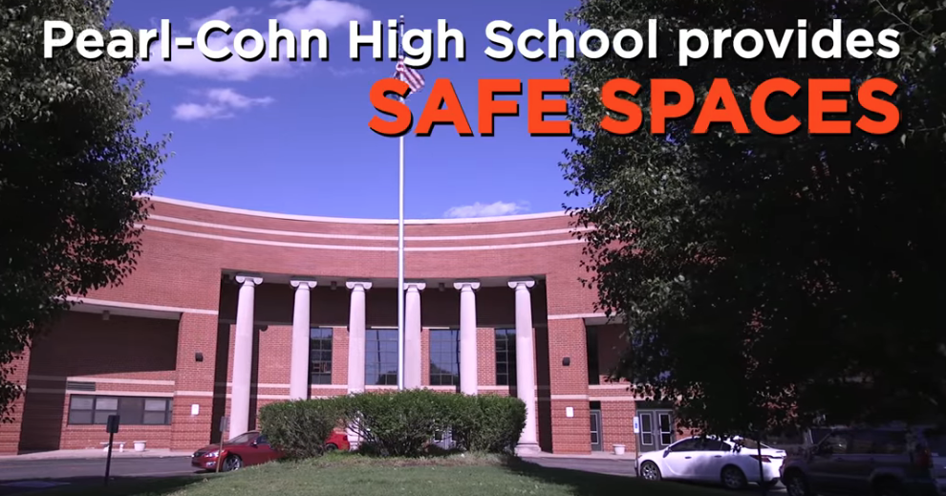
Example of De-Escalation
https://www.youtube.com/watch?v=YxC_Q8zE0SU
Notes:
https://www.youtube.com/watch?v=YxC_Q8zE0SU

Slide 31
Model for Escalating Behavior
Phases of the Escalation Cycle
Notes:
Section Introduction Slide

Slide 32
Recovery Strategies
Focus on returning to normal activities and prevention
Follow through with initial expectations if possible
Debrief/problem solve how to handle situation next time – identify alternative skill
Provide opportunity to practice alternative skill
Notes:
Strategies to use when the individual is in the recovery phase.

Slide 33
Recovery Strategies
Effective Consequences
Does the consequence…
Model, instruct or teach a more appropriate behavior?
Give the learner opportunities to practice replacement behavior?
Give the learner the opportunity to learn how to restore relationship and/or repair harm?
Notes:
Strategies to use when the individual is in the recovery phase.

Slide 34
Debriefing Session
Occurs when the thinking brain is back online
Facilitates transition back to class… not further negative consequence.
Pinpoint events that contributed to the incident - ABCs
Teach replacement behaviors
Goal is to increase appropriate behavior
Notes:
Debriefing occurs when the thinking brain is back online.

Slide 35
When We Know Better…We Can Do Better!
Notes:
This is an ending slide to encourage adults to move away from traditional reactions to escalating behavior and shift to safer, more proactive positive strategies for managing escalating behavior.

Slide 36
What we know helps….
Intervene early in an escalation
All adults remain calm
Understand that Teacher behavior sets the stage for the next student behavior
Identify environmental factors that can be changed
Teach replacement behaviors
Notes:
Summary Slide for how we can do better

Slide 37
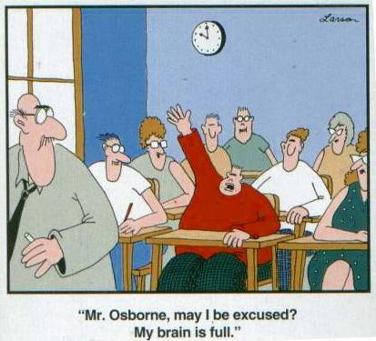
Time for planning!

Slide 38
Action Plan:
Managing the Cycle of Escalating Behavior
Who needs training?
How and when will this be done?
How will you provide coaching to those that need it?

Slide 39
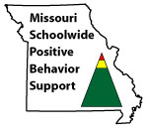
Appreciation is given to the following for their contributions to this Professional Learning:

