Slide 1
PBIS Tier 1
Team Training
Discipline Data (TFI 1.12)
Data-based Decision Making (TFI 1.13)
Notes:
Updated September 2021

Slide 2
Tier 1: Professional Learning Roadmap
TFI Sub-Scale: Team
TFI 1.1 | Team Composition
TFI 1.2 | Team Operating Procedures
TFI Sub-Scale: Evaluation
TFI 1.12 | Discipline Data
TFI 1.13 | Data-based Decision Making
TFI 1.14 | Fidelity Data
TFI 1.15 | Annual Evaluation
TFI Sub-Scale: Implementation
TFI 1.3 | Behavioral Expectations
TFI 1.4 | Teaching Expectations
TFI 1.5 | Problem Behavior Definitions
TFI 1.6 | Discipline Policies
TFI 1.7 | Professional Development
TFI 1.8 | Classroom Procedures
TFI 1.9 | Feedback and Acknowledgement
TFI 1.10 | Faculty Involvement
TFI 1.11 | Student/Family/Community Involvement
8 Classroom Management Practices
1 | Arrange orderly physical environment
2 | Define, Teach, Acknowledge Rules and Expectations
3 | Define, Teach Classroom Routines
4 | Employ Active Supervision
5 | Provide Specific Praise for Behavior
6 | Continuum of Response Strategies for Inappropriate Behaviors
7 | Class-Wide Group Contingency
8 | Provide Multiple Opportunities to Respond
Notes:
Today we are taking a deeper dive into using data, particularly your student outcome data, and how your team can be more purposeful in using your data to make decisions.

Slide 3
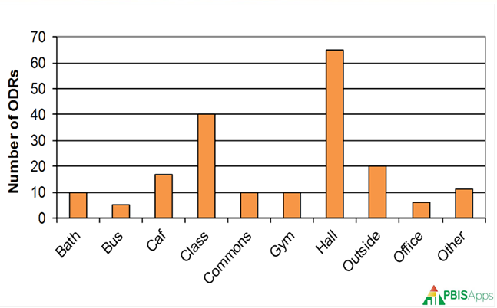
TFI 1.12 & 1.13 Purpose & Outcomes
Purpose: Prepare and plan for facilitating implementation of Data Analysis
Outcomes:
1.12 Discipline Data: Tier I team has instantaneous access to graphed reports summarizing discipline data organized by the frequency of problem behavior events by behavior, location, time of day, and by individual student.
1.13 Data-based Decision Making: Tier I team reviews and uses discipline data and academic outcome data (e.g., Curriculum-Based Measures, state tests) at least monthly for decision-making.
Notes:
Review to set the context/stage for work.

Slide 4
Culturally Responsive Elaboration
Teams regularly disaggregate their discipline data as an effective and objective way to assess and monitor equity in student outcomes.
Teams are purposeful in examining inequitable outcome data first from a systems perspective, before viewing it as an issue with an individual student or family.
Notes:
Review to set the context/stage for work. As your team continues to review your student outcome data, ensure you are conducting your analysis using an equity lens. This will allow for your team to make improved equity-conscious decisions based on data.

Slide 5
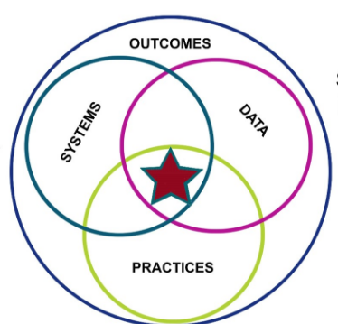
Data in the PBIS Framework
Data is one of the three major components to effective outcomes with PBIS implementation
We are doing a deep dive into how you can use your outcome data to develop goals and solutions of continuous improvement.
Notes:
Remember, using data is one of the three important components, too often not emphasized enough in supporting PBIS implementation. Emphasize second bullet point: “We are doing a deep dive into how you can use your outcome data to develop goals and solutions of continuous improvement.”

Slide 6
Quote
“If we have data, let’s look at data.
If all we have are opinions,
let’s go with mine.”
–Jim Barksdale, former Netscape CEO
Notes:
Review to set the context/stage for work.

Slide 7
3 Types of Data
Effort: What is the current status of your systems?
School-wide Tiered Fidelity Inventory (TFI Progress Monitoring)
Self-Assessment Survey (SAS) – Staff
Opinion Survey
Fidelity: Are you doing what the framework outlines? Are you doing what you said you would?
School-wide Tiered Fidelity Inventory (TFI-Annual Assessment)
Self-Assessment Survey (SAS) – Staff
Outcome: Are your systems working?
Office Discipline Referrals (ODR’s)
Check-In Check-out (CICO)/Point Sheets
Suspensions/Expulsions
Attendance
Grades/Test Scores
Notes:
Go over the importance of Effort & Fidelity Data. We will focus on Outcome Data right now, particularly STUDENT outcome data.

Slide 8
Outcome Data
Tells us if our systems are working.
Office Discipline Referrals (ODR’s)
Check-In Check-out (CICO)/Point Sheets
Suspensions/Expulsions
Attendance & Tardies
Grades/Test Scores
Health Office Visits
Other?
Notes:
We need to reflect on the systems we have in place that are collecting our outcome data. Be honest with your processes. Are the systems working efficiently and effectively at your school?

Slide 9
Activity: Are your systems working?
As a team complete
Activity 1 in your handout
Notes:
We need to reflect on the systems we have in place that are collecting our outcome data. Are the systems working?
During work time (or build in some time right now to get started - ~10 minutes), you will open your workbook to Data-Based Decision Making Activity 1 to reflect on your data systems (or see handout provided).

Slide 10
Useful Data-Based Decision Making
The statement of a problem is important
Everyone must be working on the same problem with the same assumptions.
Problems often are framed in “primary” form.
This raises awareness and concern, but is not useful for problem solving.
Use a more detailed review of the data to build precise problem statements which are solvable
Notes:
Main Idea: We need to be on the same page of data collection and how we are using that data to develop precision, versus our typical mode of operations which is in primary form. Example in primary form: “The majority of our ODRs involve cafeteria behavior”. We are going to learn how to be more specific or detailed in order to be more effective in solving problems.

Slide 11
Data-based Decision-Making
Precision Problem Statement
Monitor Outcome vs Goal
Set Measurable Goal
Use Data
Monitor Fidelity of Plan
Develop Solution & Action Plan
Notes:
Restate second purpose: “1.13 Data-based Decision Making: Tier I team reviews and uses discipline data and academic outcome data (e.g., Curriculum-Based Measures, state tests) at least monthly for decision-making.” We start the Data-Based Decision Making process by developing a Precision Problem Statement.

Slide 12
Example Precision Statements
There are 25% more ODRs for aggression in the cafeteria this month than last year. These are most likely to occur during first lunch, with 15 eighth grade students, and the aggression is related to getting access to the new lunch line options.
What?
25% More ODRs for aggression
When?
First lunch
Where?
In the cafeteria
Why?
Getting access to the new lunch line options.
Who?
15 eighth grade students
Notes:
Go through the precision problem solving statement development process. Recall the previous “Primary” form: “The majority of our ODRs involve cafeteria behavior”. This isn’t very helpful in pinpointing the issue with cafeteria behaviors. Creating a precision statement of There are 25% more ODRs for aggression in the cafeteria this month than last year. These are most likely to occur during first lunch, with 15 eighth grade students, and the aggression is related to getting access to the new lunch line options.” Now we have more detail to work with and have identified the problem to address.

Slide 13
Activity 2A : Develop Precision Statements
Using your own data create a precision problem statement
Notes:
Now you try with our own data. Develop a Precision Statement as a team, using your own ODR data. If teams don’t have their own data, refer to the Activities 1.13 & 1.12 document - there are sample data scenarios in the document for teams to use
Refer to the link on agenda to this activity or have handout prepared in advance. This usually takes some time to develop but is a beneficial activity for teams to complete as it can create more focus on how they use their data. Have teams stop upon completing statement.

Slide 14
Data-based Decision-Making
Precision Problem Statement
Monitor Outcome vs Goal
Set Measurable Goal
Use Data
Monitor Fidelity of Plan
Develop Solution & Action Plan
Notes:
Once your team has identified the problem and developed a Precision Problem Statement, the next step is to “Set Measurable Goal”.

Slide 15
Set a Measurable Goal
Goals allow you to analyze, monitor, and adjust professional practice.
Current cafeteria referrals in 8th grade average 28 per month. Our goal is to reduce cafeteria referrals by 20% per month for Feb through May.
Notes:
Using the cafeteria example, continue through this as a large group. They should write in their workbook. (Think I Do/We Do). Use this slide in conjunction with the next slide. SMART goals are Specific, Measurable, Achievable, Realistic, and Time-bound.

Slide 16
Measurable Goals
Precision Statement
There are 25% more ODRs for aggression in the cafeteria this month than last year. These are most likely to occur during first lunch, with 15 eighth grade students, and the aggression is related to getting access to the new lunch line options.
Measurable Goal
Current cafeteria referrals in 8th grade average 28 per month. Our goal is to reduce cafeteria referrals by 20% per month for Feb through May.
Notes:
Given the precision statement, here’s a measurable goal that provides focus for all involved.

Slide 17
Activity 2B : Create a SMART Goal
Develop your own SMART goal
Notes:
Now you try developing a SMART goal using YOUR data based on the precision statement you worked on in Activity 2A. Allow time to complete activity 2B and transition into a BREAK prior to Part 2 of Data Development and Solution Components.

Slide 18
Alaskan Bear
Notes:
Transition slide to Part 2

Slide 19
Data-based Decision-Making
Precision Problem Statement
Monitor Outcome vs Goal
Set Measurable Goal
Use Data
Monitor Fidelity of Plan
Develop Solution & Action Plan
Notes:
Now that we’ve had a chance to learn about and work on a Precision Problem Statement and Set a Measurable Goal, logically, the next step in using data is Develop Solution & Action Plan. Developing Solutions and Action Planning can seem like an overwhelming process. The goal is to work through the solution components and then put into action the components that are realistically doable, feasible, and likely make the most impact. Let’s go through a non-behavior related scenario first so you can paint the picture of the process in your head.

Slide 20
Develop Solution & Action Plan
Precision Statement: On the days when I work from home, I have 5,000 less steps than when I don’t, due to sitting at a desk or a table the majority of the day.
Goal: Increase steps per day from 10,000 to 15,000 within the next 8 weeks, by January 1st, 2022.
Prevention: | How can we avoid the problem context? Not getting enough steps, so I’ll put a mini bike peddler at my desk Build a desk to go over my treadmill
Teaching: | How can we define, teach, and monitor what we want? Learn how walking improves health Learn how to use a pedometer & bike peddler
Recognition: | How can we build in systematic reward for desired behavior? Each day that I reach 15,000 steps, I’ll put a sticker on my calendar After 8 weeks of meeting my goal, I’ll buy a new pair of shoes
Notes:
Read Precision Statement and Goal as stated on slide. First step in the process is Prevention: how can we avoid the problem context?

Slide 21
Develop Solution & Action Plan
Precision Statement: On the days when I work from home, I have 5,000 less steps than when I don’t, due to sitting at a desk or a table the majority of the day.
Goal: Increase steps per day from 10,000 to 15,000 within the next 8 weeks, by January 1st, 2022.
Prevention: | How can we avoid the problem context? Not getting enough steps, so I’ll put a mini bike peddler at my desk Build a desk to go over my treadmill
Teaching: | How can we define, teach, and monitor what we want? Learn how walking improves health Learn how to use a pedometer & bike peddler
Recognition: | How can we build in systematic reward for desired behavior? Each day that I reach 15,000 steps, I’ll put a sticker on my calendar After 8 weeks of meeting my goal, I’ll buy a new pair of shoes
Notes:
The second component in Developing a Solution is Teaching: how can we define, teach, and monitor what we want?

Slide 22
Develop Solution & Action Plan
Precision Statement: On the days when I work from home, I have 5,000 less steps than when I don’t, due to sitting at a desk or a table the majority of the day.
Goal: Increase steps per day from 10,000 to 15,000 within the next 6 weeks, by January 1st, 2021.
Prevention: | How can we avoid the problem context? Not getting enough steps, so I’ll put a mini bike peddler at my desk Build a desk to go over my treadmill
Teaching: | How can we define, teach, and monitor what we want? Learn how walking improves health Learn how to use a pedometer & bike peddler
Recognition: | How can we build in systematic reward for desired behavior? Each day that I reach 15,000 steps, I’ll put a sticker on my calendar After 8 weeks of meeting my goal, I’ll buy a new pair of shoes
Notes:
Third component is Recognition: how can we build in systematic reward for desired behavior?

Slide 23
Develop Solution & Action Plan
Extinction: | How can we prevent problem behavior from being rewarded? I will remove the candy/mint jar from my desk I will bring my speaker to my office
Correction: | What are efficient, consistent corrective consequences for problem behavior? No sticker on the chart when 15,000 steps are not met
Data Collection: | How will we collect and use data to evaluate (a) implementation fidelity, and (b) impact on student outcomes? Use of the pedometer daily Use of daily calendar to collect days achieved
Notes:
Fourth component is Extinction: how can we prevent problem behavior from being rewarded?

Slide 24
Develop Solution & Action Plan
Extinction: | How can we prevent problem behavior from being rewarded? I will remove the candy/mint jar from my desk I will bring my speaker to my office
Correction: | What are efficient, consistent corrective consequences for problem behavior? No sticker on the chart when 15,000 steps are not met Have to walk more days in order to get new shoes
Data Collection: | How will we collect and use data to evaluate (a) implementation fidelity, and (b) impact on student outcomes? Use of the pedometer daily Use of daily calendar to collect days achieved
Notes:
Fifth component is Correction: What are efficient, consistent, and corrective consequences for problem behavior?

Slide 25
Develop Solution & Action Plan
Extinction: | How can we prevent problem behavior from being rewarded? I will remove the candy/mint jar from my desk I will bring my speaker to my office
Correction: | What are efficient, consistent corrective consequences for problem behavior? No sticker on the chart when 15,000 steps are not met
Data Collection: | How will we collect and use data to evaluate (a) implementation fidelity, and (b) impact on student outcomes? Use of the pedometer daily Use of daily calendar to collect days achieved
Notes:
Final component is Data Collection: how will we collect and use data to evaluate implementation fidelity and impact on student outcomes?

Slide 26
Developing a Solution & Action Planning
Solution component | Definition and Example
Prevention | How can we avoid the problem context? e.g. schedule lunch times, change lighting, rearrange lunch lines
Teaching | How can we define, teach, and monitor what we want? e.g. build curriculum around roughhousing, teach line expectations
Recognition | How can we build in systematic rewards for positive behavior? e.g. 3 days without referrals = 5 extra minutes of social time at lunch
Notes:
Going back to our cafeteria example, here is what it can look like with the Measurable Goal of reducing cafeteria referrals by 20% per month for Feb through May. Go through each component with large group. Emphasize your team’s responses should “fit” the context of your school. This may be similar or much different than other schools with a similar issue. You know your school best so make it your own.

Slide 27
Building a Solution & Action Planning
Solution component | Definition and Example
Extinction | How can we prevent problem behavior by removing the reward? e.g. Continued roughhousing at lunch equals a loss in lunch options
Correction | What are efficient, consistent corrections for problem behavior? e.g: Error correction; practice appropriate behavior (document with Major/Minor ODR)
Data | How will we collect and use data for evaluating the fidelity of our solution (e.g. walkthrough reports, observations, self-assessments), and student outcomes (e.g. SWIS ODR data, time on task, etc.)?
Notes:
Go through each component with large group.

Slide 28
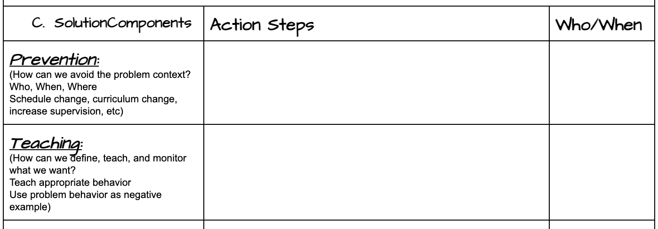
Activity 2C: Work through Solution Components and Action Steps
Notes:
Now you try using your own Precision Statement and corresponding Goal. Refer to the Activities 1.13 & 1.12 document or have Activity 2C handout.
Depending on available time, teams can work on this portion right now, or complete the upcoming slides and emphasize Activity 2C be completed during team work time.

Slide 29
Data-based Decision-Making
Precision Problem Statement
Monitor Outcome vs Goal
Set Measurable Goal
Use Data
Monitor Fidelity of Plan
Develop Solution & Action Plan
Notes:
We’ve considered the initial steps in the data decision-making process of developing a Precision Problem Statement, Setting Measurable Goal, and Developing Solution & Action Plan. The next step is for your team to monitor fielity as you implement the plan.

Slide 30
Monitor the Fidelity of Plan
Place it on your next PBIS Agenda
Develop extra check-ins on goal as needed
Make sure the right people are in place to implement the action plan
Communicate with staff
Continue to collect data
Notes:
Here are five actions your team can implement to monitor the plan. Regular check-ins on implementation efforts are crucial to success. Too often, teams put plans in place and do not continuously review their implementation efforts. Research indicates a plan (intervention) should generally be in place for at least 4-6 weeks before making significant changes. This allows the process to be tested over an ample amount of time. Make this step a priority!

Slide 31
Data-based Decision-Making
Precision Problem Statement
Monitor Outcome vs Goal
Set Measurable Goal
Use Data
Monitor Fidelity of Plan
Develop Solution & Action Plan
Notes:
Related to monitoring fidelity of the plan is Monitoring Outcome vs Goal.

Slide 32
Monitor Outcome vs Goal
Place it on your PBIS Agenda for when you wish to follow-up
Bring your new outcome data based on your SMART goal & Solution Development
Evaluate if you met your outcome or need to create an updated goal
Keep the new process/procedure/system in place or start the solution development with a new goal
Notes:
Here are four actions for teams to implement when monitoring their goal. Again, this should be a priority to determine if goal was met or needs adjusting to match progress.

Slide 33
Think About Your Process
Carve out time during your Tier 1 PBIS Team meeting to do this work.
Add the components to your agenda.
Come to your meeting with your precision statement.
Work through setting a SMART goal.
Develop an action plan based on your solution components. Communicate this plan.
Monitor the plan.
Monitor the outcome.
Repeat as necessary.
Notes:
Encourage teams to reflect back on the activities during this session.
In summary, review the listed ideas of the data based decision-making process. Teams should critically reflect on how they may be able to change their processes when not successfully looking/working though data. Do teams need to be combined, focus shifted, adopt new strategies for looking at data, etc?

Slide 34
TFI Self-Assessment
Features | Possible Sources | Criteria
1.12 Discipline Data: Tier I team has instantaneous access to graphed reports summarizing discipline data organized by the frequency of problem behavior events by behavior, location, time of day, and by individual student. | • School policy • Team meeting minutes • Student outcome data | 0 = No centralized data system with ongoing decision making exists 1 = Data system exists but does not allow instantaneous access to full set of graphed reports 2 = Discipline data system exists that allows instantaneous access to graphs of frequency of problem behavior events by behavior, location, time of day, and student
1.13 Data-based Decision Making: Tier I team reviews and uses discipline data and academic outcome data (e.g., Curriculum-Based Measures, state tests) at least monthly for decision-making. | • Data decision rules • Staff professional development calendar • Staff handbook • Team meeting minutes | 0 = No process/protocol exists, or data are reviewed but not used 1 = Data reviewed and used for decision-making, but less than monthly 2 = Team reviews discipline data and uses data for decision-making at least monthly. If data indicate an academic or behavior problem, an action plan is developed to enhance or modify Tier I supports
Notes:
Have teams complete this self assessment and use the results to determine action planning steps

Slide 35
During work time….
Develop Precision Problem Statement
Create a SMART Goal
Develop Solution & Action Plan
Determine How Your Team will Monitor Plan & Goal
Review TFI 1.12 & 1.13
Notes:
During the upcoming team work time, teams should finish up their items from Activities 2A, 2B, and 2C. If completed using their own goal, direct them to determine how your team will monitor plan and goal progress - encourage them to make decisions of Who monitors and by When? Set timelines. If completed with all these items, teams should completed the review exercise for TFI 1.12 & 1.13.

Slide 36
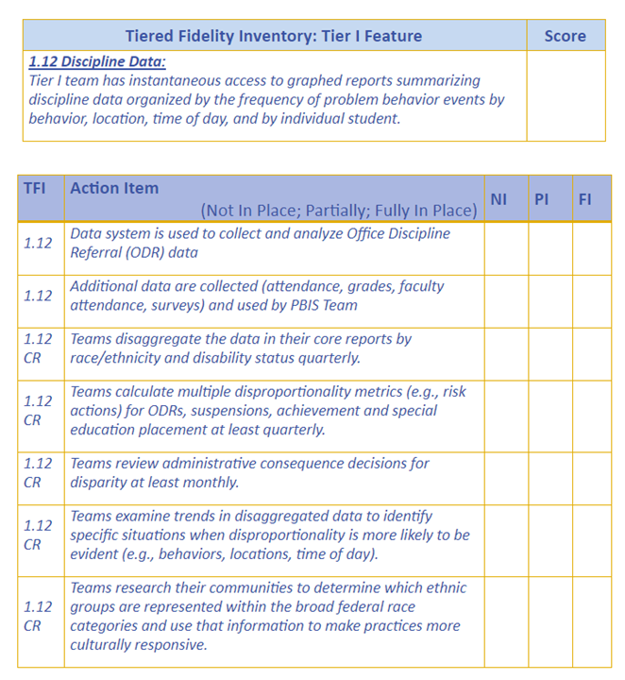
Action Steps
Identify action items below needed for full implementation
Add action items to your Action Plan
Add completed items and artifacts to your Artifact Template
Notes:
If teams have completed all activities using their own data, they should review as a team, TFI 1.12 and 1.13, by responding to these items on this slide and next. Teams can find these documents in their Workbook.

Slide 37
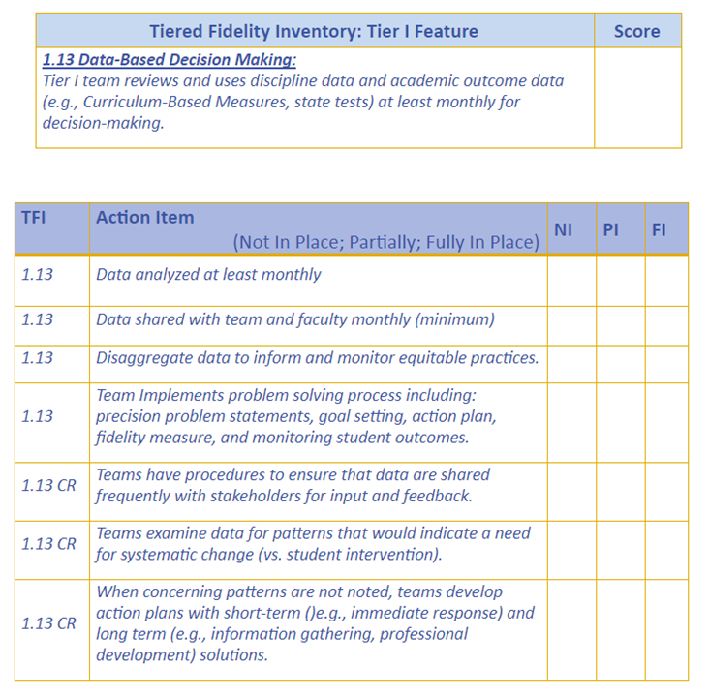
Action Steps Continued

Slide 38
Appreciation is given to the following for their contributions to this Professional Learning:

