Slide 1
Review & Re-establish School-Wide PBIS: Tier 1
Cohort 12
August 2017
Notes:
Review Big Ideas Cohort 6 Secondary 9 am
*
This content is important for teams to understand that even though this year’s focus will be the advanced tiers of PBIS, having Tier 1 in place is critical prior to implementing Tiers 2 & 3.

Slide 2
Objectives
Review School-Wide PBIS & Tier 1
Review 8 Steps of Implementation and ACTION PLAN
Take the Tiered Fidelity Inventory (TFI)
ACTION PLAN from TFI reports

Slide 3
The Minnesota Website
www.pbismn.org
http://www.pbismn.org/
Notes:
Make sure teams know how to access ppts. from today on the MN site.

Slide 4
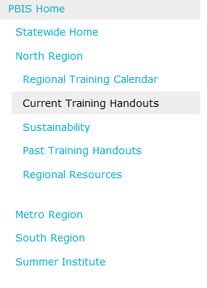
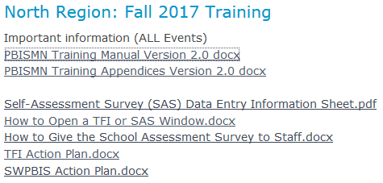
Resources for Today
19
14 minutes

Slide 5
Ready, Set…

Slide 6
PBIS is about…
Improving school and classroom
climate
Decreasing reactive
Integrating
academic & behavioral initiatives
management
Improving
Maximizing academic
support
for students with EBD
achievement
Notes:
Teams need to ensure that all staff back home understand what PBIS is about.

Slide 7
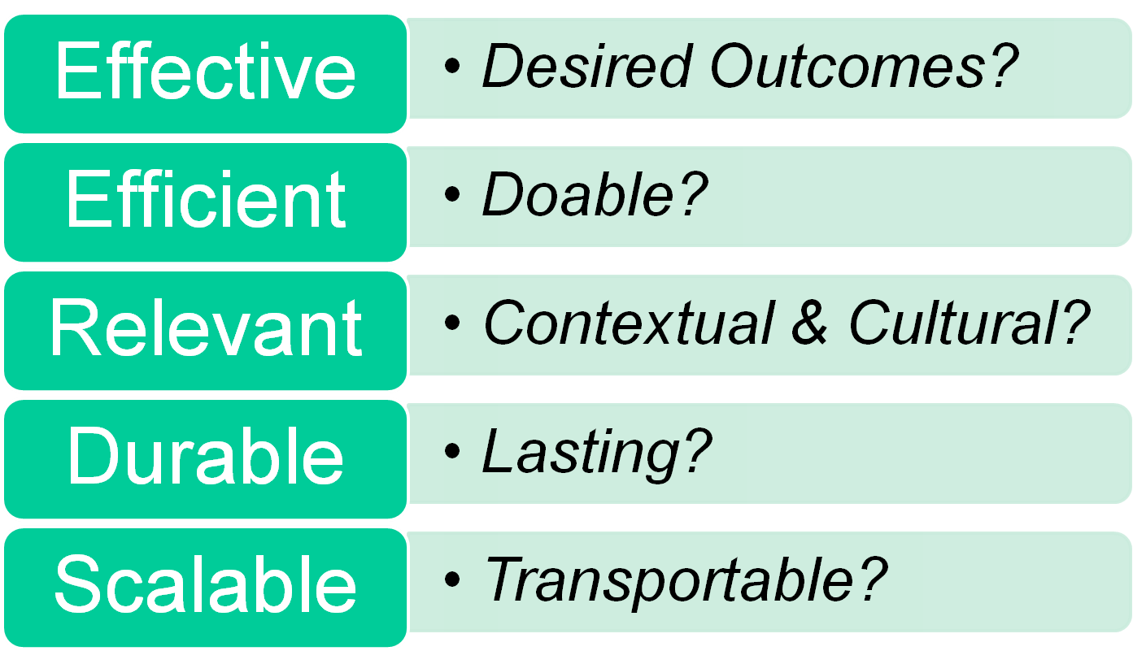
SW-PBIS Logic!
Successful individual student behavior support is linked to host environments or school climates that are effective, efficient, relevant, & durable
(Zins & Ponti, 1990)
Notes:
Review Big Ideas Cohort 6 Secondary 9 am
*
*
As teams implement all the tiers of PBIS they can use this as a guide to building PBIS that will be sustainability.

Slide 8
Integrated Elements
Integrated
Elements
OUTCOMES: What do we want to see?
OUTCOMES
SYSTEMS: What needs to be in place to support (a) practice adoption that is informed and (b) full implementation that is contextualized, accurate, and sustainable?
DATA: What do we currently see and know?
DATA
SYSTEMS
PRACTICES
PRACTICES: What practice could effectively, efficiently, and relevantly achieve what we want to see?
16
Notes:
Review Big Ideas Cohort 6 Secondary 9 am
*
*
Review the integrated elements of PBIS. How have teams taught staff about these?
Implementation of SWPBS is based on a balance of four interactive elements:
DATA – What do we currently see and know? Data-based decisions guide selection and of curricula and practices, and evaluation of progress
OUTCOMES – What do we want to see? Clearly specified outcomes related to academic achievement and social competence.
PRACTICES – What practices effectively, efficiently and relevantly achieve what we want to see? Evidence-based practices have a high probability of achieving student outcomes.
SYSTEMS – What needs to be in place to support adult adoption of the practices, high fidelity of implementation, and sustained use of effective practices?

Slide 9
Integrated Elements and Cultural Considerations
Vincent, Randall, Cartledge, Tobin, & Swain-Bradway 2011; Sugai, O’Keeffe, & Fallon, 2012ab
Culturally Equitable Academic & Social Behavior Expectations
OUTCOMES
Culturally Knowledgeable Staff
Culturally Valid Information for Decisions
SYSTEMS
DATA
PRACTICES
Culturally Relevant & Effective Instruction
16
Notes:
CULTURE is one our major considerations, and CULTURAL INFLUENCE is reflected in high attention toward
CULTURAL EQUITY of outcomes
CULTURAL VALIDITY of data
CULTURAL RELEVANCE of practices
CULTURAL KNOWLEDGE of systems about data, outcomes, practices, and students/families

Slide 10
Guidelines for Outcomes
Based on data
Locally important and meaningful
Applicable to all (culturally equitable)
Students’ social competence and academic achievement
Staff implementation of critical skills
Observable and measurable
Written as a goal

Slide 11
Outcomes 2017-18
Questions to address during Action Planning Time:
What were your outcomes/goals last year?
What are the outcomes you want to achieve in 2017-18?
Activity: page 17
14 minutes

Slide 12
SWPBIS
School-wide
Classroom
24
Non-classroom
Family
Smallest #
Evidence-based
Biggest, durable effect
Student
Notes:
Review Big Ideas Cohort 6 Secondary 9 am
*
*
As you review each if these systems and the practices of each explain to schools that this is what they are working toward. Ask them to reflect upon their current status as compared to the standard presented here.
Within SWPBS, we want to focus on practices and interventions that are most effective, efficient and relevant and that match the needs, resources and competence of users. Practices and interventions are organized in 5 subsystems
School-wide: all students and staff, all settings
Classroom: Settings where instruction is emphasized
Non-classroom: Settings in which emphasis is on supervision and monitoring
Student: Individual students whose behaviors aren’t responsive to primary prevention
Family: engaging family in implementation
Continuum of positive behavior support for all families
Frequent, regular positive contacts, communications, & acknowledgements
Formal & active participation & involvement as equal partner
Access to system of integrated school & community resources

Slide 13
School-Wide Review
8 Step Planning Guide
How Are You Doing?
Notes:
Review Big Ideas Cohort 6 Secondary 9 am
*

Slide 14
School-wide
Leadership team
Behavior purpose statement
Set of positive expectations & behaviors
Procedures for teaching SW & classroom-wide expected behavior
Continuum of procedures for encouraging expected behavior
Continuum of procedures for discouraging rule violations
Procedures for on-going data-based monitoring & evaluation
Notes:
Review Big Ideas Cohort 6 Secondary 9 am
*
*
Leave the slide up and give individuals a minute of quiet to reflect on their team and their school status with school-wide.

Slide 15
Establish Leadership Team Membership
Representative of school/community demographics
1-2 individuals with behavior/classroom management competence
Administrator as active member
Schedule for presenting to whole staff at least monthly
Schedule for meeting at least monthly
Integration with other behavior related initiatives and programs
Appropriate priority relative to school/district goals
Rules/agreements established
Schedule for annual self-assessments
Coaching support (school/district/region)

Slide 16
Team 2017-18
Questions to address during Action Planning Time:
Do you have holes in your team to fill due to changes in staff? Who is responsible for filling the holes? Who will join the team?
Do you have assigned roles on the team for this year?
What is the meeting schedule for your team this year? Dates and times on the master schedule?
How is your team working? Activity page 55
When do you plan to complete the Self-Assessment Survey (SAS)?
When and how do you plan to communicate your outcomes and action plan with licensed and non-licensed staff this fall? Parents/families? Bus drivers? Others?
When do you plan to share data with staff throughout the year?
15 minutes

Slide 17
Develop Brief Statement of Behavior Purpose
Positively stated
2-3 sentences in length
Supportive of academic achievement
Comprehensive in scope (all students/staff/settings)
Why does this team exist?

Slide 18
Behavior Purpose 2017-18
Questions to address during Action Planning Time:
What is your behavior purpose statement?
Does everyone on your team know where to find it? Summarize/paraphrase it if needed?
Does your statement need any revision?
10 minutes

Slide 19
Identify Positive School-Wide Behavioral Expectations
Linked to social culture of school
Considerate of social skills that already exist
3-5 in number
1-3 words per expectation
Positively Stated
Supportive of academic achievement
Comprehensive in scope
Mutually exclusive (minimal overlap)

Slide 20
Behavioral Expectations 2017-18
Questions to address during Action Planning Time:
Do you have a shorthand way to refer to your school-wide expectations?
Are your expectations easy to remember?
Do your expectations need any revision?
10 minutes

Slide 21
Develop Procedures for Teaching School-Wide Behavior Expectations
Teach social behavior like academic skills
Like academic skills that have been learned initially, social skills must be practiced regularly and acknowledged/reinforced frequently for mastery, sustained use, and generalized applications to be realized.
Operationally define what the expectations look like across all the routines and settings in your school

Slide 22
Teaching Matrix 2017-18
Questions to address during Action Planning:
Is your teaching matrix posted in classrooms, public areas, non-classroom areas your school?
Do you need to print new copies of the matrix? Who is responsible for printing?
Are there any routines/settings on the matrix that need to be added or revised?
Are there any operational definitions of expectations that need to be added or revised?
11 minutes

Slide 23
Develop Procedures for Teaching School-Wide Behavior Expectations - 2
Teach Expectations in the Context of Routines
Prompt or Remind Students of the Expectation
Monitor Students Behavior in the Natural Context
Evaluate the effect of instruction and the fidelity of implementation

Slide 24
Non-classroom
Positive expectations & routines taught & encouraged
Active supervision by all staff
Scan, move, interact
Precorrections & reminders
Positive reinforcement
Notes:
Review Big Ideas Cohort 6 Secondary 9 am
*
*
same

Slide 25
Lessons 2017-18
Questions to address during Action Planning Time:
How do your lesson plans compare in content to the lesson plan guide on page 76? What revisions need to be made? Are there new lessons which need to be written? Who is responsible for writing/revising the lessons?
Do your lesson plans include the follow-up activities in the lesson on page 76? Prompting, reinforcing, correcting, monitoring, collecting? How will you increase use of pre-correction in your lessons?
What is the schedule for teaching school-wide expectations this fall? Who is responsible for teaching the lessons? How will you know the lessons have been taught?
Are the rules being followed/expectations being met?
16 minutes

Slide 26
Develop Procedures for Teaching Classroom-Wide Behavior Expectations
School-wide action plan for classroom management practices and procedures based on data
Definitions and process for class vs. office managed expectation-violating behaviors
Teaching matrix, procedures, and schedules developed for teaching school-wide behavior expectations in typical classroom contexts and routines
Data systems in place to monitor ODRs from classrooms
Procedures in place to support behavior of students whose behaviors do not respond to classroom management
Prompts for display of expected behaviors in natural contexts
Use the same process and lesson plan format to teach classroom expectations as you do to teach school-wide expectations – contextualize for classroom

Slide 27
Classroom
All school-wide
Maximum structure & predictability in routines & environment
Positively stated expectations posted, taught, reviewed, prompted, & supervised.
Maximum engagement through high rates of opportunities to respond, delivery of evidence-based instructional curriculum & practices
Continuum of strategies to acknowledge displays of appropriate behavior, including contingent & specific praise, group contingencies, behavior contracts, token economies
Continuum of strategies for responding to inappropriate behavior, including specific, contingent, brief corrections for academic & social behavior errors, differential reinforcement of other behavior, planned ignoring, response cost, & timeout.
Notes:
Review Big Ideas Cohort 6 Secondary 9 am
*
*
Leave the slide up and give individuals a minute of quiet to reflect on their team and their school status with classroom.

Slide 28
Classroom Expectations 2017-18
Questions to address during Action Planning:
What are the classroom routines that are common across the majority of classrooms? Use the matrix on page 79.
How will you teach classroom routines within your school-wide systems?
How will you incorporate prompts for display of expected behaviors in natural contexts in lessons?
How will you know that the classroom lessons have been taught?
How do teachers access support for students who don’t respond to tier 1 SW or CR practices? How do you train teachers about accessing support?
15 minutes

Slide 29
Develop Continuum of Procedures for Encouraging and Strengthening Student Use of School-Wide Behavior Expectations
Easy and quick form of acknowledgement linked to SW-expectations and used across all settings (non-classroom and classroom
Develop written procedures for acknowledgements
Schedule for teaching acknowledgement systems
Instructions and practice for staff on how to pair tangible/activity acknowledgements with social acknowledgments
Schedule for initial introduction of acknowledgements to students and regular boosters or reimplementation of acknowledgements

Slide 30
Encouraging & Strengthening Student Use of School-wide Expectations 2017-18
Questions to address during Action Planning:
How do you describe your acknowledgement system? Is it one-size-fits all? Do you have a variety of acknowledgements? Activity on pg. 81
What is the schedule for celebrating student success and acknowledgement activities this fall?
Did your staff use the acknowledgement system last year?
What is the plan to teach the acknowledgement systems (including pairing tangible and social acknowledgement) this fall to staff? Students? Families?
15 minutes

Slide 31
Develop Continuum of Procedures for Discouraging Student Behavior Violations of School-Wide Behavior Expectations
Definitions for Violations
Procedures for Processing Behavior Violations
Implementation across the school

Slide 32
Discouraging Student Behavior Violations 2017-18
Questions to address during Action Planning:
Have you completed definitions of behavior violations? Teacher vs. office managed behaviors? If not, what is the time line for doing so, how will you get staff input and agreement? Activity page 83.
Does your office discipline referral form need any revisions?
Are responsibilities for office staff vs. teachers in processing an ODR documented clearly?
Is the discipline referral system used by all staff?
How are you tracking the number of acknowledgements vs. ODRs or violations?
What are the procedures for identifying and supporting students who don’t respond?
15 minutes

Slide 33
Develop Data-Based Procedures for Monitoring Implementation of SWPBIS
Data-based procedures for monitoring school-wide implementation.
What do you want to know?
What information can be collected?
How and when should this information be gathered?
How was the question answered and what should be done next?

Slide 34
Evaluation Questions
Are your expectations easy to remember?
How will we know that the lessons have been taught – school-wide and/or in the classroom?
Are the rules being followed?
Did the staff use the student acknowledgement system last year?
Is the discipline referral system used by staff?
What is the ratio of acknowledgements to violations?

Slide 35
Evaluation Questions 2017-18
Action Planning:
What evaluation questions do you have based on your implementation experience last year? Are these questions you want to answer now or in the coming school year? What data do you need?
Data and Evaluation Worksheet – page 86
Who is responsible for preparing data for sharing with staff throughout the year?
How will you record, manage and respond to evaluation questions that arise throughout the coming school year?
14 minutes

Slide 36
TFI TIME!

Slide 37
WHY Take the TFI?
Progress monitor implementation at each tier
Celebrate accomplishments
Action plan how you will take your next steps to implementation
ALWAYS share the results of your TFI with all staff
Highlight celebrations and back them up with outcome data
Share action planning next steps

Slide 38
Taking the TFI Review
External coach reads each feature, reviews possible data sources and scoring criteria and the team discusses
Internal coach enters the score in pbisapps.org

Slide 39
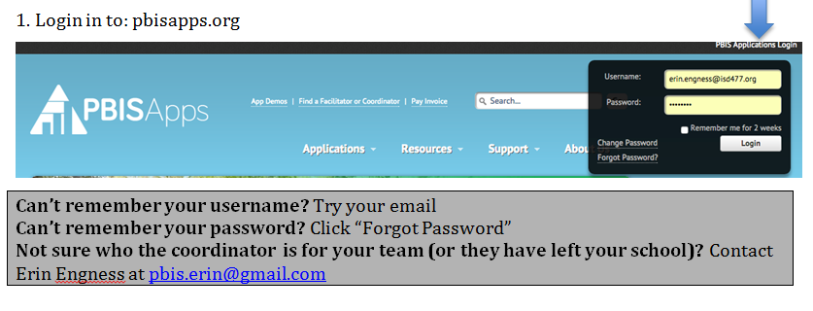
pbisapps.org
www.pbisapps.org
Notes:
Make sure teams know how to access pbisapps.

Slide 40
PBIS Assessment

Slide 41
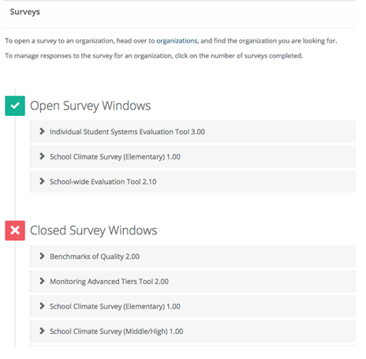
Open Surveys

Slide 42
Take Survey!
29 minutes

Slide 43
Action Planning
Access TFI reports from pbisapps.org
Use reports to action plan for next steps for Tier 1 implementation
Use discussion, activities from Steps 1-8 in the implementation manual from this morning to action plan for next steps for Tier 1
Use the TFI Action Plan or SWPBIS Action Plan
Notes:
Now teams will have some good progress monitoring data to use for their action planning time. They can use the TIC action planning form, the one shown in this slide or if they have another form that is fine too, but the template they use needs to be updated each month and be a living document that is updated and shared with staff regularly.There is an action plan in Appendix D page 44 of the manual. There is a monthly planning guide in Appendix E.

Slide 44
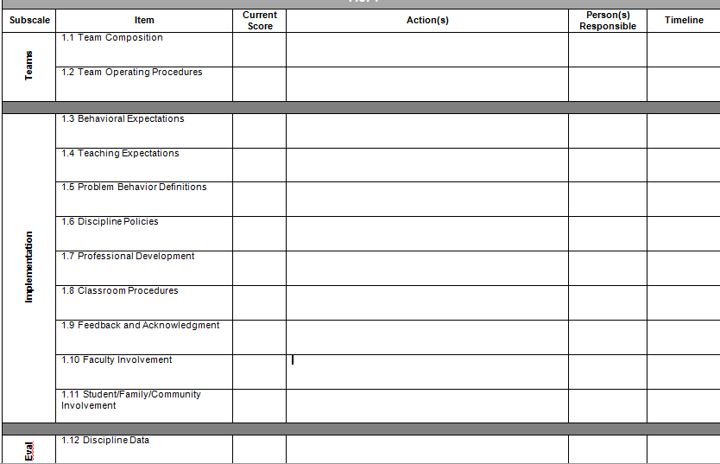
TFI Action Plan

Slide 45
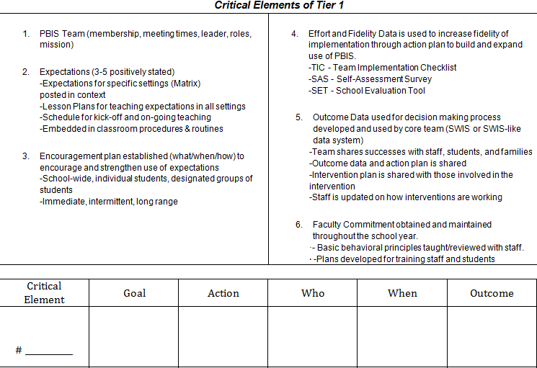
SWPBIS Action Plan

Slide 46
Only competition is yourself

