Slide 1
Sustainability:
Tier II Interventions

Slide 2
Overview of Session
Essential Features of Tier II (10min)
Review of Common Tier II Interventions (10min)
Tier II Around the World (35 min)
-Break (10 min)-
Tier II Action Planning with Teams (40 min)
Intervention Sharing (30 min)

Slide 3
Basic Steps Towards Tier II Interventions
School-Wide, including classrooms, universal systems in place (Tier I).
Identify students who need additional supports
Identify what supports the students need
Environment
Intervention
Monitor and Evaluate Progress

Slide 4
Starting Point
Work within current formal and informal systems
Develop missing steps of efficient process
Provide training and technical assistance to facilitators
Classroom problem solving teams
Tier II team
Guided Process with templates for environmental modifications and interventions
Goal = fluency among all staff members

Slide 5
The ABCs of Behavior Function
Antecedent- the events, action, or circumstances that occur before a behavior.
Behavior- The behavior.
Consequences (outCome)- The action or response that follows the behavior.

Slide 8
Common Tier II Interventions
Check & Connect
Check-In/Check-Out
Second Step
Safe Seat
Skillstreaming

Slide 9
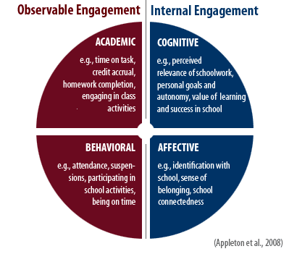
Check & Connect Mentorship Program
Check
Connect
It’s all about
student
engagement!
http://checkandconnect.umn.edu/

Slide 10
Student Recommended for CICO
Check-In/ Check-Out
https://www.youtube.com/watch?v=f8Jhy_LxWDk
CICO Implemented
Morning
Check-In
CICO Coordinator
Summarizes Data
for Decision Making
Parent
Feedback
Regular Teacher
Feedback
Biweekly Meeting
to Assess Student
Progress
Afternoon
Check-Out
Revise
Program
Graduate
Program
Notes:
Student recommended for BEP by Teacher, parent, other school personnel?
Prior to BEP implementation- meeting with Counselor, parent and student
Go over expectations for each party (parent, school, and student)
Set goal
Sometimes contract is signed (I don’t know if you this was ever used Kelly)
3) BEP Implemented
4) Morning check-in
What did you check for? Pencil, binder, agenda, BEP form from day before
Gave students supplies if they did not have them to help them be successful
BEP Daily progress report given (can flip to next slide to show)
Teacher Feedback
Student carries card to teachers
Teachers have been trained to provide some sort of positive interaction upon receiving the card
-Teachers have also been trained not to use the system as punishment- no nagging
Afternoon check-out
BEP coordinator checks for goal
Reinforcement for checking out (High 5)
Bigger reinforcement for checking out and meeting goal (snack)
Parent Feedback
Send home- student gets feedback from parent
Student brings back form signed the next day
BEP Coordinator Summarizes Data for Decision Making
Using Quattro pro Spread sheet program- graphs data
Weekly BEP Meeting
½ hour to assess progress
who attends meeting
decisions made in meeting

Slide 11
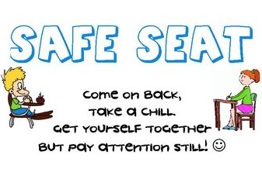
Safe Seat (Reflection Desk)
The Reflection Desk is placed in the room to allow for limited distractions (no interactions with the class is allowed)
Students completes Reflection Sheet
Process with the teacher
Return to their normal seat
Or...Go to Buddy Room
Then...office

Slide 12
Second Step
http://www.secondstep.org
It is a universal, classroom-based program designed to:
Decrease problem behaviors
Increase students' school success
Empathy Training
Impulse Control & Problem Solving
Anger Management

Slide 13
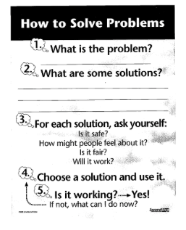
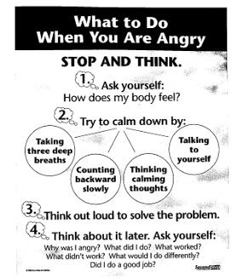
Second Step
https://www.youtube.com/watch?v=pdmI40aOWts

Slide 14
Skillstreaming
Four-part training approach—
modeling, role-playing,
performance feedback,
and generalization
http://www.skillstreaming.com

Slide 15
Externalizing Behaviors
Disrupting class
Refuse to do work
Refuse to follow directions or Minor physical contact
Property misuse
Inappropriate verbal language
Poor task completion

Slide 16
Internalizing Behaviors
Exhibits sadness or depression
Sleeps a lot
Appears unmotivated
Does not participate in games
Very shy or timid
Acts fearful
Does not stand up for self
Self‐injury (cutting, head banging)

Slide 17
Local Examples
Tier II “homemade” interventions that work!

Slide 18
Name & description of intervention:
Non-verbal self-monitoring system. Student has a laminated card on desk in each class. This card is used as a self-monitoring system, teacher supported. Teachers mark when student is showing positive behaviors and inappropriate behaviors. Once student gets to determined level (i.e. 3 marks) student is moved to next process (break, office, reward system, etc.)
Targeted behavior & students who may see most success with this intervention:
Students who are unable to self-manage their behaviors. Students who tend to show outbursts are easily distracted in the classroom setting.
Who is involved? Classroom Teachers, iTeam member (s), Student, Parents, Dean
Time required: Minimal - time for making copies, laminating, and communicating with stakeholders. Teachers monitor throughout class.
Data collected:
Each card is collected by the teacher and tallied at the end of the class period.
Indicators of success:
Student receives more positive reinforcements, less demerits . Remains in class.
Data collection process:
Teachers collect day-to-day data. They are given a summary sheet to tally on. Each week, the teacher gives data to iTeam member responsible for case. Data is compiled and brought to the next iTeam meeting for discussion and planning.
Notes:
Please be prepared to share things that you learned or things you might change for other students:

Slide 19
Name & description of intervention: Recess Leadership Team: Reteaching- select students will join the Recess Leadership Team. Students will be taught lessons targeting self regulation and a game to play at recess that minimizes competition and physical contact. Students will then have an end product to share with their class.
Targeted behavior & students who may see most success with this intervention:
Physical Aggression - Students who are struggling with self- regulation
Who is involved?
select 3rd grade students
Time required:
25 minutes 2 times a week for 2 weeks
Data collected: ODR
Indicators of success: Students demonstrating problem solving skills
Data collection process: Behavior data will be reviewed 4 weeks following the classes.
Notes:
Please be prepared to share things that you learned or things you might change for other students:

Slide 20
Name & description of intervention:
Tier II tool box for grade levels - all supplies needed and directions included for 3 different interventions (rubber band, mystery motivator, talk tickets)
Targeted behavior & students who may see most success with this intervention: many behaviors that disrupt the learning environment - elementary aged students
Who is involved? PBIS team created and trained grade level teachers
Time required: Minimal to get started - actual daily time to implement varies
Data collected: Individual data collected when a teacher implements one of the interventions
Indicators of success: When used with fidelity we have had success with individual students (reduced behaviors)- getting teachers to use the intervention consistently w/fidelity---less success
Data collection process: Varies for each intervention
** Directions for the interventions can be found on www.interventioncentral.com
Notes:
Please be prepared to share things that you learned or things you might change for other students:

Slide 21
Tier II Around the World
You will see stations around the room with a poster and interventions listed.
When dismissed, you will head to one of the stations.
At that station, you will discuss your success, failures, and questions with other schools.
When time is called, move to another station.
Repeat.
You will end up at 3 stations.
After the 3rd station, you will head back to your team to discuss and action plan.

Slide 22
Tier II Around the World
At each station, please start discussion around the following:
Age-group you have used the intervention with.
Things that went well.
Obstacles you’ve faced.
Recommendations for others who are looking to start the intervention.

Slide 23
Tier II Around the World-
Reflection with Team
Back with your teams:
Give everyone a chance to share what they learned.
Think about programming at your school that could piggy-back off these interventions.
Start prioritizing which interventions may work at your school.
Intervention Guide Map
Make a copy & save to your drive
Next steps?

