Slide 1
Moving from Reactive to Proactive:
Tier II and Tier III Behavioral Supports
June 21, 2017
Jeff Horton - Director of Student Services
Karli Johnson - Social Emotional Learning Coordinator

Slide 2
Welcome!
What is your current position?
Does your district/school have PBIS?
How long have you been doing PBIS?

Slide 3
Needs Assessment and Analyze Data
Hexagon Tool
School Climate Data
District Climate Survey
Office Discipline Referrals
Suspension Data
Focus Groups
Community Input
What does your district/school already have in place? What does it still need?

Slide 4
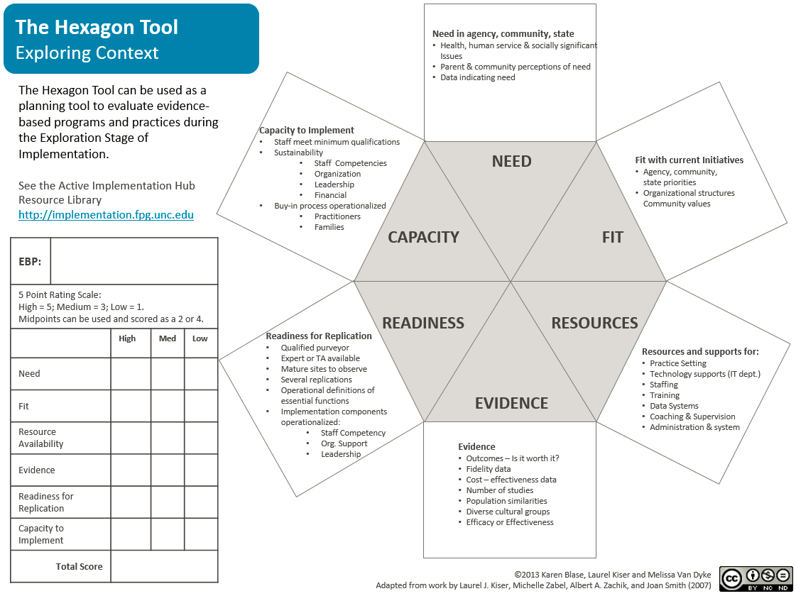
Hexagon Tool – Exploring Context
Notes:
The Hexagon Tool can help states, districts, and schools appropriately select evidence-based instructional, behavioral, and social- emotional innovations and prevention approaches by reviewing six broad factors in relation to the program or practice under consideration.

Slide 5
Research Potential Solutions
Social Emotional Learning Competencies
Positive Behavior Interventions and Support
Restorative Practices
Student Support Rooms
Check and Connect

Slide 6
Propose Your Solution to Stakeholders
Board Committee
Superintendent's Cabinet
Directors
Principals
Staff

Slide 7
“How are you going to pay for it?”
Achievement Integration Funds
Alternative Delivery of Specialized Instructional Services (ADSIS)
Alternative to Suspension Funds
Strategic Funds

Slide 8
St. Cloud Student Support Room
Vision
A systemic approach to proactively support as well as respond to student behavior and emotional needs. The program focuses on short, intense services and supports to build skills and fade away supports while simultaneously increasing student independence. The goal of the program is to see students exit and have independent success. The program will also support the school’s need for ISS supports.

Slide 9
Purpose
Provide an alternative learning opportunity for students for short periods of time.
Proactive, planned breaks
Responsive breaks through guidance of administration
Group sessions (such as social skills groups)
Short term plans with the goal of returning the student to the classroom full time.
Utilizing fade away supports
Provide an opportunity for hands on support for self calming and awareness.
Increase student emotional and behavioral self awareness and calming abilities.

Slide 10
Student Support Room
Staff
BRS- Behavior Resource Specialist
BSS- Behavior Support Specialist
Behavior Tools
FBA- Functional Behavior Assessment
PBIP- Positive Behavior Intervention Plan

Slide 11
Talahi Elementary Student Support Room

Slide 12
Student Referral Process
Teacher, Parent, or Administrative Recognition of an Increased Need for Student Support.
Functional Behavior Assessment
MTSS
Parent Permission slip
Review FBA
Discuss Positive Behavior Intervention Plan
PBIP
Short term objectives working towards reachable behavioral goals including remaining in classroom at increased time intervals.
*Exception through administration for responsive action.
FBA and BIP Resource: http://www.pbisworld.com/

Slide 13
Opportunities
Small group learning
Social Skills groups
Friendship groups
Lunch groups
Celebration Lunches
Push In Supports
Proactive Breaks
Planned energy breaks
Check in/Check out
Reactive response

Slide 14
Expectations for Reactive Response
Reactive Response/ Urgent referral from Administration
Communication from referral source
Engage the student in the calming process, explain expectations gently
Identify readiness to move forward after calming
Engage with student
Reflective conversations and processing with students
Antecedent, triggers, personal response, personal responsibility
Identify plan of action within Student Support Room
Identify plan of action to return to class and manage emotions/behaviors
Communicate transition plan
Send Communication form

Slide 15
Expectations for Proactive Response
Students with Proactive Plans
Be aware of the plan
Identify readiness to move into plan or if calming time is needed prior
Movement to plan area
Academic, sensory, calming etc.
Engage with student
Identify if the student has appropriately utilized plan, offer praise, review transition plan.
Communicate transition plan
With proactive plans, communicating the transition plan following the first few days of the plan may not be necessary. Check with teacher to coordinate this communication.
Send Communication form if needed

Slide 16
Requirements Post Student Contact
Documentation
Attendance, time in/time out, race, referral source, purpose
Family contact as needed
Be sure this is communicated across parties as to who will contact family.
Communication with administration or child’s team as needed
Referral concerns:
Safety concerns
Home safety, abuse, neglect concerns referred to Guidance and/or Administration (mandated reporting)
Medical or medication concerns referred to Nursing
Recommendations for outside services can be made to the student’s team
Communicate concerns immediately and effectively to the appropriate party.

Slide 17
How Will You Collect Data?
Student Information System
Google Apps
Microsoft Office Products
Paper
Other

Slide 18
Initial Professional Development
Initial BRS Training
3 Trainings in September
Focus on vision, process, data entry, FBA, PBIP
Principals and Assistant Principals
All BRS trainings available for review
Principal Meetings
Assistant Principals
Communication through Principal Playbook

Slide 19
Ongoing Professional Development
BRS Training
Training Bi-monthly
Connect, review
Restorative Practice training
Cultural Competency
Provide work time away from building site/collaborate and brainstorm
Summer 2017
Restorative Justice
Conscious Discipline

Slide 20
Ongoing Professional Development
BSS Training
Site Based
Superintendent’s Cabinet Presentations
At quarter or trimester
Principal Training
Developed with support of the Superintendent's Cabinet

Slide 21
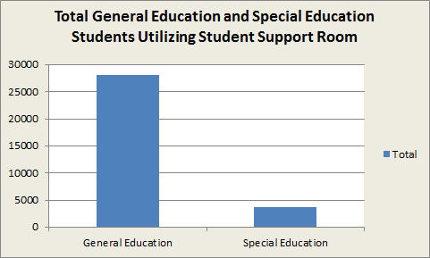
General Education Students and Special Education Students Utilizing Student Support Room
General Education Students:
28,050 (88.5%)
Special Education Students:
3,643 (11.5%)

Slide 22
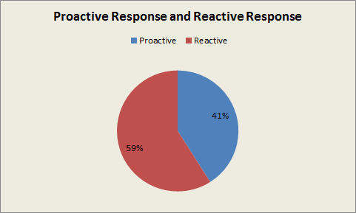
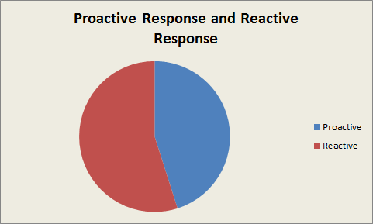
Proactive VS Reactive Response
Districtwide February 2017
59% Reactive
41% Proactive
Districtwide June 2017
55% Reactive
45% Proactive
55%
45%

Slide 23
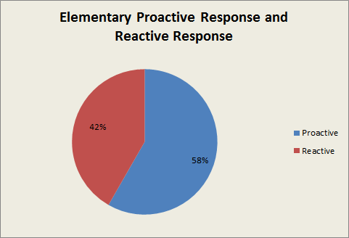
Elementary Response Data
June 2017

Slide 24
Questions?

