Slide 1
F10 Scaling-up PBIS in Big Ways: Stories from Two Large Urban School Districts
This presentation will examine the ways in which district teams, informed by data, evolve and support the capacity of schools to manage implementation and move toward both improved PBIS fidelity and student outcomes.
Kate Emmons, Diana Bledsoe and Alex Berg, Osseo Area Schools, Osseo, MN;
Erin Metz, LaNisha Paddock and Paul Richardson, Saint Paul Public Schools, Saint Paul, MN;
Eric Kloos, Minnesota Department of Education, Roseville, MN

Slide 2
Scaling-up PBIS in Big Ways: Stories from Two Large Urban School Districts
Download presentation at http://pbisMN.org/school-teams
APBS 18th International Virtual Conference on Positive Behavior Support
March 19, 2021
Saint Paul Public Schools – St. Paul, MN
Erin Metz, District PBIS Coordinator
LaNisha Paddock, Principal | Battle Creek Middle School
Paul Richardson, Assistant Principal | Battle Creek Middle School
Osseo Area Schools – Osseo, MN
Kate Emmons, Special Education Director
Diana Bledsoe, Principal | North View Middle School
Alex Berg, Assistant Principal | North View Middle School
Eric Kloos, Assistant Director of Special Education | Minnesota Department of Education

Slide 3
You Are Here
F10: Scaling-up PBIS in Big Ways: Stories from Two Large Urban School Districts
This presentation will examine the ways in which district teams, informed by data, evolve and support the capacity of schools to manage implementation and move toward both improved PBIS fidelity and student outcomes.

Slide 4
Takeaways
The supports needed to scale-up PBIS at a district level.
Building local capacity in others has allowed implementation to sustain and scale…
…despite predictable changes that occur at school and district levels.
The importance of regularly measuring and using implementation data.
Notes:
The supports needed to scale-up PBIS at a district level.
Leadership team
Policy supports
School improvement plans: district policy to include PBIS for culture-building and action planning.
Intersected with other priority work at Osseo and SPPS as part of strategic plan.
Implementation efforts in Tier 1, schools learning to navigate support for students with more intensive needs
Access to training and external coaching to support teams with capacity and fidelity data to differentiate and provide support
How building local capacity in others has allowed implementation to sustain and scale, despite predictable changes that occur at school and district levels.
For districts larger than 15 schools, we don’t have examples where implementation happens in a year or two
Osseo and Saint Paul are two real examples of district systems that can consistently grow and scale.
Don’t have examples of 0-25 (or 0-75) schools in two years.
Implementation doesn’t have to be perfect, it just has to be real
It’s fluid and is a constant work-in-progress - might feel it more during years where turnover is highest, but it is to be expected
Worked hard to get Tier 1 in place first, in both districts
The importance of regularly measuring and using implementation data.
Ties to the second-day keynote with Caryn Ward
The TFI made a big difference at the district level - easier for schools to use and easier for district's to use. Going from requiring tier 1, and the number of schools finding value in Tiers 2 and 3 as a way to go and action plan
Learned that, especially with Tier 2, it’s not just jumping to interventions, but finding those systems we need to have in place in order to pick the right interventions. TFI has been an essential tool.
Understand implementation of practices within a multi-tiered framework
Restorative Practices
SEL
Value of being able to add other things into it. Important for people to hear

Slide 5
Quote from Rob Horner
“Never put something in place that won’t endure for a minimum of 10 years…
…do it with a level of precision, with a level of fidelity, and with the organizational systems that will go beyond just you getting good at it.”
- Rob Horner
APBS 2018
Source: https://www.apbs.org/play-video?v=263456934

Slide 6
Overview PBIS in Minnesota

Slide 7
Welcome to Minnesota

Slide 8
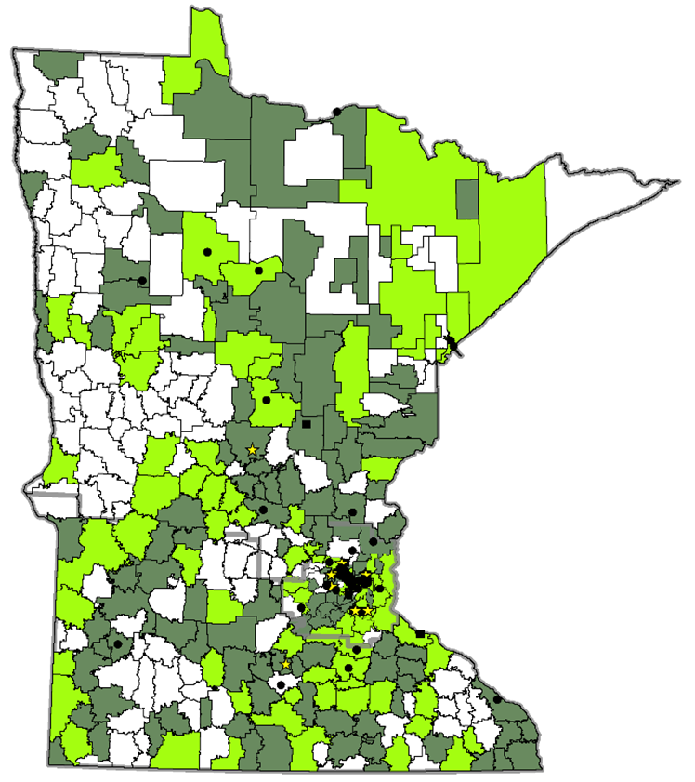
Purpose of Schoolwide PBIS and Initiative 2005 – 2021
Minnesota Regional Implementation Projects for SW-PBIS
Cohorts 1- 16
PBIS – Evidence-based framework for:
Preventing problem behavior
Providing instruction and support for positive, prosocial behaviors
Supporting social, emotional and behavioral needs for all students
PBIS initiative – Evidence-based implementation for:
Distributed, team-based implementation of PBIS
Building capacity, skills, competency and beliefs to sustain implementation beyond initial training
Districts Implementing SW-PBIS
Education districts
Charter schools
Other schools
Districts with 60% or more schools
Districts with 1% to 59% schools
No participating schools to date
Implementation regions

Slide 9
PBIS Scale-Up in Minnesota 2005 – 2021
Minnesota Regional Implementation Projects for SW-PBIS
Cohorts 1- 16
274 districts/charters
821 school teams
60% early childhood and/or elementary
15% middle school
25% high schools or ALCs
39% of schools in Minnesota
43% of students (approx. 378,097) in Minnesota
Districts Implementing SW-PBIS
Education districts
Charter schools
Other schools
Districts with 60% or more schools
Districts with 1% to 59% schools
No participating schools to date
Implementation regions
9
Notes:
769 schools have been or are in cohort training.
Approximately 20 schools have been through training more than once.
The parentages of school types were determined using the numbers at the end of the current list.
Out of 754 on list
452 (60%) were EC and Elementary
115 (15%) were MS
186 (25%) were HS or ALC
"The Valley of the Jolly Green Giant" refers to the Minnesota River valley around Le Sueur. Today, just before dropping down into the valley heading south on U.S. Route 169 an enormous wooden sign of the Jolly Green Giant, along with the Little Green Sprout, is visible with the caption "Welcome to the Valley."
Sixty miles (97 km) further south on US 169, in the city of Blue Earth, Minnesota, stands a 55-foot (17 m) fiberglass statue of the Jolly Green Giant. The statue was first unveiled in 1978 and was set on its permanent base on July 6, 1979, at 43°39′02″N 94°5′46″W. The statue attracts over 10,000 visitors a year.
The statue was the idea of Paul Hedberg, the founding owner of local radio station KBEW. During weekdays in the summertime Hedberg would interview people passing through Blue Earth on U.S. Highway 169 for his popular radio program Welcome Travellers. At the end of each interview, Hedberg presented guests with a sample of the peas and corn which had been produced by the town's Green Giant canning plant, along with a sample of what passed for the blue riverbed clay that gave the town its name. A common theme arising in these interviews was a desire to "see the Green Giant."

Slide 10
Growth of PBIS in Minnesota (Cohort 15 highlighted) 2005 – 2021
Cohort 16
49 more teams!
821
School teams
Notes:
821 school teams participating, 18 come back through twice, how rare to do it, but still an option if that’s the way to reteach and retrain these teams.

Slide 11
Keeping the outcomes in mind, Fidelity Directs Improvement

Slide 12
Fidelity Directs Improvement
A fidelity assessment that is ready-to-use gives Implementation Teams progress monitoring at startup
While getting started, it gives patience for improvement in outcomes
Provides a road map for action planning at school, district, regional and state levels

Slide 13
Average School Fidelity Data For New PBIS Schools Tiered Fidelity Inventory (TFI) Tier 1 – 2015-present
2015-2017
n=53
2016-2018
n=49
2017-2019
n=60
2018-2020
n=47
2019-present
n≈68
2020-present
n≈52
Notes:
Each cohort represents about 45-60 schools, and each bar shows the average fidelity score across fall, winter, spring plus a fidelity walk-though at the end of the school year. The “stair step” profile shows that teams take information from the fidelity assessment to action plan and implement over the 3-4 month period. They celebrate the implementation growth, then find another 2-3 items that they can improve until they reach fidelity, when students can receive the full benefits of school-wide PBIS implementation.

Slide 14
Sustaining PBIS in Minnesota
Minnesota Quick Facts
Evidence shows that a lot of schools are using a fidelity assessment including the TFI, SAS, BoQ and SET
216 schools independently used a fidelity assessment – Cohort 1-13 schools (n=162) and non-cohort schools (n=54)
In 2019-2020, 321 schools completed a TFI (n=321), both cohort (n=268) and non-cohort trained (n=53)
330 schools in Minnesota used a
fidelity assessment last year!

Slide 15
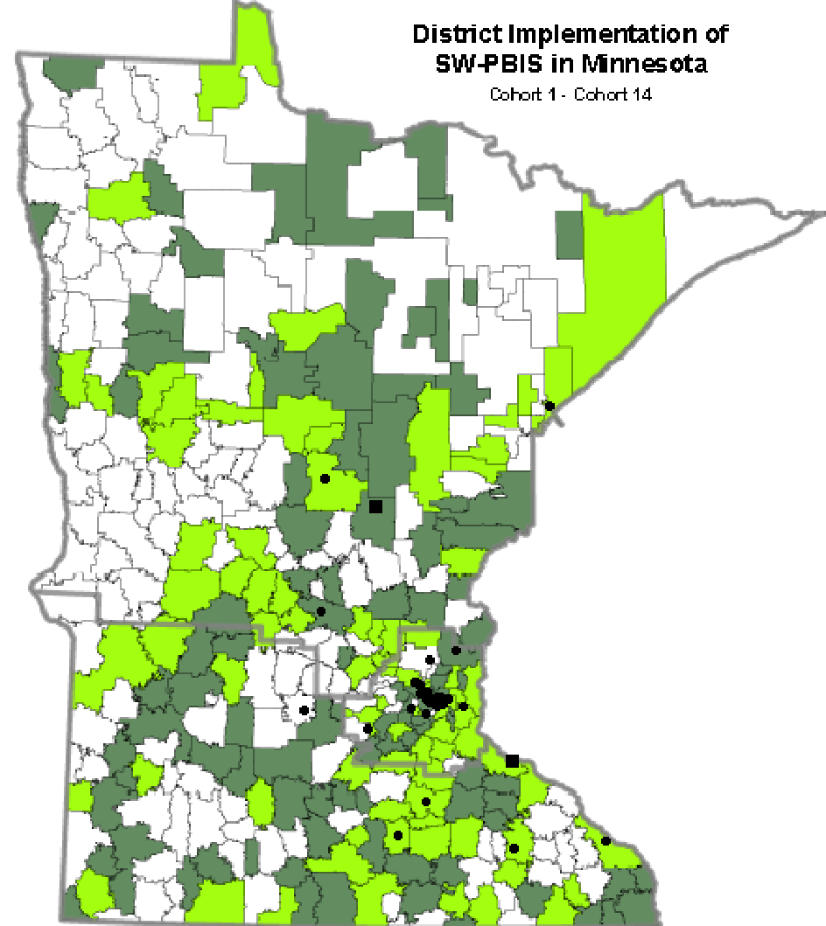
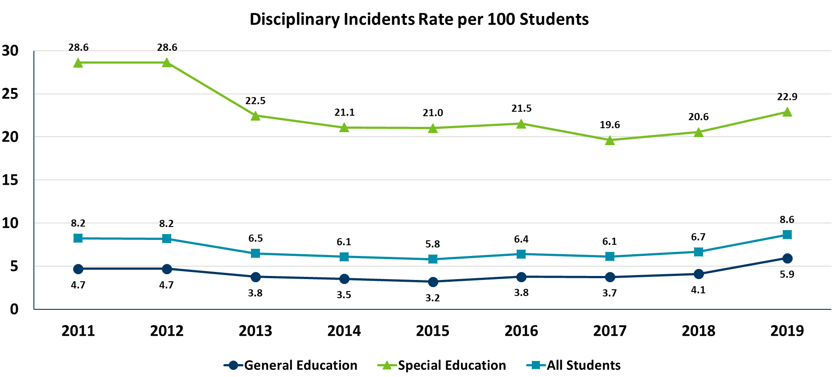
Statewide Outcomes: State Rates per 100 Students for General Ed, Special Ed and All Students
State-Level
Notes:
STATEWIDE: What is the rate per hundred of all disciplinary incidents (regardless of incident type or disciplinary action) for general and special ed students in the state?
These statewide data show that there were more disciplinary incidents in 2011 for students receiving special education than students that are not receiving special education services or supports.
While the gaps are not closing overnight, there is a decreasing trend that is closing the gaps. As PBIS continues to scale, it gives us information for team-based supports that schools, districts, regions and the state can provide to continue to close this gap.

Slide 16
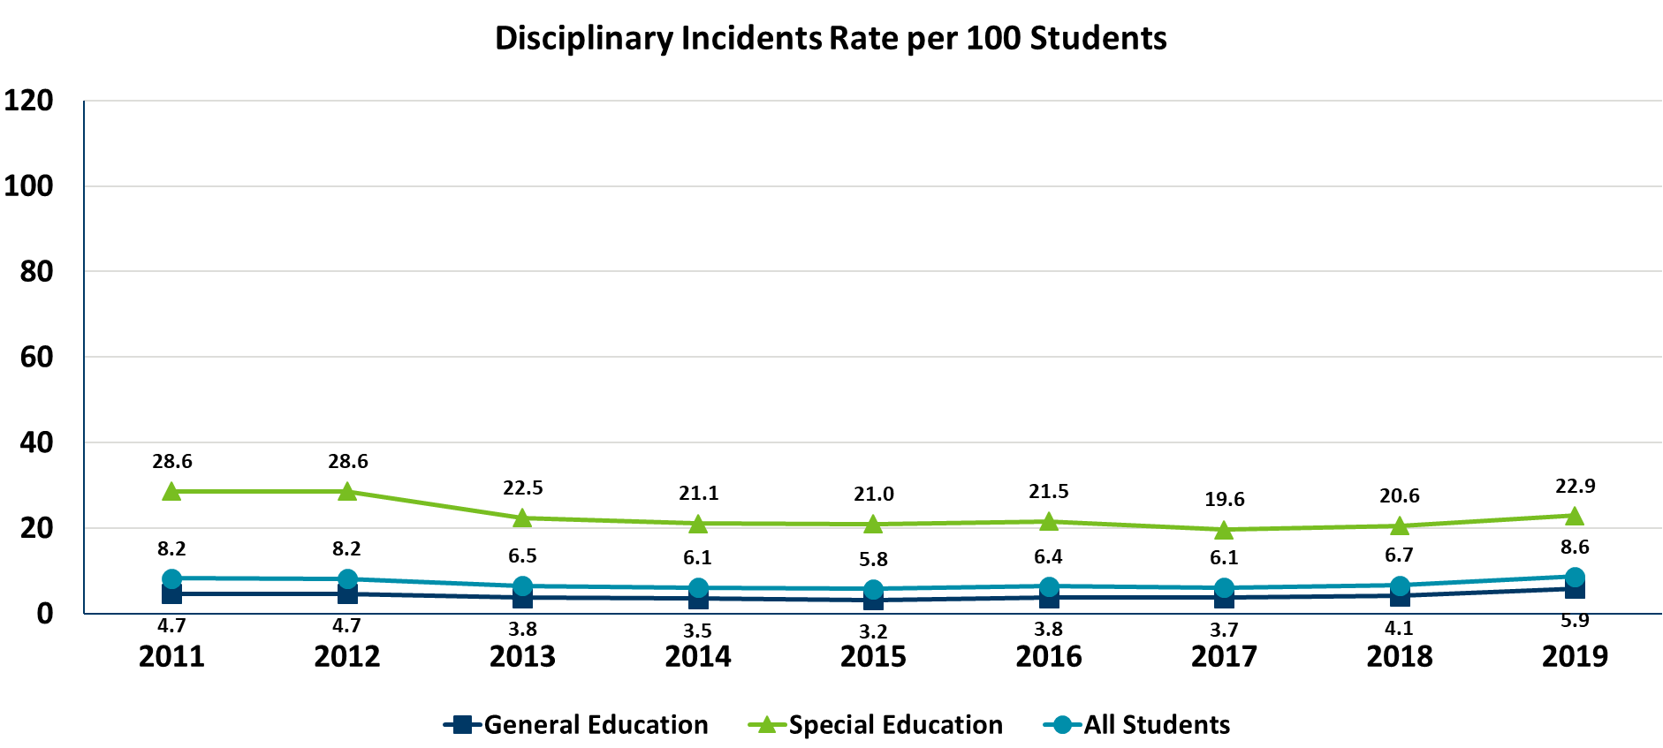
Increased Axis to Show Impact on Statewide Outcomes: State Rates per 100 Students for General Ed, Special Ed and All Students
State-Level
Notes:
STATEWIDE: What is the rate per hundred of all disciplinary incidents (regardless of incident type or disciplinary action) for general and special ed students in the state?
These statewide data show that there were more disciplinary incidents in 2011 for students receiving special education than students that are not receiving special education services or supports.
While the gaps are not closing overnight, there is a decreasing trend that is closing the gaps. As PBIS continues to scale, it gives us information for team-based supports that schools, districts, regions and the state can provide to continue to close this gap.

Slide 17
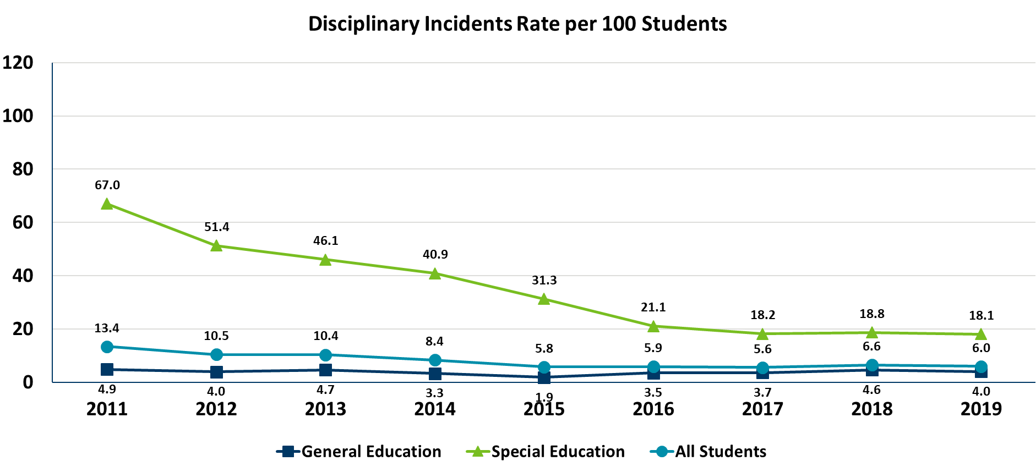
Osseo Area Schools District-Wide Outcomes: District Rates per 100 Students for General Ed, Special Ed and All Students
District-Level
Notes:
What is the rate per hundred of all disciplinary incidents (regardless of incident type or disciplinary action) for general and special ed students in the state?
These district-level data show that there were more disciplinary incidents in 2011 for students receiving special education than students that are not receiving special education services or supports.
While the gaps are not closing overnight, there is a decreasing trend that is closing the gaps. As PBIS continues to scale, it gives us information for team-based supports that schools, districts, regions and the state can provide to continue to close this gap.

Slide 18
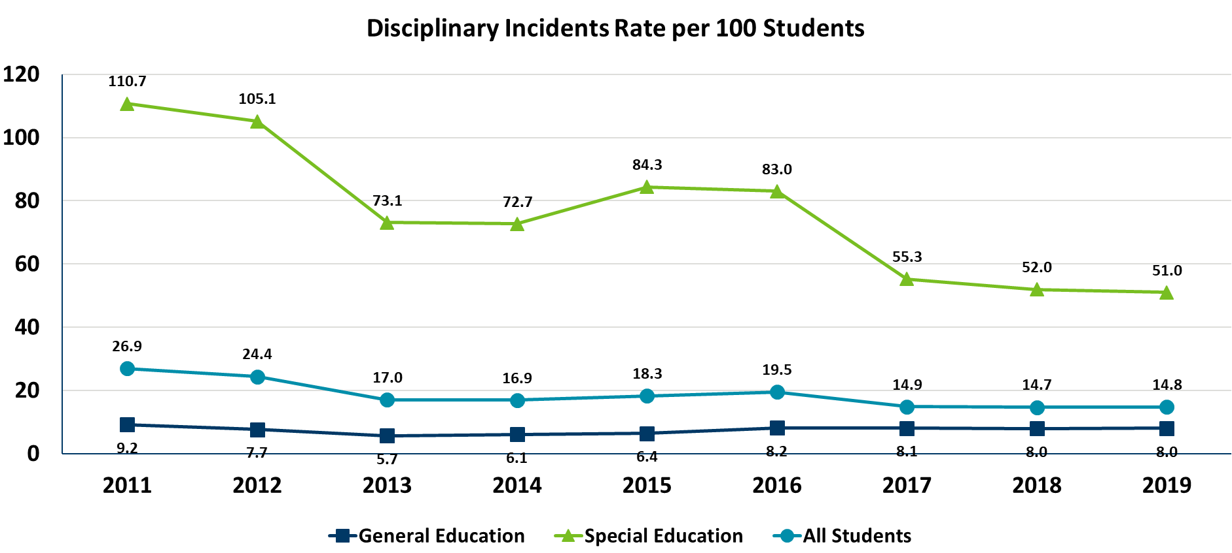
Saint Paul Public Schools District-Wide Outcomes: District Rates per 100 Students for General Ed, Special Ed and All Students
District-Level
Notes:
What is the rate per hundred of all disciplinary incidents (regardless of incident type or disciplinary action) for general and special ed students in the state?
These district-level data show that there were more disciplinary incidents in 2011 for students receiving special education than students that are not receiving special education services or supports.
While the gaps are not closing overnight, there is a decreasing trend that is closing the gaps. As PBIS continues to scale, it gives us information for team-based supports that schools, districts, regions and the state can provide to continue to close this gap.

Slide 19
District and School Implementation Stories
Information that has helped inform measurable progress indicators with implementation over time
The stories of the work of these two (2) districts and school exemplars emphasizes
Focus on equity
Use of fidelity and outcome data
Integration with district initiatives resulting in better coordinated district supports
Similarities and differences of these two (2) districts
Linked Teams to support staff to get to more equitable student outcomes

Slide 20
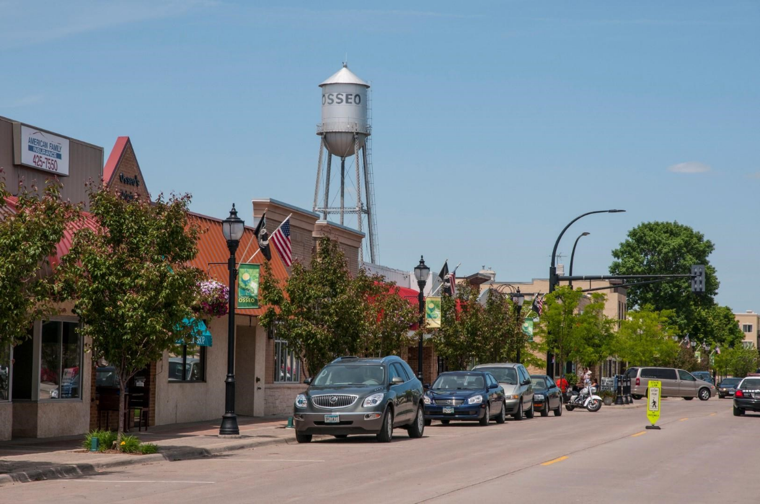
Welcome to Osseo

Slide 21
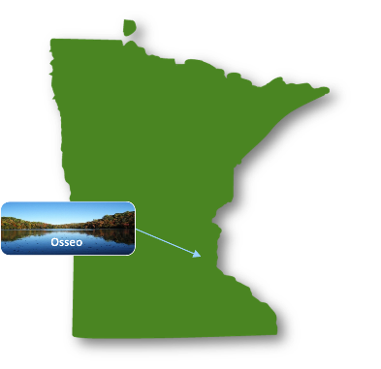
Kate Emmons, Director of Student Services Osseo Area Schools
Diana Bledsoe, Principal, North View Middle School
Alex Berg, Assistant Principal, North View Middle School
Saint Paul
Notes:
Kate

Slide 22
District Profile
Osseo School District ISD 279
Fifth largest school district in Minnesota
20,480 students
80 dialects and languages spoken
Schools
17 elementary schools
4 middle schools
3 senior high schools
1 area learning center
2 early childhood centers
2 special program sites
1 adult education/enrollment center
B-21 Distance Learning Academy

Slide 23
Demographics
Demographic | Osseo | State
American Indian / Alaskan Native | 1.9 | 1.67%
Asian | 16.6% | 6.90%
Native Hawaiian / Pacific Islander | .04% | .09%
Hispanic / Latino | 9.2% | 9.85%
Black / African American | 25.1% | 11.28%
White | 40.4% | 64.77%
2 or More | 6.8% | 3.56%
English Learner | 10.67% | 8.55%
Special Education | 14.39% | 16.65%
Homelessness | 1.34% | 1.01%
Free or Reduced Lunch | 39.07% | 35.82

Slide 24
Strategic Plan
Notes:
strategic priority comes with expectation to move system along
don’t pull staff from schools indiscriminately
expectations and tools to meet those expectations

Slide 25
2013 Results Statement
Result Statement:
Ensure all sites have implemented research-based positive behavior intervention practices that promote equitable student achievement by mid-April 2013 which include:
Agreed-upon school-wide positive behavior expectations that are clearly and positively stated and posted throughout the building;
Expectations taught like any academic subject, including guided practice and review throughout school year, and
A system to recognize or acknowledge students when they display expected behaviors.
Notes:
where we started--so excited to actually be tied to evidence based intervention--started slow--no data! didn’t even think about data...

Slide 26
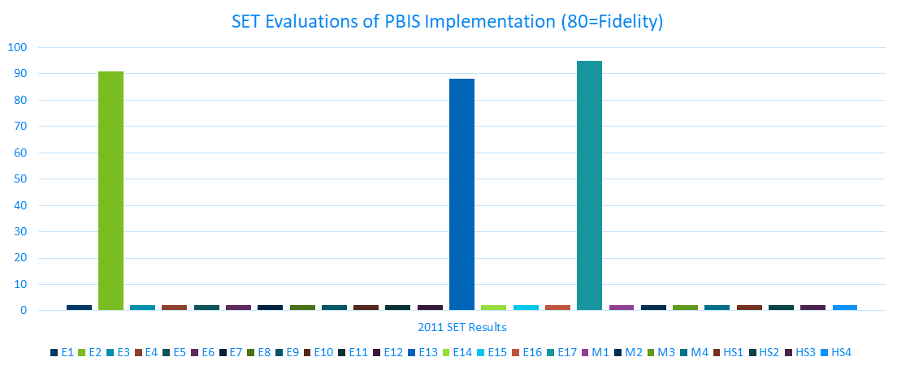
2011 Osseo PBIS Implementation Across Schools
SET = School-wide Evaluation Tool

Slide 27
MDE and Osseo Partnership: Give/Get
Osseo and MDE Agreement to Actively Manage District-wide PBIS Implementation
Priority | Osseo Get | MDE & Partners Get | Osseo Give | MDE & Partners Give | Shared Outcomes
Improve District-wide PBIS Implementation | Integration of implementation frameworks and tools into Osseo’s management of PBIS implementation district-wide (see http://implementation.fpg.unc.edu/module-1) | Model of district-wide PBIS implementation using implementation frameworks and tools | Staff time at Osseo monthly PBIS meetings to learn about implementation frameworks and tools associated with PBIS | Staff time preparing for, participating in, and meeting needs emerging from Osseo district PBIS meetings | Osseo, MDE and Partners understand what it takes to manage PBIS implementation and scale-up across a large urban district
Data-based decision making | Access to customized Osseo PBIS district-wide implementation data from MDE and Wilder Research, including regular and ongoing effort, fidelity, and outcome data reports | Experience learning which data are most helpful to districts in actively managing PBIS implementation | Agreement to share and review Osseo’s PBIS implementation data on a regular basis | Osseo district-wide PBIS implementation data in a actionable format | A district-wide data-based decision making process is developed to implement and scale-up PBIS in Osseo
Professional Development | Knowledge about PBIS implementation through participation in a Community of Practice with other selected districts actively managing PBIS implementation | MDE & Partner staffs learn from Community of Practice discussions and data review cycles about how best to meet the PBIS professional development needs of participating districts and schools | Staff dedicated time to participate in the Community of Practice and other professional development opportunities provided by MDE & Partners | Data-informed district-wide professional development (provided by MDE staff, George Sugai, Karen Blase, and others) and reserved space at MDE Implementation Forums and content-specific PBIS trainings or capacity building sessions (such as SWIS facilitator training, TIPS training, PBIS trainer training etc.) | Increased competence of Osseo, MDE and Partner staff to implement, manage and evaluate district level PBIS
Strategic PBIS meeting calendar and agenda planning | Assistance with planning PBIS district meeting calendar and customize agenda items based on available data and associated implementation frameworks | Feedback on the efficiency and effectiveness of pre-planning district PBIS meeting calendar and agendas | Share responsibility for district PBIS meeting calendar and agenda planning with MDE staff | Staff time to help with pre-planning and meeting needs emerging from Osseo PBIS meeting calendar and agendas. | Osseo and MDE develop a model for meeting calendar and agenda planning to improve the efficiency and effectiveness of PBIS implementation and scale-up
Transfer Implementation Frameworks and tools to other Osseo initiatives | Understanding of Implementation Frameworks, tools, and processes (such as the District Capacity Assessment) and how they can be used to implement other Osseo district-wide initiatives | Experience in helping a district team learn about Implementation Frameworks and tools to transfer those frameworks and tools to other district initiatives | Staff time to reflect on how the Implementation Frameworks and tools used to actively manage PBIS implementation and scale-up can be applied to implement other Osseo initiatives | Systems coaching to explicitly highlight when and how to apply Implementation Frameworks and tools to other Osseo initiatives | Osseo PBIS Team, MDE and Partners understand how to successfully use and transfer Implementation Frameworks and tools to other district initiatives
Notes:
Partnership with MDE key to success
Implementation science
partnered with MDE staff so willing to give of time and talents to support our district efforts

Slide 28
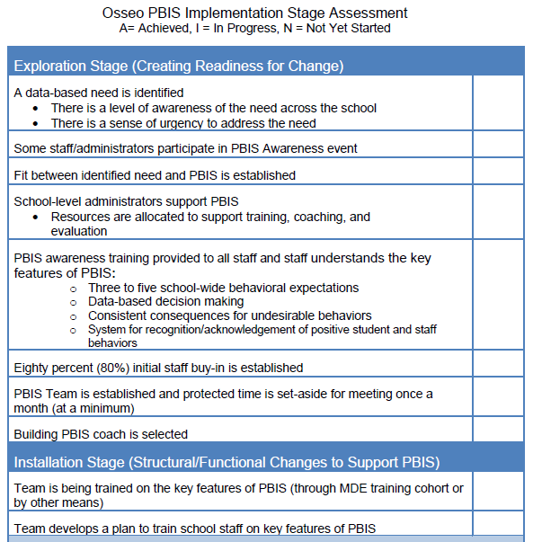
Stage-Based Assessment 2014

Slide 29
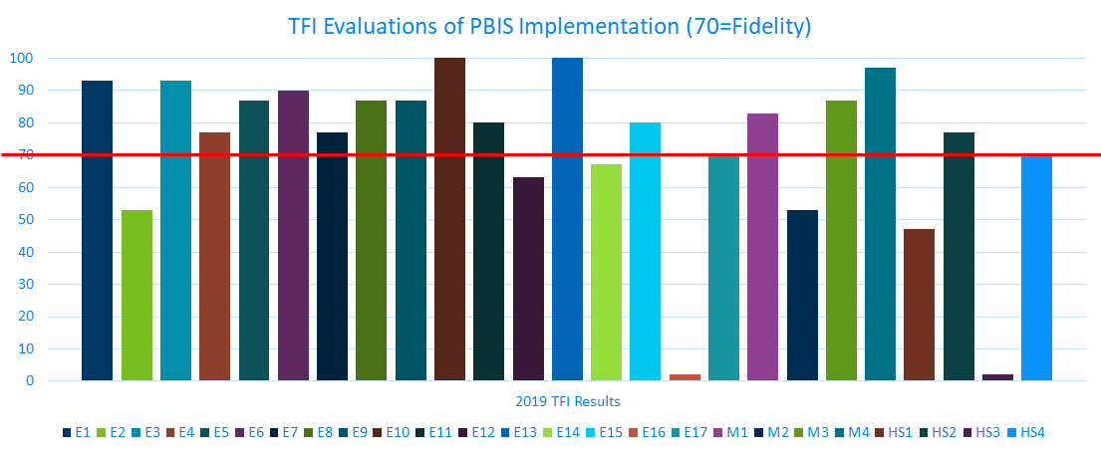
2018 Tier I Osseo PBIS Implementation Across Schools

Slide 30
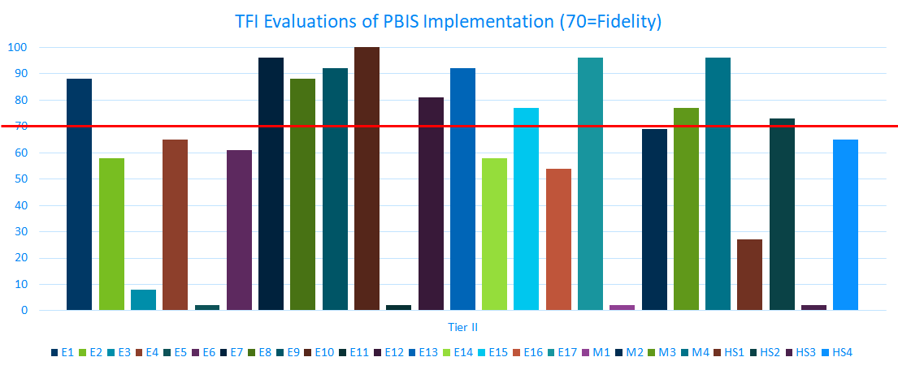
2018-19 Tier II Osseo PBIS Implementation Across Schools

Slide 31
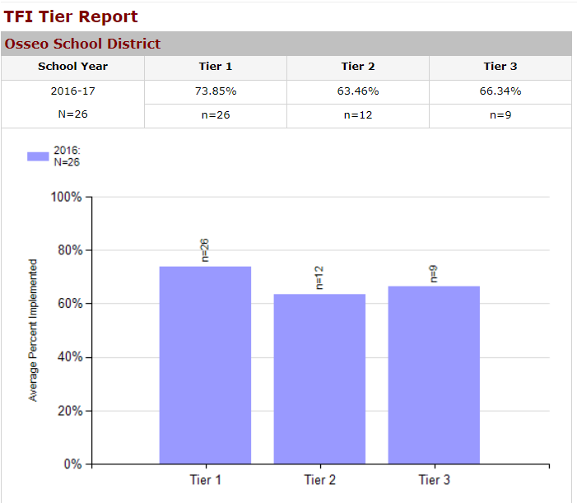
Tiered Fidelity Inventory (TFI) 2016-2017
Notes:
started requiring all sites to take the TFI in 2015--only 2 schools reported-- 16-17 data more representative --most likely overreporting
but actually starting to consider data

Slide 32
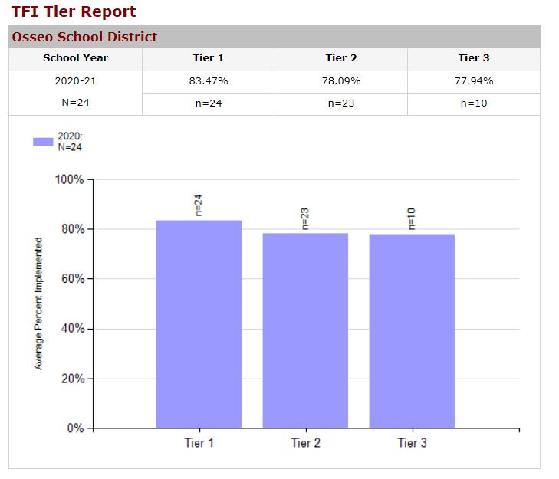
Tiered Fidelity Inventory (TFI) 2018-2019
Notes:
results over time

Slide 33
Disciplinary Incident Reporting System (DIRS) Data Osseo Area Schools
Notes:
Disciplinary Incident Reporting System
The Disciplinary Incident Reporting System (DIRS) enables both the Minnesota Department of Education (MDE) and school districts to comply with state and federal reporting requirements for suspensions, expulsions, special education and dangerous weapons. DIRS is a web-based, password-protected system where all public school districts must report disciplinary incidents that result in suspension or expulsion. State law requires us to annually report on disciplinary incidents and incidents involving dangerous weapons that occur in Minnesota public schools (Minn. Stat. § 121A.06, subd. 3). Data for this report is obtained from DIRS. Copies of past reports are available below.
“What is the rate per hundred of all students who were disciplined (regardless of incident type or disciplinary action) for general and special ed students in the state, and by districts?”

Slide 34
DIRS Data Disaggregated by Race/Ethnicity Osseo Area Schools
Osseo Area Schools: Rate per Hundred for unique students disciplined by race/ethnicity, general ed compared to SpEd
Notes:
Disciplinary Incident Reporting System
The Disciplinary Incident Reporting System (DIRS) enables both the Minnesota Department of Education (MDE) and school districts to comply with state and federal reporting requirements for suspensions, expulsions, special education and dangerous weapons. DIRS is a web-based, password-protected system where all public school districts must report disciplinary incidents that result in suspension or expulsion. State law requires us to annually report on disciplinary incidents and incidents involving dangerous weapons that occur in Minnesota public schools (Minn. Stat. § 121A.06, subd. 3). Data for this report is obtained from DIRS. Copies of past reports are available below.
“What is the rate per hundred of all students who were disciplined (regardless of incident type or disciplinary action) in the state disaggregated by education type (general vs. special ed) and federal race/ethnicity?”

Slide 35
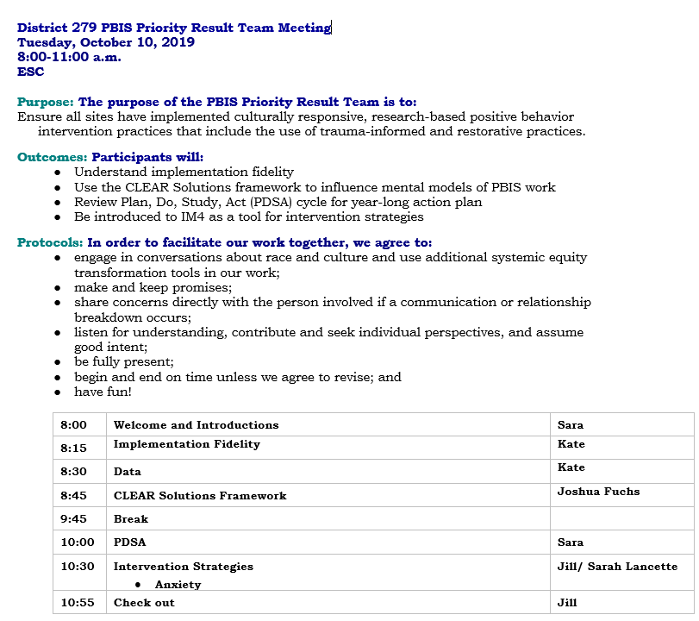
We Meet!
Notes:
strategic priority comes with expectation to move system along
don’t pull staff from schools indiscriminately
expectations and tools to meet those expectations

Slide 36
Tools

Slide 37
Equity at the Center
Notes:
mind sets need to be explored --suspensions aren’t a solution and that is well documented
what are we about?
system tools to work with

Slide 38
Distance Learning Academy, Ryan Bisson, Assistant Principal

Slide 39
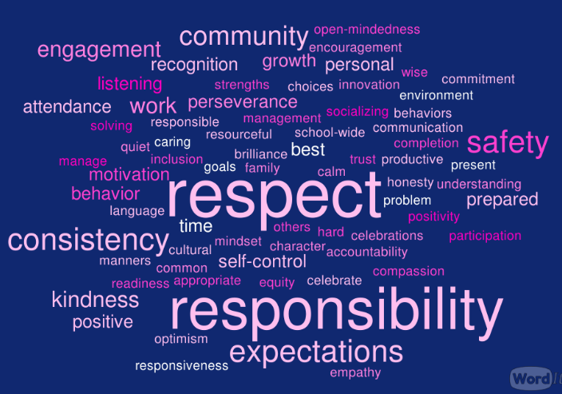
Distance Learning Academy
Staff Survey
PBIS Team
Parent Survey
Student Feedback
Native Voices PBIS--Ethan Neerdaels, Coordinator

Slide 40
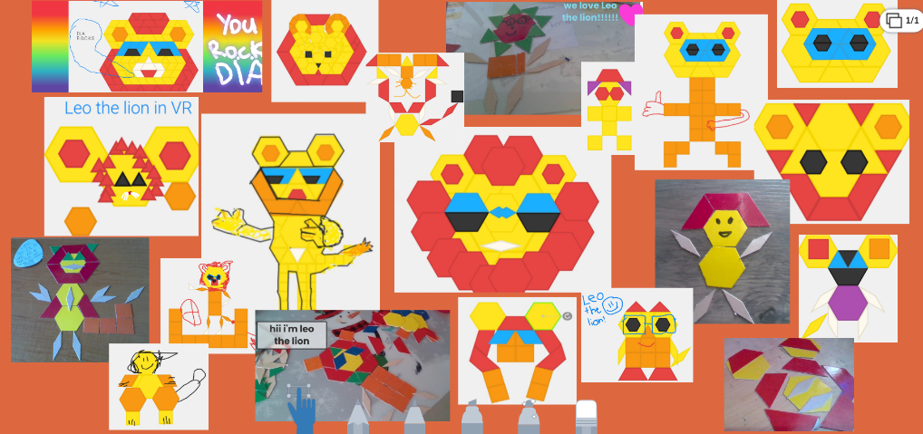
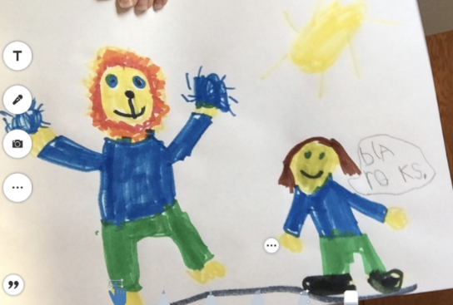
Distance Learning Academy We R.O.C.K.

Slide 41
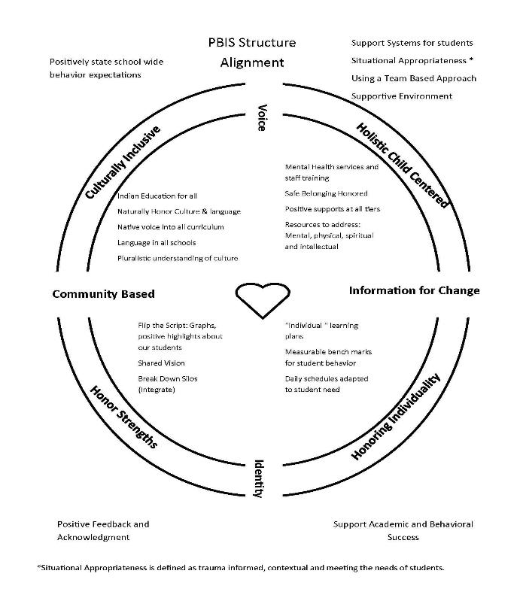
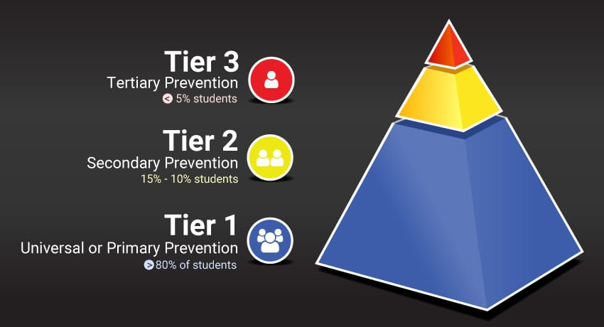
Native Voices PBIS--Ethan Neerdaels, Coordinator
Osseo Area Schools Indian Education staff continue to participate in the inaugural Minnesota Department of Education’s Native Voice for PBIS Cohort.
413 Indigenous students participating in Indigenized PBIS model through
the 2020/2021 School Year
Culturally Responsive Framework for centering student & community voice

Slide 42
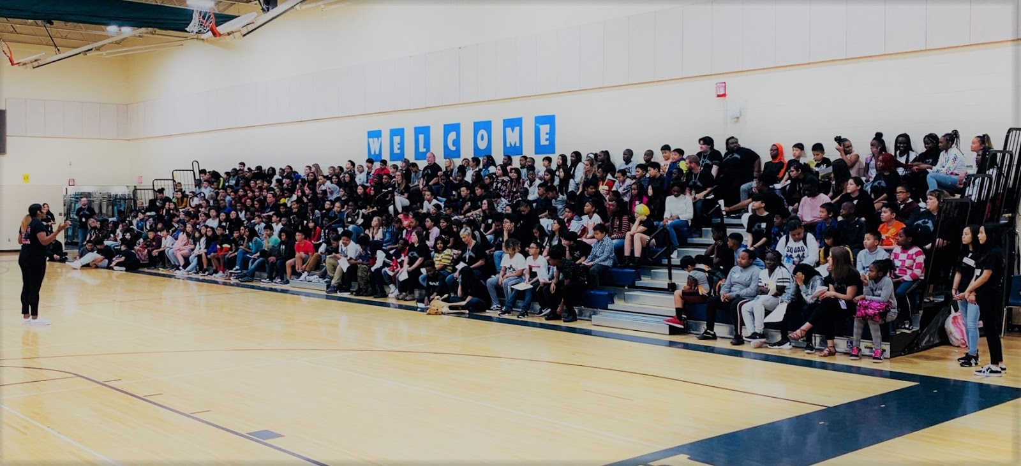
North View Middle School

Slide 43
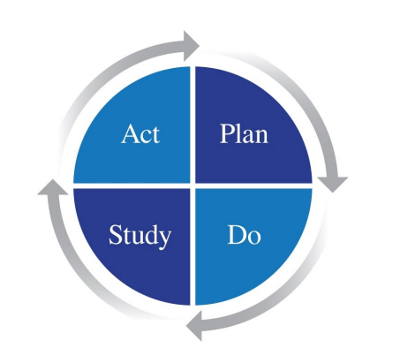
PDSA Goal: Revitalize climate and culture.

Slide 44
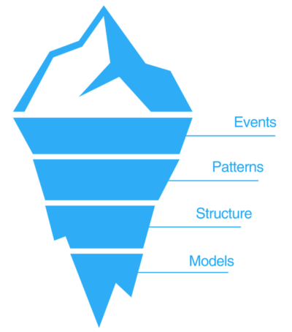
Study: 2016-2017
Self-Examination

Slide 45
The Pillars of our Work
Honest Self Study
Clear Priorities
Robust Evaluation Process
Inclusive Decision Making
Committed Staff
Improved Outcomes
Transparent Leadership
Trust
Supportive Culture

Slide 46
Action: 2017-2018
Strategic Planning

Slide 47
Action: 2017-2018
Components of a successful transition
Beliefs and Values
Visioning

Slide 48
Plan: 2018-2019
Transition Team Analysis
Stakeholder Feedback
Administrative Recommendations

Slide 49
Do: 2019-2020
Change in Mindsets:
Established an identity.
Who, How & What
Teamwork makes the dream work.
Help each other be accountable.
No significant learning can happen without a significant relationship.
Our diversity is our strength.

Slide 50
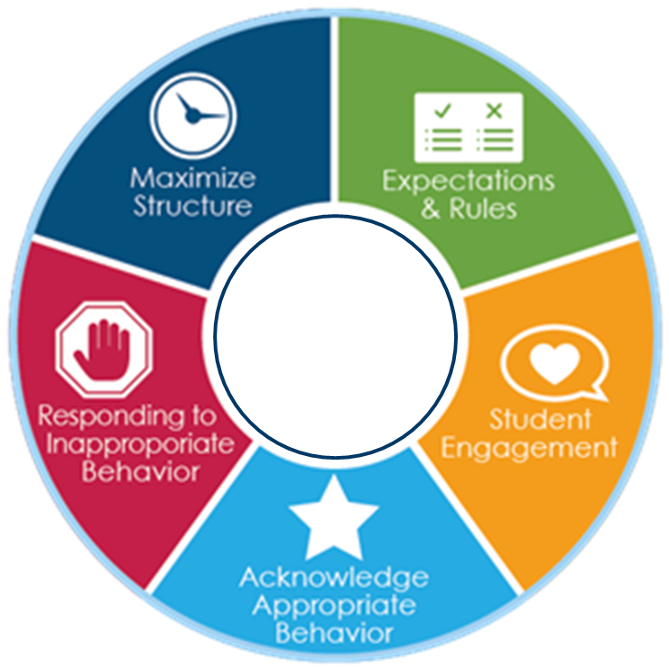
Do: 2019-2020
Change in Instructional Culture
Grade Level Engagement Plan
Classroom Standards of Practice
Instructional Leadership Team Informal Observations
Peer observations

Slide 51
Do: Change in Practice
Proactive Engagement
Grade Level Engagement Plan
Tiered responses to student behavior
Continuous data review
Restorative Practices
Opportunities for staff leadership
All Hands-On Deck Approach
Adapt to meet the needs of our new reality

Slide 52
Do: Change in Practice
Proactive Engagement
Bi-weekly staff training on Trauma-Informed Practices.
Formation of Student Support Response Team.
Shifted resources to individual student support.
Modify positive recognitions.
Strategically engaged & supported families.
Re-examined the way supports (counseling, SSW, admin, etc…) interact.

Slide 53
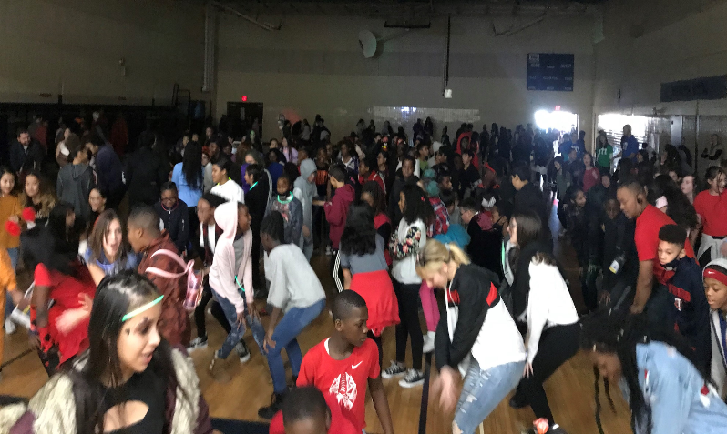
Do: Change in Practice
Proactive Engagement
Implemented monthly incentives, recognitions & rewards with academic, attendance & behavior criteria.

Slide 54
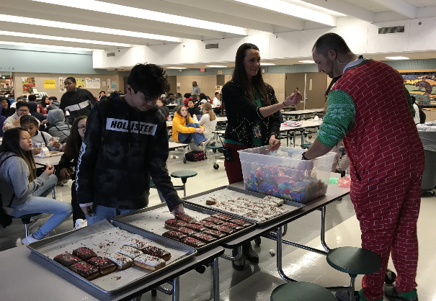
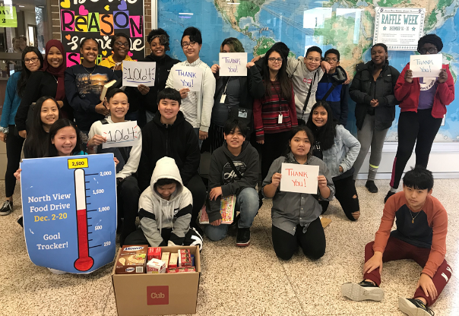
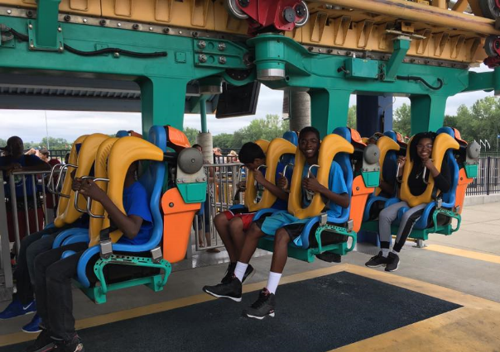
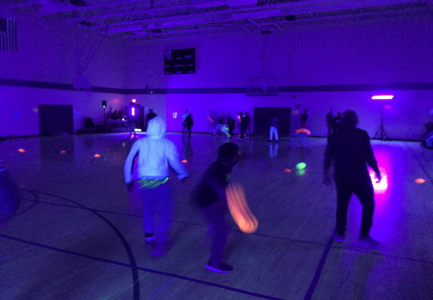
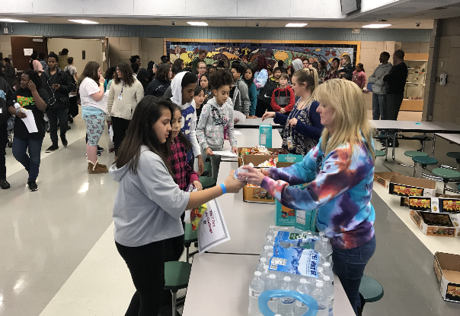
Do: Change in Practice

Slide 55
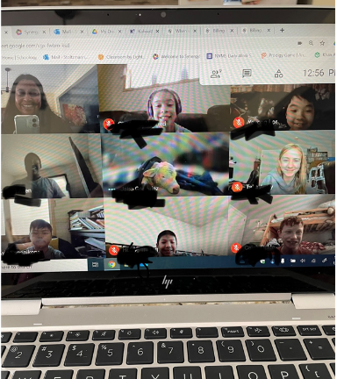
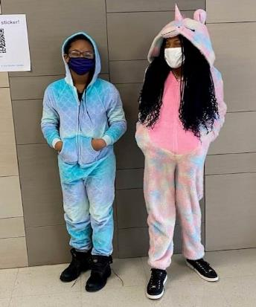
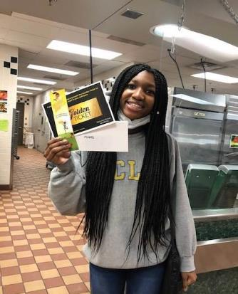
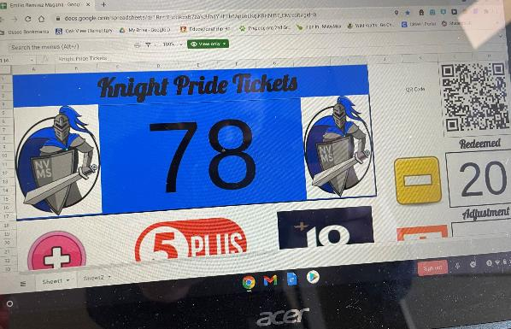
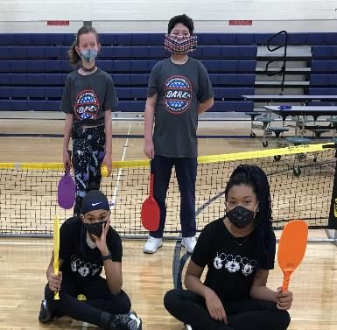
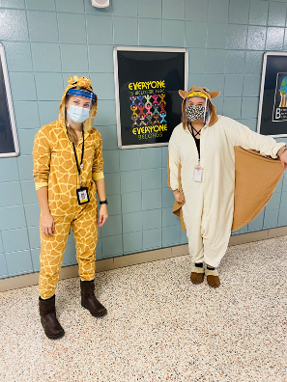
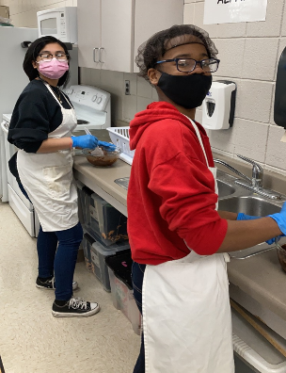
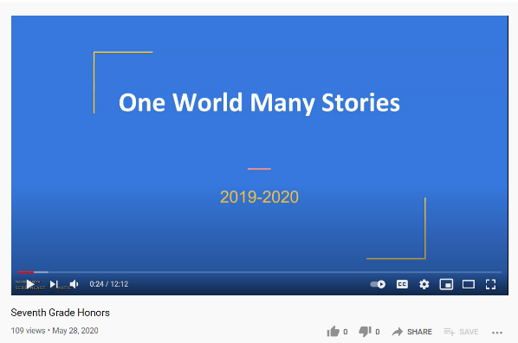
Do: Change in Practice

Slide 56
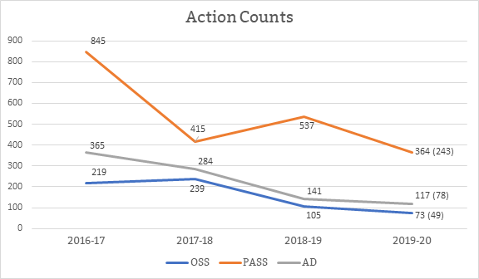
Study: Data Analysis

Slide 57
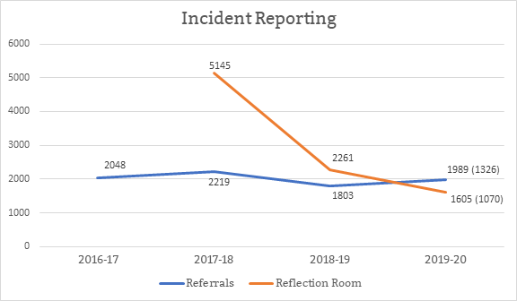
Study: Data Analysis

Slide 58
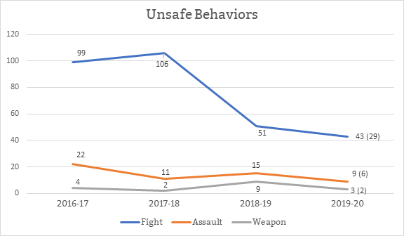
Study: Data Analysis

Slide 59
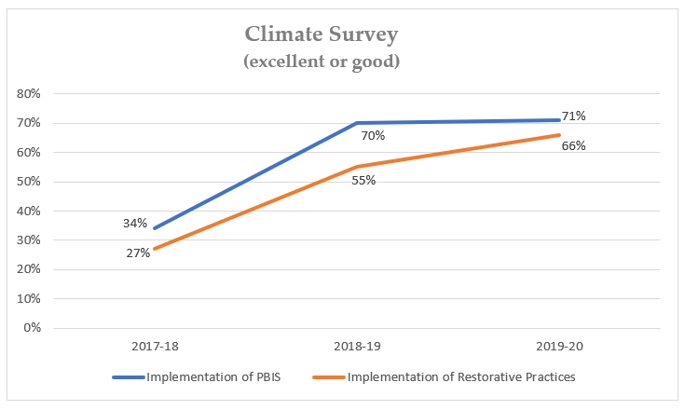
Study: Data Analysis

Slide 60
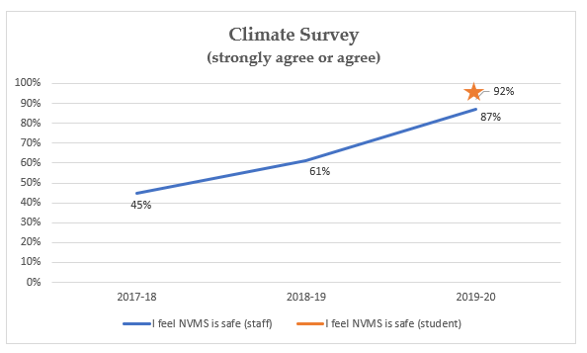
Study: Data Analysis

Slide 61
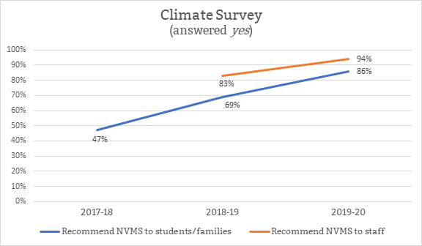
Study: Data Analysis

Slide 62
Future Work
Continue to redefine PASS (ATS).
More responsive approach to Restorative Practices.
Better engage parents/families in the process.
Continue to refine and expand upon celebrations and recognitions.
How do we continue to elevate our practices and the support we provide?

Slide 63
Thank you!

Slide 64
Hold Tight!
Strategic work
Implementation science--don’t give up
(yes, you do need to conduct the TFI TWICE this year)
Adhere to evidence base that intervention based on--no wild hairs!
What do you believe about students?

Slide 65
Let It Go!
How schools interpret positively stated behavior expectations...
How schools will engage student voice...
And most likely a lot more...
Notes:
Eye on results-- with fidelity measures along the way

Slide 66
Welcome to Saint Paul

Slide 67
Erin Metz, District PBIS Coordinator Saint Paul Public Schools
Notes:
Rochelle

Slide 68
District Profile
Saint Paul Public Schools ISD 625
Second largest school district in Minnesota
37,000+ students
125 dialects and languages spoken
Schools
30 preK - 5 schools
4 preK - 8 schools
7 K- 5 schools
1 1-8 school
4 Dual Campus Schools
5 6-8 schools
4 6-12 schools
5 9-12 schools

Slide 69
Demographics Saint Paul Public Schools
Demographic | SPPS | State
American Indian / Alaskan Native | 1.01% | 1.67%
Asian | 30.77% | 6.90%
Native Hawaiian / Pacific Islander | .04% | .09%
Hispanic / Latino | 13.88% | 9.85%
Black / African American | 25.81% | 11.28%
White | 21.34% | 64.77%
2 or More | 7.15% | 3.56%
English Learner | 29.12% | 8.55%
Special Education | 16.17% | 16.65%
Homelessness | 1.4% | 1.01%
Free or Reduced Lunch | 66.28% | 35.82

Slide 70
Overview
PBIS District Infrastructure
Tiered Fidelity Inventory
Professional Development Model
Successes & Challenges
Notes:
- Journey, road map, winding road...

Slide 71
A Framework for all Schools:
A Framework for all Schools:
https://storyboardfilmsmn.wistia.com/medias/m0jzj58ljz
*Series of videos made possible by MDE PBIS Grant Funds
Notes:
Partnership & funding opportunity from our MN Department of Education made it possible for us to create tools...
“Required” viewing opening week across district - we were strategic in the development of the video to increase support and understanding of what PBIS is (and is not) by emphasizing our own school communities, data driven framework, integration with other it. SEL, RP, equity, myths about PBIS

Slide 72
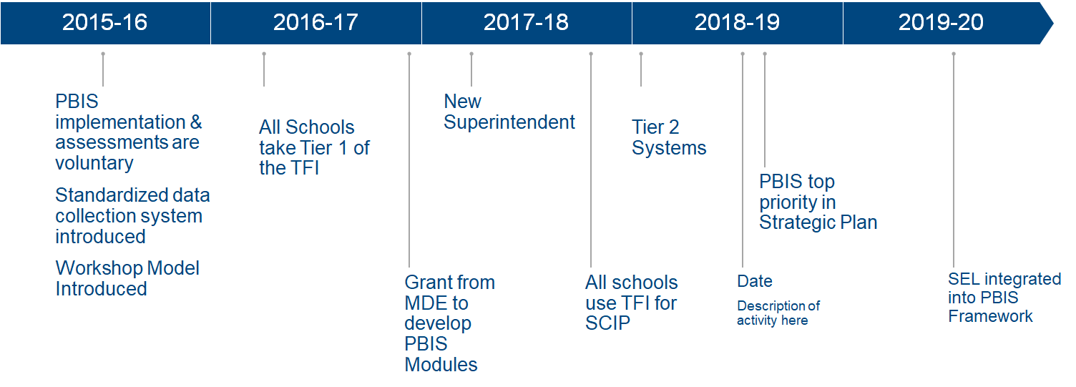
PBIS Implementation Journey
Notes:
Looks like a straight line..

Slide 73
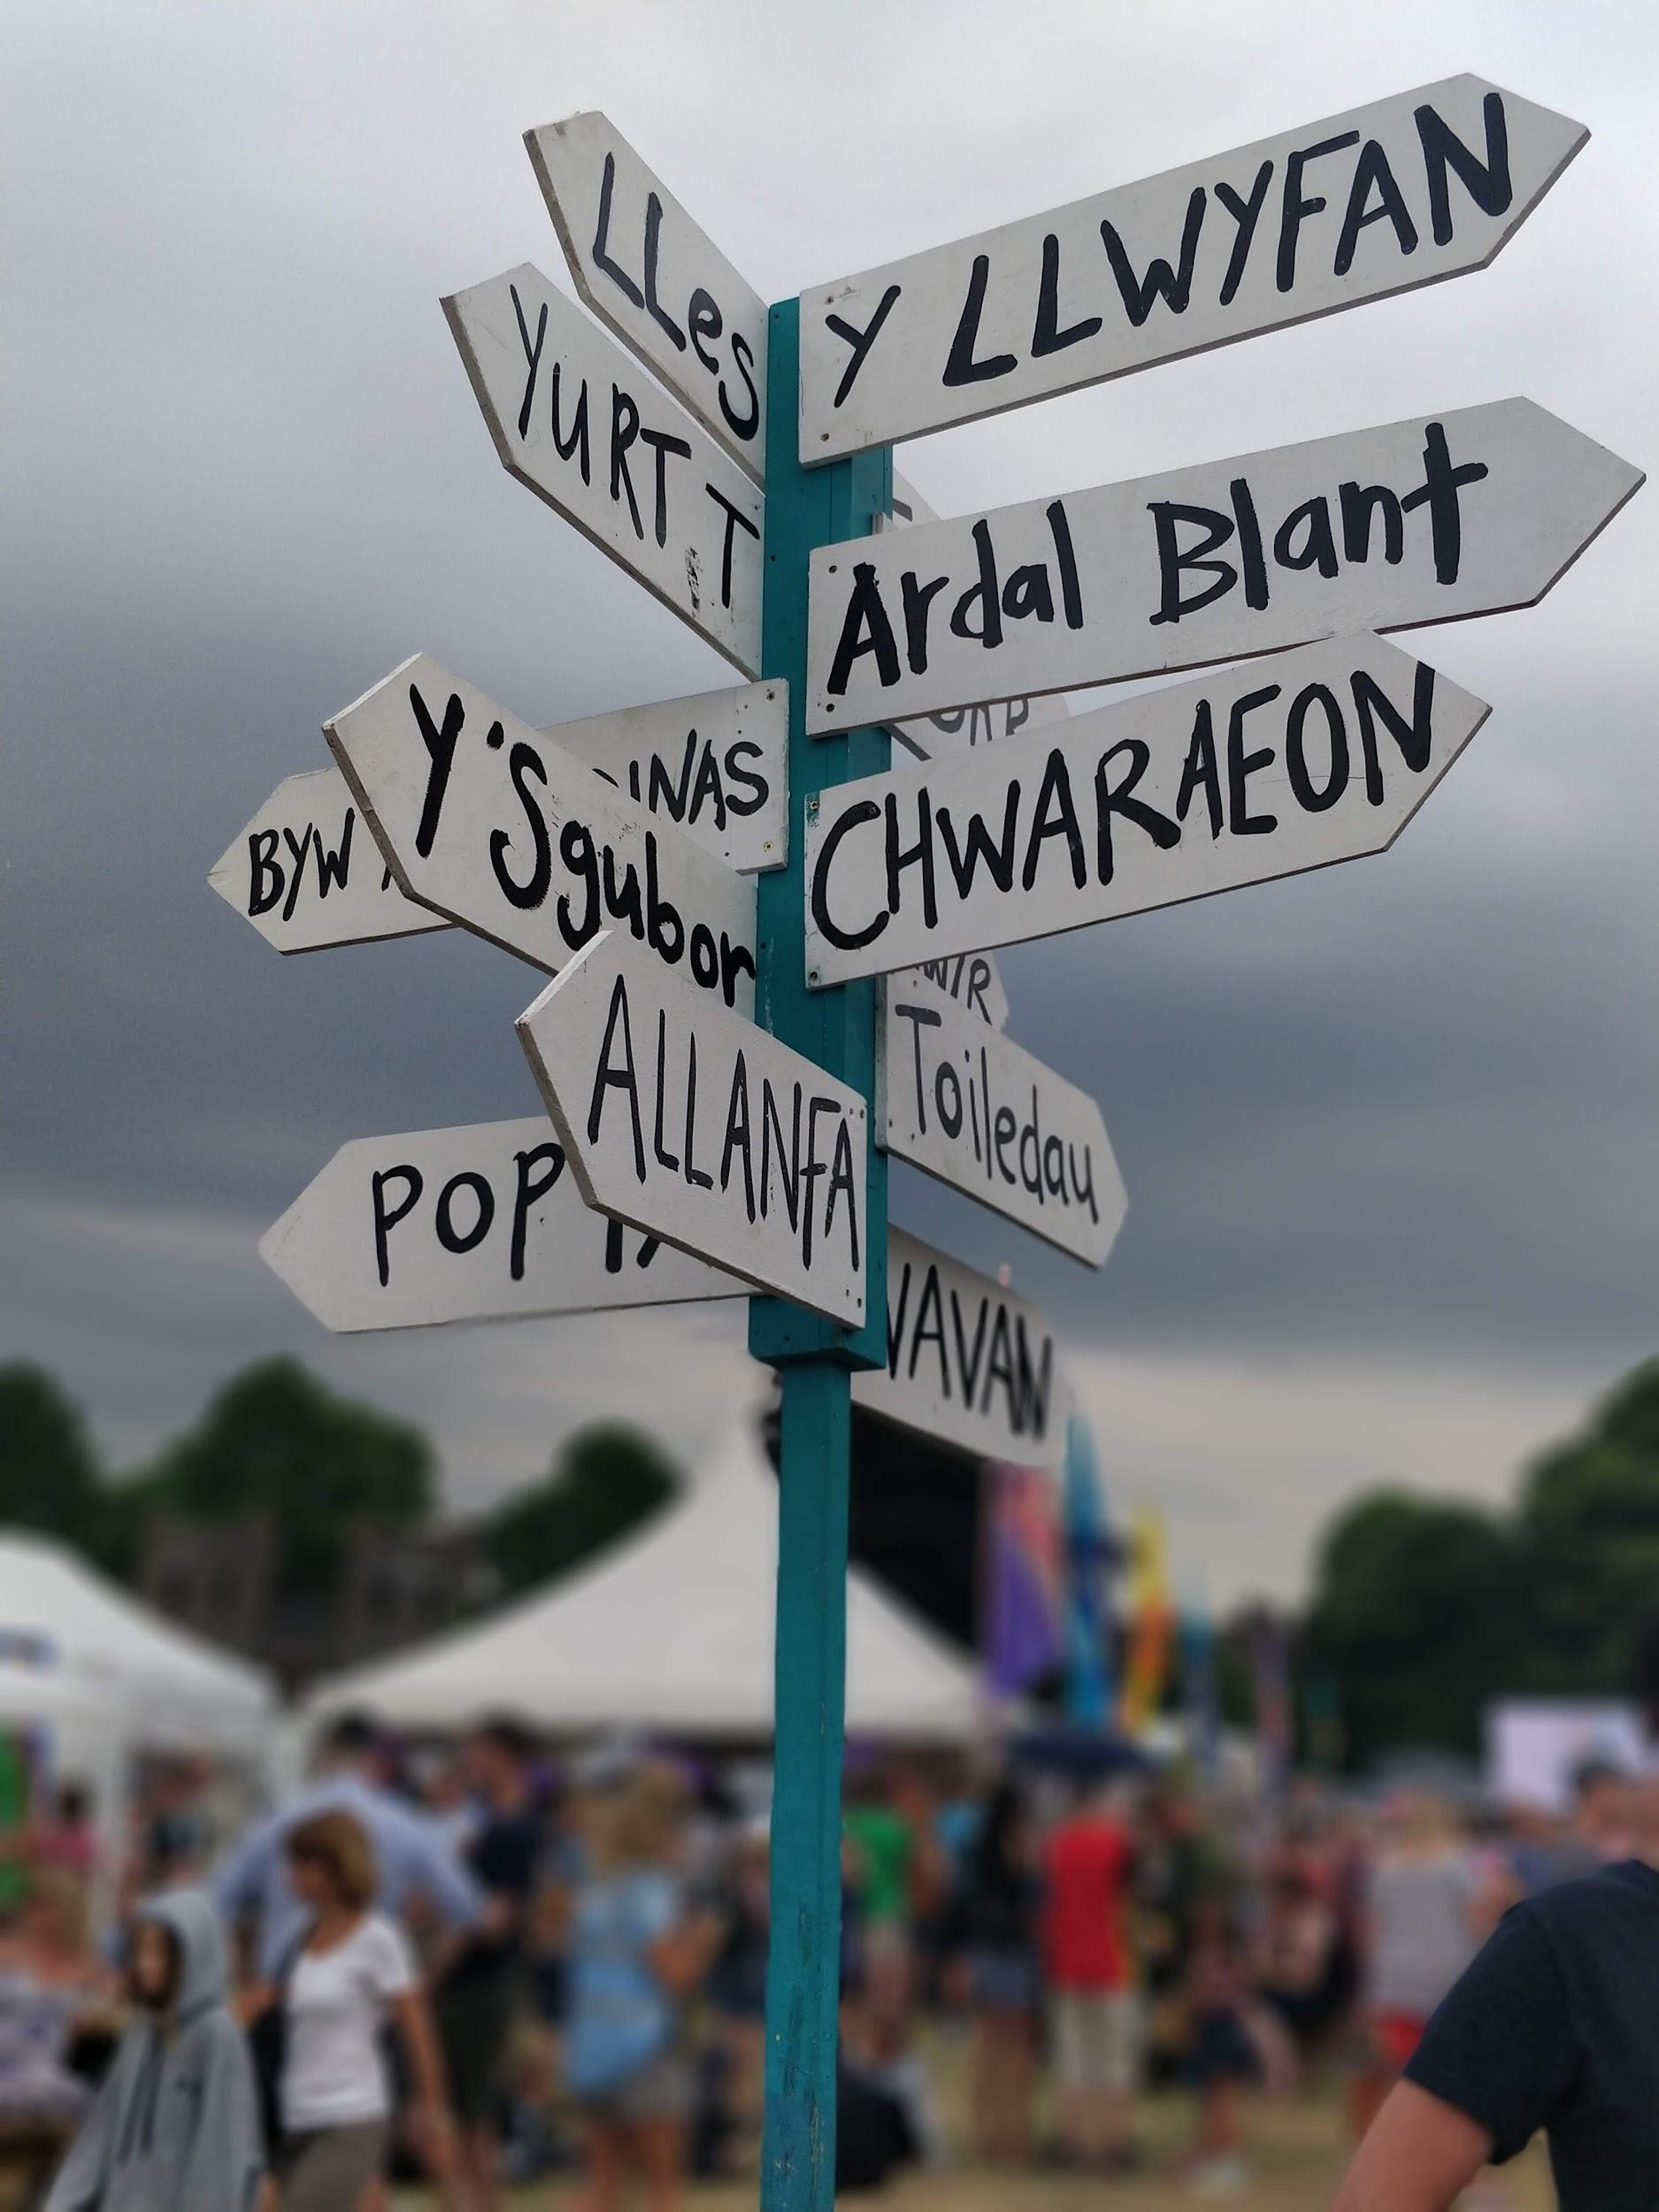
Where We Started
Schools implementing independently
District behavior data collection system not in place
Schools lacked data for data-based PBIS framework
Notes:
Schools putting in a lot of effort/work...

Slide 74
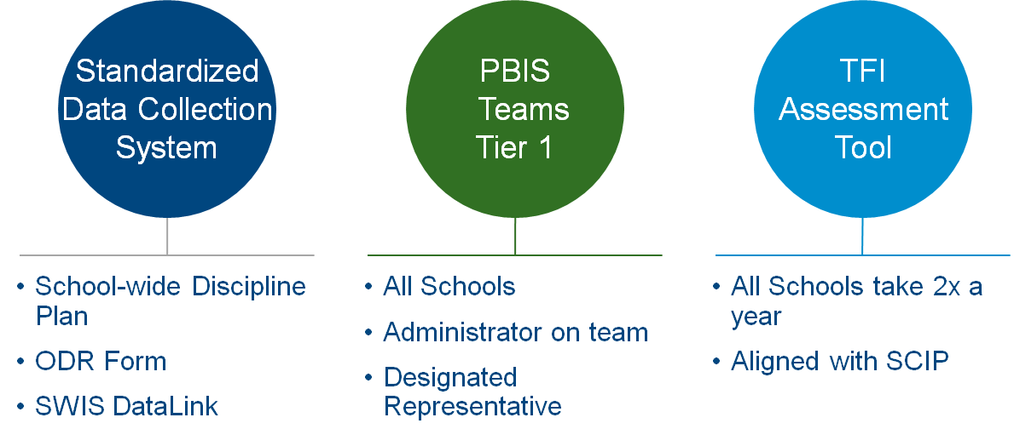
PBIS District Infrastructure
Notes:
Backed up - what was missing?

Slide 75
PBIS Infrastructure
Required Elements:
• Requiring the TFI (Tiered Fidelity Inventory ) 2x year for all schools
•Standardized School-wide Discipline Plan & ODR
•SWIS DataLink for all schools & programs
•PBIS Representative at every school
•PBIS Tier 1 team at every school
•Administrator on PBIS Tier 1 team
•SPPS PBIS Foundational Practice Profile
Notes:
Practice profile - implementation science - aligned with PP wor across the district

Slide 76
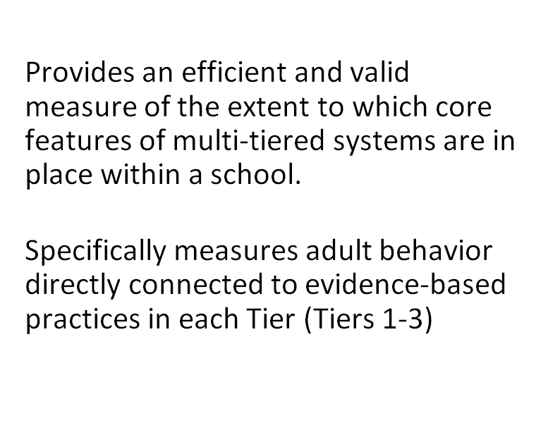
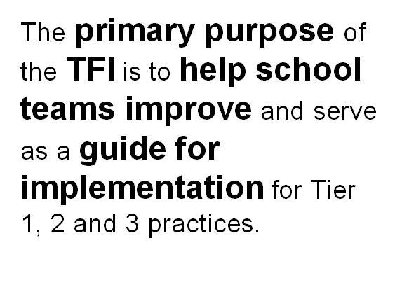
TFI Road Map For All Schools

Slide 77
Tiered Fidelity Inventory (TFI)
Leaning into the TFI to increase buy-in & scale up implementation
Require TFI Tier 1 assessment fall & spring each year
Measure “adult” practices
Provide a roadmap for school teams while allowing autonomy
School Continuous Improvement Plan (SCIP) - all schools have a PBIS/Climate Culture Goal - TFI used as the measure year to year
Schools self selected to take TFI Tier 2 - drove district-wide focus on developing Tier 2 systems
Notes:
Linking the TFI to as much as possible..Principles’ Updates, Playbook, Rights & Responsibilities Handbook, implementation science focus in other departments, measuring adult practices emphasis across district - TFI became better understood as a tool/measure that focused on adult behavior rather than just student outcomes

Slide 78
Tier 2 Systems
Focus on Tier 1 until 70% on TFI is reached
Take Tier 2 TFI with team focused on Tier 2 work and external coach
Tier 2 Team trainings
Four Tier 2 interventions supported district-wide
Tier 2 Systems
before interventions!
Notes:
eliminating the guessing - moved from talking about teams by name, but rather teams that are doing the work of Tier 1, Tier 2 etc..

Slide 79
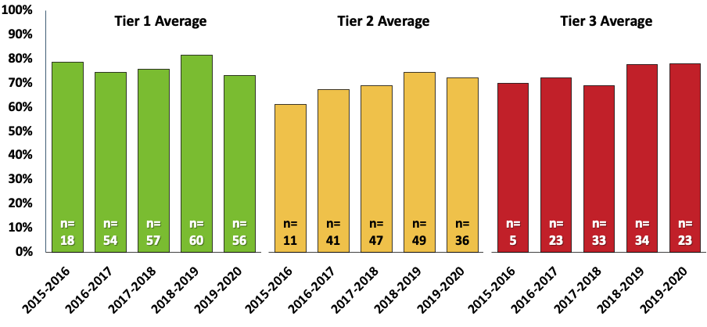
SPPS PBIS Implementation Average Score Across Schools by Tier 2015-current (as of March 6, 2020)

Slide 80
PBIS District-wide Professional Development
Workshop Model for all Schools - TFI data drives content
Schoology PBIS Modules developed with support of MDE
Integration into PD District-wide
Notes:
3 areas of professional development that has give implementation a huge lift: All new staff hired -

Slide 81
Schoology PBIS Modules
Schoology PBIS Modules Developed with support of MDE

Slide 82
District Wide Integration
Notes:
Highlight strategic plan & tiered framework

Slide 83
PBIS & Racial Equity
“PBIS is not fully implemented until it is culturally responsive.”
~Leverson, M., Smith, K., McIntosh, K., Rose, J., & Pinkelman, S. (November 2016)
Using Discipline Data to Identify & Address Disproportionality
PBIS Cultural Responsiveness Field Guide
Notes:
A mindshift in using a culturally responsive lens for all of our work in schools - lens on ourselves, adult practices, policies, systems, curricula, a lens on how we are asking, listening to and responding to the culturals in our community...

Slide 84
DIRS Data Disaggregated by Race/Ethnicity Saint Paul Public Schools
SPPS: Rate per Hundred for unique students disciplined by race/ethnicity, general ed compared to SpEd
Notes:
Disciplinary Incident Reporting System
The Disciplinary Incident Reporting System (DIRS) enables both the Minnesota Department of Education (MDE) and school districts to comply with state and federal reporting requirements for suspensions, expulsions, special education and dangerous weapons. DIRS is a web-based, password-protected system where all public school districts must report disciplinary incidents that result in suspension or expulsion. State law requires us to annually report on disciplinary incidents and incidents involving dangerous weapons that occur in Minnesota public schools (Minn. Stat. § 121A.06, subd. 3). Data for this report is obtained from DIRS. Copies of past reports are available below.
“What is the rate per hundred of all students who were disciplined (regardless of incident type or disciplinary action) in the state disaggregated by education type (general vs. special ed) and federal race/ethnicity?”

Slide 85
Our Journey Continues..
Notes:
strengths mentioned - Collaboration across departments
Common language & practices across schools
Support and communication across stakeholders (schools, principals, Asst. Superintendents, School Board)
Stronger emphasis on data and alignment with academics
Implementation science

Slide 86
Battle Creek Middle School
BCMS Story with PBIS
Our Beliefs
Relationships are the foundation of learning.
Empowering students to have their voice heard.
Proactive approach to social-emotional learning.
Opportunities for students to show up as their authentic selves.
Student Leadership that benefits the whole school community.
Clarity of Expectations
School Pride
Restorative Practices in PBIS.
Focus on Community Building.
Intentionality in Reteaching Days.
SEL
Notes:
strengths mentioned - Collaboration across departments
Common language & practices across schools
Support and communication across stakeholders (schools, principals, Asst. Superintendents, School Board)
Stronger emphasis on data and alignment with academics
Implementation science

Slide 87
Paul Richardson, Assistant Principal Battle Creek Middle School

Slide 88
Battle Creek Middle School
Successes
PBIS / RP Committee was Prioritized During Distance Learning
SEL was prioritized
New Model for Distance Learning and On-Site Support
DL Community Meetings and Activity Days
Prioritize PBIS, Relationships, Celebrate Successes
Responding to Student Needs to ReTeach Lessons
Student Surveys, Family Surveys
Intervention and Communication
Reaching Out to Families in Various Formats (i.e. social media)
Notes:
strengths mentioned - Collaboration across departments
Common language & practices across schools
Support and communication across stakeholders (schools, principals, Asst. Superintendents, School Board)
Stronger emphasis on data and alignment with academics
Implementation science

Slide 89
Battle Creek Middle School
Reteaching Lessons for On-Site Support
http://bit.ly/PBISBC

Slide 90
Battle Creek Middle School
Barriers
Technology Issues
Maintaining Relationships
Building Relationships with New Students and Staff
Routines and Rituals in 5 Different Schedules in 12 Months and a Global Pandemic
Notes:
strengths mentioned - Collaboration across departments
Common language & practices across schools
Support and communication across stakeholders (schools, principals, Asst. Superintendents, School Board)
Stronger emphasis on data and alignment with academics
Implementation science

Slide 91
Battle Creek Middle School
Racial Equity and Restorative Practices Connections
Notes:
strengths mentioned - Collaboration across departments
Common language & practices across schools
Support and communication across stakeholders (schools, principals, Asst. Superintendents, School Board)
Stronger emphasis on data and alignment with academics
Implementation science

Slide 92
Questions

Slide 93
Thanks!
Saint Paul Public Schools | http://spps.org
Erin Metz - Erin.Metz@spps.org
Battle Creek Middle School | https://spps.org/BCMS
LaNisha Paddock - LaNisha.Paddock@spps.org
Paul Richardson - paul.richardson@spps.org
Osseo Area Schools | https://www.district279.org
Kate Emmons - EmmonsK@District279.org
North View Middle School | http://NVMS.district279.org
Diana Bledsoe - BledsoeD@district279.org
Alex Berg - BergA@district279.org
Eric Kloos - Eric.Kloos@state.mn.us

Slide 94
This presentation is over

