Slide 1
40 ways to engage your students, staff, and community PBIS stakeholders
Teresa Hunt
Southern Regional PBIS State Coordinator
http://bit.ly/40waystoengagePBISstakeholders

Slide 2
OBJECTIVES
OBJECTIVES
Engagement and the tie to achievement and ESSA considerations
Engaging students
Engaging staff
Engaging other stakeholders in your community
Action plan to progress monitor your work

Slide 3
The “Why” for PBIS & Engagement
The “Why” for PBIS & Engagement
Data signals…
Behavior referrals
Low achievement scores
Frequent tardies and absences
Lack of motivation/affect/participation in school or extra-curriculars
Several ACEs (Adverse Childhood Experiences)

Slide 4
PBIS and Positive Practices
PBIS and Positive Practices
ACEs Study
Split families
Social Media
TV Shows
News Media
Negative News
Fast Paced Life – life 30 years ago to life now
In 1988, AAU bball and JO vball didn’t exist
People may change jobs up to 7 times in their life time
Technology age and instant gratification
We cannot teach how we learned 25 years ago

Slide 5
PBIS and Engagement
PBIS and Engagement

Slide 6
Relationships= Engagement & Achievement
Relationships= Engagement & Achievement

Slide 7
Relationships= Engagement & Achievement
Relationships= Engagement & Achievement

Slide 8
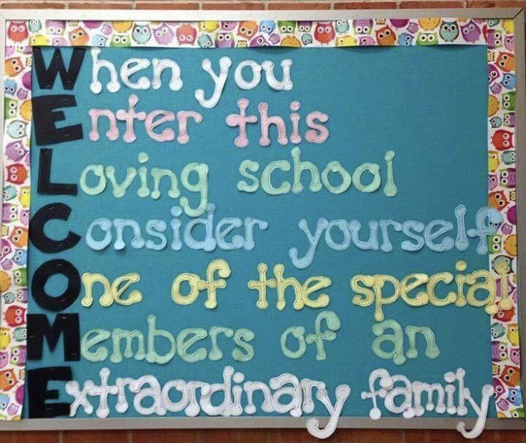
Engagement
Engagement
Relationships =

Slide 9
PBIS and School Improvement Plans
PBIS and School Improvement Plans
Review the SIP yearly and embed PBIS implementation
Familiarize and educate new staff annually
If plan is reviewed and discussed often, goals will be accomplished
Let the SIP guide all activities that occur in your school
Incorporate PBIS Implementation data (behavior and positive behavior tracking; team fidelity data), protocols, systems approaches just as you would implement SIP Practices

Slide 10
Data and School Improvement Plans
Data and School Improvement Plans
Core Instruction/ SEL | Screeners or Diagnostic Assessments | Mindful Progress Monitoring | Behavior | Formative/ Summative Assessment | MCA Results & Test Specs | Acknowledge Students & Staff
*Sequence of work for Unpacking Standards *Standards Pacing Guides *Curriculum maps *SEL (Social Emotional Learning) Standards | Fountas and Pinnell, Dibbels, etc. | *FAST, *STAR, *Aimsweb, *AR *OLPA - discontinued | Office referrals SWIS behavior tracking on the big 7 Where What Who When… MN Student Survey | *PBL *Workbooks *Quizzes *Unit tests, *Exit tickets etc. | *Trend data *Section data *Cohort data *Student group info and gap analysis *Proficiency vs Growth | *Positive Behavior tracking-*Token/Ticket for great behavior *Kudo Cards *Staff Awards and etc.
Systems Approaches | Climate & Culture | Implementation Science
What fidelity measurements/action plans are in place? Assess and applaud the great things you are doing too!

Slide 11
Engagement and ESSA
Engagement and ESSA
Engaging stakeholders is not only required under the law, but is a strong best practice to effectively improve schools.
http://partnersforeachandeverychild.org/wp-content/uploads/2017/07/LEA-and-SL-Handbook_7.25.17.pdf
Title 1 Schools and (Family) Engagement: (FAMILY now replaces Parent)
https://ra.nea.org/wp-content/uploads/2016/06/FCE-in-ESSA-in-Brief.pdf

Slide 12
Engagement Ideas for System Practices
Engagement Ideas for System Practices
Fall | All Year | Spring
“We are Cedar Mountain” – Data and Demographics info presented via Quizizz game | Communications of all PBIS meetings sent out to all stakeholders | Engagement/climate survey
Mapping out the SIP plan and school vision with leadership team; relay findings to stakeholders | TFI in fall and spring; SAS yearly Data at a Glance Calendar via MN PBIS (In and out of training)
Revisit location expectations with all pertinent staff in locations | Planned and purposeful PLCs – map out the year with outcomes
PBIS/MTSS Protocols and Practices in place; PBIS Leadership Team and Problem Solving team are on same page | Data digs monthly; behavior (positive and negative behavior tracking); equity, attendance, ACEs
 | Action Plans/Implementation Science/Logic Model

Slide 13
Engagement Ideas for the Community
Engagement Ideas for the Community
Fall | All Year | Spring
Open House/Orientation Nights | Parent walk-through tours | Middle School Showcase Night
Color Fund Run – one fundraiser for PBIS done during Homecoming week | Parents as Leaders (PALS) reach one, teach one. Bakersfield, CA | Senior Art Show; Senior Essays and Academic Awards Night
SPED family night | Bring one, Play one – Community Game Night | “Take your child to work day”
Love Literacy & Movie Night | SeeSaw electronic Newsletter | Kidz Nite Out
Math Night | Blandin Foundation | Bingo for Books

Slide 14
Engagement Ideas for Staff
Engagement Ideas for Staff
Fall | All Year Long | Spring
Staff open house with families | Kudos Cards/Love Note Fridays | Live Well Bingo Cards
OREO trivia – Who am I? | Flipped Staff Meetings
 | Alternate Wednesdays
 | Pub PD – PD at different locations; PD during their prep time
 | Staff feature of the week
 | Staff lead and learn teaching strategies out of Ci3T.org
 | Teacher Mentor Program
 | Incentives such as Flee at 3

Slide 15
Engagement Ideas for Students
Engagement Ideas for Students
Elementary | Both | H.S.
VIP Kid | Kid Cabinet for voice and choice | My superpower is…
Career of the week | TLC Box and Eating Me Alive Box | Early out letter to School Board
Author week and book binding | Passion Project or Genius Hour | Job Shadow experience
Flat Stanley | OREO Trivia | Career Fairs and Career Expo
School Store | Mindful Movement | Youth Service - open hour
Wax Museum | Interactive/5 minute notebooks…”I wish my teacher knew…”
Take your child to work and career paper | Reset and Regroup area for regulating behavior
School Patrol | OTRs (opportunities to respond)

Slide 16
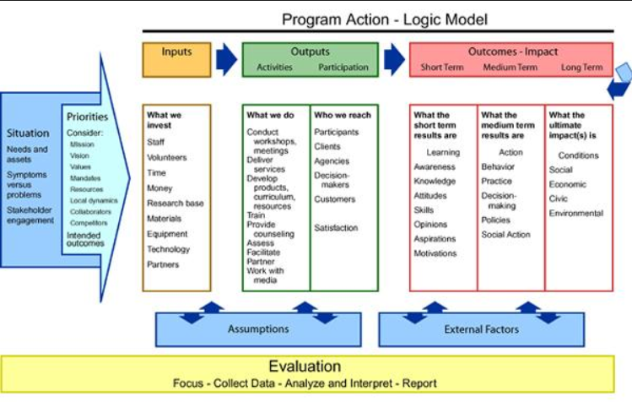
Logic Model
Logic Model
Evaluation of inputs, outputs and outcomes is essential

Slide 17
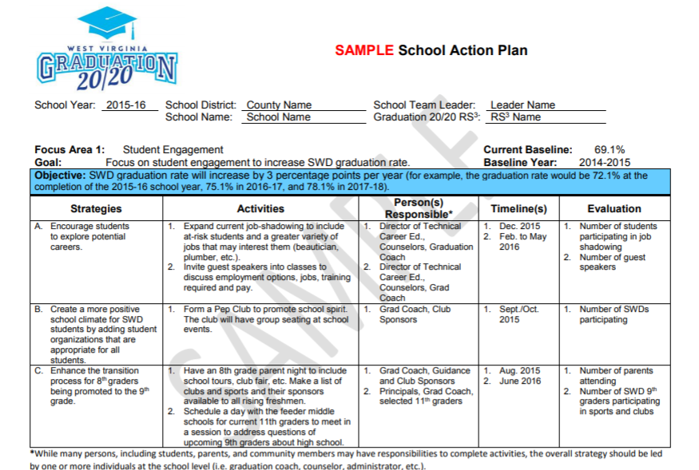
Action Planning
Action Planning
Action planning is essential for leadership teams in order to evaluate engagement and PBIS implementation
https://wvde.state.wv.us/osp/ActionPlan_Sample_12_15_2015.pdf

Slide 18
Your engagement ideas…
Your engagement ideas…
Collaborative and movement activity
Add to the list

Slide 19
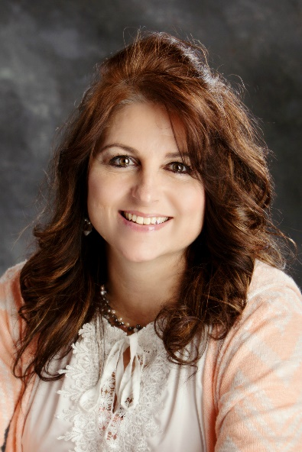
Questions?
Questions?

