Slide 1
Cass Lake- Bena Middle School Portfolio
Created 2018

Slide 2
At Cass lake –Bena Middle School, we teach, model and celebrate positive behaviors and achievements that lead to success in school, home and community.

Slide 3
Portfolio provides students, staff and families information about resources and programs provided at the middle school

Slide 4
Table of Contents
Classroom Interventions
ROARS
Handbook
Spencer Henry
Positive Behavioral Interventions and Supports (PBIS)

Slide 5
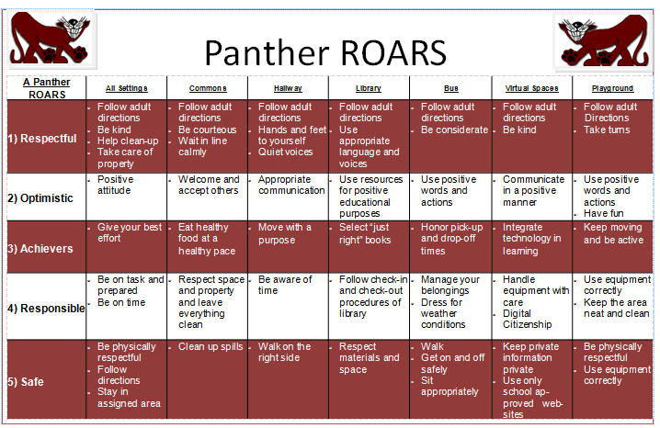
Positive Behavior Interventions & Supports ( PBIS) matrix

Slide 6
Table of Contents
Wellness
Wellness Committee
7 Mindsets
Restorative Practices
Cultural Committee/Practices
Risk Flow Chart ( assessment)
Student Support Team ( SST)
Wellness Referral
Self-Injury Homelessness
Drug Suspicion form

Slide 7
Table of Contents
Bullying
Bully form
Cease and Desist form
School House training materials
Bully survey

Slide 8
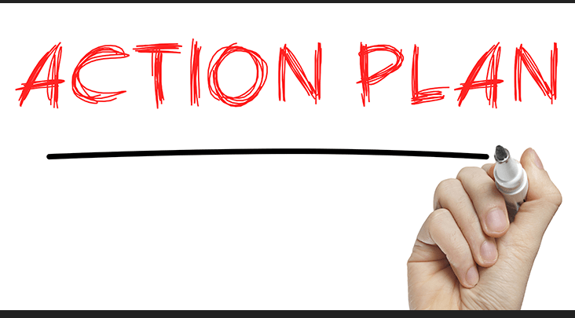
Action Plan

Slide 9
School Portfolio

Slide 10
Table of Contents
Restorative Practices
Conflict Resolution
Group Conference Agenda
Defining Restorative ( Restorative Practices)

Slide 11
Table of Contents
Social Emotional
7 Mindsets lessons
Peacemakers/Social Emotional Lessons
Students Teaching Attitudes of Respect ( STAR)-

Slide 12
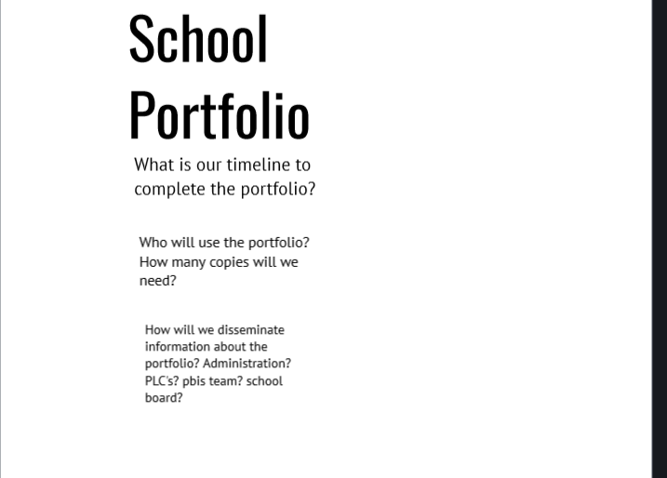
School Portfolio

Slide 13
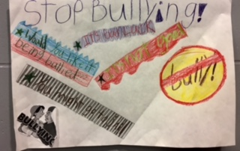
Photo from Middle School Hallway

Slide 14
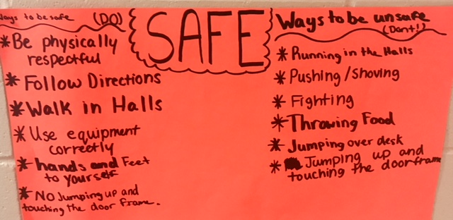
Photo from middle school hallway

Slide 15
Table of Contents
Tier 2
Check In Check Out
Photos of Curriculum

Slide 16
Table of Contents
Cultural Awareness
Cultural Advisory Committee
Pow Wow
Drums
Ojibwe Language class
Smudging

Slide 17
Cass Lake- Bena School Pow Wow

Slide 18
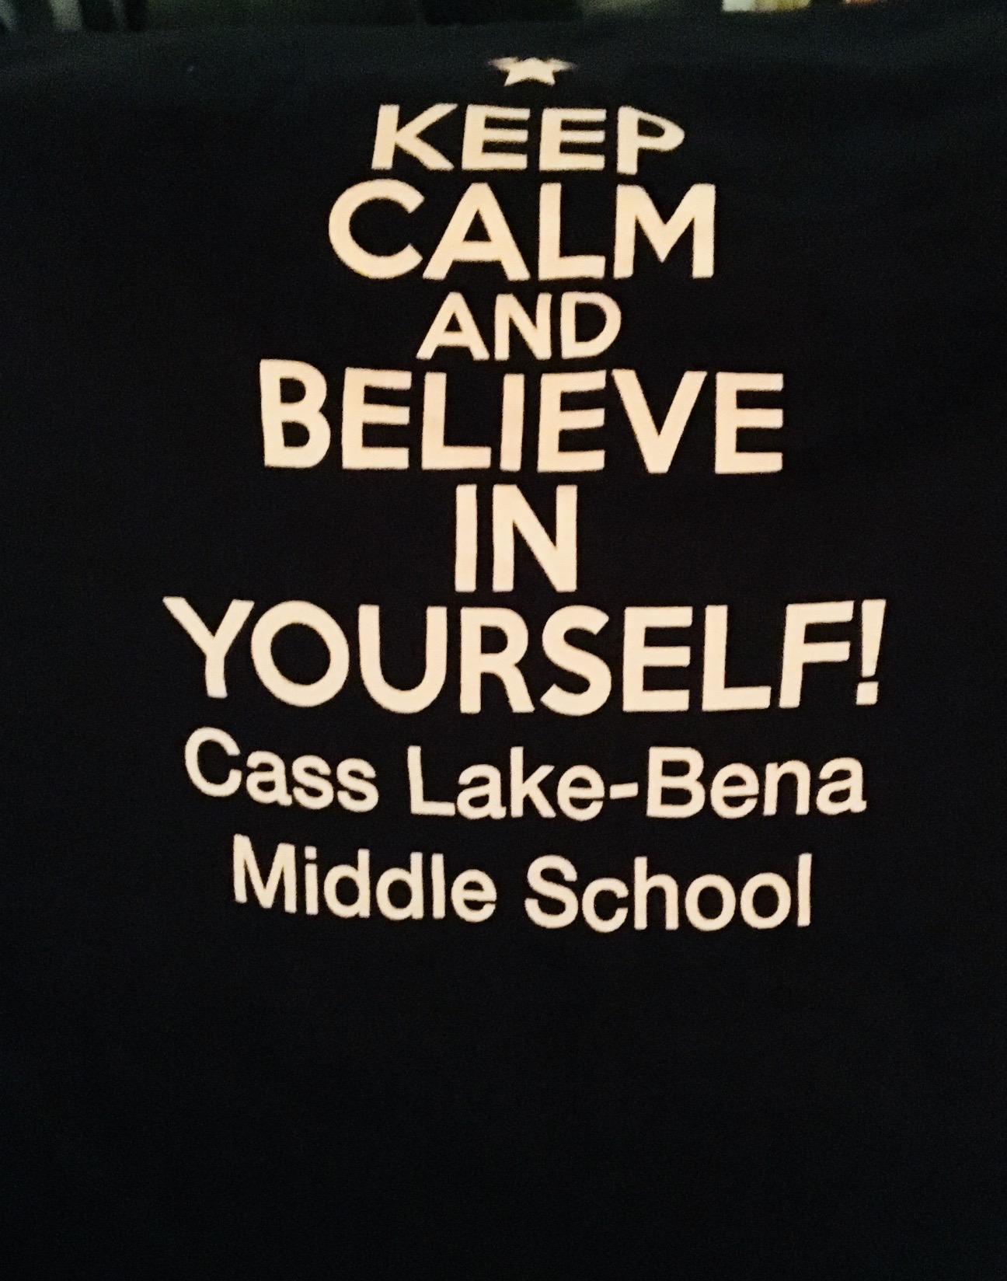
KeepCalm

Slide 19
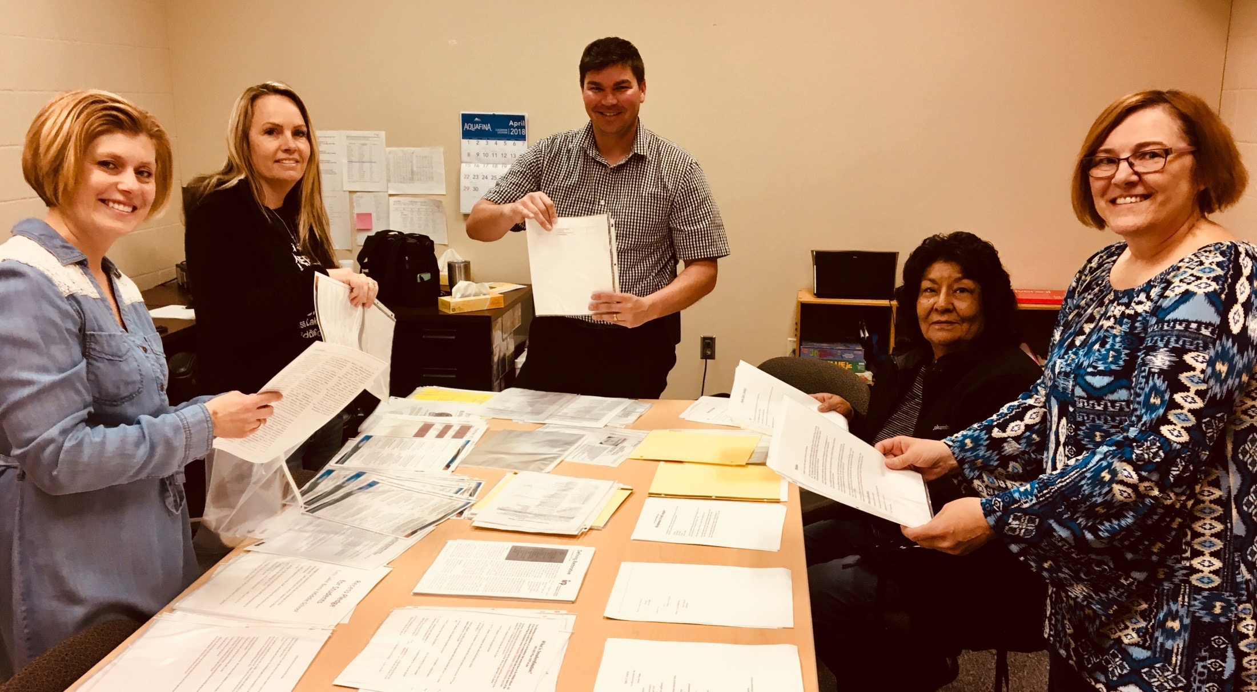
Staff

Slide 20
This Portfolio has been created by:
Jake Richter, Assistant Principal, Middle School
Missy Freeman, Behavioral Interventionist, Middle School
Muriel Crawford, Social Worker, Middle School
Mary Aery, Social Worker, Middle School
Monica De La Cruz, Guidance Counselor ,Middle School

Slide 21
Thanks for attending our presentation!
maery@clbs.k12.mn.us
jrichter@clbs.k12.mn.us
M

