Slide 1
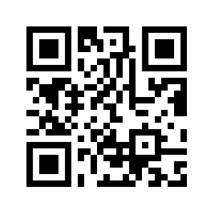
Welcome!
Please answer a few questions on Padlet.
http://bit.ly/2Jh5Uep

Slide 2
Our PBIS Journey at
Isanti Intermediate School and School For All Seasons
June 11, 2019
Funding for this program is made possible by a grant from the MN Department of Education, Federal Award CFDA#84.027A – Special Education – Grants to States, IDEA Part B-611
Notes:
Alt text for the Minnesota PBIS logo is annotated on slide 1/title slide only.

Slide 3
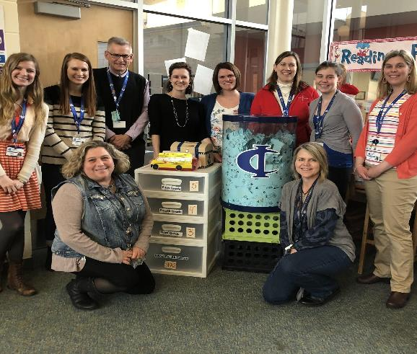
HELLO!
Mark Ziebarth, Principal
Sara Edwards, Academic Coach
Cindy Paulson, School Counselor
If you’d like to follow along with the
Presentation: http://bit.ly/2JeiJXx

Slide 4
PBIS Basics
Slides in this section are adapted from previous presentations given by Erin Engness, North MN PBIS Coordinator

Slide 5
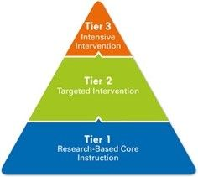
Overview of Tier 1 System

Slide 6
Why School-wide PBIS
The fundamental purpose of SWPBIS is to make schools more effective and equitable learning environments for all students.
Predictable
Positive
Consistent
Safe

Slide 7
School Wide PBIS is:
A multi-tiered framework for establishing the social culture and behavioral supports needed for a school to achieve behavioral and academic outcomes for all students.
Evidence-based features of SWPBIS
Prevention
Define and teach positive social expectations
Acknowledge positive behavior
Arrange consistent consequences for problem behavior
Ongoing collection and use of data for decision-making
Continuum of intensive, individual intervention supports.
Implementation of the systems that support effective practices

Slide 8
Improving classroom and school climate
Improving classroom & school climate
Integrating academic & behavior initiatives
Decreasing reactive management
Improving support for students w/ EBD
Maximizing academic achievement

Slide 9
What is PBIS?
Culturally Equitable Academic & Social Behavior Expectations
OUTCOMES
Culturally Knowledgeable Staff
Culturally Valid Information for Decisions
SYSTEMS
DATA
PRACTICES
Culturally Relevant & Effective Instruction
Vincent, Randall, Cartledge, Tobin, & Swain-Bradway 2011; Sugai, O’Keeffe, & Fallon, 2012ab
Notes:
CULTURE is one our major considerations, and CULTURAL INFLUENCE is reflected in high attention toward
CULTURAL EQUITY of expectations
CULTURAL VALIDITY of data
CULTURAL RELEVANCE of practices
CULTURAL KNOWLEDGE of implementers

Slide 10
Continuum of Support for all
Continuum of Support for ALL
Intensive
Few
Targeted
Some
Universal
All

Slide 11
SWPBISS Practices
SWPBS
Practices
School-wide
Classroom
Non-classroom
Family
Student

Slide 12
Common Misconceptions
Only about rewards/prizes
Packaged curriculum
For certain students
One-shot training
Quick fix

Slide 13
The Start...

Slide 14
The Start of PBIS at IIS/SFAS
Accepted to Cohort 6
Year 1 Training:
Three 2-day sessions
Year 2 Training:
Three
1-day
sessions

Slide 15
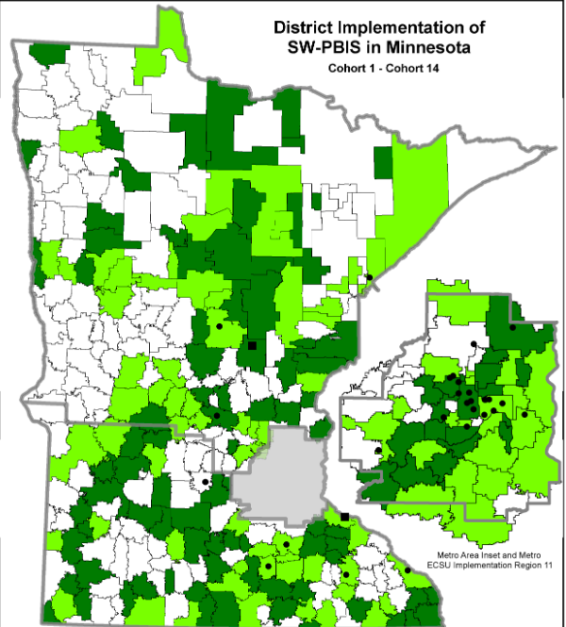
SWPBIS TRAINING
School-wide PBIS Training
Team-based training
9 training days over two years
Distributed, team-based implementation of PBIS
Intended to build capacity, skills, competency and beliefs to sustain implementation beyond initial training in a school

Slide 16
Timeline of Events
Training and Implementation
...Sustaining...
Apply for Cohort 6
2009-10
2011-12
2013-14
2015-16
2017-18
2019 -20
2010-11
2018-19
2012-13
2014-15
2016-17

Slide 17
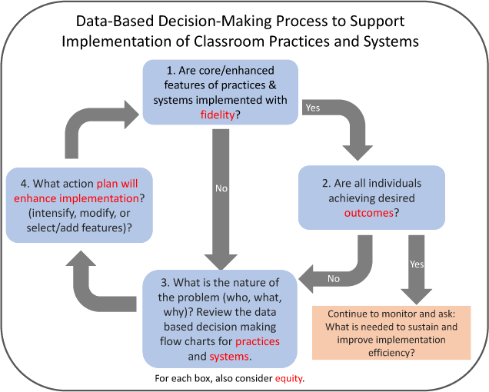
Sustaining PBIS
https://www.pbis.org/school/pbis-in-the-classroom/classroom-pbis-data

Slide 18
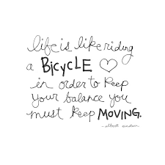
Quote

Slide 19
Matrices

Slide 20
Matrices
Developed lists that contain 3-5 positively stated rules or expectations that support the school’s mission/purpose. These rules should consist of common vocabulary and few words (e.g., Respect Others, Respect Yourself, Respect Property), and should apply to all students and staff members.
Sugai, G. (1998). School-wide positive behavior supports: School-wide expectations - teaching matrix. Retrieved from https://www.pbis.org/common/cms/documents/NewTeam/manuals/teaching%20matrix.doc

Slide 21
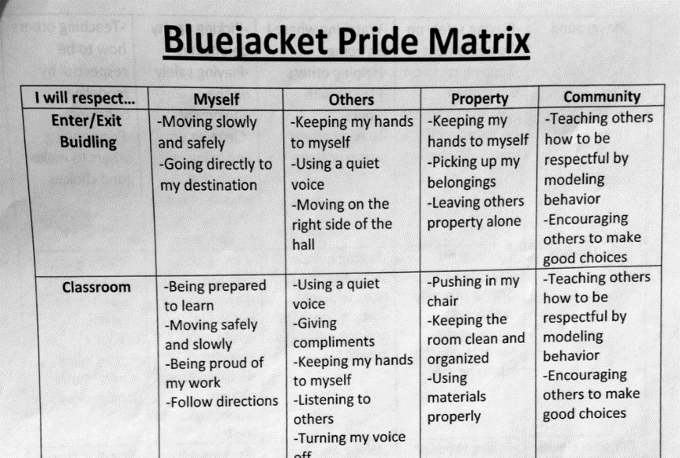
First Matrix

Slide 22
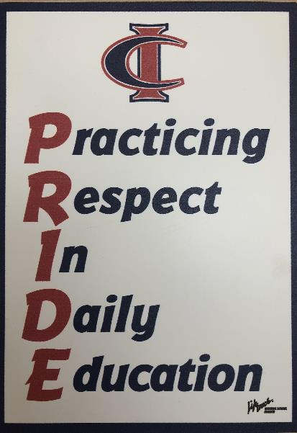
PRIDE
P-R-I-D-E
In the beginning of our PBIS journey, we tied everything to PRIDE and respecting myself, others, property, and community.

Slide 23
Honesty
Honesty
Respect
Responsibility
Self-discipline
Compassion

Slide 24
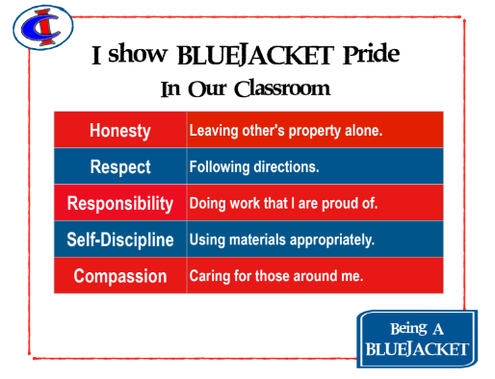
Bluejacket pride

Slide 25
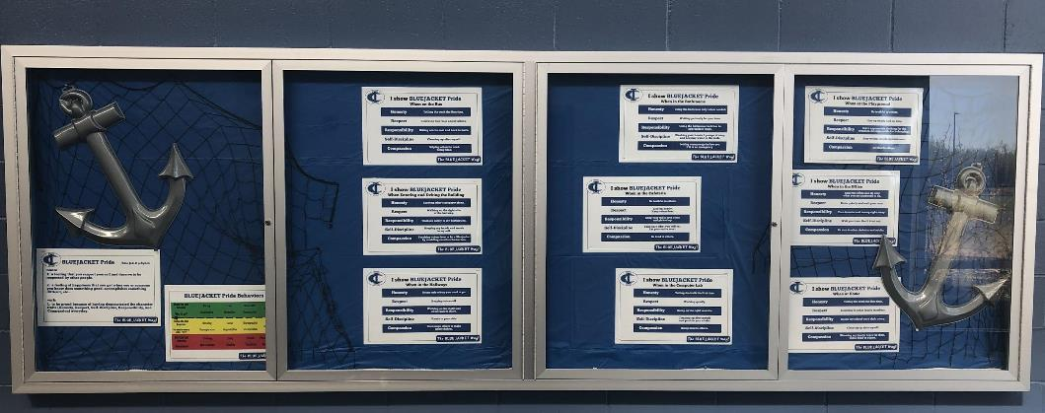
Bulletin Board by the Entrance

Slide 26
bathroom

Slide 27
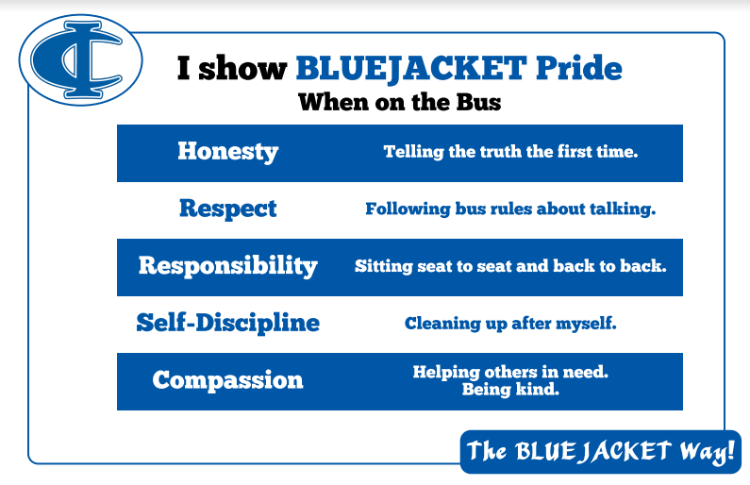
Bus

Slide 28
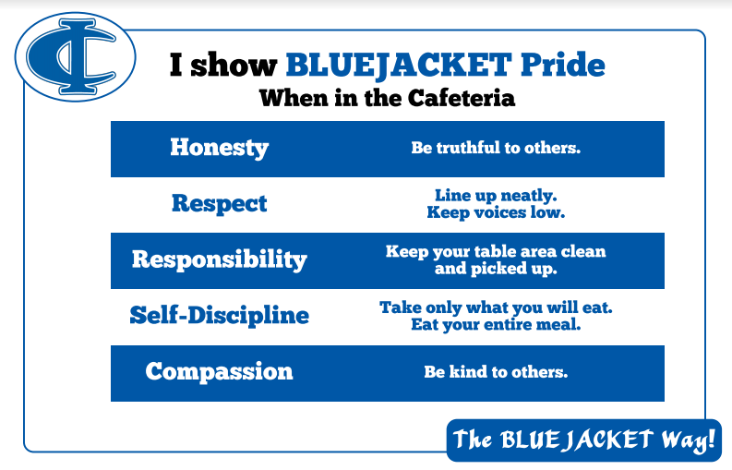
Cafeteria

Slide 29
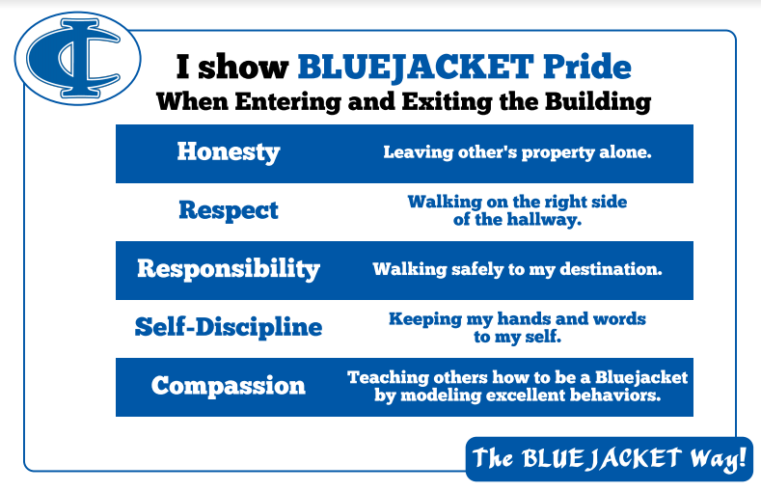
Exiting and entering building

Slide 30
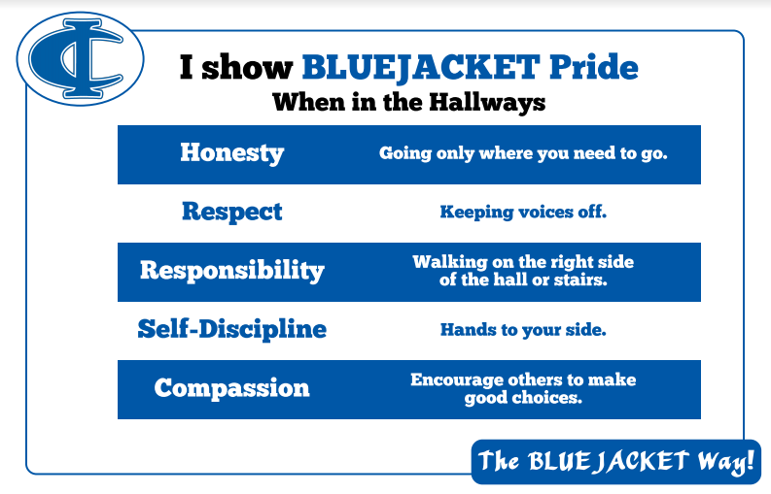
Hallways

Slide 31
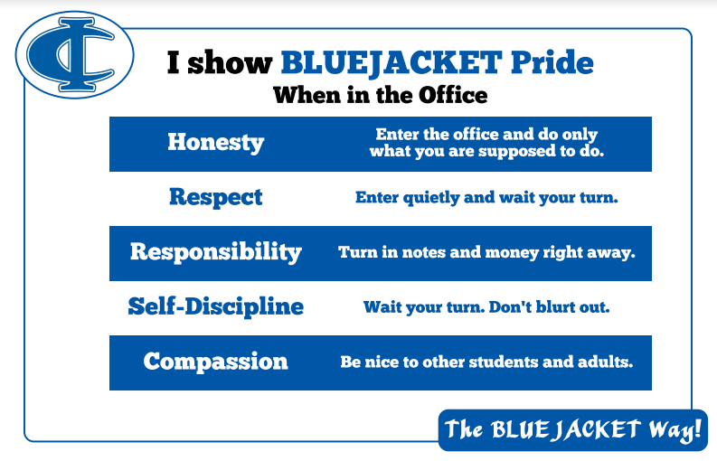
Office

Slide 32
Playground

Slide 33
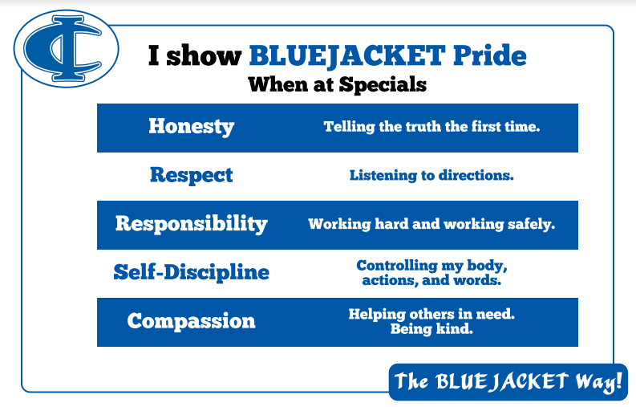
Specials

Slide 34
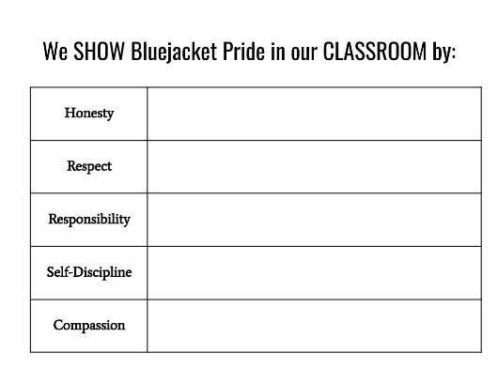
Classroom Matrix
Blending Responsive Classroom and PBIS, we have mixed rule creation and the classroom matrix. Teachers guide their students in creating the matrix that applies to their classroom.

Slide 35
Office Discipline Referrals (ODRs)

Slide 36
Minor Behaviors - 2016
Classroom Behaviors
Crawling on the floor
Off task
Drawing inappropriate pictures
Missing school work
Leaving class without permission
Throwing or spitting objects
Inappropriate gestures
Impolite behavior or comments
Disruptive Behavior
Blurting
Running around
Up out of desk
Inappropriate language
Recess/Lunch Behavior
Safety issues
Pushing/shoving/kicking
Throwing/spitting objects
Taking another’s food
Hallway Behavior
Tripping or shoving (could become Major)
Running
Inappropriate bathroom behavior

Slide 37
Major Behaviors - 2016
1. Stealing 2. Lying/ Cheating/ Forgery
3. Suicidal comments 4. Weapons at school
5. Mimicking drug use 6. Talking about guns/ killing
7. Bullying/ Harassment 8. Not following acceptable use policy
9. Destruction of school property 10. In the wrong location at school
11. Disrespect-Swearing, giving the finger, or arguing with adults.
12. Fighting

Slide 38
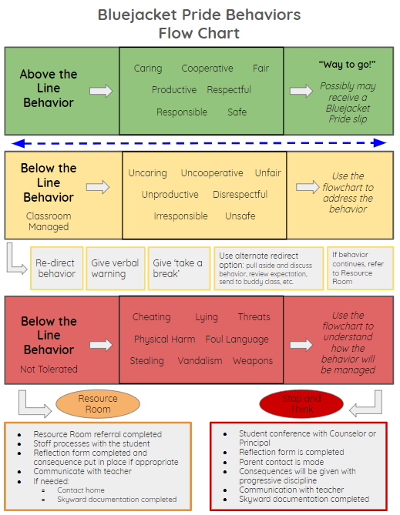
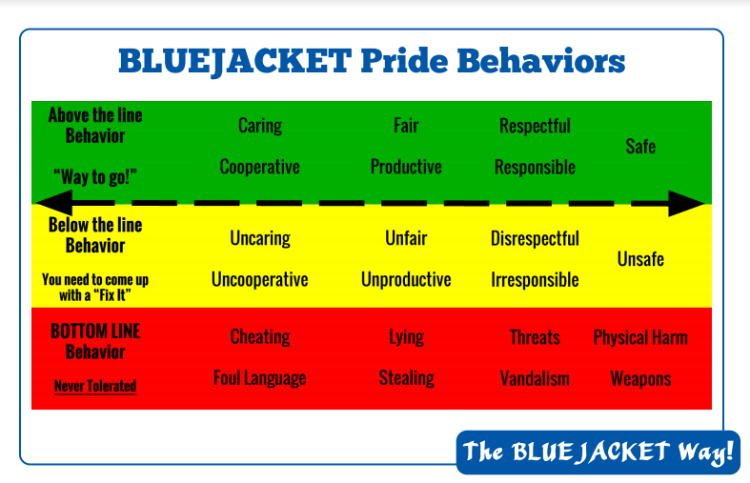
Flowchart
2017 2019

Slide 39
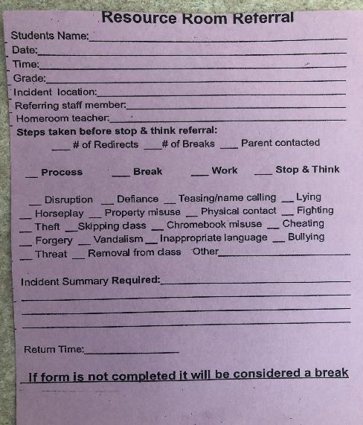
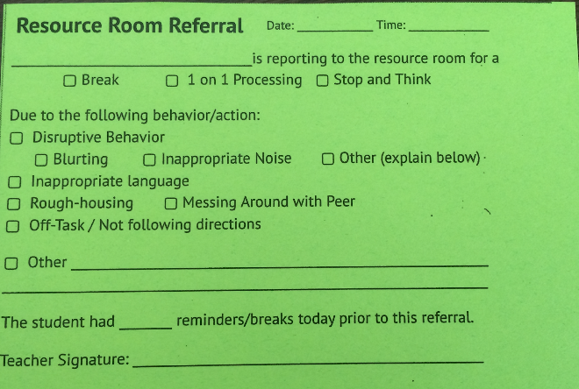
Resource Room Referral
Referral Forms

Slide 40
Using the Data

Slide 41
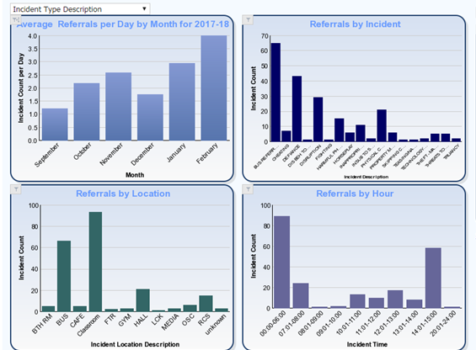
Skyward
Sample of our data

Slide 42
Variety of Data
Skyward Data
Attendance
Behavior
Academic
OLWEUS Bully Prevention Questionnaire
SAEBRS - behavior screener

Slide 43
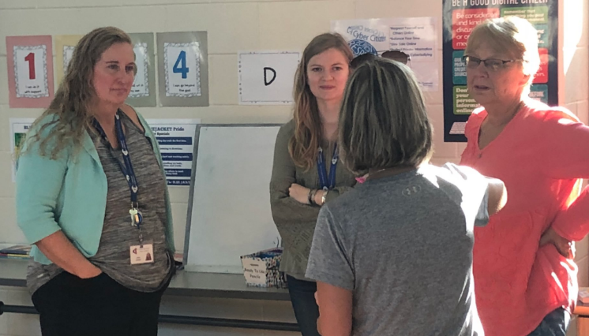
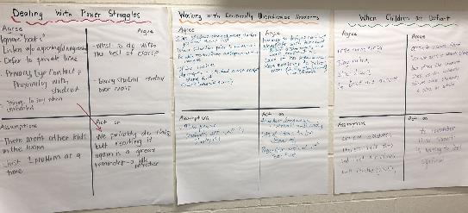
Addressing an Issue and Learning Together

Slide 44
Bluejacket Pride Tickets

Slide 45
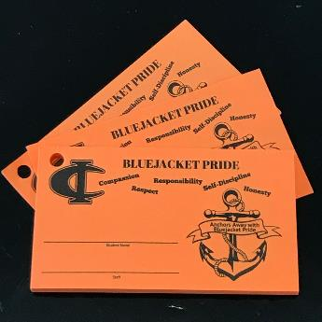
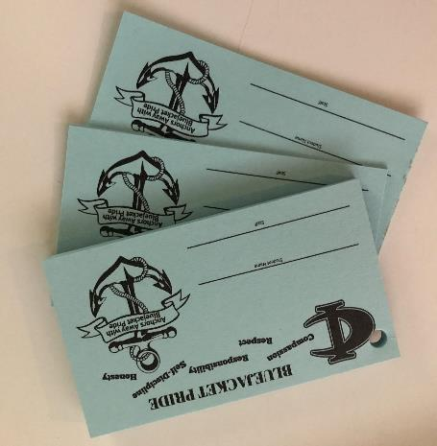
3 Different Types of Tickets
Orange tickets on the substitute lanyards.
Students will earn these ONLY from subs. These tickets will go into a special monthly drawing for an exciting prize .
We still have Ride with Pride tickets too.

Slide 46
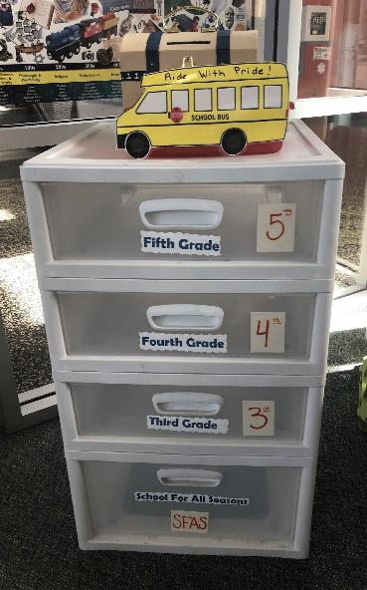
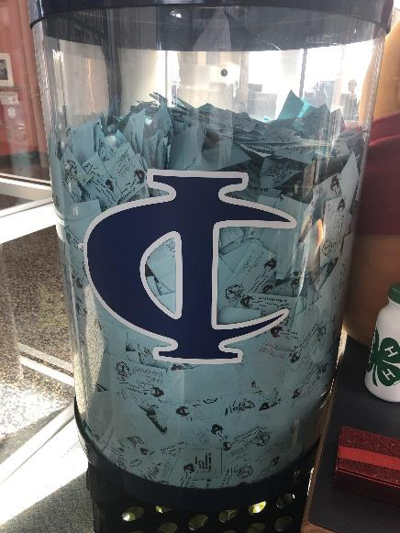
Acknowledgements

Slide 47
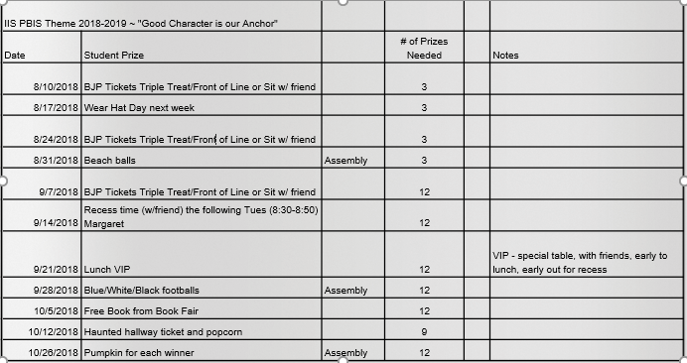

Slide 48
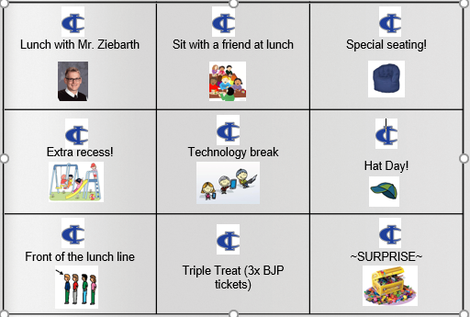
PBIS Bingo
Some of the prize options for winners in our weekly drawings.

Slide 49
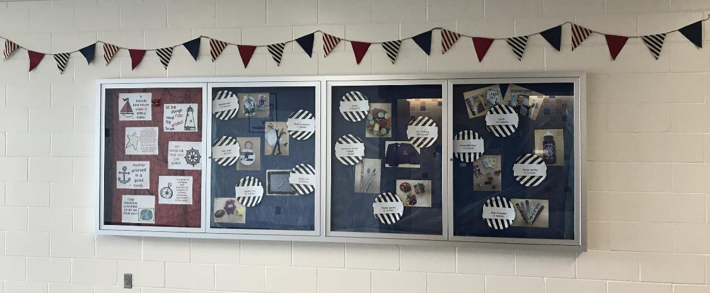
School Store
School Store - Students can redeem their tickets for a variety of items

Slide 50
Morning Announcements

Slide 51
Pledge of Allegiance
Each classroom has been assigned 1 week for leading the school in the pledge prior to our video announcements.

Slide 52
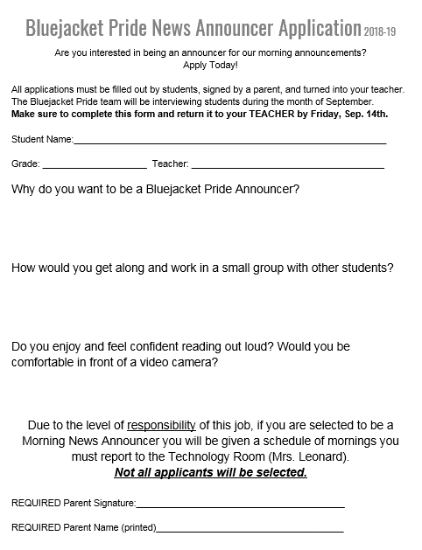
Application
The PBIS Team reviews the applications and selects students that have demonstrated responsibility and self-discipline.

Slide 53
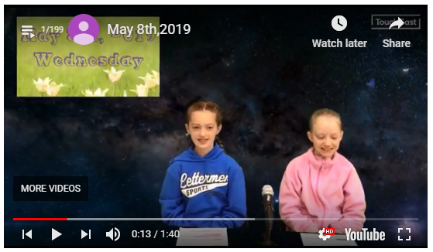
Video

Slide 54
Assemblies

Slide 55
Evolving Over Time
Sporadic and principal led
Scheduled monthly, but still principal led
Scheduled monthly and led by teacher teams

Slide 56
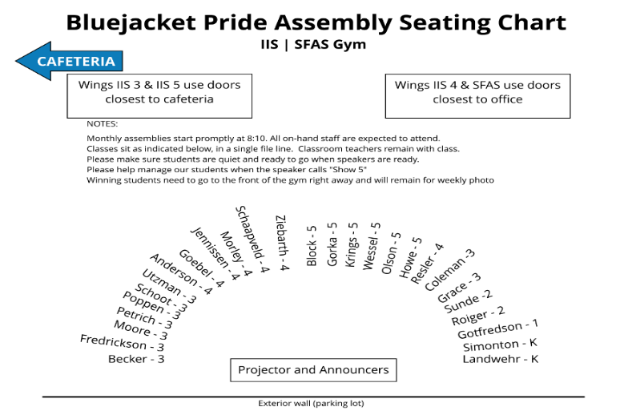
Seating Chart
Assemblies now follow the structure of a Morning Meeting to blend Responsive Classroom practices

Slide 57
Monthly
Assemblies

Slide 58
Spirit Events
Homecoming
Red Ribbon Week
I Love to Read Month
Acts of Kindness
Reaching our BJP Ticket goal
Payday Breakfast
Staff potlucks
After-school gatherings 2x year

Slide 59
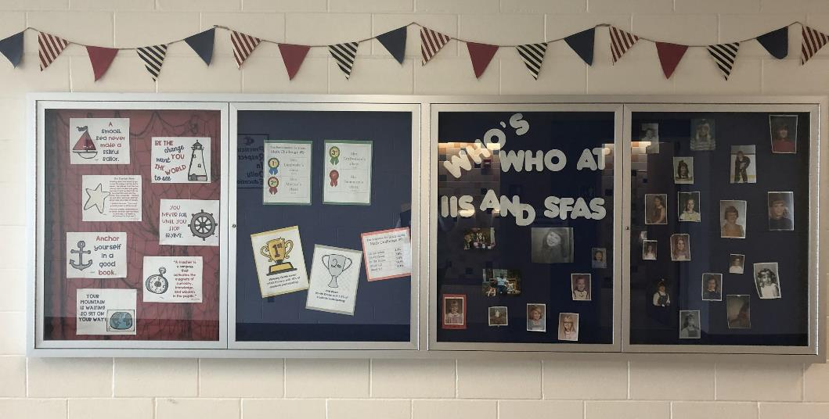
Bulletin Board by the Lunchroom

Slide 60
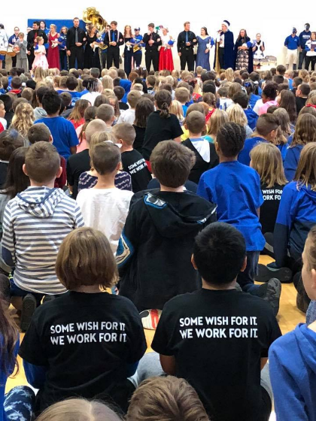
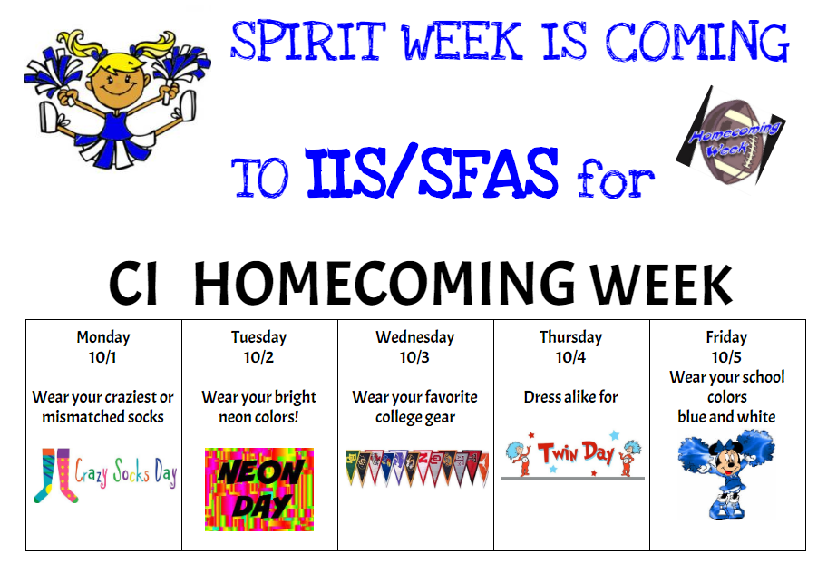
Homecoming Spirit Days

Slide 61
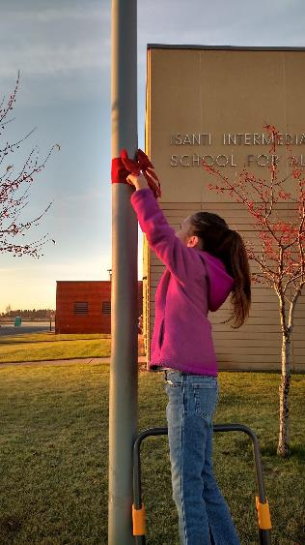
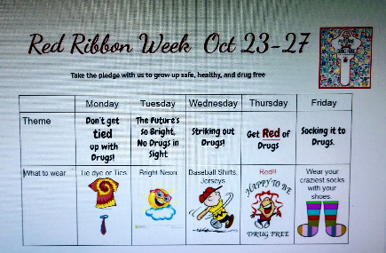
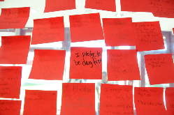
Red Ribbon Week
An alcohol, tobacco, and other drug and violence prevention awareness campaign observed annually in October in the United States
Our students pledge to be drug free

Slide 62
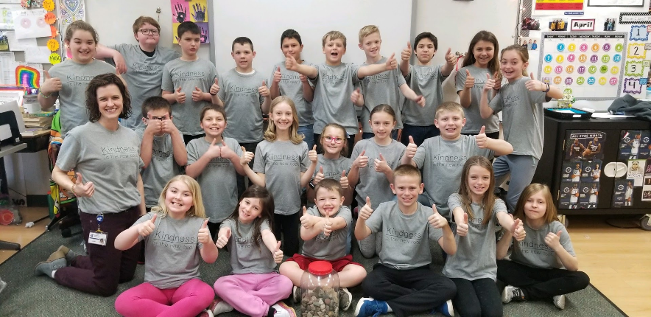
Acts of Kindness
30 day Kindness focus during the month of May to “The Breakfast Club” where random Acts of Kindness are shown in many ways all year.

Slide 63
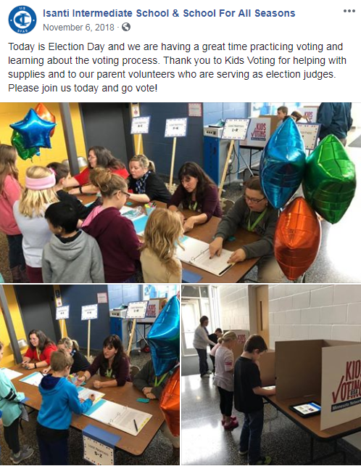
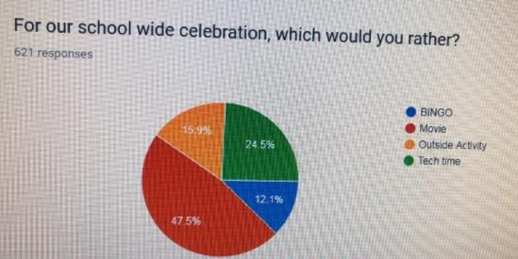
Voting with a Purpose

Slide 64
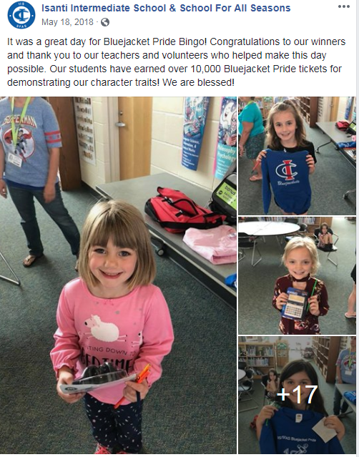
End of Year Celebrations
We celebrate when we have filled our CI bucket with BJP slips
BINGO
Inflatables
Movie choice day

Slide 65
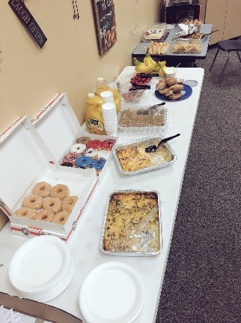
PBIS Planned events
PBIS Planned Social Events
Staff Social, Etc.
August-October 22nd(end of MEA); Staff Social | August
Back to School Staff Social FridaySept 7th 3:30pm-whenever @Wintergreens | September
After MEA (Oct. 23rd)- January 6th (end of winter break for SFAS) Jan. 1 (end for traditional) | October
School Staff Potluck/Social Taco Bar | November
Staff Social- Wintergreens? - Krisanne and Rachel | December
January 7th- March 17th | January
Staff Activity Random Acts of Kindness | February
March 18th- end of year | March
School Staff Potluck Appetizers | April
 | May
Staff Social June 6th | Last day of school/ June

Slide 66
Bluejacket Pride Training - Students

Slide 67
Back to School - Expectations for Common Areas
Schedule for PBIS Expectations Review in the Cafeteria:
8:35-Czeck/Petrik/Goebel 8:55-Anderson/Morley/Jennissen
9:15-Becker/Utzman/Wyszynski 9:25-Fredrickson/Schoot
9:35-Ott/Larson 9:50- Gorka/ Jennissen
10:00-Krings/Olson 10:10-Ferreira/Wessel

Slide 68
Video
Place your screenshot here
Video
This video was created in our implementation years as a way to show students the hallway expectations

Slide 69
Bus Safety

Slide 70
Video
Place your screenshot here
Video
This video was created in our implementation years as a way to show students the expectations for entering and exiting the building

Slide 71
Bluejacket Pride Training - Staff
Edpuzzle activity that was done in teams at our back to school workshop

Slide 72
Building POSITIVE Relationships
“Teachers who are effective behavior managers build and maintain relationships with kids while managing their behavior. Building positive relationships is the key factor in any successful behavior management program or discipline plan.”
-C.Kronenberg

Slide 73
Bluejacket Pride at
IIS | SFAS
2018-19

Slide 74
Today’s Objectives
What is PBIS
Why PBIS in ISD #911
What PBIS looks like at IIS/SFAS
How we recognize students
The schedule for our celebrations

Slide 75
School-wide Positive Behavioral Intervention and Supports (PBIS)
School-wide PBIS is:
A multi-tiered framework for establishing the social culture and behavioral supports needed for a school to achieve behavioral and academic outcomes for all students.
Evidence-based features of SWPBIS:
Prevention
Define and teach positive social expectations
Acknowledge positive behavior
Arrange consistent consequences for problem behavior
On-going collection and use of data for decision-making
Continuum of intensive, individual intervention supports.
Implementation of the systems that support effective practices

Slide 76
Continuum of Support
Tier III
Individualized
Intense Intervention
Tier II
Some Students
Targeted Intervention
Tier I
All Students
All Staff
All Settings

Slide 77
Why PBIS
Organized system of Positive Behavior management in all settings
Organized system of disciplinary actions
Clear school wide expectations with incentives and consequences
Actual teaching of Positive Behavior Expectations
Behavioral recognition system for kids doing the right thing

Slide 78
The 3 Major Components of PBIS
Teaching appropriate behavior in all settings.
Interventions when behavior expectations are not met.
Recognition when behaviors are met.

Slide 79
PBIS Depends on
CONSISTENCY
in
Expectations
Training
Involvement
Interpretation
Implementation
Accountability
BY
BY
Administrators
Students
Teachers
Families
School staff
Support groups

Slide 80
Where does Bluejacket Pride happen?
Bluejacket Pride happens
EVERYWHERE.
Bluejacket Pride needs to be shown and recognized in all areas of our school, not just individual classrooms.

Slide 81
Hallway
What does Bluejacket Pride look like?
What is a consequence for bad behavior?
Video Link Video Link
Honesty | Going only where you need to go
Respect | Voices off
Responsibility | Walking feet on the right side of the hall or stairway.
Self-Discipline | Hands to your side.
Compassion | Encourage others to make good choices.
Staff Expectation: Model voices off and monitor all students in the hallway.

Slide 82
Entering and Exiting the Building
What does Bluejacket Pride look like?
What is a consequence for bad behavior?
Honesty | Leaving other’s property alone.
Respect | Walking feet on the right side of the hall or stairway.
Responsibility | Walking safely to your destination.
Self-Discipline | Keeping my hands and words to myself.
Compassion | Teaching others how to be a Bluejacket by modeling excellent behavior.
Staff Expectation: At the end of the day signal, walk your class outside to the bus transfer area

Slide 83
Bathroom
What does Bluejacket Pride look like?
What is a consequence for bad behavior?
Honesty | Using the bathroom only when you need to.
Respect | Waiting patiently for your turn.
Responsibility | Using the bathroom facilities in an appropriate way.
Self-Discipline | Washing your hands with the right amount of soap while keeping the water in the sink.
Compassion | Letting someone go before you if it's an emergency.
Active supervision: Have clear expectations for bathroom use and monitor/limit bathroom use.

Slide 84
Recess
What does Bluejacket Pride look like?
What is a consequence for bad behavior?
Video Link
Honesty | Be truthful to others.
Respect | Line up neatly on time.
Responsibility | Have appropriate clothing for the weather and being responsible for your own belongings.
Self-Discipline | Stay within our playground area.
Compassion | Be kind to others.
Active supervision: Walking in unpredictable paths monitoring student behavior.

Slide 85
Lunch
What does Bluejacket Pride look like?
What is a consequence for bad behavior?
Honesty | Come down and do what you are supposed to do only.
Respect | Enter the lunch room quietly, stay seated.
Responsibility | Clean up your messes.
Self-Discipline | Wait quietly to get dismissed from your table.
Compassion | Be nice to others students and adults.
Active supervision: Walk students to the cafeteria and follow hallway expectations.

Slide 86
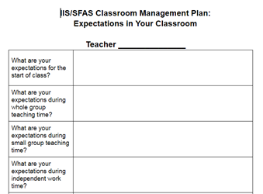
Classroom
As a class, you and your students are going to make our own Bluejacket Pride Expectation Chart for our classroom!
We will be focusing on our
Five Bluejacket Pride Character Traits!
Active supervision: Clearly define all procedures for your classroom - assume nothing! Remember to be consistent.
Notes:
This will be shared with Mrs. Paulson and Mr. Ziebarth to help them understand your classroom expectations and allow for better support when students are sent out.

Slide 87
Bluejacket Pride Behaviors
Above the line
Behavior
“Way to go!”
Caring
Cooperative
Fair
Productive
Respectful
Responsible
Safe
Below the line
Behavior
You need to come up with a “Fix It”
Uncaring
Uncooperative
Unfair
Unproductive
Disrespectful
Irresponsible
Unsafe
BOTTOM LINE
Behavior
Never Tolerated
Cheating
Foul Language
Lying
Stealing
Threats
Vandalism
Physical Harm
Weapons

Slide 88
Staff Managed Behaviors
Tardiness returning to class from transitions (Dyads, specials, bathroom, recess)
Bullying (first offense)
Non-compliance with staff direction
Classroom disruption
Inappropriate language
Non-district issued electronic devices/cell phones in the classroom (students can keep these in lockers)
Unprepared for class
Leaving the classroom without permission
Inappropriate computer use
Inappropriate locker behavior
Dress code violation
Throwing objects
Eating/drinking in class
Academic dishonesty
Inappropriate language
Sleeping in class (first offense)

Slide 89
Office Managed Student Behaviors
Bomb Threat/False Alarm
Bullying
Possession of a Weapon/Explosive Device
Threats of bringing/using Weapons
Fighting/Physical Aggression
Physical Assault/Harassment
Intimidation
Sexual Harassment/Sexual Offense
Theft/Burglary
Verbal Abuse and/or Threat of Violence
Inappropriate Bus Behavior
Truancy
Vandalism/ Property Damage
False Fire Alarm or Arson
Leaving the Classroom without Permission
Chronic Violation of Teacher Managed Behaviors
Possession of weapons or drugs

Slide 90
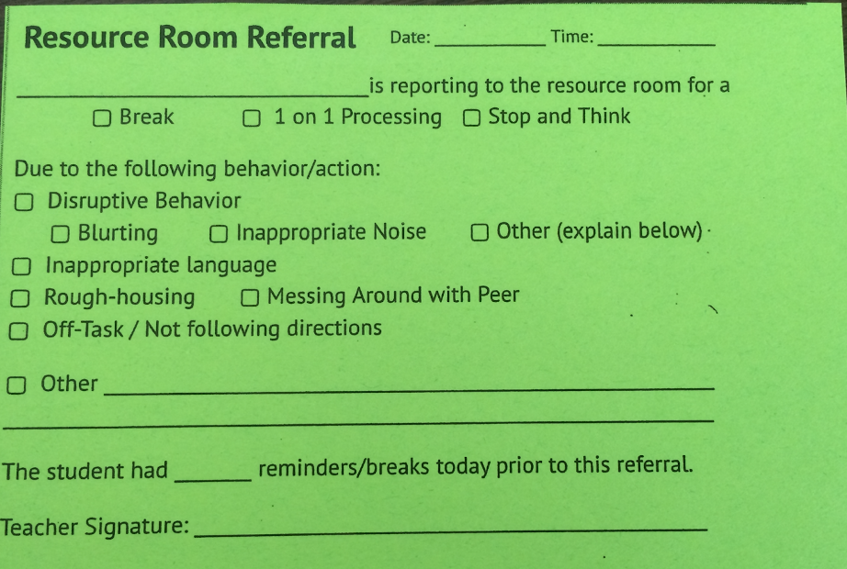
Resource Room Referral Slip
A green slip MUST be sent along with the student to the Resource Room.
Importance of record keeping
Review referral slip
What happens when a student is sent out of the room? - Carol will be handling all entry-work on Resource Room referrals.
Parent communication

Slide 91
Lunchroom and Recess Staff
We have a great staff that is dedicated to the lunchroom and recess. This staff will handle actions and behaviors that happen in the lunchroom and recess.
** This staff is not disciplinary, resource room, or behavior staff **
If you choose to have a student owe time, the lunch staff will TRY to send the student back to your classroom, but will not be supervising the student.
Owed lunch time is served in classrooms and needs to include some 1-on-1 processing.
Notes:
Thank you staff - this topic has seen huge improvements over the past school year. Remember, that if you have students owe lunchtime, YOU will need to monitor them in your class. Please do not leave students unsupervised in your classes.

Slide 92
Bluejacket Pride Tickets
Orange tickets on the substitute lanyards.
Students will earn these ONLY from subs. These tickets will go into a special monthly drawing for an exciting prize .
We still have Ride with Pride tickets too.

Slide 93
Guidelines for Awarding
Bluejacket Pride Tickets
Why?
The Bluejacket Pride tickets are a positive behavior recognition to encourage our students to consistently demonstrate Bluejacket Pride's core values:
Honesty, compassion, self-discipline, respect, responsibility
When?
Bluejacket Pride tickets should be given immediately to students when a behavior in the Expectations Matrix is consistently observed.
Who?
All staff (teaching, office, building service, cafeteria, bus driver and substitute teacher) should be awarding Bluejacket Pride slips any deserving student.

Slide 94
Guidelines for Awarding Bluejacket Pride Tickets cont.
How?
When you award the BJP ticket to a student, the student should know exactly why he/she is getting the recognition. The reason should be valid and connected to the core values:
Honesty, compassion, self-discipline,
respect, responsibility
Make sure the staff member has signed the ticket, and that the student puts their first and last name on it.

Slide 95
Guidelines for Awarding Bluejacket Pride Tickets cont.
Additional information
Additional BJP tickets are located in the copy room cabinet.
Try to hand out a minimum of 5 tickets per day
Focus on WHAT you are giving out the BJP ticket for.

Slide 96
We can reinforce positive behaviors by offering students…
Praise and positive reinforcement
Recognition
Weekly drawing and school store
School supplies & materials
Non-tangible incentives (recess, tech time, etc.)

Slide 97
Monthly Schedule
Announcements | Character Trait Focus | Who’s doing announcements | Who’s running the assembly | Date of Assembly | Theme for Assembly
August | Honesty | Mark | Sara and Ann | August 31 | Beach
September | Honesty | Krisanne | 5th grade IIS | September 28 | BlueJacket Pride
October | Responsibility | Sonia | 3rd Grade IIS | October 26 | Halloween (pumpkins)
November | Responsibility | Trisha | SFAS Intermediate | November 29 (THURSDAY) | Camouflage
December | Compassion | Kate G. | Music | December 19 (WEDNESDAY) | Sing-Along
January | Self-discipline | Ann | SFAS Primary | January 25 | Vikings
February | Respect | Margaret | Media | March 1 | ILTR (Free Books)
March | Cooperation | Natalie | Specialists | March 29 | Music in our Schools
April | Perseverance | Trisha | 4th Grade | April 26 | Twins
May | Respect and self-discipline | Krisanne | SPED | May 22 WEDNESDAY | Camping/Outdoors
Last day of school/ June | Self-discipline | Mark | PBIS | June 6 | 5th Grade Send off/Track & Field Day

Slide 98
What does the PBIS Team do at IIS|SFAS
Evaluate student data
Generate reports
Look for trends with behaviors
Support team members with student behavior challenges
Assist in building School Culture
Bluejacket Pride News
Whole school assemblies (monthly)
Bluejacket Pride Drawings (student and staff incentives)
Staff Events

Slide 99
Staff School Culture
NEW this year:
All staff will be showcased on the bulletin board by the lunchroom.
Please help your students and colleagues get to know more about you by sharing the picture type requested.
Please submit your picture to Trisha or Sonia by October 23. THANKS!
-A picture with you and your family
Potlucks and Staff Night Out
Friday, August 24th @ 3:30pm Back to School Bash at Wintergreens
Thursday, June 6 @ 3:30 End of Year Celebration
Other events and potlucks will be held throughout the year. Watch your email for details.
Suggestions??? Let us know!

Slide 100
Who is the PBIS team at IIS | SFAS?
Krisanne Wessel - PBIS Internal Co-Coach
Sara Edwards - PBIS Internal Co-Coach
Margaret Boege
Natalie Miller
Malissa Zabel
Mark Ziebarth
Trisha Roiger
Ann Landwehr
Sonia Utzman
Kate Goebel
Rachel Olson
Cindy Paulson

Slide 101
Resources for PBIS
http://pbismn.org/
http://www.pbis.org/
http://www.pbisworld.com/
https://www.facebook.com/pages/MN-PBIS/545187875542060?ref=br_tf

Slide 102
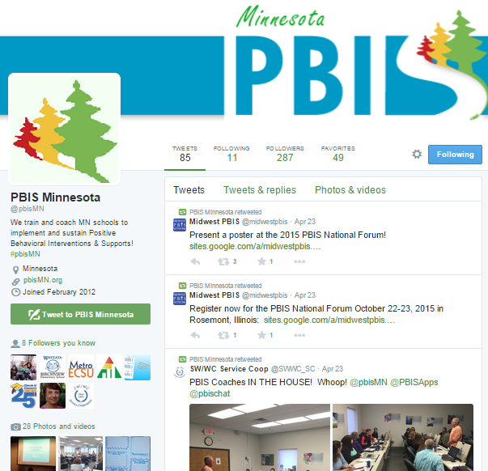
Social Media
twitter.com/pbisMN
#pbisMN
facebook.com/pbisMN

Slide 103
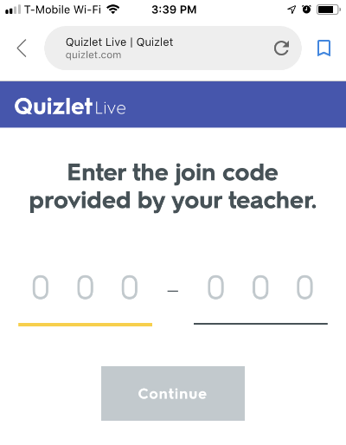
Wrapping Up...
https://quizlet.com/live
Enter this code:
436-481

Slide 104
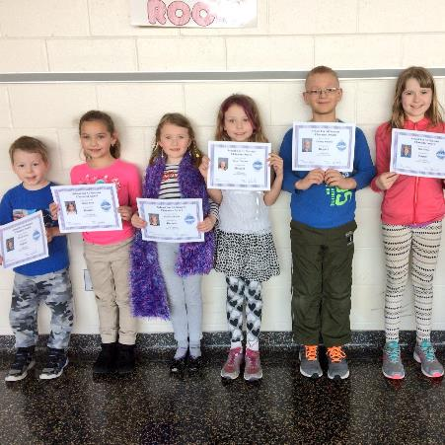
THANKS!
Any questions?
You can follow our school on Twitter: @IISSFAS

