Slide 1
MNPBS Network: Expanding PBIS Across
School, Home and Community
MNPBS Network is bringing practitioners together across settings, populations and the life span to articulate key PBS features and share about exemplary PBS at a community level.
Rachel Freeman | University of Minnesota – Institute on Community Integration
Erin Engness | PBIS MN North Regional Implementation Project – Resource Training & Solutions
Garrett Petrie | PBIS State Management Team – MN Department of Education
6/12/2019

Slide 2
Takeaways
Communities of practice help to scale, sustain, and improve PBIS to achieve your valued outcomes.
The MNPBS Network is working to increase awareness and understanding of positive behavior support across all environments and the lifespan.
The benefits of active APBS and/or MNPBS Network membership.
Be able to answer the question … “What’s happening in March 2021?!”
Notes:
MNPBS Network: Expanding PBIS Across School, Home and Community
Communities of practice are one of the four (4) recommended principles for sustaining PBIS. The Minnesota Positive Behavior Support (MNPBS) Network is our newly formed regional APBS Network that brings together people using positive behavior support from across the state to encourage interagency collaboration, learn from each other, and continue momentum with important stakeholders. We look to highlight the successes when schools and districts work collaboratively with other agencies to make sure students have the social, emotional, and behavioral health supports they need to be successful in school and community settings. In this presentation, we will describe how the MNPBS Network is working across education and human service systems at local, regional, and statewide levels to increase awareness and understanding of multi-tiered positive behavior support across all environments and across the lifespan.
This will also be an opportunity to recruit local PBIS experts, as we prepare to share and learn from others across the world when Minnesota hosts the international APBS conference in March 2021.
Takeaway 1: There are a finite number of core features are not unique for positive behavior support, regardless of the setting, context, situation, group, etc. We share more similar than different, so we can focus on those universal PBS core features that also apply to increased layers of support. As a result, people in Minnesota now have this thing that we believe works to both increase desirable behaviors by supporting people in the ways they find the most pleasant or literally, positive.
Takeaway 2 As a result of Takeaway #1, we expect our competencies to be more similar than different across school, community, demographics, cultures, etc. especially if they match with what is important shared values to the people we support.
Takeaway 3: Tiered systems coordinate efforts too. We expect, and want to select teams and networks that have a variety of skills that they bring that are integrated and compensatory. Think of it as a potluck. It would be a lot of work for one person to do the entire meal and sustain it over and over again. It also would be a problem if all 10 people brought a bag of chips. Tiered systems is coordination and alignment so that the right people with the right skills are bringing the right information at the right time to make decisions.
MNPBS Network is a way to structure to keep people coming back and staying in the right level of consistent communication. It ties back to Takeaway 3 by ‘setting the table’ at and expected and consistent time and place so that we can all get the benefit of all the ‘dishes’ that people bring. There’s perhaps a human tendency to want to ‘make it your own’, but ultimately we have to have non-negotiable core features. We could give all of our blueprints, fidelity assessments being developed, terms of references, Give/Gets, etc. as examples for people to do it on their own (e.g., “Letting it Happen”), but we each have to have that experience making it work for your team with experience doing it collaboratively as a network in a less high pressure, high stakes situation.
Takeaway 4: This will be a first-time, international APBS event for the area!

Slide 3
Communities of practice
Scale, Sustain and Improve PBIS

Slide 4
What would
Kent say?
Kent McIntosh, University of Oregon
Co-Director of National Technical Assistance Center on PBIS
U.S. Department of Education, Office of Special Education Programs and Office of Elementary and Secondary Education

Slide 5
Key Variables for Sustainability of Tier 1 PBIS
State | State Leadership Teams | Centralized Training Systems | Standardized Training Curriculum | Blueprint Self-assessment
District | District Training Systems | District Coaching Systems | Communities of Practice | Maintain Model Sites for Visits
School | Effective and Efficient Teaming | Data Collection and Use | Sharing Data with Whole Staff | Classroom PBIS Systems
Hume & McIntosh (2013), McIntosh et al. (2013), McIntosh et al. (2015), Childs et al. (2016), Mathews et al. (2014), McIntosh et al. (2016), McIntosh et al. (in press)
Notes:
Communities of practice are one of the key variables beyond your school that predict whether or not you sustain PBIS implementation, so stay focused on your shared valued outcomes to decide the best larger community for you and your team.
And whether or not your valued outcomes are one or more of the following:
Reductions in major disciplinary infractions and antisocial behavior.
Improvements in aggressive behavior, concentration, prosocial behavior, and emotional regulation
Improvements in academic engagement and achievement
Enhancements in perceptions of organizational health and safety
Reductions in teacher and student reported bullying behavior, peer rejection, and substance abuse
Improvements in school climate
Something else?
You will always be part of the broader PBIS community with the common experience of coming together as a team, looking at shared information, celebrating growth and making decisions on the best next steps for you, your team, your school, and your entire community.

Slide 6
Four Principles for
Sustaining School-wide Systems
Promote PRIORITY
Ensure EFFECTIVENESS
Increase EFFICIENCY
Use data for CONTINUOUS REGENERATION

Slide 7
Using data for CONTINUOUS
REGENERATION
Adjust practices for a changing environment
  Priority
  Effectiveness
  Efficiency
Connect with a community of practice

Slide 8
Create Communities of Practice
Share fairs, networking sessions, district mini-conferences, web-based sharing
Opportunities for school teams to:
  Celebrate successes
  Learn from peers
  Steal ideas
  Continue momentum
  Invite important stakeholders

Slide 9

MNPBS Network Purpose
MNPBS Network is bringing practitioners together across settings, populations and the lifespan to articulate key PBS features and share about exemplary PBS at a community level.
Notes:
Takeaway 1: There are a finite number of core features are not unique for positive behavior support, regardless of the setting, context, situation, group, etc. We share more similar than different, so we can focus on those universal PBS core features that also apply to increased layers of support. As a result, people in Minnesota now have this thing that we believe works to both increase desirable behaviors by supporting people in the ways they find the most pleasant or literally, positive.
Takeaway 2 As a result of Takeaway #1, we expect our competencies to be more similar than different across school, community, demographics, cultures, etc. especially if they match with what is important shared values to the people we support.
Takeaway 3: Tiered systems coordinate efforts too. We expect, and want to select teams and networks that have a variety of skills that they bring that are integrated and compensatory. Think of it as a potluck. It would be a lot of work for one person to do the entire meal and sustain it over and over again. It also would be a problem if all 10 people brought a bag of chips. Tiered systems is coordination and alignment so that the right people with the right skills are bringing the right information at the right time to make decisions.
Takeaway 4: MNPBS Network is a way to structure to keep people coming back and staying in the right level of consistent communication. It ties back to Takeaway 3 by ‘setting the table’ at and expected and consistent time and place so that we can all get the benefit of all the ‘dishes’ that people bring. There’s perhaps a human tendency to want to ‘make it your own’, but ultimately we have to have non-negotiable core features. We could give all of our blueprints, fidelity assessments being developed, terms of references, Give/Gets, etc. as examples for people to do it on their own (e.g., “Letting it Happen”), but we each have to have that experience making it work for your team with experience doing it collaboratively as a network in a less high pressure, high stakes situation.

Slide 10






Impact On Life Trajectory
If We Collaborate to Provide Positive Supports and Choice Across the Lifespan…
End of Life
Achieve each person’s vision for a full life in the community
Aging
Adulthood
Transition
School
Early
Childhood
Life Trajectory
Community Life
Good Paid Life
Birth
… Instead of a life defined by …
[FILL IN THE BLANK]
Service Life Trajectory
Adapted from Integration of LifeCourse Life Trajectory© and
Person Centered Thinking©

Slide 11
Network Overview
Minnesota Positive Behavior Support (MNPBS)

Slide 12
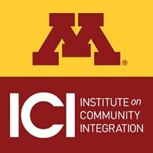









Organization Members

Slide 13
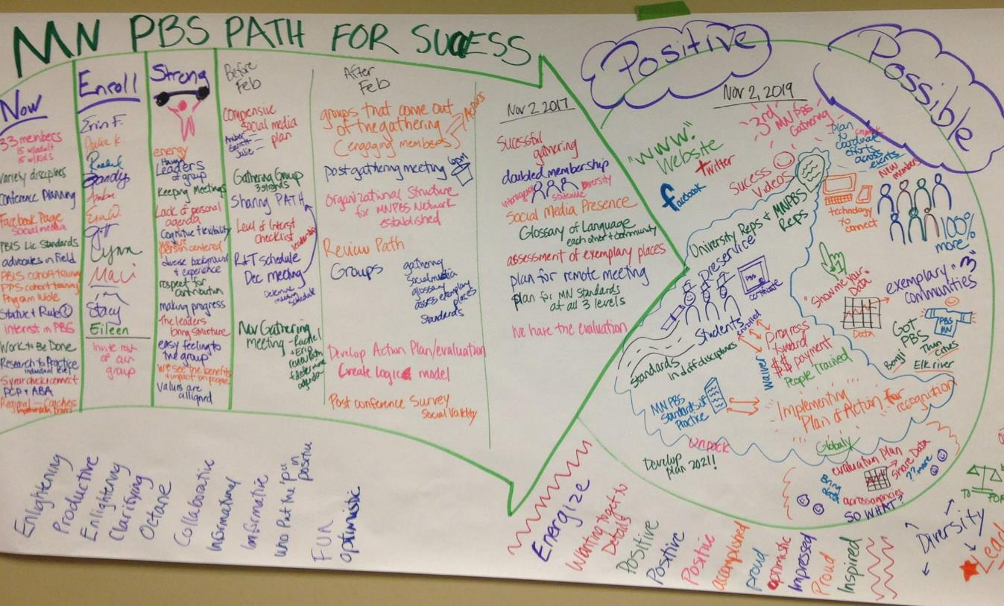
MNPBS Network PATH

Slide 14
Chronology of MNPBS Network
2016
Formation
APBS event award
PATH completed for the network
2017
Inaugural statewide event
Social media launch
PATH-driven organizational structure / working groups
Formalized interface with Olmstead-driven statewide planning team
2018
Logic model and evaluation; revised organizational structure
Dedicated website page for the MNPBS Network on MNPSP.org
New MNPBS network logo
Second annual statewide event (May 9, 2018)
Expanded social media
2019
Third annual statewide event (April 30, 2019)
Collaboration with Intelligent Lives Screening Event (April 30 - May 1, 2019)
Expansion of MNPSP.ORG/MNPBS website
Exemplary Communities Mapping Program
New Path Planned

Slide 15
PATH-Driven Organizational Structure
Leadership Team
Marketing & Social Media
Event Planning
Exemplary PBS Communities

Slide 16
Levels of MNPBS Network Membership (2019)
Current Cost = FREE
General Membership
Stay informed about training and networking opportunities, and other news
Active Membership
Commit to participation, in collaboration with other active members and MNPBS leaders, that furthers the work of the network
Leadership
Commit to Active Membership responsibilities, and
Dedicate time to collaborate with others who steer the organization

Slide 17
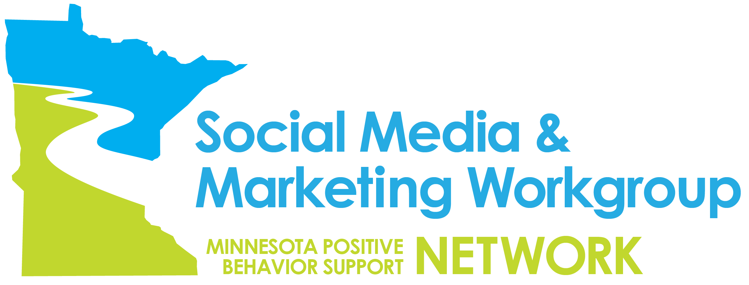
Marketing and Social Media Workgroup

Slide 18
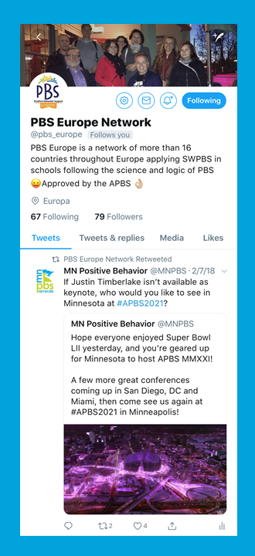
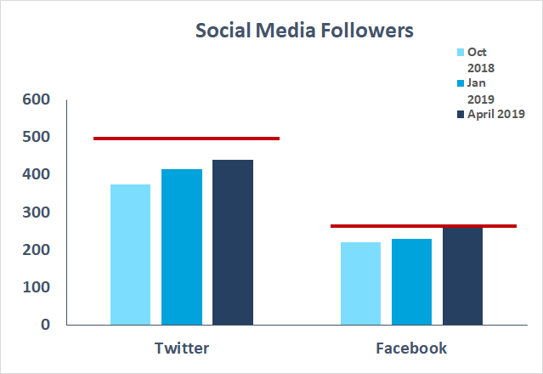

Marketing and Social Media Workgroup
Platform | October 2017 | October 2018 | January 2019 | Goal for Oct 2019
Twitter followers | 174 | 375 | 414 | 500
Facebook followers | 145 | 221 | 229 | 275
YouTube Videos | 0 | 6 | 7 | 10

Slide 19
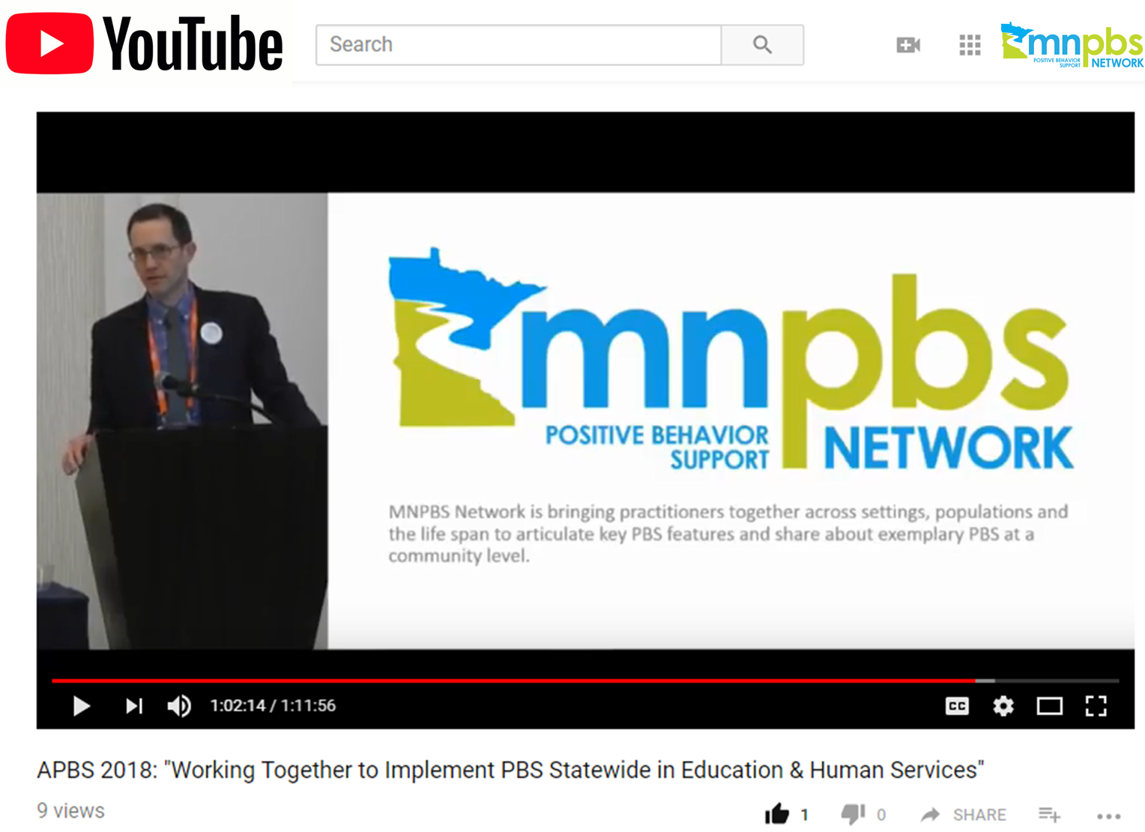
MNPBS YouTube Channel
This link goes to the MNPBS Network YouTube Channel

Slide 20
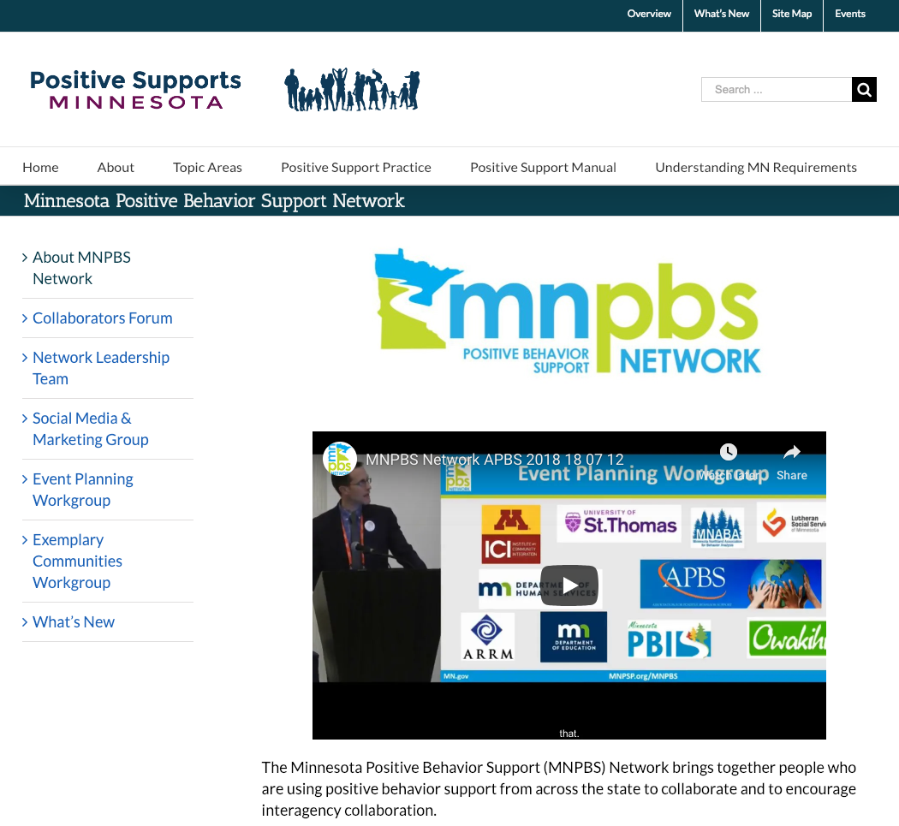
MNPBS Network Webpage
Pageviews on www.mnpsp.org/mnpbs | 2018
2018 Collaborators Forum Main Page | 2,350
2018 Collaborators Forum Agenda | 569
2018 Collaborators Forum Session Information | 401
2018 Collaborators Forum PowerPoints | 204
MNPBS Network Pages launched in fall 2018
Main Page | 658
Exemplary Communities Workgroup Page | 79
Network Leadership Team Page | 47
Event Planning Workgroup Page | 39
Social Media & Marketing Workgroup Page | 36

Slide 21
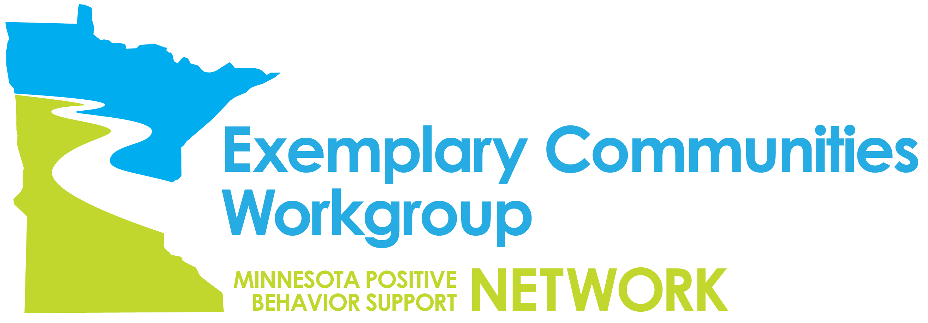
Exemplary Communities Workgroup

Slide 22
MN Positive Behavior Support Network
Exemplary Communities Workgroup
Purpose: Highlight quality implementation of positive behavior support (PBS) in regions across the state of Minnesota. The MNPBS Network is interested in:
Celebrating the excellent positive behavior support that is implemented in Minnesota,
Sharing ideas and strategies that encourage interagency collaboration, and
Helping people reach out and learn more about PBS in their region.
Summary of Major Activities:
Assess where PBS is being implemented across the state, with maps detailing these efforts available at: https://mnpsp.org/mnpbs-exemplarycommunities
Notes:
Context for identifying exemplary communities
72 Pyramid Model Trained Early Childhood Sites
690 schools (33.3%) cohort trained to implement SW-PBIS across Minnesota
22 Organization-wide teams in 4 regions across the state
PBS Facilitators - strong presence but small numbers
2/3 of attendees of first statewide event were working in adult/community-based services

Slide 23
Aspirational to Exemplary Communities – Continuum of Positive Behavior Support Across the Lifespan
Minnesota Positive Behavior Support Network
Aspirational to Exemplary Communities – Continuum of Positive Behavior Support Across the Lifespan
 | Early Childhood | K-21 years old | Adulthood
Tier 1 | Systems & Supports Core people on implementation team, especially PBIS team Staff buy-in Collaborative effort with families Capacity to collect data at child, classroom, and program level System for coaching in place, including behavioral expertise Strategies & Skills Implementation & Outcome Measures for Decision-making Ongoing assessment for child outcomes across developmental areas Transition Considerations IEP meetings Teacher connections Kindergarten visits (at K and Pre) | Systems & Supports Team with administrative and behavioral expertise that’s regularly 3-5 positively stated expectations across the building and classes Have discipline policies in place, including positive and restorative approaches Feedback system built in Families and stakeholders where data are shared Strategies & Skills Implementation & Outcome Measures for Decision-making Measure teaching to expectations Define student and teacher behaviors Easy access to graphs/data on where, when, why & location of problems TFI, SET, BoQ are collected and reviewed annually Transition Considerations | Systems & Supports Team meets regularly All stakeholders involved within the framework of consensus building Mission and policy aligns with PBS values Promotion of universal positive behavior Promoting and acknowledging positive behavior among staff Actively recruiting people from diverse cultures Staff development includes competency based training PBS and person centered strategies are taught throughout the organization Strategies & Skills Implementation & Outcome Measures for Decision-making Fidelity data (direct observation quarterly) Individual outcome measures (including quality of life) Staff retention data Review of all data regularly Annual evaluation on-site from external expert or peer supports Transition Considerations
Tier 2 | Systems & Supports Program wide behavior expectations, taught and referenced throughout the day Social-emotional curriculum, teaching key competencies Ongoing staff support plan Strategies & Skills Implementation & Outcome Measures for Decision-making Transition Considerations | Systems & Supports Team of expertise meeting regularly, possible overlap with Tier 1 Linkage back to Tier 1 expectations (across people, classes, etc.) and Tier 3 approaches Strategies & Skills Implementation & Outcome Measures for Decision-making TFI Tier 2 or MATT Fidelity of Tier 2 interventions Transition Considerations | Systems & Supports Team composition is diverse, clear role and expectations – smaller and more specialized to work with Tier 1 team on planning and decision-making Accessing higher services Strategies & Skills Implementation & Outcome Measures for Decision-making Proportion of people participating in Tier 2 Outcomes of programs at Tier 2 Implementation of programs at Tier 2 Transition Considerations
Tier 3 | Systems & Supports Behavior support and crisis planning Families involved in design of individualized supports and services Strategies & Skills Generalization training for parents and caregivers to use skills in home setting Implementation & Outcome Measures for Decision-making Using BIR data (behavior incident report) Transition Considerations | Systems & Supports Behavioral supports expertise (BCBA or similar training) FBA and BIP Wraparound, RENEW Screening Stakeholder involvement and feedback Coordination with mental health supports Training includes all members of team Strategies & Skills Implementation & Outcome Measures for Decision-making Quality of life indicators Fidelity Transition Considerations | Systems & Supports Each person using Tier 3 supports has team Direct involvement of person and stakeholders within and external to the organization Ongoing plan for professional development – all staff involved in delivering supports Paid and unpaid supports Alignment with Tier 1 and 2 supports Strategies & Skills Implementation & Outcome Measures for Decision-making Proportion of people participating in Tier 2 Outcomes of programs at Tier 2 Implementation of programs at Tier 2 Transition Considerations

Slide 24
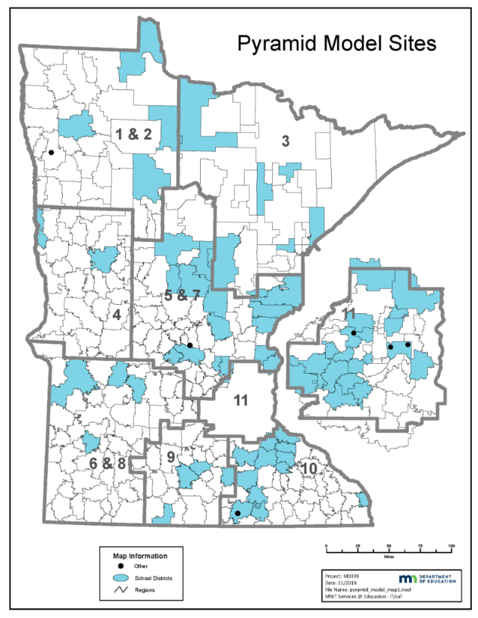
MNPBS Network Exemplary Communities:
Pyramid Model (Early Childhood Education) Since 2010
In 2010, the Minnesota Department of Education (MDE) announced a statewide collaborative effort to improve the social, emotional, and behavioral development of all children birth to five in inclusive early childhood settings through installation of the Pyramid Model.
The map shows the location of all of the school based early childhood programs, Head Start programs, and child care programs that have partnered to install the Pyramid Model since 2010.
More information about this and other PBS efforts across the lifespan here:
mnpsp.org/mnpbs-exemplarycommunities
Notes:
The National Center for Pyramid Model Innovations (NCPMI) is a federally-funded project established to disseminate effective use of the Pyramid Model to support young children’s social, emotional and behavioral development through a variety of training and technical assistance activities. The Pyramid Model Consortium (PMC) is a nonprofit, fee-for-service organization that, similarly, was established to disseminate high-fidelity use of the Pyramid Model. NCPMI and PMC have similarities and differences.
Similarities. Both NCPMI and PMC focus on the Pyramid Model as a framework for promoting effective practices for young children’s social-emotional development and both do so with training and technical assistance for states and local programs. Many of those who developed the Pyramid Model were involved in establishing PMC (in 2014) and are also faculty with NCPMI (beginning in 2017). NCPMI and PMC intend to establish a partnership in order to coordinate their activities.
Differences. NCPMI does not charge for services as it is funded by a 5-year grant that supports activities that are limited by time, work scope and resources. PMC, on the other hand, is a fee-for-service organization that can accommodate a greater range of requests involving Pyramid Model training and technical assistance.
Additional information can be found at www.challengingbehavior.com(NCPMI) and www.pyramidmodel.org (PMC).
62 schools districts identified on the map, of those 62 , 53 are districts that have at least some PBIS involvement, buy may not be at the elementary level

Slide 25
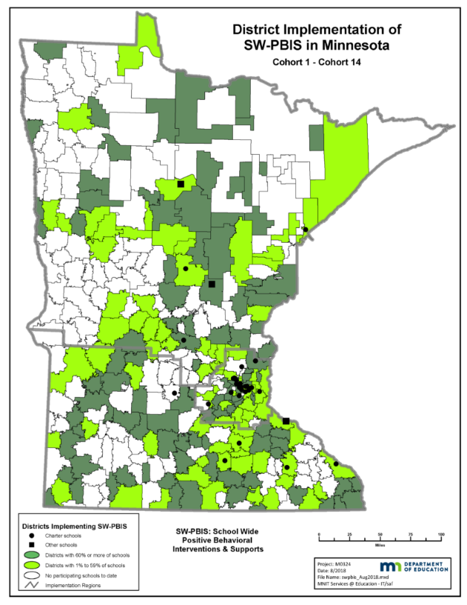
MNPBS Network Exemplary Communities:
SW-PBIS Implementation (Education) Since 2005
Since 2005, PBIS Minnesota has supported school teams to implement school-wide PBS. This color-coded map shows district level of PBIS implementation and charter school locations.
More information about this and other PBS efforts across the lifespan here:
mnpsp.org/mnpbs-exemplarycommunities

Slide 26

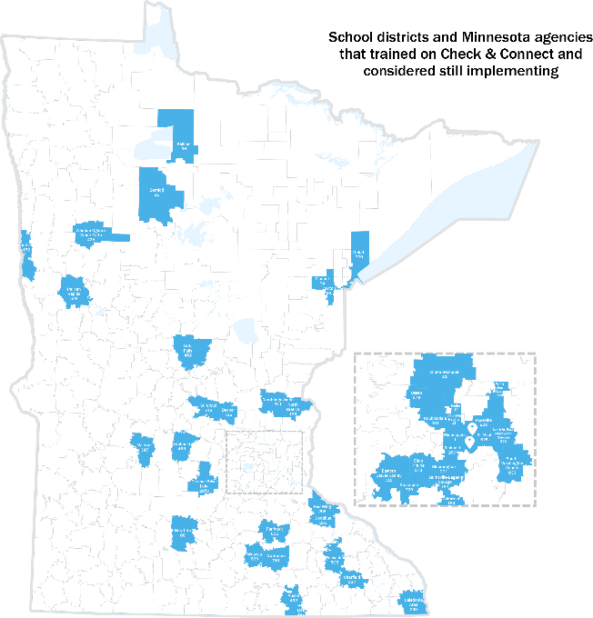
MNPBS Network Exemplary Communities:
Check & Connect (Education & Family)
This color coded map shows where Check & Connect Trainings have taken place across the state.
More information about this and other PBS efforts across the lifespan here:
mnpsp.org/mnpbs-exemplarycommunities

Slide 27

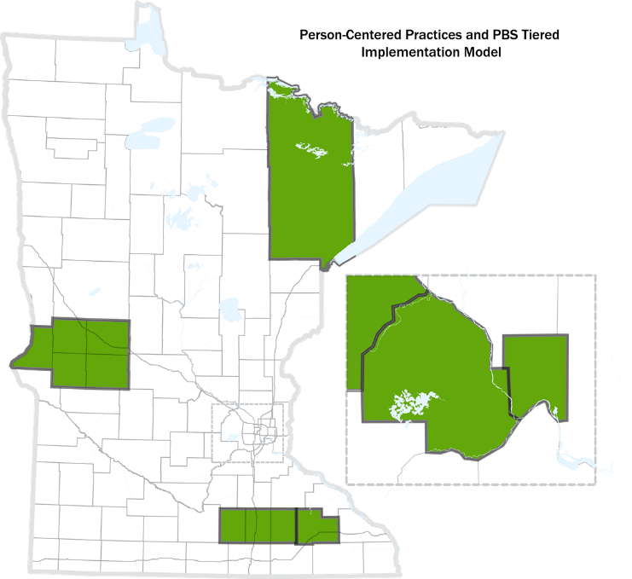
MNPBS Network Exemplary Communities:
PBS & Person-Centered Practices (Home &Community) Since 2015
Since 2015, Minnesota Person-Centered PBS Initiative has supported training cohorts with participants working in organizations who have demonstrated a commitment to implementing person-centered practices and positive supports within their organizations with individuals that they support who experience complex challenges.
This color-coded map shows 4 regions across the state involved in implementation.
More information about this and other PBS efforts across the lifespan here:
mnpsp.org/mnpbs-exemplarycommunities

Slide 28
PBS Related Initiative Maps to be Shared Soon…
We are looking to share the following maps that have been developed to highlight possible areas of that highlight and encourage increased collaboration:
Board Certified Behavior Analysts (BCBAs)
  Mapping the concentration of BCBAs working in schools
School-Wide Information System (SWIS)
  Map showing district use and location of active and/or seeking facilitators
School-Linked Mental Health (SLMH)
  State infrastructure grants that support school-linked mental health services
  Map of school/program sites here: https://mn.gov/dhs/partners-and-providers/policies-procedures/childrens-mental-health/school-linked-mh-services

Slide 29


Early Childhood PBS in Minnesota
72 sites trained in Pyramid Model since 2010

Slide 30
Minnesota Centers of Excellence
Minnesota Department of Education funds the MN Centers of Excellence for Young Children with Disabilities (MN COE; https://mncoe.org/).
72 sites trained since 2010
Intentional distribution across state supported by 12 Professional Development Facilitators located in each of the 11 economic development regions

Slide 31
New Pyramid Model Implementation Sites 2019-2020
Anoka Hennepin
Buffalo Hanover
Chisholm
Deer River
Fillmore Central
Greenway
Monticello
Mountain Iron
Nashwauk
New Ulm
Salk Centre

Slide 32
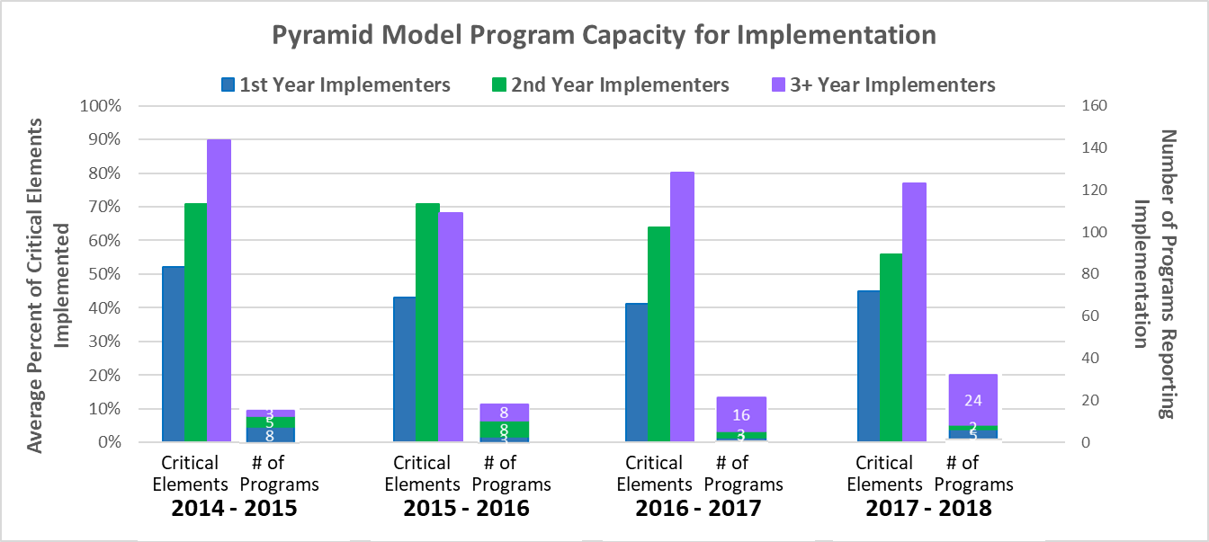
Early Childhood Benchmarks of Quality
(completed at the program level)

Slide 33
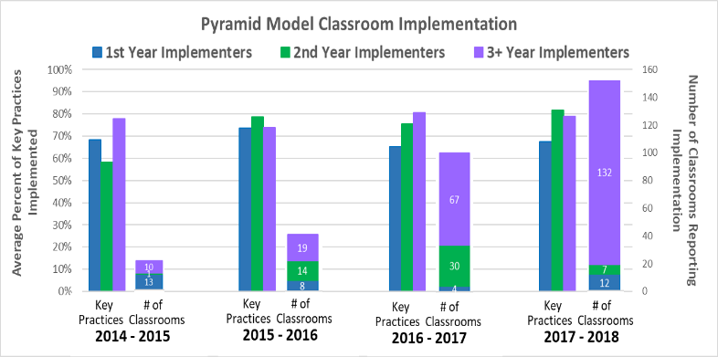
Classroom Fidelity Monitored and Supported through use of the Teaching Pyramid Observation Tool (TPOT)

Slide 34
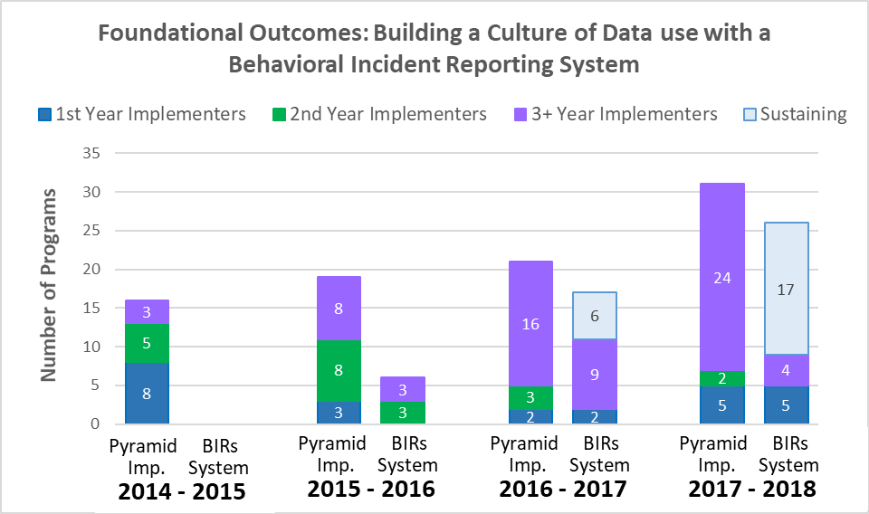
Foundational Outcomes: BIRS

Slide 35
School-wide PBIS in Minnesota
690 schools trained since 2005

Slide 36
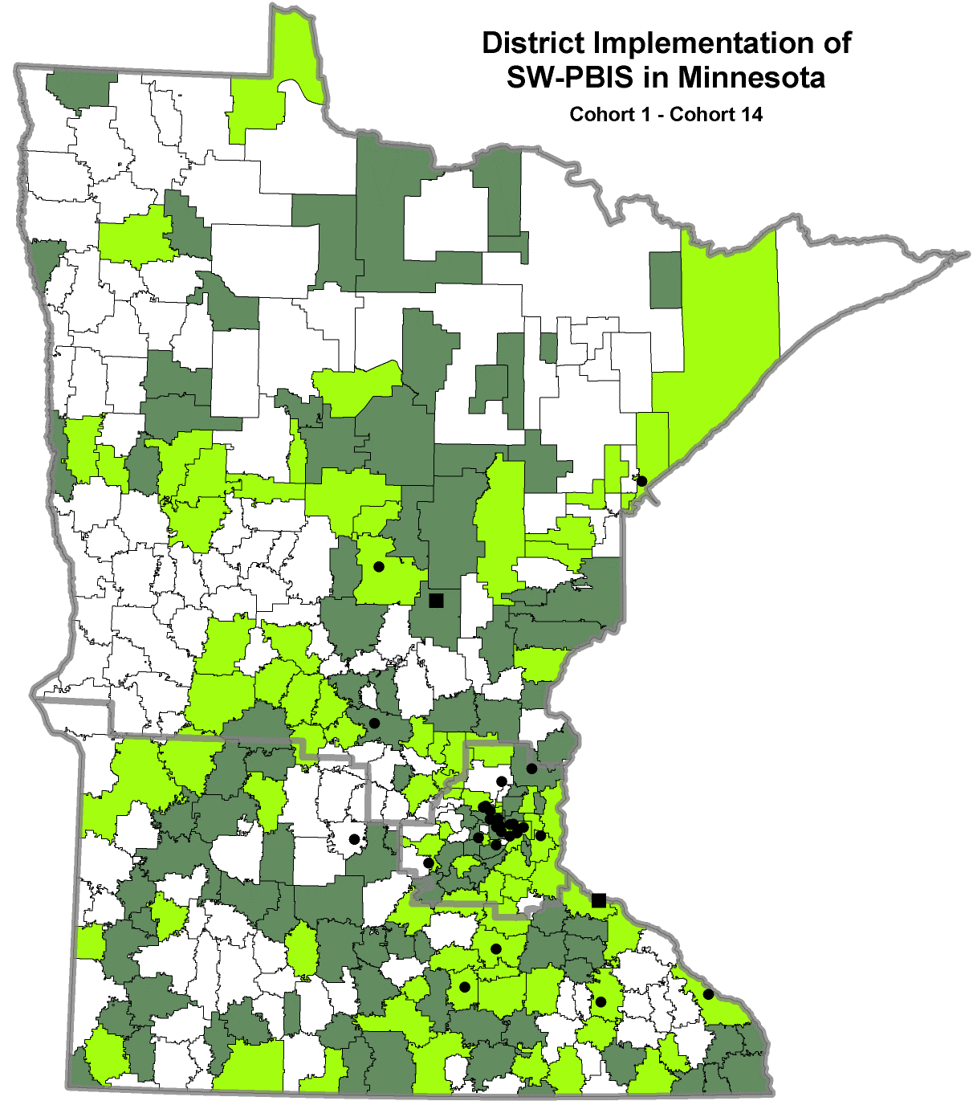
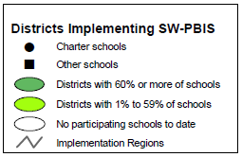
Schoolwide PBIS Across Districts and Charters
Cohorts 1- 14
(2005-2020)
Districts (60% or more of schools)
Districts (1% to 59% of schools)
Charter schools
Other schools

Slide 37
Growth of PBIS in Minnesota: 2005-present
690
Cohort 14
45 more schools!

Slide 38
PBIS by the Numbers in Minnesota
234 districts/charters
690 schools
33.3% of the state’s schools
335,598 students impacted by SWPBIS
38.9% of the state’s students
Notes:
33.3% of the schools was calculated by dividing 2072 (total number of schools on MDE website for 2018) by 690 schools as identified in the second bullet
335,598 students was determined by adding 311,280 (last count) with 24,318 ( the number of students pulled from the application. This number may change as the child count may be different once Kirsten looks at it. Also, it may not account for schools that have closed or dropped.
38.9% of states students was determined by dividing 335,598 by 862,160 ( k-12 child count 2018 on MDE website.

Slide 39
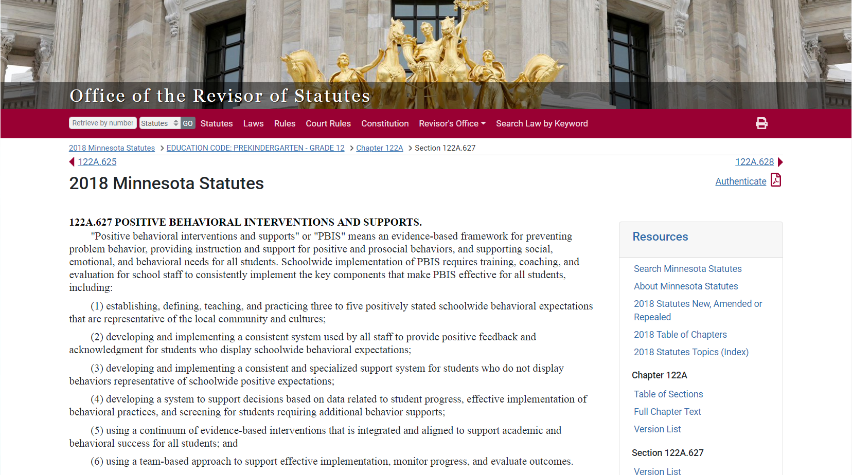
PBIS Defined in MN Statute 122A.627
Source: https://www.revisor.mn.gov/statutes/?id=122A.627
Notes:
This was done in consultation with the National TA Center, with many iterations to get to this point. There was a rationale to get this in plain language. We careful with the education language because we knew it had to be read by other agencies as well as legislatures.
122A.627 POSITIVE BEHAVIORAL INTERVENTIONS AND SUPPORTS.
"Positive behavioral interventions and supports" or "PBIS" means an evidence-based framework for preventing problem behavior, providing instruction and support for positive and prosocial behaviors, and supporting social, emotional, and behavioral needs for all students. Schoolwide implementation of PBIS requires training, coaching, and evaluation for school staff to consistently implement the key components that make PBIS effective for all students, including:
(1) establishing, defining, teaching, and practicing three to five positively stated schoolwide behavioral expectations that are representative of the local community and cultures;
(2) developing and implementing a consistent system used by all staff to provide positive feedback and acknowledgment for students who display schoolwide behavioral expectations;
(3) developing and implementing a consistent and specialized support system for students who do not display behaviors representative of schoolwide positive expectations;
(4) developing a system to support decisions based on data related to student progress, effective implementation of behavioral practices, and screening for students requiring additional behavior supports;
(5) using a continuum of evidence-based interventions that is integrated and aligned to support academic and behavioral success for all students; and
(6) using a team-based approach to support effective implementation, monitor progress, and evaluate outcomes.
Consistent with section 120B.232, subdivision 1, character education curriculum and programs may be used to support implementation of the key components of PBIS.
History:
1Sp2017 c 5 art 2 s 26
Source: https://www.revisor.mn.gov/statutes/?id=122A.627

Slide 40
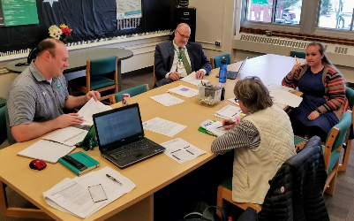
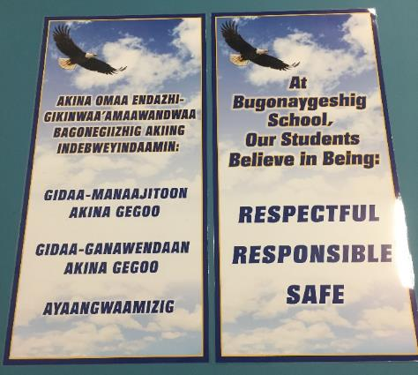
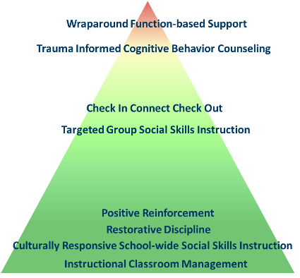
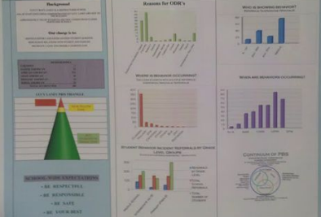

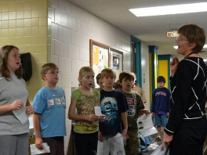

PBIS Definition from Statute in Practice
An evidence-based framework with these core features
3-5 positive expectations, taught and practiced
Acknowledgement and feedback system
Continuum of procedures to support behavior
Data-based decision making
Integrated and aligned with academics for all
Team-based approach
Source: https://www.revisor.mn.gov/statutes/?id=122A.627
Notes:
It’s not just good enough. How do you know it is being done? There are tools and measures for teams to use.

Slide 41
Average School Fidelity Data For New PBIS Schools
Tiered Fidelity Inventory (TFI) Tier 1 – 2015-present
C11: 2015-2017
C12: 2016-2018
C13: 2017-present
C14: 2018-present

Slide 42

Minnesota Organization-wide Positive Behavior Support (MN-OPBS)
29 organizations trained since 2015

Slide 43

Positive Behavior Support
& PC-Practices
Cohorts 1- 4
(2015-2019)
Growth
Regions = 4
Cohorts = 4
Counties Represented = 12
Teams = 24
Organizations = 29
Teams Involved
Counties
Providers IDD
Public Health
Mental Health
Training Layers
Team Training
Person-Centered Thinking Trainers/Coach Training
Picture of a Life Planners/Trainers
PBS Facilitators

Slide 44
Effort Data Showing Expansion Over Time
 | 2015 | 2016 | 2017 | 2018 | 2019
Region | 1 | 3 | 4 | 4 | 4
Active Organizations | 4 | 16 | 22 | 20* | 27 (24 Teams)
Total Trained Coaches | 44 | 167 | 212 | 282 | 318
Total Trained Key Contacts | 6 | 24 | 36 | 29 | 45
PBS Facilitators | 0 | 6 | 15 | 73 | 77
PCT Trainers by Region | 4 | 14 | 18 | 53 | 55
Total PCT Trainers | 46 | 66 | 86 | 78 | 78
Team Attrition Occurred in 2018 N=2

Slide 45
Growth in Minnesota: PBS in Human Service Organizations 2015-Present
Year | Sustaining | 2nd Year | 1st Year
2014-2015 | 0 | 0 | 4
2015-2016 | 0 | 4 | 12
2016-2017 | 4 | 12 | 6
2017-2018 | 16 | 4 | 0
2018-2019 | 20 | 0 | 8

Slide 46
Tiered Onsite Evaluation Tool (TOET)
Person Centered Practices & Positive Behavior Support
* One agency listed represents five counties that are collaborating
** Agency 1 & 2 completed training using different curriculum

Slide 47
Olmstead Plan, Positive Support Rule & Statewide Logic Model for Promoting Positive Supports
New Positive Support Goals:
Establish Training Systems for Positive Supports
Design and Implement Statewide Evaluation
Expand Awareness of Positive Supports Across the State
Create & Maintain Strategies for Establishing Policies
Notes:
These are major goals that set the stage for showing real examples and tie to how we evaluate and improve our work with databased decision making at all levels, informing our processes.

Slide 48
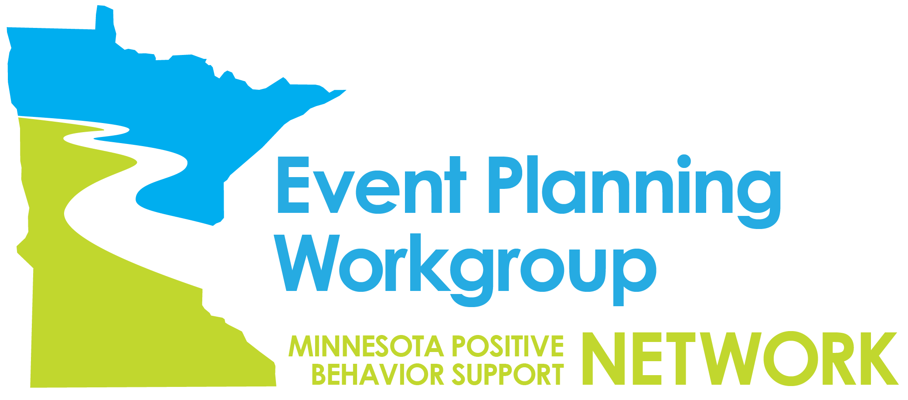
Event Planning Workgroup

Slide 49
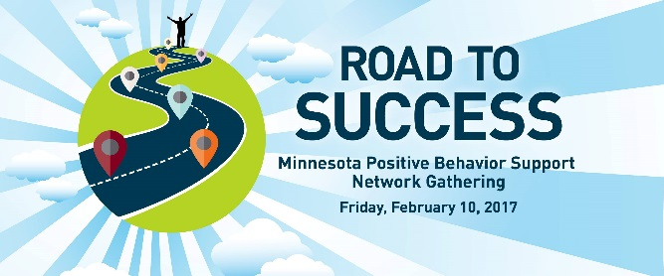
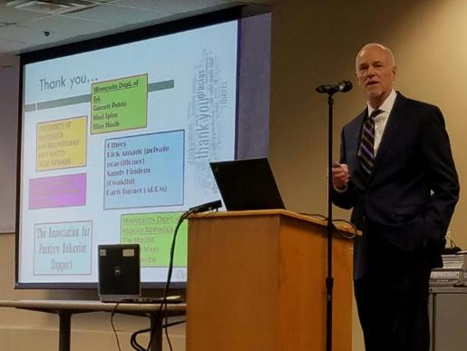
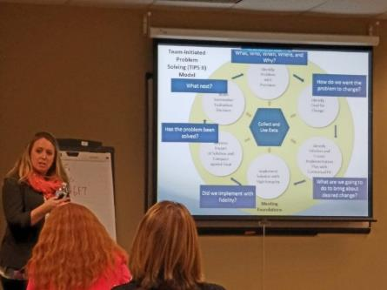
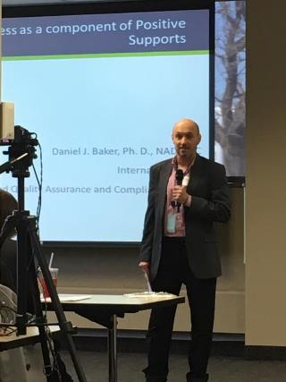
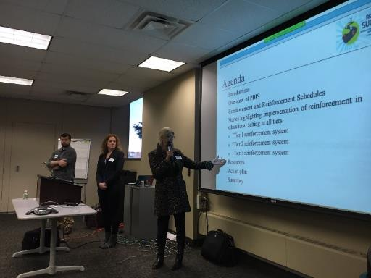
2017 MNPBS Network Gathering
Early Childhood strand:
Dr. LeAnne Johnson
Keynote:
Dr. Barry McCurdy
K-21 strand:
Dr. Lynn Brusnahan
Adult / community
strand:
Dr. Dan Baker

Slide 50


2018 MNPBS Collaborators Forum
Keynote Speaker:
Ashley MacSuga-Gage, Ph.D.
During this interactive keynote session participants learned about ways that PBS practitioners, researchers, and consumers have formed meaningful connections. We focused on sharing success stories from around the country and world via experiences leaned through the Association for Positive Behavior Support (APBS). Additionally, time was spent encouraging interaction between participants to initiate contacts within and across regions in the state of Minnesota
Total Onsite Attendance: 175
Total Offsite Attendance: 118

Slide 51
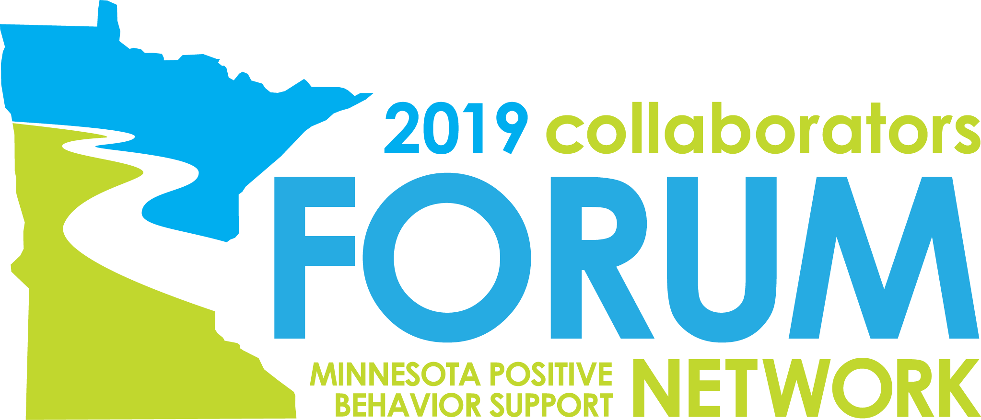
April 30, 2019
5/9/2018

Slide 52
Initial Registrations for the May 9, 2018 Collaborator’s Forum
The Data from 2018 Led the Team to Identify Additional Sites for the Collaborator’s Forum
Presenters Were Located Across the State

Slide 53
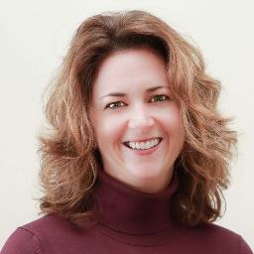
Major Outcomes
2019 MNPBS Network Collaborators Forum
Keynote Speaker:
Caryn Ward, PhD, HSP-P
Associate Director, National Implementation Research Network
Total Onsite Attendance: 170*
Roseville: 99
Brainerd: 37
Duluth: 34
*Online connections were also available

Slide 54

Fidelity and Capacity:
What Have We Learned?
Given implementation and fidelity data, teams do a great job picking next steps that lead to growth
Be comfortable with fidelity following capacity
  After experiences with these improvement cycles, you will learn to enjoy the anticipation
Eric Kloos
MDE
Opening

Slide 55

Which program would YOU want?
A
B
or
Caryn Ward
NIRN
Keynote
Notes:
Fixsen, Blase, & Metz, 2015

Slide 56
Behavior-Bullying School Program
Caryn Ward
NIRN
Keynote

Slide 57

Choose a Program
Caryn Ward
NIRN
Keynote
In each chart
A and B were the SAME PROGRAM!
(EBPs = PATHS, TFM, SE, PBIS, DBT)
= Low Fidelity use of EBP in practice
= High Fidelity use of EBP in practice
A
B
First do it as intended (if you can) then change it.
Fidelity FIRST
Achieve intended outcomes
Improve with use of data

Slide 58
Website Data From Forum

Slide 59
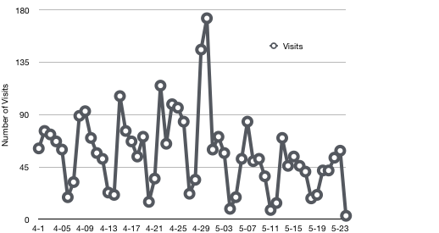
Visits on MNPSP.org from April 1, 2019 – May 24, 2019
April 30, 2019
Collaborators Forum
(173 Visits)

Slide 60
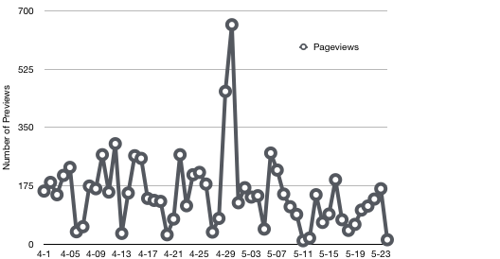
Pageviews on MNPSP.org from April 1, 2019 – May 24, 2019
April 30, 2019
Collaborators Forum
(658 Pageviews)

Slide 61
Pageviews Related to Collaborators Forum
Pageviews by Dates of Review | Number (Dec 1, 2016 - Mar 22, 2017) | Number (Jan 1, 2018 - May 30, 2018)
Main MN Event Page | 1,353 | 2,066
Strand Pages | 63 | 365
Program Materials | 437 | 197
Agenda | 165 | 533
Sessions/Program | 125 | 163
Directions | 31 | 91
Evaluation | 39 | 48
Other Related | 74 | 420
Overall Total Pageviews | 2,287 | 3,383

Slide 62
Pageviews Related to the MNPBS Network Pages and the Collaborators Forum
Dates | Number of Pageviews January 1, 2019- June 9, 2019
MN Network Pageviews
Main Pages | 1,763
Exemplary Communities | 181
Collaborators Forum Pageviews Pageviews
Main Page | 1,671
Agenda | 324
Session Information | 303
Downloads | 363
Program | 164

Slide 63
Conference Evaluation Results 2019

Slide 64
All Responders for 2019
Notes:
Note that the quadrants we just made are pretty cut and dry and based on numbers. If you choose to do this IRL, then nearly all of the time you’re going to have judgement calls.
Since this is a relatively new Usability Test that we have begun this year, some of the regions are also using this information to show growth over time. The idea of watching a school move to the upper right quadrant via either path (meeting training usefulness criteria or meeting benchmark fidelity or both).
How we are currently thinking about and using fidelity and usefulness data to differentiate training and coaching supports.

Slide 65

Association for Positive Behavior Support (APBS)

Slide 66
Mission of APBS
The mission of APBS is to enhance the quality of life of people, across the life-span, by promoting evidence-based and effective positive behavior support to realize socially valid and equitable outcomes for people, families, schools, agencies, and communities.

Slide 67
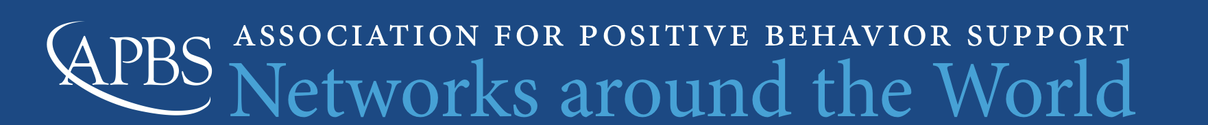
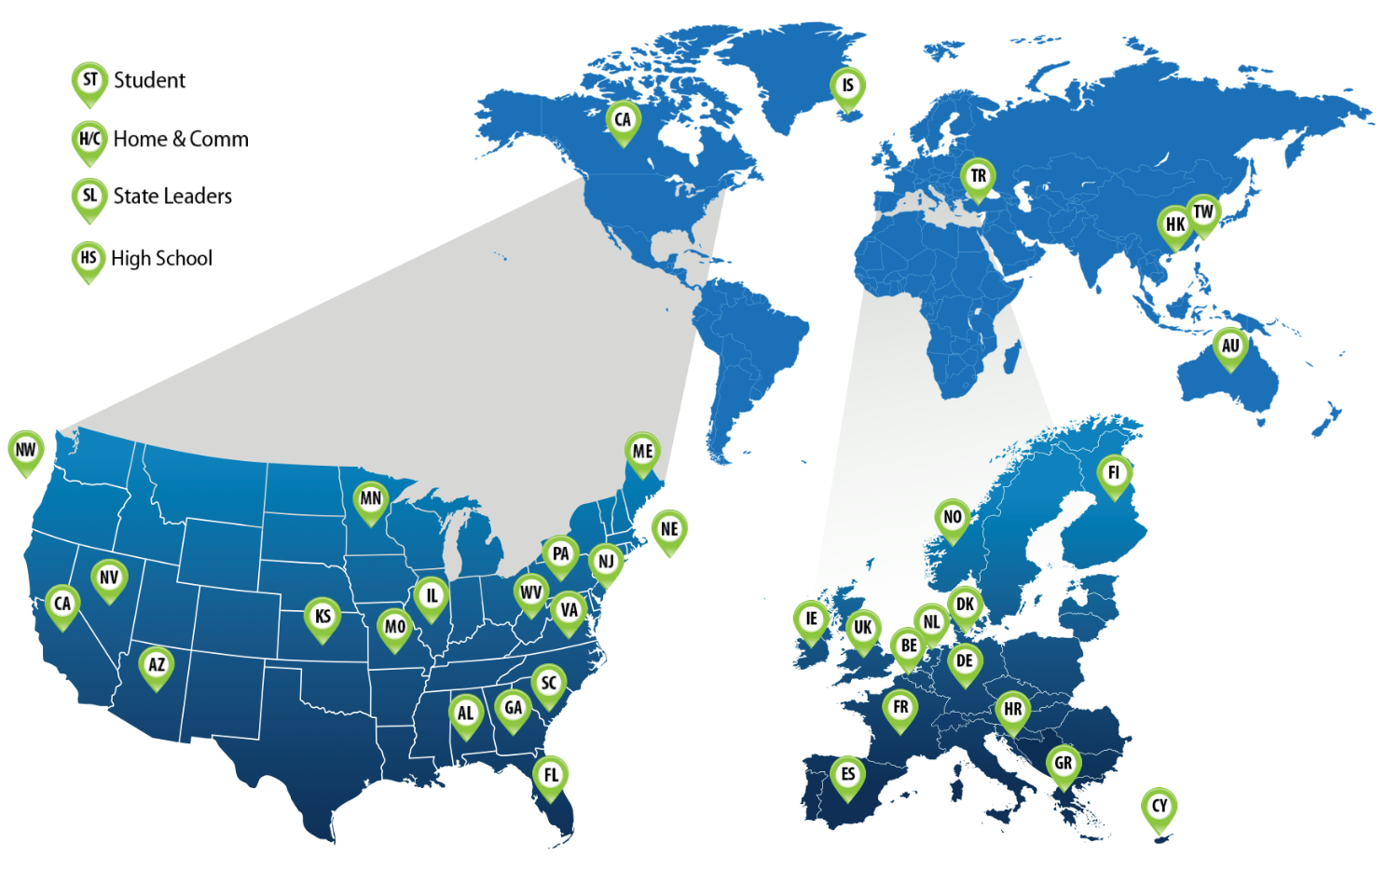
APBS Networks around the World
Types
State-based
Regional
International
Thematic (n=4)
  Student
  Home & Community
  State Leaders
  High School

Slide 68
Why APBS Networks?
APBS regards continued growth and support of APBS Networks as essential for facilitating peer-based relationships, partnerships and collaboration, which in turn will strengthen and advance the mission of APBS.

Slide 69
Why APBS Networks?
Promote and monitor the implementation of evidence based practices based on the science of PBS;
Influence the fidelity of implementation;
Maximize resources through collaboration
Span boundaries of related efforts such as training, integrated systems of care, and evaluation;
Influence policy and funding sources;
Interact with a broader array of implementers with common ground.

Slide 70
Cost of APBS Membership
Regular membership: $80.00/year or 3 years for $200.00
Agency membership: $125.00/year
More information about membership fees and other types of membership: http://www.apbs.org/membership

Slide 71
Primary Benefits of Professional Membership
Complementary hard copy and online subscription to the Journal of Positive Behavior Interventions (JPBI), and to the quarterly APBS Newsletter.
Access to content resources posted on the APBS website via the membership page, including archived conference presentations and webinars.
Complementary access to live webinars.
Reduced cost of attendance at yearly conference – this cost is already far lower than most similar conferences and is further reduced per membership in the organization.
Connections and mentorship from leaders in the field of Positive Behavior Support.
Opportunity to vote on business matters and to elect APBS Board members.
Opportunity to join regional, national, international and thematic networks and help to grow Positive Behavior Support within your constituency group and community.
Increased opportunity to join a community of like-minded professionals committed to providing high quality Positive Behavior Support services in home, school and/or community settings.
Increased opportunity for access to Positive Behavior Support leaders in your community.
Notes:
Primary Benefits of Professional Membership
Professional members are professionals in Human Services, Mental Health Services, P-12 Education, or Higher Education working to advance the practice of positive behavior support, Positive Behavioral Interventions and Supports (PBIS), or Multi-level Systems of Support (MTSS) in the home, community, and/or school settings.
Complementary hard copy and online subscription to the Journal of Positive Behavior Interventions (JPBI), and to the quarterly APBS Newsletter.
Access to content resources posted on the APBS website via the membership page, including archived conference presentations and webinars.
Complementary access to live webinars.
Reduced cost of attendance at yearly conference – this cost is already far lower than most similar conferences and is further reduced per membership in the organization.
Connections and mentorship from leaders in the field of Positive Behavior Support.
Opportunity to vote on business matters and to elect APBS Board members.
Opportunity to join regional, national, international and thematic networks and help to grow Positive Behavior Support within your constituency group and community.
Increased opportunity to join a community of like-minded professionals committed to providing high quality Positive Behavior Support services in home, school and/or community settings.
Increased opportunity for access to Positive Behavior Support leaders in your community.

Slide 72
Journal of Positive Behavior Interventions (JPBI)
Most read articles in last 6 months
Positive Greetings at the Door: Evaluation of a Low-Cost, High-Yield Proactive Classroom Management Strategy, Clayton R. Cook et al.
Relationship Between School-Wide PBIS and Academic, Attendance, and Behavior Outcomes in High Schools, Jennifer Freeman et al.
Implementing Positive Behavior Support in Preschools: An Exploratory Study of CW-FIT Tier 1, Krystine A. Jolstead et al.
The Use of Responsive Circles in Schools: An Exploratory Study, Elaine L. Wang et al.
Most cited in last 3 years
Promoting Positive Behavior Using the Good Behavior Game: A Meta-Analysis of Single-Case Research, Lisa Bowman-Perrott et al.
Predictors of Sustained Implementation of School-Wide PBIS, Kent McIntosh et al.
Average Treatment Effect of School-Wide PBIS on School-Level Academic Achievement in Florida, Nicholas A. Gage et al.
Notes:
Primary Benefits of Professional Membership
Professional members are professionals in Human Services, Mental Health Services, P-12 Education, or Higher Education working to advance the practice of positive behavior support, Positive Behavioral Interventions and Supports (PBIS), or Multi-level Systems of Support (MTSS) in the home, community, and/or school settings.
Complementary hard copy and online subscription to the Journal of Positive Behavior Interventions (JPBI), and to the quarterly APBS Newsletter.
Access to content resources posted on the APBS website via the membership page, including archived conference presentations and webinars.
Complementary access to live webinars.
Reduced cost of attendance at yearly conference – this cost is already far lower than most similar conferences and is further reduced per membership in the organization.
Connections and mentorship from leaders in the field of Positive Behavior Support.
Opportunity to vote on business matters and to elect APBS Board members.
Opportunity to join regional, national, international and thematic networks and help to grow Positive Behavior Support within your constituency group and community.
Increased opportunity to join a community of like-minded professionals committed to providing high quality Positive Behavior Support services in home, school and/or community settings.
Increased opportunity for access to Positive Behavior Support leaders in your community.

Slide 73
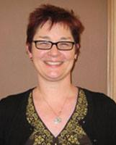
Webinars – Live and Archived
Integrating School Mental Health into PBIS' Data, Systems, and Practices, Joni Splett, Ph.D.
How is Your Tier 3 System Working?, Rose Iovannone, Ph.D.
Critical Issues in Implementing and Evaluating Tier 2 Interventions, Allison Bruhn, Ph.D.
District-wide Systems of Positive Behavior Support, Tim Lewis, Ph.D.
Integrating Trauma-Informed Approaches With PBIS Within an MTSS Framework, Lynne Desousa
Effective Responses to Student Escalation: Adult Behaviors as Predictors for Student Success, Terry Scott, Ph.D.
PBIS and Equity: Neutralizing Implicit Bias in School Discipline Decisions, Kent McIntosh, Ph.D.
Aligning RtI and PBIS: Lessons Learned and Opportunities for an Integrated MTSS, Brian Gaunt, Ph.D.
Supporting Effective Practices: An Overview of Active Implementation Frameworks and the Hexagon Tool, Angela Preston, Ph.D. and Kathleen Ryan Jackson, Ed.D.
Organization-wide Strategies for Implementing Person-Centered Practices and Positive Behavior Support, Rachel Freeman, Ph.D.
PBS in Juvenile Justice Settings, Diana Myers
Notes:
Primary Benefits of Professional Membership
Professional members are professionals in Human Services, Mental Health Services, P-12 Education, or Higher Education working to advance the practice of positive behavior support, Positive Behavioral Interventions and Supports (PBIS), or Multi-level Systems of Support (MTSS) in the home, community, and/or school settings.
Complementary hard copy and online subscription to the Journal of Positive Behavior Interventions (JPBI), and to the quarterly APBS Newsletter.
Access to content resources posted on the APBS website via the membership page, including archived conference presentations and webinars.
Complementary access to live webinars.
Reduced cost of attendance at yearly conference – this cost is already far lower than most similar conferences and is further reduced per membership in the organization.
Connections and mentorship from leaders in the field of Positive Behavior Support.
Opportunity to vote on business matters and to elect APBS Board members.
Opportunity to join regional, national, international and thematic networks and help to grow Positive Behavior Support within your constituency group and community.
Increased opportunity to join a community of like-minded professionals committed to providing high quality Positive Behavior Support services in home, school and/or community settings.
Increased opportunity for access to Positive Behavior Support leaders in your community.

Slide 74
Takeaways Met?
Communities of practice help to scale, sustain, and improve PBIS to achieve your valued outcomes.
The MNPBS Network is working to increase awareness and understanding of positive behavior support across all environments and the lifespan.
The benefits of active APBS and/or MNPBS Network membership.
Be able to answer the question … “What’s happening in March 2021?!”
Notes:
MNPBS Network: Expanding PBIS Across School, Home and Community
Communities of practice are one of the four (4) recommended principles for sustaining PBIS. The Minnesota Positive Behavior Support (MNPBS) Network is our newly formed regional APBS Network that brings together people using positive behavior support from across the state to encourage interagency collaboration, learn from each other, and continue momentum with important stakeholders. We look to highlight the successes when schools and districts work collaboratively with other agencies to make sure students have the social, emotional, and behavioral health supports they need to be successful in school and community settings. In this presentation, we will describe how the MNPBS Network is working across education and human service systems at local, regional, and statewide levels to increase awareness and understanding of multi-tiered positive behavior support across all environments and across the lifespan.
This will also be an opportunity to recruit local PBIS experts, as we prepare to share and learn from others across the world when Minnesota hosts the international APBS conference in March 2021.
Takeaway 1: There are a finite number of core features are not unique for positive behavior support, regardless of the setting, context, situation, group, etc. We share more similar than different, so we can focus on those universal PBS core features that also apply to increased layers of support. As a result, people in Minnesota now have this thing that we believe works to both increase desirable behaviors by supporting people in the ways they find the most pleasant or literally, positive.
Takeaway 2 As a result of Takeaway #1, we expect our competencies to be more similar than different across school, community, demographics, cultures, etc. especially if they match with what is important shared values to the people we support.
Takeaway 3: Tiered systems coordinate efforts too. We expect, and want to select teams and networks that have a variety of skills that they bring that are integrated and compensatory. Think of it as a potluck. It would be a lot of work for one person to do the entire meal and sustain it over and over again. It also would be a problem if all 10 people brought a bag of chips. Tiered systems is coordination and alignment so that the right people with the right skills are bringing the right information at the right time to make decisions.
Takeaway 4: MNPBS Network is a way to structure to keep people coming back and staying in the right level of consistent communication. It ties back to Takeaway 3 by ‘setting the table’ at and expected and consistent time and place so that we can all get the benefit of all the ‘dishes’ that people bring. There’s perhaps a human tendency to want to ‘make it your own’, but ultimately we have to have non-negotiable core features. We could give all of our blueprints, fidelity assessments being developed, terms of references, Give/Gets, etc. as examples for people to do it on their own (e.g., “Letting it Happen”), but we each have to have that experience making it work for your team with experience doing it collaboratively as a network in a less high pressure, high stakes situation.

Slide 75
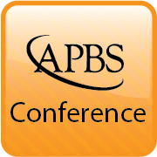
Locations of Annual Conferences To Date
Tampa, FL (2005)
Reno, NV (2006)
Boston, MA (2007)
Chicago, IL (2008)
Jacksonville, FL (2009)
St. Louis, MO (2010)
Denver, CO (2011)
Atlanta, GA (2012)
San Diego, CA (2013)
Chicago, IL (2014)
Boston, MA (2015)
San Francisco, CA (2016)
Denver, CO (2017)
San Diego, CA (2018)
Washington, DC (2019)
Miami, FL (2020)
Notes:
The Fifteenth International Conference on Positive Behavior Support
San Diego, CA 2018
The Fourteenth International Conference on Positive Behavior Support
Denver, CO 2017
The Thirteenth International Conference on Positive Behavior Support
San Francisco, CA 2016
The Twelfth International Conference on Positive Behavior Support
Boston, MA 2015
The Eleventh International Conference on Positive Behavior Support
Chicago, IL 2014
The Tenth International Conference on Positive Behavior Support
San Diego, CA 2013
The Ninth International Conference on Positive Behavior Support
Atlanta, GA 2012
The Eighth International Conference on Positive Behavior Support
Denver, CO 2011
The Seventh International Conference on Positive Behavior Support
St. Louis, MO 2010
The Sixth International Conference on Positive Behavior Support
Jacksonville, FL 2009
The Fifth International Conference on Positive Behavior Support
Chicago, Illinois 2008
The Fourth International Conference on Positive Behavior Support
Boston, Massachusetts 2007
The Third International Conference on Positive Behavior Support
Reno, Nevada 2006
Ted Carr's Keynote Presentation
The Expanding Vision of Positive Behavior Support: Happiness, Helpfulness, Hopefulness
Keynote Paper Published in JPBI
Carr, E.G. (2007). The Expanding Vision of Positive Behavior Support: Research Perspectives on Happiness, Helpfulness, Hopefulness. Journal of Positive Behavior Interventions, 9(1), 3-14.
The Second International Conference on Positive Behavioral Support
Tampa, Florida 2005

Slide 76


APBS Conference 2021 – Minneapolis
18th Annual Conference
March 17th-20th
Hyatt Regency – Minneapolis, MN
https://twitter.com/MNPBS/status/960660570532990976

Slide 77
Thanks!
Rachel Freeman
freem039@umn.edu
Erin Engness
EEngness@resourcecoop-mn.gov
Garrett Petrie
Garrett.Petrie@state.mn.us

Slide 78
Organization Members

