Slide 1
Native Voice for PBIS PBIS Summer Institute 2020
Dan Torrez| MN Department of Education
April 14th, 2019

Slide 2
Ten Minnesota Commitments to Equity
Prioritize equity.
Start from within.
Measure what matters.
Go local.
Follow the money.
Start early.
Monitor implementation of standards.
Value people.
Improve conditions for learning.
Give students options.

Slide 3
Presenter
Dan Torrez
Alternative and Prevention Specialist
Minnesota Department of Education

Slide 4
Objectives
Distinctions between Framework and Practices within PBIS
PBIS and American Indian Students
Current Native Voice PBIS Initiative
Notes:
Overview of PBIS framework and implementation efforts
Statute definition in practice
Current scale
Aligned initiatives and supports
School-Linked Mental Health (SLMH)
Applied behavior analysis (ABA)
Supports available for all schools and programs in Minnesota
New
Sustaining
Reconnecting

Slide 5
Overview of PBIS framework “(5) … a continuum of evidence-based interventions that is integrated and aligned to support academic and behavioral success for all students”

Slide 6
PBIS FAQ
What is Positive Behavioral Interventions and Supports (PBIS)?
Implementation FRAMEWORK for maximizing the selection and use of evidence-based prevention and intervention practices along a multi-tiered continuum that supports the academic, social, emotional, and behavioral competence of all students.

Slide 7
Framework vs Strategy
Framework | Local Strategy
Core Features | Vision and Values
Stated Objectives | Systems
Focused Goals and Results | Needs/Goals
Known Participants | Specific Interventions

Slide 8
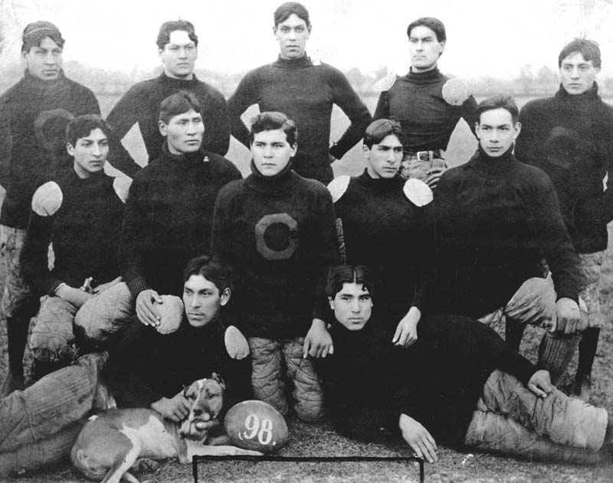
The Real All-Americans

Slide 9
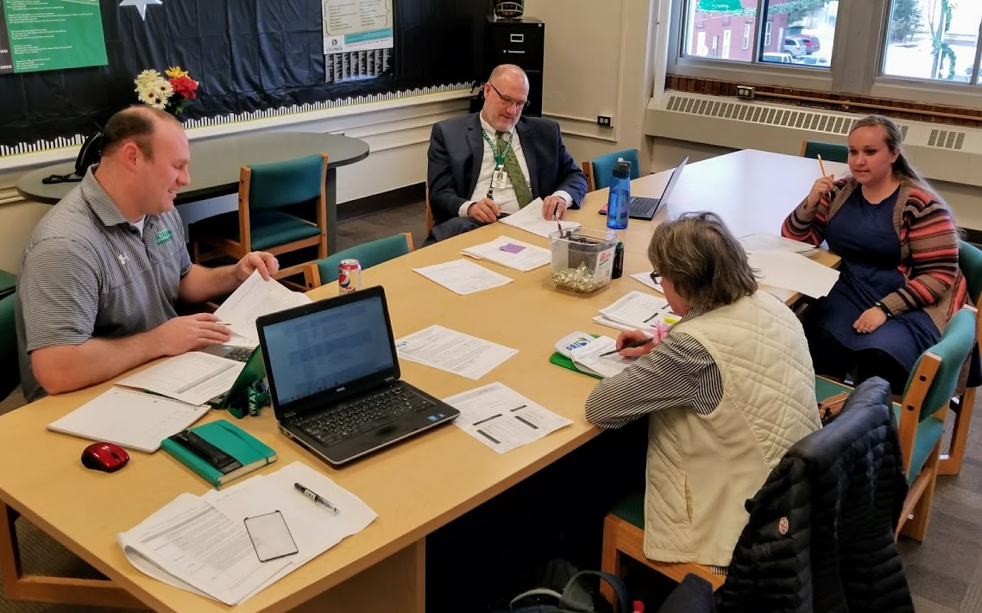
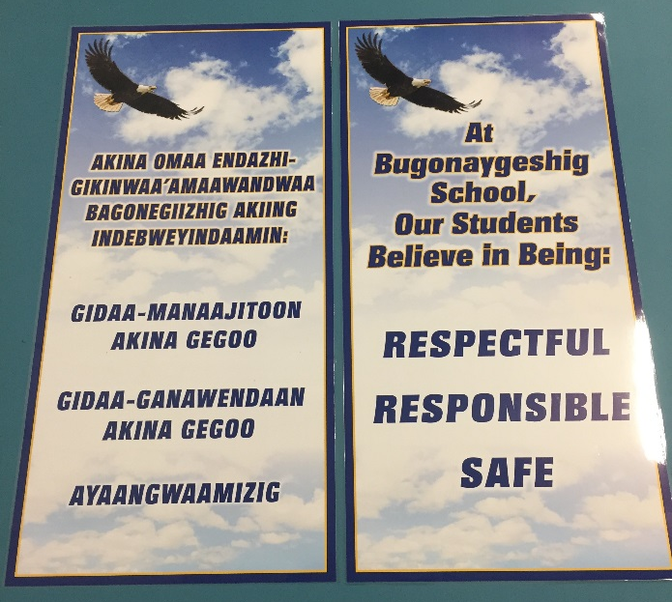
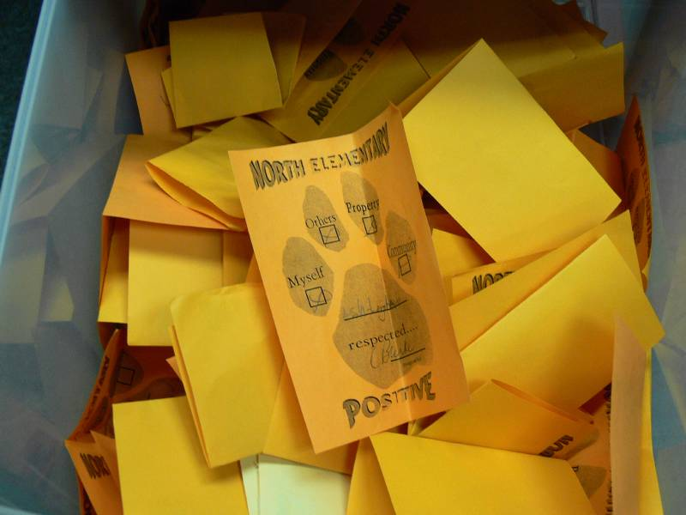
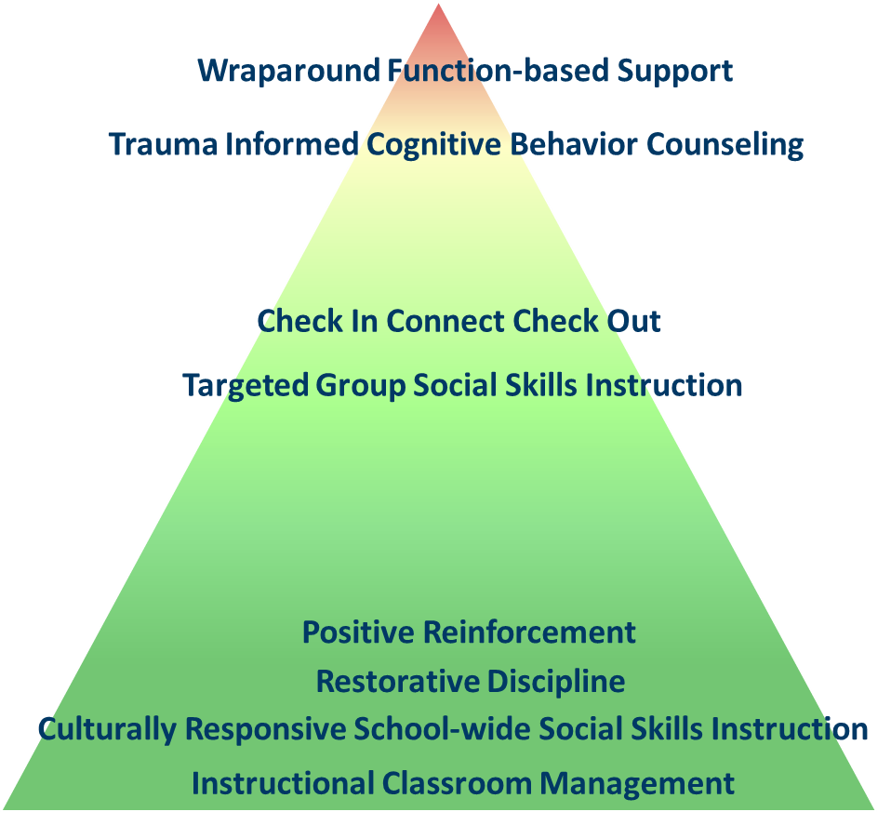
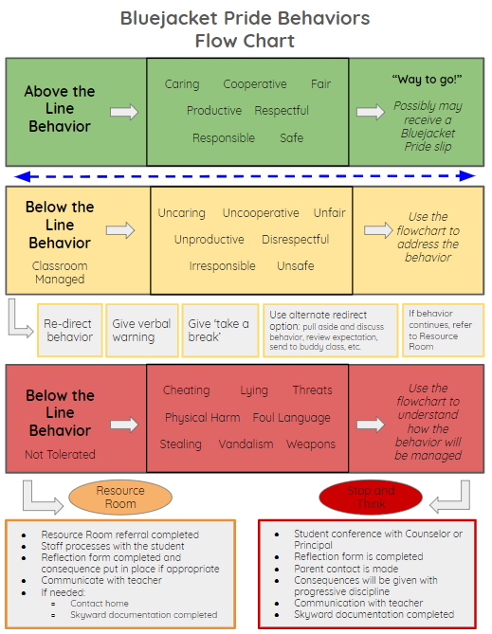
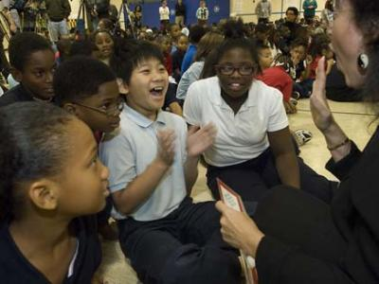
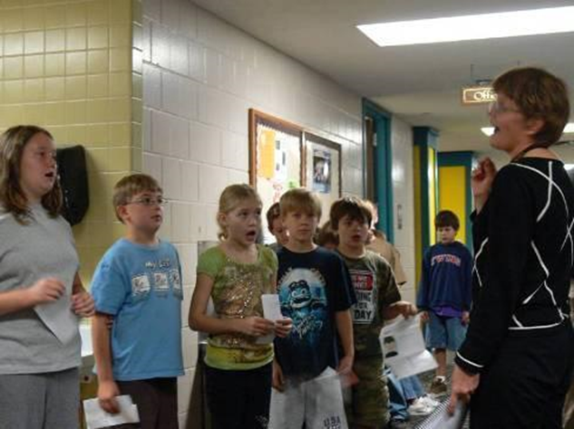
Statute PBIS Definition in Practice: An Evidence-Based Framework to Prevent Problem Behavior and Support Positive, Prosocial Behaviors
3 to 5 positive expectations, taught and practiced
Acknowledgement and feedback system
Consistent and specialized supports for student needs
Data-based decision making
Continuum of interventions for all, integrated and aligned with supports to ensure academic success
Team-based approach
Source: https://www.revisor.mn.gov/statutes/?id=122A.627
Notes:
It’s not just good enough. How do you know it is being done? There are tools and measures for teams to use.
122A.627 POSITIVE BEHAVIORAL INTERVENTIONS AND SUPPORTS.
"Positive behavioral interventions and supports" or "PBIS" means an evidence-based framework for preventing problem behavior, providing instruction and support for positive and prosocial behaviors, and supporting social, emotional, and behavioral needs for all students. Schoolwide implementation of PBIS requires training, coaching, and evaluation for school staff to consistently implement the key components that make PBIS effective for all students, including:
(1) establishing, defining, teaching, and practicing three to five positively stated schoolwide behavioral expectations that are representative of the local community and cultures;
(2) developing and implementing a consistent system used by all staff to provide positive feedback and acknowledgment for students who display schoolwide behavioral expectations;
(3) developing and implementing a consistent and specialized support system for students who do not display behaviors representative of schoolwide positive expectations;
(4) developing a system to support decisions based on data related to student progress, effective implementation of behavioral practices, and screening for students requiring additional behavior supports;
(5) using a continuum of evidence-based interventions that is integrated and aligned to support academic and behavioral success for all students; and
(6) using a team-based approach to support effective implementation, monitor progress, and evaluate outcomes.
Consistent with section 120B.232, subdivision 1, character education curriculum and programs may be used to support implementation of the key components of PBIS.
History:
1Sp2017 c 5 art 2 s 26
Source: https://www.revisor.mn.gov/statutes/?id=122A.627
From National TA Center
School-wide PBIS is:
A multi-tiered framework for establishing the social culture and behavioral supports needed for a school achieve behavioral and academic outcomes for all students.
Evidence-based features of PBIS
Prevention
Define and teach positive social expectations
Acknowledge positive behavior
Arrange consistent consequences for problem behavior
On-going collection and use of data for decision-making
Continuum of intensive, individual intervention supports.
Implementation of the systems that support effective practices

Slide 10
Layers of Support

Slide 11
Unhealthy Layers

Slide 12
Culturally Relevant Layers

Slide 13
Where Are We Now?

Slide 14
Significant Disproportionality
Specific Learning Disability (8)
Students with a Disability (7)
Emotional Behavioral Disorders (6)
Total Disciplinary Actions (5)
Other Health Disabilities (3)
In-School Suspensions, 10 days or less (2)
Developmental Cognitive Disabilities (2)
Placement in Federal Settings 4-8 (2)
Out of School Suspensions, more than 10 days (1)
Out of school suspensions, 10 days or less (1)
Data From 2018/2019

Slide 15
Top 20 School Districts Serving American Indian Students
PBIS Trained
No
Yes
1 | 10
5 | 4
No
Disproportionality
Yes
Data From 2018/2019

Slide 16
Tribally Consulting Districts/Schools (28)
PBIS Trained
No
Yes
2 | 14
5 | 7
No
Disproportionality
Yes
Data from 2018/2019

Slide 17
Native Voice for PBIS Initial Work

Slide 18
Group Photo
4/25/2019

Slide 19
Participants at Fond du Lac Tribal and Community College Meeting
Participant | Organization/District
Amy Kilde | Frazee-Vergas
Babette Sandman | ISD 709
Carley Amsden | Kelliher
Christina Clitso Nayquonabe | Onamia
Dan Torrez | ISD 622
Gerald White | Deer River
Jeanine Whiteman | Nett Lake
Luann Frazer | Cass Lake-Bena
Alicia Garcia | Minneapolis
Rodney White | Walker-Hackensack-Akeley
Sonia Wadena | Bemidji
Tara Dupuis | Fond du Lac Ojibwe School
Tom Peacock | Author
Roxanne DeLille | FDLTCC
Govina Budrow | FDLTCC
Guthrie Caposella | MDE
Janet Christensen | MDE
Clay Keller | MDE

Slide 20
Dreamer Meeting
Vision of how things would look in 2027 if positive behavior supports were in place for AI students
Individual Responses
Small group consensus on what are most important
Content analysis to cluster small group responses into 4 themes
Presentation about PBIS, PBIS in Minnesota, and adapting PBIS culturally
Discussion about implementing PBIS with a Native voice
Blending 2 sets of PBIS components to the 4 themes
6 components of the definition in statute
5 core components of the cultural responsiveness definition from the PBIS field guide
Questions to address what’s needed to strengthen the vision

Slide 21
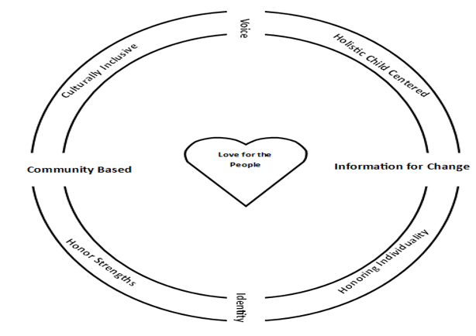
Native Voice for PBIS

Slide 22
Holistic Child Centered

Slide 23
Balance
Spiritual
Intellectual
Physical
Mental
Whole
Child
Safe, Belonging, Honored

Slide 24
Location

Slide 25
Duration

Slide 26
Frequency

Slide 27
Honor Strengths

Slide 28
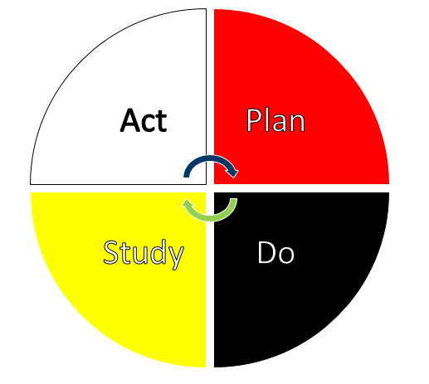
Honor Strengths
Power of Positive Feedback and Acknowledgment
Flip Script-Use data to find the Positive Highlights

Slide 29
Honor Individuality and Culturally Inclusive

Slide 30
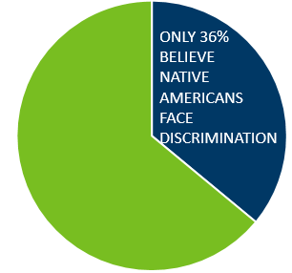
Reclaiming Native Truth Research 2018
Largest public opinion research project on Native Americans
Invisibility was a major theme that impacts perceptions and meeting needs in “invisible” communities.
rnt.firstnations.org
ONLY 36%
BELIEVE
NATIVE
AMERICANS
FACE
DISCRIMINATION
“Invisibility of Native people is the modern form of racism”
-Dr. Stephanie A Fryberg, Associate Professor,
University of Washington

Slide 31
Invisibility
Media
.0% to .04% media representations portray Native Americans as contemporary people (Tukachinsky, Mastro, & Yarchi, 2005; Fryberg, 2003)
Google/Bing Search
95% of first 100 Google images and 99% of first 100 Bing searches for the terms “Native American” and “American Indian” are antiquated portraits (Leavitt, Covarrubias, Perez, and Fryberg, 2015)
School Curricula
87% of references to Native American in 50 states’ academic standards portray them in a pre-1900 context (Shear, Knowles, Soden, Cnaitz, & Castro, 2015)

Slide 32
How Do You Honor Someone When You Do Not See Them?

Slide 33
Workgroup Members
Name | District
Govinda Budrow | Fond du Lac Tribal and Community College
Dan Torrez | MDE
Edye Washington | Duluth Public Schools
Holly Schmitt | Redwood Area Public Schools
Carline Sargent | St. Francis Public Schools
Ethan Neerdaels | Osseo Public Schools
Lowana Greensky; Laurie Eide | Greenway Public Schools
Delores Gabbard | Moorhead Public Schools

Slide 34
Examining PBIS from a Native perspective
If major components of PBIS are…
Positively stated behavioral expectations
System for positive feedback and acknowledgement
Support system for students who do not display behaviors
Data-based decision making
Supporting academic and behavioral success
Using a team-based approach
How can we implement them in Native ways?

Slide 35
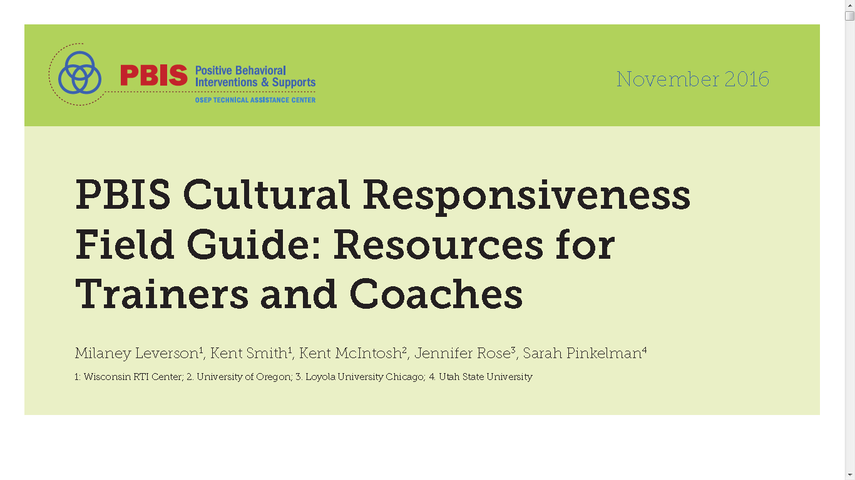
PBIS Cultural Responsiveness Field Guide
PBIS Cultural Responsiveness Field Guide
“The primary goal of cultural responsiveness within a SWPBIS framework is to use SWPBIS principles to change school cultures and systems to enhance educational equity.” (p. 2)
Core components of the cultural responsiveness definition
Identity
Voice
Supportive environment
Situational appropriateness
Data for equity

Slide 36
Closing Circle

Slide 37
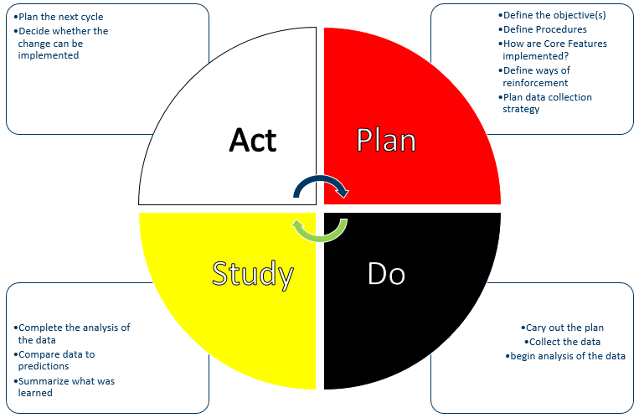
Continuous Improvement

Slide 38
Thank you!
Dan Torrez
Daniel.Torrez@state.mn.us
651-582-8713

