Slide 1
Transitioning to Adult Like with PBIS
Transitioning to Adult Life with PBIS
LouAnn Strachota & Melissa Paulsen
Notes:
Melissa

Slide 2
Agenda
Background about our site
Share our journey
Give you ideas to bring back
Answer Questions
Notes:
LouAnn

Slide 3
Bloomington Transition Center
The Bloomington Transition Center Bloomington Transition Center
We support students who are 18-21 years old with mild to moderate disabilities
Our infographic we use to share with incoming students and families
We run on a modified schedule to emulate a college-like setting
Notes:
LouAnn

Slide 4
Bloomington Transition Center
The Bloomington Transition Center
Our site has undergone significant structural and staff changes over the past 3-5 years
This greatly impacted the roll out of the rebooted PBIS
Students were heavily involved with the process
Notes:
LouAnn

Slide 5
Highlights of our Journey
The Highlights of Our Journey
Student creating/designing our AIM logo
Students creating AIM & how to use AIM in the classroom, hallways, lunchroom, and community
Staff focusing on positive student behaviors
Students respecting one another
Bridging what we do for PBIS into employment skills
Notes:
LouAnn

Slide 6
AT BTC WE AIM
Notes:
LouAnn

Slide 7
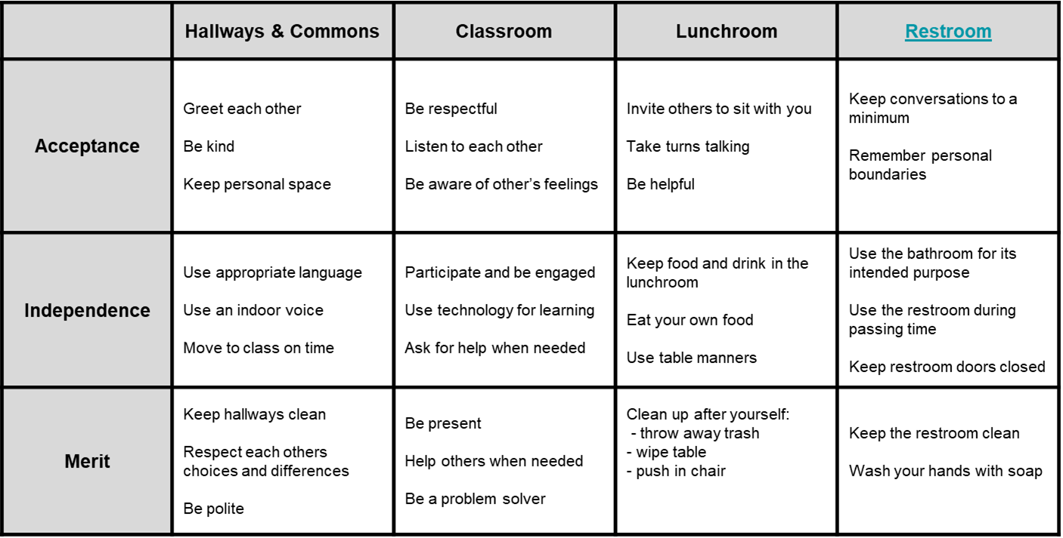
BTC Building Matrix Restroom
Lesson Template

Slide 8
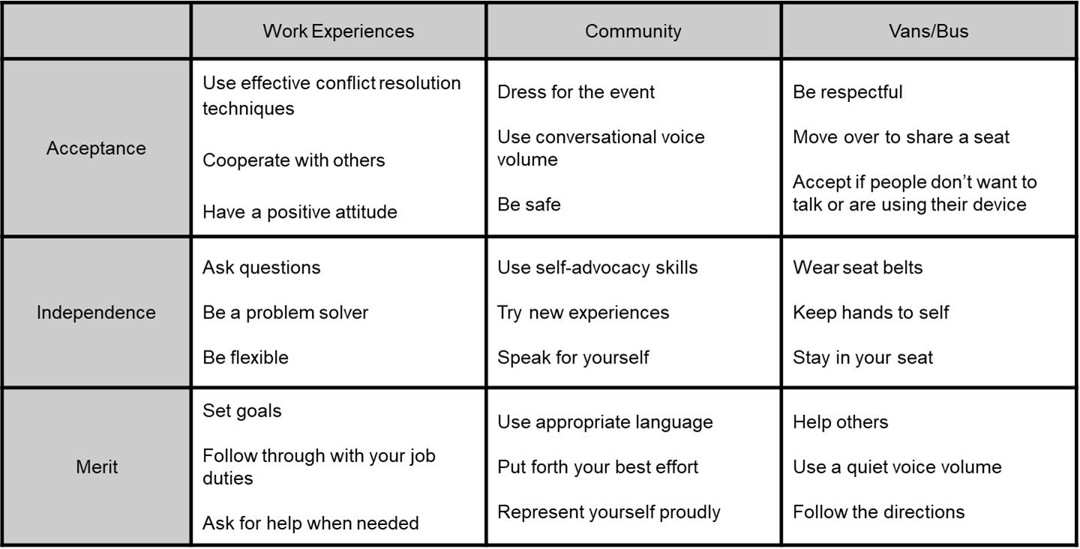
BTC Extensions Matrix

Slide 9
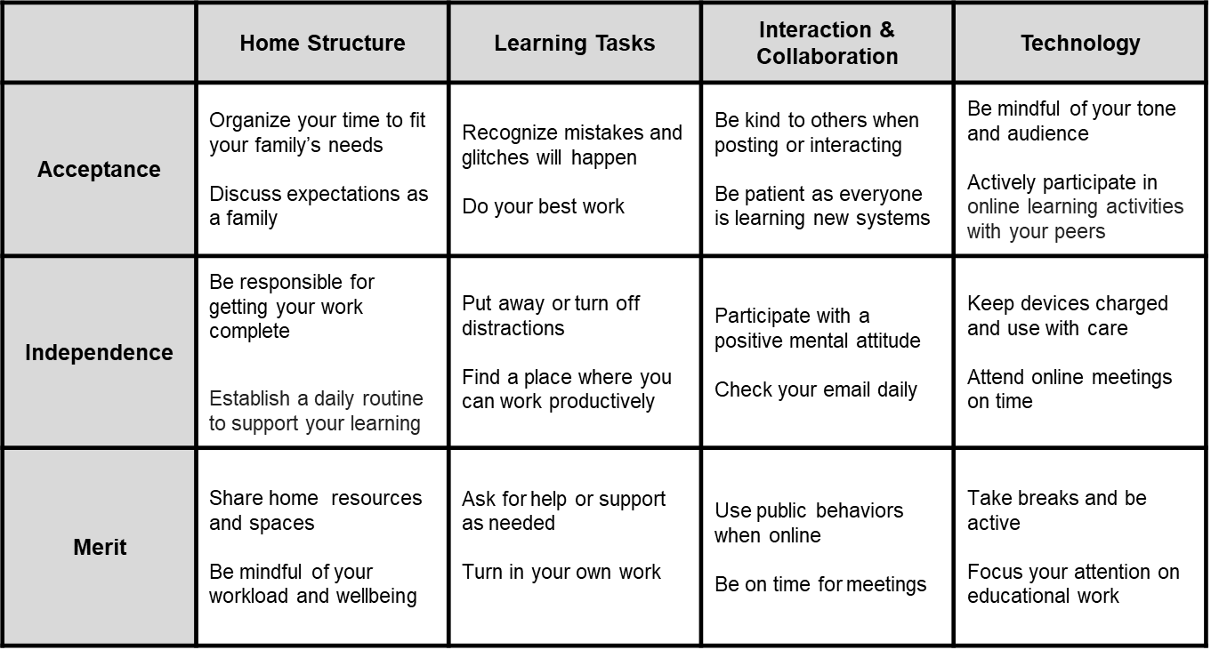
BTC Distance Learning Matrix

Slide 10
AIM TICKETS
At BTC We
At BTC We
For Success
A.I.M.
For Success
A.I.M.
Way to go for showing...
Way to go for showing...
*Acceptance *Independence *Merit
Acceptance
Independence
Merit
Student Name:_______________
Case Manager: ______________
Staff Giving the Ticket: ________
Student Name:_______________
Staff Giving the Ticket:
__________________________
Link to our flowchart
Notes:
Melissa

Slide 11
Some fun things we have done and used with students:
Golden Shovel Award
Bounce Cards
Making Social Learning Stick
Social Autopsy
Wheel of Emotion and Sensation Word List
Notes:
Melissa

Slide 12
Some things we have done and used with staff:
BTC Favorites
May Day Baskets
Staff Form
Managing Escalating Behaviors
How to Address Student Behaviors
Sample Bathroom Lesson Plan using our template
Notes:
Melissa

Slide 13
Implementation Success
Implementation Successes
Student engagement with the process & journey
Students on the PBIS Team presenting to the other students and taking on a leadership role
Staff following through with “AIM”
Students acknowledging each other and holding each other accountable
Notes:
LouAnn

Slide 14
Questions?
Questions???
mpaulsen@isd271.org
lstrachota@isd271.org
Notes:
LouAnn

Slide 15
Thank you for attending!
Notes:
LouAnn

