Slide 1
Pave Your Path Back: Core Systems & Practices for 2021-2022
Summer Institute 2021
Via Zoom
Introduce yourself in the chat and name your favorite summer activity

Slide 2
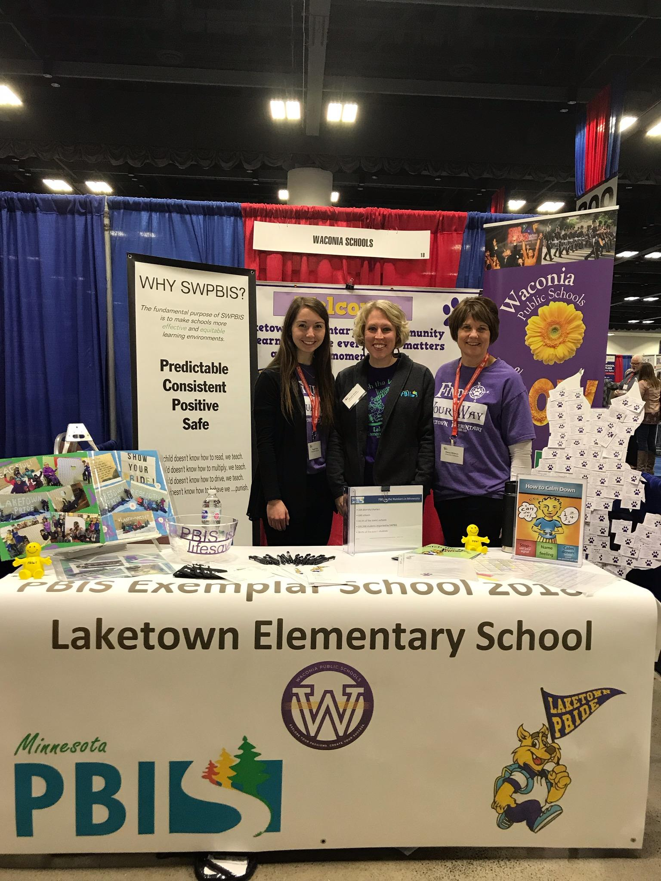
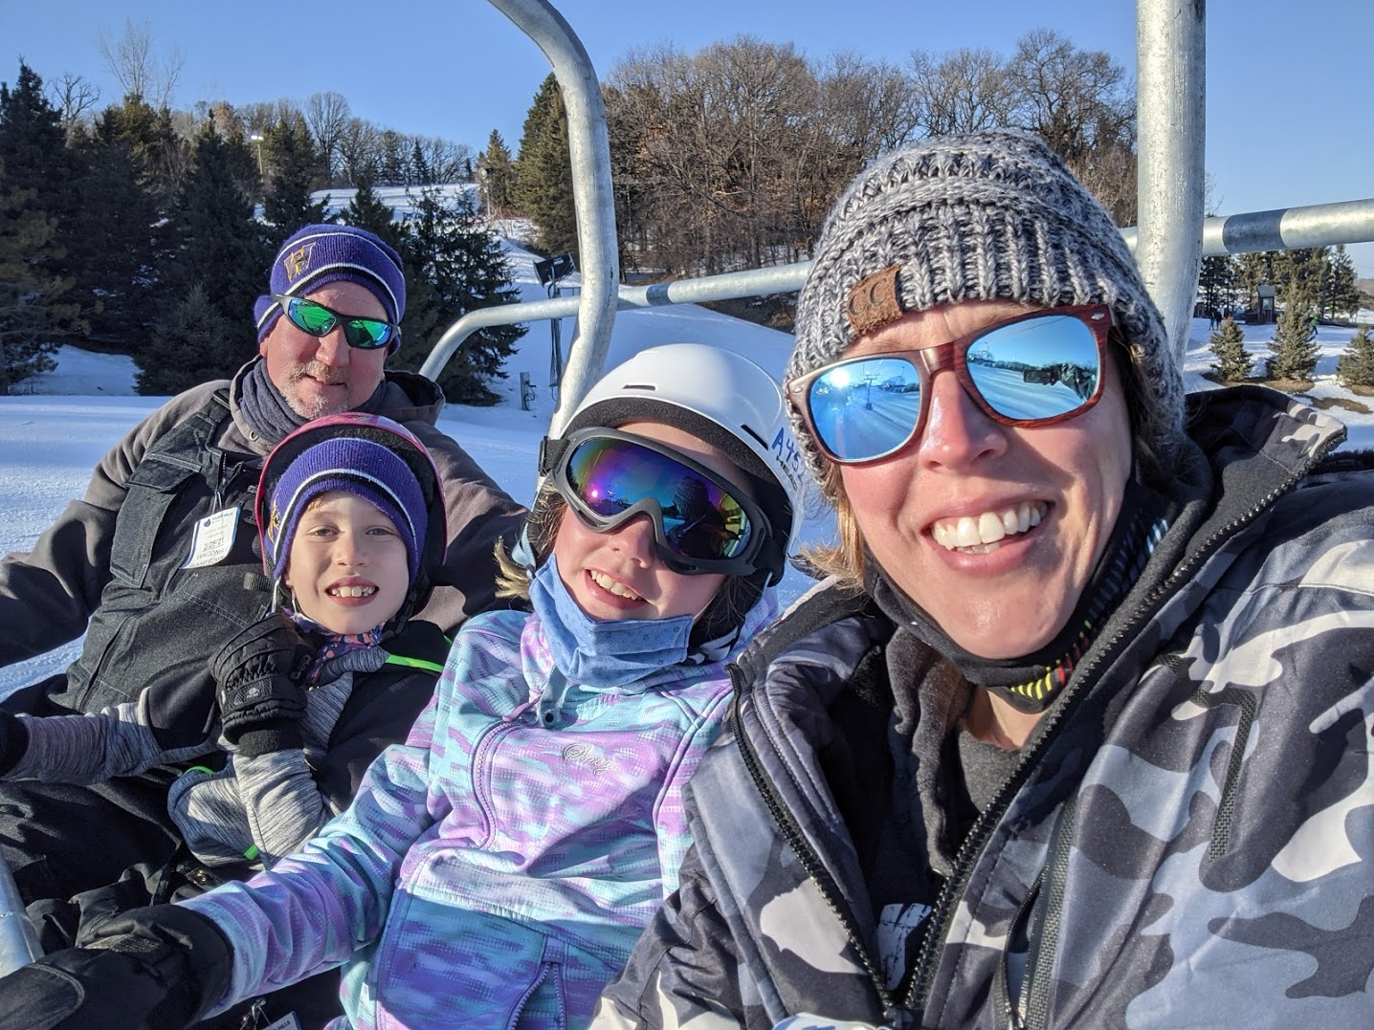
Megan Gruis
Email: pbis.megan@gmail.com
mrip Coaching & evaluation Coordinator
Laketown PBIS Team Parent Rep & PTO
TRAINER STATS: @Coach Gruis
Years implementing PBIS in any form: 13
Years training/coaching cohorts: 9
Area of expertise or favorite part of PBIS: supporting teams, coaches & Districts to enhance implementation, specifically Tier 2, SEL & whole child work
Interesting fact: i have been on a run streak since april 1st, 2020
District #110 cohort 4 & 12
Notes:
PLEASE DO NOT ALTER SLIDES OTHER THAN YOUR OWN.

Slide 3
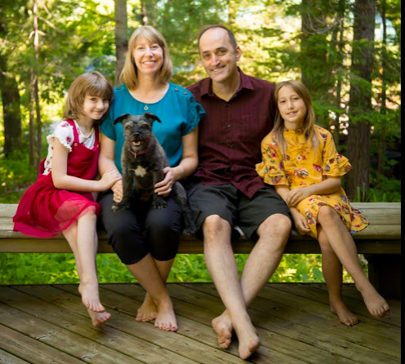
Erin Heine Engness
PBIS Coordinator North Region
Stats
Elementary Teacher 10 years
Cohort 1 Team
District Coach 6 years PreK-12
Trainer 5 years
Regional Coordinator
Minnesota Reading Corps Master Coach
Interesting facts:
*National winner for DECA - Fashion Merchandising
*3 of our cats are named after Star Wars characters
*Bought a new to me car and have only put 3,000 miles on it 4 months.
Notes:
PLEASE DO NOT ALTER SLIDES OTHER THAN YOUR OWN.

Slide 4
We encourage participation by:
Unmute your Microphone
Please share your ideas and ask your questions. Unmute microphone to participate!
Turn on your Video
If you are comfortable share your video during the coach meeting. This helps this meeting feel more personal.
Add your questions in Chat
Please share your questions or comments in the chat box. We are here to support you.
More Ways...
Share your reactions and participate in polls!

Slide 5
Polls/Questions
Notes:
What’s your role at your school site?
Teacher
Special Ed Teacher
Paraprofessional
Student Support Worker(Social Worker, Counselor, Psych, etc)
Administrator
Other - list in chat
What is your role/responsibility on your PBIS team?
Admin Rep
PBIS Coach
Data Analyst
Note Taker/Communicator
Facilitator
Team Member
When did your school go through PBIS Training?
Within the last 3 years
More than 3 years ago
We are a PBIS DIY school
I have no idea!

Slide 6
Session Goals
Reflect on the school year and how to start next school year
Ground the big picture of PBIS into manageable core systems and practices for 2021-2022
Provide resources to guide the work

Slide 7
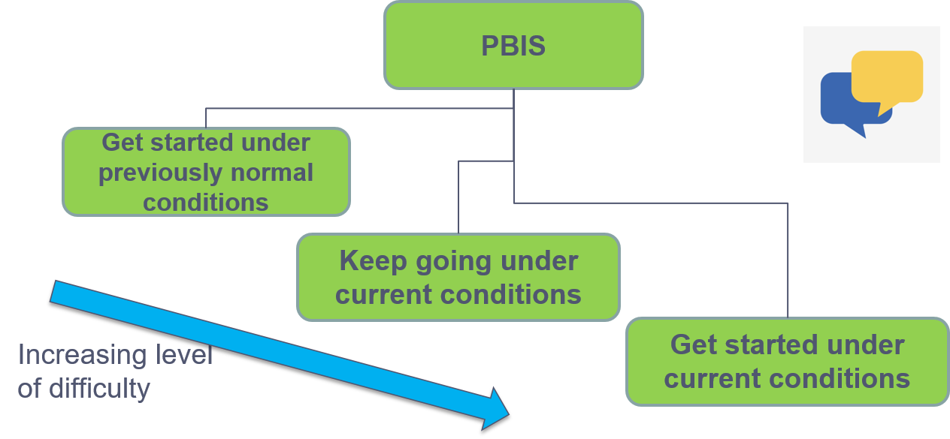
Consider where you are with PBIS Implementation

Slide 8
Consider Your Options
Notes:
Poll -
If you get stuck with your implementation, what usually is the cause? If other, note reason in the chat.
Not sure what to do so won’t do anything
Must do it all so won’t do anything
Other

Slide 9
Grounding Ourselves - Article
Read the Article:
PBIS Practices Pave Your Path to Recovery
Notes:
https://www.pbisapps.org/community/Pages/PBIS-Practices-Pave-Your-Path-to-Recovery.aspx

Slide 10
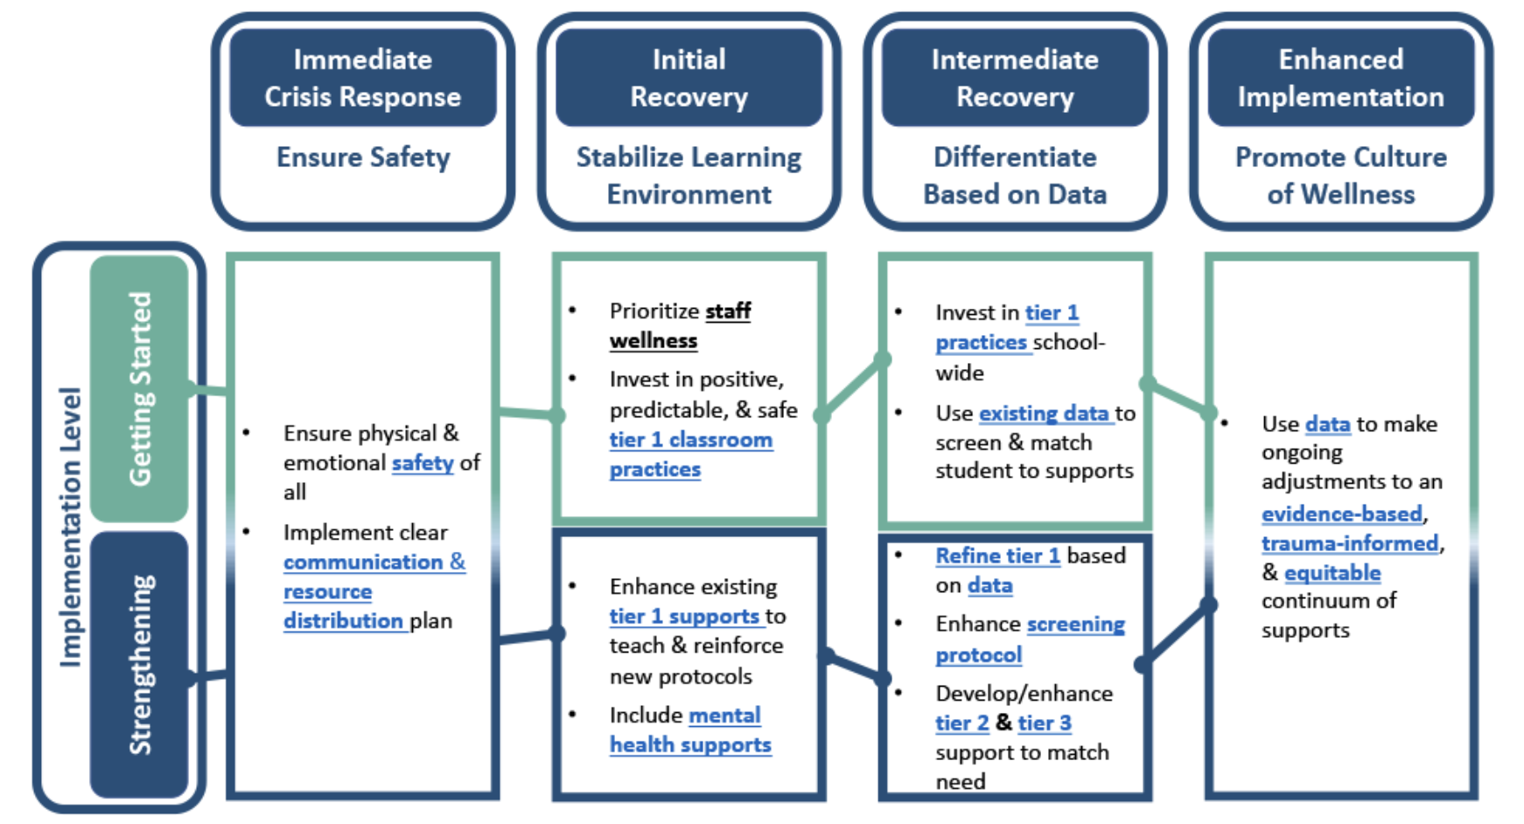
Crisis Response Stages
Notes:
Launch the poll, we will know when they are done when the poll is 100% complete.
Poll Q: What crisis response stage are you currently in? After responding, place a take-away from the article in the chat.
Answer 1: Immediate Crisis Response
Answer 2: Initial Recovery
Answer 3: Intermediate Recovery
Answer 4: Enhanced Implementation

Slide 11
Grounding Ourselves - Reflect
Reflect:
When you look back over the things you did to make this year work, what was more successful than you thought it would be?

Slide 12
Priorities Moving Forward!
“Be adamant about the core PBIS features, be flexible about the rest.” -Rob Horner

Slide 13
Positive and Effective Environments
Teaching behavior exp­­ectations in all situations
Acknowledge and provide specific praise for following expectations
Respond to behavior systematically
Use data for continuous improvement
From these 4 basics, what do you know you need to focus on the most for next year? How do you know?
Notes:
teaching expectations, feedback, response to behavior, using data

Slide 14
Reminder!
There is no successful implementation without a designated TEAM!!!
Teaming Resource
This work is dependent upon a well functioning team that:
Has solid membership, roles & responsibilities
Meets regularly
Owns the work as a team vs an individual leading the team
Will you have new team members for next year? How are you planning to address this?
Notes:
teaching expectations, feedback, response to behavior, using data

Slide 15
1. Directly Teach Behavior Expectations
Teaching plans for behavior expectations are in place
Educators actively teach expectations in current context
Adapt your teaching matrix as needed
Include new procedures
Include district and site-based expectations so everyone can be clear (staff & students)
Consider your stakeholders of staff, students, families
List some “COVID safe” expectations & ways of teaching the strategies you may need to continue.

Slide 16
2. Acknowledge & Specific Praise
Staff have tools to implement praise
Staff are reminded of 5:1 ratio
Re-teach/Remind on Behavior Specific Praise
Contingent, specific, and sincere recognition of a specific behavior exhibited by the student
What has worked to remind staff to praise specific behaviors?
Notes:
https://drive.google.com/file/d/10w4FHt5K4gENZkL2J8o5HJXhfq8f03av/view

Slide 17
3. Respond to Behavior
Go back to behavior definitions and refine as needed
Continue to document behaviors, although it may look different
Continue to use your flowchart
Add in practical responses
Continuum of Response to Behavior
Restorative Practices
SEL Language
What practices do you that can be embedded into your responses to behavior? Give examples of what has/has not worked.
Notes:
https://drive.google.com/file/d/10w4FHt5K4gENZkL2J8o5HJXhfq8f03av/view

Slide 18
4. Use Data
Continue to collect outcome data where/when you can
Office Referrals
Attendance, Health Office, Student Supports, etc.
Allow opportunity for perception data
Students/Families
Think about new data
Engagement data
Coping Skills/SEL data
What data practices did you use this year? Give examples of what has/has not worked.

Slide 19
Priorities Moving Forward! Question 1
KickOffPBISGuide
Planning how to implement priorities with your school community members.
In the chat, which subgroup do you need to focus on the most next year?
Team, Staff, Student, Families?

Slide 20
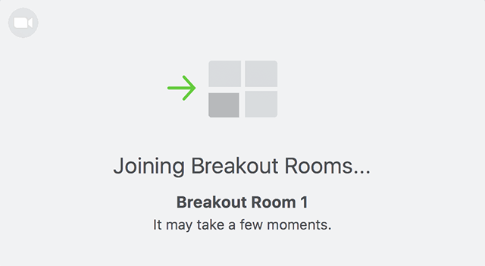
Breakout Discussions
Team To-Dos
Staff Kickoff
Student Kick Off
Families Kick Off
Notes:
https://docs.google.com/document/d/1-gHOj04g9n7VBZ3rQG6LRpy3Ist1Lrdamqhfn2CkYeU/edit

Slide 21
Focus Your Team To-Dos
Team Tasks to accomplish:
Establish a monthly PBIS School-wide Team meeting schedule for the year
Establish schedule for communicating/reporting/problem-solving with staff for the year
Establish schedule of celebrations/reinforcement activities
Plan for Staff Kick-off
Plan for Student Kick-off
Plan for new student training
Plan for Families Kick-off
Plan for Bus Driver Kick-off
Plan for how School-wide Team will provide data to the staff/team managing Targeted & Intensive Interventions
Activities to Conduct:
Conduct all Kick-offs
Administer staff & student Fall Training

Slide 22
Start with Staff
OBJECTIVES
Celebrate commitment to student success- academic, social-emotional, & behavioral
Highlight the research and “biggest idea” of PBIS
“Research is demonstrating that schools make greater academic gains when they simultaneously build a school-wide positive social culture.”
“PBIS organizes adults and students to create a social culture in schools that will encourage positive behavior and interactions, while discouraging problem behaviors. This social culture will lead to a safer environment where students achieve academically and build positive relationships with each other and with adults.”
Notes:
All staff need to have a working knowledge of PBIS-What is my role in PBIS? Where are the resources I need to fulfill my role? How do I do PBIS practices with fidelity?

Slide 23
Move on to Students
OBJECTIVES
Discuss with students the goal of creating a positive school culture
“This year, we are going to work together to really build a positive culture here in our school. We want to make sure that students interact with each other with respect, and that adults interact with students with respect. So, we are going to teach you what is expected of you here at school AND we are going to tell you what you can expect from us. For instance, we are going to celebrate much more regularly when students meet our school-wide expectations and we are going to point out when they are not meeting our expectations and we will reteach them to you.”
Notes:
This is where your Tier 1 SEL practices can be integrated into the PBIS framework-Class Charter from Ruler, Hopes and Dreams from Responsive Classroom, Class Commitments from CD. Start with your school wide expectations and embed them into your SEL structures. This is all about getting students to share how they want to feel at school. What will give them a felt sense of safety, a sense of belong-both are prerequisite to best learning.

Slide 24
Engage your families
OBJECTIVES
Communicate about the goals of PBIS
“The goal is to create a social culture in our school building that will encourage positive behaviors and interactions, while discouraging problem behaviors. This social culture will lead to a safe environment where students achieve academically and build positive relationships with each other and with adults. The foundation of the approach emphasizes teaching students the behaviors we expect to see, reminding them to use those behaviors, acknowledging them when they do, and correcting them when they do not.”
Notes:
Families are a valuable resource for your to make your PBIS culturally relevant for learners. Tap into their knowledge of child and community. Include them in planning and invite them to play an active role in implementation.

Slide 25
Priorities Moving Forward! Question 2
Do few things well!
In the chat, what is one thing that you are taking with you as you plan for 2021-2022?

Slide 26
Contact Information
Megan Gruis
Coaching & Evaluation Coordinator - Metro Region
612-499-2310
pbis.megan@gmail.com
Erin Engness
PBIS Coordinator - North Region
320-267-7818
eengness@resourcecoop-mn.gov

