Slide 1
2023 PBIS Film Festival
PBIS Summer Institute
June 14, 2023
This presentation - https://tinyurl.com/y2eyljwg
John Beach
Princeton Intermediate School
john.beach@isd477.org

Slide 2
Topics
Rubrics for Film Creation
National PBIS Film Repository
Local and National Film Festival Submissions
Video Use Examples

Slide 3
Rubrics for Film Creation
SCHOOL ENGAGEMENT: Videos are defined as videos that align with the principles of PBIS but are not considered instructional. School engagement videos promote a positive school climate by frequently providing a general overview of the schoolwide PBIS program.
INSTRUCTIONAL: Videos are used to teach viewers a concept or skill such as an expected behavior from the PBIS matrix. These videos are grounded in explicit instruction and video modeling.
Engagement type videos (https://tinyurl.com/y3me7jqm)
Instructional videos (https://tinyurl.com/y2ushsfp)

Slide 4
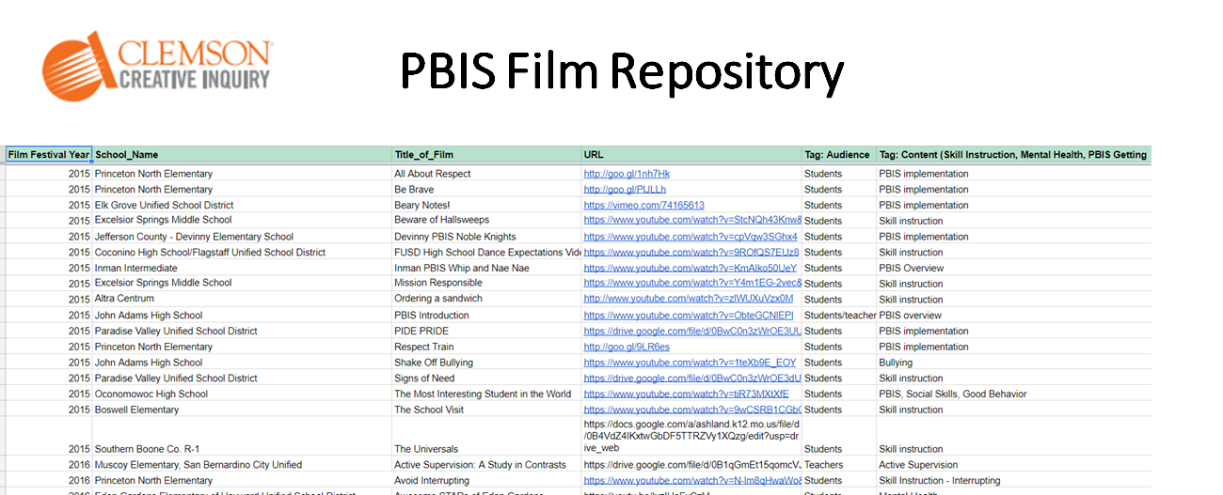
View PBIS Films from 2015-2021
Access the Repository
(https://tinyurl.com/PBISFilmArchive)

Slide 5
Intermediate School Video Library
Intermediate School Video Library (https://docs.google.com/spreadsheets/d/1WsB1YUpFKlLk8YHMml0jUakckbXu0NrrHp2dHU6mDQo/edit?usp=sharing)

Slide 6
Do you have a video you can share?
Do you have a video you can share?
Link it in the chat!

Slide 7
East Union PBIS
East Union PBIS
East Union Elementary
Carver, MN, USA
East Union PBIS Positive Behavior Intervention System
(https://www.youtube.com/watch?v=tAfiAnacExY)
East Union Elementary
Jay Woller
Carver, MN, USA
Dreams Can Come True

Slide 8
PBIS overview
Knox County Schools
Jeffrey Wright
Knoxville, Tennessee
Faculty and Staff
PBIS overview
(https://vimeo.com/203837881/b32860ed52)
Knox County Schools PBIS
Faculty/Staff
Schoolwide PBIS Expectations

Slide 9
Saint Paul Pubic Schools
Saint Paul Public Schools
Erin Metz
Saint Paul, MN
PBIS: A Framework for All Schools
(https://storyboardfilmsmn.wistia.com/medias/m0jzj58ljz)
Teachers, Faculty/Staff, This video was created to share info with all audiences - especially; school board, families and the larger community
Faculty, Staff, Parents, and Community
Elementary, Middle School, High School
School Wide
PBIS overview

Slide 10
Corbin High School
Corbin High School
Kelly Mackey
Corbin, KY
How the Dab was Born
(https://youtu.be/M6OC96iq5Ws)
Students, TE
Health
High
School Wide

Slide 11
Cambridge-Isanti Schools
Cambridge-Isanti Schools
Tammy Kraft
Cambridge, MN USA
Cambridge-Isanti Schools, Every Student Every Day PBIS 2018-2019
(https://www.youtube.com/watch?v=uqWhe5wmcj0&feature=youtu.be)
Community Members or Families
School Pride

Slide 12
Tennessee Behavior Supports Project and Humboldt City Schools
2020
Tennessee Behavior Supports Project and Humboldt City Schools
Shelby Cook
Jackson, TN USA
Family and Community Engagement: BRIDGE Night
(https://www.youtube.com/watch?v=cYbYYr_gh7Q)
Community Members or Families
School Pride
High

Slide 13
IRIS Educational Media and Trifoia
2020
IRIS Educational Media and Trifoia
Adam Wendt
Eugene, Oregon
Parenting Pride: Give Effective Directions
(https://youtu.be/293MGCICyXk)
Community Members or Families
Setting Expectations
Other

Slide 14
Princeton Intermediate
Princeton Intermediate - Get to know staff and appreciate what they do –
Custodians (https://youtu.be/BsLAM5_XmTY)
Cooks (https://youtu.be/ZGBAK76z_hg)

Slide 15
Chippewa Valley Montessori
2017
Chippewa Valley Montessori School, Eau Claire Area School District
Jen Peck
Eau Claire, WI USA
Hallway Expectations
(https://drive.google.com/open?id=0B0EOXl-heAI9UUNtMVgzakFKZms)
Students
Modeling Behavior
Elementary

Slide 16
Central School District 13J
2018
Central School District 13J
Jennifer Kubista, Ed.D.
Independence, OR, USA
ALONE
(https://www.facebook.com/midvalleysuicidepreventioncoalition/videos/1912126939109873/)
Students
Mental Health & Antibullying
Middle School, High School

Slide 17
Dr. N. E. Roberts Elementary School
2020
Dr. N. E. Roberts Elementary School - Polk County Schools
Raihan Duzan
Lakeland, FL, USA
Be a ROCKET
(https://drive.google.com/file/d/1GGK3zzqkr5CELn363kBOclRun4CNsc6a/view?usp=sharing)
Students
Schoolwide Expectations
Elementary

Slide 18
Corbin Independent Schools
2017
Corbin Independent Schools
Kelly Allen
Corbin, KY, USA
Behind the Curtain
(https://youtu.be/_5G7MJAxrKQ)
Students
Mental Health
High

Slide 19
Birchview Elementary
2019
Birchview Elementary, Wayzata Public Schools
Aaron Benesh
Plymouth, Minnesota, USA
Birchview PBIS - Music
(https://www.youtube.com/watch?v=W7UgeAL7nJM)
Students
Elementary

Slide 20
North Mahaska Elementary School
2021
North Mahaska Elementary School
Amber Goemaat
New Sharon, Iowa
Bus Expectations
(https://youtu.be/wh42obXP66I)
Students
Setting or Specific Expectations (e.g., bathroom expectations, hallway expectations, arriving at class on time)
Elementary

Slide 21
Franklin Public Schools
2016
Franklin Public Schools
Gail DeClark
Franklin, WI USA
FHS Saber Pride Lip Dup
(https://vimeo.com/156895038)
Students
School Pride
Middle, High

Slide 22
Vancouver Public Schools
2020
Vancouver Public Schools
Jennifer Blechschmidt, Principal
Vancouver, WA
FOCUS Room
(https://drive.google.com/a/vansd.net/file/d/12YFC7Q1nGAl57-L9vSpNETKtiN2O2TNO/view?usp=drivesdk)
Students
Mental Health/Anti-bullying
Elementary
Mental Health/Anti-bullying

Slide 23
Electronic Lesson Plan
Uses fewer resources
Streamlines lesson delivery and verification
Easier for staff to deliver, all they do is click
Digital timestamp helps with accountability
Easy to quickly remind staff to deliver the lesson
Can easily show newly enrolled students the year’s lesson to get them up to speed
Can use as training for new staff to introduce them to PBS
Engaging for most students

Slide 24
Electronic Lesson Plans
Lesson plan using technology (https://docs.google.com/document/d/17azlGjdsAC-U2f5AUmoXeZyt1CZl9qleUvEb8L6KVm4/edit)
Inspired by Jessica Rogers

Slide 25
Handbook Statement
Photos/Video in School/District Publications/Media Sites
Throughout the year, photographs and video are taken in classrooms, around the school, and at school activities. Some of these may be published in local newspapers, Intermediate School, District 477 publications, broadcasted on Tiger Pride News, or shared with other schools in the state or even nationally. Princeton Intermediate gets a lot of attention because of Tiger pride. IS uses YouTube, TeacherTube, and Vimeo to share of efforts with Tiger Pride. We also have a morning news program which features many, many students over the course of the year.
Parents may request that their children’s photographs and/or video and identifying names not be published or shared. Please make your written request to the principal. (This does not apply to pictures of school events taken by the news media. They are responsible for negotiating their own process for obtaining permission from parents or legal guardians to publish movies or photographs.)

Slide 26
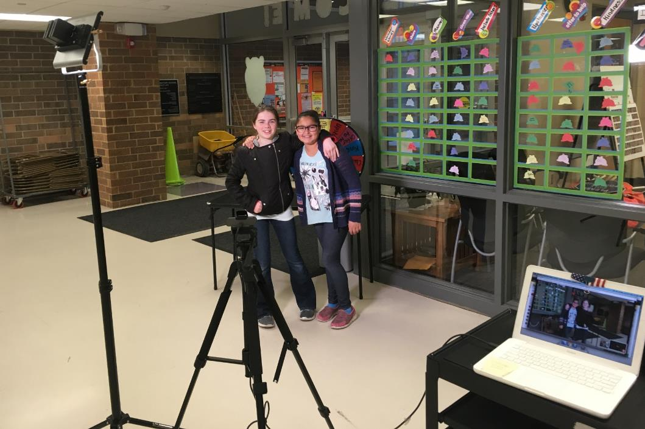
Tiger Pride News
TPN Link – Live morning announcements - Tiger Pride News homepage with morning announcements (https://www.youtube.com/channel/UCt6y6ypj3OiGTjZHwpduFaQ)

Slide 27
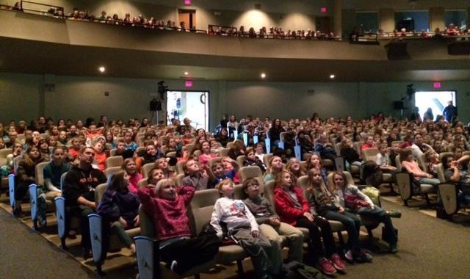
Tiger Pride – Film Festival

Slide 28
Film Festival

Slide 29
Other Examples
No More Gossip – 2013 Best Picture (https://youtu.be/8xtY4lyrZJw?list=PLOxXlvDwofg9ExgYgXiU56BdqhudS-h7w)
Tiger Pride in the Cafeteria (https://youtu.be/wsaWHkKtu98?list=PLOxXlvDwofg__ctkdBXklEqDZ2wJyv6Uz)
Bathroom Dance (http://vimeo.com/groups/pbisvideos/videos/20956797)
Zimmerman – Zebra Pride (http://www.youtube.com/watch?v=jhEjycWp1uk&feature=related)
Active Supervision – There are 3 versions – this is the most recent (http://www.youtube.com/watch?v=u23WEkt1FvM&list=UU1LOKOBZKUJ6kdZtvNWS26w&index=3&feature=plcp)
PBIS Infomercial (http://www.youtube.com/watch?v=4XTzLex8RvI&feature=channel)
Sleepy Eye HS- Tardy (start at 2:15) (http://www.youtube.com/watch?v=r5JZ3yD2f14)

Slide 30
More Examples
Garbagio – keeping the school clean (http://www.youtube.com/watch?v=rT3Nk5EB7SM&list=PLOxXlvDwofg9K9LE7KlujNBBKAitSrMHt&index=29)
Cash Elevator (http://vimeo.com/36485886)
What does the Mustang Say? (https://vimeo.com/groups/pbisvideos/videos/87471546)
Imma Be - John Early Magnet Charter School in Nashville, Tennessee (https://vimeo.com/38387470)
Tiger Pride is Growing (https://youtu.be/cL9UMdOhJ0k?list=PLOxXlvDwofg9ExgYgXiU56BdqhudS-h7w)

Slide 31
National Film Festival Winners
2017 - Nixa, Missouri - Can't Keep From Soarin’ (https://www.youtube.com/watch?v=Mk0ByxJgJmc)
2018 - Tulare, CA Tulare Union High School - HEART Teacher (https://vimeo.com/243022938/3fd9c5a9b4)
2019 - Jonesboro, GA - Mundy's Mill Middle School - 2:00 Bullys No! Anti-Bullying Song (https://youtu.be/8-qM5FzB1Lw)
2020 Film of the Year - 2020 PBIS Film of the Year. LYCO & CCPS Presents: Nirvana (PSA: Teen Suicide Prevention Video)
(https://www.youtube.com/watch?v=5v7u-25EFyE)

Slide 32
2020 Association for Positive Behavior Film Festival
From the 2020 Association for Positive Behavior Film Festival
I have a voice (https://www.youtube.com/watch?v=UkRvgRLApNs)

Slide 33
From the 2021 Association for Positive Behavior Film Festival
W.O.L.F. COVID-19 Expectations
(https://www.youtube.com/watch?v=RPMq_ieCjzk)
Winfield-Mount Union Elementary School, Winfield, Iowa - Shelli Blazic
It’s Going Down at REES (https://drive.google.com/file/d/1-qwHMqRPjnMOAH4CA_DyiPeoCQaEB9Bq/view)
River's Edge Elementary- Clayton County Public Schools, Fayetteville, GA - Tonishia Whitlow

Slide 34
Intermediate School Highlights
Tiger Pride Kids (https://youtu.be/waHzF-miV1Q) - A. Ruzek
We Belong, We are Tiger Strong (https://youtu.be/FQPC3stHn6w) - T. Tschumper

Slide 35
Video Creation/Tips and Tricks
Scripts – Post in large print on poster board “cue cards”
Length – generally 3 minutes or less
Just a tool to start dialogue/teaching/reviewing…
Take an idea and make them your own

Slide 36
Use a Mic
Rysavy - I Love My Job – wired for sound – example at 1-minute mark - Ryan Loves His Job Video (https://youtu.be/l0g7UeFC1aI?list=PLOxXlvDwofg_rVO_WxI_I35Eiu28l7j-w)
Laying a mic in an area or on the quietest person - Cyber Bullying video with example of mic placement (https://youtu.be/Kk8rKzwgyiA?list=PLOxXlvDwofg_ULcD0Yndk26iVOvKLNMyC)

Slide 37
Hollywood Style Intros
Hollywood style video introduction examples (https://goo.gl/PsGJsi)
Ivipid website home page (http://ivipid.com/)

Slide 38
Green Screen
Tiger Pride Tiger Traveling Route 66 (first try with green screen) - Route 66 Video using a green screen (http://www.youtube.com/watch?v=xzprkcKyfcs)
Tiger traveling through time – 2008 Olympics The Tiger travels to the 2008 Olympics - more green screen use (http://www.youtube.com/watch?v=aRvGnmzxhRU)
Superheroes visit the cafeteria - using a green screen (https://youtu.be/aUuF2bwbKJ4?list=PLOxXlvDwofg_rVO_WxI_I35Eiu28l7j-w)

Slide 39
Hardware/Software
Editing Software – PowerDirector by Cyberlink (PC product)
Camera – Sony Handycam FDR-AX100
Microphone - Azden WMS-PRO Wireless Microphone System
iPhone/iMovie – Award winning video – Be Brave - shot on an iPhone - Be Brave video example shot with an iPhone (https://youtu.be/nAnfpCORYwY?list=PLOxXlvDwofg_rVO_WxI_I35Eiu28l7j-w)

Slide 40
The End

