Slide 1
Native Voices for PBIS
Minnesota PBIS Summer Institutes
Thursday, June 15th, 2023

Slide 2
Ten Minnesota Commitments to Equity

Slide 3
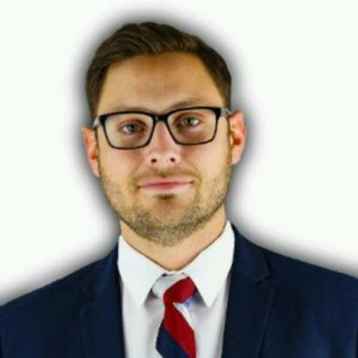
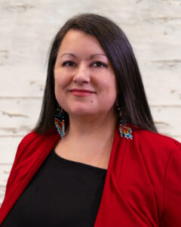
Presenters

Slide 4
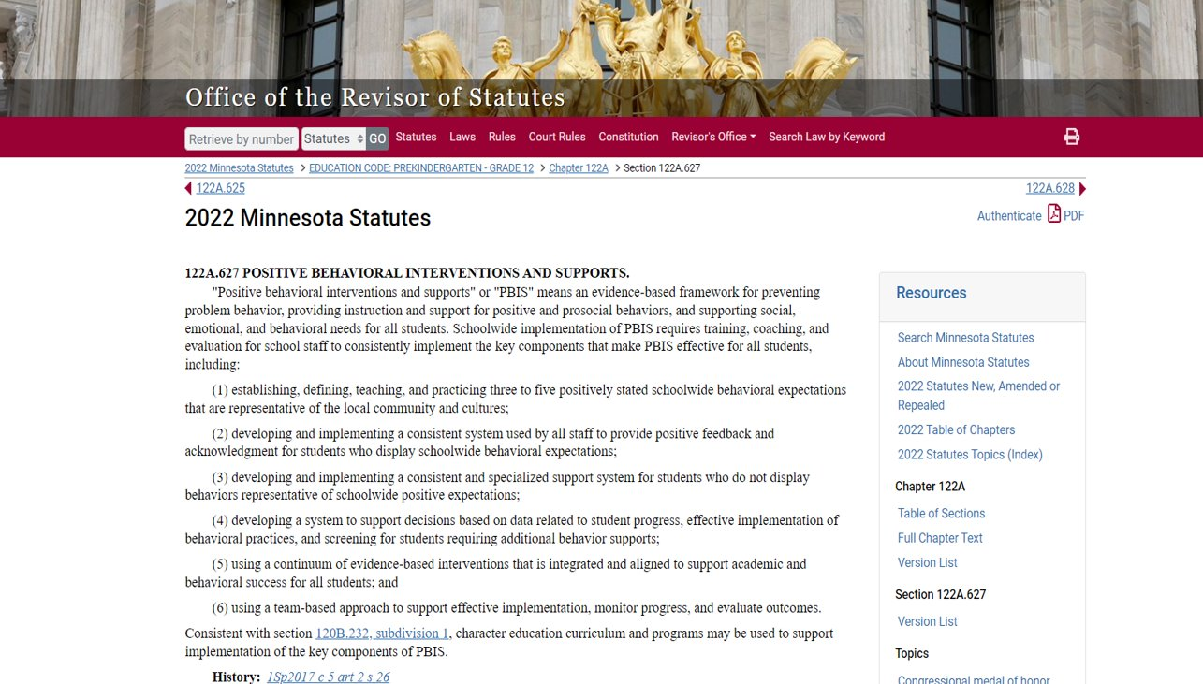
122A.627 Positive Behavioral Interventions and Supports
122A.627 Positive Behavioral Interventions and Supports

Slide 5
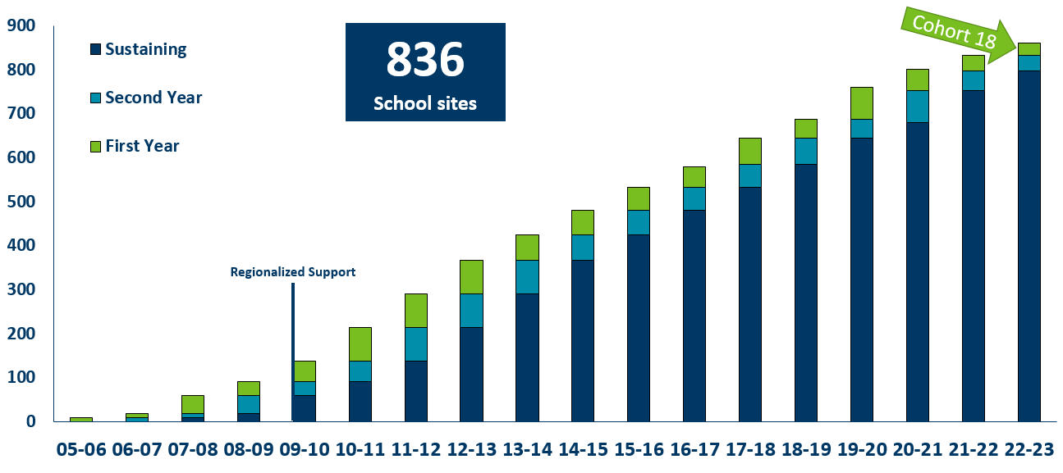
Growth of PBIS in Minnesota 2005-2022
Notes:
PBIS Fact Sheet
https://education.mn.gov/mdeprod/idcplg?IdcService=GET_FILE&dDocName=MDE086099&RevisionSelectionMethod=latestReleased&Rendition=primary
In 2004, MDE began collaborating with Dr. George Sugai, co-director of the National Technical Assistance Center on PBIS. Dr. Sugai worked with MDE to create a State Leadership Team (SLT) and to develop a state action plan and blueprint for supporting schools that were ready to implement SW-PBIS in Minnesota.
Summer 2005 was the first SW-PBIS training in Minnesota with a two-year training including a cohort of nine schools from three independent school districts. The first cohort included elementary, middle and high schools.
Minnesota has since added between 13 and 50 schools per year from a diverse group of districts, cooperatives and charters. A regional support model developed in 2009 accommodated the growing demand for SW-PBIS technical assistance. MDE funded the establishment of three regions (North, Metro and South) to coordinate training, coaching and evaluation across new, returning and sustaining schools and districts. Additionally, adding an evaluation partner ensured a coordinated and comprehensive decision support data system to guide implementation. A representative PBIS SLT managed the entire project. By 2022, 16 cohorts will have completed Minnesota's two-year training sequence. Best practices in applied implementation science ensure multiple and ongoing team support to improve and sustain local PBIS use with fidelity continuously.
Training, coaching and system development are conducted in partnership with the Regional Implementation Projects and evaluation partners funded by MDE. Schools are required to identify a team, generate staff buy-in, demonstrate administrative support, commit to attending all nine sessions over the two years, and regularly collect information on outcomes, implementation and effort.
At the start of the 2022-23 school year, 836 schools in 288 school districts or charters are implementing PBIS in Minnesota.

Slide 6
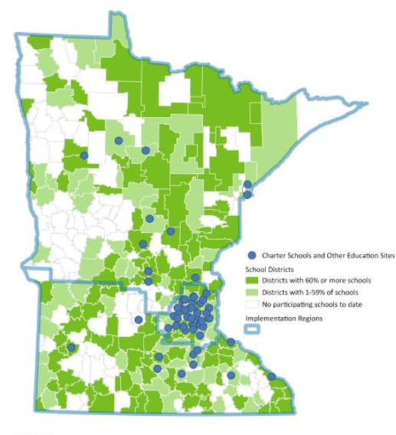
PBIS Scale-Up in Minnesota As of 2022
288 districts/charters
57% of districts/charters in Minnesota
836 schools
40% of schools in Minnesota
392,506 students
45% of students in Minnesota
Notes:
Schools, Districts and Teachers at a Glance
https://public.education.mn.gov/MDEAnalytics/Summary.jsp
Data Sources: MDEORG, MARSS Student
Report Run:03/27/2023
(2022-2023)
Public School Districts 570
Number of Schools 2,239

Slide 7
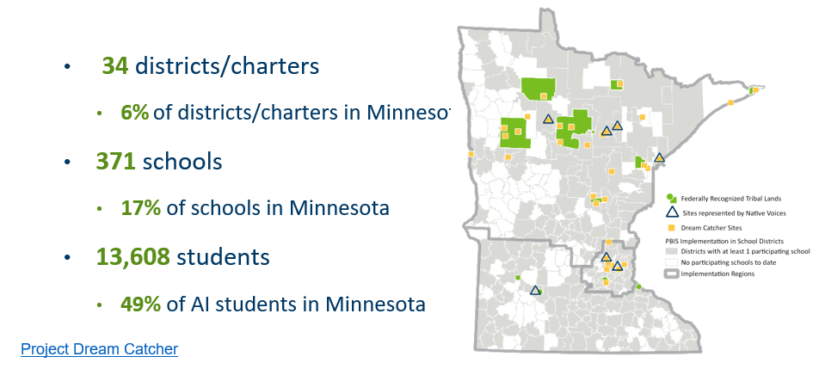
Project Dream Catcher

Slide 8
Fair Systems

Slide 9
Invisibility
Lots of Data but No Change
Reclaiming Native Truth Study (2018)
Over 70% of Americans never encounter or seek out information on Native people.
Strategies for interpreting data and creating representative and supportive systems were not inclusive.
Schools, districts, or states cannot plan for positive change in populations that they do not see or populations that they do not expect to have positive change.
Reclaiming Native Truth Detailed Report Findings

Slide 10
Layers of Support

Slide 11
Unhealthy Layers

Slide 12
Culturally Relevant Layers

Slide 13
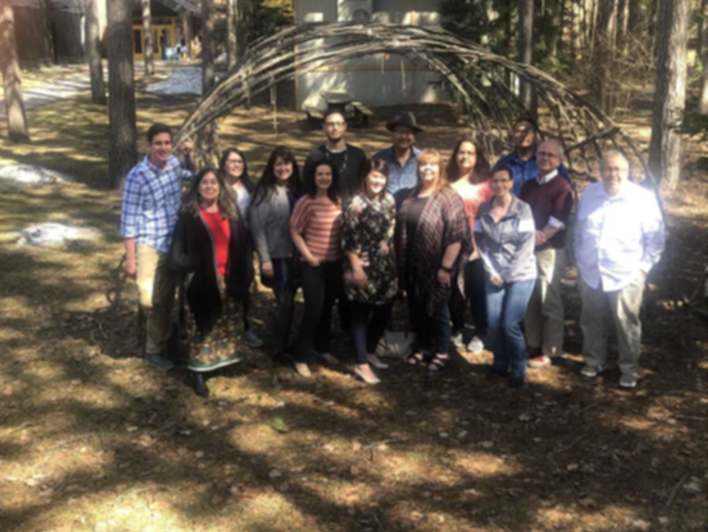
The Dreamers
If we had everything we needed to support American Indian children 7 years from now, what would it be?
April 25, 2019, Fond du Lac Tribal and Community College,
Cloquet, Minnesota​

Slide 14
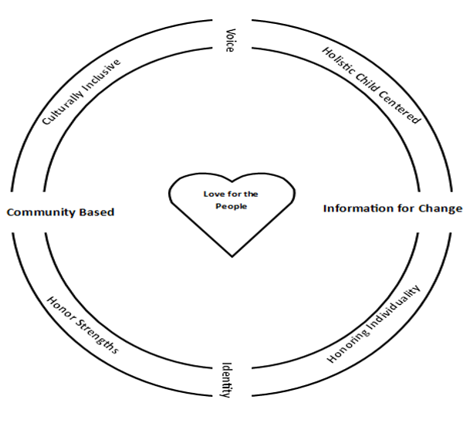
Native Voices
Notes:
Govinda

Slide 15
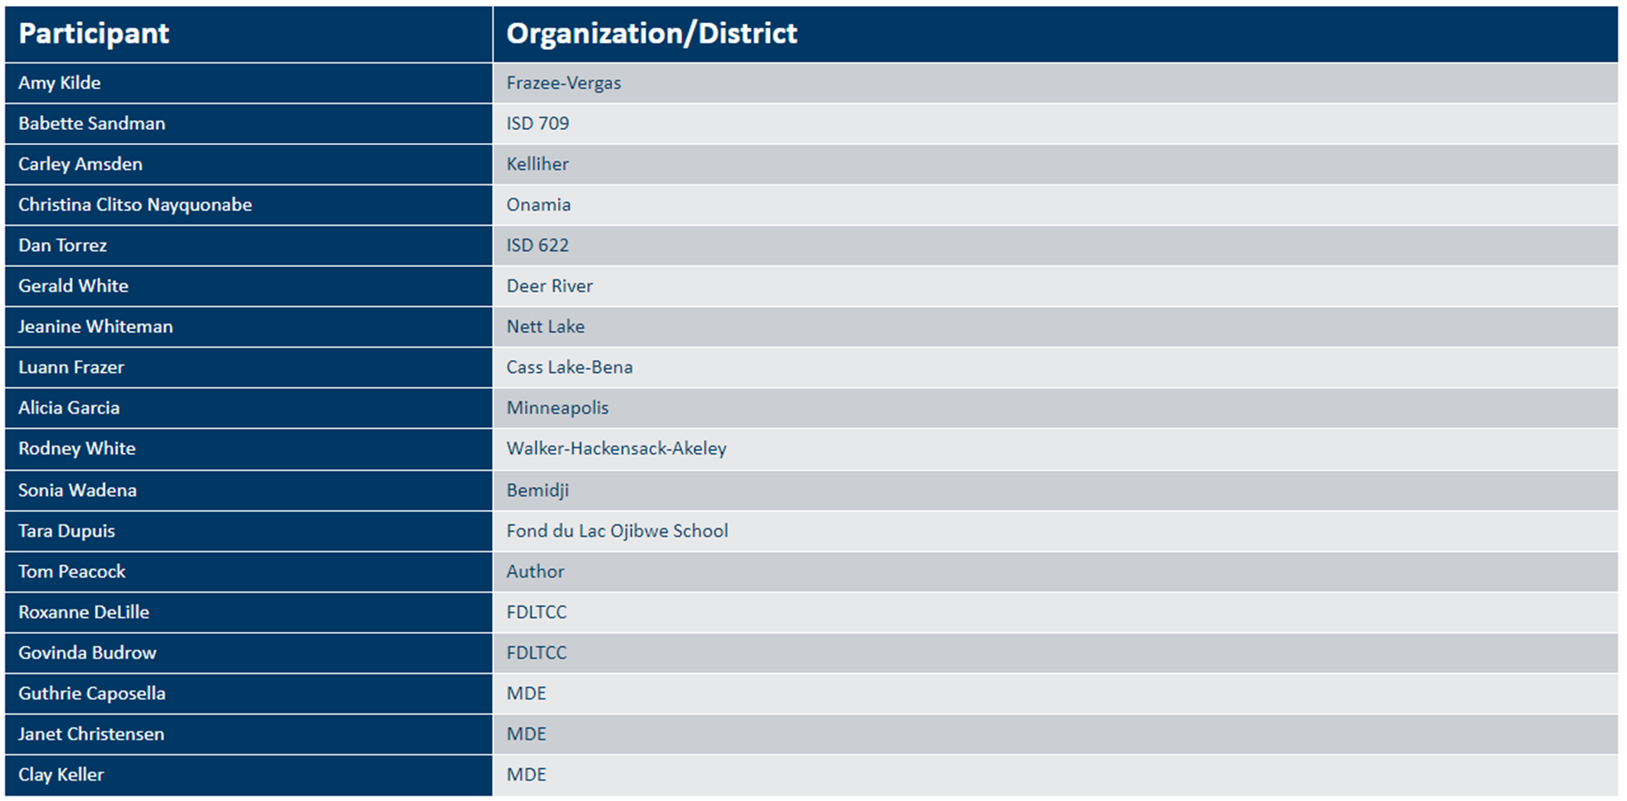
Participants

Slide 16
Native Voices/The Listeners
•Workgroup representing 7 different Indian Education programs and throughout the state.
•Elder Conversation
•Caregiver and Teacher survey
•American Indian Parent Advisory Committee (AIPAC) interviews
•Tribal Nations Education Committee
•School and District American Indian Education Departments
•Office of Indian Education, MDE

Slide 17
Workgroup Participants 2022-2023
Notes:
Govinda

Slide 18
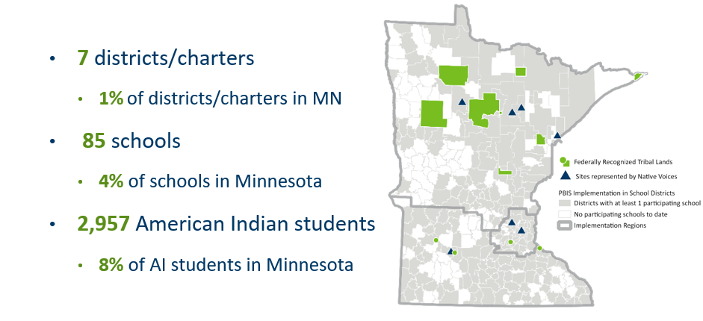
Native Voices for PBIS (2)

Slide 19
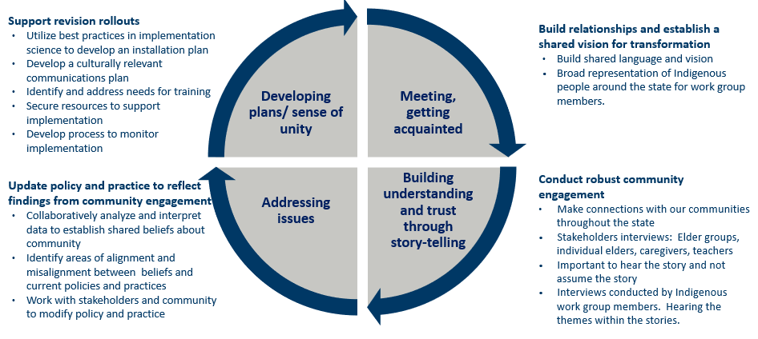
Balance in the Process

Slide 20
Elder Interviews
Notes:
Tamarah

Slide 21
Elder Interview Example Questions
What was the most powerful impact school had on your life, positive or negative? And how, when you reflect back on it, could it have gone better or been improved?
What is your educational philosophy?
What prompted you to get into the educational field?
Describe how your first relationship was built with a student who needed extra support in learning?
What do you wish for future teachers/educators who work with and represent our children/students?
In what way did you advocate for your students in meetings with school co-workers? How could we hold school district accountable for teaching our children “in a good way” that reflects our/their culture and way of life?

Slide 22
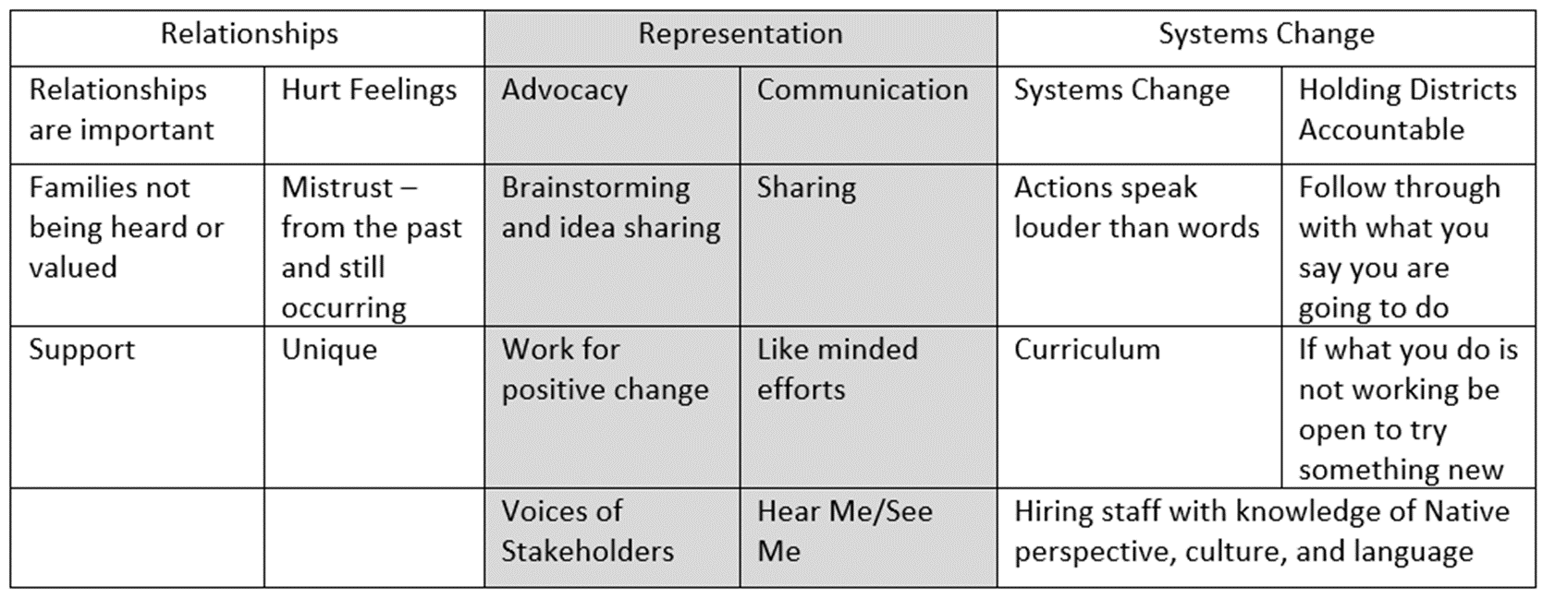
Elder Interview Themes

Slide 23
Tiered Fidelity Inventory (TFI)
Notes:
Tamarah

Slide 24
Greenway Secondary School TFI
What can we do to support American Indian students?

Slide 25
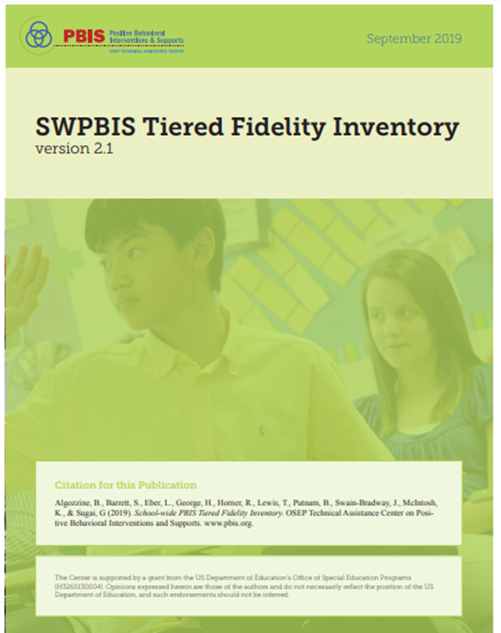
Tiered Fidelity Inventory
•The purpose of the SWPBIS TFI is to provide a valid, reliable, and efficient measure of the extent to which school personnel are applying the core features of school-wide positive behavior interventions and supports (SWPBIS).
•15 item checklist scored on a Likert scale of 0, 1, or 2.
•70% is benchmark for Tier 1 implementation

Slide 26
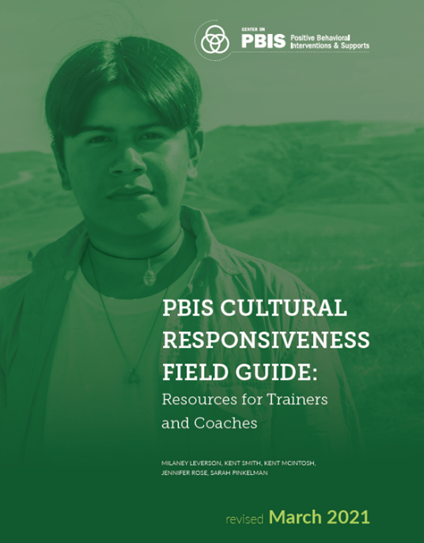
Measuring the Effectiveness of Implementation
•Published in 2016, Revised in 2021
•Schoolwide Positive Behavior Support is not fully implemented unless it is Culturally Responsive.
•Core components of Cultural Responsiveness:
1.Identity
2.Voice
3.Supportive Environments
4.Situational Appropriateness
5.Data for Equity
PBIS Culturally Responsiveness Field Guide

Slide 27
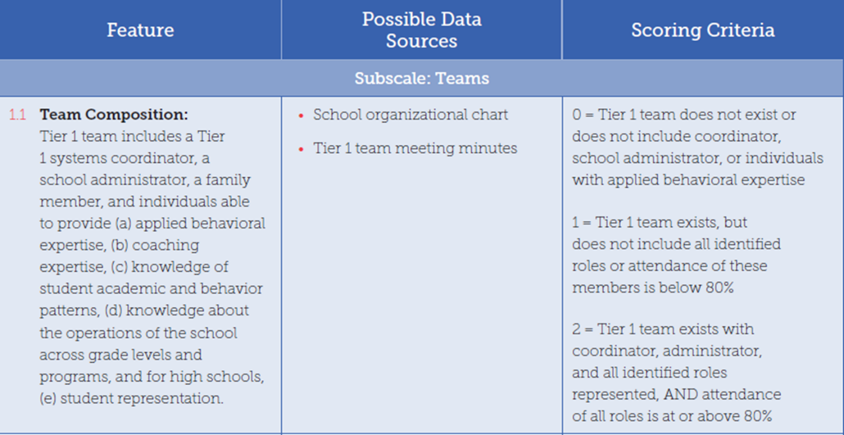
TFI Scoring Example

Slide 28
Team Composition

Slide 29
Greenway Progress
•2022-2023 was an especially difficult year for Greenway School District
•Staffing turnover
•Administration changes
•Staff capacity challenges
•Many action items from 2022 TFI facilitation still "in progress"
•PBIS Team completed their second TFI on 5/9/23
•Implementation as a continuous process (not linear; not a destination)

Slide 30
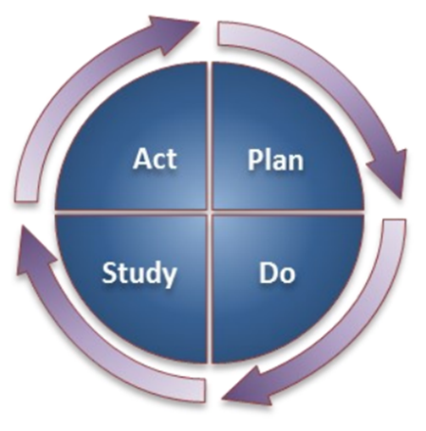
Action Planning

Slide 31
Osseo District Capacity Assessment (DCA)
Notes:
Tamarah

Slide 32
Osseo Implementation Capacity: PBIS Total Score Trend Data: 10 Years

Slide 33
District Wide Implementation – Duluth Public Schools
Notes:
Tamarah

Slide 34
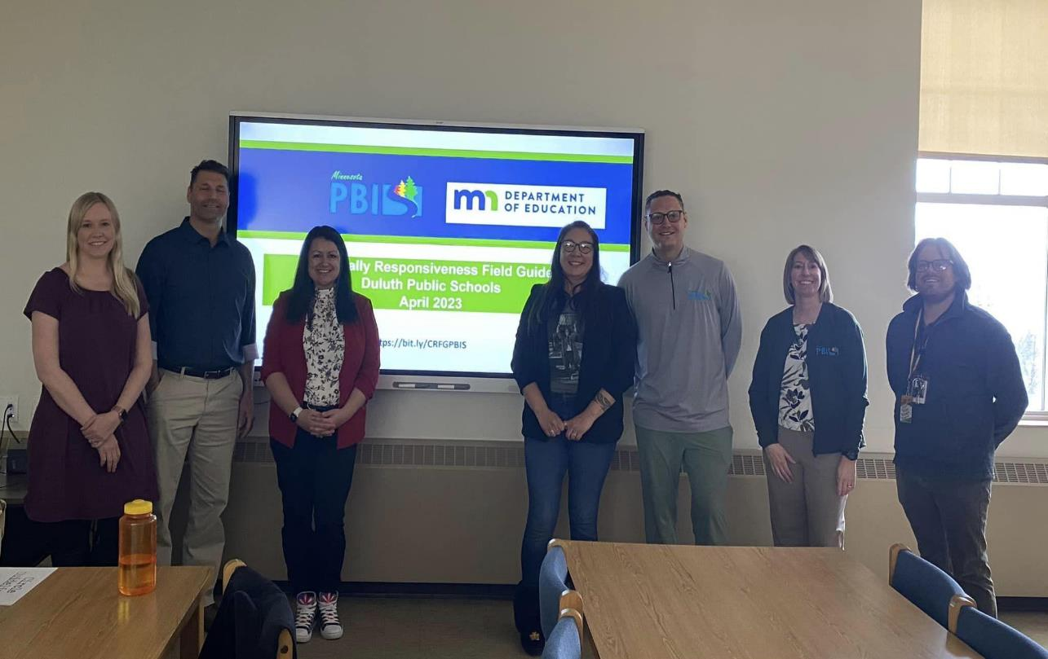
Duluth Training - Cultural Responsiveness

Slide 35
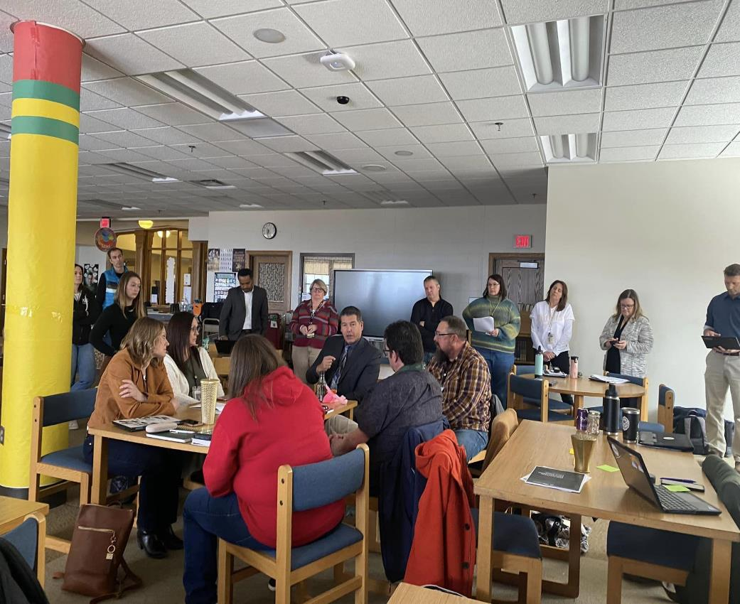
Duluth Plan
PBIS District wide
Cultural Field Guide embedded not an additional task
Ongoing training support
MTSS integration
Representation Indian Education, AIPAC, Equity and Inclusion

Slide 36
Flow Charts
Notes:
Tamarah

Slide 37
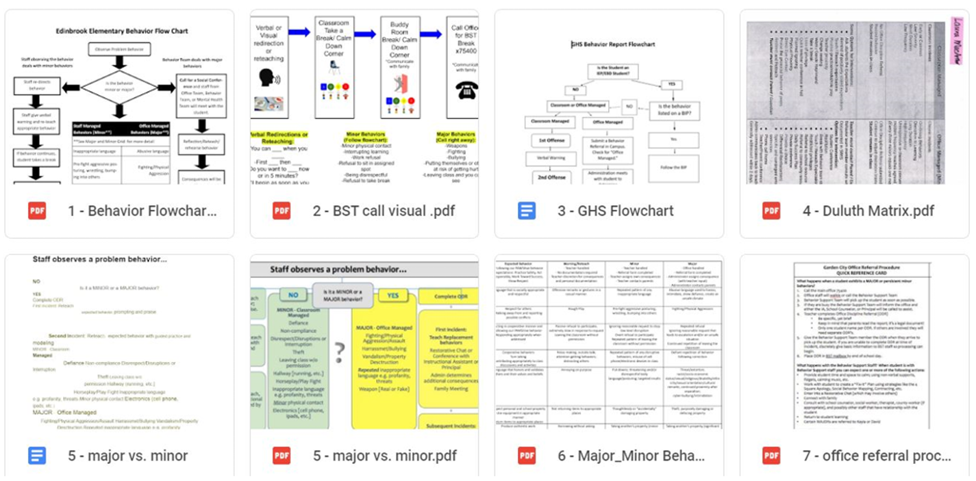
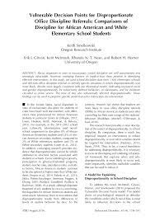
Vulnerable Decision Points
Smolkowski, Girvan, McIntosh, Nese, and Horner, 2016

Slide 38
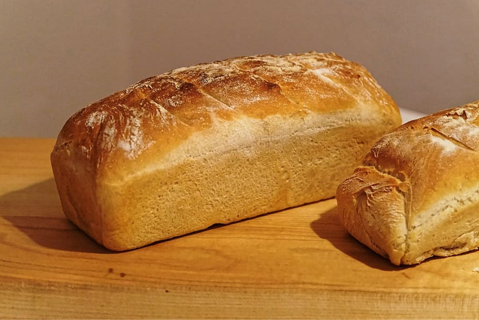
Equity From The Start
What happens when EQUITY is not baked into the system?

Slide 39
SWPBIS School Team Training Application/ Cohort Application
Notes:
Tamarah

Slide 40
Two-year PBIS Implementation Training Cohort Application (2023-2025)
Cohort application guides through Exploration activities to form a team and get data system in place.
Teams get pre-requisites in place to be ready for PBIS Installation, including commitment to data collection and analysis.
https://pbisMN.org/getting-started
Notes:
Tamarah
Every year, the PBIS State Leadership Team selects Minnesota schools that apply to take part in our 2-year PBIS implementation training cohort. Our Regional Implementation Projects coordinate training and support implementation in the northern, southern and metro areas of our state.
Cohort 19 Training Application
We will select Minnesota school teams who apply to take part in our two-year Cohort 19 School-Wide PBIS Training (Summer 2023-Spring 2025) based on complete and accurate information provided in the application. A strong emphasis is placed on:
Evidence of data system that informs behavioral practice;
Administrative support and participation;
Demonstration of staff buy-in/informed commitment; and
Capacity to participate in all required trainings and complete all PBIS assessment tools (TFI, SAS, etc.) in the Data Calendar-at-a Glance.

Slide 41
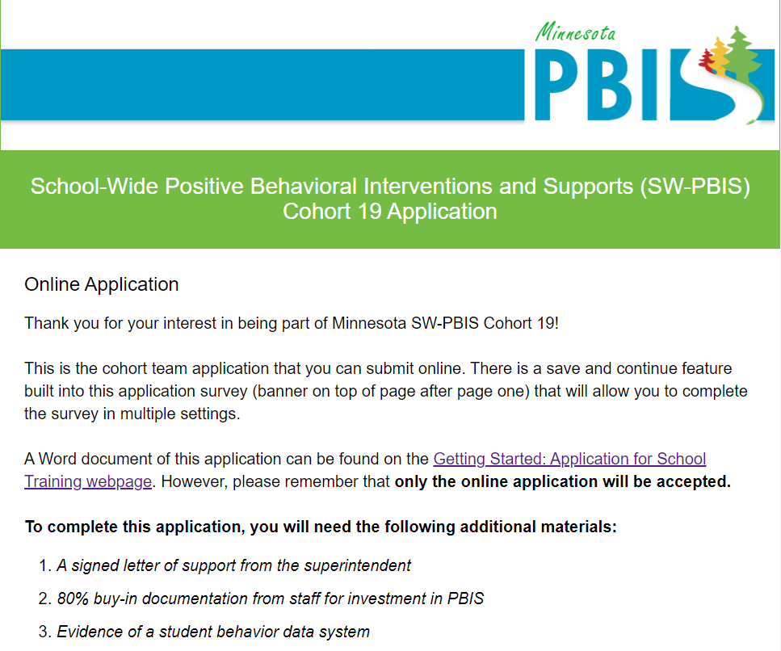
Cohort Application Overview
General Information
Team Information Up to 8 Members
Representative of your school staff.
Consider including American Indian Liaison
SWPBIS Readiness Checklist
Narrative
Endorsement, Input and Support
Does your district have 10 or more American Indian students?
Notes:
Tamarah

Slide 42
Statutory Requirements - American Indian Liaison
Minnesota Statutes Section 124.76 In addition to employing American Indian language and culture education teachers, each district or participating school providing programs pursuant to sections 124D.71 to 124D.82 may employ paraprofessionals. Paraprofessionals must not be employed for the purpose of supplanting American Indian language and culture education teachers.​
Any district or participating school which conducts American Indian education programs pursuant to sections 124D.71 to 124D.82 must employ one or more full-time or part-time community coordinators or Indian home/school liaisons if there are 100 or more American Indian students enrolled in the district. Community coordinators shall promote communication understanding, and cooperation between the schools and the community and shall visit the homes of children who are to be enrolled in an American Indian education program in order to convey information about the program.
Notes:
Dan
General Information
Team Information Up to 8 Members
Representative of your school staff.
Consider including American Indian Liaison
SW-PBIS Readiness Checklist
Narrative
Endorsement, Input and Support
Does your district have 10 or more American Indian students?
As we look to build infrastructure to support American Indian student success within PBIS, the AIPACs provide an resource for PBIS implementing schools to access for teaming structures and implementation feedback.
Unique to Minnesota
Policy of AI Liaison's

Slide 43
Incorporating American Indian Voice - Cohort School Team Training Application
16. School-wide team should be representative of your school staff. In addition to the school administrator, consider including:
Community coordinator or American Indian home/school liaison
Cultural liaisons
General education teachers
Guidance counselors
Paraprofessionals
Parents
School psychologists
Special education teachers
Social workers
Students
Consider team members from your staff, district or community who represent and/or have expertise in the cultures that comprise diversity in your school.
Notes:
Dan
General Information
Team Information Up to 8 Members
Representative of your school staff.
Consider including American Indian Liaison
SW-PBIS Readiness Checklist
Narrative
Endorsement, Input and Support
Does your district have 10 or more American Indian students?

Slide 44
Statutory Requirements
Minnesota Statutes, section 124D.78, subdivision 1, states that a school district in which there are 10 or more American Indian students enrolled and each American Indian school must establish an American Indian education parent advisory committee (AIPAC). These committees are critical to the achievement and success of American Indian students statewide, and offer a valuable opportunity to strengthen district and parent partnerships.
Notes:
Dan
General Information
Team Information Up to 8 Members
Representative of your school staff.
Consider including American Indian Liaison
SW-PBIS Readiness Checklist
Narrative
Endorsement, Input and Support
Does your district have 10 or more American Indian students?
As we look to build infrastructure to support American Indian student success within PBIS, the AIPACs provide an resource for PBIS implementing schools to access for teaming structures and implementation feedback.
So far 11/18 cohort 19 applications meet criteria

Slide 45
Incorporating American Indian Voice Cohort Training Application
Notes:
Dan
General Information
Team Information Up to 8 Members
Representative of your school staff.
Consider including American Indian Liaison
SW-PBIS Readiness Checklist
Narrative
Endorsement, Input and Support
Does your district have 10 or more American Indian students?

Slide 46
Questions?

Slide 47
Miigwech Thank You

