Slide 1
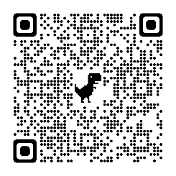
Using the Principal/PBIS Coach Relationship to Implement a Proactive/Instructive Approach to Student Behavior
Presented by Nick Jurrens
Principal - Jefferson Elementary
and
Scott Morrissey
Dean of Students - Jefferson Elementary

Slide 2
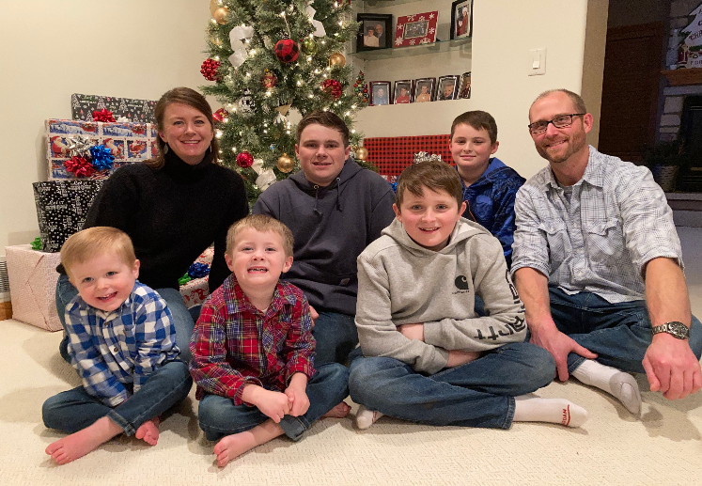
Who is Mr. Jurrens?
19th year in education
5th grade teacher and coach
Elementary principal
Involved in PBIS since 2017
Husband/Father/Step-Father
Clifton Strengths
Learner
Input
Arranger
Ideation
Responsibility
Winona State University
Research-based decision making
Action-research

Slide 3
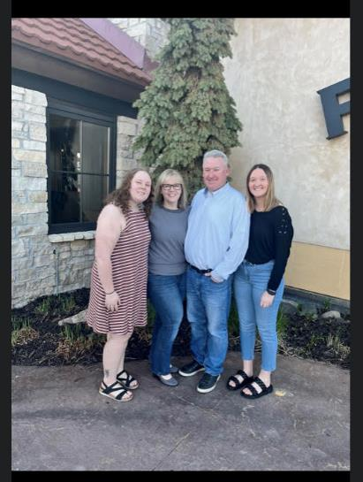
Who is Mr. Morrissey?
24th year in education
4th Grade Teacher at Divine Mercy Catholic School
K-5th Special Education Teacher at the Rice County Day Treatment Center (Level 4)
Emotional Behavioral Disorder (EBD) teacher at Lincoln Elementary
Currently Dean of Students/PBIS Coach at Jefferson Elementary
Husband/Father/Step-Father
Clifton Strengths; Harmony, Developer, Arranger
Head coach in Boys/Girls Basketball, Fastpitch Softball, and current Girls Golf Coach at Faribault High School.
Minnesota State University, Mankato
Elementary Education/Coaching Minor
Masters in Special Education (EBD)

Slide 4
A Little Background…
Jefferson Elementary began their PBIS journey in 2013
Principal… 2013-2017 - PBIS trained
Principal… 2017-2022 - not PBIS trained
NJ/SM… 2022 - PBIS trained
2021-2022 School Year
Things became inconsistent and unpredictable, data not shared or used to make decisions
Building was “on fire”
Calling to ask for help
Scott hired as Dean in December or 2021, unable to take on role until summer of 2022
Nick hired as Principal in April of 2022

Slide 5
Summer 2022
Breaking Down 2021-2022 Data
What is the reality?
Defining our Mindset Around Behaviors
Behavior skills are learned, just like reading and math
Behavior Skills x Social Emotional Skills = Conditions for Learning Academics
Defining Roles and Responsibilities
Defining Processes/Procedures to Create Consistency and Predictability
Behavior Flowchart
ABC Chart - It’s about building the skills of staff
July 27th - Building Relationships with Current PBIS Team
August 8th-16th - New Leadership Transition Meetings with Staff

Slide 6
Implementation
Rethinking Discipline and Every Opportunity
Shared with PBIS team on July 27th
Shared with Jefferson staff at the beginning of workshop week
Behavior Flowchart
Shared with PBIS team on July 28th
Shared with Jefferson staff at the beginning of workshop week
SWIS Paperless Referrals
Shared with PBIS team on July 27th
Shared with Jefferson staff at the beginning of workshop week
PBIS Coach and Principal’s Secretary ensured all staff had access
ABC Chart
PBIS Coach fills out with staff member who submits minor in SWIS
TFI (Tiered Fidelity Inventory)
Completed by PBIS Team on October 12th

Slide 7
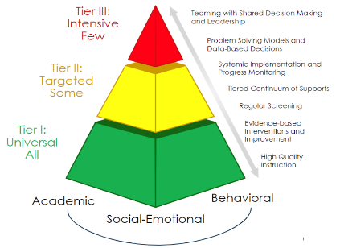
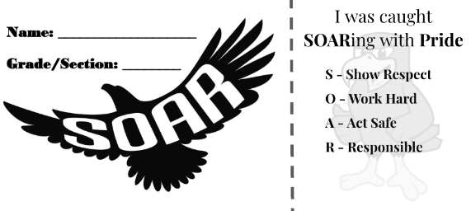
Execution
Consistent and Predictable Language
Falcon Pride Traits
Consistent and Predictable Responses to SWIS Referrals
Scott - all minors
Scott/Nick - majors
Communication/Follow-up with staff
Consistent and Predictable Access to Data
April SWIS Data
Focus on the MTSS Triangle
Consistent Access to and Visibility of Scott and Nick
Hallways, classrooms, lunchroom, etc whenever possible
Meetings with staff (formal and informal) to listen, process, and problem solve
Consistent Modeling of Expected Behavior
Relationships matter!
Bring Calm to the Chaos
Consistently Gather Feedback from Staff
Formal and informal

Slide 8
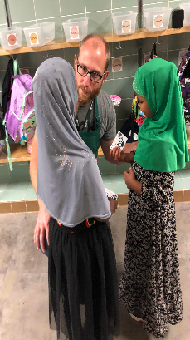
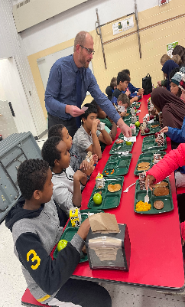
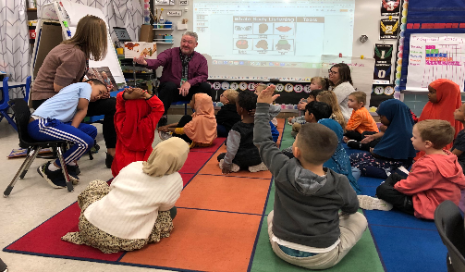
PBIS Best Practices
PBIS is a Framework and Mindset
not a Curriculum/Program/something we do
Define Consequence
A consequence is a result of something that happened prior
Focus on Tier I first
You can’t intervene yourself out of a Tier I problem
Model What You Expect
Teach/Co-Teach SEL Lessons
Whisper Criticism/Shout Praise
Monthly Falcon Pride Assemblies
PBIS Coach leads the PBIS Team
PBIS Team Meetings
Get your agenda organized and follow it
Consistency and Predictability
Celebrations Team/Lesson Planning Team
Dedicate Time
Running agenda item at staff meetings
PBIS Board Certified Behavior Analyst Presentations
Gather Feedback
Exit Slip results from staff meetings

Slide 9
Questions/Discussion/Feedback
We would appreciate your feedback!
Nick Jurrens (njurrens@faribault.k12.mn.us)
Scott Morrissey (smorrissey@faribault.k12.mn.us)

Slide 10
Tier 3 - Intensive, Individualized (3-5%)
Tier 2 - Targeted for Small Groups
(10-20%)
Tier I - Core/Universal
(100%)
Notes:
10
Our language and the ways we communicate with our colleagues, families, and other school community members is important. Sometimes we hear folks referencing T II students or T III students. It's important to communicate that the tiers refer to the layer of support and we use person first language. So, it might be a student needing T II support with math computation or a student needing TIII support with comprehension or a student needing TI support with making friends.
Support is always “layered” onto the previous supports. When a small group of students require a little more support, they continue to receive universal/tier 1 core or instruction. Students receiving secondary supports have increased opportunities for more frequent contingent feedback, additional structure, re-teaching of expectations, etc.
Students in need of intensive, individualized support, continue to receive universal supports. Tier III often builds upon the supports that the student receives with Tier II interventions.
All that we do is anchored to tier 1 and this is true for social and academic (e.g., literacy, math) instruction.
10

