Slide 1
Transitioning Students from the Pyramid Model to PBIS
PBIS Summer Institute 2023

Slide 2
Introductions
Scott Lhotka, Director of Community Education, Westonka Public Schools
Dr. Emily Rustman, Director of Special Services, Westonka Public Schools

Slide 3
Learning Targets
Understand the essential components of the Pyramid Model (PM) and Positive Behavior Interventions & Supports (PBIS)
Understand the differences and similarities between the PM and PBIS
Provide examples of collaboration between Early Learning and Elementary programming

Slide 4
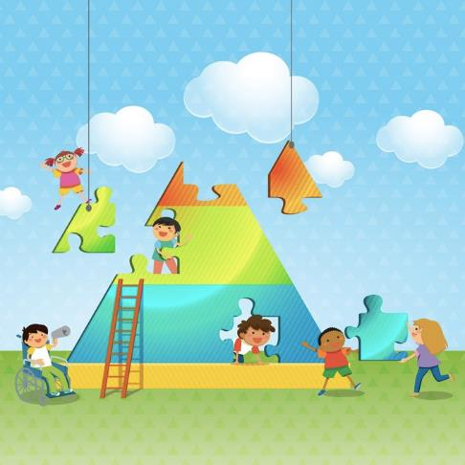
Our Journey with the Pyramid Model (PM) & PBIS
7 years of implementing PM
Essential components of PM are: promotion, prevention and intervention to support children socially and emotionally
6 years of implementing PBIS K-7
Essential components of PBIS:
Formally teaching common expectations
Provide research based interventions
Reinforce the positive behaviors
Notes:
Emily talk about PM
Scott talk about PBIS

Slide 5
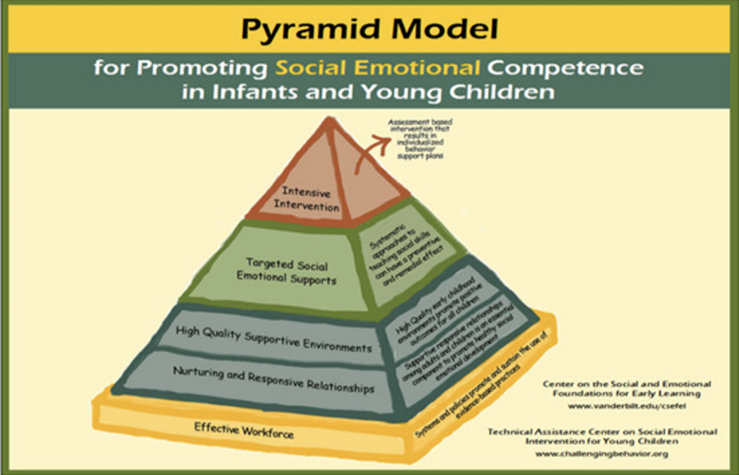
What is the Pyramid Model (PM)?
Notes:
Emily - Discuss

Slide 6
What is the Positive Behavior Intervention & Supports (PBIS)? (2)
Three Major Components of PBIS
Teaching appropriate behavior in all settings.
Interventions when behavior expectations are not met.
Recognition when behaviors are met
Notes:
Scott does 6

Slide 7
What is the Positive Behavior Intervention & Supports (PBIS)? (3)
PBIS is a CULTURE
PBIS is a 3-5 year process.
It is a data driven program that has helped schools reduce their office referrals by 50% the first year.
It focuses on a school’s ability to teach and support positive behavior for all students.
It is a SCHOOL-WIDE design for discipline.
It is for (and by) ALL students, ALL staff, and in ALL settings.
Notes:
Scott

Slide 8
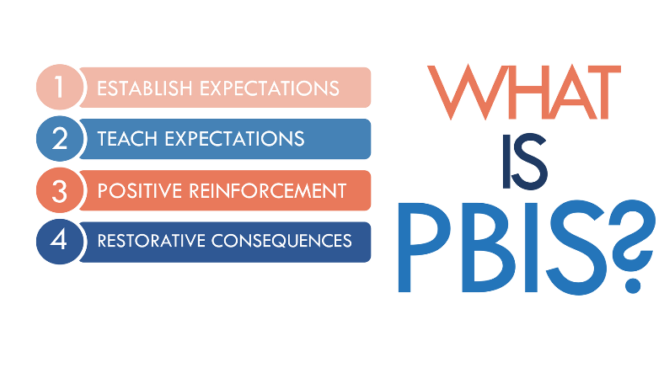
What is the Positive Behavior Intervention & Supports (PBIS)? (4)
PBIS is a team based process for creating a safe and effective school environment through systematic problem solving, planning, and evaluation.
It’s a system approach to enhance schools by education children on schoolwide and classroom behavior support systems.
https://www.lauramooiman.com/post/what-is-pbis
Notes:
Scott

Slide 9
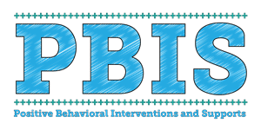
What is the Positive Behavior Intervention & Supports (PBIS)? (5)
The process focuses on teaching and supporting positive behavior of all students.
PBIS is a framework for schools to create a common set of expectations
Notes:
Scott

Slide 10
PM vs PBIS: Compared
Pyramid Model
What does PM look like:
Multi-tiered Model
Assessment based intervention that results in individualized behavior support plans
Systematic approaches to teaching social skills
Supportive responsive relationships
sustain the use of evidence-based practices
2- 4 short & clear expectations
Classroom wide Model School wide
PBIS
What does PBIS look like:
Multi-tiered Model - 3 Tiers
3-5 common short & clear expectations
School wide Matrix
Data based decision making
School wide Model
Notes:
Emily - PM
Scot PBIS

Slide 11
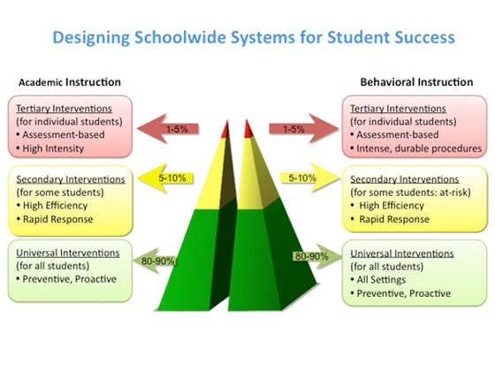
PM vs PBIS: Compared (2)
Notes:
District Wide MTSS Plan
Multi- tiered Approach
3 tiers in Early Learning
3 tiers in Elementary
Coordinated Problem Solving Team
Schoolwide Expectations & Celebrations Assemblies

Slide 12
PM vs PBIS: Site Defined
Pyramid Model
An ECSE program of a local school district in MN, and their inclusion partners including, but not limited to:
Voluntary Pre-K/School Readiness
School Readiness Plus
Early Childhood Family Education
Early Childhood Special Education only classrooms
Head Start
Center Based Child Care programs
PBIS
A public, private or charter school setting varying in age level from Pre-K to 12 and may include
Community Education
ALC
Special Education Setting IV
Transition centers
Juvenile Justice schools
Notes:
PM - Emily
PBIS - Scott

Slide 13
PM vs PBIS: Coaching
Pyramid Model
Internal Coaches:
Attend full day Practice Based Coaching (PBC) Training
Attend 2 Day TPOT Reliability Training
Voluntarily participate Coaching Connections
Coach coachee teams to “fidelity”
Behavior Coaches:
Attend Practice Based Coaching Training
Voluntarily participate in Behavior Coach Networks
PBIS
Coaches attend regional coaching days in the fall where they learn about coaching role & responsibilities, take the annual coach self-assessment, and develop SMARTE goals.
Additional coaching sessions in-person, on-site, and virtual are offered to coaches based on the two year scope and sequence AND their personal action plan and goals.
Multiple check-ins on progress, data decision making, and content sharing is done based on individual coach needs.
Notes:
PM - Emily
PBIS - Scott

Slide 14
PM vs PBIS: Data Systems
Pyramid Model
Statewide: Online data system to measure innovation data housed on MDE’s EDIAM platform: Minnesota Innovation Implementation Data (MIID)
School level:
TPOT to measure practitioner’s use of Pyramid Model practices and to set goals for coaching;
Internal Coaching and Behavior Coaching logs to determine amount of time spent and strategies used;
Benchmarks of Quality; to guide Implementation Teams to effective program wide adoption.
Student level: BIRs (Behavior Incident Reports) to monitor incidents of challenging behavior of individual children
PBIS
Statewide: Quickbase is used to collect and review statewide fidelity and outcome data. Schools in and out of training update contact information here, and upload existing outcome data and automatically upload fidelity data from pbisapps.
School teams: PBISapps is used to measure implementation fidelity using the Tiered Fidelity Inventory and Self Assessment Survey primarily - but there are others used
(BoQ, School Climate, etc.)
Notes:
PM - Emily
PBIS - Scott

Slide 15
PM vs PBIS: Resources
Pyramid Model
National Center on Pyramid Model Innovations
Pyramid Model Consortium
Pyramid Model Share Site
PBIS
www.pbis.org
https://www.midwestpbis2.org/home/what-is-pbis
https://www.pbismn.org/
Tier I Training Materials
Notes:
PM - Emily
PBIS - Scott

Slide 16
Early Learning Efforts Connected to Elementary Efforts: Westonka Examples
Expectations around common areas
Restorative Practices
Stop and Think/Pause and Process
Positive Rewards for Positive Behaviors (stickers, tickets home, etc.)
SWIS and EC-SWIS
Notes:
Emily

Slide 17
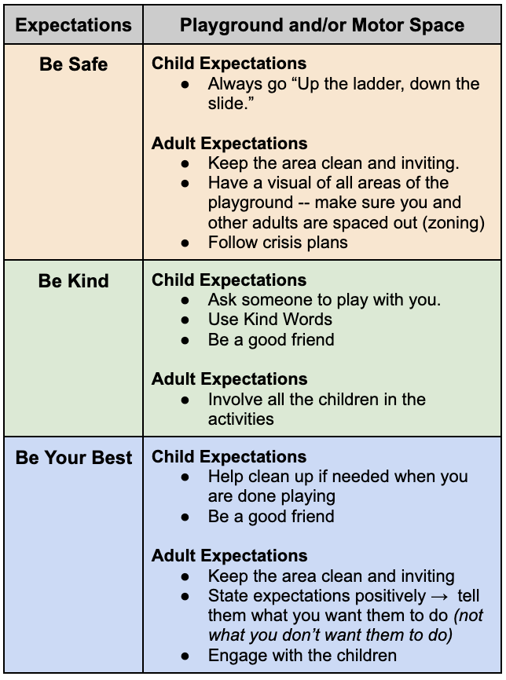
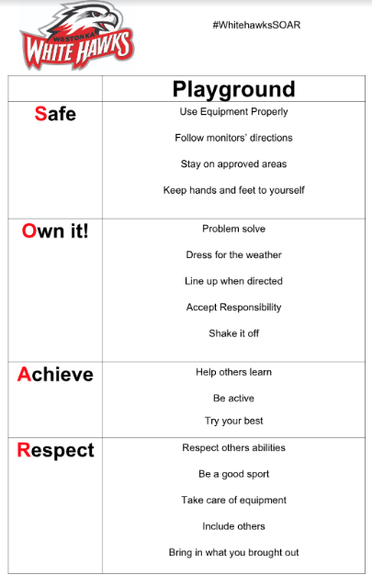
Collaborative Examples
Early Learning Elementary
Notes:
Emily Scott

Slide 18
Transition Efforts from Early Learning to Elementary
Kindergarten Readiness Meetings in March
Introduction to SOAR with Early Learning kid
Expectations
BIRS Data, Stop & Think Data, Matrix (Be Safe, Bek Kind, Be Your Best)
Notes:
Emily and Scott Collabo

Slide 19
Where do we go from here?
Classroom Engagement Model (CEM) Efforts for Early Learning
Phasing this in
MTSS alignment
Increased collaboration between Early Learning and Early Elementary
Notes:
Both - Collaborate

Slide 20
Questions?
FEEL FREE TO CONNECT WITH US!
Scott Lhotka → lhotkas@westonka.k12.mn.us
Dr. Emily Rustman → rustmane@westonka.k12.mn.us

Slide 21
Thank You!

