Slide 1
PBIS Team Training 1B
Fidelity Data (TFI 1.14)
Annual Evaluation (TFI 1.15)
Notes:
Updated July 2019
Updated 7/2018

Slide 2
Learning Expectations
EXPECTATION | BEHAVIOR
Be Responsible | Make yourself comfortable Take care of your needs (water, food, restroom, etc.) Action plan to implement what you are learning Follow through on your action items
Be Respectful | Turn cell phones off or to “vibrate” Listen attentively while others are speaking Have only the training materials up on your computer/tablet/phone
Be Engaged | Ask what you need to know to understand and contribute Contribute to the group by sharing relevant information and ideas
Notes:
2

Slide 3
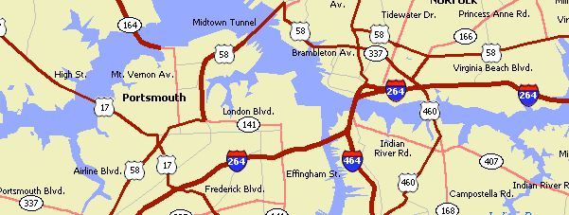
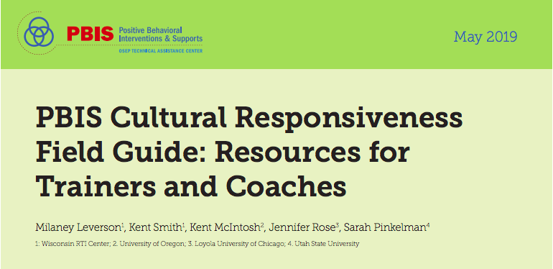
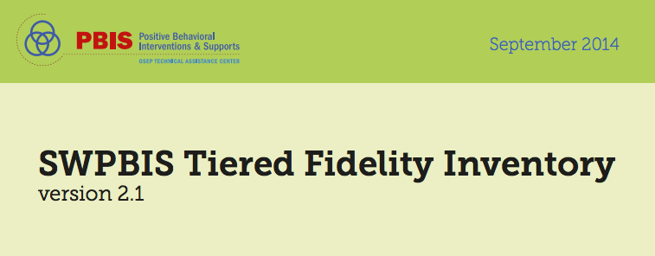
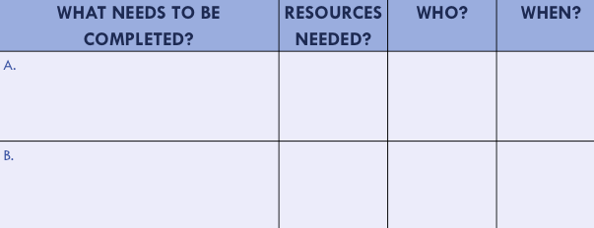
Organization of Modules
Organization of Modules
Content:
Aligned to TFI Items 1.1 – 1.15
Activities/Team Time: Activities for Fluency
Culturally Responsive:
Aligning culturally responsive practices to the core components of SWPBIS
Self-Assessment:
Tiered Fidelity Inventory
Action Planning: Applying the core content to your school
Notes:
These are the icons that you will see throughout the training and will serve as a guide and a prompt to the content of each slide.

Slide 4
Tier 1: Professional Learning Roadmap
TFI Sub-Scale: Team
TFI 1.1 | Team Composition
TFI 1.2 | Team Operating Procedures
TFI Sub-Scale: Evaluation
TFI 1.12 | Discipline Data
TFI 1.13 | Data-based Decision Making
TFI 1.14 | Fidelity Data
TFI 1.15 | Annual Evaluation
TFI Sub-Scale: Implementation
TFI 1.3 | Behavioral Expectations
TFI 1.4 | Teaching Expectations
TFI 1.5 | Problem Behavior Definitions
TFI 1.6 | Discipline Policies
TFI 1.7 | Professional Development
TFI 1.8 | Classroom Procedures
TFI 1.9 | Feedback and Acknowledgement
TFI 1.10 | Faculty Involvement
TFI 1.11 | Student/Family/Community Involvement

Slide 5
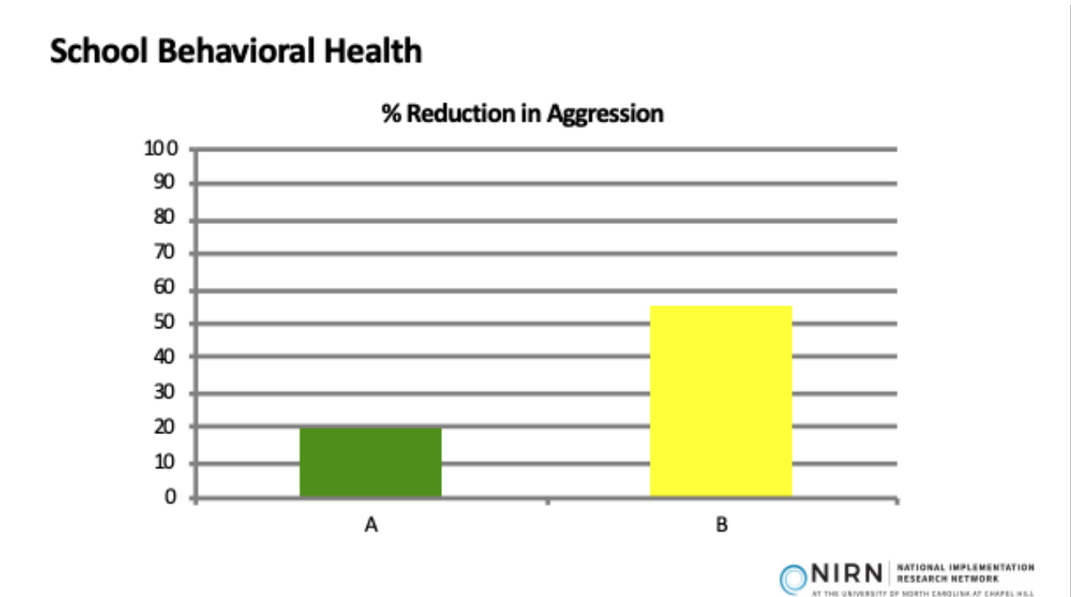
Which program would you want?
Notes:
Program B has a higher % of reduction in aggression

Slide 6
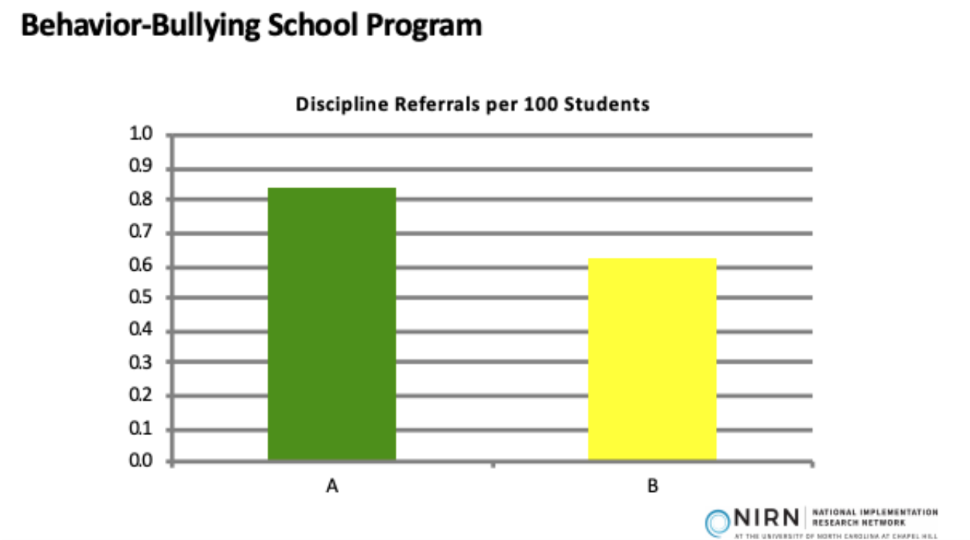
Now which program would you want?
Notes:
Program B has less referrals per 100 students

Slide 7
Last time- which program would you want?
Notes:
Program B has less of a chance of recidivism

Slide 8
Trick Questions
Notes:
EBP= Evidence Based Practice

Slide 9
Fidelity Data and Evaluation Purpose & Outcomes
Purpose: Prepare to measure fidelity and outcomes of all Tier 1 efforts using multiple forms of data
Outcomes:
Tier I team reviews and uses SWPBIS fidelity e.g., Tiered Fidelity Inventory (TFI), SAS, data at least annually. (TFI 1.14)
Tier I team documents fidelity and effectiveness (including on academic outcomes) of Tier I practices at least annually (including yearly- year comparisons) that are shared with stakeholders (staff, families, community, district) in a usable format. (TFI 1.15)

Slide 10
Definition
Evaluation is the iterative process for determining (a) how successful we are at implementing PBIS, and guiding (b) our planning to continue or improve that success.
Evaluation is multi-faceted and relies on the integration of data from other systems: expectations, acknowledgements, classroom and discipline.

Slide 11
Rationale
Evaluation systems are a way to hold ourselves accountable, celebrate our successes, and change our PBIS implementation based on data.
Evaluation helps us see the big picture and fit in all the small details.

Slide 12
How Will You Get Feedback From Staff?
Self-Assessment Survey (SAS)
Tiered Fidelity Inventory
(TFI)
Notes:
In addition to assessing how effective professional development / trainings are, soliciting ongoing, routine feedback is important to maintain buy-in and support from the staff.
For this project, we will be using two main surveys: SAS and TFI

Slide 13
Tiered Fidelity Inventory (TFI)
Assists teams in finding areas of implementation strength and needs
Completed by PBIS team members and coach at the same time.
Goal: 70% or more of total points for implementation
Notes:
The TFI is the implementation measure for fidelity, The SAS is the perception and knowledge measure.

Slide 14
Setting Up PBIS Assessments for your schools
Identify a coordinator who will open and close surveys, and generate graphs for all schools.
Overview of PBIS Assessments:
https://www.pbisapps.org/Resources/Pages/PBIS-Assessment-Overview-Webinar.aspx
Complete PBIS Assessments User's Manual:
https://www.pbisapps.org/Resources/SWIS%20Publications/PBIS%20Assessment%20Users%20Manual.pdf
Notes:
Trainer Notes: This process sets up your account in PBIS Assessments to use the fidelity tools.

Slide 15
Day to Day…
The SAS and TFI provide perception data
Teachers
Team and coach
There are other “quick” ways to evaluate teachers use of PBIS Tier 1 practices

Slide 16
Day to Day… Continued
Share data on office referrals
Ask if accurate
Share counts for acknowledgements.
Consider:
Teacher names pre-printed on slips/tickets
Tracking by grade level
Teachers making a quick frequency count

Slide 17
Outcomes
Our fidelity and perception data are important in relation to our Tier I outcome data.
Office referral
Attendance

Slide 18
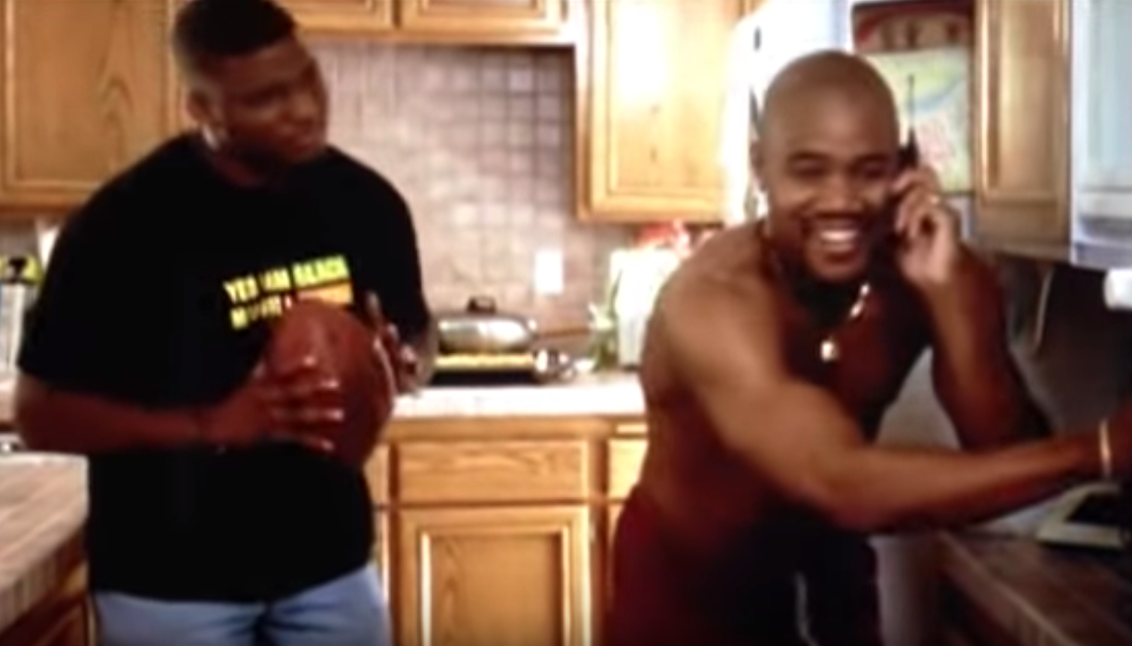
Show Me the Data!
https://www.youtube.com/watch?v=SJXbSZK1Pps
Notes:
Trainers play a short snippet of video or skip
Some of the audience may not even know this movie ;)
https://www.youtube.com/watch?v=SJXbSZK1Pps
4 minutes 42 seconds

Slide 19
Taking The TFI
To identify our perception of our current implementation status
To celebrate our success and plan for sustaining those efforts
To determine next steps of implementation
To communicate with staff
Purpose

Slide 20
Enter TFI from Team Training
www.pbisapps.org
Notes:
Teams should have already designated a person that will enter scores- see Regional Coordinator for help logging in
Username-email
Password- should have been emailed to them, but they can always click “Forgot Password”

Slide 21
Enter TFI from Team Training
Notes:
ACTIVITY: Pull up a SAS report (item analysis)
1. Fidelity (TFI or BoQ)
Perception (SAS)
Outcome (ODR, Attendance)
2. Precision statement, What, where, when, why, who

Slide 22
Enter TFI from Team Training
Notes:
ACTIVITY: Pull up a SAS report (item analysis)
1. Fidelity (TFI or BoQ)
Perception (SAS)
Outcome (ODR, Attendance)
2. Precision statement, What, where, when, why, who

Slide 23
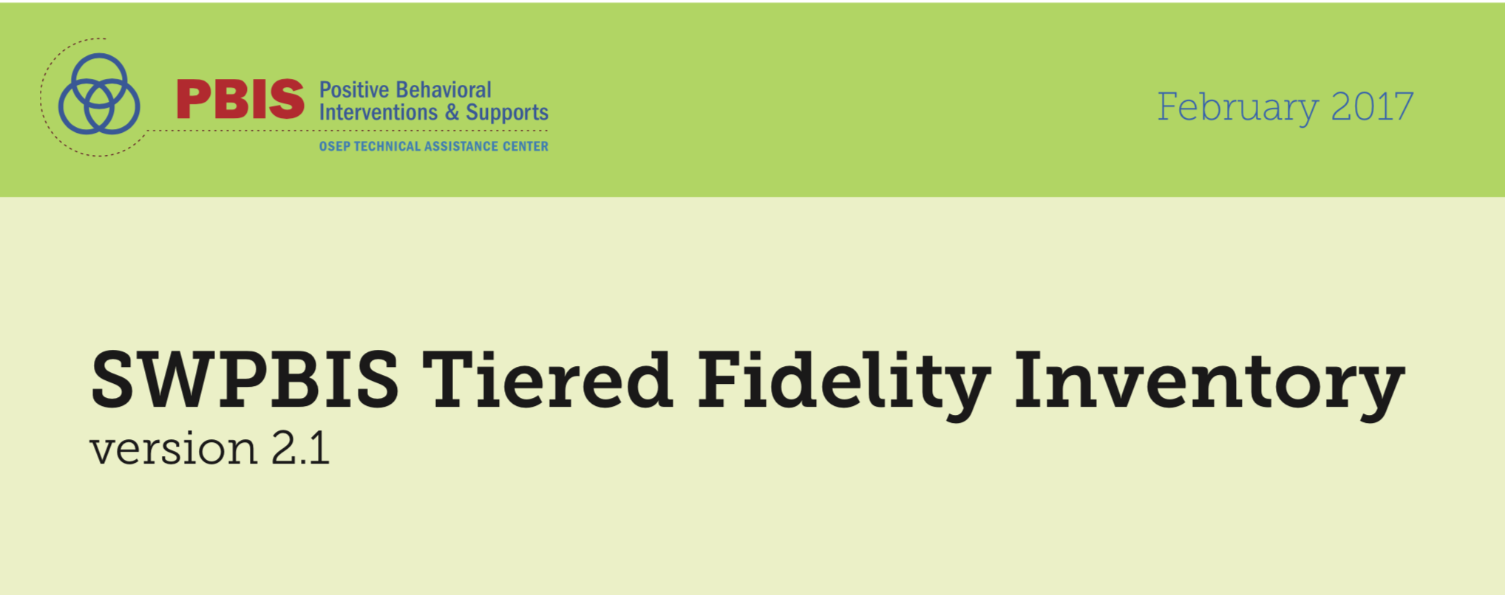
What is the Walk Through Tool?
An individual interviews a random selection of staff (at least 10% of staff or at least 5 for smaller schools) and students (minimum of 10).
Your team will collect walk through data prior to November training to use when you take the TFI on Day 3.
p. 27-28

Slide 24
Staff Questions in Walk Through Tool
Staff Interview Questions
Interview at least 10% of staff or at least 5 for smaller schools
What are the __________________ (school rules, high 5's, 3 bee’s)?
(Define what the acronym means)
Have you taught the school rules/behavioral expectations this year?
Have you given out any _______________________ since _______________?
(recognition for appropriate behavior) (1 months ago)
Remember:
In the SPRING one person from each team will go to another school to do
a TFI WalkThrough AND facilitate the TFI.
p. 27-28

Slide 25
Student Questions in Walk Through Tool
Student interview Questions
Interview a minimum of 10 students
What are the _________________ (school rules, high 5's, 3 bee’s)?
(Ask for the name of the school rules, and what they look like in that setting)
Have you received a _______________________ since ________________?
Remember:
In the SPRING one person from each team will go to another school to do
a TFI WalkThrough AND facilitate the TFI.
p. 27-28

Slide 26
External Facilitators will guide your team
Opening the administration ppt.

Slide 27
Process for taking the TFI
The coach will have the survey open on pbisapps and record the vote of the team
A facilitator will have the survey open and read and show the questions and criteria for voting to the team
The team will briefly assess current status and vote using a visual signal response to as indicated by the scoring criteria
0=not implemented
1=partially implemented
2=fully implemented

Slide 28
Coach will Enter Your Team’s Score – keep paper copy too!
Notes:
Slides 27-31 are about entering TFI scores. These are included so the whole group can see how easy it is and because typically it is not the same person entering it from training to training.

Slide 29
Coach will Submit Your TFI
You are only required to
Tier 1 of the TFI
After Tier I is done…..scroll down to the bottom of the page CLICK NEXT
Scroll down to the bottom of the page and CLICK SUBMIT

Slide 30
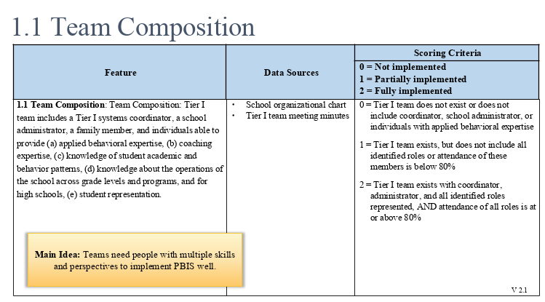
TFI Question #1

Slide 31
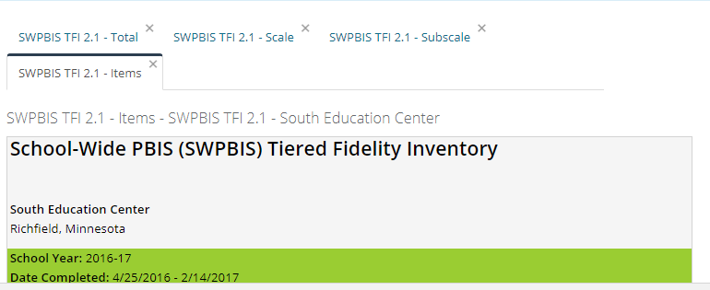
Pull All Reports and Review As a Team
Total
Scale
Subscale
Items
Notes:
Show to whole group after TFI completion
Can also show at indivudal tables

Slide 32
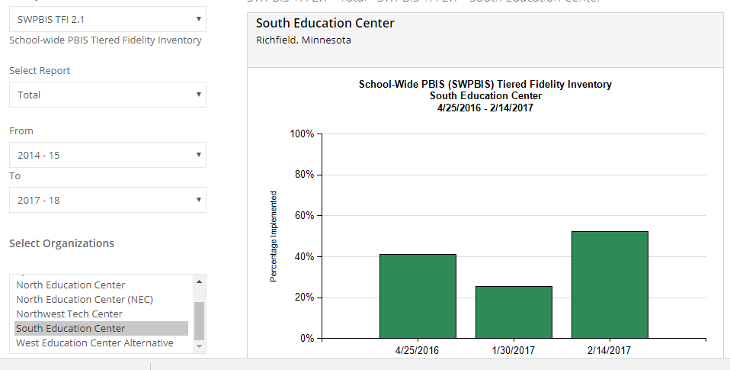
Total Report
Notes:
This report assumes you have taken all three tiers- it does not give an accurate picture of just Tier I!!

Slide 33
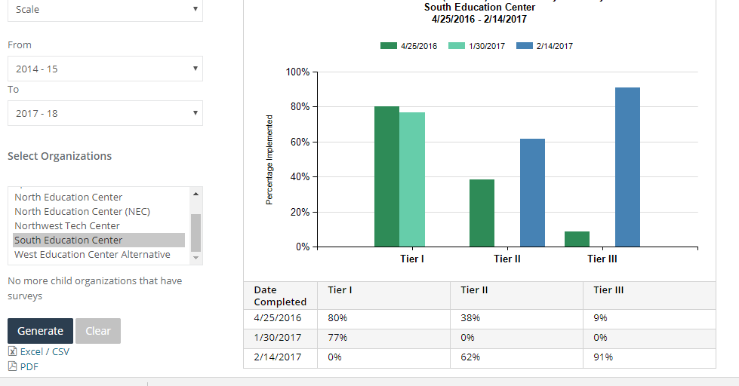
Scale Report
Notes:
Use this report to see your Tier I score

Slide 34
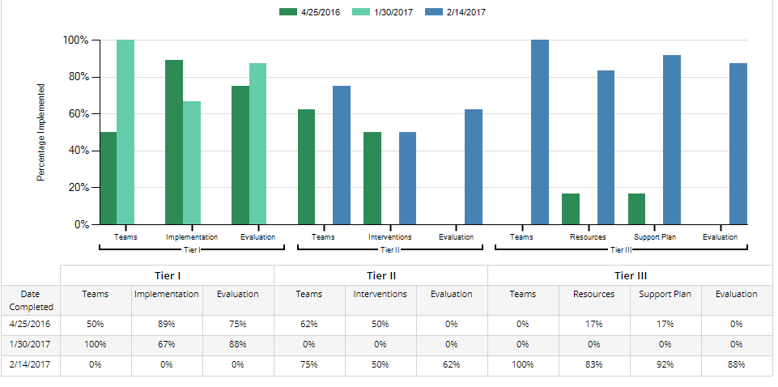
Subscale Report

Slide 35
Prioritize Action Plan

Slide 36
Prioritize Your Action Plan
One Method: A, B, C Priority for all items
Put an A, B, or C next to each line on your action plan.
Use A for items of highest priority
Use B for items of moderate priority
Use C for items of lower priority
Review the A’s, and sub prioritize those into A1, A2, A3. Repeat for the B’s and C’s.
Assign roles and timelines for the work.
Notes:
Action plan templates are in handbook and online

Slide 37
SELF-ASSESSMENT SURVEY (SAS)
Notes:
This should be shown at a different time than the TFI portion. These slides will intro the SAS which teams need to do before November training.

Slide 38
Self-Assessment Survey (SAS)
WHAT: Annual assessment of staff perception of PBIS implementation
WHO: All school staff
WHEN: By November 1 and May 1
WHY: Shows how well adults understand and are implementing with PBIS

Slide 39
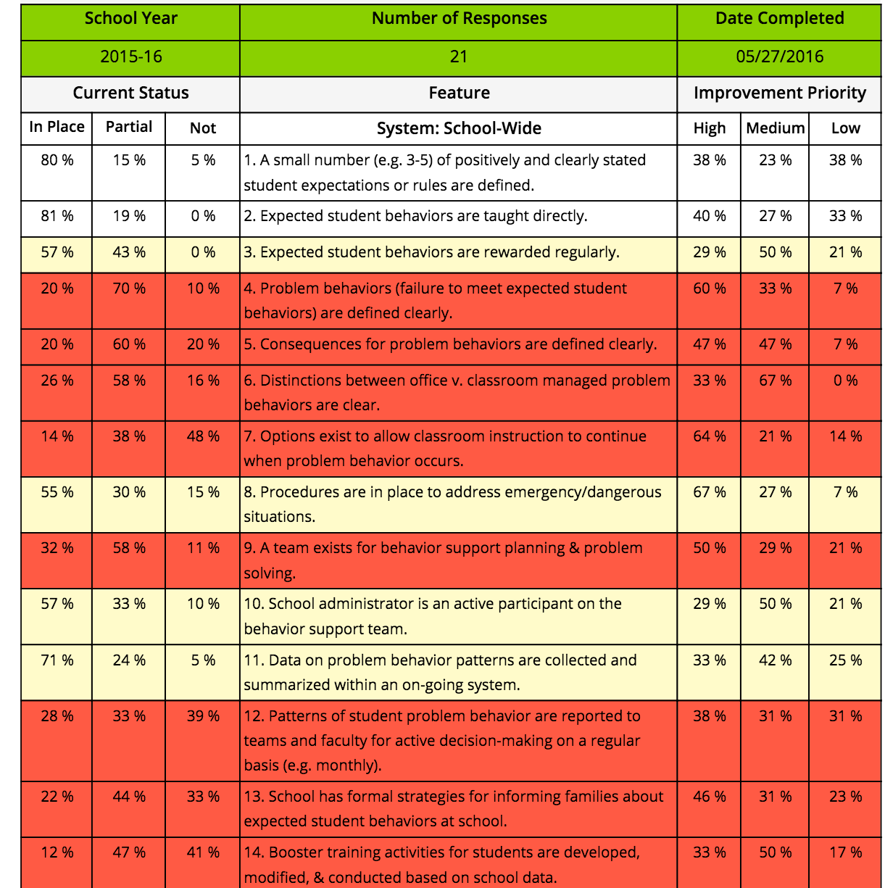
Sample SAS Item Analysis Report
What do you see? How is this helpful?

