Slide 1
Tier 1
Training Day 4
Discipline Data (TFI 1.12)
Updated May 2022
Notes:
This presentation will prepare teams for implementing effective discipline data analysis.
Updated 7/2018

Slide 2
Learning Expectations
EXPECTATION | BEHAVIOR
Be Responsible | Make yourself comfortable Take care of your needs (water, food, restroom, etc.) Action plan to implement what you are learning Follow through on your action items
Be Respectful | Turn cell phones off or to “vibrate” Listen attentively while others are speaking Have only the training materials up on your computer/tablet/phone
Be Engaged | Ask what you need to know to understand and contribute Contribute to the group by sharing relevant information and ideas
Notes:
2
We again want to place emphasis on and model the behavior we expect from our students. So we’ve created an expectation matrix for any training and/or presentation we give regarding PBIS. Sit back, relax, don’t hesitate to ask questions as we go along, you can always wait until the end to ask. In particular, I call your attention to the 3rd behavior item aligned with “Be Responsible”. As I walk you through this presentation and as you consider collecting behavioral data, be thinking how best to include these ideas within your overall Action Plan.

Slide 3
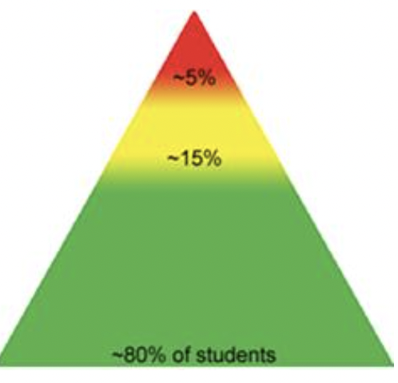
Tier 1: Implementation Fidelity
TFI Sub-Scale: Team
TFI 1.1 | Team Composition
TFI 1.2 | Team Operating Procedures
TFI Sub-Scale: Evaluation
TFI 1.12 | Discipline Data
TFI 1.13 | Data-based Decision Making
TFI 1.14 | Fidelity Data
TFI 1.15 | Annual Evaluation
TFI Sub-Scale: Implementation
TFI 1.3 | Behavioral Expectations
TFI 1.4 | Teaching Expectations
TFI 1.5 | Problem Behavior Definitions
TFI 1.6 | Discipline Policies
TFI 1.7 | Professional Development
TFI 1.8 | Classroom Procedures
TFI 1.9 | Feedback and Acknowledgement
TFI 1.10 | Faculty Involvement
TFI 1.11 | Student/Family/Community Involvement

Slide 4
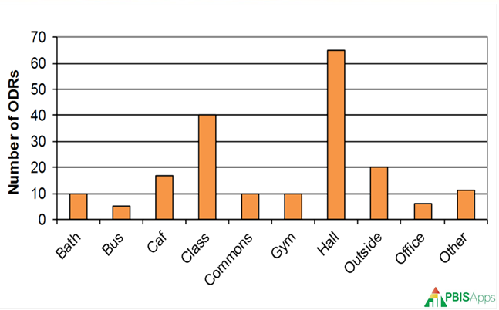
TFI 1.12 Purpose & Outcomes
Purpose: Prepare and plan for facilitating implementation of Data Analysis
Outcomes:
1.12 Discipline Data: Tier I team has instantaneous access to graphed reports summarizing discipline data organized by the frequency of problem behavior events by behavior, location, time of day, and by individual student.
Notes:
Read through the purpose and outcome emphasizing that teams will prepare and plan for data analysis through efficient access to graphed reports.
Trainers could share a QUICK example of how this item has impacted their site implementation/school/team.

Slide 5
Data Overview
Data is one of the three major components to effective outcomes with PBIS implementation
We are doing a balcony overview of data so you can see what you will be measuring and you can continue to map out how you will make it happen.
Notes:
We are doing balcony overview of data so you can see what you will be measuring and you can continue to map out how you will make it happen.

Slide 6
Quote
“If we have data, let’s look at data.
If all we have are opinions,
let’s go with mine.”
–Jim Barksdale, former Netscape CEO

Slide 7
Culturally Responsive Elaboration
SWPBIS Big Idea
Teams with access to current and reliable data are able to make more accurate and relevant decisions regarding staff and student instruction and support.
Tier 1 Team …
regularly disaggregate discipline data to assess and monitor equity in student outcomes.
is purposeful in examining inequitable outcome data first from a systems perspective, before viewing it as an issue with an individual student or family.
Notes:
Provide teams with the overall goal of analyzing discipline data from an Equity or Cultural Responsiveness perspective.

Slide 8
How can we analyze data more equitably?
Examples
Teams disaggregate the data in their core reports* by race/ethnicity and disability status quarterly.
Teams calculate multiple disproportionality metrics (e.g., risk ratios) for ODRs, suspensions, achievement, and special education placement at least quarterly.
Teams review administrative consequence decisions for disparity at least monthly.
Teams examine trends in disaggregated data to identify specific situations when disproportionality is more likely to be evident (e.g., behaviors, locations, time of day).
Teams research their communities to determine which ethnic groups are represented within the broad federal race categories and use that information to make practices more culturally responsive.
PBIS Cultural Responsiveness Field Guide-page 24
Notes:
The main idea here is to get teams thinking about how to analyze data more equitably for all stakeholders. Restate a couple of the examples for emphasis and/or add a local example.

Slide 9
Discipline Data Tasks
Teams will prepare and plan for discipline data analysis:
analyze their current data systems
determine effectiveness of current data systems
refer to Cultural Responsiveness Field Guide - page 24
include Discipline Data collection and analysis in Overall Action Plan
Notes:
This slide let’s teams know the implementation actions they will take to prepare and plan for effective discipline data analysis.

Slide 10
Discipline Data Tasks
Teams will prepare and plan for discipline data analysis:
analyze their current data systems
determine effectiveness of current data systems
refer to Cultural Responsiveness Field Guide - page 24
include Discipline Data collection and analysis in Overall Action Plan
Notes:
This slide let’s teams know the implementation actions they will take to prepare and plan for effective discipline data analysis.

Slide 11
Definition
Data are the many sources of information we use to make decisions about how to allocate our resources of time and attention for teaching, redirecting, prompting, and reinforcing behaviors.
Data come in many forms such as office referrals, attendance records, grades, surveys, verbal feedback, and observations.
Data must be documented and shared to be most effective in action planning.
Notes:
Let’s first define what we mean and what is all involved when we talk about Data.

Slide 12
Rationale
Data allow us to look at a problem more objectively.
Without data, we are more likely to make ambiguous or emotionally driven decisions.
Data can be used for identifying and planning to address problems, celebrating successes, and accountability.
Notes:
Some thoughts around the rationale for using data.

Slide 13
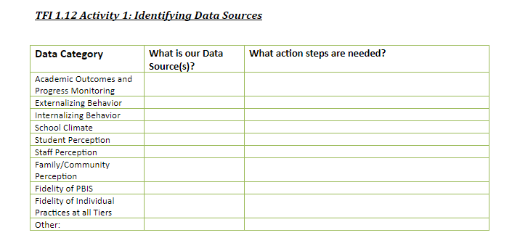
What are our data sources?
Workbook: TFI 1.12 Activity 1
Notes:
Think through data sources you currently have that can inform your systems development. In your Workbook, section TFI 1.12, Activity 1, will help your team consider what data sources you use. (Allow 10-15 minutes of team time to begin this activity now. Or, just introduce it and direct teams they will complete Activity 1 during Work Time)

Slide 14
Why Use Data For Decision Making?
Data helps us ask the right questions…it does not provide answers.
Use data to:
Identify problems
Refine problems
Define the questions that lead to solutions
Data helps place the “problem” in the context rather than in the students.

Slide 15
3 Types of Data
Effort: What is the current status of your systems?
School-wide Tiered Fidelity Inventory (TFI Progress Monitoring)
Self-Assessment Survey (SAS) – Staff
Opinion Survey
Fidelity: Are you doing what the framework outlines? Are you doing what you said you would?
School-wide Tiered Fidelity Inventory (TFI-Annual Assessment)
Self-Assessment Survey (SAS) – Staff
Outcome: Are your systems working?
Office Discipline Referrals (ODR’s)
Check-In Check-out (CICO)/Point Sheets
Suspensions/Expulsions
Attendance
Grades/Test Scores
Notes:
Go over the importance of Effort & Fidelity Data. We will be focusing on Outcome Data right now.

Slide 16
Outcome Data
What reports can your data system generate?
Notes:
From a student outcome perspective, teams should consider how effective their data systems are, particularly when it relates to discipline data or ODRs. What reports can your system generate that allows your team to efficiently analyze data? Let’s look at several examples to help you ….

Slide 17
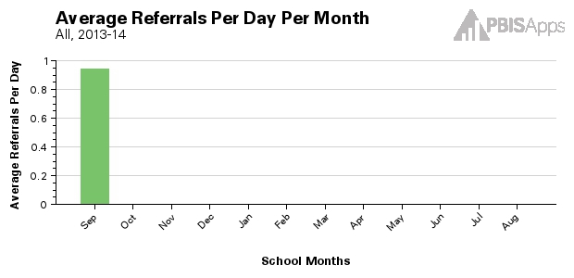
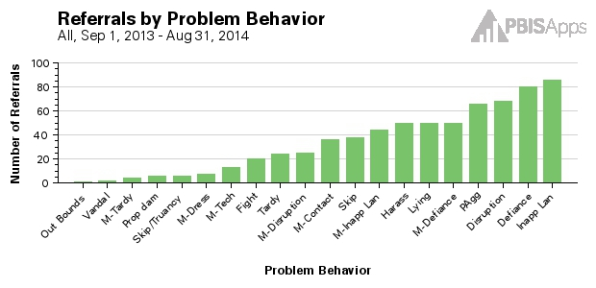
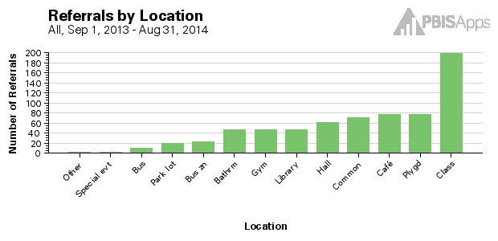
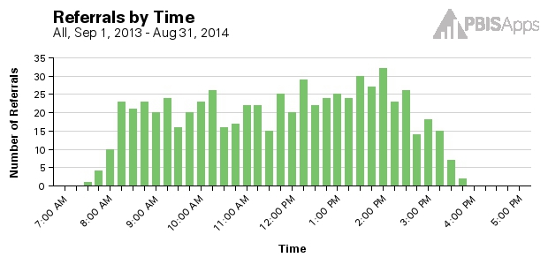
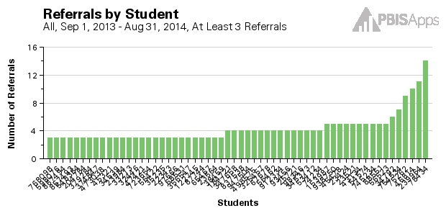
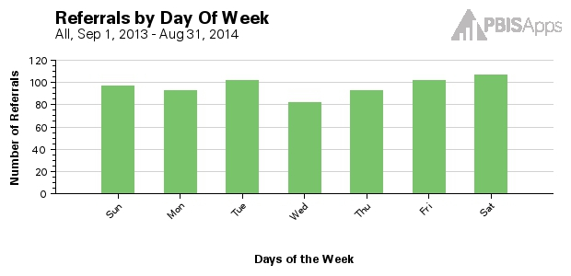
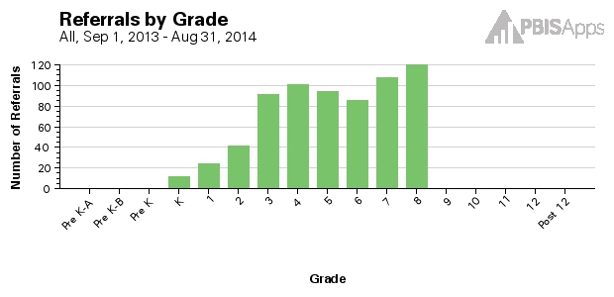
Core Reports – Data System
Avg Referrals/Day/Month
Referrals by Prob Behavior
Referrals by Location
Referrals by Time
Referrals by Student
Referrals by Day of Week
Referrals by Grade
Notes:
Trainer Notes: These examples come from SWIS- any system used should be able to produce these reports
Core Reports provide information at the school-wide level. These reports are presented on the main SWIS Dashboard and are also available in the reports dashboard (View Reports). The value of the Core Reports is they help schools quickly and visually identify “red flags” or potential problems that may need further inquiry. The Core Reports include: Average Referrals Per Day Per Month, Referrals By Location, Referrals By Problem Behavior, Referrals By Time, Referrals By Student, Referrals By Day of Week, and Referrals By Grade.

Slide 18
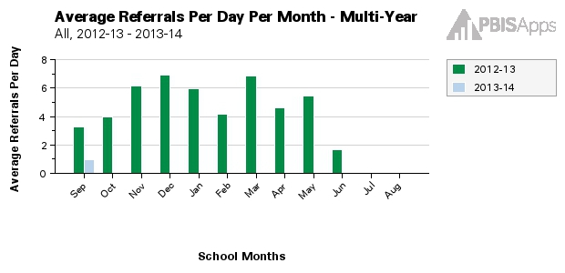
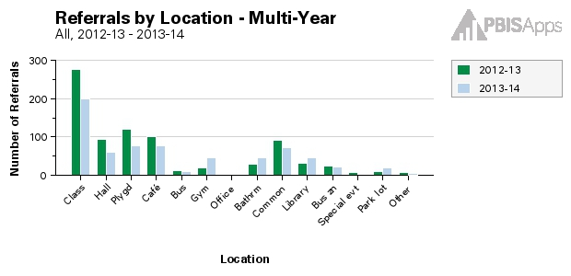
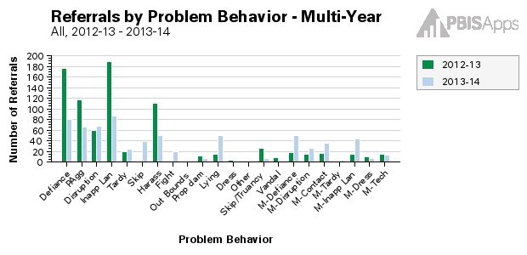
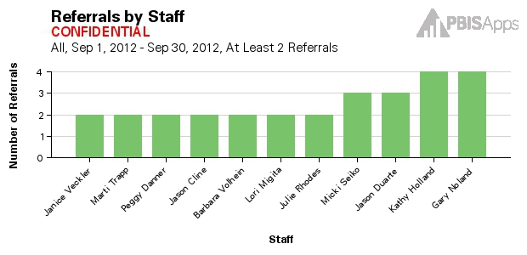
Additional Reports
Avg Referrals/Day/Month – Multi-Year
Referrals by Location – Multi-Year
Referrals by Prob Behavior – Multi-Year
Referrals by Staff: Confidential
Notes:
Trainer Notes: These examples come from SWIS- any system used should be able to produce these reports
Additional Reports provide some of the same information presented in the Core Reports and display it in a multi-year format so schools/facilities can see changes over time. For example, the Average Referrals Per Day Per Month report is represented in a multi-year format so users can see a specific month (e.g., March) and compare it to the previous year, the year before that, the year before that, etc. The same is true for the Location report presented in the multi-year format. This specific report allows users to see the number of referrals in various locations compared across years. The Problem Behavior report presented in the multi-year format allows users to see the number of referrals associated with individual problem behaviors compared across years. The Staff report is only accessible to certain users with appropriate access levels. The Staff report displays the number of referrals written by staff members within a designated time range.

Slide 19
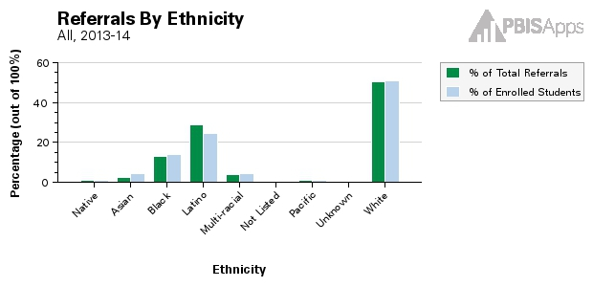
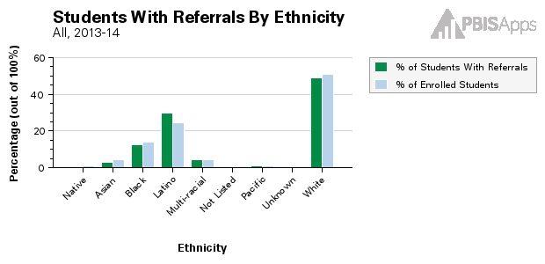
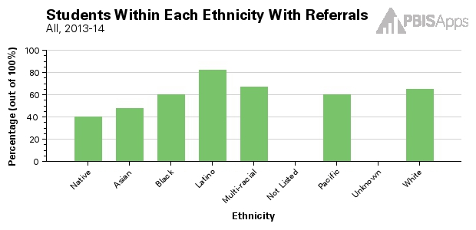
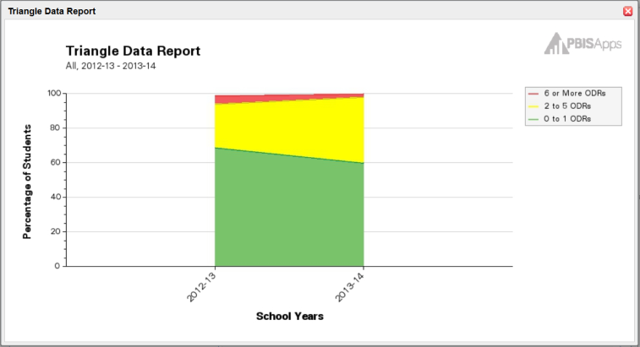
Additional Reports (cont.)
By Students with IEPs
Referrals by Ethnicity (three graphs)
Triangle Data Report
Notes:
Trainer Notes: These examples come from SWIS- any system used should be able to produce these reports
The Suspension/Expulsion Report displays the total number of days, total number of events, and total number of students contributing for in-school suspensions, out-of-school suspensions, and expulsions. This report will also display individual student information and note which specific students received a suspension or expulsion.
*******The Ethnicity report is presented using three different graphs and is used to monitor referral patterns across a school/facility’s various racial/ethnic groups. The Ethnicity report can assist schools in providing equity in education and taking actionable steps towards avoiding disproportionality in discipline practices. Reviewing this data is ESSENTIAL FOR ensuring EQUITABLE discipline practices******

Slide 20
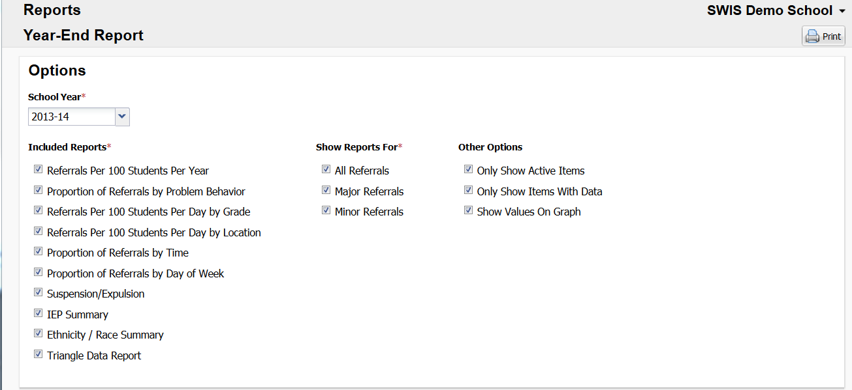
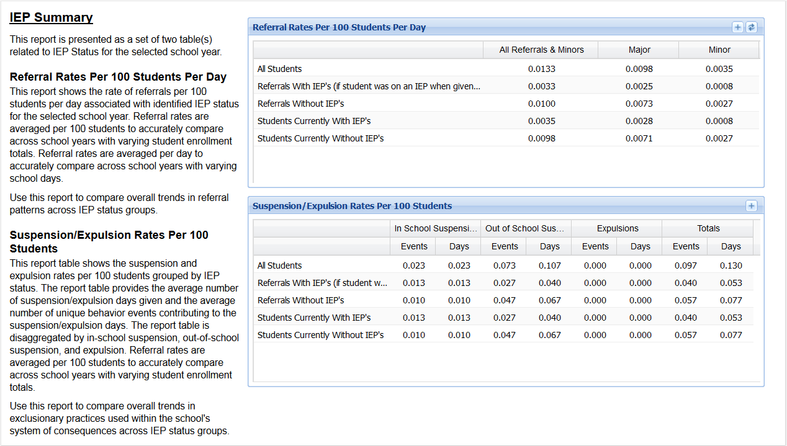
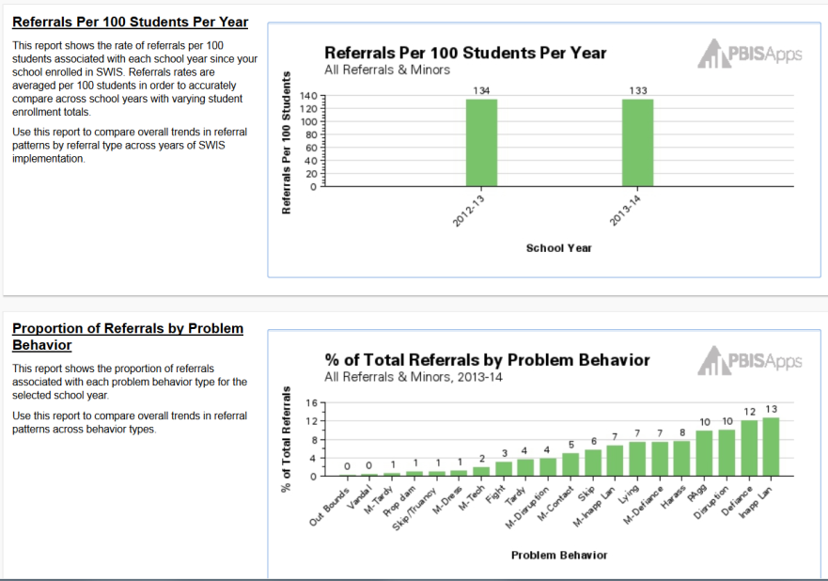
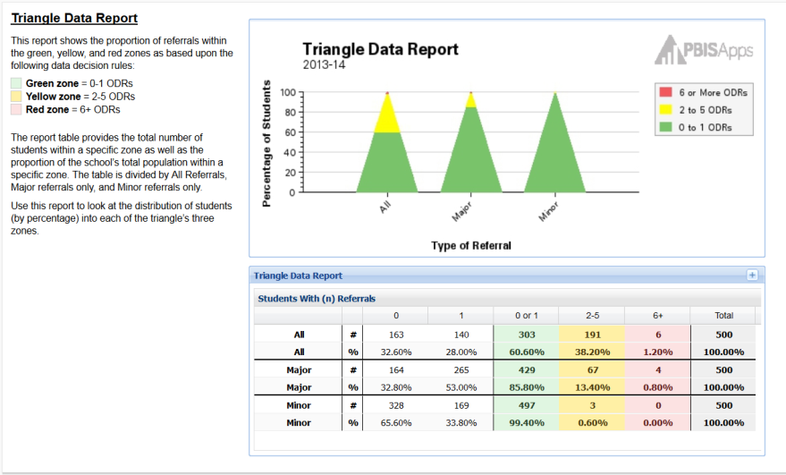
Additional Reports (cont.)
Year-End Report
IEP Summary
Referrals/100 Students/Year
Annual Triangle Data Report
% Total Referrals by Problem Behavior
Notes:
The Year-End Report contains several reports together to give an accurate representation of referral data across the school year. Only a sample of the reports are shown here. The table at the top of the report allows the report to be customized in terms of referral types and charts to include.
Each section of the Year-End Report includes a description to ensure that the information and/or purpose of the chart is clear.
SWIS provides us with tools to make decisions- have to use this as a template for other data sources

Slide 21
Data System Questions
Can I enter in referrals easily? 30 seconds/referral
Can I generate reports easily? 5 second rule!!
Do I have access to the Core Data Reports?
What other reports do I need on a regular basis?
Notes:
Now that you’ve consider your own data sources and have viewed various reports, ask and determine as a team is your system efficient? Questions to ask ….

Slide 22
Additional Data Sources
Other data can inform our behavioral supports:
Attendance
Grades
Health Office Visits
Student Support Worker Visits
Surveys
Perception: Climate Surveys, MN Student Survey, etc
What other outcome data does your system collect that could aid in systems change?
Resources
Identify and Address Disproportionality document
Trauma informed
Notes:
In addition to ODRs, there are other sources of student outcome data to collect and use when making decisions. Also included here are links to two resources teams can refer to when analyzing data.

Slide 23
Where we are headed:
Data Analysis
Is there a problem?
What areas/systems are involved?
Are there many students or a few involved?
What kinds of problem behaviors are occurring?
When are these problems likely to occur?
What is the most effective use of our resources to address this problem?
Notes:
High level overview, where we are headed. Please preface, this is an intro to what data-based decision making looks like. In year two of training, we will go deeper into this. However, it is good to know our ultimate outcome as we dig into the work so we know we are developing the systems that allow us to do the work.

Slide 24
Data for Continuous Improvement
Precision Problem Statement
Monitor Outcome vs Goal
Set Measurable Goal
Use Data
Monitor Fidelity of Plan
Develop Solution & Action Plan
Notes:
During year 2, we will look more carefully at using a data based decision-making process as depicted here. Briefly explain the process …

Slide 25
Useful Data-Based Decision Making
Example of Problem framed in “primary” form.
The majority of our ODRs involve cafeteria behavior
Notes:
Frequently, teams will look at discipline data and create general or what is called “primary” statements related to the data. For example: “The majority of our ODRs involve cafeteria behavior”. This example raises concern but isn’t useful for developing a solution. This is what we call a “primary” data statement. We are going to learn how to be more specific or detailed in order to be more effective in solving problems.

Slide 26
Precision Problem Solving
Statements
There are 25% more ODRs for aggression in the cafeteria this month than last year. These are most likely to occur during first lunch, with 15 eighth grade students, and the aggression is related to getting access to the new lunch line options.
What?
25% More ODRs for aggression
When?
First lunch
Where?
In the cafeteria
Why?
Getting access to the new lunch line options.
Who?
15 eighth grade students
Notes:
Recall the previous “Primary” form: “The majority of our ODRs involve cafeteria behavior”. This isn’t very helpful in pinpointing the issue with cafeteria behaviors. Upon looking more carefully at ODR data and answering the questions of What? Where? Who When? and Why?, we can create what’s called a “Precision Statement”: There are 25% more ODRs for aggression in the cafeteria this month than last year. These are most likely to occur during first lunch, with 15 eighth grade students, and the aggression is related to getting access to the new lunch line options.” Now we have more detail to work with and have identified the problem to address. Again, more about using data to solve problems in Year 2.

Slide 27
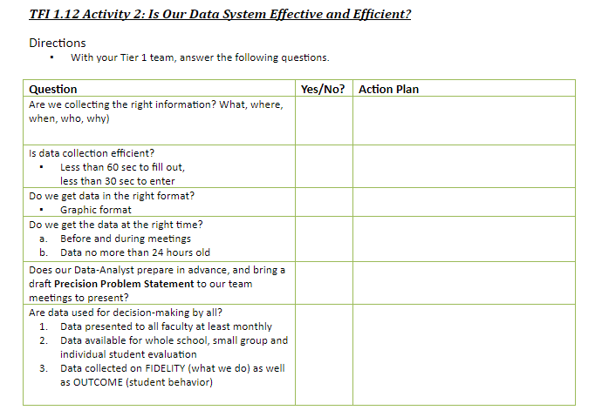
Do We Have an Efficient Data System?
Workbook: TFI 1.12 Activity 2
Notes:
In a few minutes, we’ll turn you loose for team planning time. Activity 2 helps your team facilitate the question of do we have an efficient and effective data system? Take time to complete this document as your team considers your outcome data system.

Slide 28
Team Implementation Planning
Teams will prepare and plan for discipline data analysis:
finish analyzing current data systems - Activity 1, p. 77
determine effectiveness of current data systems - Activity 2, p. 77
refer to Cultural Responsiveness Field Guide - page 24
include Discipline Data collection and analysis in Overall Action Plan
MN Implementation Planning Workbook TFI 1.9
Professional Development
How and when will you bring this information back to staff?
Update your action plan as needed for
1.9
Notes:
This slide let’s teams know the implementation actions they will take to prepare and plan for effective discipline data analysis. Use Team Planning Time to complete these steps. As you plan, determine PD activities that addresses discipline data and include in your action plan.

