Slide 1
Tier 1
Training Day 7
Professional Development (TFI 1.7)
Updated April 2022
Notes:
This presentation will prepare teams for implementing effective professional development centered on four Tier 1 SWPBIS core practices.
Updated 7/2018

Slide 2
Learning Expectations
EXPECTATION | BEHAVIOR
Be Responsible | Make yourself comfortable Take care of your needs (water, food, restroom, etc.) Action plan to implement what you are learning Follow through on your action items
Be Respectful | Turn cell phones off or to “vibrate” Listen attentively while others are speaking Have only the training materials up on your computer/tablet/phone
Be Engaged | Ask what you need to know to understand and contribute Contribute to the group by sharing relevant information and ideas
Notes:
2
We again want to place emphasis on and model the behavior we expect from our students. So we’ve created an expectation matrix for any training and/or presentation we give regarding PBIS. Sit back, relax, don’t hesitate to ask questions as we go along, you can always wait until the end to ask. In particular, I call your attention to the 3rd behavior item aligned with “Be Responsible”. As I walk you through this presentation and as you consider professional development for your staff, be thinking how best to incorporate these ideas within your overall Action Plan.

Slide 3
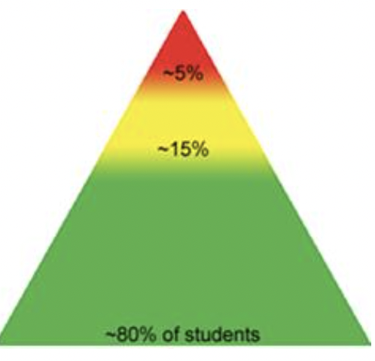
Tier 1: Implementation Fidelity
TFI Sub-Scale: Team
TFI 1.1 | Team Composition
TFI 1.2 | Team Operating Procedures
TFI Sub-Scale: Evaluation
TFI 1.12 | Discipline Data
TFI 1.13 | Data-based Decision Making
TFI 1.14 | Fidelity Data
TFI 1.15 | Annual Evaluation
TFI Sub-Scale: Implementation
TFI 1.3 | Behavioral Expectations
TFI 1.4 | Teaching Expectations
TFI 1.5 | Problem Behavior Definitions
TFI 1.6 | Discipline Policies
TFI 1.7 | Professional Development
TFI 1.8 | Classroom Procedures
TFI 1.9 | Feedback and Acknowledgement
TFI 1.10 | Faculty Involvement
TFI 1.11 | Student/Family/Community Involvement
Notes:
3
As we consider the PBIS Tier 1 Professional Learning Roadmap, professional development truly fits in with and should be embedded in your team’s action plan when training on all other TFI components. Again, our focus is preparing teams for implementing effective professional development centered on four Tier 1 SWPBIS core practices.

Slide 4
TFI 1.7 Purpose & Outcome
Purpose:
Teams will develop a PD plan for
training all staff on the 4 core Tier 1
PBIS practices and ensure that staff
understand their implementation role.
Outcome:
TFI 1. 7 Professional Development: A written process is used for orienting all faculty/staff on 4 core Tier I PBIS practices:
(a) teaching school-wide expectations,
(b) acknowledging appropriate behavior,
(c) correcting errors, and
(d) requesting assistance.
Notes:
Read through the purpose and outcome emphasizing that teams will develop a written plan for professional development focused on the 4 core practices.

Slide 5
Culturally Responsive Elaboration
SWPBIS Big Idea
Formal processes for providing training and practice to staff on implementing SWPBIS increases fidelity and consistency in SWPBIS practices
Professional development focuses on:
implementation of the SWPBIS framework
the cultural responsiveness core components (outlined in the guide)
historic context and present-day issues specific to the school’s underserved populations
Notes:
Provide teams with the overall goal of creating a Tier 1 Professional Development plan from an Equity or Cultural Responsiveness perspective.

Slide 6
How can we make professional development more equitable?
Examples
The district has a long-term professional development plan that includes SWPBIS and enhancing equity.
Professional development opportunities are identified based on system and student outcome data.
Teams partner with local community supports and families to provide professional development that orients staff to the community cultures, values, and historical perspectives (e.g., marginalization from schooling).
Teams have procedures to provide staff with explicit training and practice in specific skills for enhancing equity and examining implicit bias.
Teams have procedures to provide staff with explicit training and practice in de-escalation skills.
PBIS Cultural Responsiveness Field Guide-page 14
Notes:
The main idea here is to get teams thinking about how to make their PD more equitable for all stakeholders. Restate a couple of the examples for emphasis and/or add a local example.

Slide 7
Professional Development Implementation Tasks
Develop list of Professional Development & Coaching Considerations centered on 4 core Tier 1 practices
Develop a Timeline to include Professional Development Components
Refer to the Cultural Responsiveness Field Guide - page 19
Include Professional Development Plan in Overall Action Plan
Notes:
This slide let’s teams know the implementation actions they will take to develop a written Professional Development plan with fidelity so they can achieve the outcomes just outlined.

Slide 8
Definition
Professional Development Plan is the scope of all implementation activities including timelines.
The Professional Development Plan is developed by the team and coach. It incorporates all of the school-wide and classroom components.
It is flexible and is informed by the measures we have discussed to date: SWIS, SAS, and the TFI
Notes:
What does SWPBIS Professional Development consist of? Let’s define this.

Slide 9
Rationale
It provides the roadmap to Tier I implementation and supports us thinking about professional development as an ongoing process.
As we accomplish our professional development goals, we celebrate and then create new ones, all for the improvement of outcomes for our students and staff.

Slide 10
Professional Roadmap
Notes:
Here’s a visual of the Roadmap that includes rolling out PBIS plans to staff and students, identifying staff and students who need more support, and when to conduct booster trainings.

Slide 11
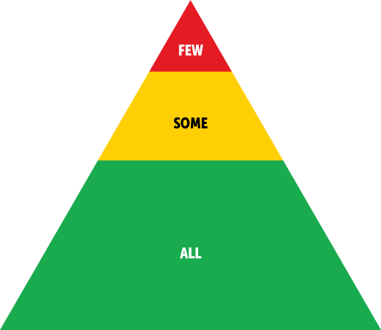
And so...Professional Development
Is determining who needs what and then...
•Train-Core Practices-How can I participate in PBIS?
•Coach-Embed into your coaching program
•Dose-Train and coach in doses that allow staff time to implement the practice
•Apply the triangle of support to staff
Notes:
Review items on the slide

Slide 12
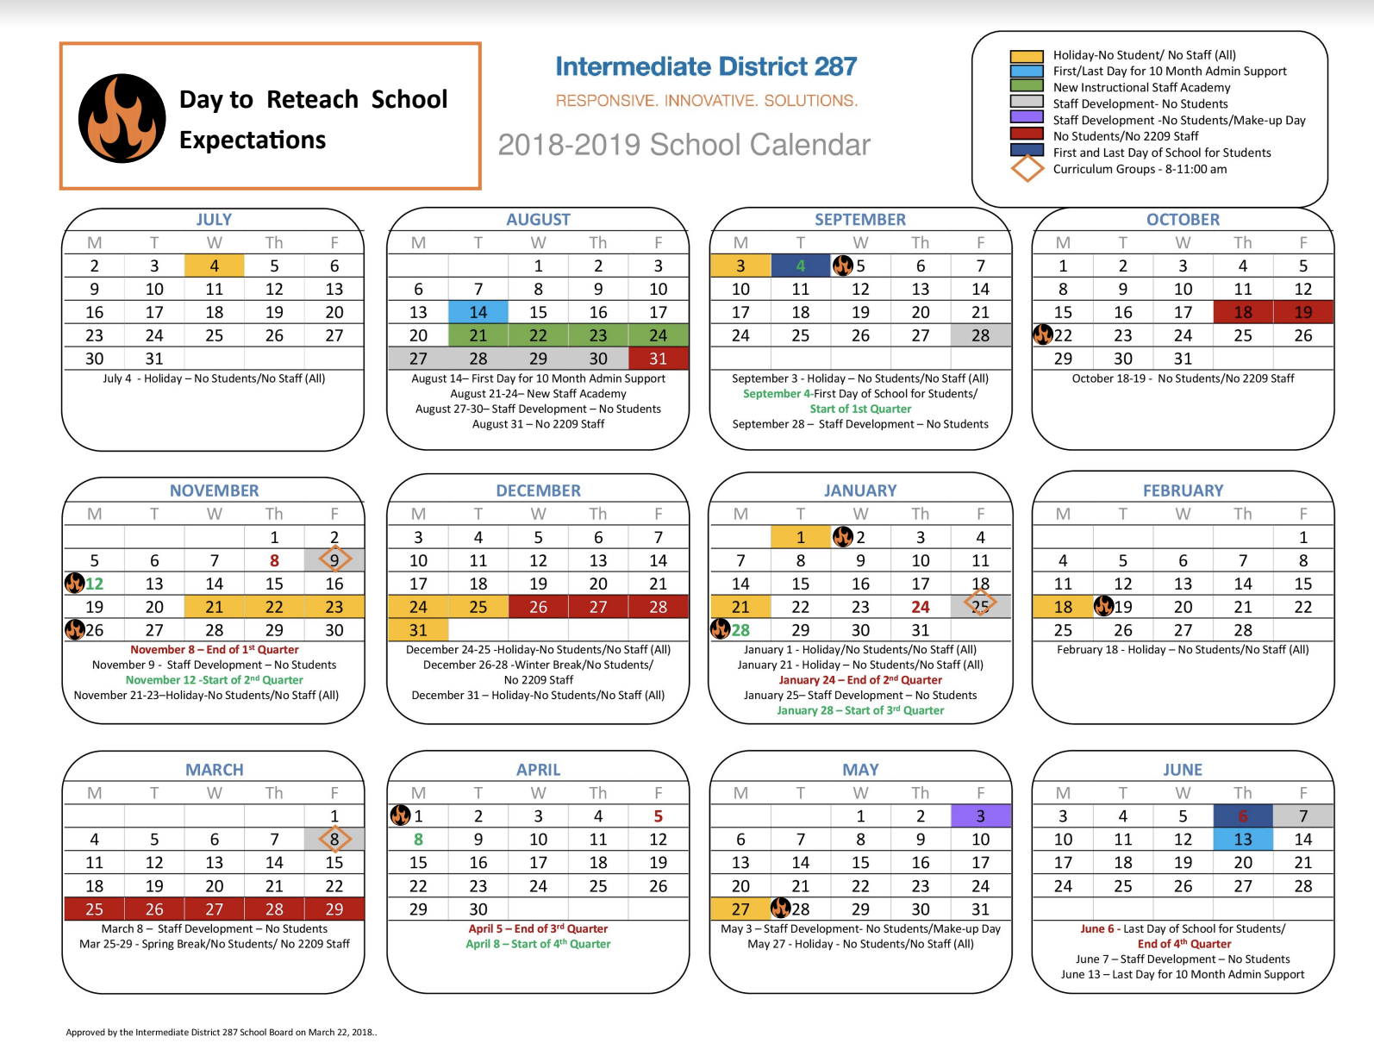
Secure Time in PD Calendar
Secure time for the school year and bring it into your school calendar.
Workbook: TFI 1.7
Notes:
A high priority is to secure time consistently on your school’s PD calendar. These can include brief trainings (10-15min) during weekly or monthly staff meetings or 30-60min sessions during scheduled Staff Development time or days throughout the year. This is also in the workbook.

Slide 13
Professional Development Plan Tasks
A curriculum to teach the components of the discipline system to all staff is developed and used
Plans for training staff how to teach expectations/rules/acknowledgments are developed, scheduled and delivered
A plan for teaching students expectations/rules/acknowledgments is developed, scheduled, and delivered
Workbook: TFI 1.7
Notes:
Read these, stress that they have learned about these tasks in earlier presentations. This portion functions as a review as well as emphasizing the important features of an implementation plan.

Slide 14
Professional Development Plan Activities
Booster sessions for students and staff are planned, scheduled, and delivered
Schedule for acknowledgments for the year is planned
Plans for orienting incoming staff and students are developed and implemented
Plans for involving families/communities are developed and implemented
Workbook: TFI 1.7
Notes:
….. continued

Slide 15
How do you orient people new to your school community?
How will you share your School-wide PBIS plan with:
Short-term and long-term substitutes?
Staff starting after your school’s kick-off?
Students starting after your school’s kick-off?
Guest teachers or presenters?
Volunteers?
Workbook: TFI 1.7
Notes:
Your team needs to think about staff and students who come to your building after the school year begins. In addition, be thinking about and develop plans to communicate PBIS components to folks who are not regulars in your building - guest teachers, presenters, volunteers, etc.

Slide 16
Priority: Ensure ALL Staff Understand …
Teaching SW-Expectations
- how to use your teaching matrix and definitions
Acknowledging Appropriate Behavior
- the process for using concrete example with expectation (ticket, slip)
Correcting Errors
- and practice using consistent and positive language
Requesting Assistance
- the process for making referrals (flowchart, minor vs major)
Notes:
REVIEW SLIDE: To be effective, we need to ensure ALL staff understand …This is the PRIORITY - it’s your team’s place to start with your PD training at your school, ensure ALL staff understand the 4 core SW-PBIS Tier 1 Practices.

Slide 17
What does PD look like? Example
Teaching SW-Expectations
- how to use your teaching matrix and definitions
Acknowledging Appropriate Behavior
- the process for using concrete example with expectation (ticket, slip)
Correcting Errors
- and practice using consistent and positive language
Requesting Assistance
- the process for making referrals (flowchart, minor vs major)
Notes:
So what should PD look like? Let’s consider an example of a brief staff training activity focused on one of the four core practices: Correcting Errors.
(Trainer - slides 18-22 is a PD example. You may wish to use your own example here. The key is to illustrate PD for SWPBIS is often most effective with brief activities where staff get to practice and provide input during their training)

Slide 18
Remember …
Every adult interaction with a student is an instructional moment that influences what happens next
Notes:
To introduce the topic of Correcting Errors by using consistent and positive language, recall the quote that “Every adult interaction with a student …..”

Slide 19
How Do You Respond to Behaviors?
TOld Way
Exclusionary, Punitive, Reactive, Disciplinary Approach to Student Behavior
d Way
A Better Way
Positive, School-wide, Proactive, Instructional Approach To Student Behavior
Exclusionary, Punitive, Reactive, Disciplinary Approach to Student Behavior
Notes:
We emphasize moving away from the traditional models of reacting and punishing when misbehaviors occur to a more positive, proactive, and instructional approach.

Slide 20
Remember: Change Starts with us!
We must be willing to change and learn if we expect the same from our students
This is Adaptive Change
It’s not easy
We must work to address problems that we don’t yet know the solutions for
Notes:
As noted previously, any change we expect in student behavior must first result from changes in ADULT behaviors. This is not always easy and that’s why we should practice, just as we do with academics.

Slide 21
Great!! Now What??
Let’s start with one adaptive change:
Work on Language Patterns
No more rules
“Don’t do this” and “Don’t do that”
Only Expectations taught Positively
Find ways to say YES
Emphasize the desired behaviors
Be encouraging reassuring, and positive
Give choices when possible
Notes:
We’ve learned that consistency matters and one way for staff to be consistent is through their language they use with students. Again, our goal is to move away from the traditional model of reacting and punishing to a more positive and instructional response. Let’s practice!!

Slide 22
Let’s Practice!!
The Old Way
A Better Way
“NO, you can’t go to the bathroom.”
“Yes, you may go just as soon as we finish.”
“STOP running in the hall.”p running in the hall.”
“Do we run in the hall at __(school name)__?”
“Put that phone away right NOW!”
“Where should your phone be during class?”
“DON’T talk to me in that tone of voice!”
“I’m happy to listen when things are calm.”
Notes:
Read each “Old Way” statement and if time permits, allow attendees to provide “A Better Way” response. There certainly are more ways to respond. Add to the list if time allows.

Slide 23
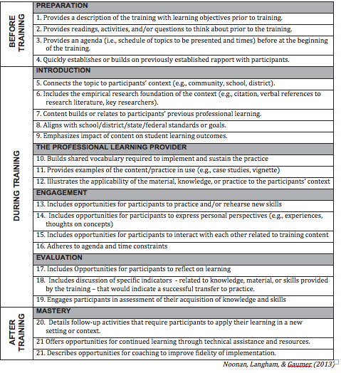
High Quality PD Checklist
Workbook: TFI 1.7
Notes:
To wrap up the topic of Professional Development, there’s a nice, high quality PD checklist in your workbook that teams can use to help design effective activities.

Slide 24
Prof. Development Calendar
Workbook: TFI 1.7
Notes:
Included in your workbook is a PD activity document that assists teams in putting together their PD calendar. Include some form of this document in your overall Action Plan.

Slide 25
Professional Development/ Training Timelines
Brainstorm!
We need a timeline that is reasonable and allows us to teach and train all staff and students on the core features (expectations, acknowledgements, discipline and data).
What are all the components in our PD Plan?
Who do we train first?
When do we hold “boosters”?
Workbook: TFI 1.7 Activity 1: PD Considerations
Notes:
As you determine your needs for PD, work towards a timeline that is reasonable and covers the core features of Tier 1.

Slide 26
Team Implementation Planning
Develop list of Professional Development & Coaching Considerations centered on 4 core Tier 1 practices
Develop a Timeline to include Professional Development Components
Refer to the Cultural Responsiveness Field Guide - page 19
Include Professional Development Plan in Overall Action Plan
Year 1 Team Training Workbook 2021- original.docx
Notes:
This slide reminds teams to work on these implementation tasks during their work time.

