Slide 1
Tier 1 Team Training
Day 9
Sustaining Tier 1
Updated December, 2022
Notes:
Updated 7/2018

Slide 2
Tier 1: Implementation Fidelity
TFI Sub-Scale: Team
TFI 1.1 | Team Composition
TFI 1.2 | Team Operating Procedures
TFI Sub-Scale: Evaluation
TFI 1.12 | Discipline Data
TFI 1.13 | Data-based Decision Making
TFI 1.14 | Fidelity Data
TFI 1.15 | Annual Evaluation
TFI Sub-Scale: Implementation
TFI 1.3 | Behavioral Expectations
TFI 1.4 | Teaching Expectations
TFI 1.5 | Problem Behavior Definitions
TFI 1.6 | Discipline Policies
TFI 1.7 | Professional Development
TFI 1.8 | Classroom Procedures
TFI 1.9 | Feedback and Acknowledgement
TFI 1.10 | Faculty Involvement
TFI 1.11 | Student/Family/Community Involvement
6 Classroom Management Practices
1 | Arrange orderly Physical Environment
2 | Classroom Teaching Matrix (Expectations, Rules, Routines)
3 | Employ Active Supervision
4 | Encouraging Appropriate Behavior
5 | Continuum of Response Strategies for Inappropriate Behaviors
6 | Engagement & Opportunities to Respond
Notes:
LOOK HOW FAR YOU’VE COME!! You’ve been exposed to all of the PBIS Implementation components which includes items related to your Tier 1 Team, Implementation actions, evaluation, as well as specific components involved with the classroom.

Slide 3
Learning Expectations
EXPECTATION | BEHAVIOR
Be Responsible | Make yourself comfortable Take care of your needs (water, food, restroom, etc.) Action plan to implement what you are learning Follow through on your action items
Be Respectful | Turn cell phones off or to “vibrate” Listen attentively while others are speaking Have only the training materials up on your computer/tablet/phone
Be Engaged | Ask what you need to know to understand and contribute Contribute to the group by sharing relevant information and ideas
Notes:
‹#›
Let’s model the behaviors we expect and need from our students by being responsible, respectful, and engaged, paying close attention to item #3 under Be Responsible - Action Plan to implement what you are learning. Always be thinking how to make these ideas real in your school and how to include in your overall Action Plan.

Slide 4
Purpose and Outcome
Purpose:
Teams will Identify actions for a school-wide team to sustain the core systems & practices of Tier 1 PBIS
Outcome:
Create an action plan for sustaining PBIS Tier 1 at your school
Notes:
Review to set the context/stage for work.

Slide 5
Sustaining Tier 1 Tasks
Teams will ….
learn 4 tips & checks for sustaining Tier 1
update Overall Action Plan for sustaining Tier 1
plan professional development for staff on Tier 1 practices for remainder of the year
Notes:
Here are the tasks teams will be instructed to complete during and/or following this presentation.

Slide 6
Sustainability
Definition
Durable implementation of a practice at a level of fidelity that continues to produce valued outcomes
(McIntosh et al., 2009)

Slide 7
4 Tips & Checks for Sustaining PBIS
Research has identified 4 key tips as most important to sustaining PBIS and 4 checks to see if you have them in place.
Video Link
Notes:
Video is 4 minutes long – done by Kent McIntosh: https://pbisapps.wistia.com/medias/uhkgj8pf29
The following slides are a recap of the video.
You Choose:
Watch video only
Watch Video review slides
Review slides only

Slide 8
Tip #1 Strong Team Check
One superhero can’t sustain PBIS!
Do we have defined roles?
Do team members share the workload?
Do we have a way to encourage new team members to gain fresh perspective and ideas?

Slide 9
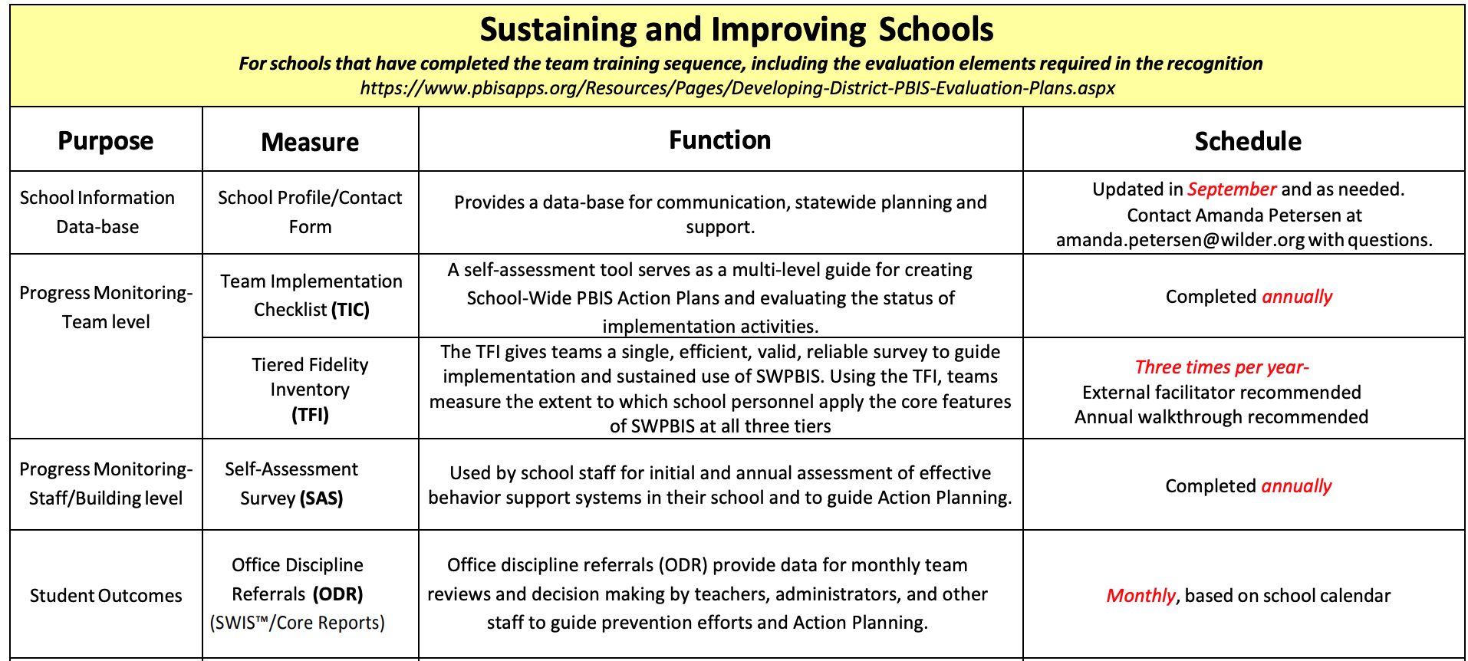
Tip # 2 Fidelity Measures Check
Ongoing measures check fidelity of implementation and identify action steps for improving systems!
Data Calendar At-A-Glance-Sustaining
Do we know our next action steps?

Slide 10
Tip # 3 Use School Discipline Data Check
You are gathering data to inform decision making!
Do we share how we are using the data to improve systems, practices and outcomes with staff at least monthly?

Slide 11
Tip #4 PBIS Classroom Check
Students spend most of their school day in the classroom!
6 Classroom Practices
Physical Environment
Classroom Teaching Matrix (Expectations, Rules, Routines)
Active Supervision
Encouraging Appropriate Behavior
Continuum of Response Strategies for Inappropriate Behaviors
Engagement & Opportunities to Respond
Are we doing PBIS in the classroom?
PBIS in the Classroom Resources

Slide 12
Answers to Some Common Questions- Find them on pbismn.org
Most of the team that went through training is no longer working here. Do we have to go through training again?
We have a new principal. What’s the best way to transition?
Our building needs a PBIS booster. How do we do that?
We don’t have current data. How do we start getting a system back in place?
Do we have to continue to get staff buy-in during or after training?
pbismn.org/school-teams

Slide 13
Panel Discussion
As we wrap up, we have an opportunity to hear from schools across the state working hard to sustain implementation.
https://bit.ly/3e0519A
Full-length Panel discussion
Notes:
A video is linked here. It should be played during the presentation. Members of the panel include several coaches and administrators from MN PBIS Sustained Exemplar schools

Slide 14
Team Implementation Planning
Teams will prepare & plan for sustaining Tier 1:
Complete Activity 1 - Tips for Sustaining Tier 1 Checklist, p.62
Include Sustaining Tier 1 practices in Overall Action Plan
Determine PD plan for staff around Tier 1 for remainder of year
Implementation Planning Workbook: Sustaining Tier 1 p. 62
Professional Development
How and when will you bring this information back to staff?
Update your action plan as needed for Sustaining Tier 1

