Slide 1
PBIS Team Training Day 3
Fidelity Data (TFI 1.14)
Annual Evaluation (TFI 1.15 )
Notes:
Updated October 2019
Updated 7/2018

Slide 2
Learning Expectations
EXPECTATION | BEHAVIOR
Be Responsible | Make yourself comfortable Take care of your needs (water, food, restroom, etc.) Action plan to implement what you are learning Follow through on your action items
Be Respectful | Turn cell phones off or to “vibrate” Listen attentively while others are speaking Have only the training materials up on your computer/tablet/phone
Be Engaged | Ask what you need to know to understand and contribute Contribute to the group by sharing relevant information and ideas
Notes:
2

Slide 3
Tier 1: Professional Learning Roadmap
TFI Sub-Scale: Team
TFI 1.1 | Team Composition
TFI 1.2 | Team Operating Procedures
TFI Sub-Scale: Evaluation
TFI 1.12 | Discipline Data
TFI 1.13 | Data-based Decision Making
TFI 1.14 | Fidelity Data
TFI 1.15 | Annual Evaluation
TFI Sub-Scale: Implementation
TFI 1.3 | Behavioral Expectations
TFI 1.4 | Teaching Expectations
TFI 1.5 | Problem Behavior Definitions
TFI 1.6 | Discipline Policies
TFI 1.7 | Professional Development
TFI 1.8 | Classroom Procedures
TFI 1.9 | Feedback and Acknowledgement
TFI 1.10 | Faculty Involvement
TFI 1.11 | Student/Family/Community Involvement

Slide 4
Taking The TFI
To identify our perception of our current implementation status
To celebrate our success and plan for sustaining those efforts
To determine next steps of implementation
To communicate with staff
Purpose

Slide 5
Enter TFI from Team Training
www.pbisapps.org

Slide 6
Enter TFI from Team Training
Notes:
ACTIVITY: Pull up a SAS report (item analysis)
1. Fidelity (TFI or BoQ)
Perception (SAS)
Outcome (ODR, Attendance)
2. Precision statement, What, where, when, why, who

Slide 7
Enter TFI Walk Through Data That You Collected
Notes:
ACTIVITY: Pull up a SAS report (item analysis)
1. Fidelity (TFI or BoQ)
Perception (SAS)
Outcome (ODR, Attendance)
2. Precision statement, What, where, when, why, who

Slide 8
Walk Through Data
You will use your internal (meaning someone on-site asked the questions of students and staff)
on questions:
1.3 - Behavioral Expectations
1.4 - Teaching Expectations
1.9 - Feedback and Acknowledgement

Slide 9
Process for taking the TFI
The coach will have the survey open on pbisapps and record the vote of the team
A facilitator will have the survey open and read and show the questions and criteria for voting to the team
The team will briefly assess current status and vote using a visual signal response to as indicated by the scoring criteria
0=not implemented
1=partially implemented
2=fully implemented

Slide 10
Coach will Enter Your Team’s Score – keep paper copy too!
Notes:
Slides 27-31 are about entering TFI scores. These are included so the whole group can see how easy it is and because typically it is not the same person entering it from training to training.

Slide 11
Coach will Submit Your TFI
You are only required to Tier 1 of the TFI
After Tier I is done…..scroll down to the bottom of the page CLICK NEXT
Scroll down to the bottom of the page and CLICK SUBMIT

Slide 12
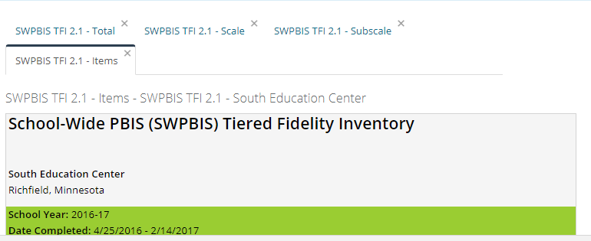
Pull All Reports and Review As a Team
Total
Scale
Subscale
Items

Slide 13
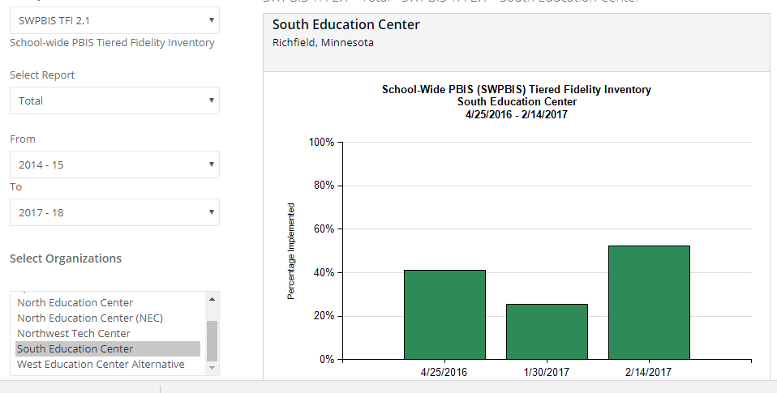
Total Report

Slide 14
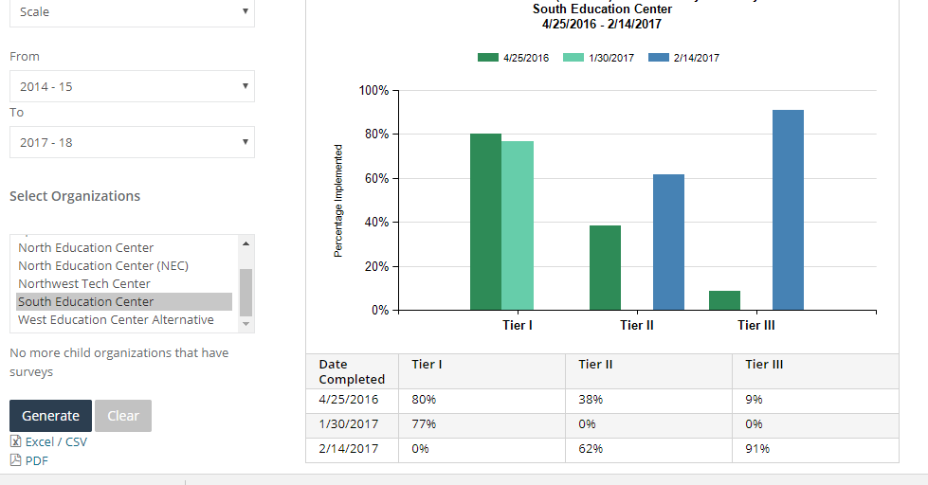
Scale Report

Slide 15
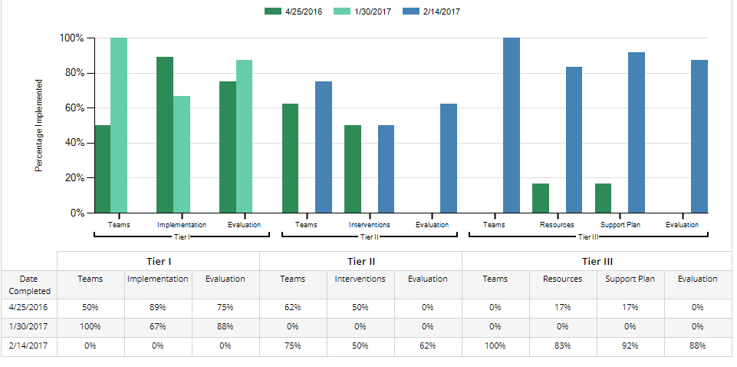
Subscale Report

Slide 16
Self-Assessment Survey (SAS)
WHAT: Annual assessment of staff perception of PBIS implementation
WHO: All school staff
WHEN: By November 1 and May 1
WHY: Shows how well adults understand and are implementing with PBIS

Slide 17
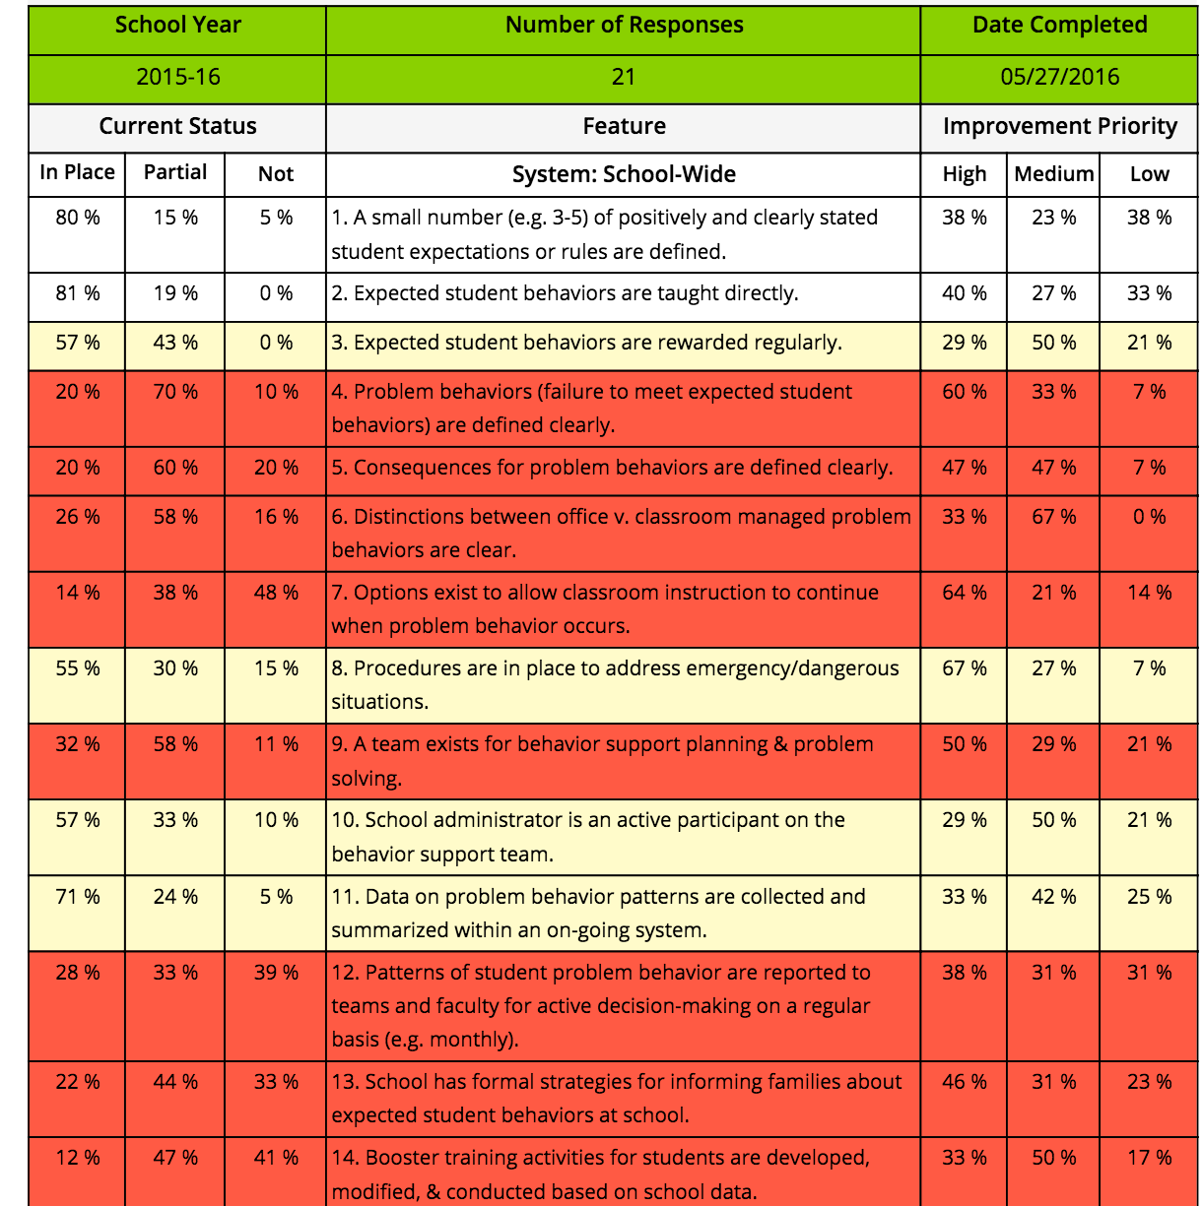
Sample SAS Item Analysis Report
What do you see? How is this helpful?

