Slide 1
PBIS Team Training 4A Supporting and Responding to Student Behavior Guide
Group Activity
Notes:
Updated July 2019
Updated July 2019
Updated 7/2018

Slide 2
Learning Expectations
EXPECTATION | BEHAVIOR
Be Responsible | Make yourself comfortable Take care of your needs (water, food, restroom, etc.) Action plan to implement what you are learning Follow through on your action items
Be Respectful | Turn cell phones off or to “vibrate” Listen attentively while others are speaking Have only the training materials up on your computer/tablet/phone
Be Engaged | Ask what you need to know to understand and contribute Contribute to the group by sharing relevant information and ideas
Notes:
2

Slide 3
Supporting and Responding to Behavior
Link to Guide
Notes:
Page 1. You have a hard copy of a document titled Supporting and Responding to Behavior. I will also share it with you electronically so that you have all of the links included. We are going to take some time to walk through this document and look at ways you can use it to coach staff. The purpose of this document, is to summarize evidence based, positive, proactive, and responsive classroom behavior interventions.

Slide 4
What needs to be in place for strategies to work?
Strategies are maximized when:
They are part of a multi-tiered approach
Classroom and school-wide expectations are directly linked
Strategies are in alignment with effective instructional design, curriculum, and delivery; and
School/classroom based data are used to guide decision making
Notes:
Page 1. In order for any strategies to work, they need to be part of a multi tiered system of support. That is the framework that PBIS provides.

Slide 5
Examples of School-Level Supports
Multi-tiered approach
Framework is guided by school-wide discipline data
Appropriate supports for staff are provided
Notes:
Page 1. Multi tiered approach includes: strategies for identifying and teaching expectations, acknowledgment system, how to respond to inappropriate behavior
Framework includes the discipline date – reviewing it, digging deep and basing decisions on the data
Appropriate supports: leadership teaming, supporting policy, coaching, and implementation monitoring

Slide 6
Examples of Classroom Level Supports
A classroom system is in place
Classroom management expectations are clear
Instructional strategies within the classroom are effective
Curriculum is based on student need and supporting data
Notes:
Page 1.Classroom system in place for teaching expectations, acknowledging positive behavior, and managing problem behavior
Curriculum is based on student need Classroom management decisions are based on classroom behavioral data

Slide 7
Guiding Principles
These define the characteristics and cultural features that are used in the framework. Guiding principles help establish the norms, rules, and ethics that are needed for success.
Notes:
Page 2. Guiding principals help establish the norms, rules, and ethics that are needed for success.

Slide 8
7 Principles
Professional
Cultural
Informed
Fidelity-Based
Educational
Instructive
Preventive
Notes:
The 7 principles are the foundational values that drive the success of classroom strategies.
Professional – neutral, impartial, unbiased
Cultural – practices are considerate of individual learning history and experience (family, community, peer group)
Informed - Data based (RtI)
Fidelity Based – Implementation is monitored and adjusted as needed
Educational – design and delivery of instruction is considered
Instructive – behavior is taught, modeled, monitored, and reinforced
Preventive – The environment encourages previously taught social skills and discourages anticipated errors

Slide 9
About the Guide
The guide includes:
Interactive maps with corresponding tables tools and tips
Self-assessment and decision-making chart
Scenarios
Notes:
Page 2. Interactive map provides the links to the document with the content to support implementation of the classroom strategies
Self-assessment and decision-making chart are are in place to guide the user to the most useful part of the document. (think of “I need help” requests yet not knowing exactly “what” they need help with)
Scenarios – provide examples with strategies and tools

Slide 10
What not to do?
Rely ONLY on this guide!
Notes:
Page 3. This doesn’t replace comprehensive training for staff. It can be used for individual student however, there will always be those “outliers”. Those students who need more support from a school psych, behavior specialist, counselor, etc.

Slide 11
Let’s Get Started!
Interactive map resource
Step 1 – Self-assessment
Step 2 – Use the interactive map for direction
Step 3 – Use the decision-making flow chart to help guide teachers in possible classroom adjustments
Notes:
Page 4. Interactive map – organizational layout and some basic definitions that might help prior to taking the self assessment. It is all laid out in front of you.
Page 5. Self-assessment – Used to help gauge current classroom management practices – will help teachers know where to focus their attention (for example: foundations practices, data systems) . After taking the assessment, the interactive map should direct them to the most helpful content.

Slide 12
Interactive Map Resource

Slide 13
Self Assessment

Slide 14
Decision Making Chart

Slide 15
Foundations Matrix
1.1 Settings
Critical features
Elementary examples
Secondary examples
Non-examples
Additional resources
Notes:
Page 7. You will notice that each page is set up the same:
Critical features – what are the key strategies?
Elem. examples – How can I use them in my classroom?
Sec. examples – How can I use them in my secondary classroom?
Non-examples - What to avoid

Slide 16
Working Through the Matrix
1.1 Settings
1.2Routines
1.3 Expectations
2.1 Supervision
2.2 Opportunity
2.3 Acknowledgement
2.4 Prompts and Precorrections
2.5 Error Correction
Notes:
Page 7 and beyond.
1.1 Settings – physical environment
1.2 Routines – be sure you have developed predictable classroom routines
1.3 Expectations – your 3 – 5 positive classroom expectations are posted, defined, and taught
2.1 Supervision – You are utilizing active supervision and proximity (explain active supervision?)
2.2 Opportunity – Providing high rates of response and opportunities for students to respond
2.3 Acknowledgement – Be sure your praise if behavior specific (not “good job” and walk away)
2.4 Prompts and Precorrections – Be preventative – remind before an event if you know that there may be a problem behavior –
2.5 Error Correction – Be brief, calm, concise

Slide 17
Matrix cont’d
2.6 Other Strategies to Respond to Problem Behavior
3.1 to 3.4 Data Systems
Notes:
2.6 – When selecting strategies – remember the purpose! A strategy is in place to preempt the escalation of negative behavior, to minimize the likelihood of reinforcing the problem behavior, and to just maintain instruction for the rest of the students – it is to just keep on teaching!
3.1 is all about data systems.

Slide 18
Additional Tools for Responding to Behaviors
FAST
Functional
Accurate
Specific
Timely
Notes:
Page 20
Functional – looking for the “behavioral why”
Accurate – the response is accurate and CONSISTENT to minimize the the problem behavior
Specific – using the student’s name and the reason for the response
Timely – responding immediately make the response much more powerful (think about if/when you say, “we are going to talk about this after class”)

Slide 19
Types of Behavior and Common Responses
Appropriate or expected behavior
Infrequent/non-disruptive minor behaviors
Repeated non-disruptive minor behavior errors and/or disruptive major behavior errors
Administrator-managed behaviors
Notes:
How do you handle these: Approp/expected behavior – acknowledgement – be specific
Infrequent/non-disruptive minor – draw little attention, reminders, modeling, reinforcement
Repeated minor or major – follow school procedures, anticipate when there might be a problem and pre-discuss expectations/practice
Admin. Managed behaviors – follow school procedures and individualized support plans

Slide 20
Overview on Classroom PBIS Practices
Before jumping into content, let’s preview the features of this resource
Developed by: Brandi Simonsen, Jennifer Freeman, Steve Goodman, Barbara Mitchell, Jessica Swain-Bradway, Brigid Flannery, George Sugai, Heather George, Bob Putnam, &Renee Bradley et al. (OSEP)
Notes:
Tool can be found at
http://www.pbis.org/common/cms/files/pbisresources/Supporting%20and%20Responding%20to%20Behavior.pdf
If you want you can pull up document so you can show them how the hyperlinks work

Slide 21
Interactive Map of Core Features

Slide 22
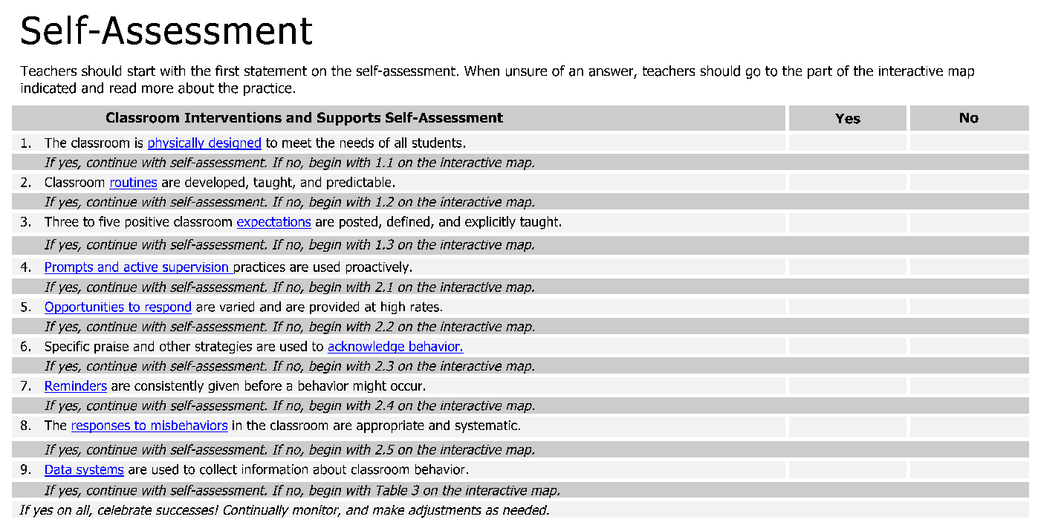
Self-Assessment

Slide 23
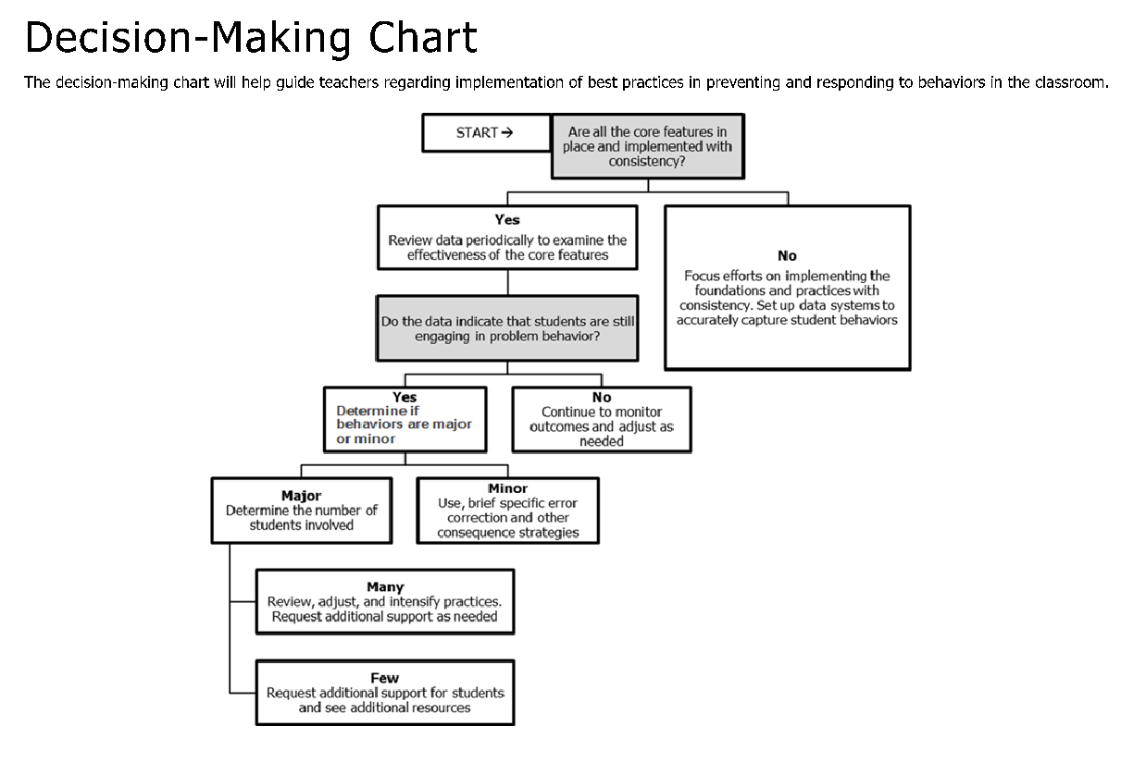
Decision Making Chart

Slide 24
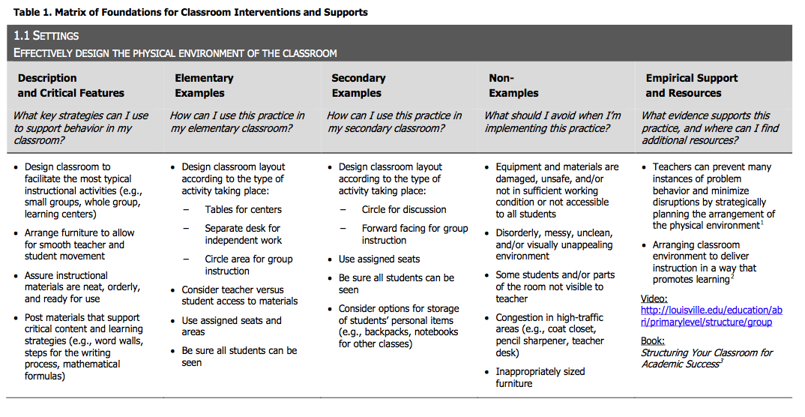
Tables with Definitions, Examples, Non-Examples, and Resources

Slide 25
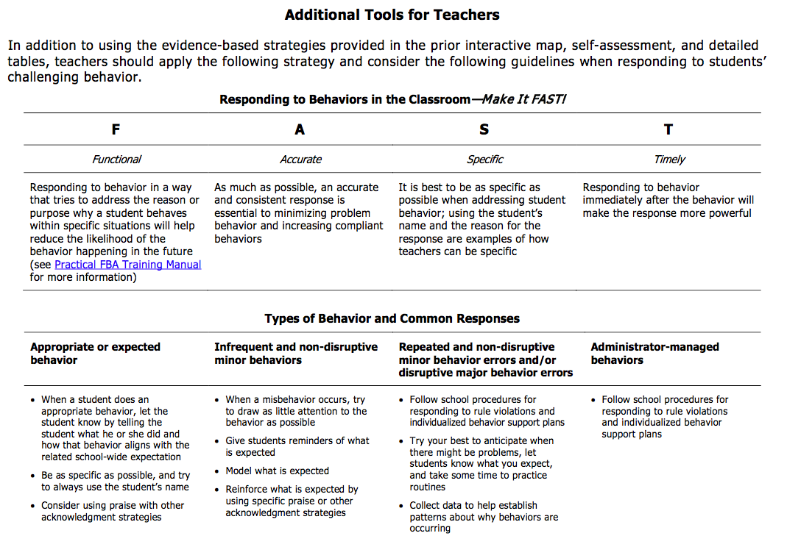
Additional Tools

Slide 26
Scenarios to Illustrate Implementation Elementary and Secondary

Slide 27
Activity
On a sticky note write the problem behavior you experience the most frequently.
Put your sticky note in the center of your table.
Organize the sticky notes by similar behaviors looking for overlap.
Coach read the sticky notes.
Choose one or two behaviors from the center of the table.
Explore the Supporting and Responding to Behavior guide to find strategies to help staff respond supportively to your chosen behaviors.
Write the problem behavior on top of your poster paper and then 3 strategies you found in the Supporting and Responding to Behavior staff could use.
Workbook p. ___ Activity ___

